Slide 1
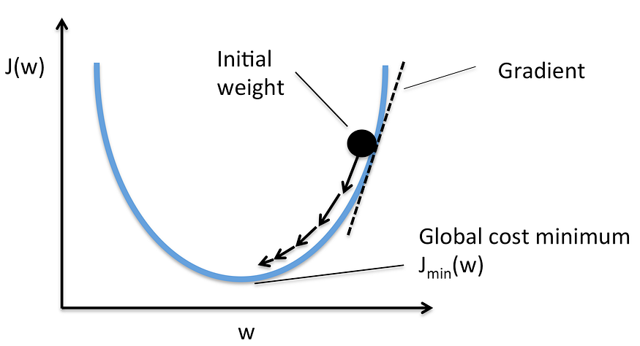
Compute Gradient

Slide 2
Recap prediction with linear regression
Find a sample dataset
Propose a linear model
Compute (MSE, w) pairs, given w with a range
Find the w with minimum MSE
Predict a new y’ for a given x with the model y’=w*x

Slide 3
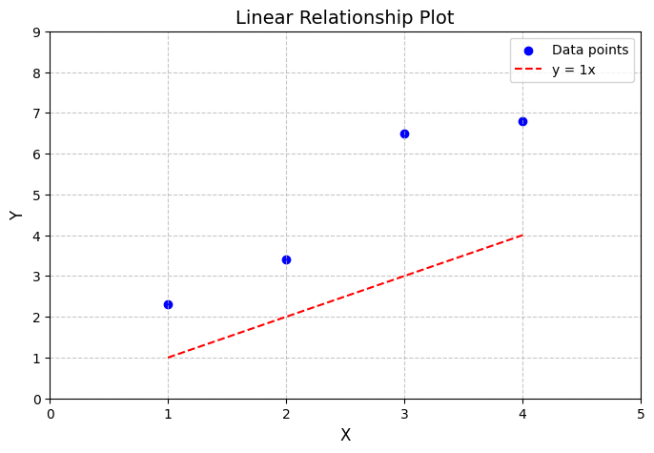
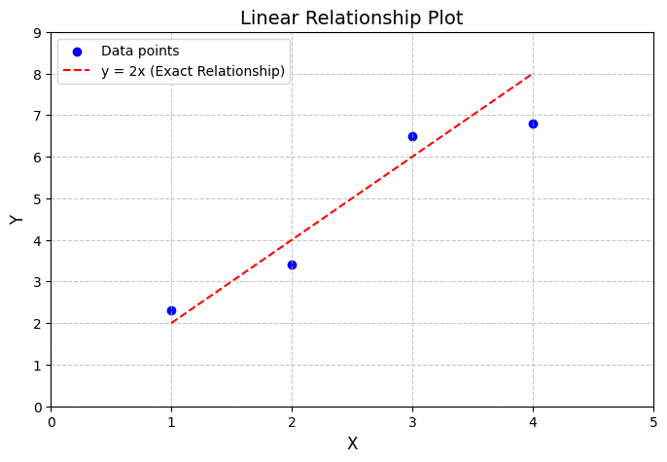
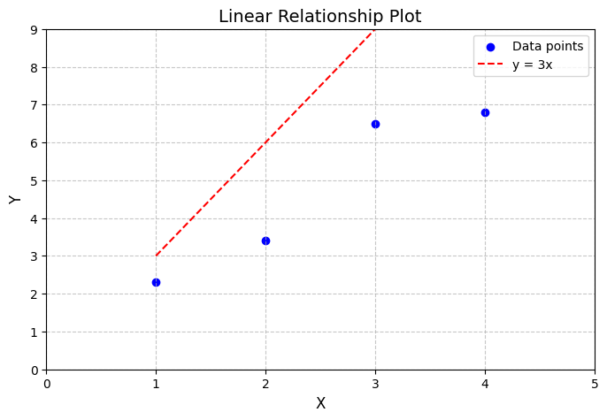
Training dataset
Features (x) | Target (y)
1 | 2.3
2 | 3.4
3 | 6.5
4 | 6.8
Our goal is to find the best fit line (with the least error): y’= wx+b with b=0

Slide 4
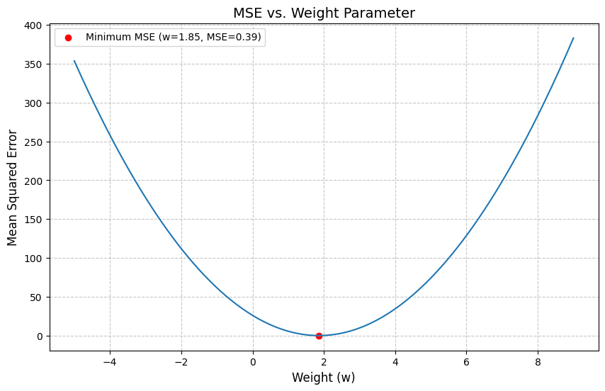
(MSE, w) with w_values = np.arange(-5, 9.05, 0.05)
we find w with min MSE

Slide 5
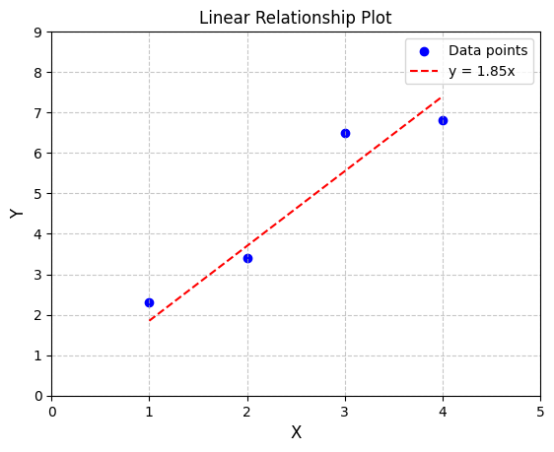
Prediction with the linear model y’=1.85*x

Slide 6
Two key issues of the approach
It isn’t easy to predefine a range for w
It is impractical to compute all possible values of w

Slide 7
Idea?
Start with a random w, then we move it to the bottom

Slide 8
But, how?
Question: Assume w = 4 (a random value). How can we move it to the bottom?

Slide 9
Solution: move along the red line with slope (gradient = dloss/dw) at w =4

Slide 10
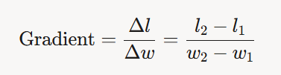
What is gradient?
The direction of the move to minimize loss at the current parameters
The partial derivatives of a loss function with respect to the model's parameters (e.g., weights and biases).
Linear regression model
Loss function: MSE
Parameter: weights and biases (b=0 in our example for simplicity)
Math notation
gradient = dloss/dw
gradient = dloss/db (our example doesn’t have b)

Slide 11
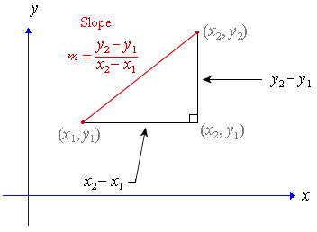



Calculate a gradient between any two points in a curve
Two points in a line

Slide 12
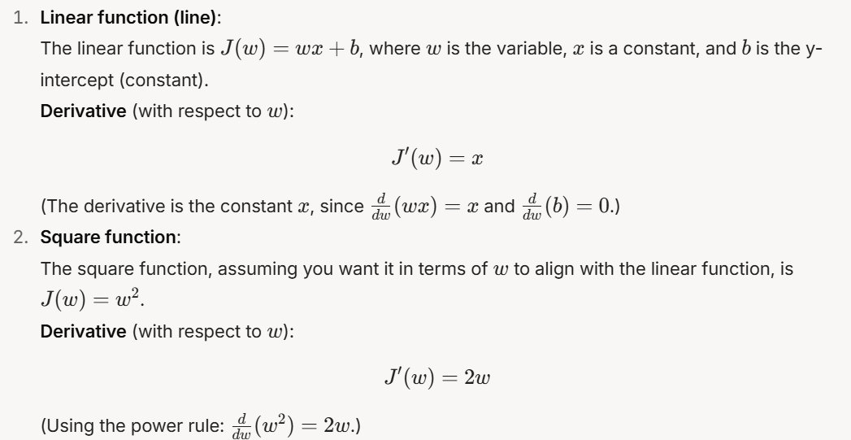
Formulas to Computer Derivatives
Takeaway: We can compute the gradient for any curve (function) for any w on the curve.

Slide 13
Compute the gradient directly based a set of dataset

Slide 14
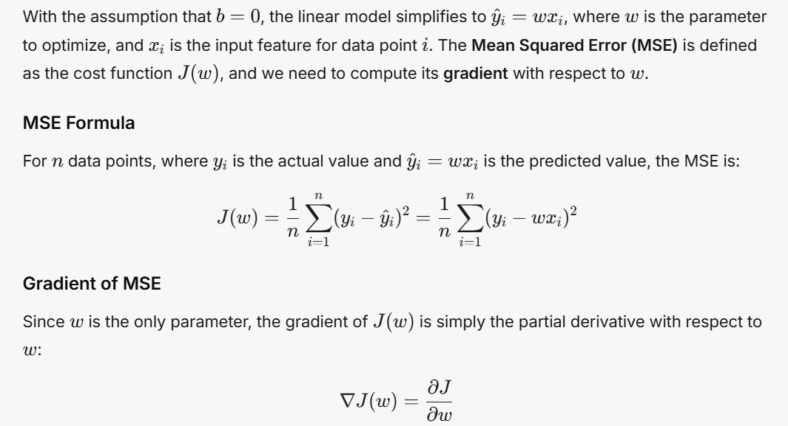
Problem definition

Slide 15
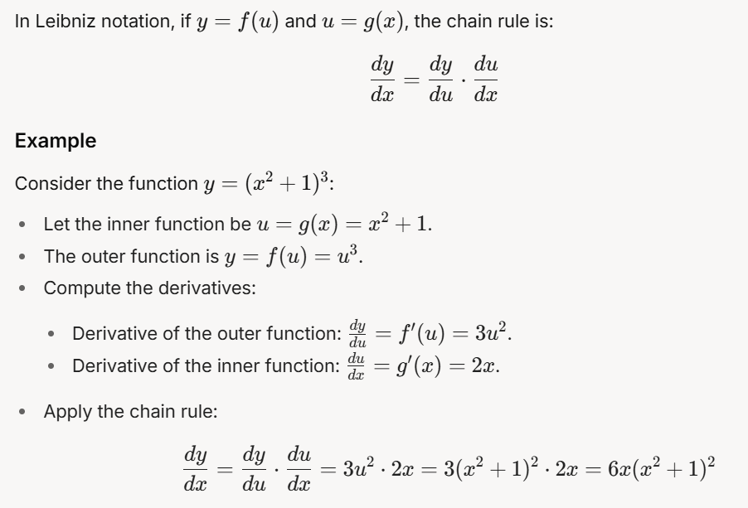
Key concept used to compute gradient - Chain rule
A fundamental concept in calculus used to compute the derivative of a composite function.

Slide 16
Apply chain rule (1): two linear functions
2
3
computational graph
x
y
z
*
*
x | y | rate of change (dy/dx=change of y/ change x) | z | rate of change (dz/dy=change of z/ change y) | dz/dx=dz/dy*dy/dx (chain rule)
1 | 1*2=2 |  | 3*2= 6
2 | 2*2=4 | (4-2)/(2-1)=2 | 3*4= 12 | (12-6) /(4-2)=3 | 2*3
3 | 2*3=6 | (6-4)/(3-2)=2 | 3*6= 18 | (18-12) /(6-4)=3 | 2*3
 |  | Slope=2 |  | Slope =3 | Slope=2*3
Example of applying chain rule: Let y=2x and z=3y,
dz d(3y) d(2x)
-- = -------- * --------- =3*2
dx dy dx

Slide 17


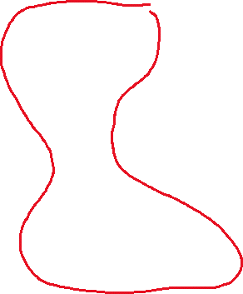
Apply chain rule (2): MSE dloss/dw
MSE= (y’-y)² = (y-wx)²
Given one training example, x=1, y=2.3, and a random weight w=1,
we can compute y’=1, e=1-2.3=-1.3, and loss=1.69
x
y
e
loss
w
y’
dloss dloss de dy’
-------- = --------- * ----- * -----
dw de dy’ dw
=2ew = 2*(-1.3)*1=-2.6
*
-
^2
dloss d(e^2)
-------- = -------- =2e
de de
dy’ d(wx)
-------- = -------- =w
dw dw
de d(y’-y)
-------- = -------- =1
dy’ dy’

Slide 18
Show gradient when w=1
dloss dloss de dy’
-------- = --------- * ----- * -----
dw de dy’ dw
=2ew = 2*(-1.3)*1=-2.6
1

Slide 19
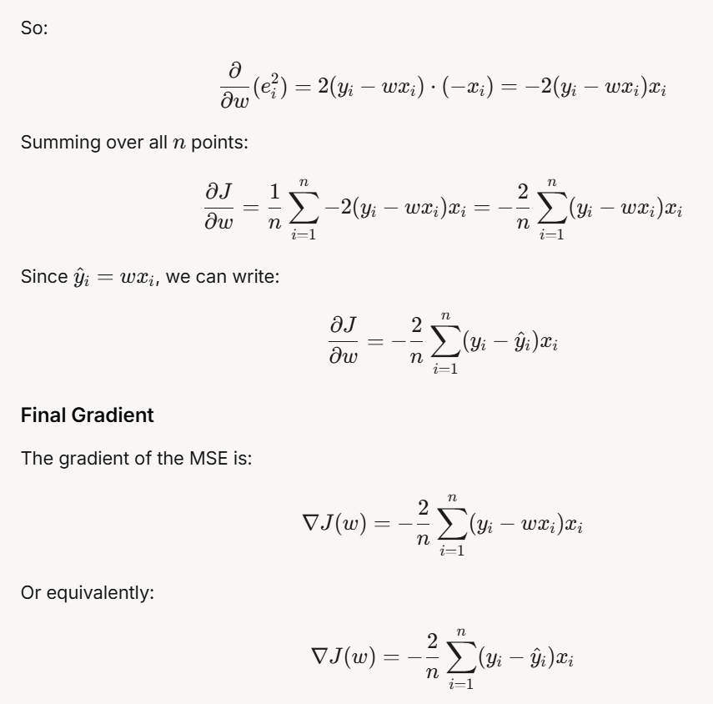
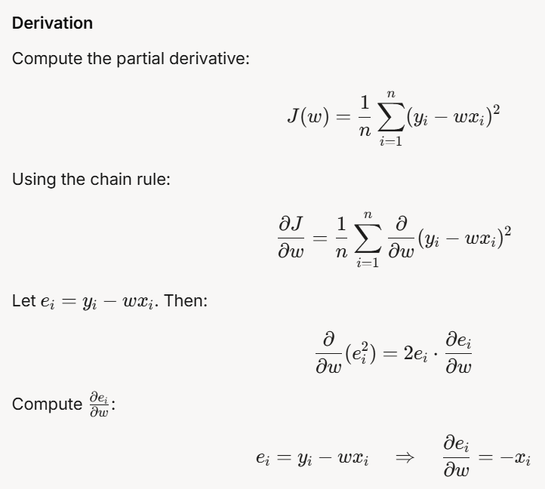

Slide 20
Update weight with gradient
gradient <0
w=w-α* gradient,
Where α is the learning rate
gradient >0

Slide 21
Gradient descent
a gradient-based optimization

Slide 22
Gradient descent
parameter = parameter - learning_rate * gradient
It is an iterative optimization algorithm used to minimize a loss function
adjusting its parameters (weights in models) in the direction that reduces the error.
Key steps
A loss function measures how far a model’s predictions are from the true values.
Gradient descent uses the gradient (a vector of partial derivatives) of the loss function with respect to the parameters to determine the direction and magnitude of parameter updates.
By iteratively moving the parameters in the direction opposite to the gradient, gradient descent reduces the loss.

Slide 23
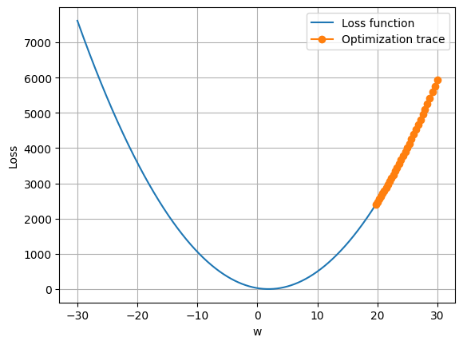
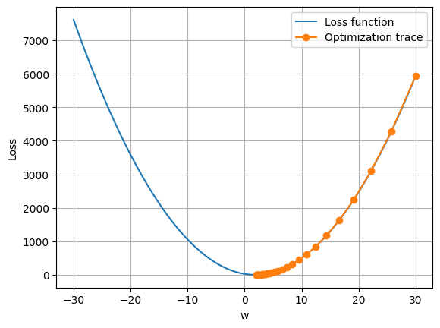
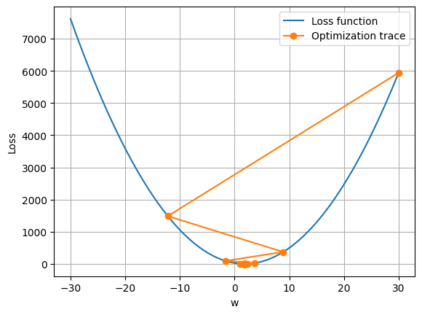
Learning Rates (30 iterations)
Learning rates = 0.001
Learning rates = 0.01
Learning rates = 0.1
Which one is better?

Slide 24
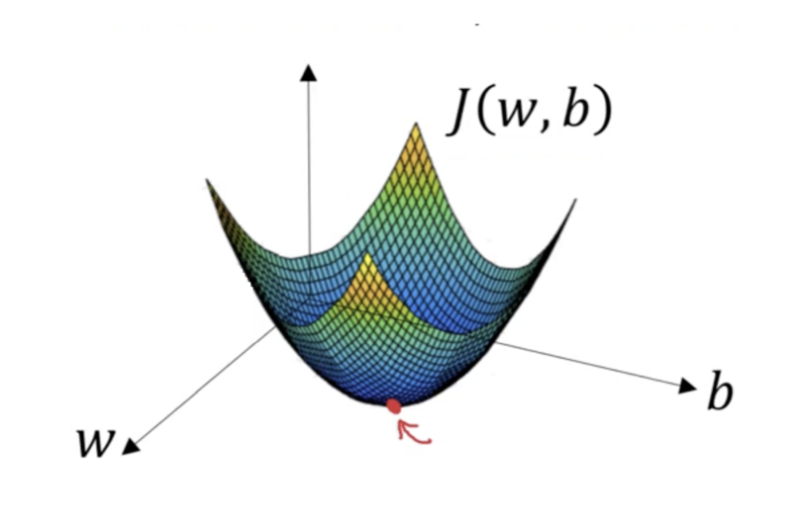
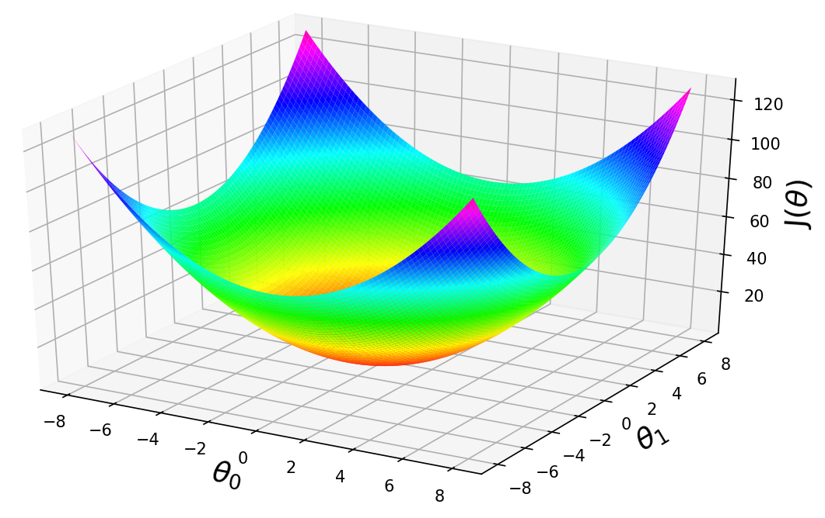

Cost with two parameter J(w, b) or J(φ)
https://builtin.com/data-science/gradient-descent
https://machinelearningspace.com/a-comprehensive-guide-to-gradient-descent-algorithm/
Notes:
https://machinelearningspace.com/a-comprehensive-guide-to-gradient-descent-algorithm/

Slide 25
Summary

Slide 26
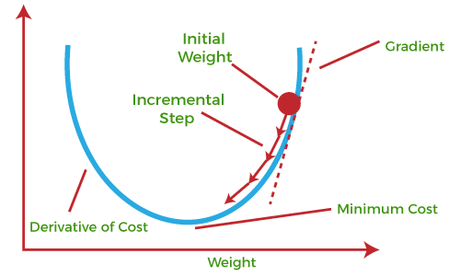
Summary key concept in ML
https://www.tpointtech.com/gradient-descent-in-machine-learning

Slide 27
Learning rates
Backward
gradient
x
adjust parameters/weights)
loss (cost) function
loss
training inputs (features)
w1, w2, ..
gradient
predicted output
loss
-
w
compute gradient (dloss/dw)
AI Model under training
training inputs (target/label/ground truth )
Forward

Slide 28

How do humans learn to adjust the water temperature?
If the water is too hot
slightly turn down the hot water faucet
slightly turn up the cold water faucet
If the water is too cold
slightly turn up the hot water faucet
slightly turns down the cold water faucet

Slide 29
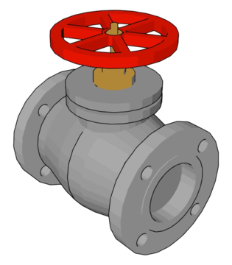

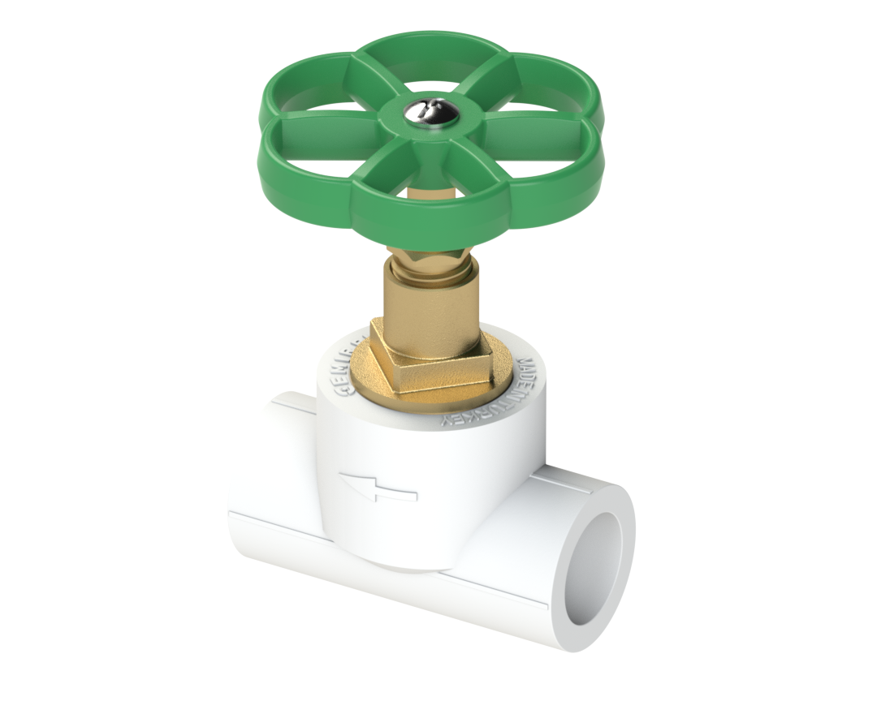
direction/speed of changes at the current valve's opening
adjust the valve opening
The difference between the mix and the desired temperature
temperature with mixed water
Bob
-
hot water
code water
Computing how changes in the valves’ opening may increase/decrease the errors (MUST be a single real number)
Bob’s desired temperature

