Slide 1
Machine Learning Workflow
A Step-by-Step Guide to Building ML Models

Slide 2
Introduction
What is Machine Learning?
Algorithms that learn patterns from data to make predictions or decisions
Why is a structured workflow important?
Ensures efficiency, reproducibility, and success in ML projects
Objective: Break down the ML workflow into clear, actionable steps

Slide 3
Step 1 - Define the Problem
Identify the business or research goal
Example: Predict breast cancer diagnosis (benign or malignant)
Determine the type of ML problem
Classification, regression, clustering, etc.
Define success metrics
Accuracy, precision, recall, F1-score, etc.
Key Question: What are we trying to achieve?

Slide 4
Step 2 - Collect and Prepare Data
Data Collection
Gather relevant data from databases, APIs, or public datasets
Example: Breast cancer dataset from sklearn
Data Cleaning
Handle missing values, remove duplicates, correct errors
Data Exploration
Visualize distributions, check correlations, identify outliers
Importance: Quality data is the foundation of a good model

Slide 5
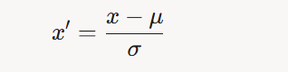
Step 3 - Preprocess Data
Feature Engineering
Create new features or transform existing ones
Example: Combine features or encode categorical variables
Feature Scaling
Standardize (mean=0, std=1) or normalize (scale to [0,1])
Ensures that all the feature values are on the same scale.
Why? Improves model convergence and fairness in feature influence
Split Data
Training set (e.g., 80%), validation set, test set (e.g., 20%)
Prevents overfitting and allows evaluation

Slide 6
Step 4 - Choose a Model
Select an algorithm based on the problem
Classification: Logistic Regression, SVM, Neural Networks
Regression: Linear Regression, Random Forest
Clustering: K-Means, DBSCAN
Consider trade-offs
Interpretability vs. performance
Computational resources
Example: BinaryClassifier (Neural Network) for breast cancer

Slide 7
Step 5 - Train the Model
Feed training data to the model
Optimize model parameters
Use loss functions (e.g., Binary Cross-Entropy Loss)
Apply optimization algorithms (e.g., SGD, Adam)
Monitor training
Track loss and metrics over epochs
Example: Print loss every 10 epochs
Goal: Minimize error on training data

Slide 8
Step 6 - Evaluate the Model
Test the model on unseen data (test set)
Calculate performance metrics
Accuracy, precision, recall, F1-score, etc.
Example: Accuracy = (Correct Predictions) / (Total Predictions)
Analyze errors
Confusion matrix, ROC curve
Key Question: Does the model generalize well?

Slide 9
Step 7 - Tune and Improve
Hyperparameter Tuning
Adjust learning rate, number of epochs, model architecture
Use grid search or random search
Address Overfitting
Regularization, dropout, simpler models
Feature Selection
Remove irrelevant or redundant features
Iterate: Retrain and re-evaluate as needed

Slide 10
Step 8 - Deploy and Monitor
Deploy the model
Integrate into production systems (e.g., web app, mobile app)
Example: API for real-time cancer diagnosis
Monitor performance
Track predictions, detect data drift
Maintain the model
Retrain with new data, update as needed
Goal: Ensure reliability in real-world use

Slide 11
Best Practices
Document every step
Code, decisions, and results
Use version control
Git for code and data versioning
Ensure reproducibility
Set random seeds, save preprocessing steps
Collaborate effectively
Communicate findings with stakeholders
Stay ethical
Address bias, ensure fairness, protect privacy

Slide 12
Case Study - Breast Cancer Classification
Problem: Predict benign/malignant tumors
Data: sklearn breast cancer dataset (569 samples, 30 features)
Preprocessing: StandardScaler, train-test split (80-20)
Model: BinaryClassifier (Neural Network with sigmoid)
Training: 100 epochs, SGD, BCELoss
Evaluation: Achieved ~95% accuracy on test set
Takeaway: Structured workflow led to reliable results

Slide 13
Conclusion
Recap: ML workflow is a systematic approach
Problem definition → Data prep → Model training → Deployment
Benefits
Improves efficiency, reduces errors, ensures scalability
Next Steps
Apply workflow to your own projects
Explore advanced techniques (e.g., deep learning, ensemble methods)
Call to Action: Start building your ML model today!

Slide 14
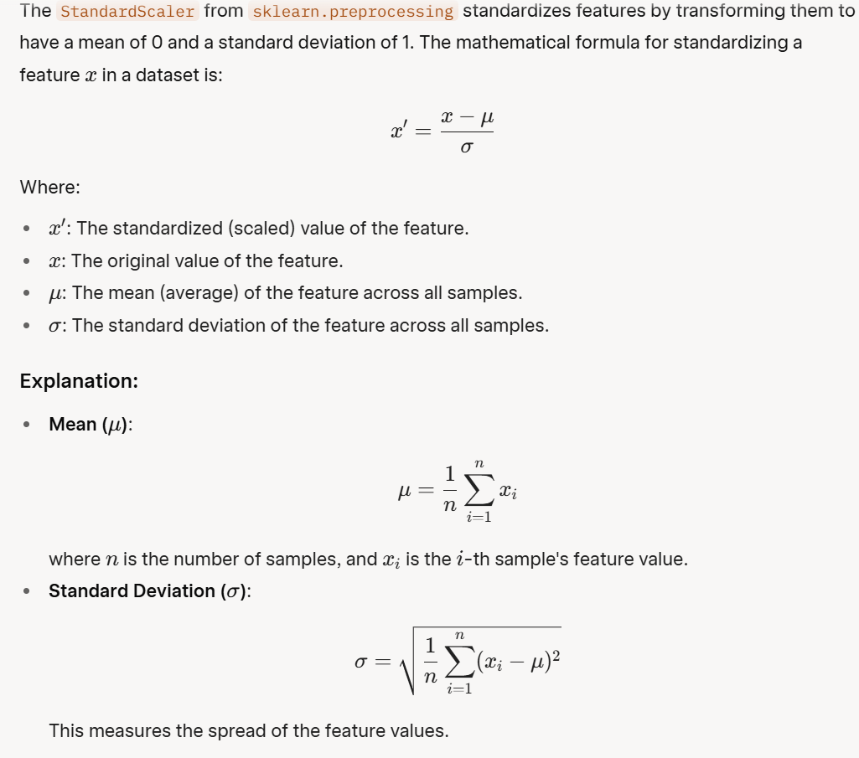
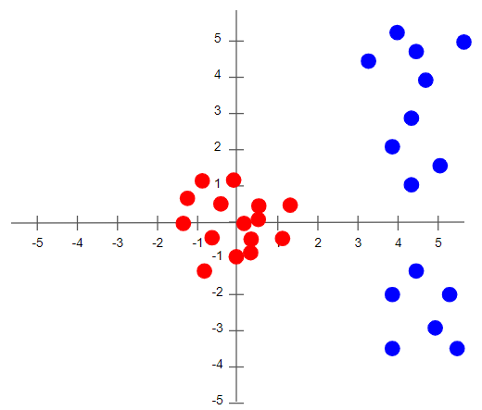
Appendix: how StandardScaler() works
https://towardsdatascience.com/batch-norm-explained-visually-how-it-works-and-why-neural-networks-need-it-b18919692739/

Slide 15
