Slide 1
Understanding Confusion Matrix in Binary Classification
Evaluating machine learning models

Slide 2
Overview
Confusion Matrix: Breaking down predictions
Precision and Recall: Measuring model quality
F1 Score: Balancing precision and recall
Example: Breast Cancer Dataset
Implementation: Calculating metrics in PyTorch
Key Takeaways

Slide 3
What is a Confusion Matrix?
Confusion Matrix: Summarizing Predictions
Definition: A table showing true vs. predicted labels
Binary Classification (e.g., Benign vs. Malignant):
True Positive (TP): Correctly predict Malignant
True Negative (TN): Correctly predict Benign
False Positive (FP): Benign predicted as Malignant
False Negative (FN): Malignant predicted as Benign
Structure:
Rows: Actual labels (Benign, Malignant)
Columns: Predicted labels (Benign, Malignant)
FN is dangerous as it misses cancer cases

Slide 4
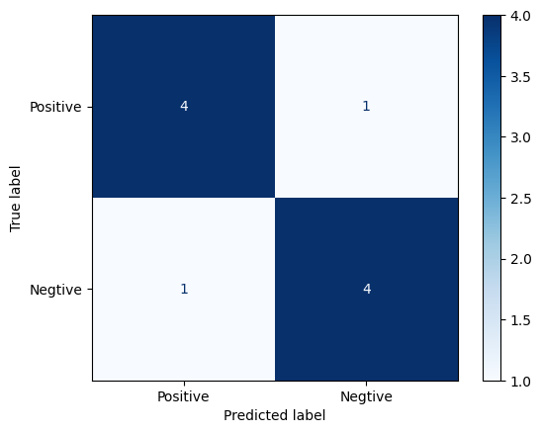
TP
FN
n | Y actual | Y’ pred |  | TP | TN | FP | FN
1 | 1 | 1 |  | 1
2 | 1 | 1 |  | 1
3 | 1 | 1 |  | 1
4 | 1 | 1 |  | 1
5 | 1 | 0 |  |  |  |  | 1
6 | 0 | 0 |  |  | 1
7 | 0 | 0 |  |  | 1
8 | 0 | 0 |  |  | 1
9 | 0 | 0 |  |  | 1
10 | 0 | 1 |  |  |  | 1
Total |  |  |  | 4 | 4 | 1 | 1
FP
TN

Slide 5
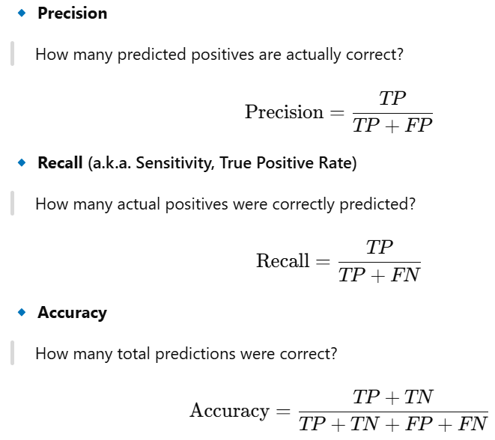
Precision and Recall: Measuring Model Quality
Precision: How many predicted Malignant cases are correct?
Recall: How many actual Malignant cases are caught?
TP
FN
FP
TN

Slide 6

n | Y actual | Y’ pred |  | TP | TN | FP | FN
1 | 1 | 1 |  | 1
2 | 1 | 1 |  | 1
3 | 1 | 1 |  | 1
4 | 1 | 1 |  | 1
5 | 1 | 0 |  |  |  |  | 1
6 | 0 | 0 |  |  | 1
7 | 0 | 0 |  |  | 1
8 | 0 | 0 |  |  | 1
9 | 0 | 0 |  |  | 1
10 | 0 | 1 |  |  |  | 1
Total | 5 | 5 |  | 4 | 4 | 1 | 1
4
Recall
=
5
4
Precision
=
5
Trade-off: High precision may lower recall, and vice versa
4
4
Accuray
=
n
precision
recall => we catch most cancers => false alarms
Precision => false alarms => miss diagnose
recall

Slide 7
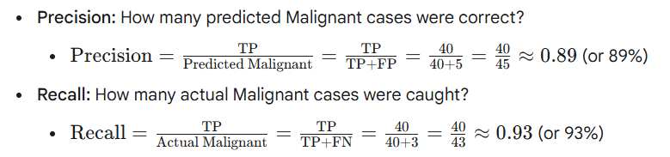
Confusion Matrix with Example Numbers
 | Predicted: Malignant | Predicted: Benign | Total Actual
Actual: Malignant | 40 (TP) | 3 (FN) | 43
Actual: Benign | 5 (FP) | 90 (TN) | 95
Total Predicted | 45 | 93 | 138 (Total Cases)
Notes:
Breakdown using these numbers:
True Positives (TP) = 40: 40 cases were actually Malignant, and the model correctly predicted them as Malignant.
False Negatives (FN) = 3: 3 cases were actually Malignant, but the model incorrectly predicted them as Benign. (These are the "missed" Malignant cases).
False Positives (FP) = 5: 5 cases were actually Benign, but the model incorrectly predicted them as Malignant. (These are the "false alarms").
True Negatives (TN) = 90: 90 cases were actually Benign, and the model correctly predicted them as Benign.
Using these numbers to calculate Precision and Recall:
Precision: How many predicted Malignant cases were correct?
Precision=Predicted MalignantTP​=TP+FPTP​=40+540​=4540​≈0.89 (or 89%)
Recall: How many actual Malignant cases were caught?
Recall=Actual MalignantTP​=TP+FNTP​=40+340​=4340​≈0.93 (or 93%)

Slide 8


F1 Score: Balancing Precision and Recall
Harmonic mean of precision and recall with a single value
Why Use It?
Balances precision and recall
Useful when classes are imbalanced (e.g., fewer Malignant cases)
Example Calculation
Precision ≈ 0.89
Recall ≈ 0.93

Slide 9
Summary
Confusion Matrix: Summarizes TP, TN, FP, FN to understand model errors
Precision: Measures correctness of positive predictions
Recall: Measures coverage of actual positives
F1 Score: Balances precision and recall, ideal for imbalanced data
Application: Evaluated breast cancer model performance
Code: Implemented metrics in PyTorch for practical use

