Slide 1
PyTorch Custom DataLoader

Slide 2
Introduction
PyTorch DataLoader facilitates efficient data handling
Custom datasets enable flexible data processing
Tutorial covers:
Creating a custom dataset
Setting up a DataLoader
Example with wine dataset

Slide 3
Why Custom Datasets?
Handle unique data formats (CSV, images, etc.)
Preprocess data on-the-fly
Integrate with PyTorch's DataLoader for:
Batching
Shuffling
Parallel data loading
Example: Wine dataset (CSV with features and labels)

Slide 4
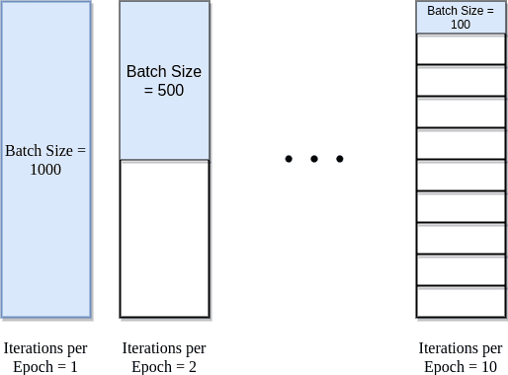
Key Concepts
Epoch: One full pass through the training dataset
Batch Size: Number of samples per forward/backward pass
Iterations: Number of passes = ceiling(total samples / batch size)
Dataset: Abstract class to define data access
DataLoader: Handles batching, shuffling, and loading
https://www.baeldung.com/cs/epoch-neural-networks

Slide 5
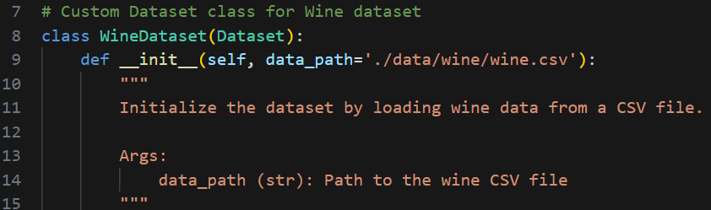
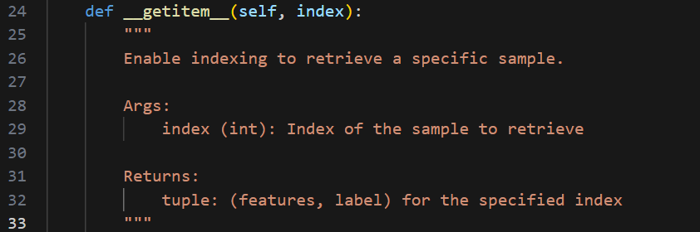
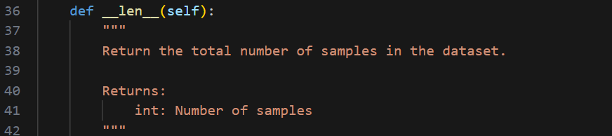
Creating a Custom Dataset
Inherit from torch.utils.data.Dataset
Implement three methods:
init: Initialize data
getitem: Access a sample
len: Return dataset size

Slide 6
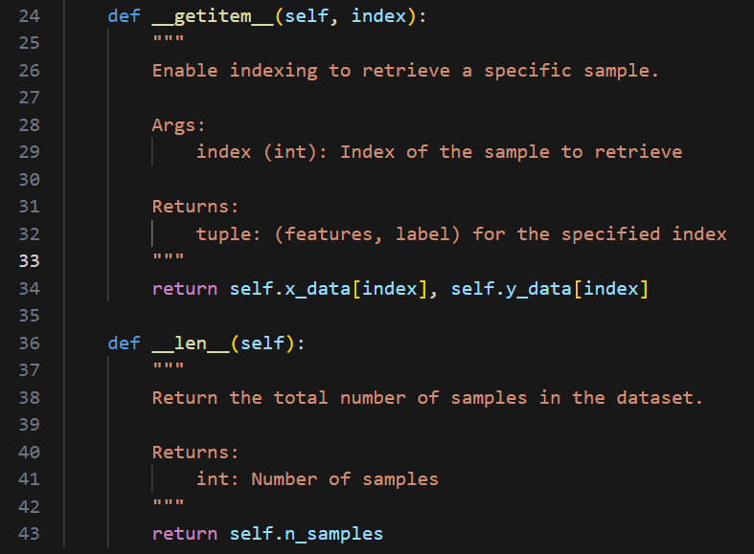
Implementing getitem and len

Slide 7

Setting Up DataLoader
Create DataLoader to handle batching and shuffling
Key parameters:
dataset: Your custom dataset
batch_size: Samples per batch
shuffle: Randomize data order
num_workers: Subprocesses for loading
Code: from torch.utils.data import DataLoader

Slide 8
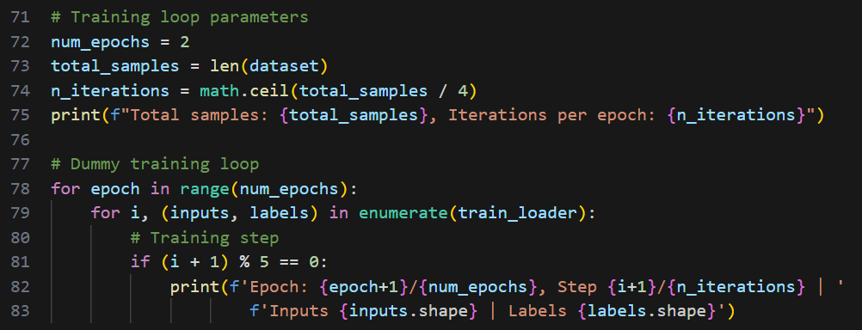
Using DataLoader in Training

Slide 9
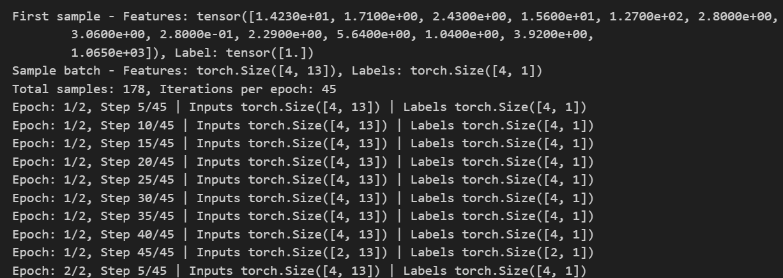
Example Output

Slide 10
Tips and Best Practices
Set num_workers=0 if errors occur during loading
Use shuffle=True for training, False for validation
Preprocess data in getitem for efficiency
Handle large datasets with lazy loading or memory mapping
Test dataset with small batch sizes first

Slide 11
Conclusion
Custom datasets enable flexible data handling
DataLoader simplifies batch processing
Key steps:
Define Dataset with init, getitem, len
Configure DataLoader for batching and shuffling
Integrate into training loop
Explore torchvision for built-in datasets (MNIST, CIFAR10, etc.)

Slide 12
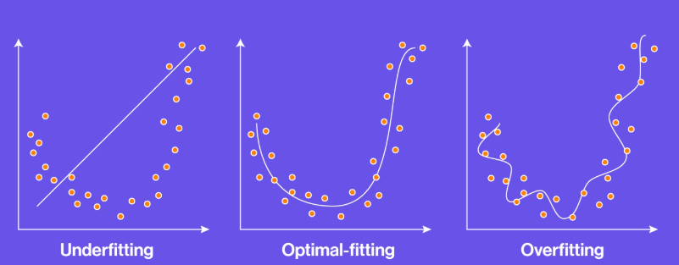
Determine the optimal values for Epoch, Batch Size, and Iterations
https://www.sabrepc.com/blog/Deep-Learning-and-AI/Epochs-Batch-Size-Iterations

