Slide 1
Machine Learning Concepts for Multiclass Classification
Entropy, Cross-Entropy Loss, ReLU, and Adam Optimizer

Slide 2
Overview
Entropy: Measuring uncertainty in data
Cross-Entropy Loss: Evaluating model predictions
ReLU Activation: Enabling non-linear learning
Adam Optimizer: Efficiently updating model weights
How these concepts work together in our PyTorch model

Slide 3
Entropy

Slide 4


What is Entropy/Information Entropy?
Entropy quantifies the uncertainty/surprise/impurity in a dataset.
Example: You pick a black bird from each data set with a different distribution (event: pick a bird, outcome: a black bird)
dataset 1
dataset 2
dataset 3
If something is very unlikely but happens → big surprise
If something is very likely → you’re not surprised
high
medium
low
Notes:
what if we pick up a white bird?

Slide 5
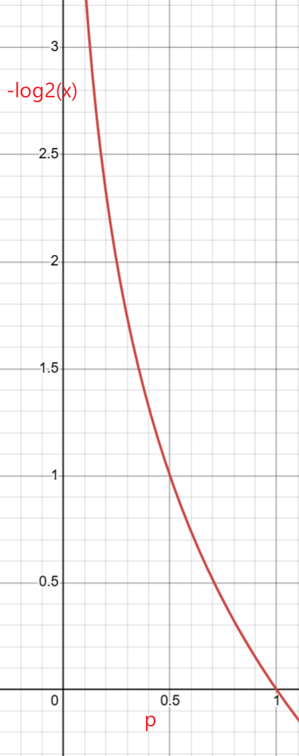
Compute the entropy of an event (picking a black bird with a probability of p)
Entropy _{black} =​log₂​(1/p _{black} ​)
dataset 1
dataset 2
dataset 3
p _{black} =1/8=0.125
Entropy _{black} =​log₂​(1/0.125​)=3
p _{black} =4/8=0.5
Entropy _{black} =​log₂​(1/0.5​)=1
p _{black} =7/8
Entropy _{black} =​log₂​(1/(7/8​)= 0.19
The uncertainty can be encoded by the number of bits
transform a p to entropy

Slide 6
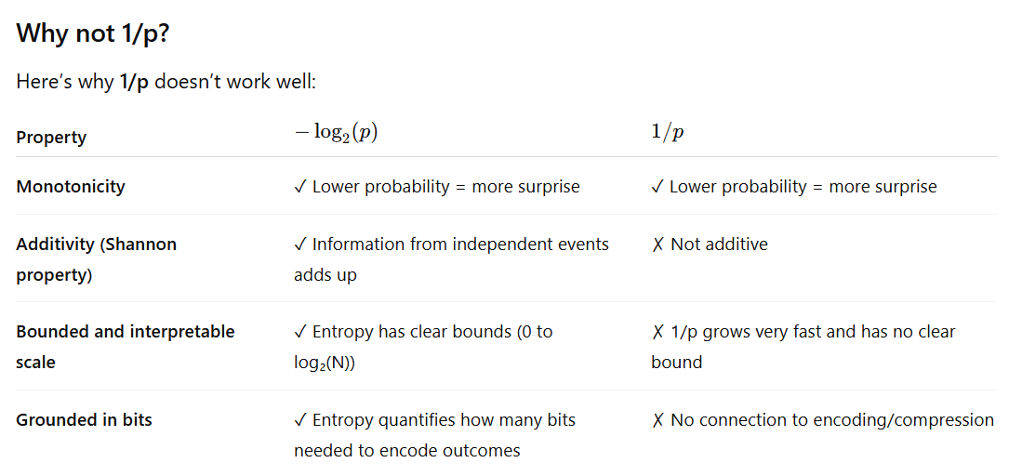
Takeaway: Entropy can be measured in bits, e.g., a 50% outcome can be encoded and represented in 1 bit

Slide 7
Should consider two outcomes: a black or a white bird
Entropy _{black} =​log₂​(1/p _{black} ​)
Entropy _{white} =​log₂​(1/p _{white} ​)
consider weighted entropy for both outcomes
Weighted Entropy _{pick a bird} =​ p _{black} log₂​(1/p _{black} ​) + p _{white} log₂​(1/p _{white} ​)
=​ p _{black} log₂​(1/p _{black} ​) + (1-p _{black} )log₂​(1/p _{black} ​)
Takeaway: We are always interested in Weighted Entropy

Slide 8
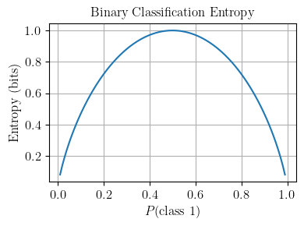
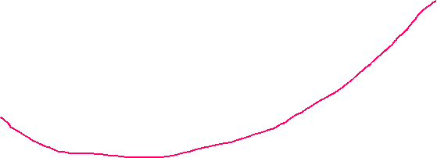

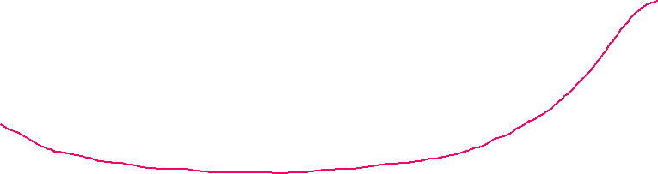

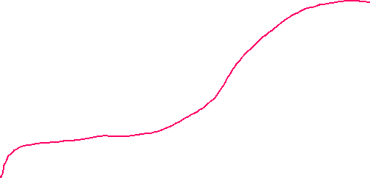

Example: Compute weighted entropy
Entropy _{pick a bird} =​ p _{black} log₂​(1/p _{black} ​) + p _{white} log₂​(1/p _{white} ​)
dataset 1
dataset 2
dataset 3
0.125 log₂​(1/0.125 ​) + 0.875 log₂​(1/0.875 ​) =0.54
0.5 log₂​(1/0.5 ​) + 0.5 log₂​(1/0.5 ​)=1
0.875 log₂​(1/0.875 ​) + 0.125 log₂​(1/0.125 ​) =0.54
Why does dataset 2 have the highest entropy? equal distribution has the highest uncertainty

Slide 9
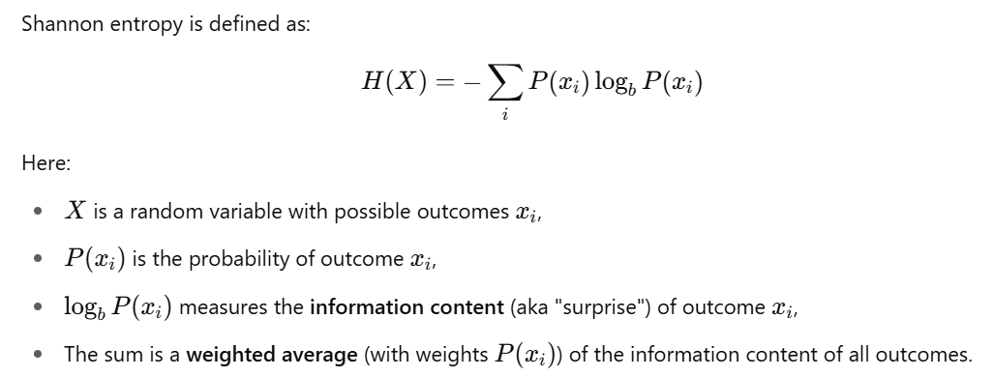
Takeaway: Entropy is the
expected information or average uncertainty associated with a random variable (with probability of all possible outcomes)
the average number of bits we’d need to encode the information (distribution)

Slide 10
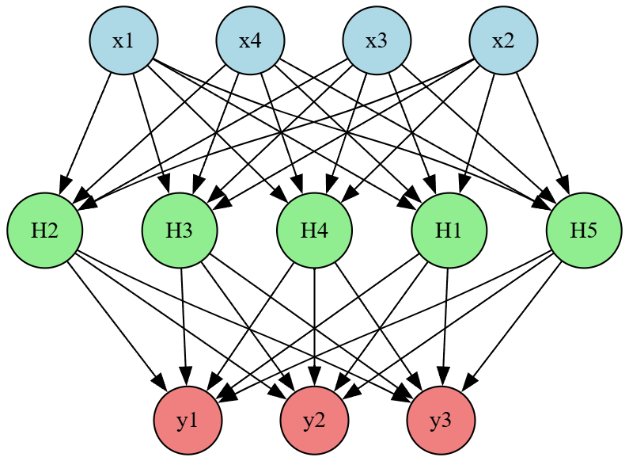
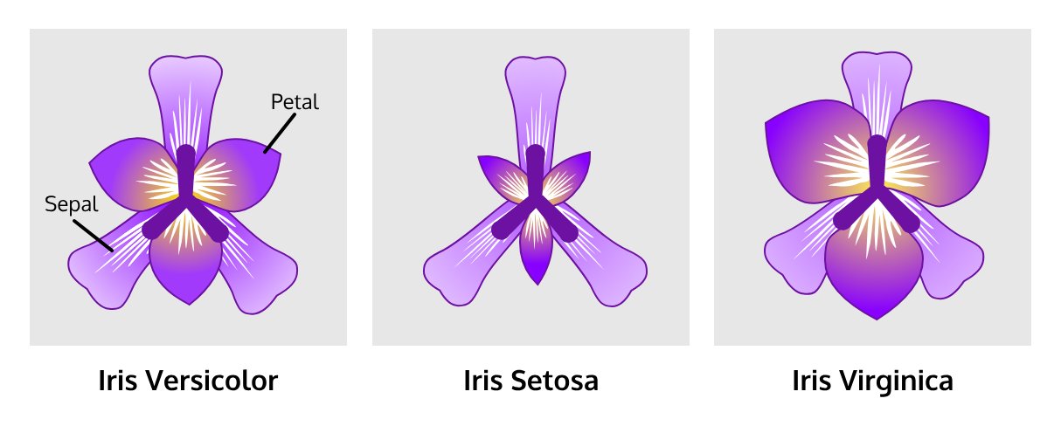
Measure a model’s confidence using entropy
Iris dataset with 3 classes [Setosa, Versicolor, Virginica]
The model is a random variable
with or without training
Model prediction results:
Prediction case 1 : [0.33, 0.33, 0.33] → High entropy → High uncertainty → confidence is low
Prediction case 2: [0.8, 0.1, 0.1] → Low entropy → Low uncertainty → confidence is higher
Prediction case 2: [0.8, 0.1, 0.1]
Takeaway: A trained model should produce low-entropy outputs (e.g., [0.8, 0.1, 0.1]) for accurate classification.
Notes:
digraph NeuralNetwork {
rankdir=TB; // Changed from LR to TB for top-to-bottom layout
splines=true;
nodesep=0.5;
ranksep=1.0;
// Input Layer (4 neurons)
node [shape=circle, style=filled, fillcolor=lightblue];
I1 [label="x3"];
I2 [label="x2"];
I3 [label="x1"];
I4 [label="x4"];
{rank=same; I1; I2; I3; I4}
// Hidden Layer (5 neurons)
node [shape=circle, style=filled, fillcolor=lightgreen];
H1 [label="H5"];
H2 [label="H2"];
H3 [label="H3"];
H4 [label="H4"];
H5 [label="H1"];
{rank=same; H1; H2; H3; H4; H5}
// Output Layer (3 neurons)
node [shape=circle, style=filled, fillcolor=lightcoral];
O1 [label="y1"];
O2 [label="y2"];
O3 [label="y3"];
{rank=same; O1; O2; O3}
// Edges: Input to Hidden Layer
I1 -> {H1, H2, H3, H4, H5};
I2 -> {H1, H2, H3, H4, H5};
I3 -> {H1, H2, H3, H4, H5};
I4 -> {H1, H2, H3, H4, H5};
// Edges: Hidden to Output Layer
H1 -> {O1, O2, O3};
H2 -> {O1, O2, O3};
H3 -> {O1, O2, O3};
H4 -> {O1, O2, O3};
H5 -> {O1, O2, O3};
}

Slide 11

A small Issue: A multiclass classification model produces raw results (e.g., [3.1, 1.01, 1.01]), but calculating entropy needs probabilities
Solution: Softmax- converts raw model outputs (logits) into probabilities
z= [3.1 1.01 1.01]
softmax
sum([0.8, 0.1, 0.1])=1
nn.Softmax()

Slide 12
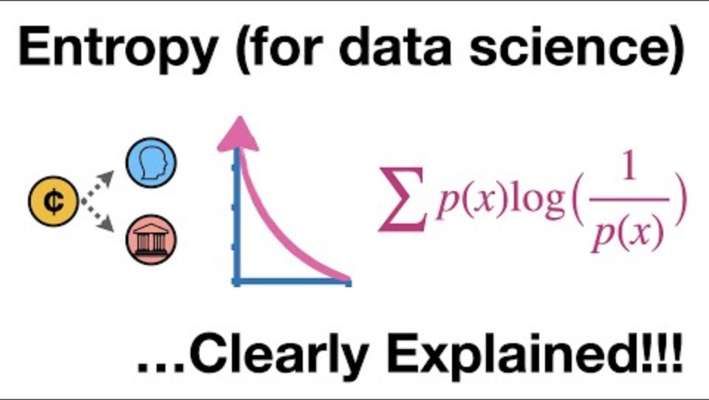

Slide 13
Cross-Entropy

Slide 14
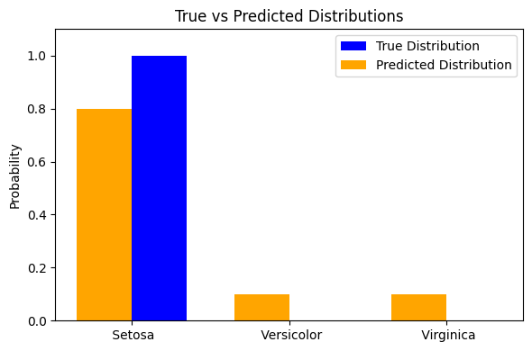
Cross-Entropy: Evaluating Predictions
Definition: Measures the difference between two distributions (predicted probabilities and true labels).
0.8
0.1
0.1
1
0
0
Setosa
Versicolor
Virginica
y= true label/ distribution (one-hot encoded)
y’=predicted distribution (after softmax)

Slide 15
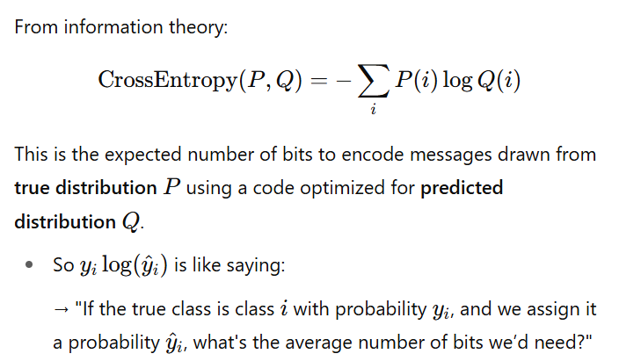
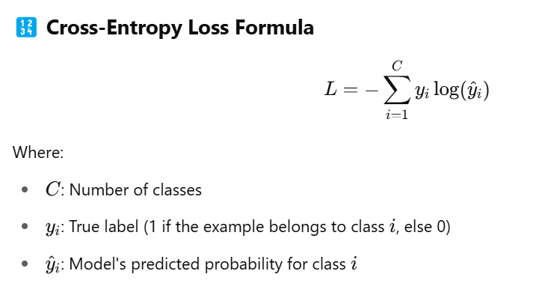
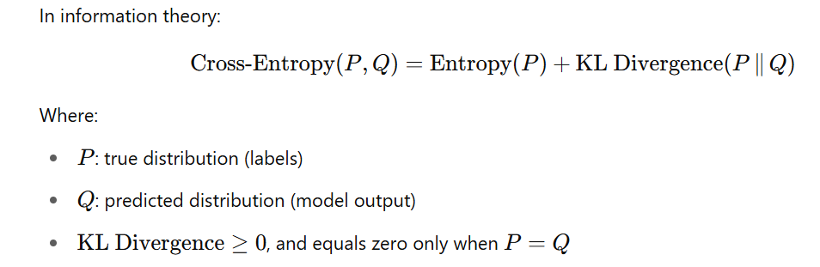
Cross-Entropy loss related to Information Theory (Cross-Entropy)
- Entropy of y
omitted due to the minimax problem
vs.
extract bits need to encode information
https://www.youtube.com/watch?v=ErfnhcEV1O8
Notes:
Formula: L = -\sum y_i \log(\hat{y}_i) \\
y_i : \text{True label (1 for correct class, 0 otherwise)}\\
\hat{y}_i : \text{Predicted probability for class ( i )}

Slide 16
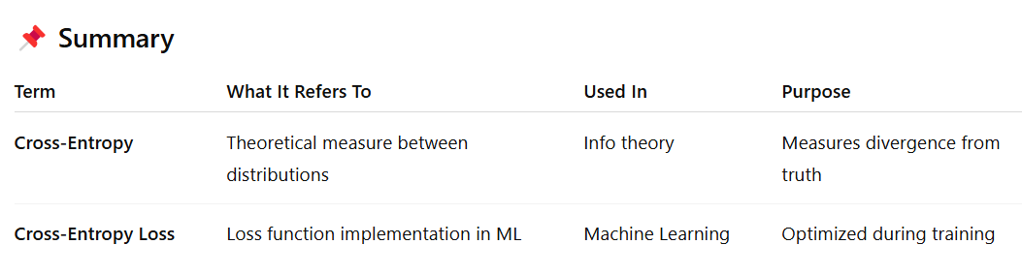

Slide 17





Simplify Cross-Entropy loss
Simplify the Loss function with one-hot encoded true distribution, e.g., y=[1,0,0]
y=[1,0,0] as a mask
=
= −log(y​₂​’)
y=[1,0,0]

Slide 18
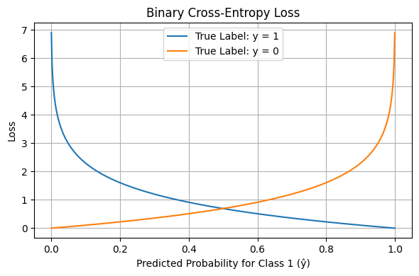
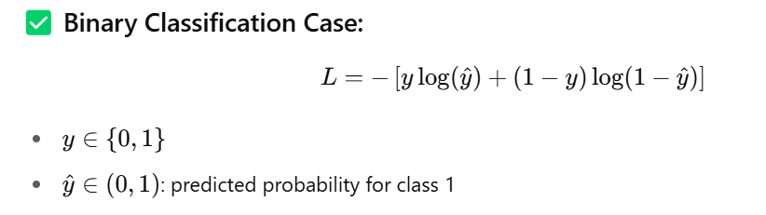
Binary Cross-Entropy Loss is a special case of Cross-Entropy Loss

Slide 19
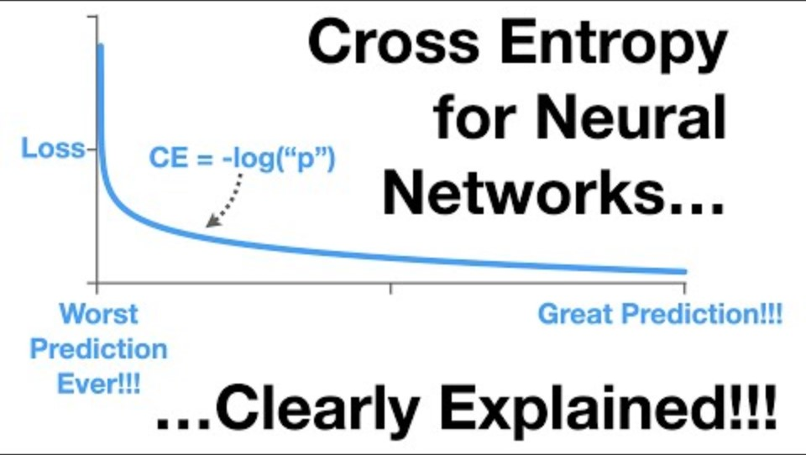

Slide 20
Activation Function
Enabling Non-Linear Learning

Slide 21
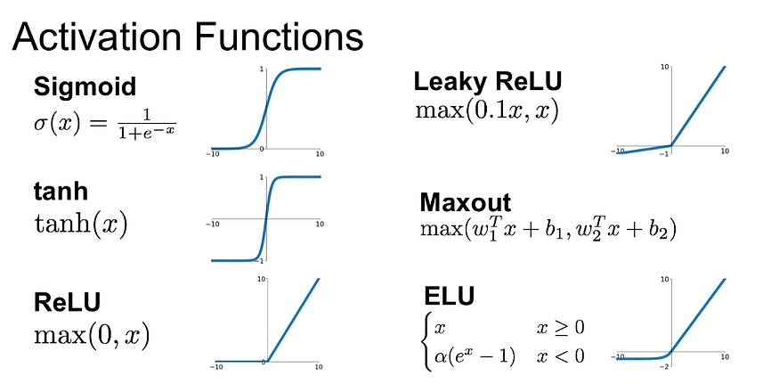
Activation Function: Introduces non-linearity in neural networks
ReLU’s simplicity makes training faster

Slide 22
Optimizer

Slide 23
https://community.deeplearning.ai/t/optimization-algorithms/305154/3

Slide 24
Adam Optimizer
Definition: Adaptive Moment Estimation, a gradient-based optimization algorithm
How It Works:
Combines momentum (moving average of gradients) and RMSProp (adaptive learning rates)
Updates weights to minimize cross-entropy loss
In PyTorch Code:
optimizer = optim.Adam(model.parameters(), lr=0.001)
optimizer.step() updates weights after backpropagation
Benefits:
Fast convergence
Adapts to different features (e.g., Iris’s varying scales)

Slide 25
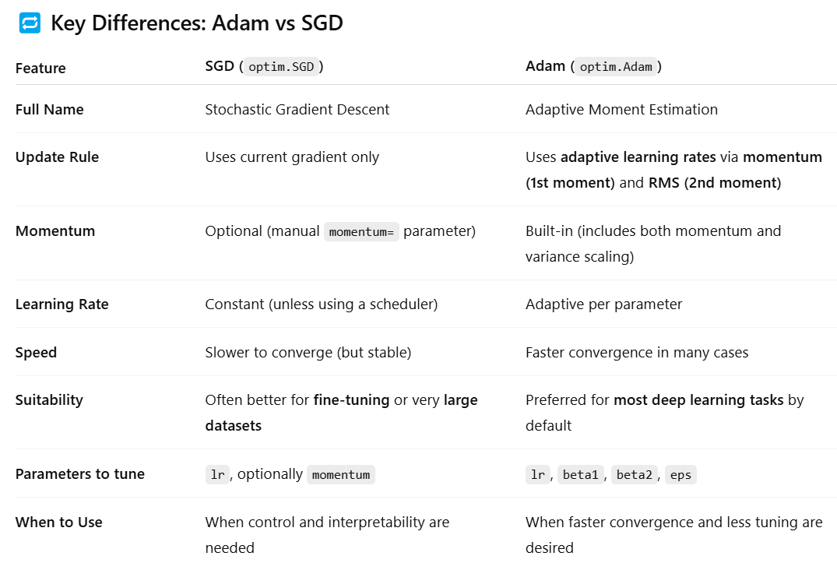

Slide 26
Which optimizer to use
Use Adam when you want good performance quickly and don't want to worry too much about hyperparameter tuning.
Use SGD (with momentum) when training very large models, fine-tuning pre-trained networks, or when you want tighter control over optimization behavior.
Compare both optimizers for Iris training with 100 epochs (150 samples)

Slide 27
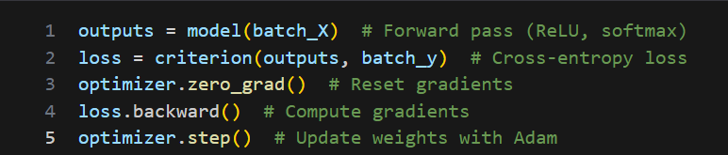
Putting It All Together
Entropy: Measures uncertainty in predictions (goal: low entropy for correct class)
Cross-Entropy Loss: Guides model to reduce uncertainty (criterion)
ReLU: Enables learning complex patterns in Iris features (relu1, relu2)
Adam: Optimizes weights to minimize loss (optimizer)

Slide 28
Summary
Entropy: Quantifies prediction uncertainty
Cross-Entropy Loss: Measures prediction error for multiclass tasks
ReLU: Adds non-linearity for complex patterns
Adam Optimizer: Efficiently minimizes loss
Application: These concepts power our PyTorch model to classify Iris species with high accuracy

