Slide 1

Digital Evidence Search with Regex Pattern Matching
The Power of Regular Expression

Slide 2
Introduction
Data and patterns

Slide 3
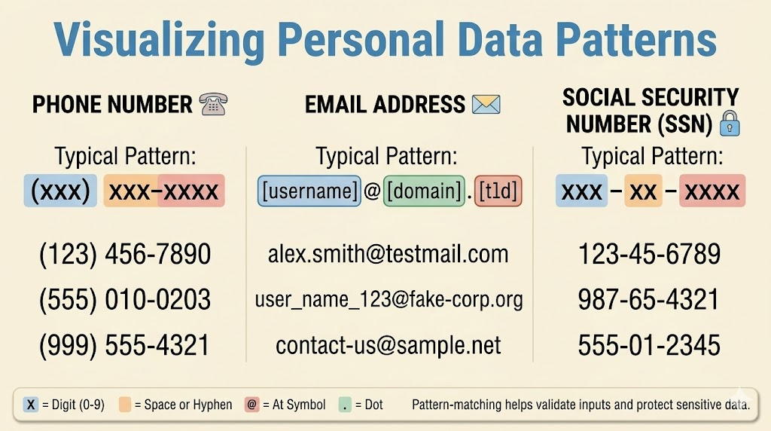

Slide 4
What types of evidence can patterns find?
Personal identifiers: names, phone numbers, email addresses, dates of birth, ZIP codes, SSNs
Account artifacts: usernames, passwords, tokens, and other credential-like strings
Source-code artifacts: HTML, Java, scripts, configuration values, and comments
Network artifacts: URLs, IP addresses, MAC addresses, timestamps, hex values, and protocol fields
File artifacts: file names, paths, file attributes, and metadata values

Slide 5

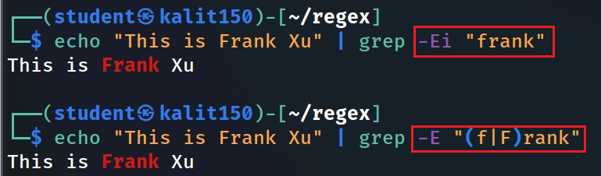
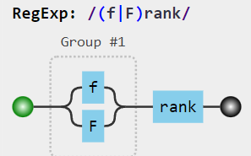
What is a regular expression (regex)?
A regex describes a search pattern, not just one literal string.
It is useful for extracting artifacts from logs, source code, documents, and raw text strings.
In this chapter, regex is mainly used with grep for searching and sed for cleaning text.
Test the pattern on small examples before running it against extracted evidence.
Literal: frank
OR/group: (f|F)rank
Case-insensitive option: grep -i
https://jex.im/regulex/#!flags=&re=(f%7CF)rank
Notes:
https://staff.washington.edu/weller/grep.html
https://www.regular-expressions.info/
echo "This is Frank Xu" | grep -Ei "frank“
echo "This is Frank Xu" | grep -E "(f|F)rank"
https://jex.im/regulex/#!flags=&re=frank
https://jex.im/regulex/#!flags=&re=(f%7CF)rank

Slide 6
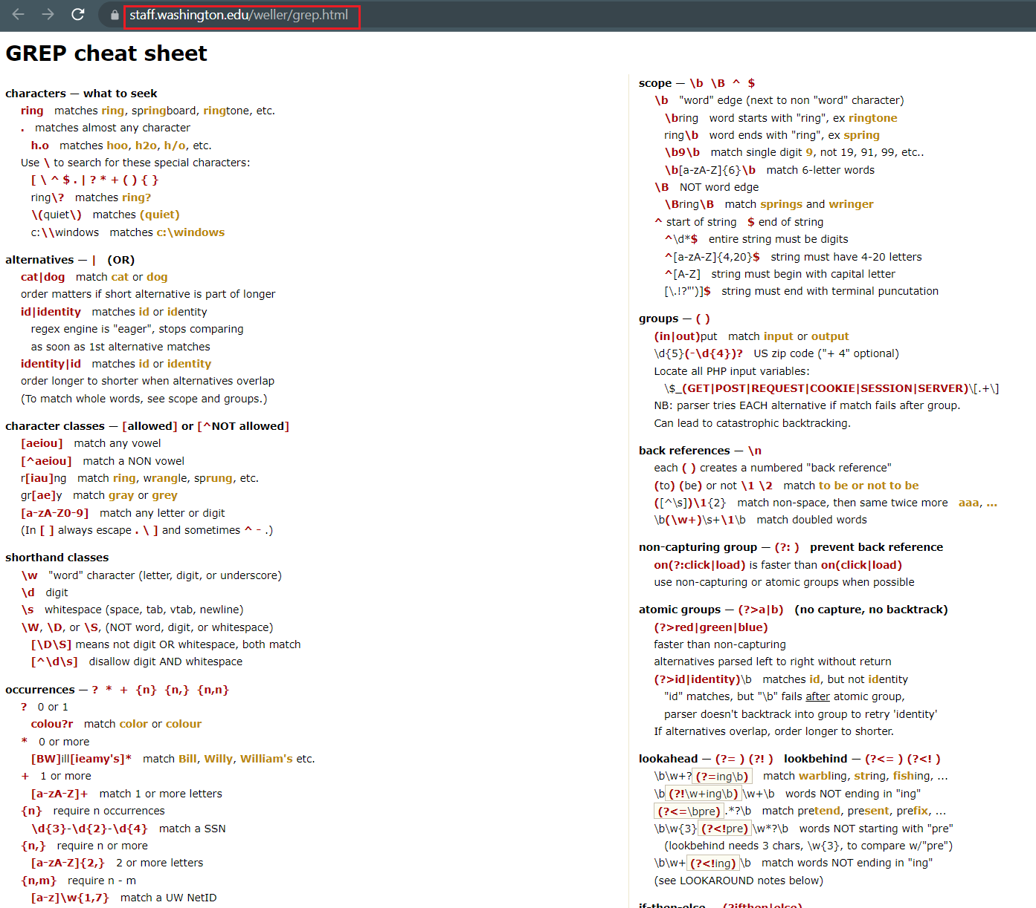
Notes:
https://staff.washington.edu/weller/grep.html

Slide 7
Chapter Roadmap
From simple pattern matching to defensible evidence extraction.
1
Setup
2
Basics
3
Precision
4
Evidence patterns
5
Artifacts
Prepare files
and run a literal search
Characters, groups,
quantifiers, boundaries
Lookaround and
false-positive reduction
Phones, emails, names,
password checks
Code, URLs, MACs,
PCAP text, DOCX/XML
Forensic rule: regex finds candidates; investigators verify context, source, and meaning.

Slide 8
Section 1
Lab Setup and First Search
Download files, inspect data, and run a literal search.
Prepare lab files and confirm what you are searching.
Run the first literal search before writing complex patterns.

Slide 9
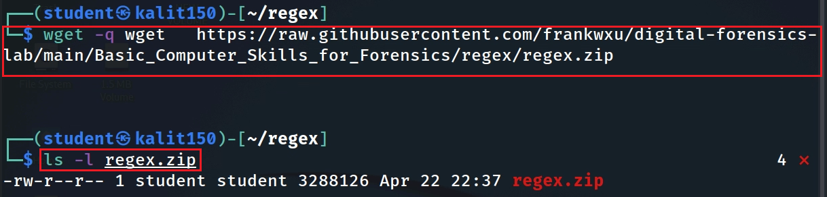
Download lab files
Notes:
wget https://raw.githubusercontent.com/frankwxu/digital-forensics-lab/main/Basic_Computer_Skills_for_Forensics/regex/regex.zip

Slide 10
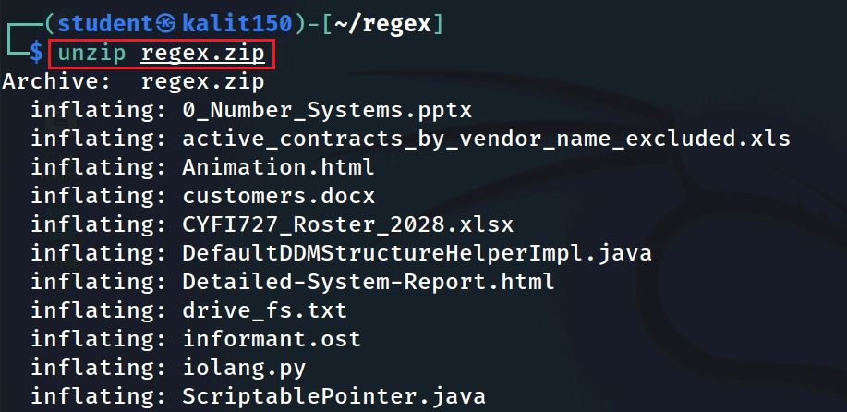
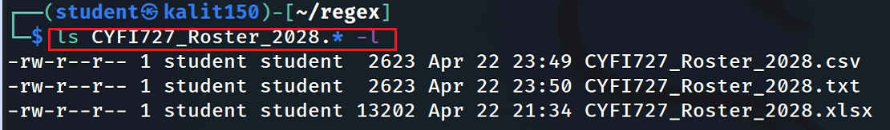
unzip the file
Verify some unzipped files

Slide 11
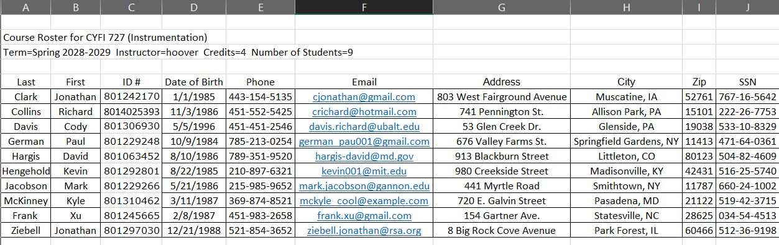
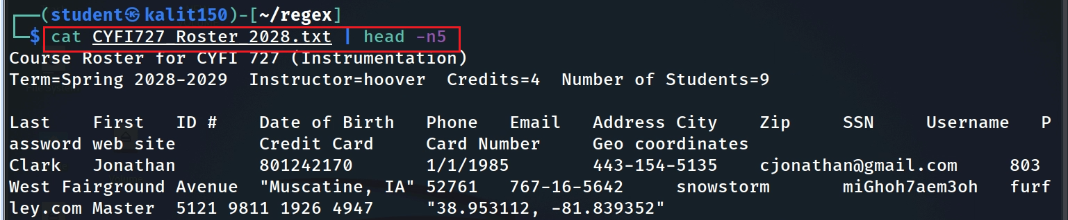
Verify the roster file before searching. Confirm the columns and delimiter first.
Notes:
cat CYFI727_Roster_2028.txt | head -n5
grep -Ei "Frank" CYFI727_Roster_2028.txt

Slide 12
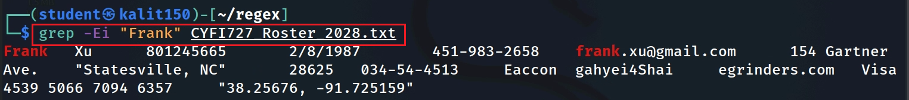
Search for a literal name
Notes:
cat CYFI727_Roster_2028.txt | head -n5
grep -Ei "Frank" CYFI727_Roster_2028.txt

Slide 13
Section 2
Regex Foundations
Literal text, character classes, quantifiers, boundaries, and whitespace.
Build patterns from literals, character classes, and quantifiers.
Use boundaries and whitespace intentionally.

Slide 14

A simple pattern of all names
Frank_Xu
Frank
Xu
Space
One Uppercase
1-10 Lowercase
1 or more space
One Uppercase
1-10 Lowercase
space
1 or more
[A-Z]
[a-z]
{1,10}
\s
+

Slide 15
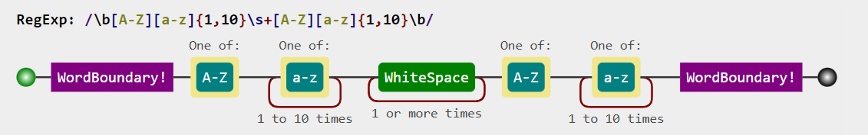
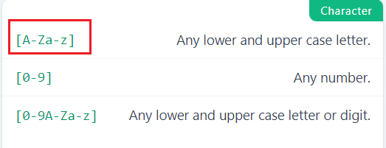
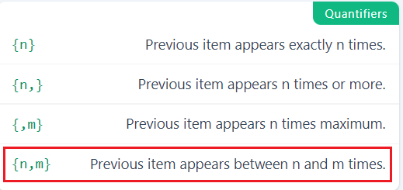
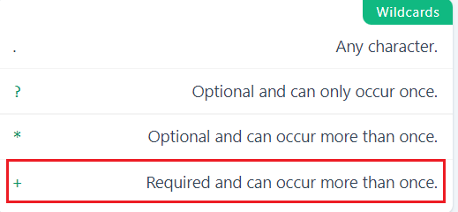
Match all names in a text file
Notes:
echo "I am Frank Xu" | grep -E -o "\b[A-Z][a-z]{1,10}\s+[A-Z][a-z]{1,10}\b“
https://jex.im/regulex/#!flags=&re=%5Cb%5BA-Z%5D%5Ba-z%5D%7B1%2C10%7D%5Cs%2B%5BA-Z%5D%5Ba-z%5D%7B1%2C10%7D%5Cb

Slide 16



Word Character: [a-zA-Z0-9_]
Word string: a list of word characters
Word Boundary: \b
Before the first character in the word string
After the last character in the word string
NOT a Word Character
I |  | am |  | 50 |  | years |  | old | , |  | he |  | is |  | 2 | !
\b
\b
\b
\b
\b
\b
\b
\b
\b
\b
\b
\b
\b
\b
\b
\b
Notes:
echo 'I am 50 years old, he is 2!' | grep -E '\b..\b’
https://learnbyexample.github.io/learn_gnugrep_ripgrep/gotchas-and-tricks.html#:~:text=Word%20boundary%20differences,-The%20%2Dw%20option&text=The%20test%20is%20that%20the,a%20non%2Dword%20constituent%20character.
https://www.regular-expressions.info/wordboundaries.html

Slide 17

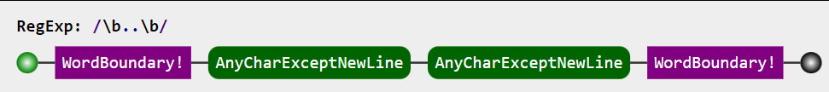
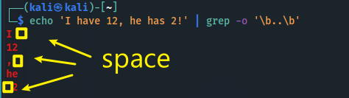
I |  | am |  | 50 |  | years |  | old | , |  | he |  | is |  | 2 | !
\b
\b
\b
\b
\b
\b
\b
\b
\b
\b
\b
\b
\b
\b
\b
\b
Search two characters between any two \b
Notes:
echo 'I am 50 years old, he is 2!' | grep -E '\b..\b’
https://learnbyexample.github.io/learn_gnugrep_ripgrep/gotchas-and-tricks.html#:~:text=Word%20boundary%20differences,-The%20%2Dw%20option&text=The%20test%20is%20that%20the,a%20non%2Dword%20constituent%20character.

Slide 18
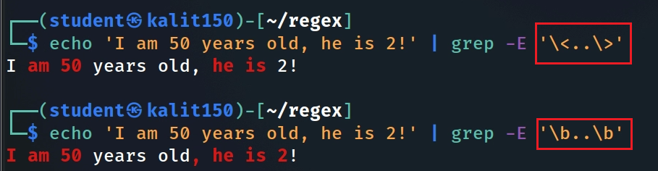



\<..\>: Don’t’ cross \b, AND must include a word string
\b..\b: any boundaries
[a-zA-Z0-9_]
I |  | am |  | 50 |  | years |  | old | , |  | he |  | is |  | 2 | !
\b
\b
\b
\b
\b
\b
\b
\b
\b
\b
\b
\b
\b
\b
\b
\b
Notes:
echo 'I am 50 years old, he is 2!' | grep -E '\<..\>'

Slide 19
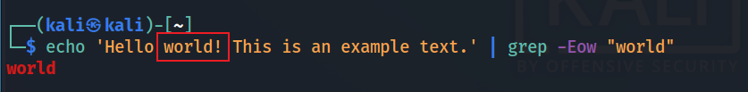
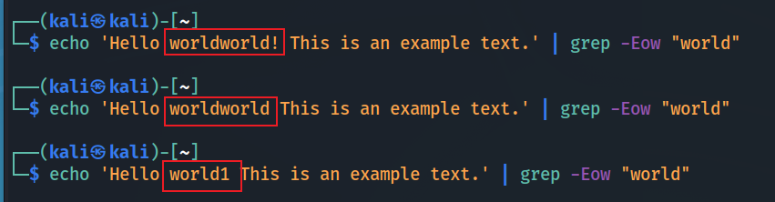
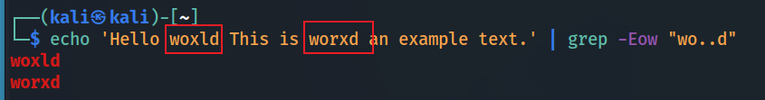
[a-zA-Z0-9_]+
-w : is a whole-word search shortcut
match only whole words
! is not a word character

Slide 20
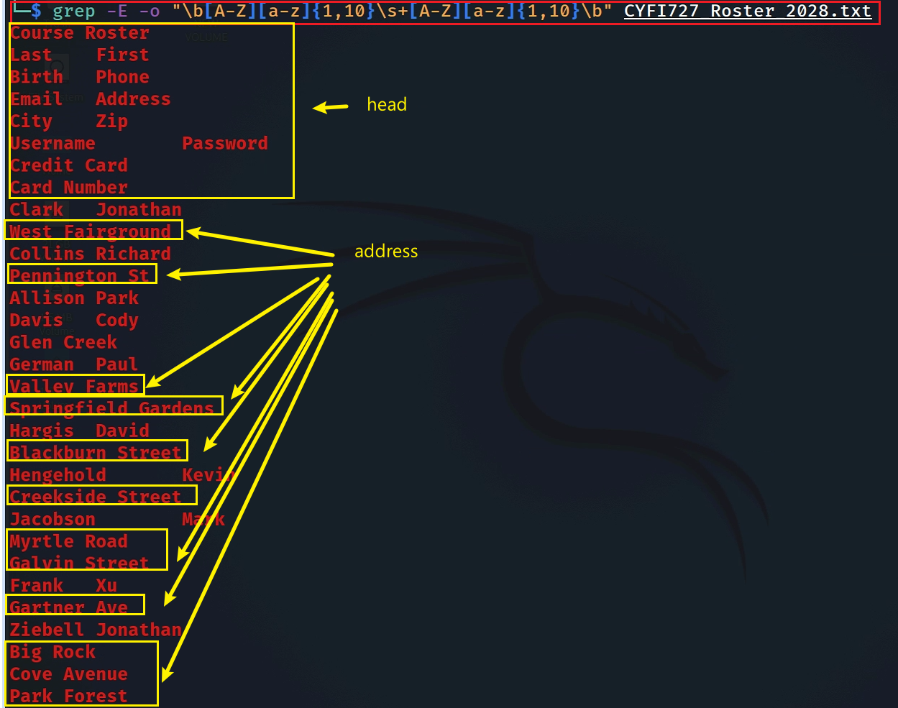

Test the patten in a text file
Search names

Slide 21
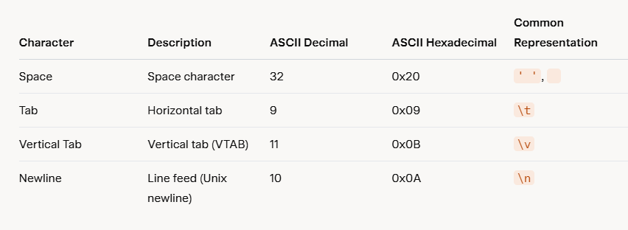
Whitespace is not always just one visible space
\s represents a list of characters
Aspect | Unix/Linux | Windows
Newline Representation | \n(LF) | \r\n(CR+LF)
Number of Characters | 1 character | 2 characters
Compatibility Issues | Files created on Unix may appear as a single line on Windows if not converted. | Files created on Windows may have extra ^M characters (visible representation of\r) on Unix if not converted.
Notes:
# Convert a file from Windows to Unix format
dos2unix filename.txt
# Convert a file from Unix to Windows format
unix2dos filename.txt

Slide 22
Section 3
Improving Match Precision
Lookaround and other techniques for reducing false positives.
• Use context to reduce false positives.
• Apply lookahead/lookbehind only when the regex engine supports it.

Slide 23

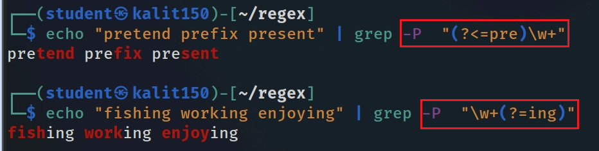



Conditional match ?
Positive lookaround with grep -P
look behind
(?<=foo)xxx
look ahead
xxx(?=foo)
Match xxx only when it is preceded by foo
Match xxx only when it is followed by foo
Lookaround requires Perl-compatible regex: grep -P
shorthand classes
  \w "word" character (letter, digit, or underscore)
  [a-zA-Z0-9_]
  \d digit
  \s whitespace (space, tab, vtab, newline)
-Po
Notes:
echo "pretend prefix present" | grep -P "(?<=pre)\w+“
echo "fishing working enjoying" | grep -P "\w+(?=ing)“

Slide 24
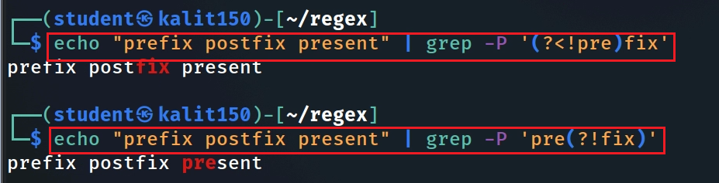
Negative lookup
look behind
(?<!foo)xxx
look ahead
xxx(? !foo)
Match xxx only when it is not preceded by a string foo
Match xxx only when it is not followed by a string foo
Negative lookup pattern MUST be single quote ‘ ’
a lookup string length must be fixed
Notes:
echo “prefix postfix present" | grep -P ‘?<!pre)fix’
echo "prefix postfix present" | grep -P 'pre(?<!fix)'

Slide 25
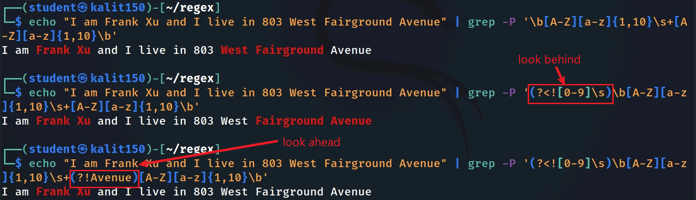


False positive: street-address words can look like person names.
Reduce false positives with lookaround
negative
can’t have “avenue” after a name!
negative
Second try: exclude suffixes such as Avenue/Ave, Street/St, and Drive/Dr.
Notes:
echo "I am Frank Xu and I live in 803 West Fairground Avenue" | grep -P '\b[A-Z][a-z]{1,10}\s+[A-Z][a-z]{1,10}\b’
echo "I am Frank Xu and I live in 803 West Fairground Avenue" | grep -P '(?<![0-9]\s)\b[A-Z][a-z]{1,10}\s+[A-Z][a-z]{1,10}\b
echo "I am Frank Xu and I live in 803 West Fairground Avenue" | grep -P '(?<![0-9]\s)\b[A-Z][a-z]{1,10}\s+(?!Avenue)[A-Z][a-z]{1,10}\b'

Slide 26
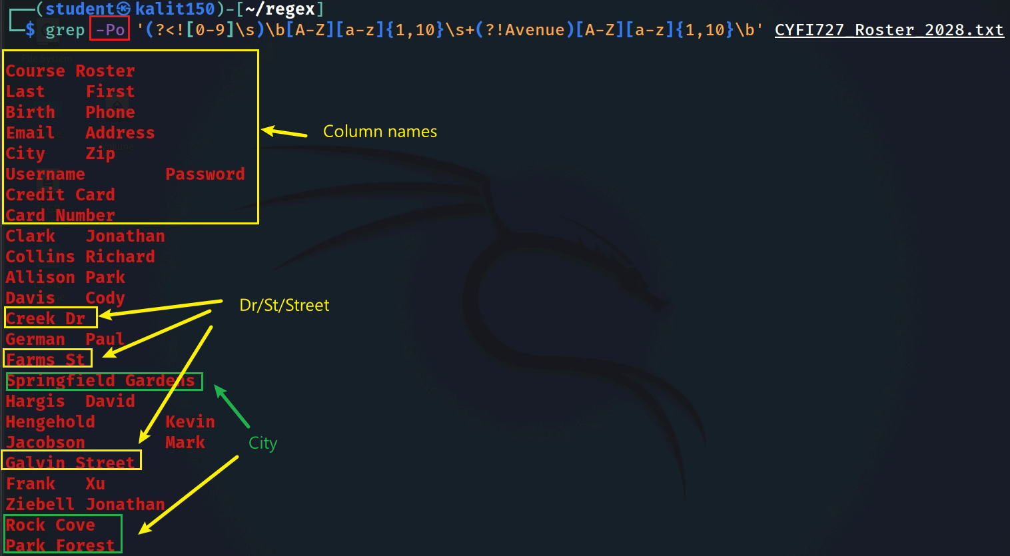
Notes:
grep -Po '(?<![0-9]\s)\b[A-Z][a-z]{1,10}\s+(?!Avenue)[A-Z][a-z]{1,10}\b' CYFI727_Roster_2028.txt

Slide 27
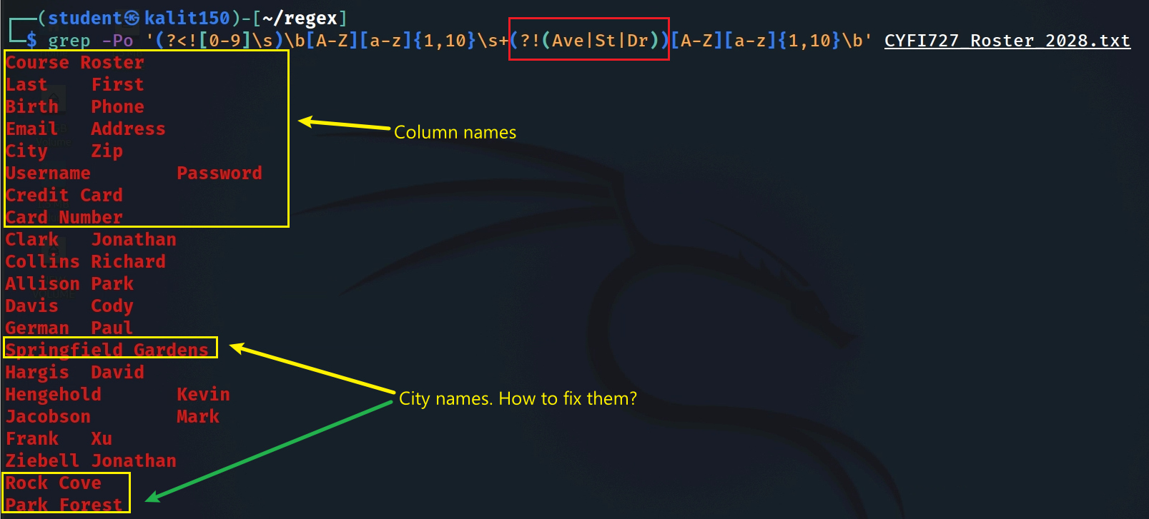
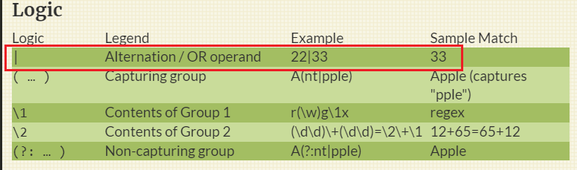
Exclude street suffixes (Ave, St, and Dr) from the last name
Use alternatives: (?!(?:Ave|St|Dr)\b)
Notes:
grep -Po '(?<![0-9]\s)\b[A-Z][a-z]{1,10}\s+(?![Ave|St|Dr])[A-Z][a-z]{1,10}\b' CYFI727_Roster_2028.txt

Slide 28
Section 4
Common Forensic Evidence Patterns
Phones, email addresses, names, and simple policy validation.
• Apply reusable patterns for phones, email addresses, and validation checks.
• Test with positive and negative examples.

Slide 29

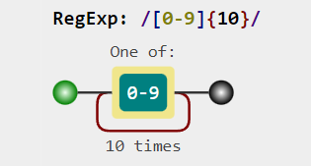
Phone-number matching: start simple, then generalize
1234567890
123.456.7890
123-456-7890
123 456 7890
(123)456-7890
+11234567890
1234567890
[0-9]{10}
Notes:
https://jex.im/regulex/#!flags=&re=%5B0-9%5D%7B10%7D

Slide 30
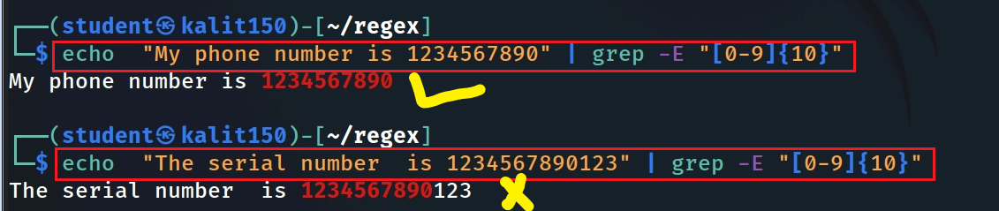
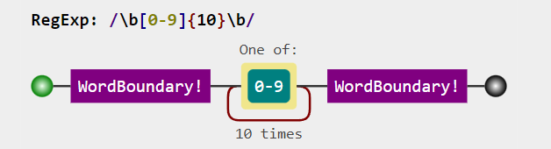
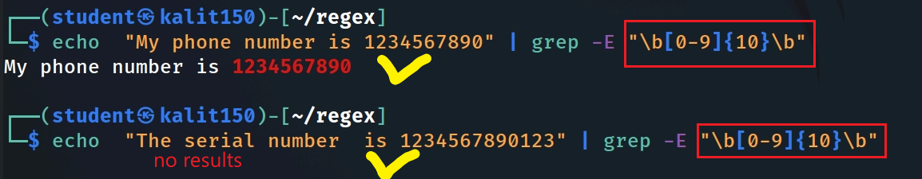
Match 10 contiguous digits only
Notes:
echo "My phone number is 1234567890" | grep -E "[0-9]{10}“
echo "The serial number is 1234567890123" | grep -E "[0-9]{10}“
echo "My phone number is 1234567890" | grep -E "\b[0-9]{10}\b“
echo "The serial number is 1234567890123" | grep -E "\b[0-9]{10}\b“
https://jex.im/regulex/#!flags=&re=%5Cb%5B0-9%5D%7B10%7D%5Cb

Slide 31
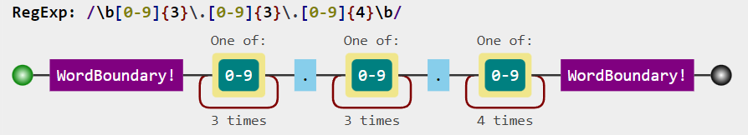
Match dotted phone numbers: xxx.xxx.xxxx
123.456.7890
\b[0-9]{3} \.[0-9]{3}\.[0-9]{4}\b
Notes:
echo "My phone number is 123.456.7890" | grep -E "\b[0-9]{3}\.[0-9]{3}\.[0-9]{4}\b"
https://jex.im/regulex/#!flags=&re=%5Cb%5B0-9%5D%7B3%7D%5C.%5B0-9%5D%7B3%7D%5C.%5B0-9%5D%7B4%7D%5Cb

Slide 32
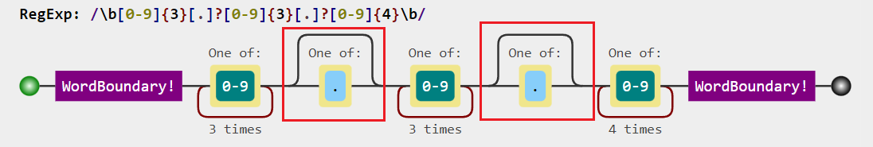
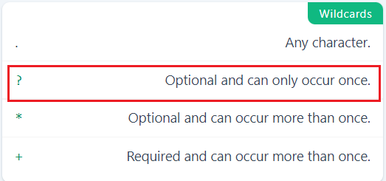
1234567890
Match both?
123.456.7890
{0,1}

Slide 33
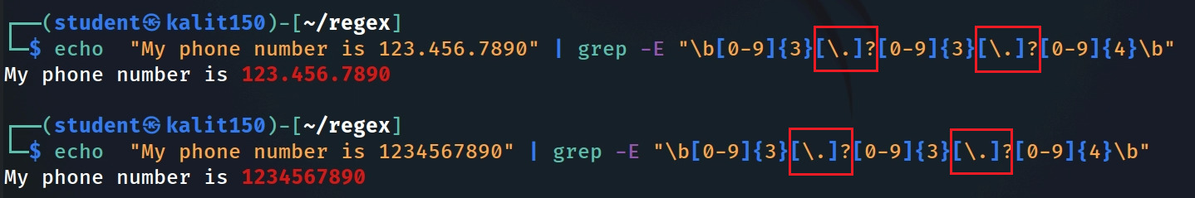
Test both phone number types
Notes:
echo "My phone number is 123.456.7890" | grep -E "\b[0-9]{3}[\.]?[0-9]{3}[\.]?[0-9]{4}\b“
echo "My phone number is 1234567890" | grep -E "\b[0-9]{3}[\.]?[0-9]{3}[\.]?[0-9]{4}\b"

Slide 34
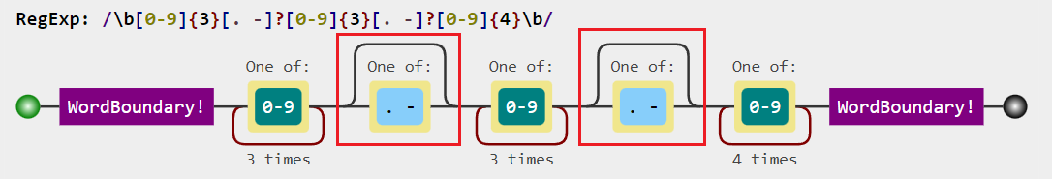
1234567890
123.456.7890
123-456-7890
123 456 7890
Match common separators: none, dot, hyphen, or space ?
Notes:
https://jex.im/regulex/#!flags=&re=%5Cb%5B0-9%5D%7B3%7D%5B.%20-%5D%3F%5B0-9%5D%7B3%7D%5B.%20-%5D%3F%5B0-9%5D%7B4%7D%5Cb

Slide 35
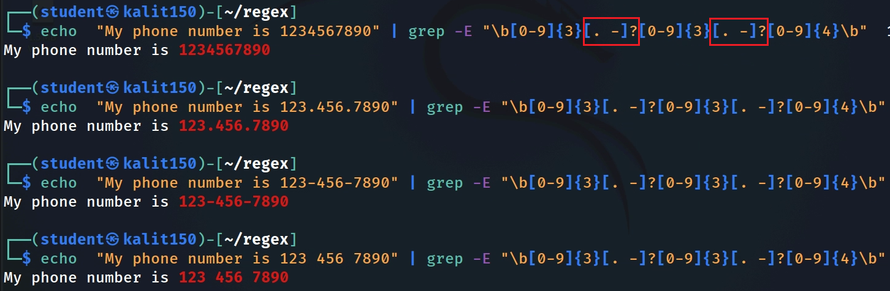

Test all four common
Notes:
echo "My phone number is 1234567890" | grep -E "\b[0-9]{3}[. -]?[0-9]{3}[. -]?[0-9]{4}\b“
echo "My phone number is 123.456.7890" | grep -E "\b[0-9]{3}[. -]?[0-9]{3}[. -]?[0-9]{4}\b“
echo "My phone number is 123-456-7890" | grep -E "\b[0-9]{3}[. -]?[0-9]{3}[. -]?[0-9]{4}\b“
echo "My phone number is 123 456 7890" | grep -E "\b[0-9]{3}[. -]?[0-9]{3}[. -]?[0-9]{4}\b"

Slide 36

1234567890
123.456.7890
123-456-7890
123 456 7890
(123)456-7890
Match optional parentheses around the area code
syntax: ?if then|else
(\()? \b[0-9]{3} (?(1) \)|[. -]?) [0-9]{3}[. -]?[0-9]{4}\b
Notes:
https://jex.im/regulex/#!flags=&re=%5Cb%5B0-9%5D%7B3%7D%5B.%20-%5D%3F%5B0-9%5D%7B3%7D%5B.%20-%5D%3F%5B0-9%5D%7B4%7D%5Cb
echo "My phone number is (123)456-7890" | grep -P "(\()?\b[0-9]{3}(?(1)\)?|[. -]?)[0-9]{3}[. -]?[0-9]{4}\b"

Slide 37
Match email addresses
john.doe@gmail.com
john-doe@md.gov
johnDoe001@mozilla.org
Local part
domain name
johndoe@ubalt.edu
.
Consists of letters, digital, -, .
2-15 characters long
[a-zA-Z0-9.-]{2,15}
@
Consists of letters, digital
1-15 characters long
[a-zA-Z0-9]{1,15}
Consists of letters, digital
3-4 characters long
[a-zA-Z0-9]{3,4}
@
\.
Teaching pattern only: real email validation is more complex than this simplified regex.

Slide 38
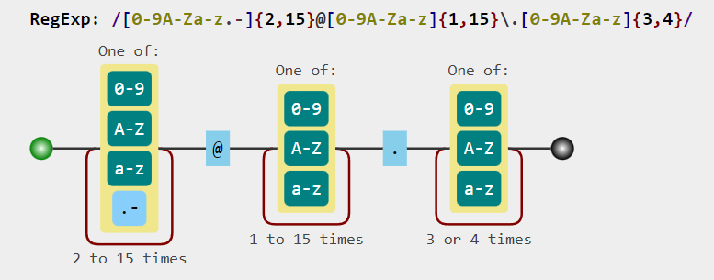
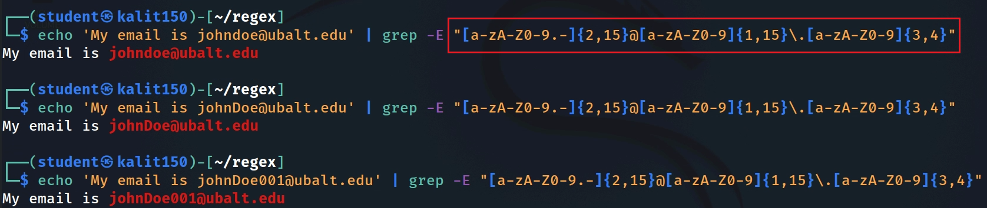
Notes:
https://jex.im/regulex/#!flags=&re=%5Ba-zA-Z0-9.-%5D%7B2%2C15%7D%40%5Ba-zA-Z0-9%5D%7B1%2C15%7D%5C.%5Ba-zA-Z0-9%5D%7B3%2C4%7D
echo 'My email is johndoe@ubalt.edu' | grep -E "[a-zA-Z0-9.-]{2,15}@[a-zA-Z0-9]{1,15}\.[a-zA-Z0-9]{3,4}“
echo 'My email is johnDoe@ubalt.edu' | grep -E "[a-zA-Z0-9.-]{2,15}@[a-zA-Z0-9]{1,15}\.[a-zA-Z0-9]{3,4}“
echo 'My email is johnDoe001@ubalt.edu' | grep -E "[a-zA-Z0-9.-]{2,15}@[a-zA-Z0-9]{1,15}\.[a-zA-Z0-9]{3,4}"

Slide 39
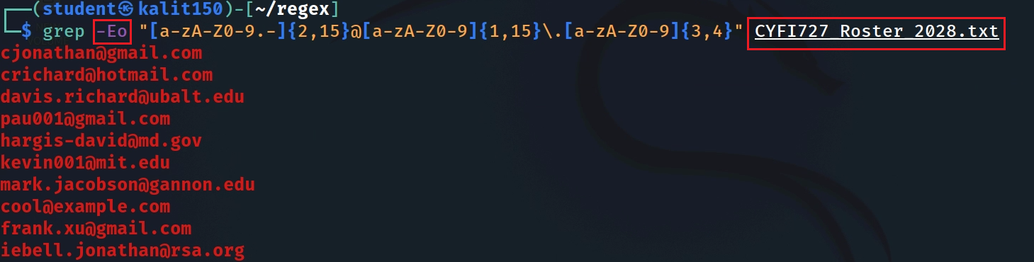
Notes:
grep -Eo "[a-zA-Z0-9.-]{2,15}@[a-zA-Z0-9]{1,15}\.[a-zA-Z0-9]{3,4}" CYFI727_Roster_2028.txt

Slide 40
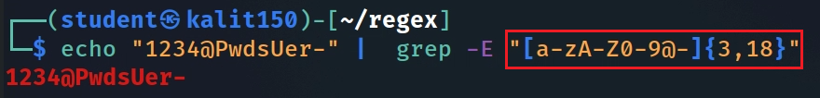
Validate a simple password policy
• Length: 3–18 characters
• Allowed characters: letters, digits, @, and hyphen
• For full validation, anchor the pattern with ^ and $
Notes:
echo "1234@PwdsUer-" | grep -E "[a-zA-Z0-9@-]{3,18}"

Slide 41
Section 5
Code and Network Artifacts
Source code, HTML, IP addresses, URLs, hex values, MACs, and PCAP-derived text.
• Search source code, HTML, URLs, IP addresses, hex, MACs, and PCAP-derived text.
• Know when preprocessing is required before grep.

Slide 42
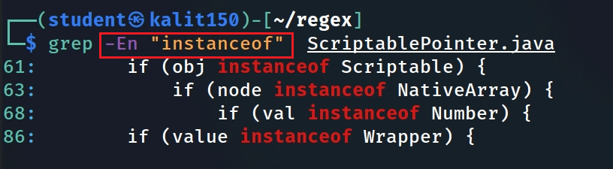
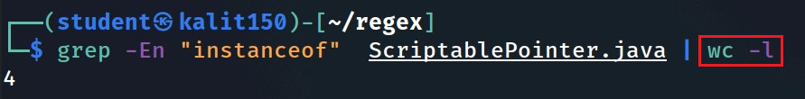
Search Java source code
Search string in Java and show line numbers
Show how many time the key words appears in Java source code
Notes:
grep -En "instanceof" ScriptablePointer.java

Slide 43
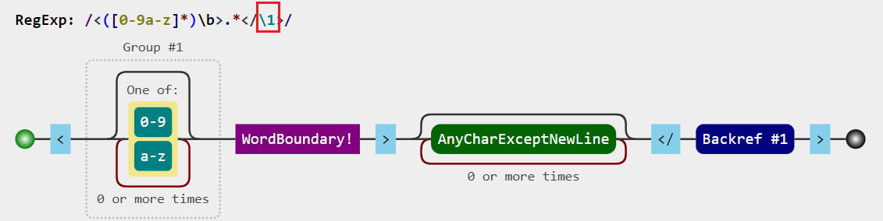

Match HTML code (including tags and content) using Backreference \n
<h1>This is a heading. </h1>
Opening tag
content
Closing tag
Notes:
echo "The following is html code. <h1>This is a heading. </h1>" | grep -E "<([a-z0-9]*)\b>.*</\1>"

Slide 44
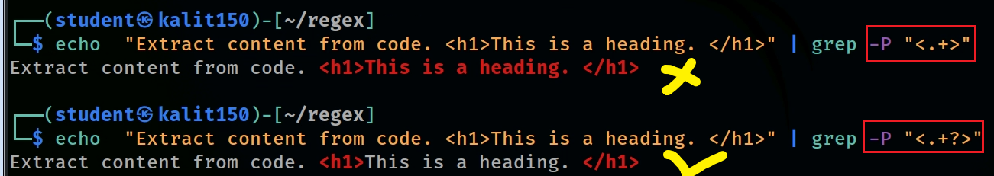
Match HTML tags using a Lazy quantifier
<h1>This is a heading. </h1>
MUST use -P
Greedy quantifier | Lazy quantifier | Description
* | * ? | Star Quantifier: 0 or more
+ | + ? | Plus Quantifier: 1 or more
? | ? ? | Optional Quantifier: 0 or 1
{n} | {n} ? | Quantifier: exactly n
{n,} | {n,} ? | Quantifier: n or more
{n,m} | {n,m} ? | Quantifier: between n and m
Notes:
echo "Extract content from code. <h1>This is a heading. </h1>" | grep -P "<.+>“
echo "Extract content from code. <h1>This is a heading. </h1>" | grep -P "<.+?>“
https://stackoverflow.com/questions/3027518/how-to-do-a-non-greedy-match-in-grep

Slide 45

Match content from an HTML code
<h1>This is a heading. </h1>
(?<=<([a-z0-9]{2}) >).* (?=</ \1>)
look behind
look ahead
Notes:
echo "Extract content from code. <h1>This is a heading. </h1>" | grep -P "(?<=<([a-z0-9]{2})>).*(?=</\1>)"

Slide 46
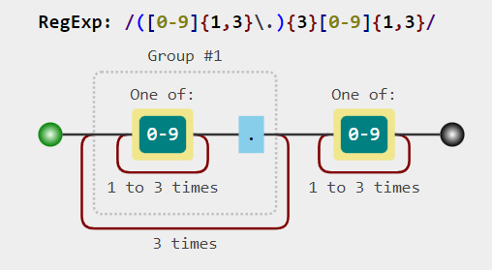
Match IPv4-like address patterns
192.168.0.1
443.125.121.1
255.255.255.0
89.25.23.0
Note: this simple pattern matches IP-like strings; it does not enforce the 0–255 range for each octet.
Notes:
https://jex.im/regulex/#!flags=&re=(%5B0-9%5D%7B1%2C3%7D%5C.)%7B3%7D%5B0-9%5D%7B1%2C3%7D
echo "The IP address is 443.125.121.1" | grep -E "([0-9]{1,3}\.){3}[0-9]{1,3}"

Slide 47
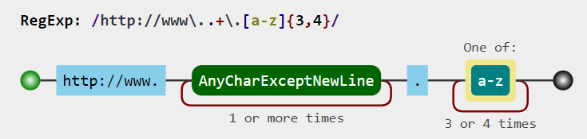
Match a specific URL pattern
http://www.ubalt.edu
Notes:
echo "It continas a valid url http://www.ubalt.edu" | grep -E "http://www\..+\.[a-z]{3,4}"

Slide 48
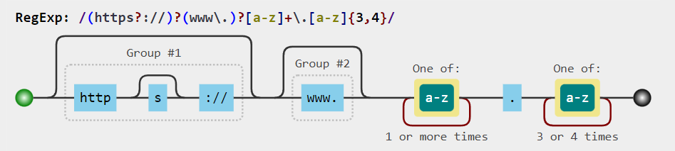
http://www.ubalt.edu
https://www.ubalt.edu
www.ubalt.edu
ubalt.edu
Match common URL variations
Notes:
https://jex.im/regulex/#!flags=&re=(https%3F%3A%2F%2F)%3F(www%5C.)%3F%5Ba-z%5D%2B%5C.%5Ba-z%5D%7B3%2C4%7D
echo "It continas a valid url www.ubalt.edu" | grep -E "(https?://)?(www\.)?[a-z]+\.[a-z]{3,4}"

Slide 49
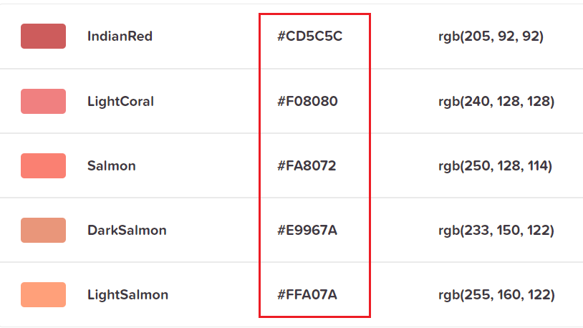


Match Hexadecimal number
Match Hex of colors
Notes:
echo "The hex of a color #CD5C5C" | grep -E "#[a-fA-F0-9]{6}"

Slide 50


Match MAC address
The standard (IEEE 802) format for printing MAC-48 addresses in human-friendly form is six groups of two hexadecimal digits, separated by hyphens - or colons :.
01-23-45-67-89-AB
01:23:45:67:89:AB
Notes:
https://jex.im/regulex/#!flags=&re=(%5B0-9A-Fa-f%5D%7B2%7D%5B%3A-%5D)%7B5%7D(%5B0-9A-Fa-f%5D%7B2%7D)
echo "My MAC address is 01-23-45-67-89-AB" | grep -E "([0-9A-Fa-f]{2}[:-]){5}([0-9A-Fa-f]{2})“
echo "My MAC address is 01:23:45:67:89:AB" | grep -E "([0-9A-Fa-f]{2}[:-]){5}([0-9A-Fa-f]{2})"

Slide 51

PaloAlto_00:0a:30
VMware_86:44:c3
Match vendor’s MAC patterns
Notes:
https://jex.im/regulex/#!flags=&re=%5Ba-zA-Z%5D%7B1%2C10%7D_(%5B%3A-%5D%5B0-9a-zA-Z%5D%7B2%7D)%7B3%7D
echo "My MAC address is PaloAlto_00:0a:30" | grep -E "[a-zA-Z0-9]{1,10}_[0-9a-zA-Z]{2}(:[0-9a-zA-Z]{2}){2}"

Slide 52


Extract network fields from a pcap before regex matching(link)
tshark help
-r <infile>, --read-file <infile>:
  set the filename to read from (or '-' for stdin)
-e <field>
  field to print if -Tfields selected (e.g. tcp.port, _ws.col.Info)
Convert pcap to text
Notes:
tshark -r vm_to_ub_traffic.log -T fields -E header=y -E separator=, -E quote=d -E occurrence=f -e ip.version -e ip.hdr_len -e ip.tos -e ip.id -e ip.flags -e ip.flags.rb -e ip.flags.df -e ip.flags.mf -e ip.frag_offset -e ip.ttl -e ip.proto -e ip.checksum -e ip.src -e ip.dst -e ip.len -e ip.dsfield -e tcp.srcport -e tcp.dstport -e tcp.seq -e tcp.ack -e tcp.len -e tcp.hdr_len -e tcp.flags -e tcp.flags.fin -e tcp.flags.syn -e tcp.flags.reset -e tcp.flags.push -e tcp.flags.ack -e tcp.flags.urg -e tcp.flags.cwr -e tcp.window_size -e tcp.checksum -e tcp.urgent_pointer -e tcp.options.mss_val -e eth.src_resolved -e eth.dst_resolved> output.csv
https://www.linkedin.com/pulse/build-machine-learning-model-network-flow-tao-liu/
https://shantoroy.com/networking/convert-pcap-to-csv-using-tshark/
https://github.com/frankwxu/digital-forensics-lab/blob/main/Basic_Computer_Skills_for_Forensics/file_carving/File_Carving_Manually/vm_to_ub_traffic.log

Slide 53


Extract standard MAC-address
Extract vendor-resolved MAC labels
Notes:
grep -Eo "([0-9A-Fa-f]{2}[:-]){5}([0-9A-Fa-f]{2})" output.csv | sort | uniq -c| sort -n
grep -Eo "[a-zA-Z0-9]{1,10}_[0-9a-zA-Z]{2}(:[0-9a-zA-Z]{2}){2}" output.csv | sort | uniq -c| sort -n

Slide 54
Section 6
Searching Structured Documents
DOCX/XML extraction and text cleanup before evidence search.
• Extract text from structured documents before matching evidence.
• Use sed to clean XML/HTML markup while preserving useful boundaries.

Slide 55

Extract email addresses from a .docx file

Slide 56

A .docx file is a ZIP package
content

Slide 57

Unzip .docx to inspect internal XML files

Slide 58


The main .docx text is stored in word/document.xml
grep “ubalt.edu”, but the result includes Word XML markup
Notes:
grep -Ei "ubalt.edu" customers/word/document.xml

Slide 59

Remove xml tag using sed
sed substitution commands
Notes:
echo "111-222-3333" | sed -e 's/1/4/’
echo "111-222-3333" | sed -e 's/1/4/g'

Slide 60



Replace only the first “1” vs. all “1” characters
Replace hyphens with dots
Remove all “-”
Notes:
echo "111-222-3333" | sed -e 's/1/4/’
echo "111-222-3333" | sed -e 's/1/4/g'

Slide 61

<h1>This is a heading. </h1>
First attempt: PCRE-style lazy matching is not supported by sed
Match any character except the caret symbol ^
Better approach: Remove all html tags using [^ not allowed character set].
In plaintext: match “<” then all non-“>” characters until “>”
Notes:
echo "Extract content from code. <h1>This is a heading. </h1>" | sed -E "s/<[^>]+>//g“
https://jex.im/regulex/#!flags=&re=%3C%5B%5E%3E%5D%2B%3E

Slide 62

Remove all xml tags
Issue: removing tags can concatenate words across paragraph boundaries.
Notes:
cat customers/word/document.xml | sed -E 's/<[^>]+>//g'

Slide 63



[^<]*: Match characters up to—but not including—another <don’t cross into nested tags
Preserve paragraph boundaries: Replace paragraph (paraID) tag with spaces
Then grep the cleaned text for emails
Notes:
cat customers/word/document.xml | sed -E 's/<[^<]*paraId[^>]*>/ /g ; s/<[^>]+>//g’
sed -E 's/<[^<]*paraId[^>]*>/ /g ; s/<[^>]+>//g' customers/word/document.xml
sed -E 's/<[^<]*paraId[^>]*>/ /g ; s/<[^>]+>//g' customers/word/document.xml | grep -Eo "[a-zA-Z0-9.-]{2,15}@[a-zA-Z0-9]{1,15}\.[a-zA-Z0-9]{3,4}"

Slide 64

Read .docx document text without extracting to disk
-p extract files to pipe, no messages
Read .docx document properties without extracting to disk
Notes:
unzip -p "*.docx" word/document.xml| sed -E 's/<[^<]*paraId[^>]*>/ /g ; s/<[^>]+>//g’
unzip -p "*.docx" docProps/core.xml| sed -E 's/<[^>]+>/ /g'

Slide 65
Summary
grep searches for evidence patterns in text or extracted strings; sed cleans or transforms matched text.
Build patterns incrementally: start with literal text, then add character classes, groups, alternation, anchors, and quantifiers.
Use grep -E for extended regex; use grep -P for lookaround, lazy quantifiers, conditionals, and other PCRE features.
Validate patterns with both positive and negative test cases to reduce false positives.
For compound files such as .docx, extract the internal XML first, clean markup, then run regex searches.
Forensic takeaway: report the exact command, pattern, source file, and validation examples so the search can be reproduced.
Notes:
address: \\d+[ ](?:[A-Za-z0-9.-]+[ ]?)+(?:Avenue|Lane|Road|Boulevard|Drive|Street|Ave|Dr|Rd|Blvd|Ln|St)\\.?

Slide 66


https://staff.washington.edu/weller/grep.html
Notes:
https://staff.washington.edu/weller/grep.html

Slide 67



