Slide 1
Acquiring a USB image
Notes:
https://www.youtube.com/watch?v=6G3qm60dfA8&ab_channel=PrashantThombre

Slide 2
Overview
What is a disk image?
Acquisition a USB in Windows using FTK Imager
Acquisition a USB in Linux using DD
Acquisition via Network

Slide 3
What is a disk image?
A disk image is a computer file
  containing the contents and structure of a disk volume (partition) or
  containing an entire data storage device,
Storage devices
  a hard disk drive, tape drive, floppy disk, optical disc, or USB flash drive
The file format
  open standard: such as the ISO image format for optical disc images,
  unique to a particular software application: encase, FTK
Image acquisition can be done in
  Windows
  Linux

Slide 4
Acquisition in Windows using FTK Imager

Slide 5
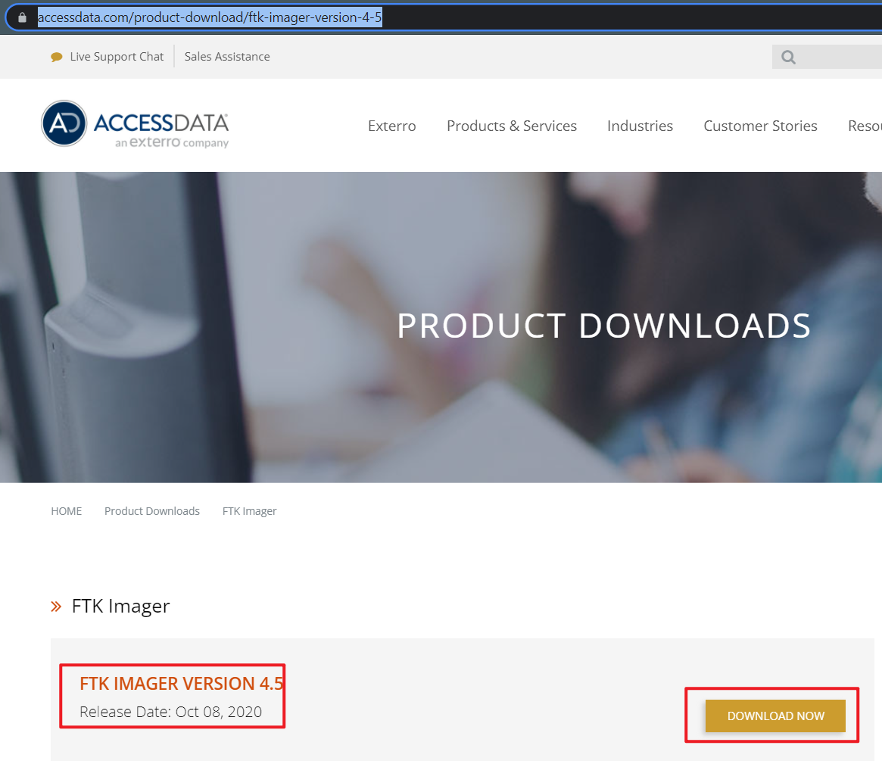
Download and install FTK
https://accessdata.com/product-download/ftk-imager-version-4-5

Slide 6
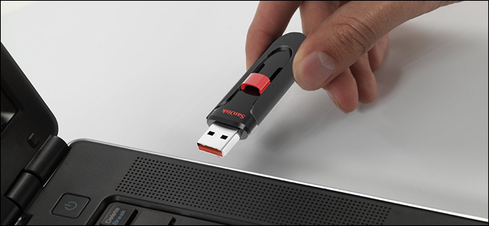
Plug in a Flash Drive to Your Computer
You can copy come files to the USB
The Lab has to be done on your local host PC
https://www.howtogeek.com/wp-content/uploads/2017/09/ximg_59b9b8dfbb300.png.pagespeed.gp+jp+jw+pj+ws+js+rj+rp+rw+ri+cp+md.ic.2DjSUAOnqK.jpg

Slide 7
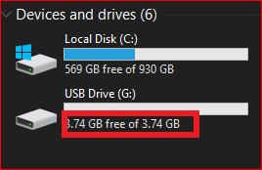
Verify your PC can read the USB drive

Slide 8

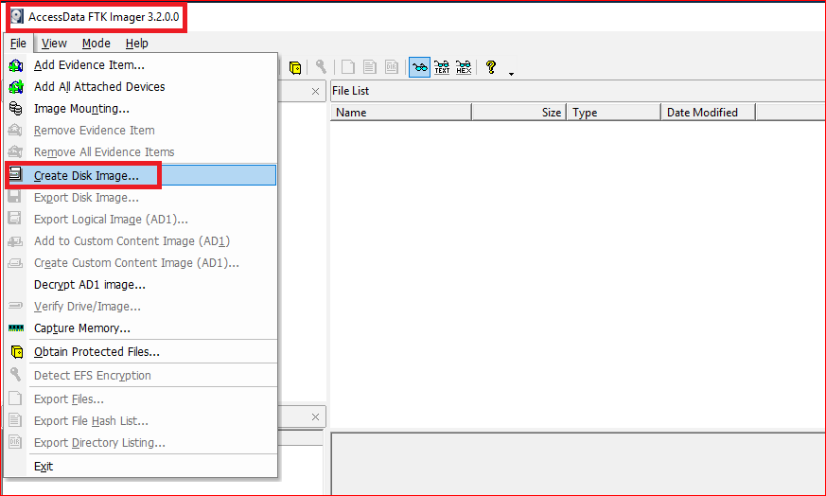
Acquiring a USB using FTK

Slide 9
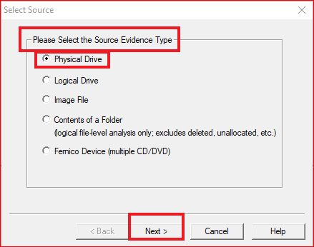
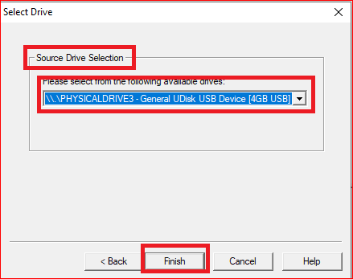

Slide 10
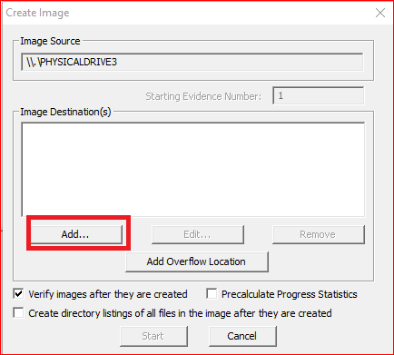
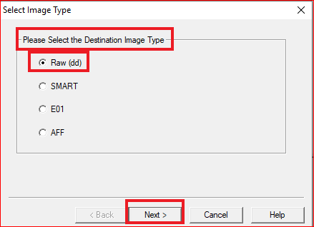
created with an imaging tool called DD
SMARTLinux has been customized and designed for Data Forensics. http://www.asrdata.com
EnCase image file format used by EnCase software
Advanced Forensics Format (AFF), an open file format
Notes:
http://www.asrdata.com/forensic-software/smart-for-linux/

Slide 11
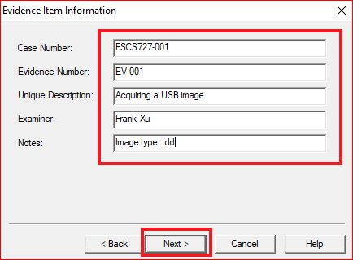

Slide 12
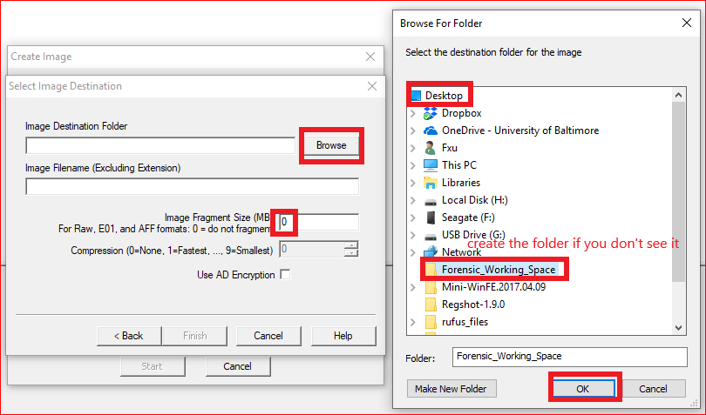

Slide 13
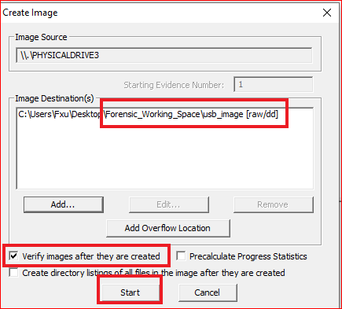
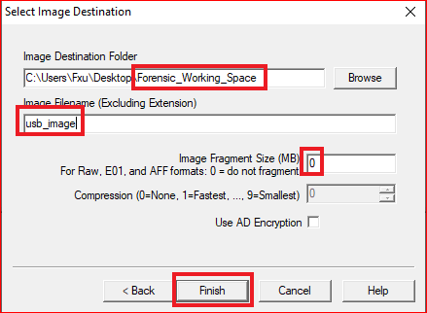

Slide 14
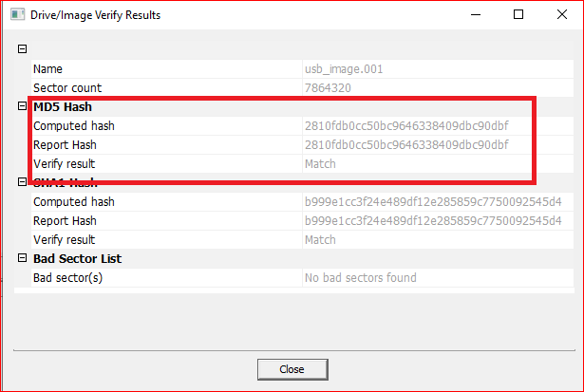
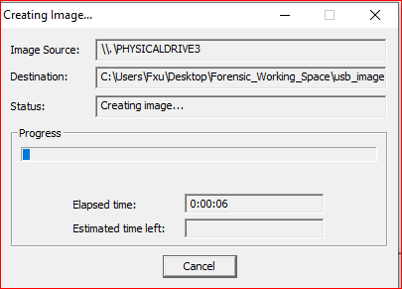

Slide 15
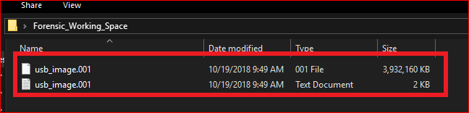

Slide 16
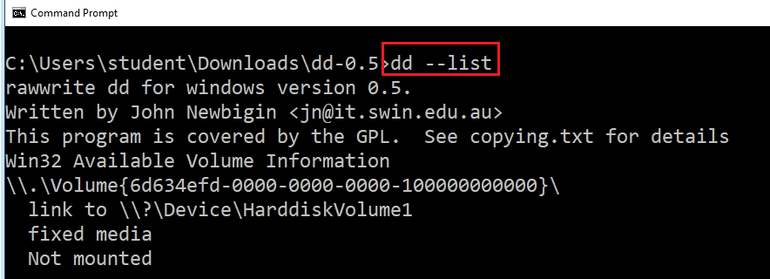
Alternative (Windows version of dd)
Download dd utility:
  http://www.chrysocome.net/downloads/dd-0.5.zip
Unzip it and make a copy on your Desktop
Check disks
  dd --list
Acquire the disk image (cmd with admin)
  dd if=\\.\Volume{6d634efd-0000-0000-0000-501f00000000} of=c:\usb.img
Notes:
dd if=\\.\Volume{9be554f0-2f7c-4e5f-b8d5-7e6fb5364f59} of=m:\vusb.dd

Slide 17

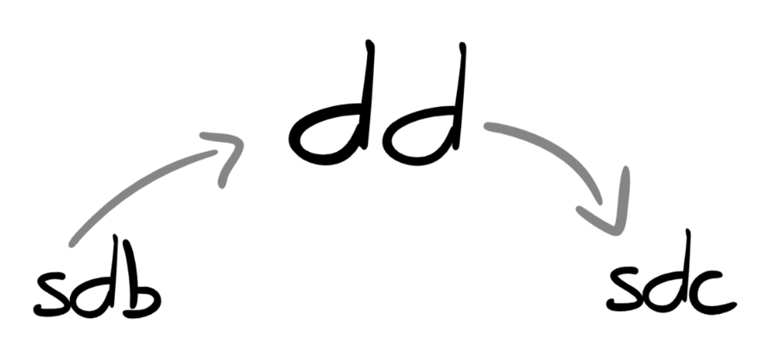
Acquisition a USB in Linux using DD

Slide 18
The Lab has to be done on your local host PC
Install VirtualBox
Install VirtualBox Guest Additions
  Your PC will recognize USB (see optional slides)
Install customized Kali from
  Contains all necessary tools
  https://github.com/frankwxu/digital-forensics-lab
Suggested reading
  https://www.linuxbabe.com/virtualbox/access-usb-from-virtualbox-guest-os
  https://www.net-usb.com/virtual-usb/virtualbox-usb-passthrough/virtualbox-usb-linux/

Slide 19
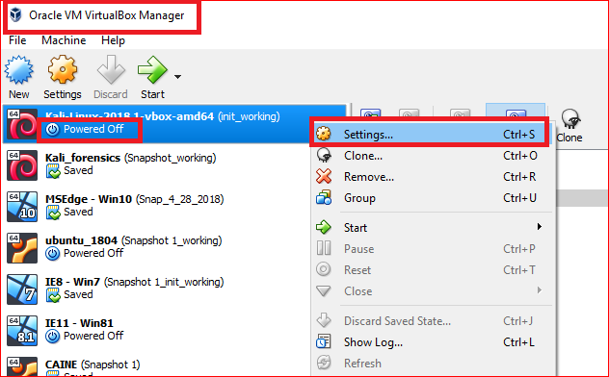

Slide 20
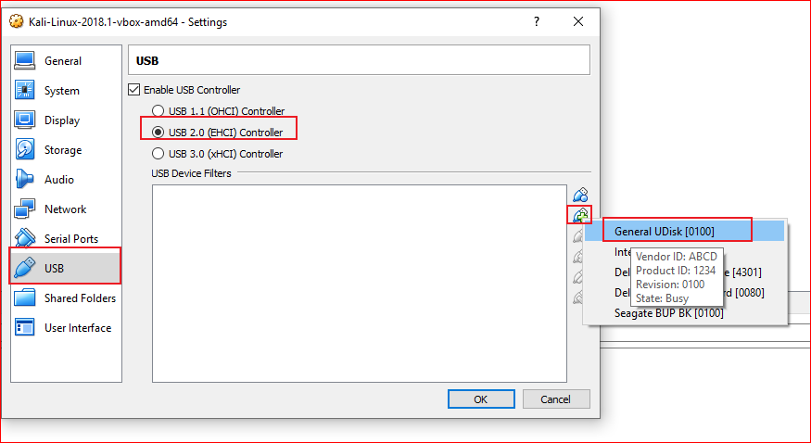

Slide 21
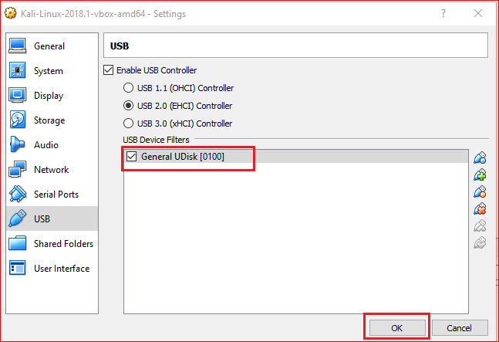

Slide 22
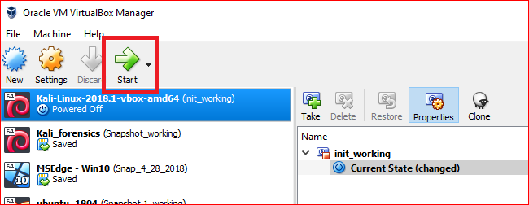

Slide 23
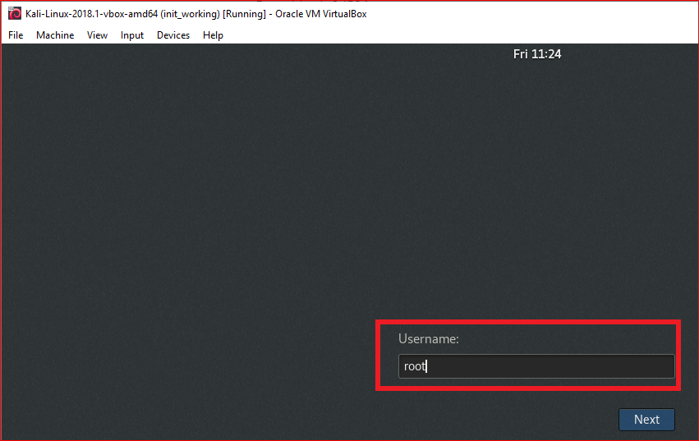
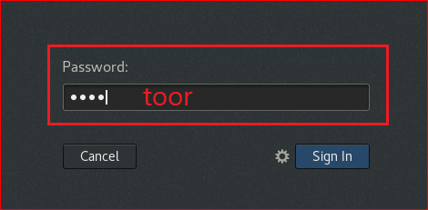
or Kali based on the version
or Kali based on the version

Slide 24
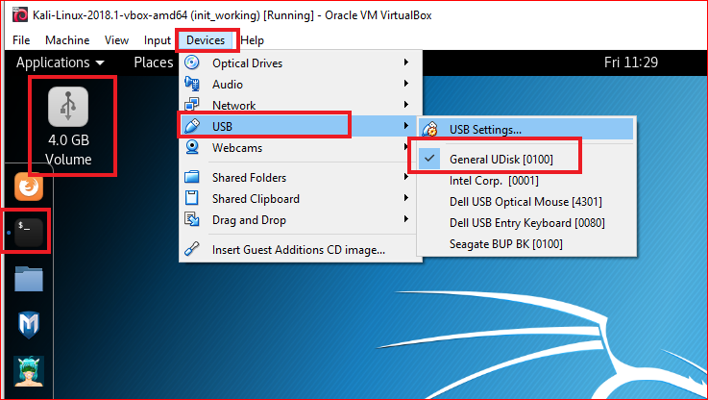

Slide 25
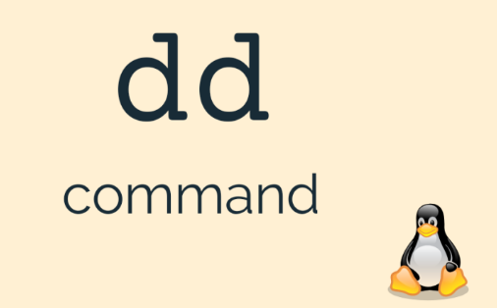
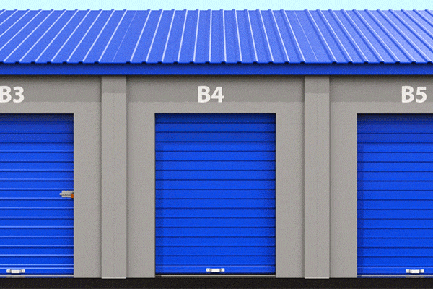






Slide 26
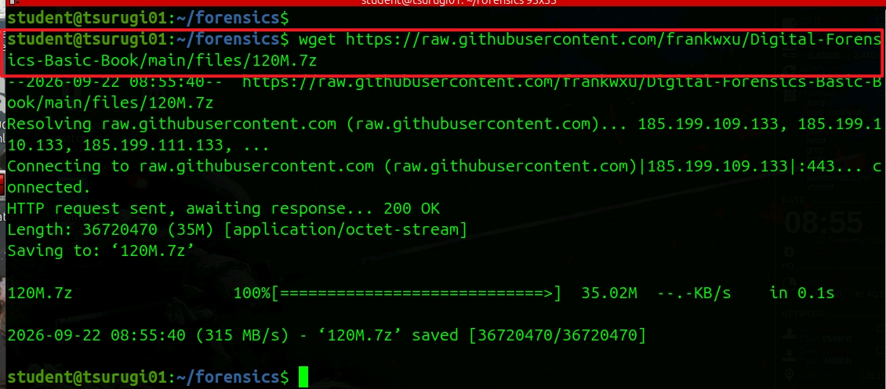
dd command to clone a disk image (1)
Notes:
wget https://raw.githubusercontent.com/frankwxu/Digital-Forensics-Basic-Book/main/files/120M.7z

Slide 27
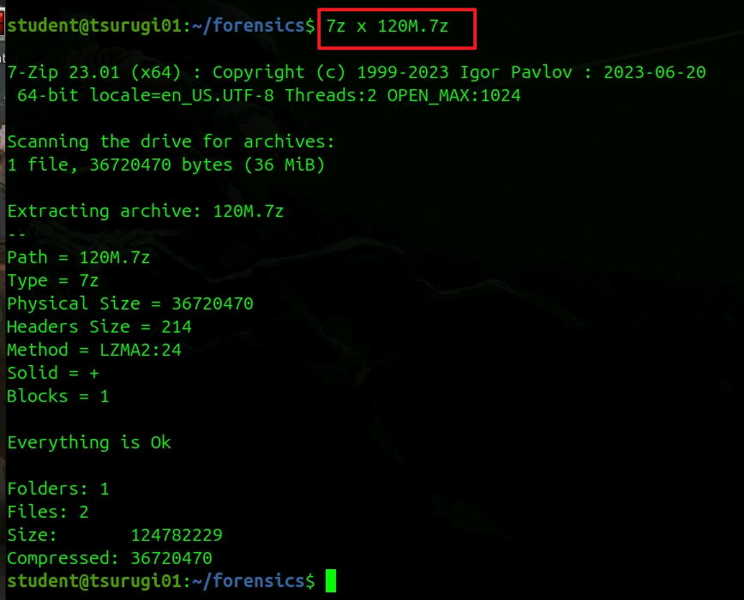
Extract the file to see a disk image

Slide 28
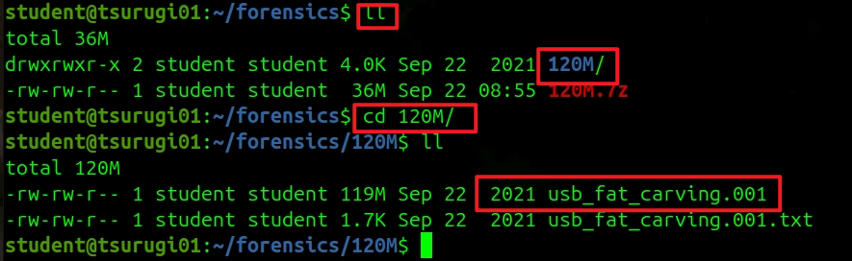
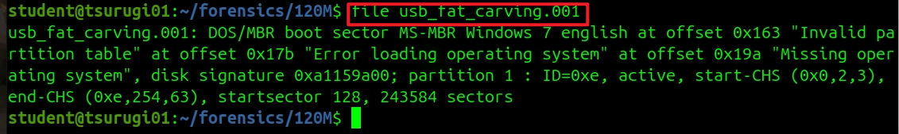
View the usb image
inspect image type

Slide 29
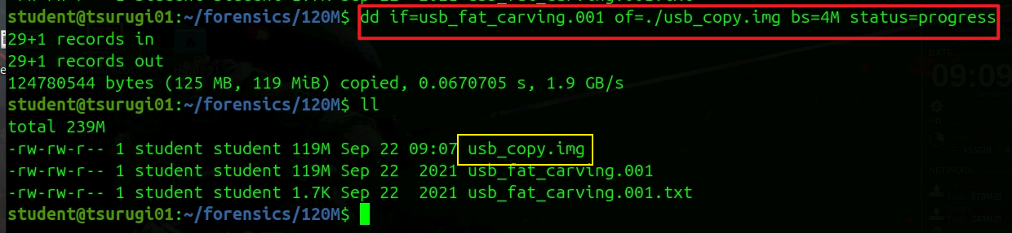
create a bit-by-bit copy of the ordinal image
Notes:
dd if=usb_fat_carving_001 of=./120M_copy.img bs=4M status=progress

Slide 30
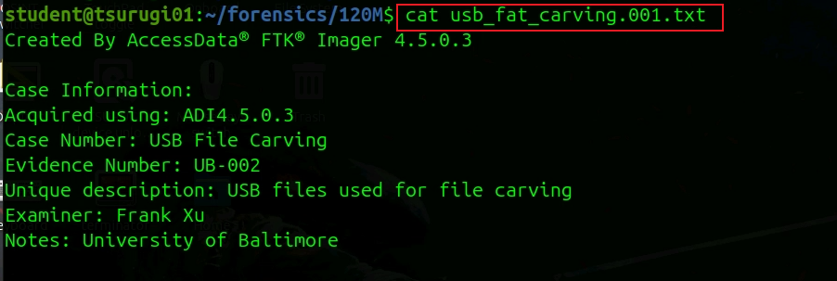
Review image acquisition information

Slide 31
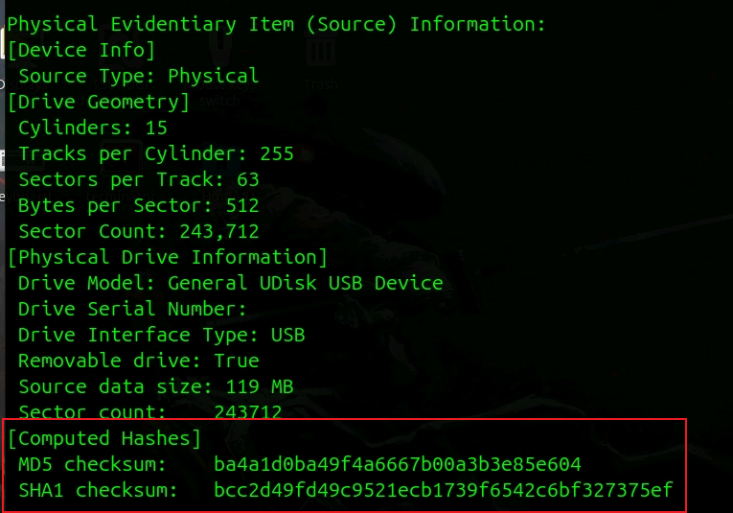
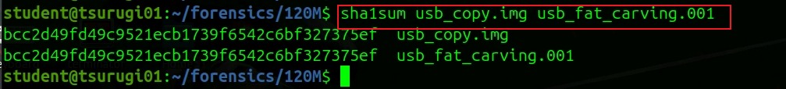
Review the hash of the image
Compare hashcode

Slide 32
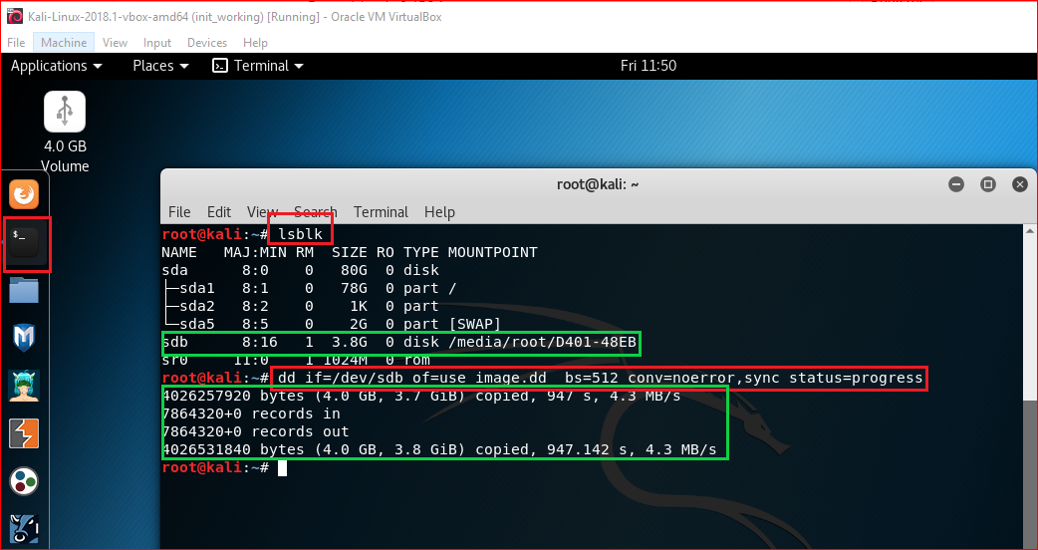
dd command to clone a USB
Notes:
If there are any errors, the above command will fail. If you give the parameter “conv=noerror” then it will continue to copy if there are read errors.

Slide 33
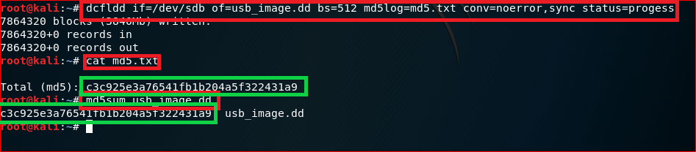
Use dcfldd
Notes:
sudo dd if=/dev/sda5 of=backup.dd status=progress
nc –lp 8080
sudo dd if=/dev/sda5 | nc 192.168.14.134 8080
md5sum /dev/sda5 | nc 192.168.14.134 8080

Slide 34
Image Acquisition via Network

Slide 35
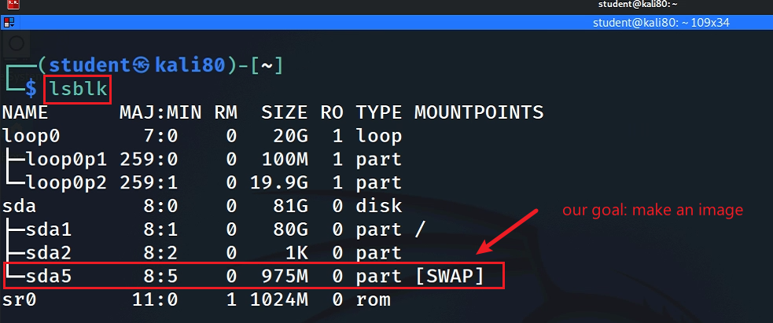
Goal 1: Kali => Windows
Set up a listener in Windows to listen to network traffic
Acquire a disk image(volume) in Kali using DD and send the image to Windows
Verify hash code of images at both OS

Slide 36
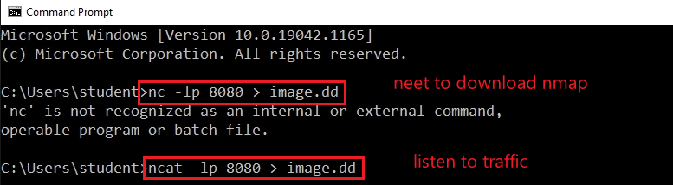
Windows as listener

Slide 37
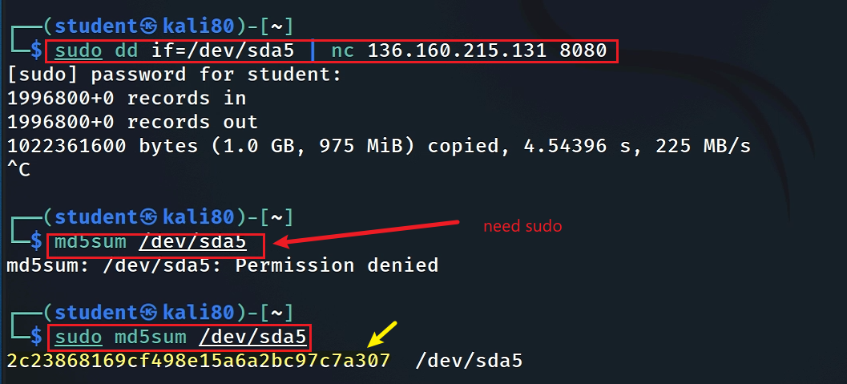
Network Acquisition

Slide 38
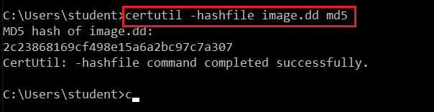
Verify the acquired image hash

Slide 39
Goal 2: Windows => Kali
Set up a listener in Kali to listen to network traffic
Acquire a file in Windows and send the file to Kali (ncat)
Verify hash code of images at both OS

Slide 40
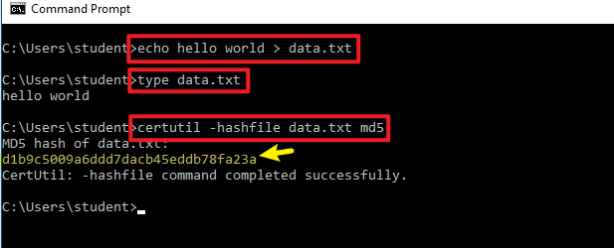
Create an example file

Slide 41
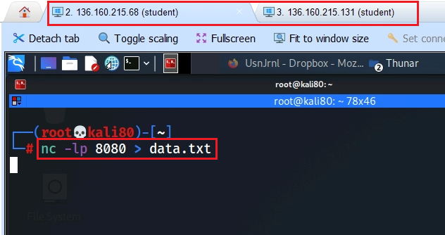
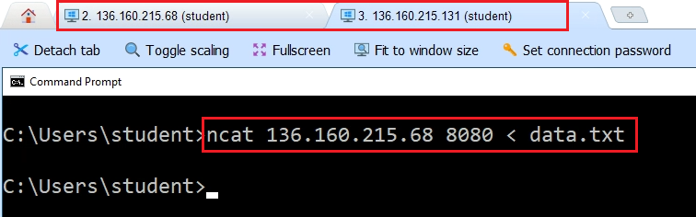
Listen and send
Listen in Kali
Send from Windows

Slide 42
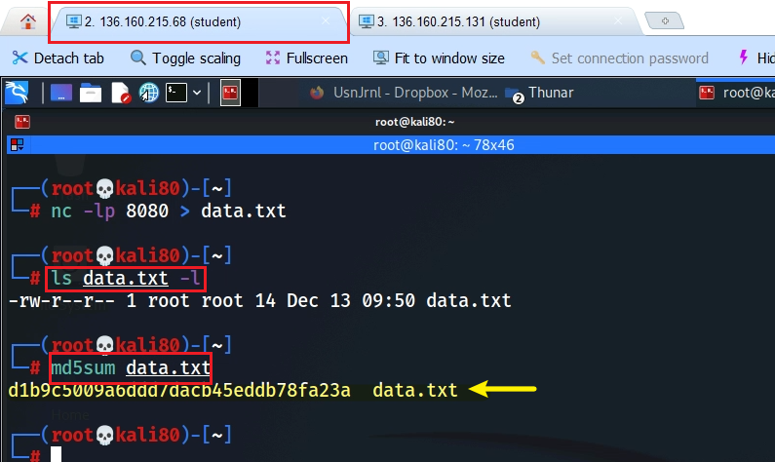
Verify the acquired file hash

Slide 43
Install guest addition for Linux (Optional)
Notes:
https://www.youtube.com/watch?v=ULSFaGmIaUo
https://www.youtube.com/watch?v=zdkl16oAS1k

Slide 44
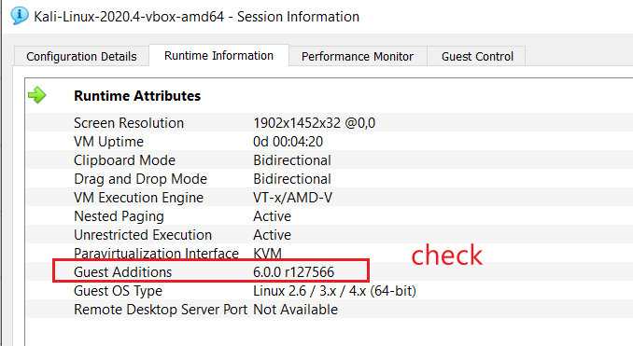
Check Guest Additions
Right control + N

Slide 45
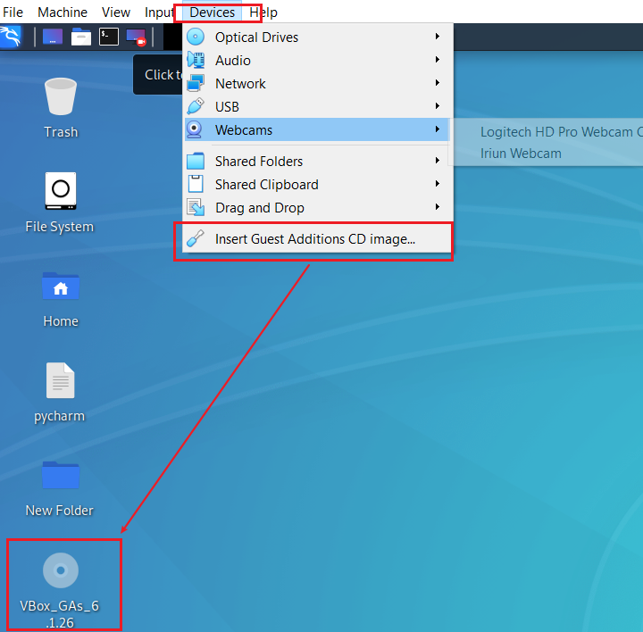

Slide 46
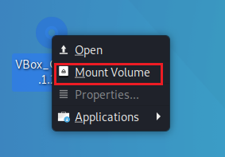
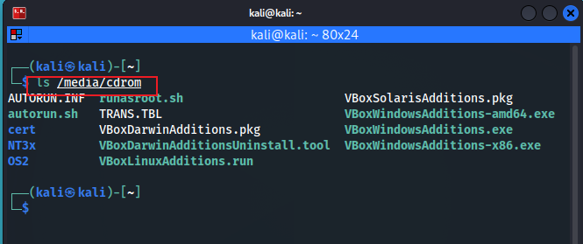
cd /media/cdrom
sudo apt update
sud apt install gcc make perl –y
sudo ./VBoxLinuxAdditions.run
sudo reboot

Slide 47
Alternative installation
cd /media/cdrom
sudo apt update
sudo apt install –y build-essential linux-headers-$(uname –r)
Click insert Guest Addition CD image
cd /media/cdrom
sudo ./VBoxLinuxAdditions.run
sudo reboot

Slide 48
Assignment- create a disk image (part 1)
Create a text file with your firstname_lastname.txt
Save the file to a USB
Pick any one platform (Windows, Mac, your own VM) to create a disk image of your USB
Calculate the hash code of the USB

Slide 49
Assignment- remote logical file acquisition (part 2)
Create a text file with your firstname_lastname.txt in Windows VM
Transfer the file using nc and ncat

