Slide 1
Number Systems, Text Encoding, and Timestamps

Slide 2
Overview
Why number systems matter in digital forensics
Decimal, binary, and hexadecimal conversion
ASCII, Unicode, and byte-level text interpretation
Epoch time, timestamp units, and time zones
Endianness and hashing for evidence integrity

Slide 3
Number Systems

Slide 4
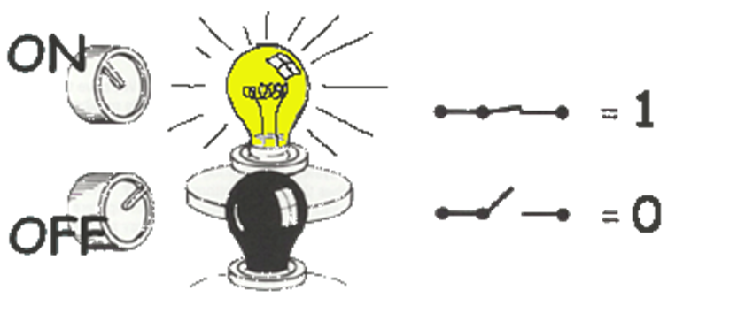

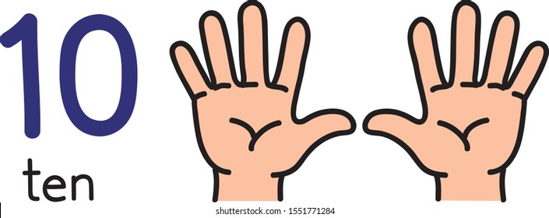
Number Systems in Digital Forensics
System | Base | Symbols | Used by humans? | Used by CPU? | Used by Forensic Professionals?
Decimal | 10 | 0, 1, … 9 | Yes | No | Yes
Binary | 2 | 0, 1 | No | Yes | Yes
Hexa- decimal | 16 | 0, 1, … 9, A, B, … F | No | No | Yes

Slide 5
Converting Between Decimal, Binary, and Hexadecimal
Decimal
Binary
Hexadecimal

Slide 6

Decimal, Binary, and Hexadecimal Values
Decimal | Binary | Hexa- decimal
0 | 0 | 0
1 | 1 | 1
2 | 10 | 2
3 | 11 | 3
4 | 100 | 4
5 | 101 | 5
6 | 110 | 6
7 | 111 | 7
Decimal | Binary | Hexa- decimal
8 | 1000 | 8
9 | 1001 | 9
10 | 1010 | A
11 | 1011 | B
12 | 1100 | C
13 | 1101 | D
14 | 1110 | E
15 | 1111 | F

Slide 7
Binary Addition: Carry Bits
A | B | A + B
0 | 0 | 0
0 | 1 | 1
1 | 0 | 1
1 | 1 | 10
1
1
10101 21
+ 11001 + 25
101110 46
carry bit

Slide 8
Decimal Place Value
digit
place weight
126₁₀ => 6 x 10⁰ = 6
2 x 10¹ = 20
1 x 10² = 100
126
Decimal
Base

Slide 9

Binary to Decimal
bit
weight
Each bit has a positional weight: 2ⁿ
Count positions from the right, starting at 0
Multiply each bit by its weight
Add the products to get the decimal value
101010₂ => 0 x 2⁰ = 0
1 x 2¹ = 2
0 x 2² = 0
1 x 2³ = 8
0 x 2⁴ = 0
1 x 2⁵ = 32
42₁₀
Base
$(()): Shell Arithmetic
2# base 2

Slide 10
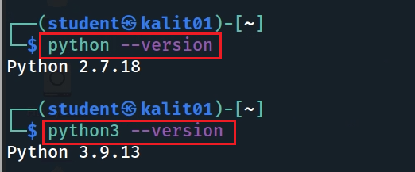
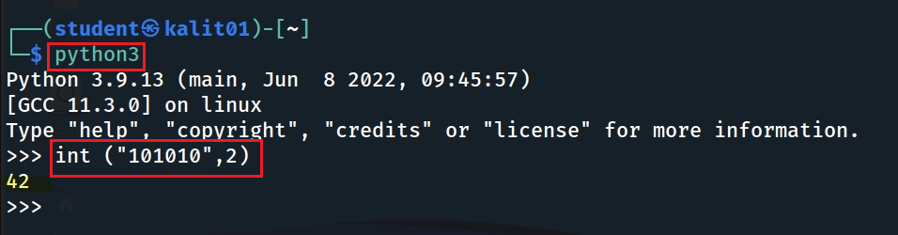
Binary to Decimal in Python
Check Python version
Use Python 3 for this course
# binary to int
int("101010", 2)
Notes:
python:
int("0101", 2)

Slide 11

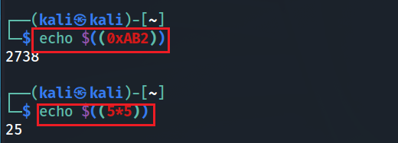
Hexadecimal to Decimal
Multiply each hexadecimal digit by 16ⁿ
Count positions from the right, starting at 0
A–F represent decimal values 10–15
Add the products to get the decimal value
AB2₁₆ => (?)₁₀
2 x 16⁰ = 2 x 1 = 2
B x 16¹ = 11 x 16 = 176
A x 16² = 10 x 256 = 2560
2738₁₀
$(()): Shell Arithmetic
python code: int("ab2", 16)
Notes:
https://www.gnu.org/software/bash/manual/html_node/Shell-Arithmetic.html
python code: int("ab2", 16)

Slide 12


Decimal to Binary: Repeated Division
126₁₀ = (?)₂
2 126
63 0
Divide by 2 and record each remainder
The first remainder is the least-significant bit
Continue until the quotient is 0
Read remainders from bottom to top
2
31 1
2
15 1
2
7 1
2
3 1
2
1 1
2
0 1
stop
126₁₀ = 1111110₂
bc calculator
Notes:
echo "obase=2;126" | bc

Slide 13


Decimal to Hexadecimal
2738₁₀ = (?)₁₆
Divide by 16 and record the remainder
Remainders 10–15 become A–F
Read remainders from bottom to top
16 2738
171 2
16
10 11 = B
16
0 10 = A
2738₁₀ = AB2₁₆
Formatter: controls the output as in C printf
%d - turns a number and displays it in base-10
%x - turns a number and displays it in base-16
%s - turns a number and displays it as a string.
Notes:
https://linuxize.com/post/bash-printf-command/

Slide 14


Decimal to Binary and Hex in Python
Decimal to Binary
Decimal to Hexadecimal

Slide 15




Binary to Hexadecimal
101010110010₂ = ?₁₆
Group bits into nibbles: 4 bits per group
Start grouping from the right
Add leading zeros only if needed
Convert each nibble to one hexadecimal digit
1010 1011 0010
10 11 2
A B 2
101010110010₂ = AB2₁₆

Slide 16
ASCII: American Standard Code for Information Interchange
Text encoding begins with bytes.

Slide 17




Bits and Bytes
A bit is a single binary value: 0 or 1
A byte is a collection of 8 bits
One byte can store one standard ASCII character
Forensics often examines data at the byte and hexadecimal level

Slide 18
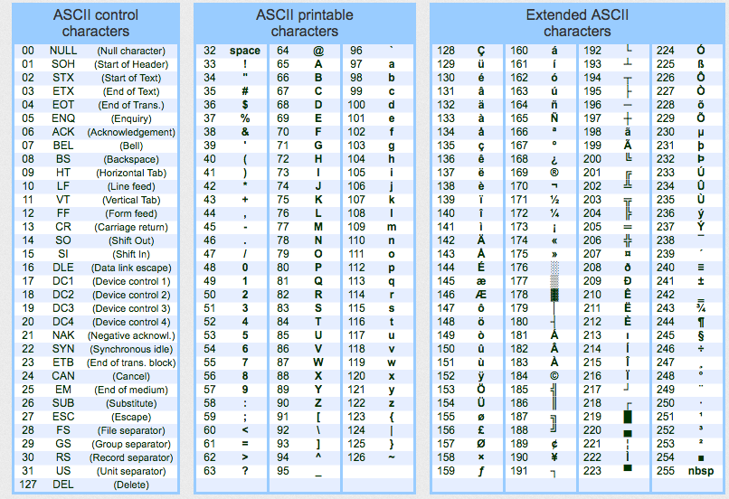
ASCII Character Encoding
ASCII maps values 0–127 to characters.
Raw bytes can become readable text.

Slide 19
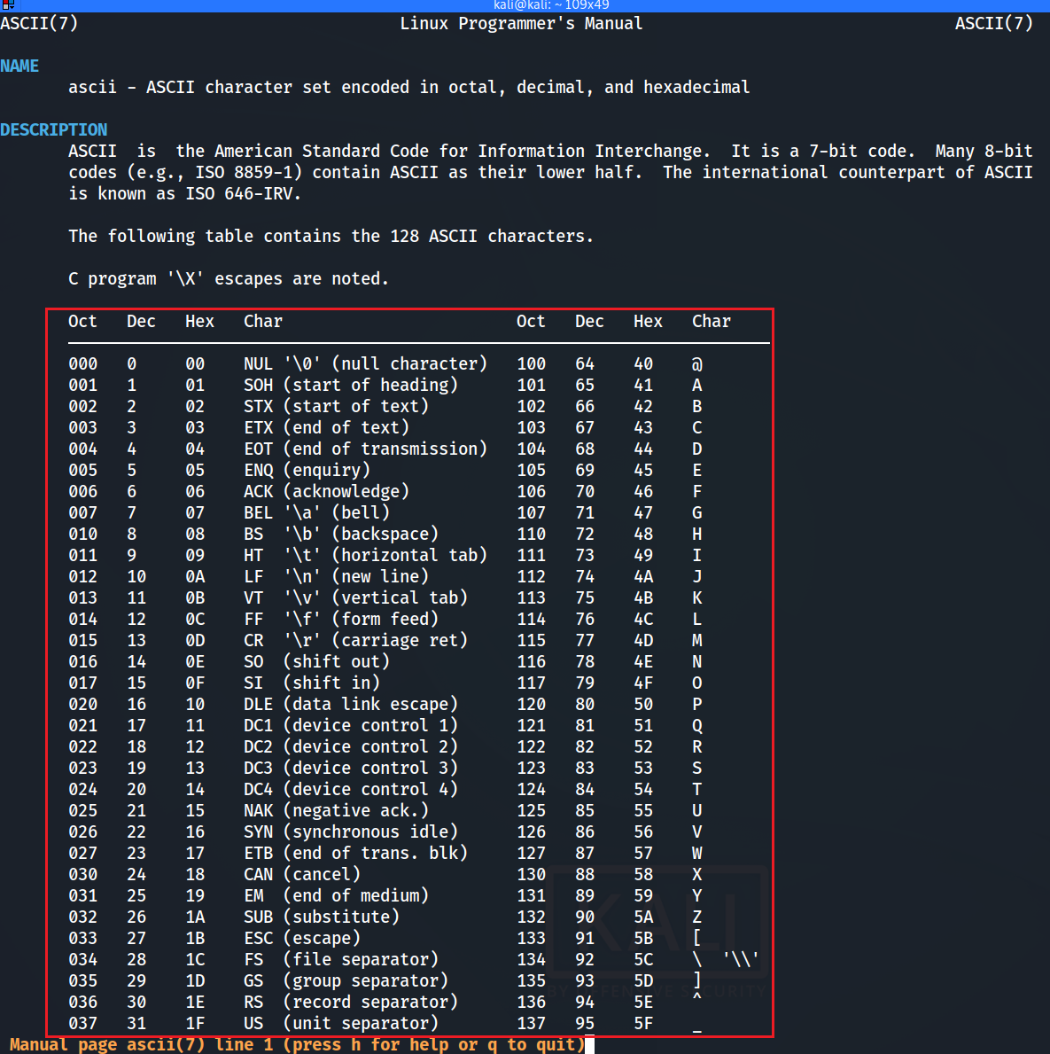

ASCII Table in Linux

Slide 20
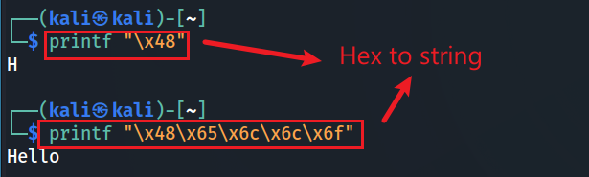

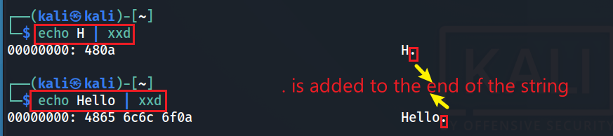
Number and ASCII Conversion in the CLI
Hex to ASCII string
Decimal to ASCII string
\x, it looks at the next two characters as a hex number and converts them into their corresponding ASCII character before printing
ASCII to Hex
“0a” represents a newline character (\n)
The newline character (\n, or 0A in hexadecimal) is not a printable ASCII character. Therefore, xxd represents it with a dot (.).
Notes:
printf "\x48\x65\x6c\x6c\x6f“
echo -n Hello | xxd

Slide 21
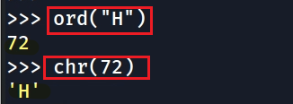
Decimal and ASCII Character Conversion in Python
Decimal to an ASCII char
ord()
ASCII
Dec
chr()

Slide 22

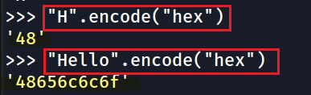

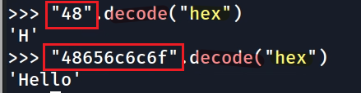
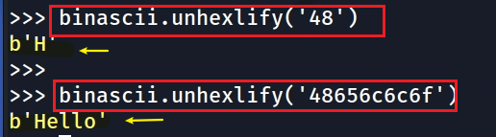
Hex and ASCII Conversion in Python
Python 2 (legacy)
Python 3 (preferred)
ASCII to Hex
ASCII to Hex
Hex to ASCII string
Hex to ASCII
hexlify()
encode(“hex”)
ASCII
Hex
ASCII
Hex
unhexlify()
decode(“hex”)
Notes:
>>> import binascii
>>> binascii.hexlify(b'H')
b'48'
>>>
>>> binascii.hexlify(b'Hello')
b'48656c6c6f'
>>> import codecs
>>> hex_encoder=codecs.getencoder('hex')
>>> hex_encoder(b'H')
(b'48', 1)
>>> hex_encoder(b'H')[0]
b'48'
>>> hex_encoder(b'Hello')
(b'48656c6c6f', 5)
>>> hex_encoder(b'Hello')[0]
b'48656c6c6f

Slide 23
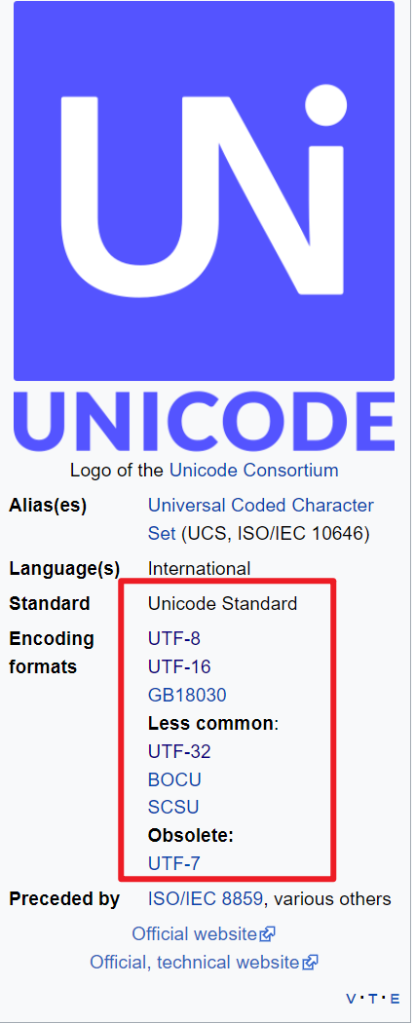
Unicode
Unicode assigns code points to characters from many writing systems. Encoding forms such as UTF-8 and UTF-16 store those code points as bytes.
In forensics, the correct encoding determines whether recovered text is readable.

Slide 24
ASCII vs. UTF-8
ASCII: 7-bit encoding for 128 values
UTF-8: variable-length encoding for Unicode
UTF-8 preserves ASCII byte values for 0–127
UTF-8 can represent non-English characters and symbols
Forensic implication: decode bytes with the correct character encoding

Slide 25
Epoch Time and Timestamps
Different formats can use different epochs, units, and time zones.

Slide 26
Epoch Time
Epoch time stores time as elapsed units from a defined start date.
Common units: seconds, milliseconds (10³) microseconds (10⁶) , nanoseconds.
Unix/POSIX: seconds since 1970-01-01 UTC
Cocoa/Core Data: seconds since 2001-01-01 UTC
HFS+: seconds since 1904-01-01 UTC
WebKit/Chrome: microseconds since 1601-01-01 UTC
Windows FILETIME: 100-ns intervals since 1601-01-01 UTC
Forensics: document epoch, unit, and time zone.

Slide 27
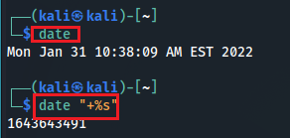
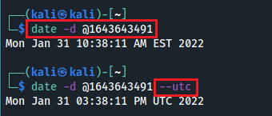
Unix Time
Unix/POSIX time represents a point in time as elapsed seconds.
Epoch: 1970-01-01 00:00:00 UTC.
Convert using CLI, Python, or forensic tools.
Always distinguish UTC from local time.
Current time → Unix time
Unix time → readable time
-d: Specifies a string to be interpreted as a date (instead of using the current time)
Notes:
1643643491

Slide 28

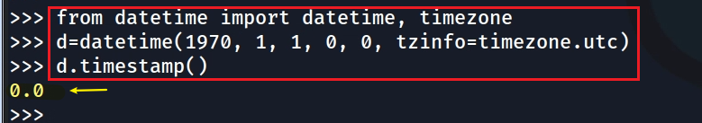
Unix Time in Python
0 second => UTC Jan 1st, 1970
datetime represents a human-readable date and time.
timestamp() converts a timezone-aware datetime to Unix seconds.
datetime.fromtimestamp(ts, timezone.utc) returns UTC time.
Avoid mixing local time and UTC during evidence analysis.
A timestamp represents elapsed seconds.
from [module] import [function1, function2]
UTC Jan, 1st, 1970 => 0 second
Notes:
from datetime import datetime, timezone
d=datetime(1970, 1, 1, 0, 0, tzinfo=timezone.utc)
d.timestamp()

Slide 29
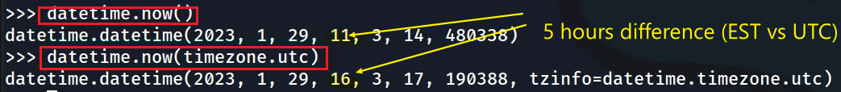

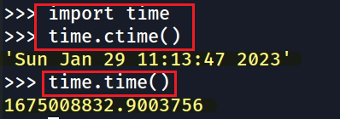
Getting Current Time in Python
datetime(year, month, day, hour, minute, second, microsecond)
format
Get current time (datetime Module)
Get current time (time Module)
Human-readable time
Get the current time in seconds. It returns the number of seconds since Jan 1, 1970, 00:00:00.
Notes:
datetime.timezone was added in Python 3.2. So it is normal to get an import error in e.g. Python 2.7.
In Python 2.7, you can use the pytz library.
from datetime import datetime, timezone

Slide 30
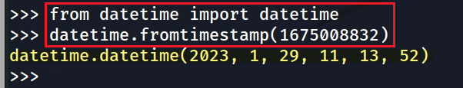

Converting Seconds to Readable Time
1.67 billion = 1,670,000,000
Convert seconds to a readable time (datetime Module)
our default time zone is EST. Pay attention to the 5 hours difference
If the timestamps are in UTC timezone (a common way to store dates) you should use
Notes:
from datetime import datetime
datetime.fromtimestamp(1675008832)

Slide 31
Mac Epoch Time: Cocoa/Core Data
Cocoa/Core Data time uses seconds since 2001-01-01 00:00:00 UTC.
Unix time uses seconds since 1970-01-01 00:00:00 UTC.
The offset is 978,307,200 seconds.
Convert by adding or subtracting this offset before interpreting the timestamp.
Notes:
date - d ‘1970-01-01 00:00:00 UTC’ +%s
date - - date=20010101 +$s
expr 1657166400 - 1609390800
datediff 1970-01-01 2001-01-01 –f %Ss

Slide 32
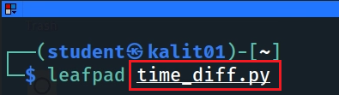
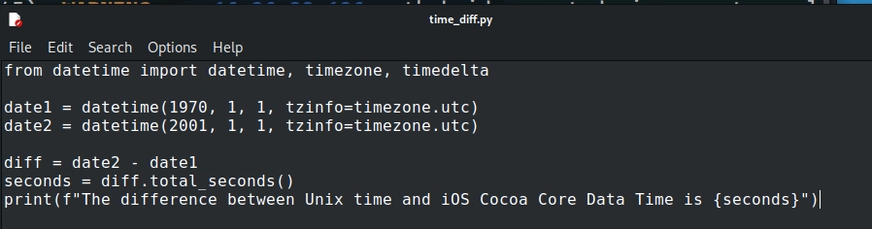
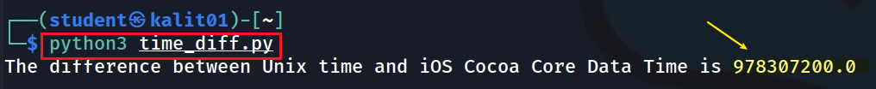
Compute the Unix–Cocoa/Core Data Offset
Notes:
from datetime import datetime, timezone, timedelta
date1 = datetime(1970, 1, 1, tzinfo=timezone.utc)
date2 = datetime(2001, 1, 1, tzinfo=timezone.utc)
diff = date2 - date1
seconds = diff.total_seconds()
print(f"The difference between Unix time and iOS Cocoa Core Data Time is {seconds}")

Slide 33
WebKit / Chrome Time
WebKit/Chrome timestamps are common in browser artifacts.
They are stored as microseconds since 1601-01-01 00:00:00 UTC.
To convert to Unix seconds: adjust from the 1601 epoch, then divide by 1,000,000.
Do not confuse this timestamp format with webpage rendering time.

Slide 34
Hash Functions
.
Evidence integrity depends on hashing exact bytes

Slide 35
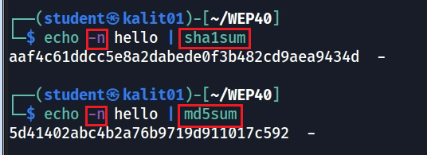
Hashing Strings in Linux
echo appends a \n
Use the -n argument to omit the trailing line break
Notes:
https://stackoverflow.com/questions/5693360/why-is-an-md5-hash-created-by-python-different-from-one-created-using-echo-and-m

Slide 36
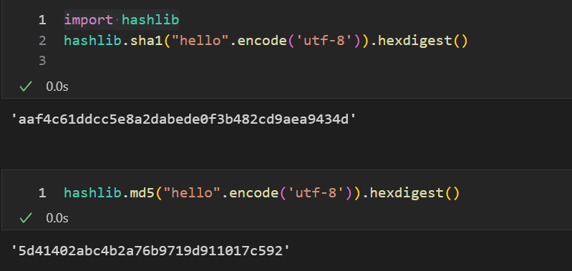
Hashing Strings in Python

Slide 37
Data Stored in Memory

Slide 38
Endianness
Endianness describes byte order for multi-byte values.
Little-endian stores the least-significant byte first at the lowest address.
Big-endian stores the most-significant byte first at the lowest address.
Forensics: wrong byte order can produce the wrong value or timestamp.

Slide 39
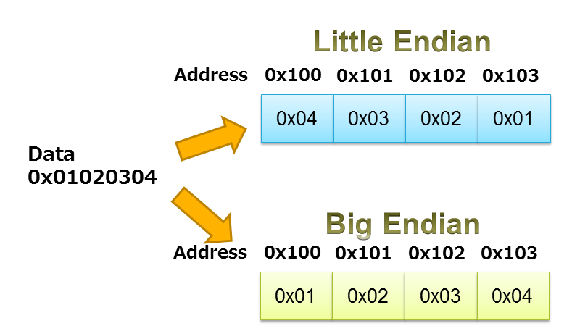




Little-Endian vs. Big-Endian
least-significant byte
https://www.iar.com/knowledge/learn/programming/migration-techniques-for-different-endianness/
Notes:
Least significant is stored in low address

Slide 40
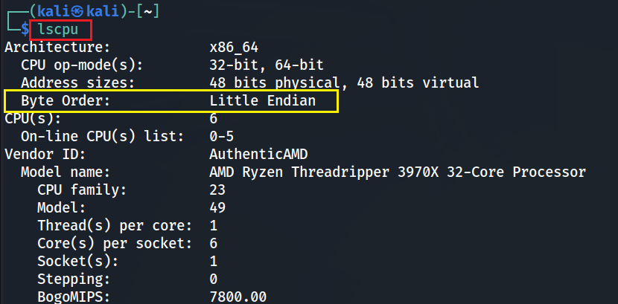
Check Byte Order with lscpu
Check byte order

Slide 41
Key Takeaways for Digital Forensics
Binary and hexadecimal help examiners read raw bytes.
ASCII and Unicode determine how bytes become readable text.
Timestamps require the correct epoch, unit, and time zone.
Endianness controls how multi-byte values are reconstructed from memory.
Hashes verify that evidence bytes have not changed.

