Slide 1
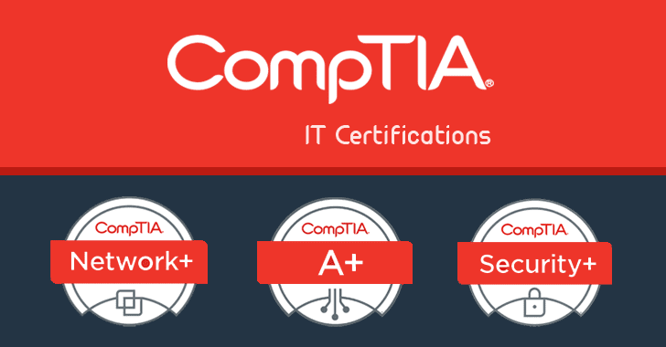
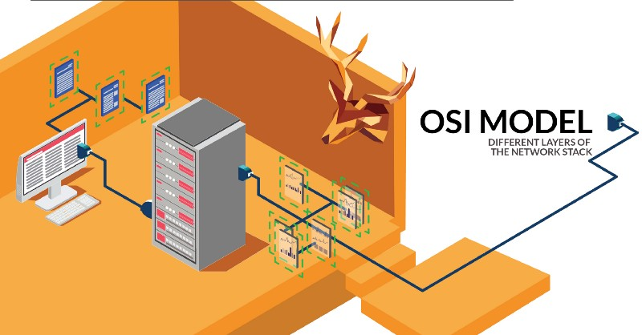
HTTP, Wireshark, and Digital Forensics
Part 1: HTTP traffic contains text information
Traffic files: https://github.com/frankwxu/digital-forensics-lab/tree/main/Illegal_Possession_Images/lab_files/traffic

Slide 2



Overview
Observe HTTP traffic with curl
Review Open Systems Interconnection Model (OSI)
Is understanding HTTP enough for forensic investigations?
Exam HTTP traffics with Wireshark
Three-way handshake (TCP)
Communication (HTTP request/response)
Close connection (TCP)

Slide 3

Observe HTTP traffic

Slide 4
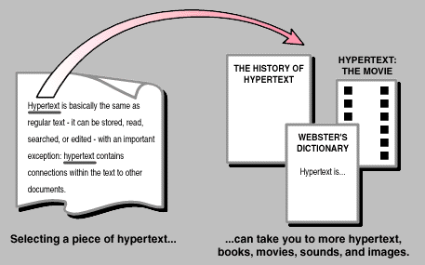

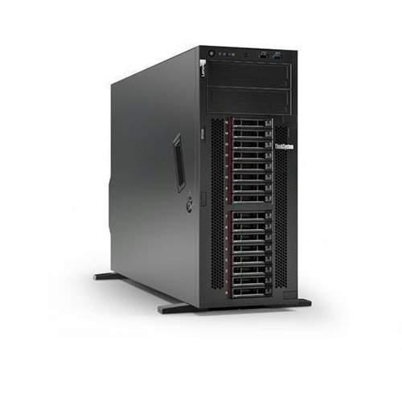

What is HTTP?
agreement
HTTP stands for hypertext transfer protocol and is used to transfer data across the Web
HTTP Request
HTTP Response
Notes:
https://www.kevcom.com/words/guide/guide.02.html

Slide 5
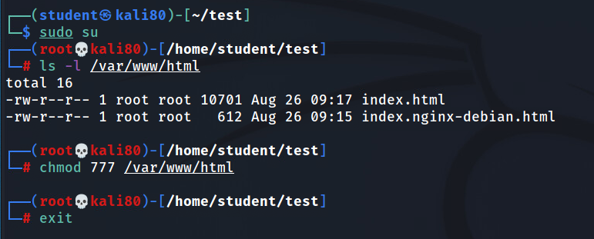
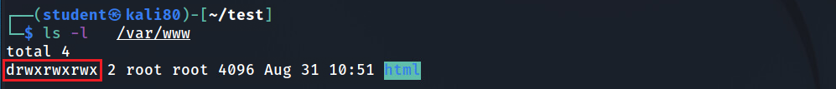
Create a simple html page to be observed in Wireshark
(optional) if you are logged in as a non-admin account, such as student, you must change the html folder permission

Slide 6
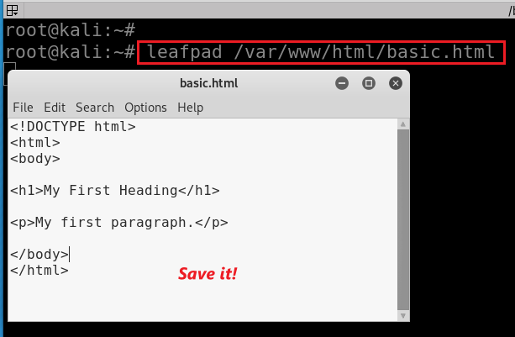
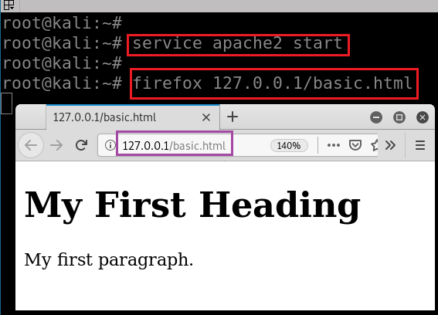

Create a simple webpage, named basic.html, and
Put it in the folder /var/www/html
Start web service
Show the webpage
service apache2 stop service apache2 restart
Notes:
<!DOCTYPE html>
<html>
<body>
<h1>My First Heading</h1>
<p>My first paragraph.</p>
</body>
</html>
https://www.w3schools.com/html/tryit.asp?filename=tryhtml_basic_document

Slide 7
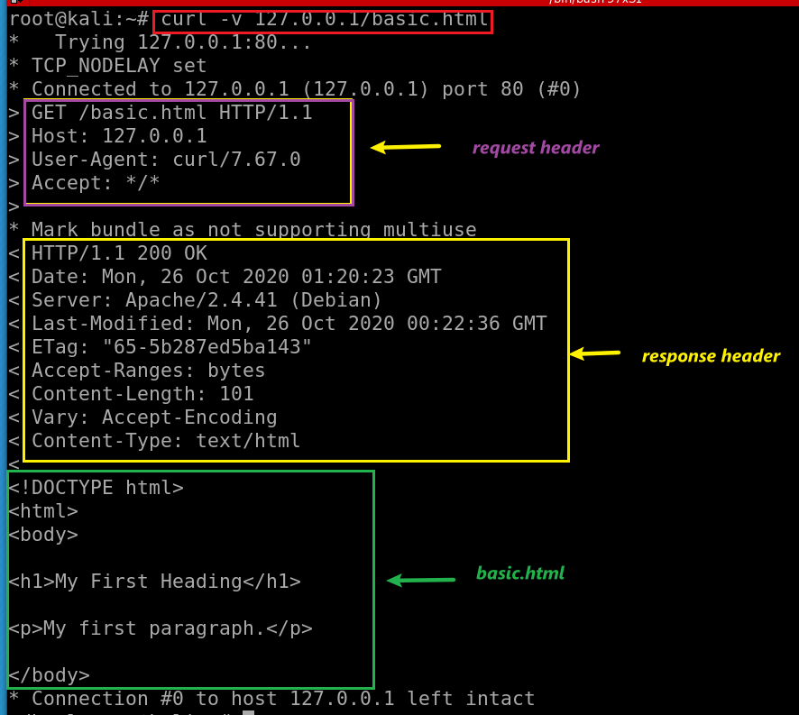
cURL (pronounced 'curl')
A command-line tool
Open source
Transferring data
Support many network protocols
-v: verbose, show headers
Method: Get, POST
Path: /basic.html

Slide 8
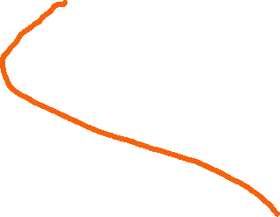

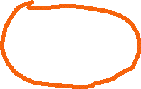
Review Open Systems Interconnection Model (OSI)
Is understanding HTTP enough for forensic investigations?

Slide 9
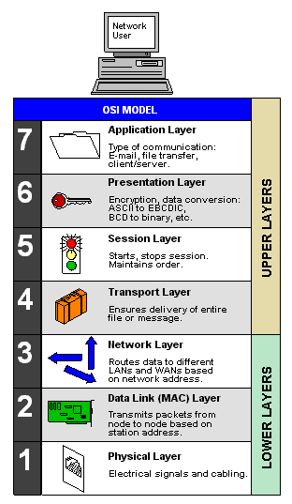
Importance of understanding underneath of HTTP
Many layers (OSI Model) are defined to form computer networks
HTTP is one protocol at an application layer
Forensic investigation focus on all layer
Malware analysis
Attack analysis
File extraction
The OSI Model (Open Systems Interconnection Model)
is a conceptual framework used to describe the functions of a networking system.

Slide 10
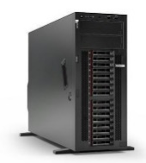
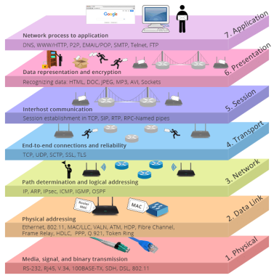
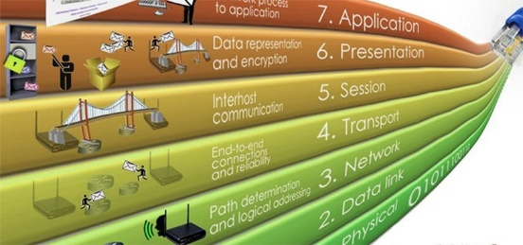
HTTP Request
HTTP Response

Slide 11
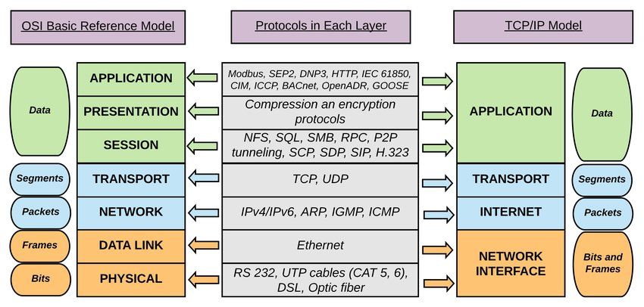






Notes:
Session Layer: This layer is also responsible for token management, through which it prevents two users to simultaneously access or attempting the same critical operation. remote procedure calls

Slide 12

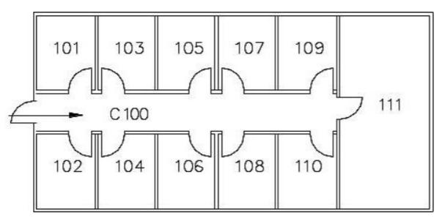







Building A
A->B
Building B
Mailroom
Mailroom
from: Building A 102
to: Building B 103
Rules:
All pages must be put in envelopes
each envelop max 3 pages
All internal mail must be delivered to the mail room
Internal emails delivered are done by staff, not an employee themselves
pp.1-3
pp.4-6
pp.7-9
part 1
part 2
part 3
address
address
address
part 1
part 2
part 3
part 1
part 2
part 3
-> mailroom111
-> mailroom 111
-> mailroom 111
-> 103
-> 103
-> 103

Slide 13





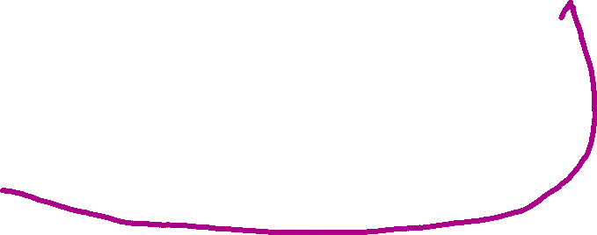


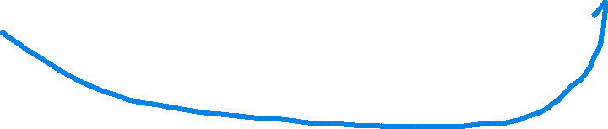
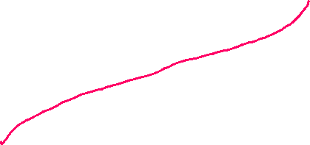

pp.4-6
from: Building A 102
to: Building B 103
One of the HTTP data
To mailroom 111

Slide 14
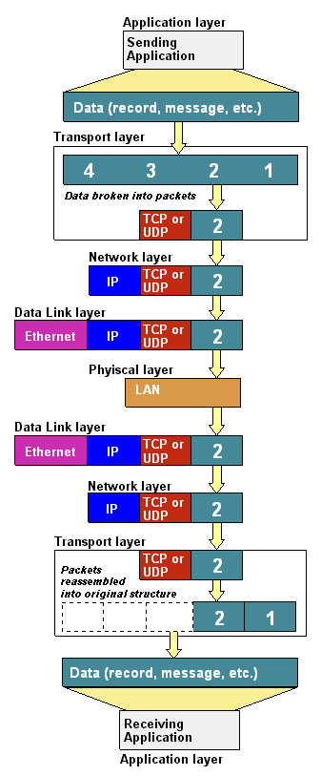

Data
Segment:
Packet
Frame
bit
Notes:
https://www.youtube.com/watch?v=-6Uoku-M6oY

Slide 15
Capture HTTP traffic using Wireshark

Slide 16

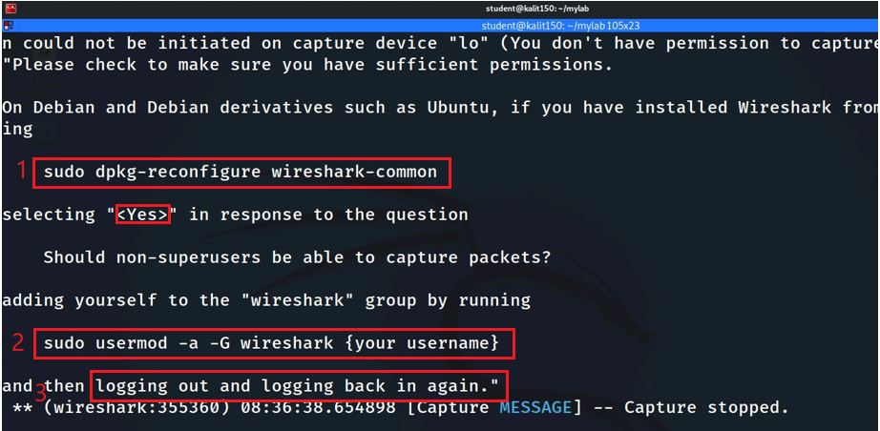
Reconfigure wireshark

Slide 17
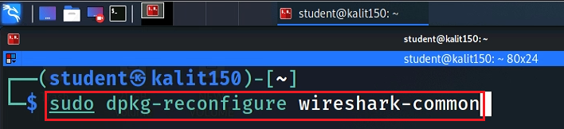
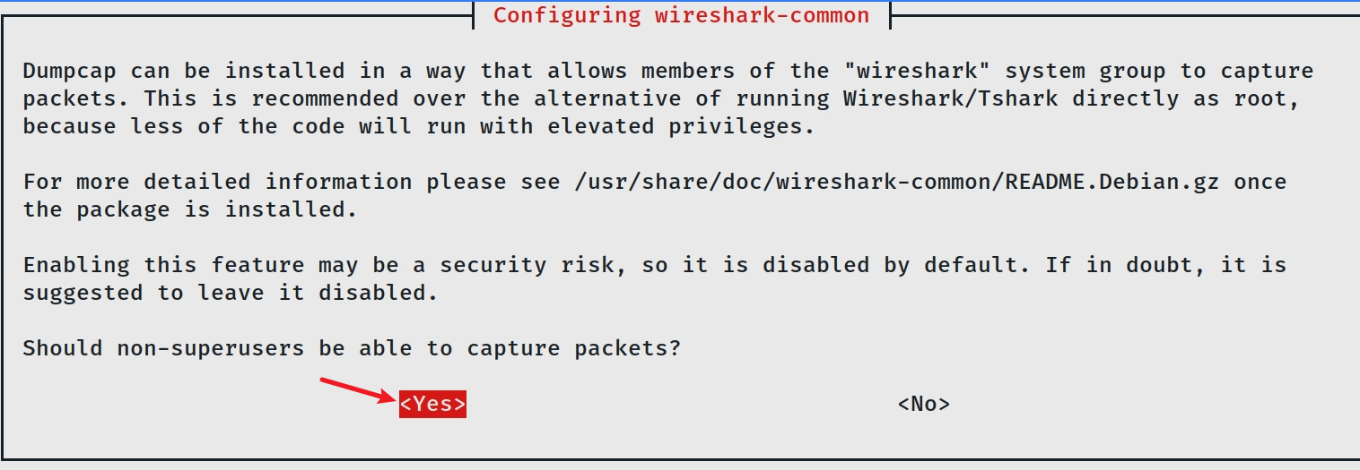
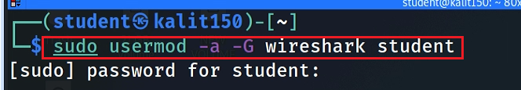

Reconfigure
Add student to wireshark group
Logout and log back in
Notes:
sudo dpkg-reconfigure wireshark-common
sudo usermod -a -G wireshark kali

Slide 18
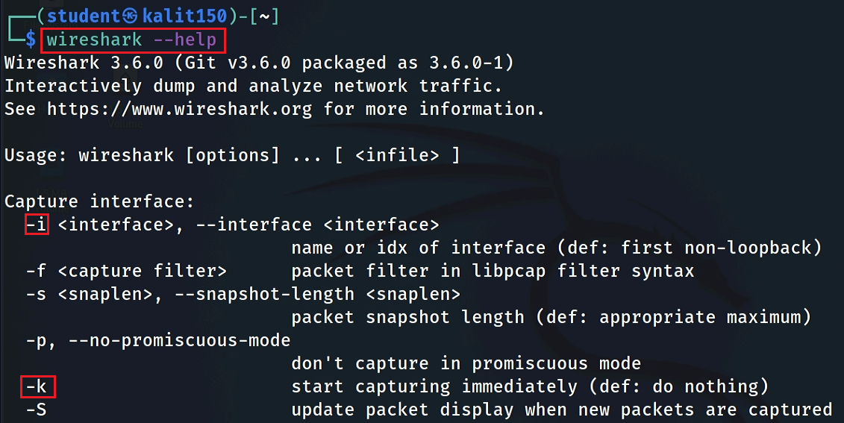

Slide 19

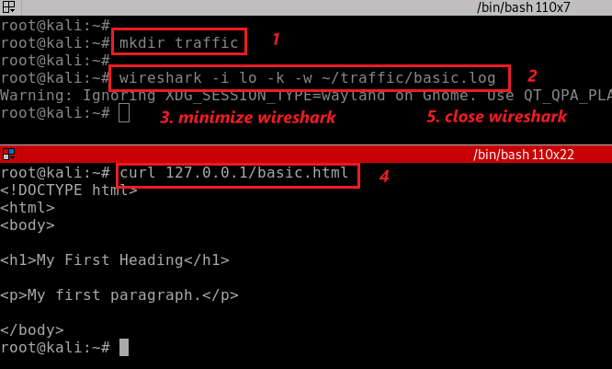
Clear browser cache
You don’t need to have root to capture traffic
change interface -i lo to eth0 if you need to capture live traffic
Notes:
rm -r ~/.cache/mozilla/firefox/*default* note: make sure the path is correct.
wireshark -i lo -k -w ~/traffic/basic.log
curl 127.0.0.1/basic.html

Slide 20

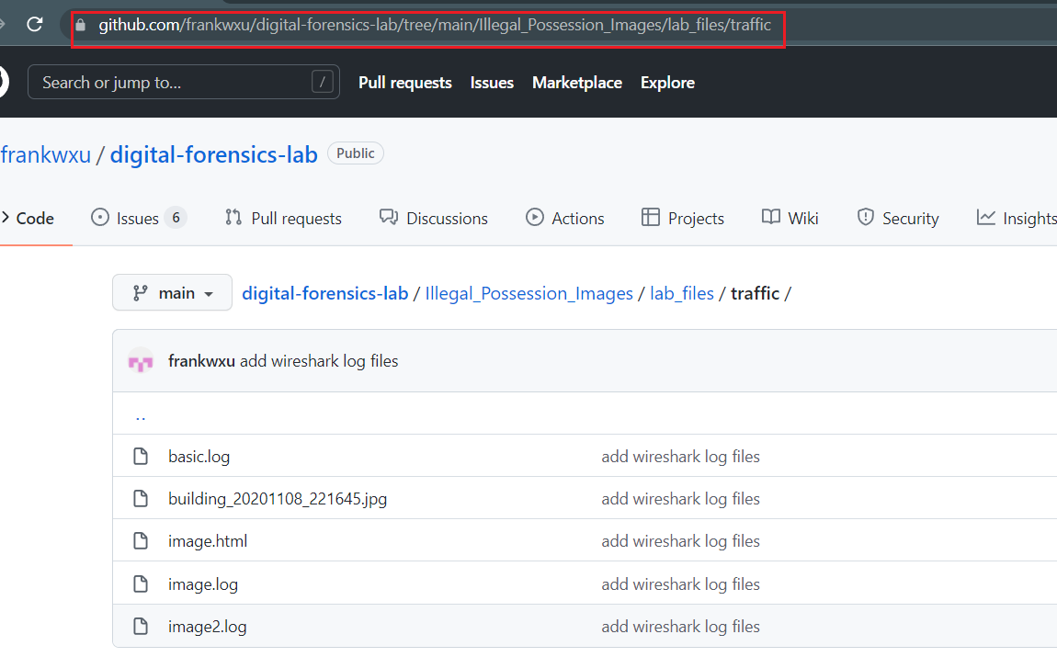
You can download the recaptured traffic
command to download the basic.log file:
wget https://raw.githubusercontent.com/frankwxu/digital-forensics-lab/main/Illegal_Possession_Images/lab_files/traffic/basic.log

Slide 21
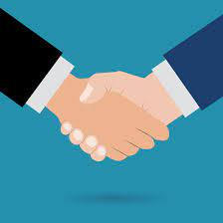
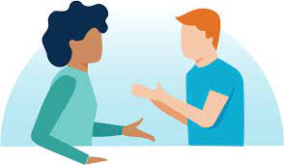

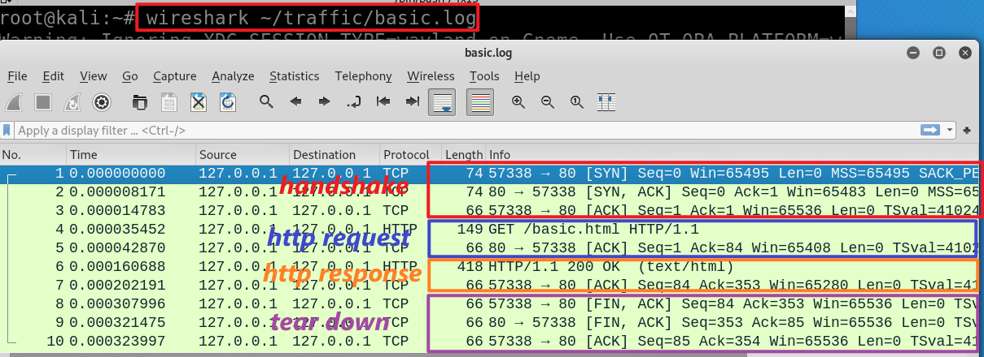
wget https://raw.githubusercontent.com/frankwxu/digital-forensics-lab/main/Illegal_Possession_Images/lab_files/traffic/basic.log
Notes:
wireshark ~/traffic/basic.log

Slide 22
Three-way handshake
No. 1, 2, and 3

Slide 23
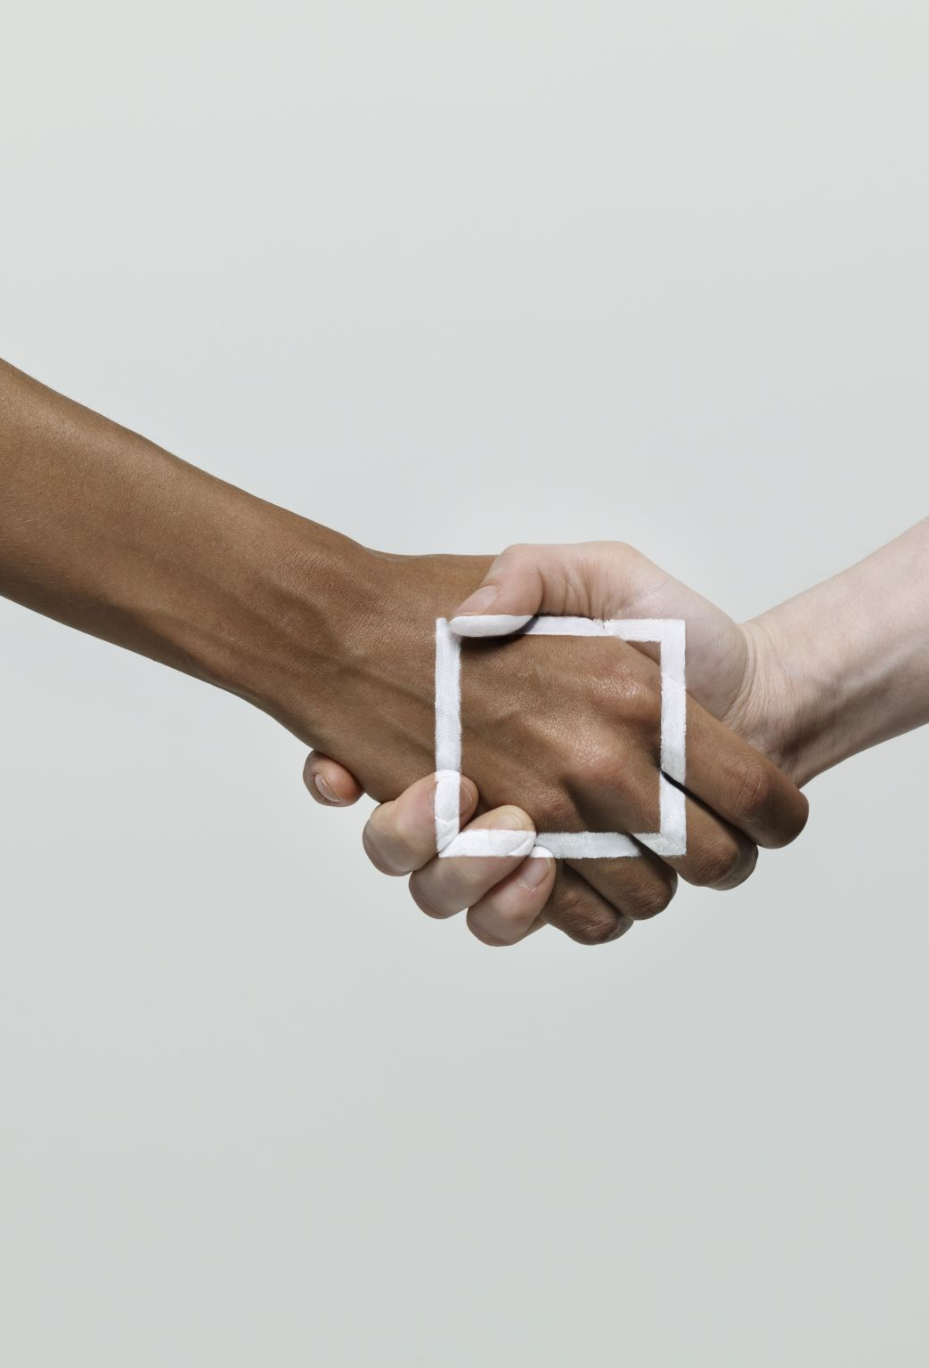

The purposes of handshake
Two participants establish a communication link at the start of the communication
Two parties are named as “Alice and Bob”
Before full communication begins
Make sure both sides ready to communicate
Each party picks and exchanges a random number
as initial reference ID (byte) to keep track of each byte sending and receiving
e.g., Bob 6 and Alice 141
receiver expects ID after three messages
6 |  |  |  | 10
141 |  |  |  | 145

Slide 24



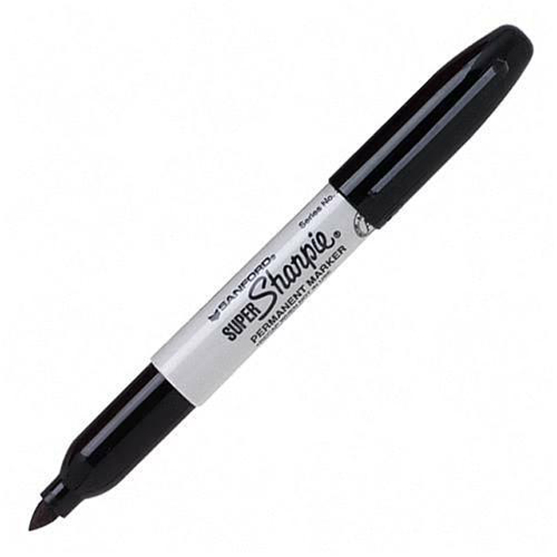





Slide 25

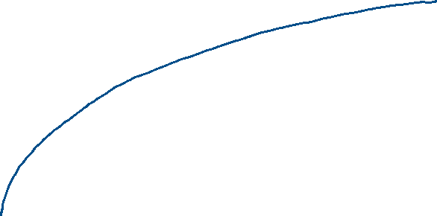
6

Slide 26


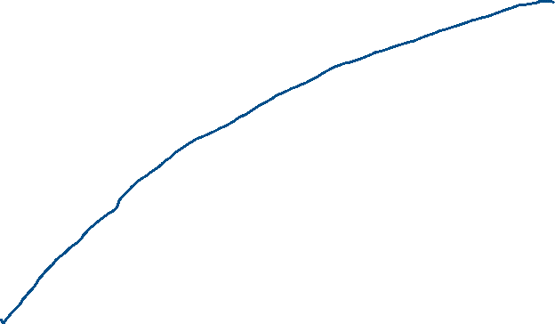


6+1
Reply:
I have received the ball labeled with # 6.
If you send me a message (contains multiple packets), I expect the first byte should be labeled as 6+1
6+1 |  | .. |  | 10

Slide 27

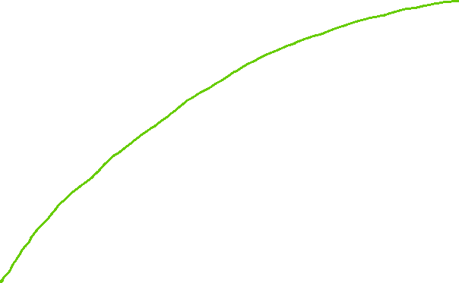
141

Slide 28

141+1

Slide 29
SYN message
6
Sequence #: random

Slide 30
ACKnowledge
6+1
ACKnowledge with seq#
I’ve received your request with seq # 6
I expect to receive your next seq# 6+ 1

Slide 31
SYN message
141

Slide 32
ACKnowledge
141+1

Slide 33
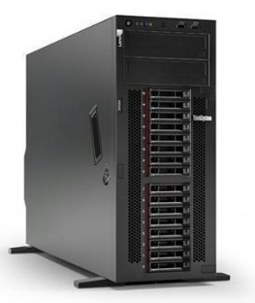

Sequence #:
the byte number of the first byte of data in the TCP segment sent
beginning at random # or 0 (relative seq#)
ACKnowledge #: the sequence number of the next byte the receiver expects to receive.
Seq # + size of packet + 1
The receiver ack'ing sequence number x acknowledges receipt of all data bytes less than (but not including) byte number x
+1 for SYN
m
n
Port 57338
Port 80
client state
Server state
CLOSED
CLOSED
choose init seq num, m
1
SYN (seq =m)
LISTEN
SYN-SEND
SYN-RECEIVED
SYN (seq =n) , ACK (m+1)
2
received SYNACK
indicates server is live;
send ACK;
ACK (n+1)
3
ESTABLISHED
ESTABLISHED
m, n are in bytes
Notes:
https://www.freecodecamp.org/news/an-introduction-to-http-understanding-the-open-systems-interconnection-model-9dd06233d30e/
https://www.geeksforgeeks.org/tcp-3-way-handshake-process/
https://www.geeksforgeeks.org/tcp-connection-termination/

Slide 34
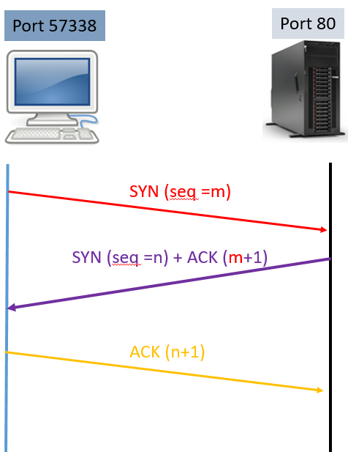
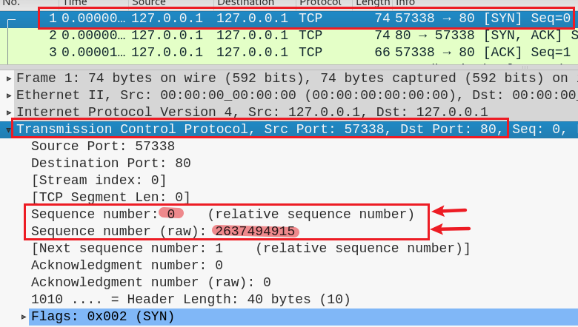
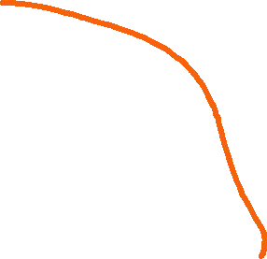

Layers involved in handshaking
1
m
Client:
I am sending seq # m
I will use the seq # m to indicate the byte number of the first byte of data in the TCP segment sent

Slide 35
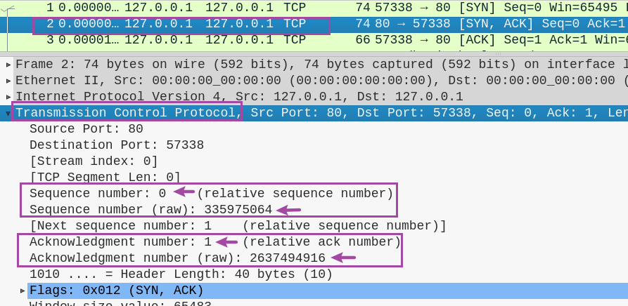
2
n
Server:
I’ve received your seq # m
I expect to receive your next seq# m+ 1
I’m sending seq # n and I will use it to indicate the byte number of the first byte of data in the TCP packet I am sending
m+ 1

Slide 36
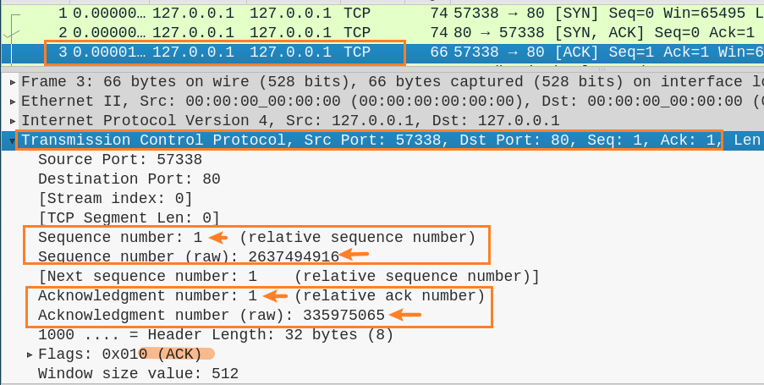
3
m+ 1
Client:
OK. I am sending seq # m+ 1 as you requested
I ack that I have received n and
I expect to receive package starts with seq # n +1
n +1

Slide 37
HTTP request protocol
No. 4

Slide 38


Port 57338
Port 80
1
SYN (seq =0)
SYN (seq =0) , ACK (0+1)
2
handshake
3
(seq =1) , ACK (0+1) TCP len=0
http request/TCP
4
(seq =1) , ACK (0+1), TCP len=t1
(seq =1) , ACK (1+t1), TCP len=0
5
Transfer
(seq =1) , ACK (1+t1), TCP len=t2
6
http response/TCP
7
(seq =1+t1) , ACK (1+t2), TCP len=0

Slide 39


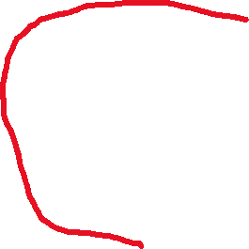

Port 57338
Port 80
TCP length t1=83
TCP length t2=352
1
SYN (seq =0)
SYN (seq =0) , ACK (0+1)
2
handshake
3
(seq =1) , ACK (0+1)
HTTP request
4
(seq =1) , ACK (0+1), TCP len=83
seq= 1
(seq =1) , ACK (1+83), TCP len=0
5
83 bytes
Transfer
(seq =1) , ACK (1+83), TCP len=352
6
http response/TCP
7
(seq =1+83) , ACK (1+352), TCP len=0

Slide 40
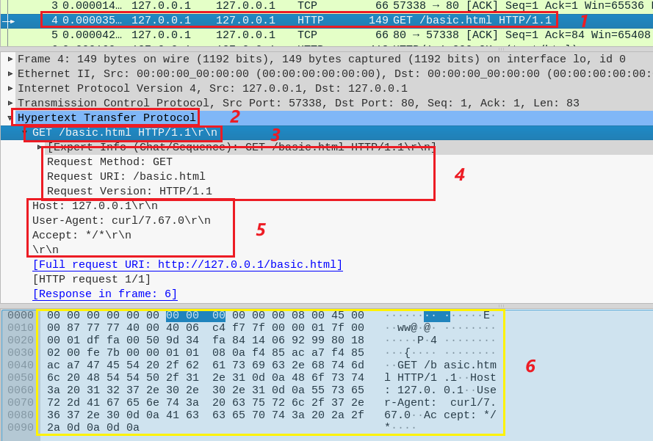
Show http request
4
Layers involved in http request

Slide 41
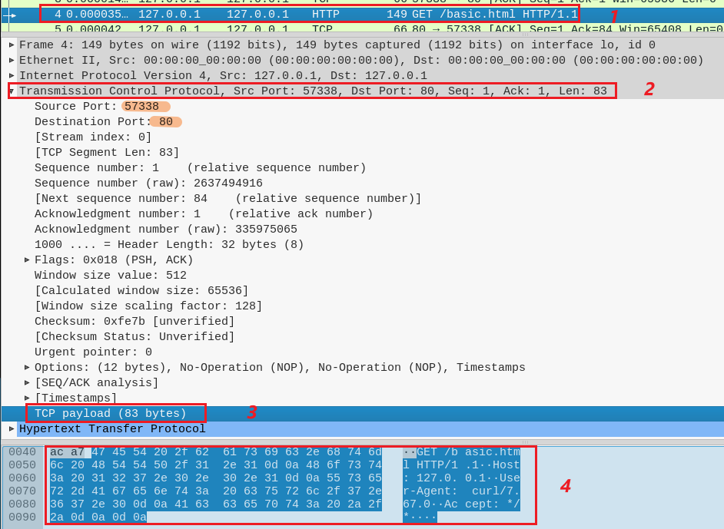
Show http request
4
Show TCP segment 4
Show TCP payload

Slide 42
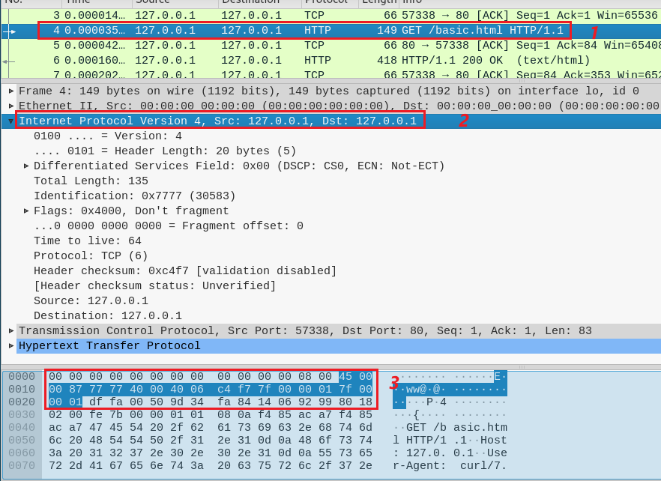
Show http request
4
Show IP packet 4

Slide 43
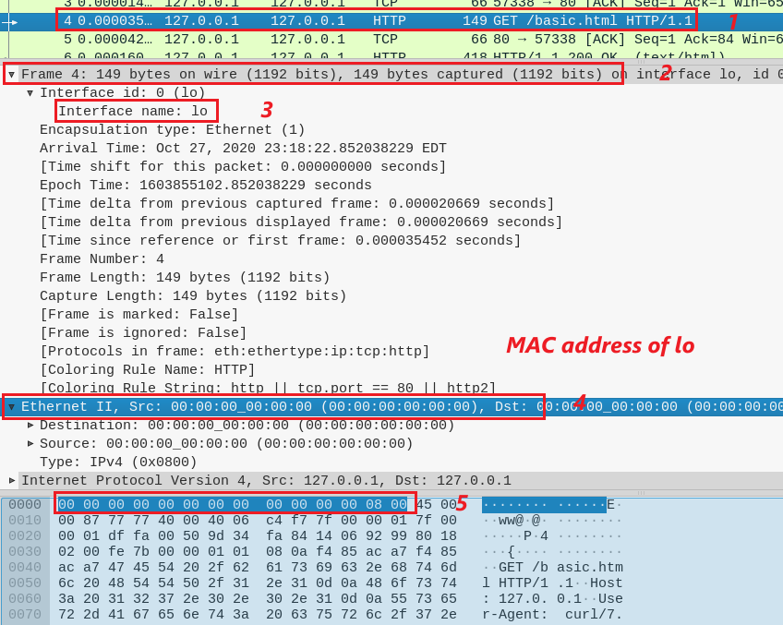
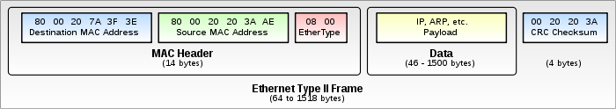
Show http request
4
Ethernet Frame 4
Show Ethernet 802.3
lo interface is not associated with a hardware network interface (it's a virtual loopback interface), it does not have an Ethernet hardware address (MAC address).
ARP (0x0806)

Slide 44
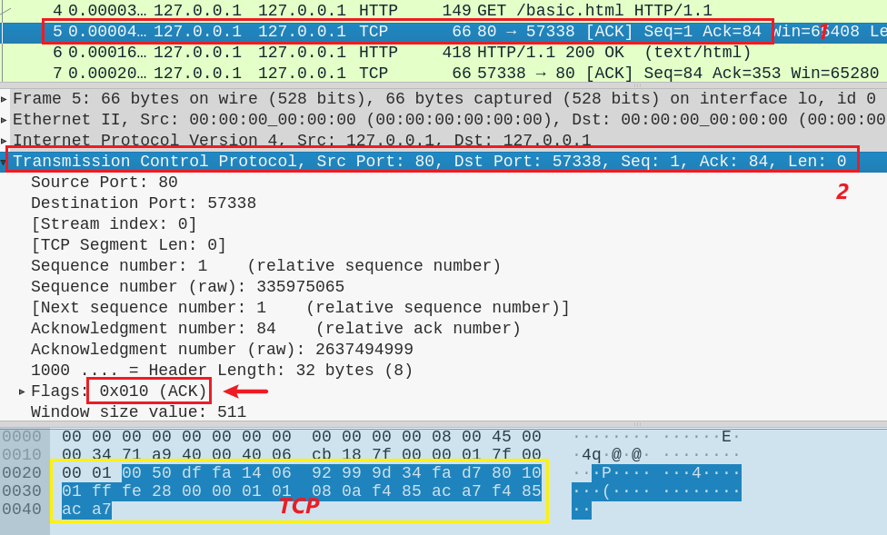
Server ACKnowledges the request
5
ACK 84 =1+ TCP length

Slide 45
HTTP response protocol
No. 5 and 6

Slide 46
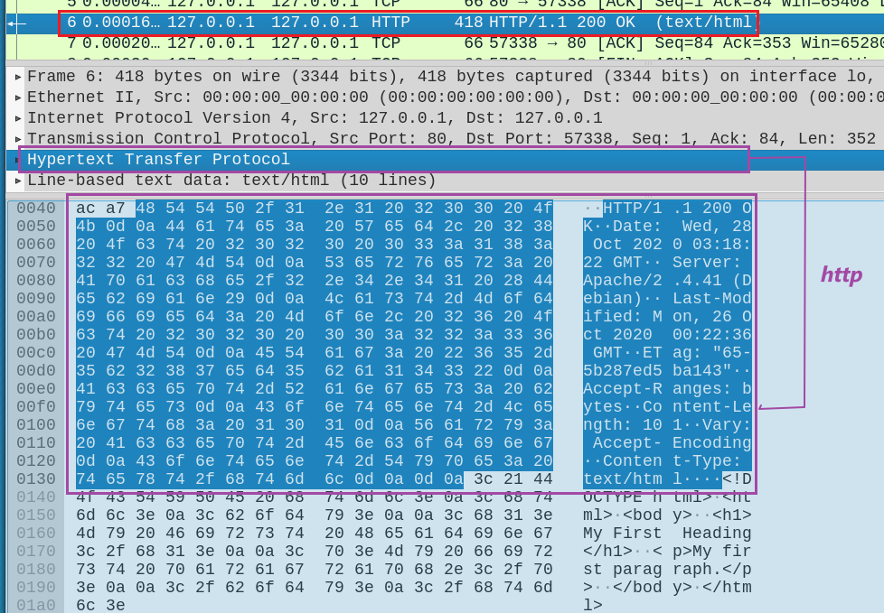
Server send HTTP response head
6
HTTP head

Slide 47

Server send HTTP response data (simple.html)
6
simple.html

Slide 48

Server send HTTP response data (simple.html)
6
TCP
PSH: data must be transmitted promptly to the receiver

Slide 49

Client sends TCP acknowledgement
7

Slide 50
TCP Close connection

Slide 51
Port 57338
Port 80
client state
server state
ESTAB
ESTAB
8
FIN_WAIT_1
can no longer
send but can
receive data
FIN, ACK=353, seq=84
CLOSE_WAIT
ACK=84+1
can still
send data
FIN_WAIT_2
wait for server
close
9
LAST_ACK
FIN, ACK=84+1, seq=353
TIMED_WAIT
can no longer
send data
10
ACK=353+1
timed wait
for 2*max
segment lifetime
CLOSED
CLOSED

Slide 52

8

Slide 53

9

Slide 54

10

Slide 55
Summary
Think of a header as an envelope
Only the smallest envelope (TCP header) contains the data (HTTP data) we want to read
An envelope describes what is inside the envelope
Information shown on an envelope is the metadata of the payload
Sequence # is the byte number of the first byte of HTTP data in the TCP segment sent
beginning at random # or 0 (relative seq#)
Acknowledge # is the sequence number of the next byte the receiver expects to receive
Seq # + size of packet + 1
Handshaking TCPs don’t have HTTP data (size=0)

Slide 56
Assignment
Create a simple website with your name on it
Capture the traffic
Capture screens with the following information
the website with your name
ports (sender and receiver)
initial sequence numbers (sender and receiver)
the timestamps of handshaking
IP addresses (sender and receiver)
Mac addresses (sender and receiver)
the timestamps of HTTP request
Repeat tasks 2 and 3 using the following website
http://shinyfreshmajesticsmile.neverssl.com/online/

