Slide 1
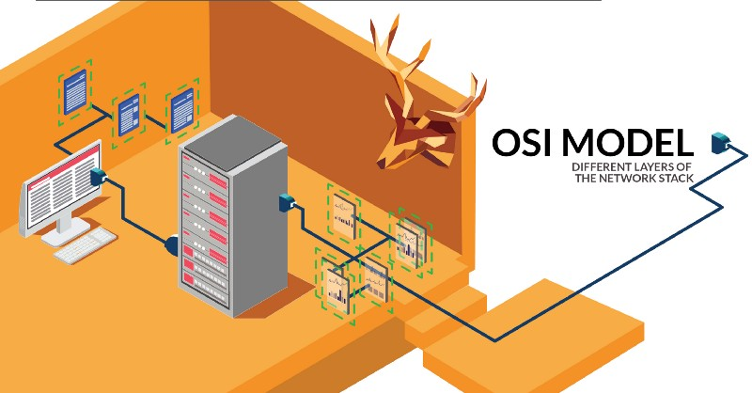
HTTP, Wireshark, and Digital Forensics
Part 2: HTTP traffic contains embedded images
Traffic files: https://github.com/frankwxu/digital-forensics-lab/tree/main/Illegal_Possession_Images/lab_files/traffic
Notes:
https://www.youtube.com/watch?v=6G3qm60dfA8&ab_channel=PrashantThombre
https://github.com/frankwxu/digital-forensics-lab/tree/main/Illegal_Possession_Images/lab_files/traffic

Slide 2
Overview
Capture HTTP traffic (with a picture embedded)
Captured HTTP Traffic Overview
Analyze the second HTTP get request/response
Traffic contains the picture
Extract the building.jpg from the traffic
Size relation between IP packet and TCP payload

Slide 3
Capture HTTP traffic
with a picture embedded

Slide 4
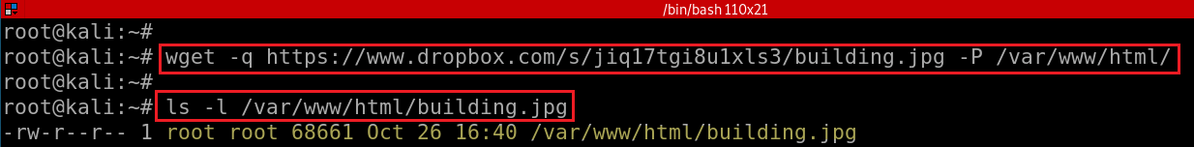
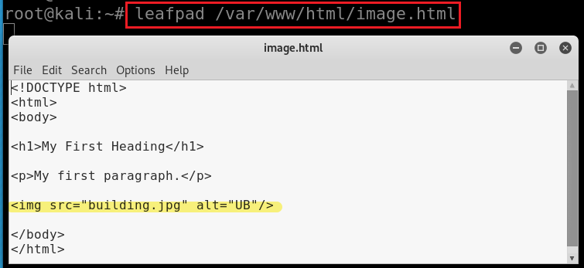
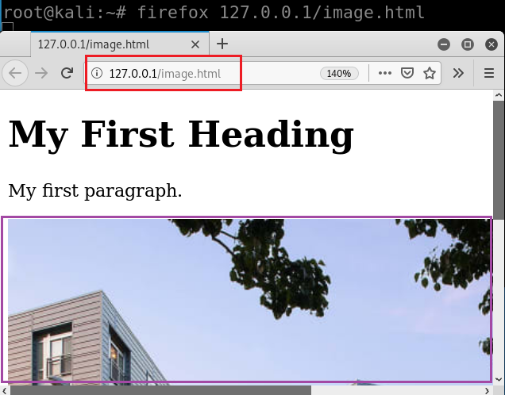

Download an image building.jpg
Save it to /var/www/html
-P: directory prefix
Add building.jpg in a webpage image.html
Show the webpage with the image
https://raw.githubusercontent.com/frankwxu/digital-forensics-lab/main/Illegal_Possession_Images/lab_files/traffic/image.html
Notes:
sudo apt update
sudo apt install apache2
wget -q https://www.dropbox.com/s/jiq17tgi8u1xls3/building.jpg -P /var/www/html/

Slide 5
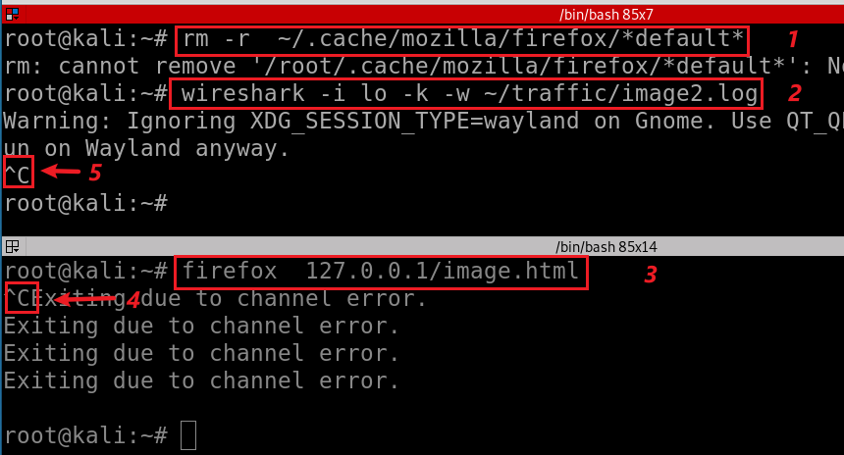
Capture traffic
Notes:
wireshark –I lo -k –w ~/traffic/image2.log

Slide 6
HTTP Traffic overview

Slide 7
How many http get requests and responses?

Slide 8

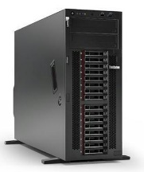
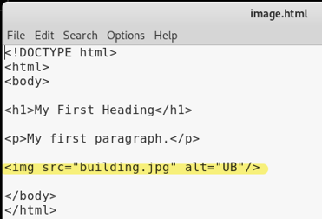
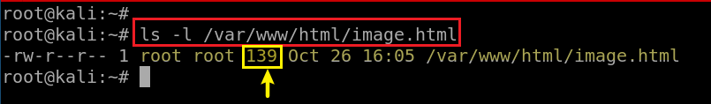
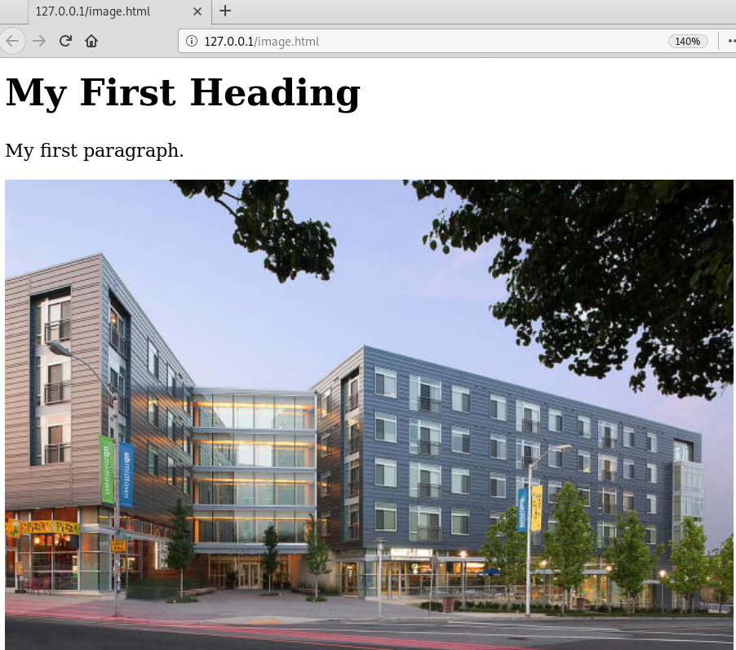
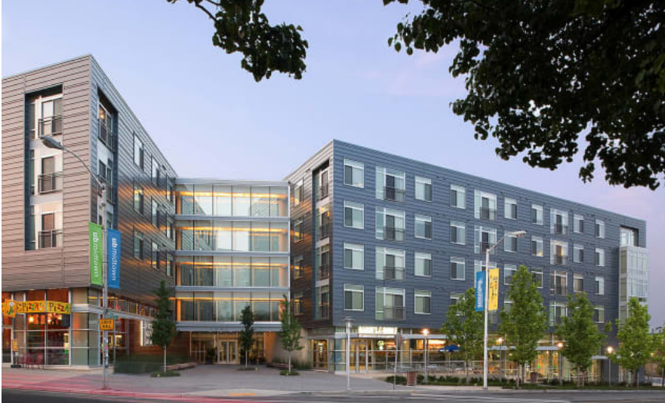
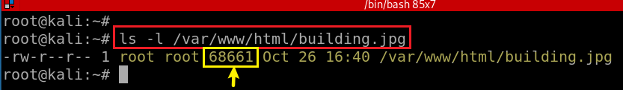
Port 52054
Port 80
GET 127.0.0.1/image.html
Parse image.html
GET 127.0.0.1/building.jpg
32768 bytes : default value of for TCP send and receive buffers
http 200 ok
32768 bytes
32768 bytes
3414 bytes
http response head length (289) + Build.jpg (68661) = TCP 1(32768)+TCP 2(32768) +TCP 3 (3414) =68950

Slide 9
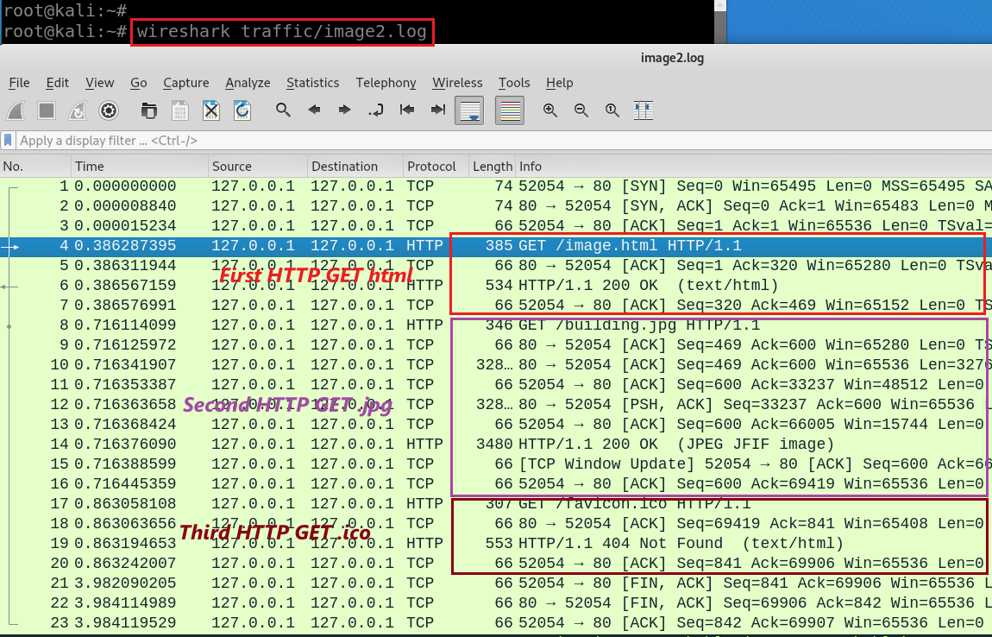
wget https://raw.githubusercontent.com/frankwxu/digital-forensics-lab/main/Illegal_Possession_Images/lab_files/traffic/image2.log
Verify two HTTP GET: .html and .jpg
Notes:
wget -q https://raw.githubusercontent.com/frankwxu/digital-forensics-lab/main/Illegal_Possession_Images/lab_files/traffic/image2.log

Slide 10
Analyzing the second HTTP get request/response
HTTP traffic for displaying images

Slide 11
Port 52054
Port 80
8
GET 127.0.0.1/building.jpg
9
http 200 ok
32768 bytes
10
TCP segment 1
11
32768 bytes
12
TCP segment reassembly takes places in HTTP layer.
TCP reassembling at receiving side
Wireshark shows the assembled TCP segment at sending side
TCP segment reassembly works only capture the entire packet and if all the checksums for that packet are valid.
TCP segment 2
13
3414 bytes
14
TCP segment 3
15
TCP Window (buffer size) Update
16

Slide 12
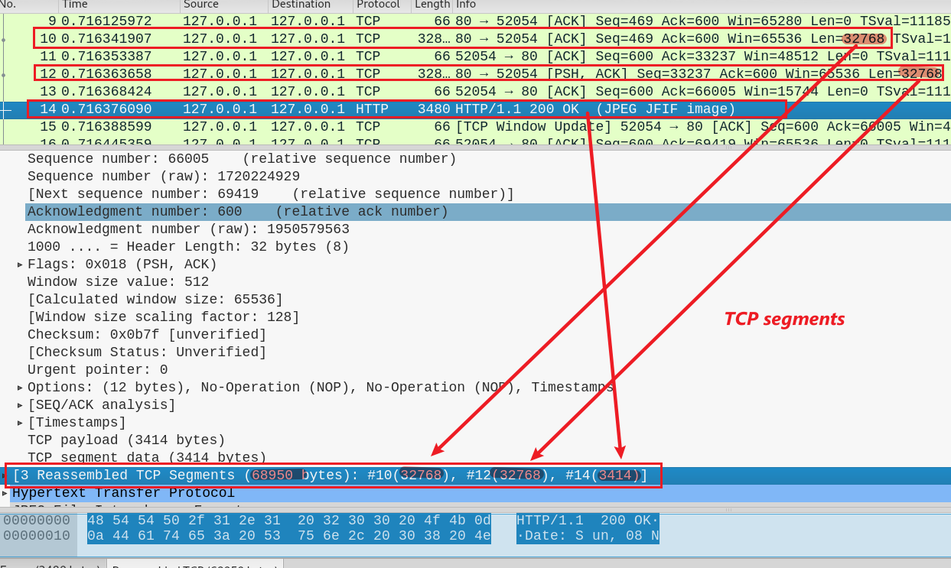
Calculate the length 3 TCP segments: 32768+32768+3414

Slide 13
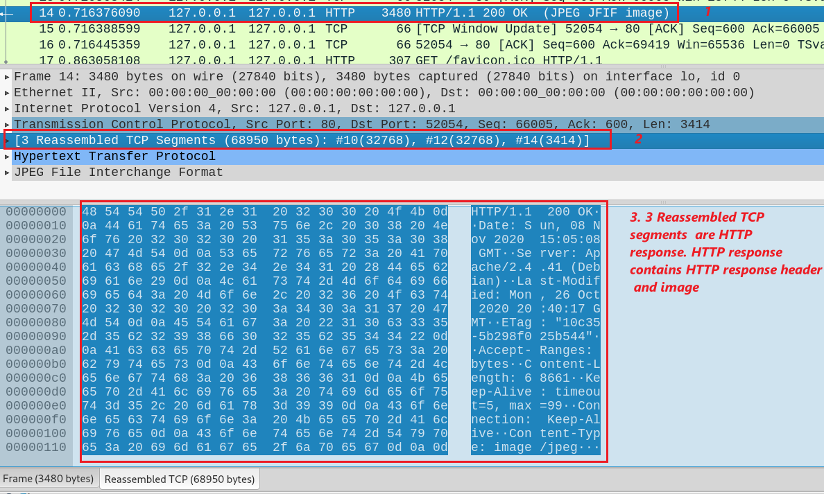



Show the content of 3 TCP segments is http response and the data (building.jpg)
14

Slide 14
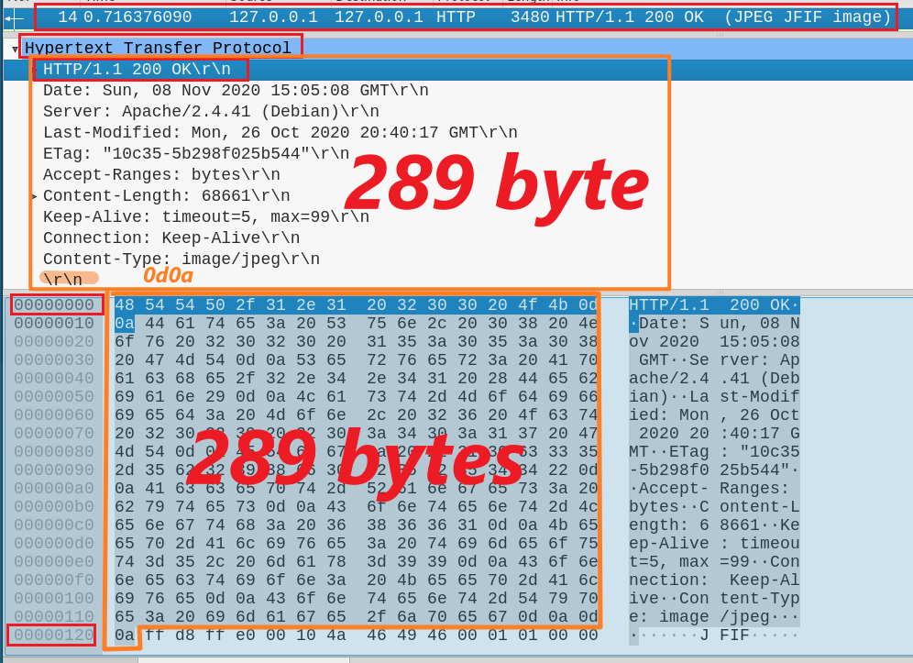

Calculate the length of http response header: 289 (0x000 -0x120)
14

Slide 15
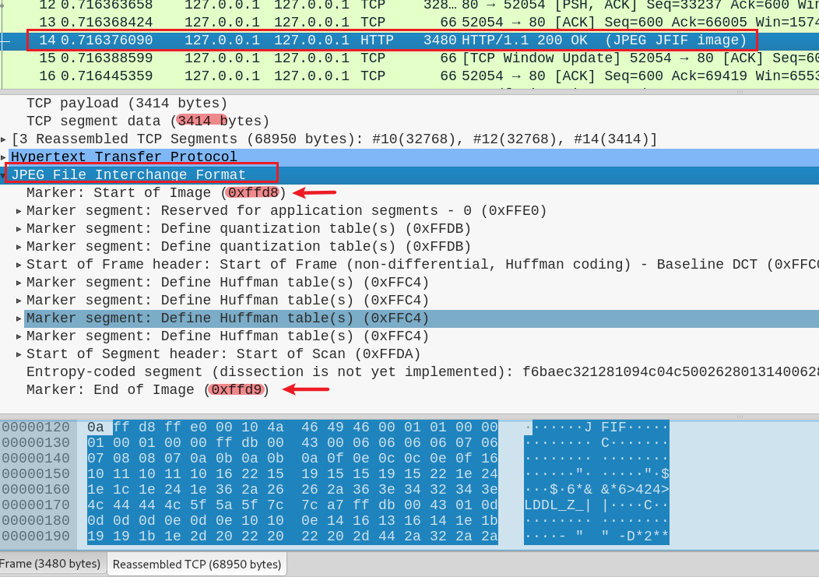
Verify start and end of Image (0x0121 – 0x10d55 +1 =68661 bytes)
14

Slide 16
Extract the building.jpg from traffic

Slide 17
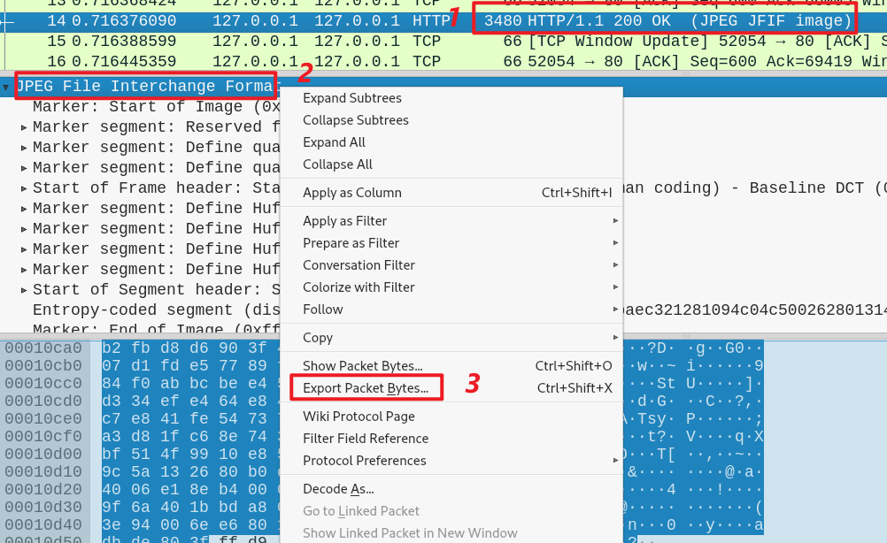
How to extract the building.jpg from log

Slide 18
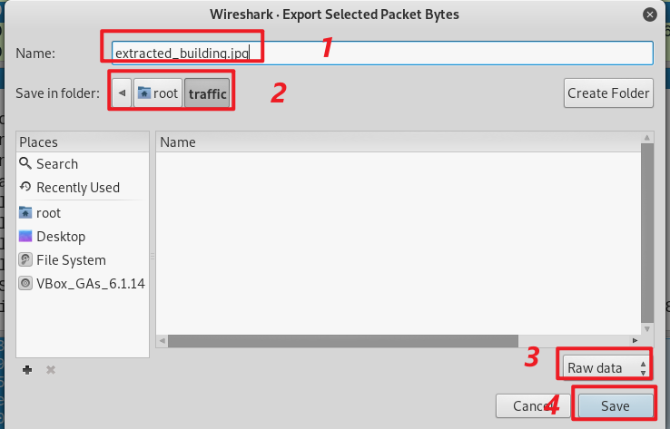
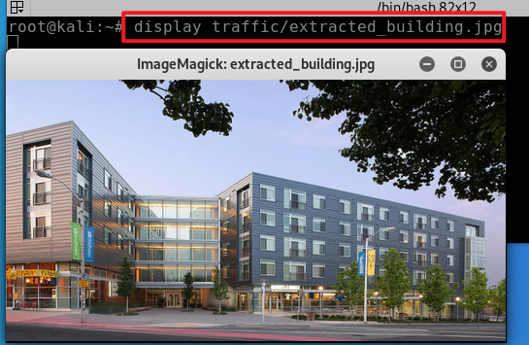
Save extracted image
Show image

Slide 19
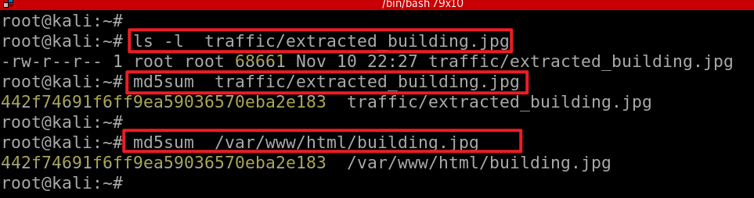

Slide 20
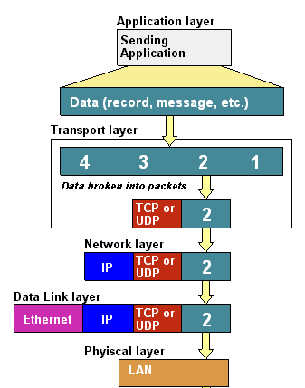
Size relation between IP packet and TCP payload
Data
Segment:
Packet
Frame

Slide 21
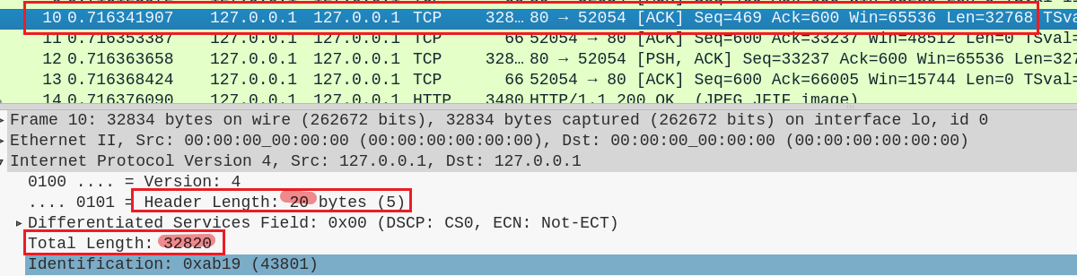
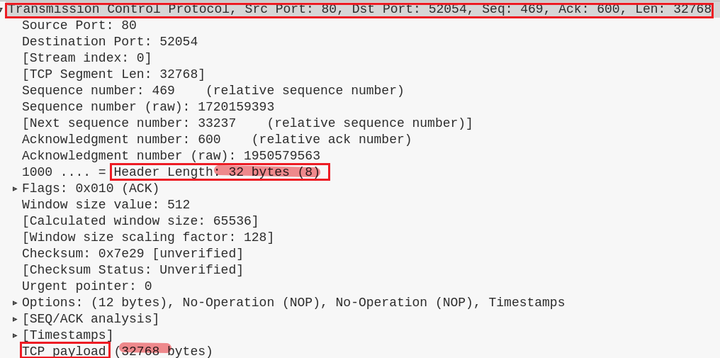
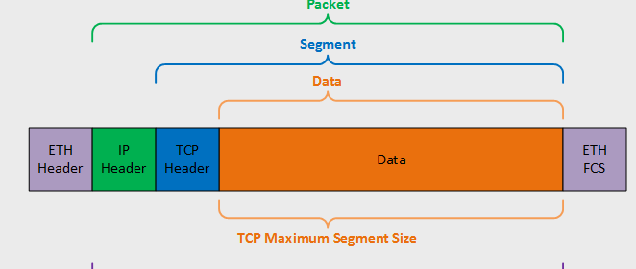
Verify the length relation between IP packet and TCP payload
10
32820
20
32768=2^15
32
TCP segment length needs to be calculated

Slide 22
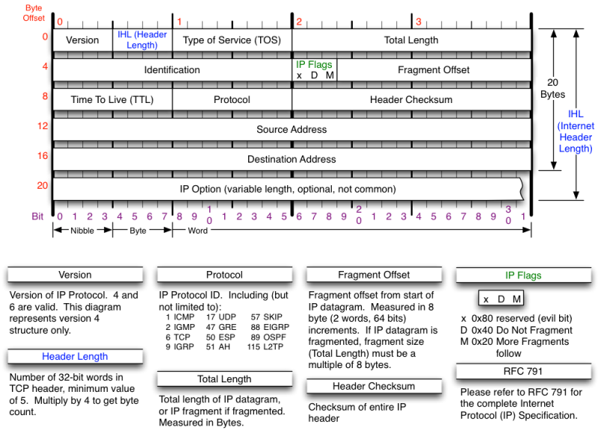


Slide 23
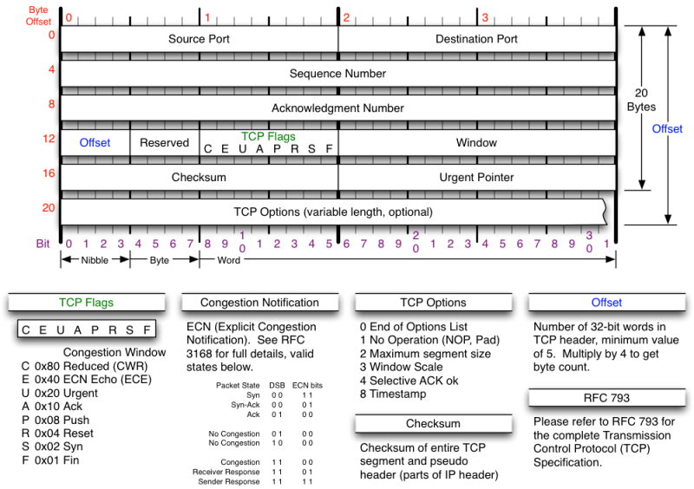

TCP segment length needs to be calculated
12

Slide 24
OSI, TCP/IP, security attacks, and forensic evidence

Slide 25
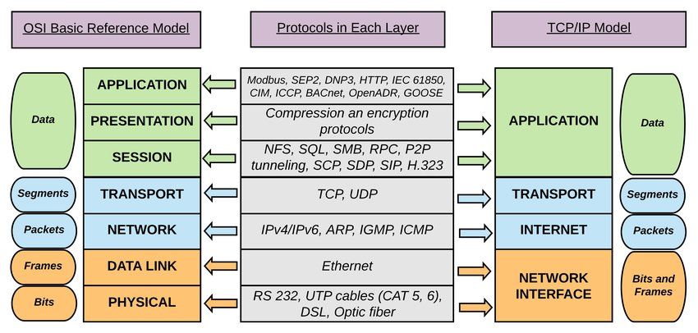

Slide 26
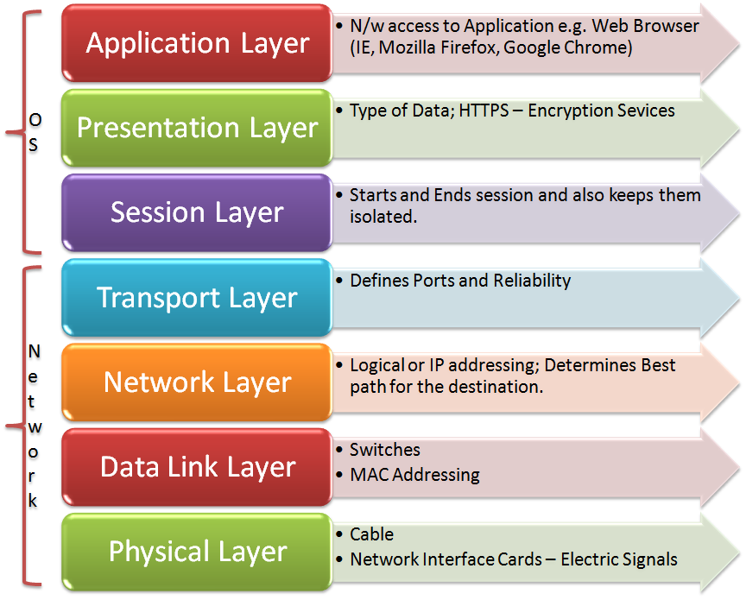
Evidence you should collect
File, images, Software installed, etc.

Slide 27
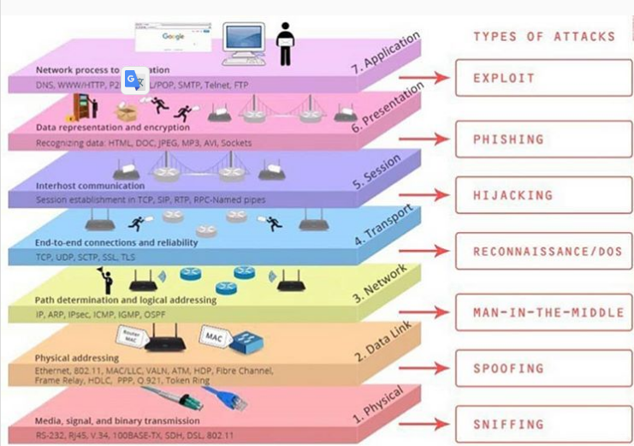

Slide 28
Assignment

Slide 29
Requirements
Using curl to sent request to the local web server
Capture the http requests and responses in image.log
Why can’t you see the TCP segments?
Using Chrome to sent requests from Win 10 and save the log file in image3.log.
insert any one photo to .html
Extract the photo

Slide 30
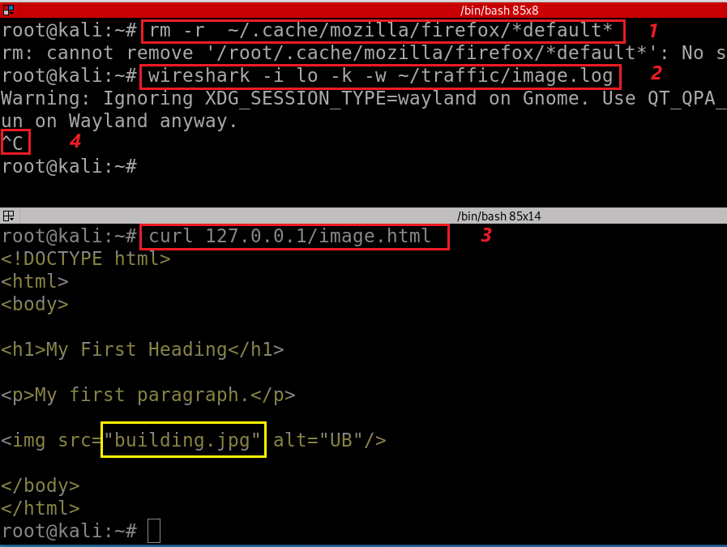
Make sure:
service apache2 start
has traffic folder
Notes:
rm -r ~/.cache/mozilla/firefox/*default*
wireshark -i lo -k -w ~/traffic/image.html
curl -V 127.0.0.1/image.html

Slide 31
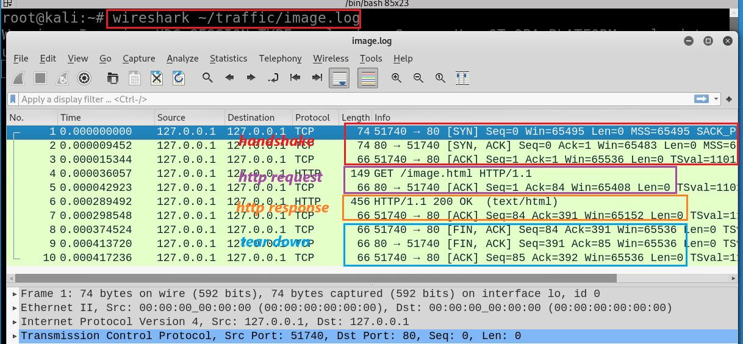
Notes:
wireshark ~/traffic/basic.log

Slide 32
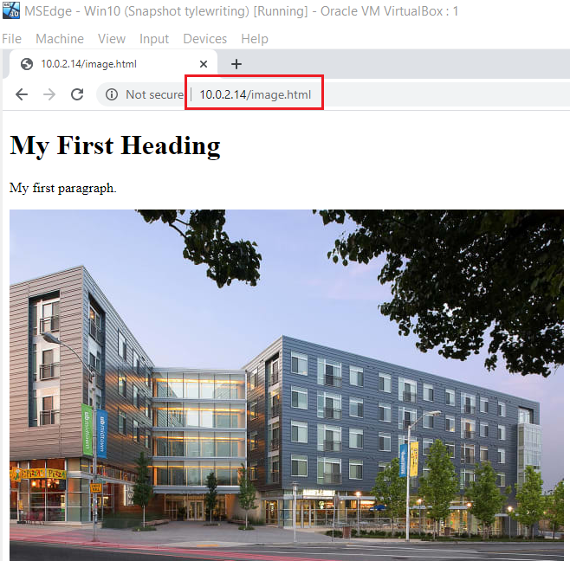
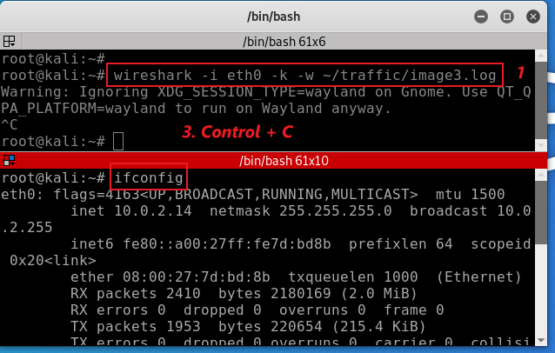
2

