Slide 1
Computer System Introduction

Slide 2
Overview
Computer systems
How do computers work?
Why computer forensics is hard?
Hard disk drives
Calculate disk partitions
PC boot process
File Systems

Slide 3
Computer systems

Slide 4
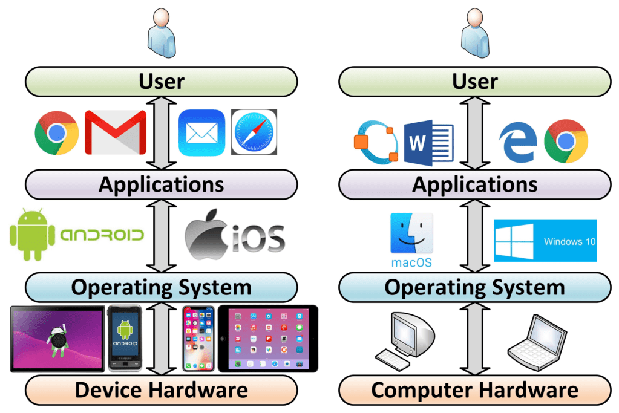
Layers of a computer system
Evidence is generated from each layer
User activities= Applications+ OS+ Disk/Memory
https://windsongtraining.ca/the-technology-layer-cake-users-apps-os-and-hardware/

Slide 5
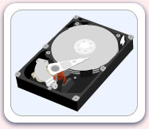
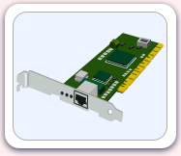
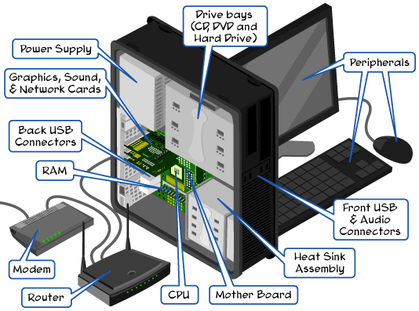
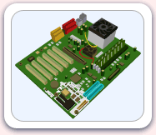
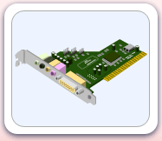
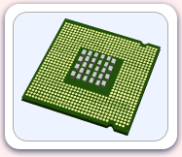
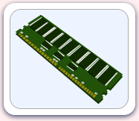



Parts of the computer
http://www.carnegiecyberacademy.com/facultyPages/computer/computers.html

Slide 6
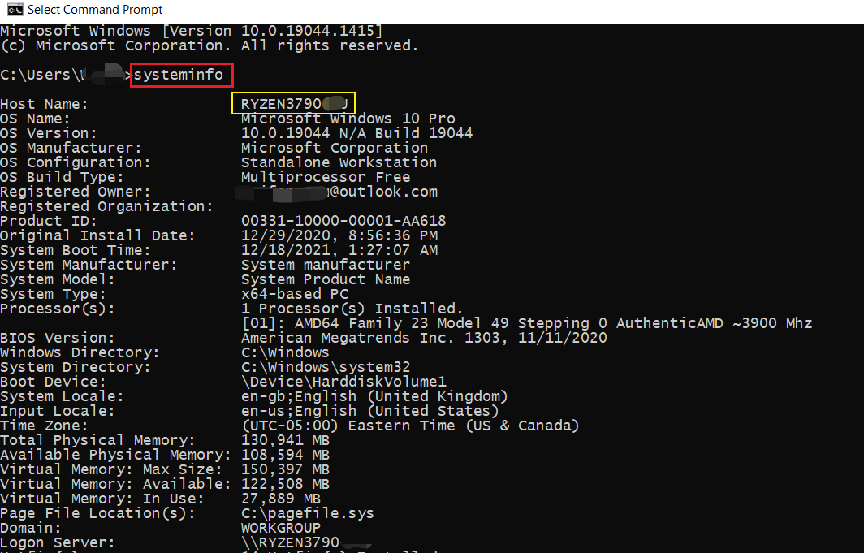
Check system specification

Slide 7
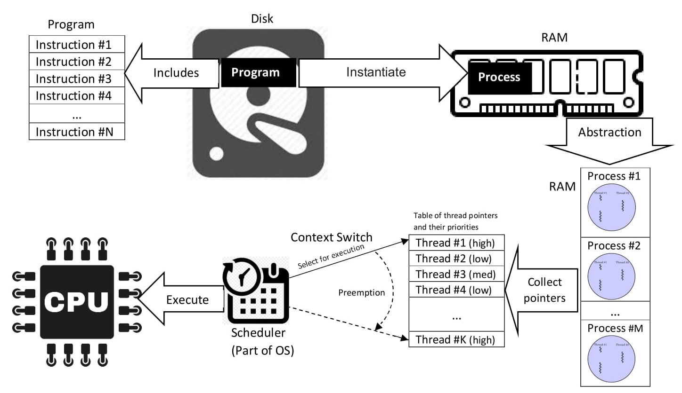
How do computers work?
Program (.py) vs. Process vs. Thread
A process is the instance of a computer program. It can create child processes (multi-core)
a process may be made up of multiple threads (sub-tasks) of execution that execute instructions concurrently.
Malware Analysis
https://en.wikipedia.org/wiki/Process_(computing)

Slide 8
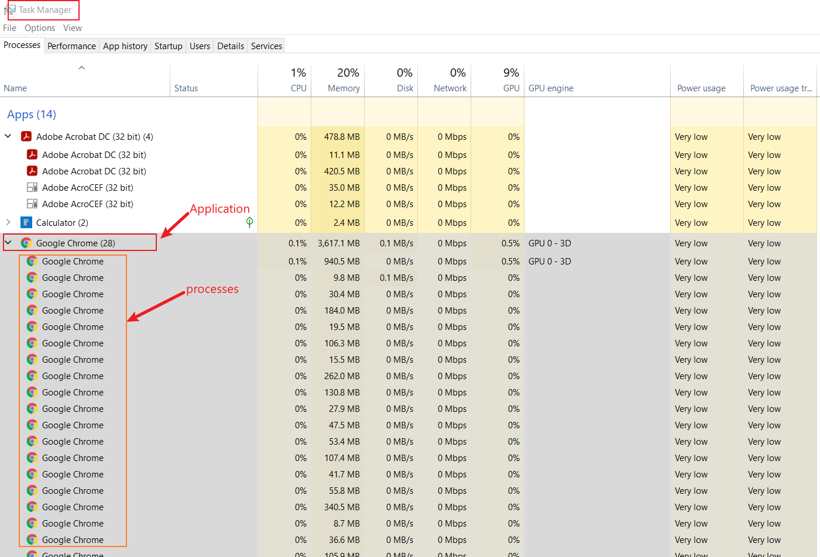

Slide 9
Why computer forensics is hard?
Technical difficulties
OS: different OS types, versions, complexity of OS
Applications: many applications, different versions of applications
Hardware: CPU, GPU, camera
Ever-advancing technology: e.g., database changes, Mobile/IoT, EV car
A complex and connected world
IoT devices: Alex, Camera, Fitbit, Smart Phone
Information explosion
too much information, different types of evidence
how to collect, analyze, and validate them systematically?
Computer forensics is NOT only a computer science discipline
criminal justice, law, computer science, security

Slide 10
Low level Analysis: malware
OS logs, Application logs,
Memory forensics
CPU execution analysis
Dynamical Analysis:
Application PID

Slide 11
Hard disk drives

Slide 12
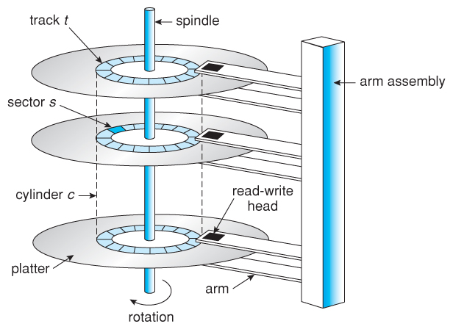
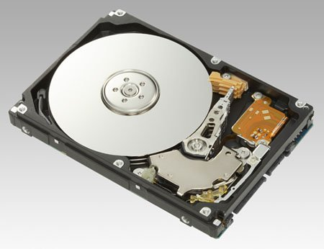
Understand disk drives
https://regmedia.co.uk/2006/12/12/fujitsu_300gb_1.jpg
Abraham Silberschatz, Greg Gagne, and Peter Baer Galvin, "Operating System Concepts, Ninth Edition "

Slide 13
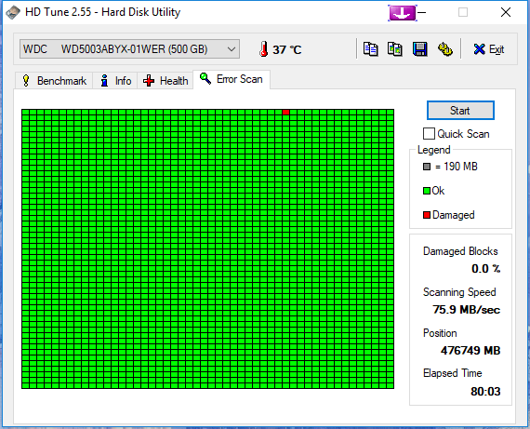
What is a disk sector?
The sector is the minimum storage unit of a hard drive.
Files occupy an integral number of sectors regardless of the file's actual size.
# bytes per sector =512 Bytes
one byte = one character (ASCII)
https://i.imgur.com/26BalHW.png

Slide 14
Calculate the total sectors
#sectors per track
# tracks (cylinders)
# headers
#Size of disk=# tracks (C) x #Heads x #Sectors per track (CHS)
no of sectors: 400
no of heads: 12
cylinders: 17000
=81600000 sectors

Slide 15
Calculate the size of a disk
1024 Bytes=1K
1024 K=1M
1024 M=1G
How to compute the size of the disk
81600000 sectors * 512 bytes= 41779200000 bytes
=40800000 KB
=39843.75MB
=38.91G

Slide 16
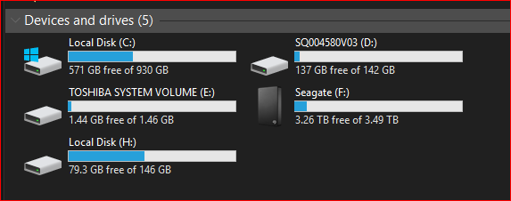
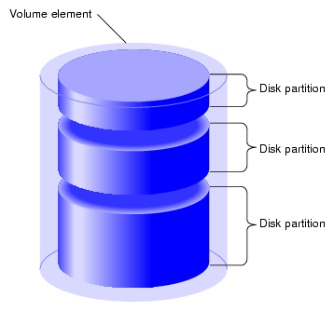
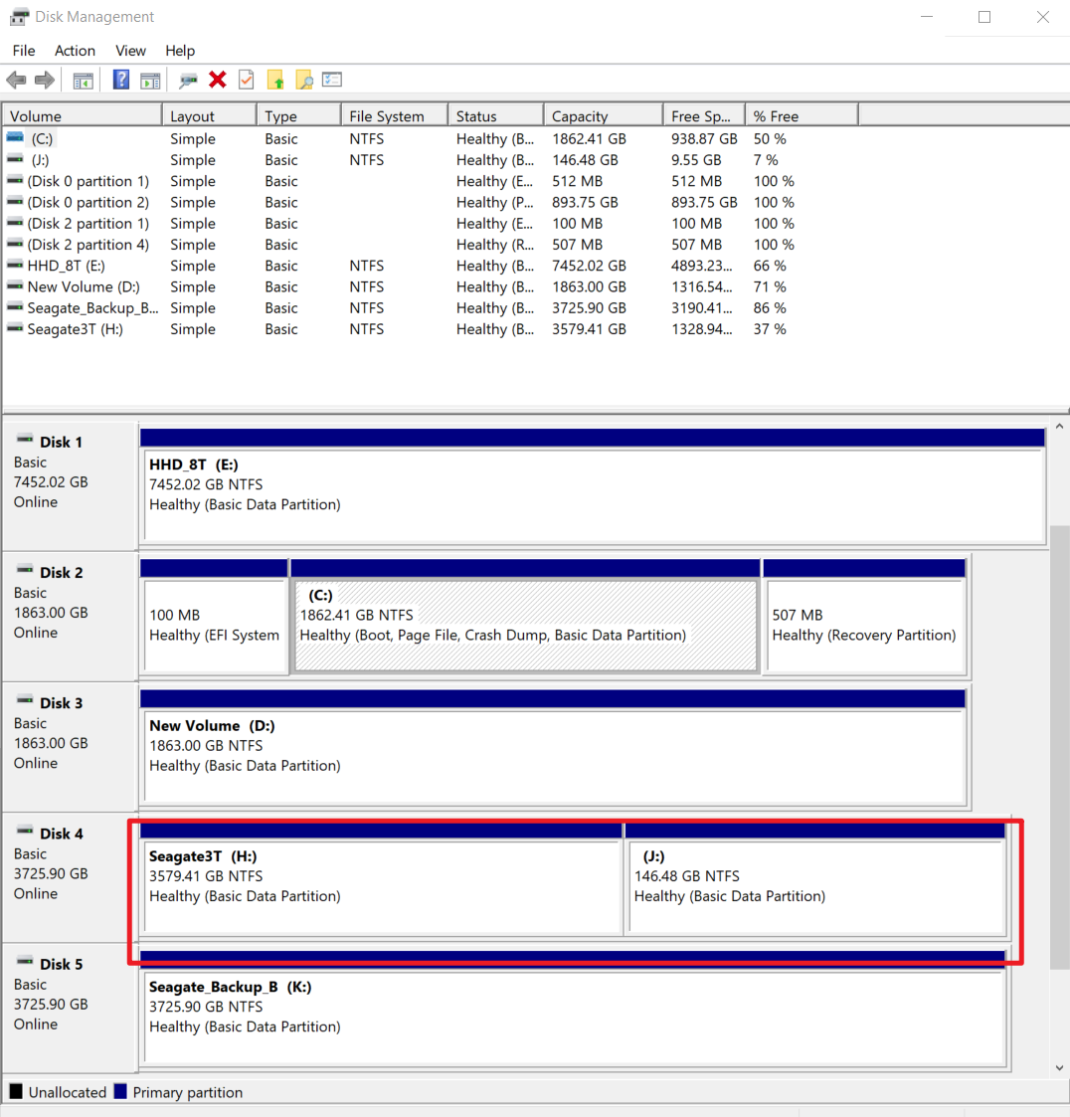
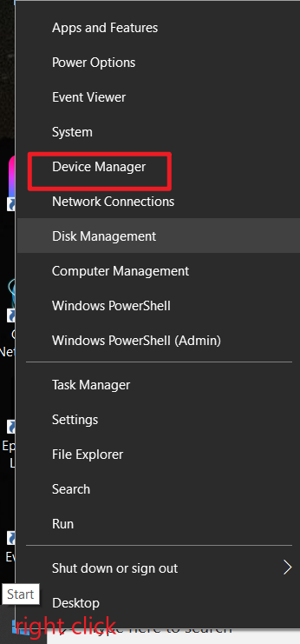
What is a partition
https://www.maketecheasier.com/assets/uploads/2012/05/partitions-partition-diagram.png

Slide 17
PC booting process

Slide 18
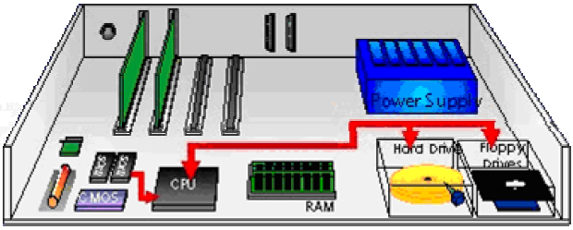
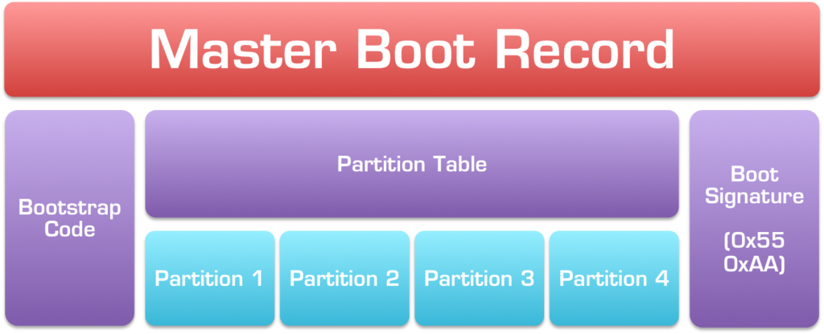





Booting a computer
Power up; computer runs power-on self-test (POST)
Boot sequence governed by (Basic input/output system) BIOS ROM
BIOS parameters stored in CMOS
Control passes to the Master Boot Record (MBR)
MBR points to the boot record of a selected operating system
“system” volume = pre-load OS (Done by boot manager/loader)
"boot" volume = actual load OS (Done by OS kernel)
Operating system takes control
Jump to bootable partition
http://www.c-jump.com/CIS24/Slides/Booting/Booting.html
https://i2.wp.com/neosmart.net/wiki/wp-content/uploads/sites/5/2015/01/Master-Boot-Record.png?resize=1024%2C416&ssl=1

Slide 19
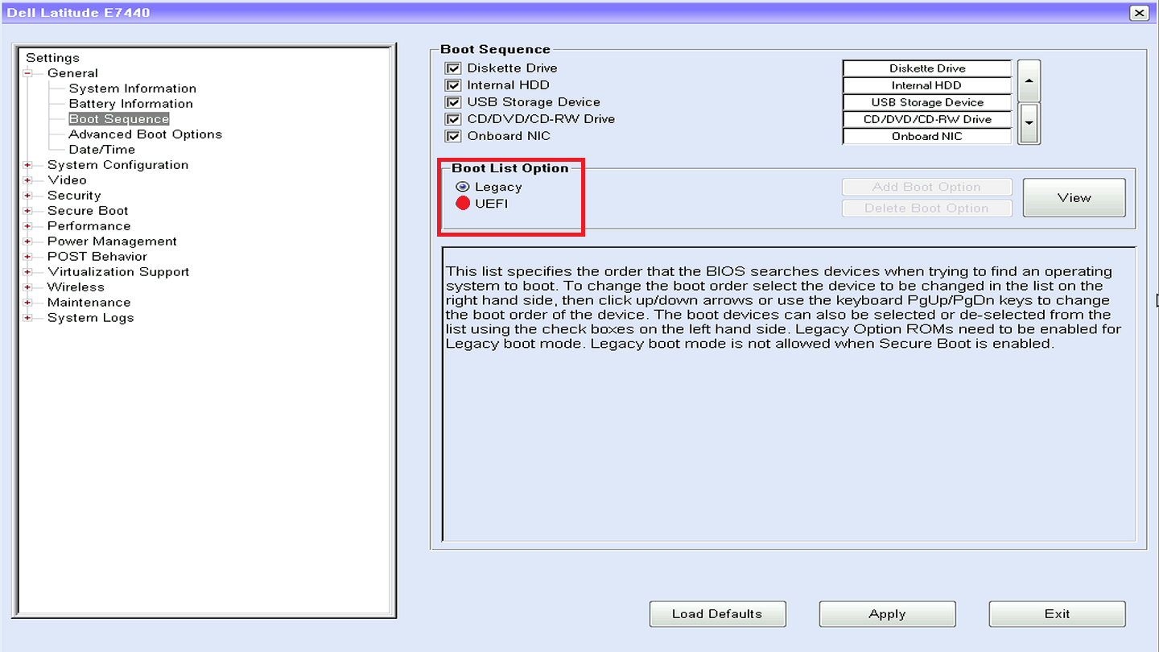
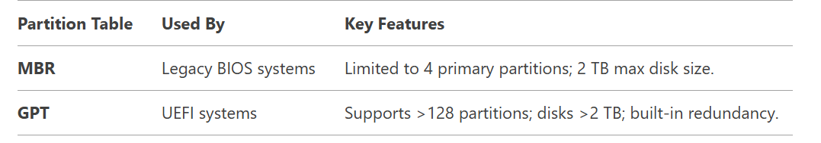
Two different boot options
Basic Input/Output System
Unified Extensible Firmware Interface

Slide 20
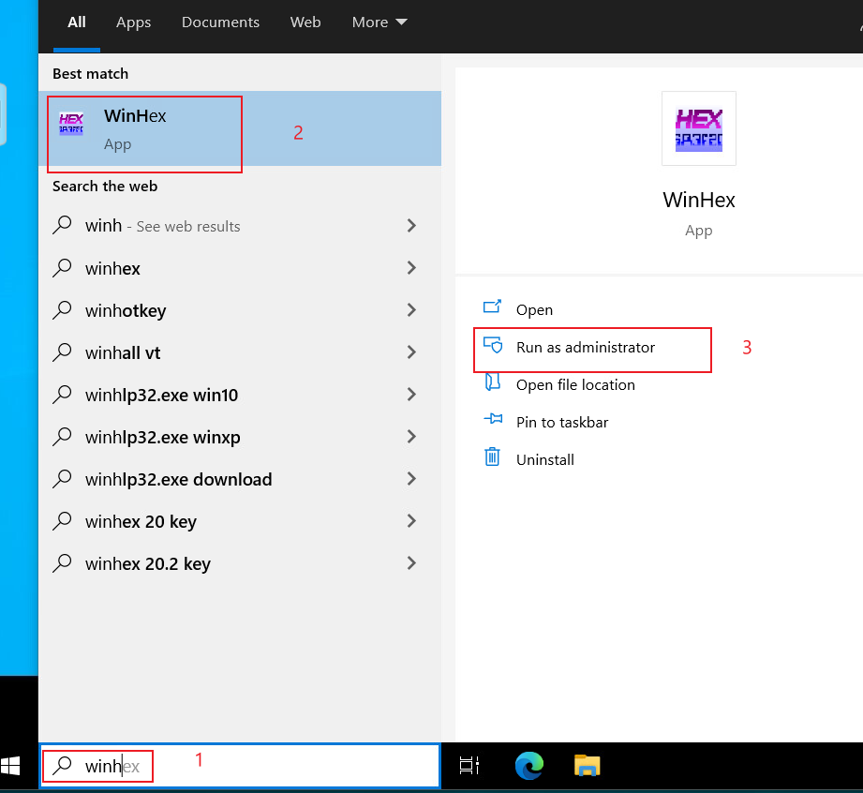
What does Master Boot Record look like?
Open Winhex or HxD
https://mh-nexus.de/en/hxd/

Slide 21
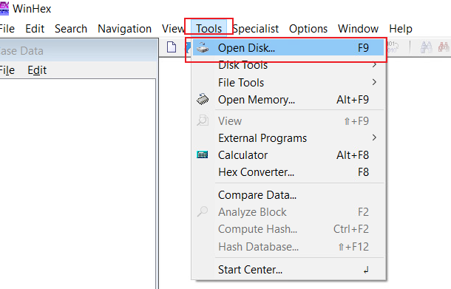
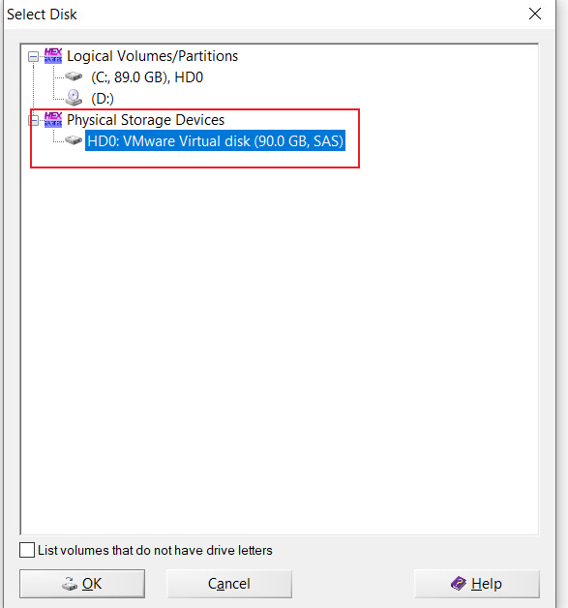
List Physical Storage Devices

Slide 22
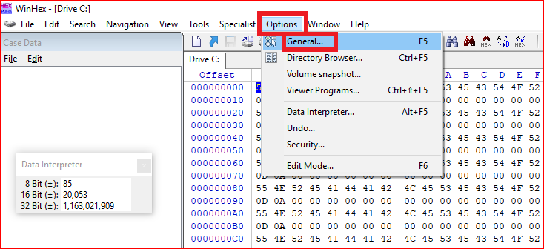
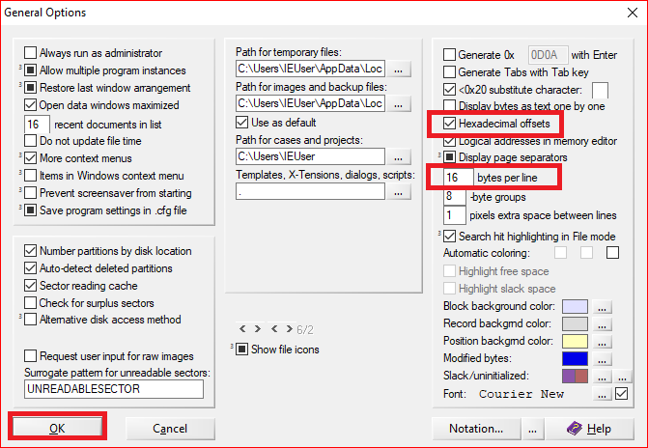
Winhex option setting

Slide 23
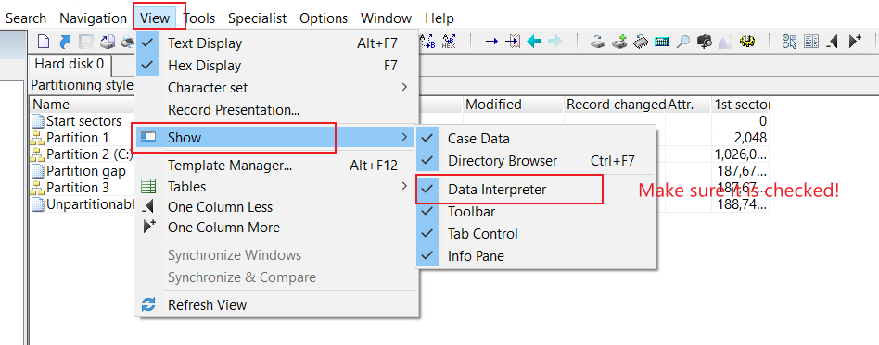
Enable Data Interpreter

Slide 24
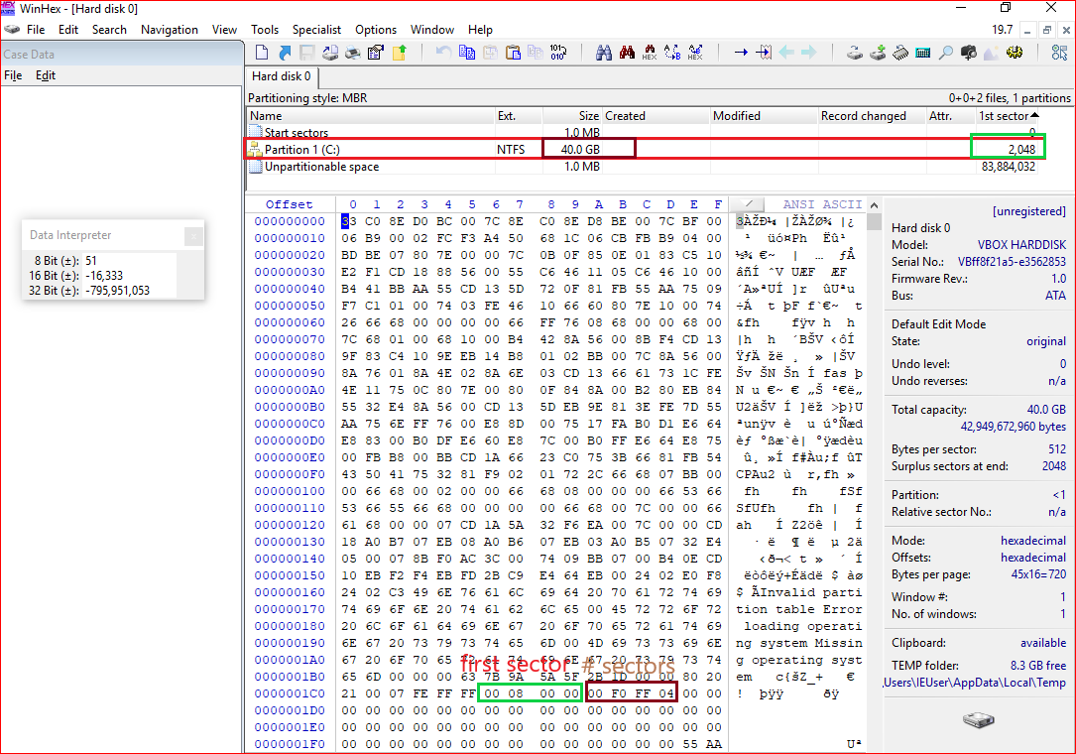
Master Boot Record:
1980s
Allow up to a maximum of 2 TB
Show
the first sector of partition 1
the number of sections in partition 1

Slide 25
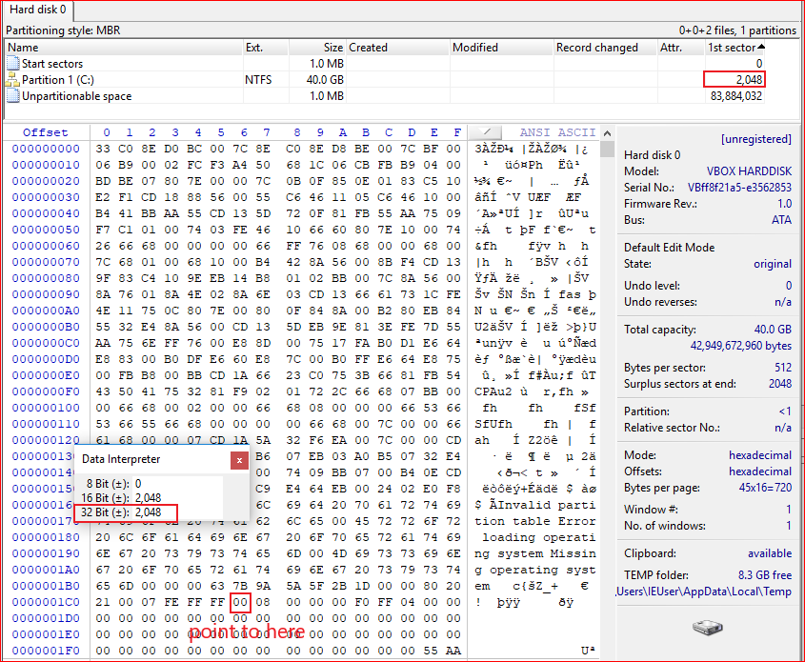
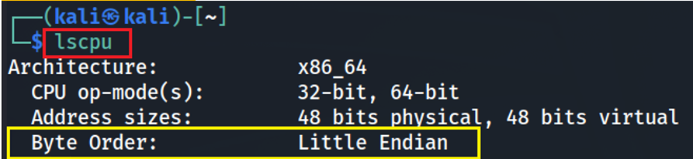
Covert Hex to decimal
(00000800)₁₆=(2048)₁₀
0x01c6
0x01ca

Slide 26
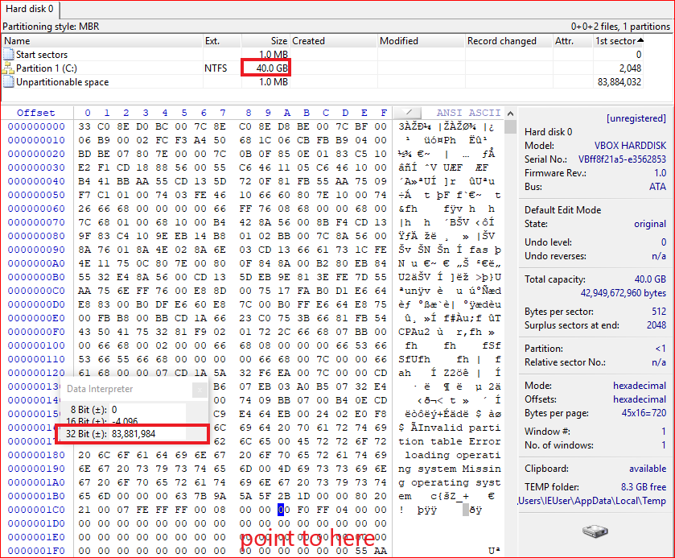
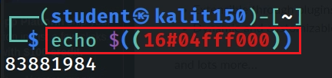
Show the size of the
total sectors in decimal
ox01CA
Compute the partition
size
83881984 sectors *512 bytes per sector = 39.99 G
Notes:
1024000*512/1024/1024=500
echo $((16#04fff000))

Slide 27
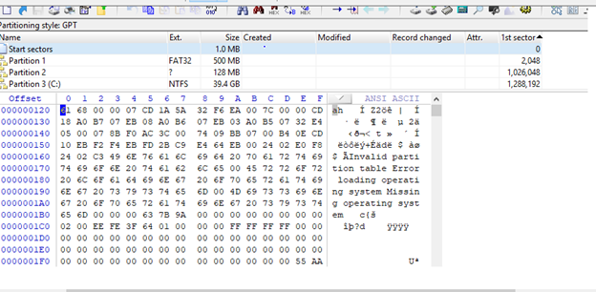
GUID Partition Table: GPT

Slide 28
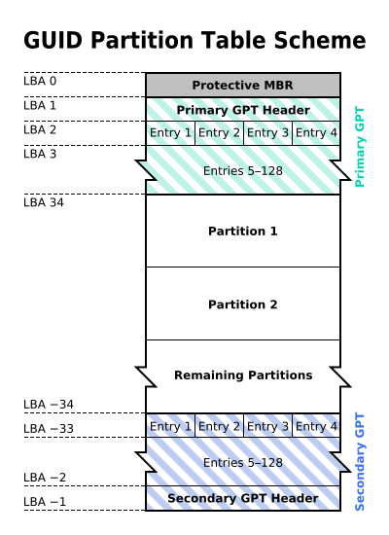
Why GPT
MBR: 1980s
Allow up to a maximum of 2 TB
GPT: maximum size is 9.4 ZB
1ZB=1024TB
logical block addressing (LBA)
Replace CHS
512 bytes per LBA
By The original uploader was Kbolino at English Wikipedia. - Transferred from en.wikipedia to Commons. Transfer was stated to be made by User:Kbolino., CC BY-SA 2.5, https://commons.wikimedia.org/w/index.php?curid=3036588

Slide 29
backward compatibility for MBR
Describe each partition (128 bytes per entry)
Backup of the primary GPT header and entries

Slide 30
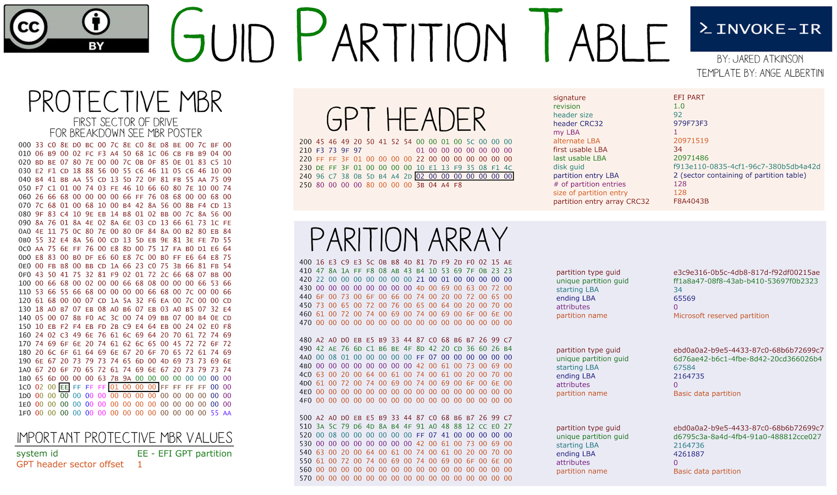
Starting LBA of array of partition entries (always 2 in primary copy)
Why 0x400? The start of sector 2
(0x400=1024)
Notes:
21

Slide 31
Steps to calculate partition size of GPT
offset 1C2 in MBR: EE (indicate it is a GPT)
offset 247 (next 8 bytes): the start sector of partition arrays (sector 2)
Each partition array is described in 128 bytes
Find the starting LBA
Find the end LBA
Calculate partition size
echo $((0x010021))= 65569

Slide 32
Show MBR/GPT details using template

Slide 33
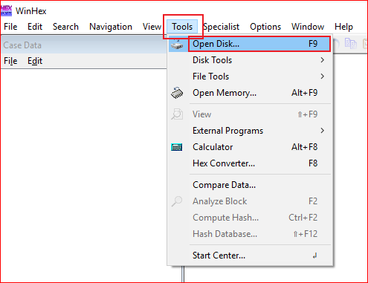
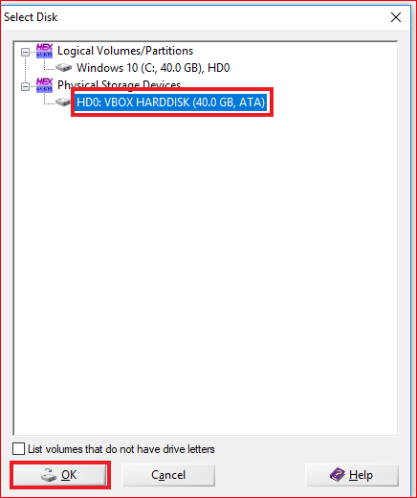
Open Physical Devices

Slide 34
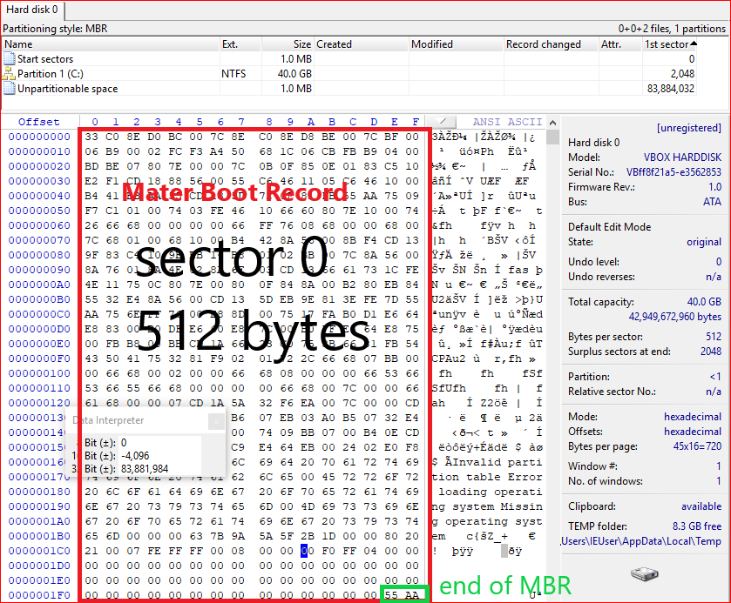
Show MBR

Slide 35
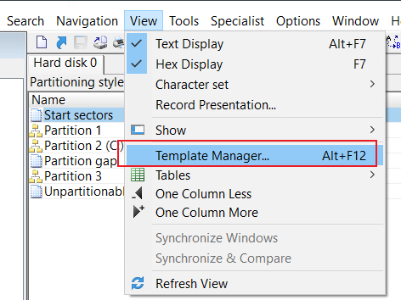
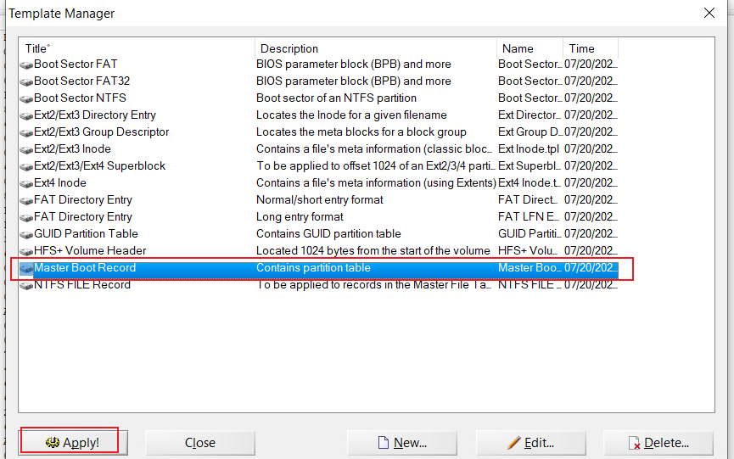
Show MBR details using template

Slide 36
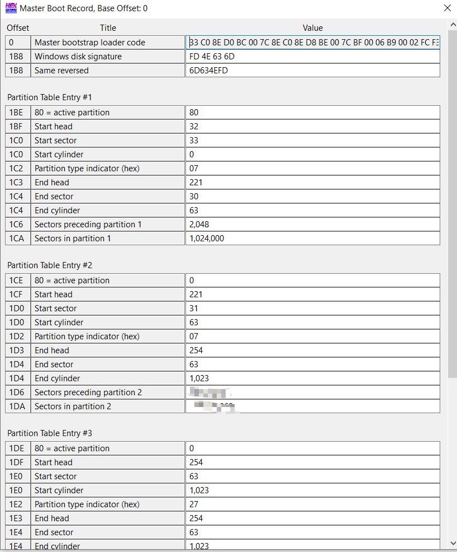


Another example of MBR details using template, which contains multiple partitions

Slide 37
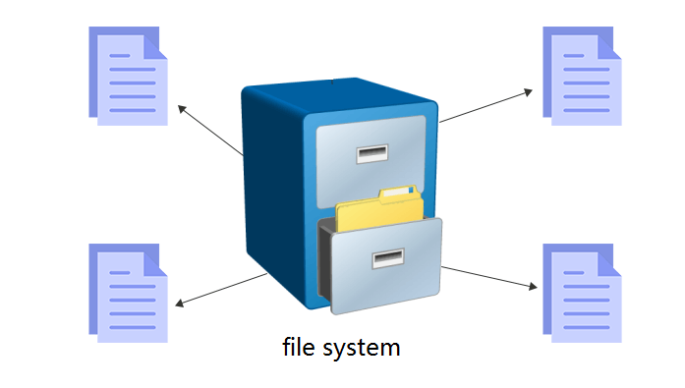
File Systems

Slide 38


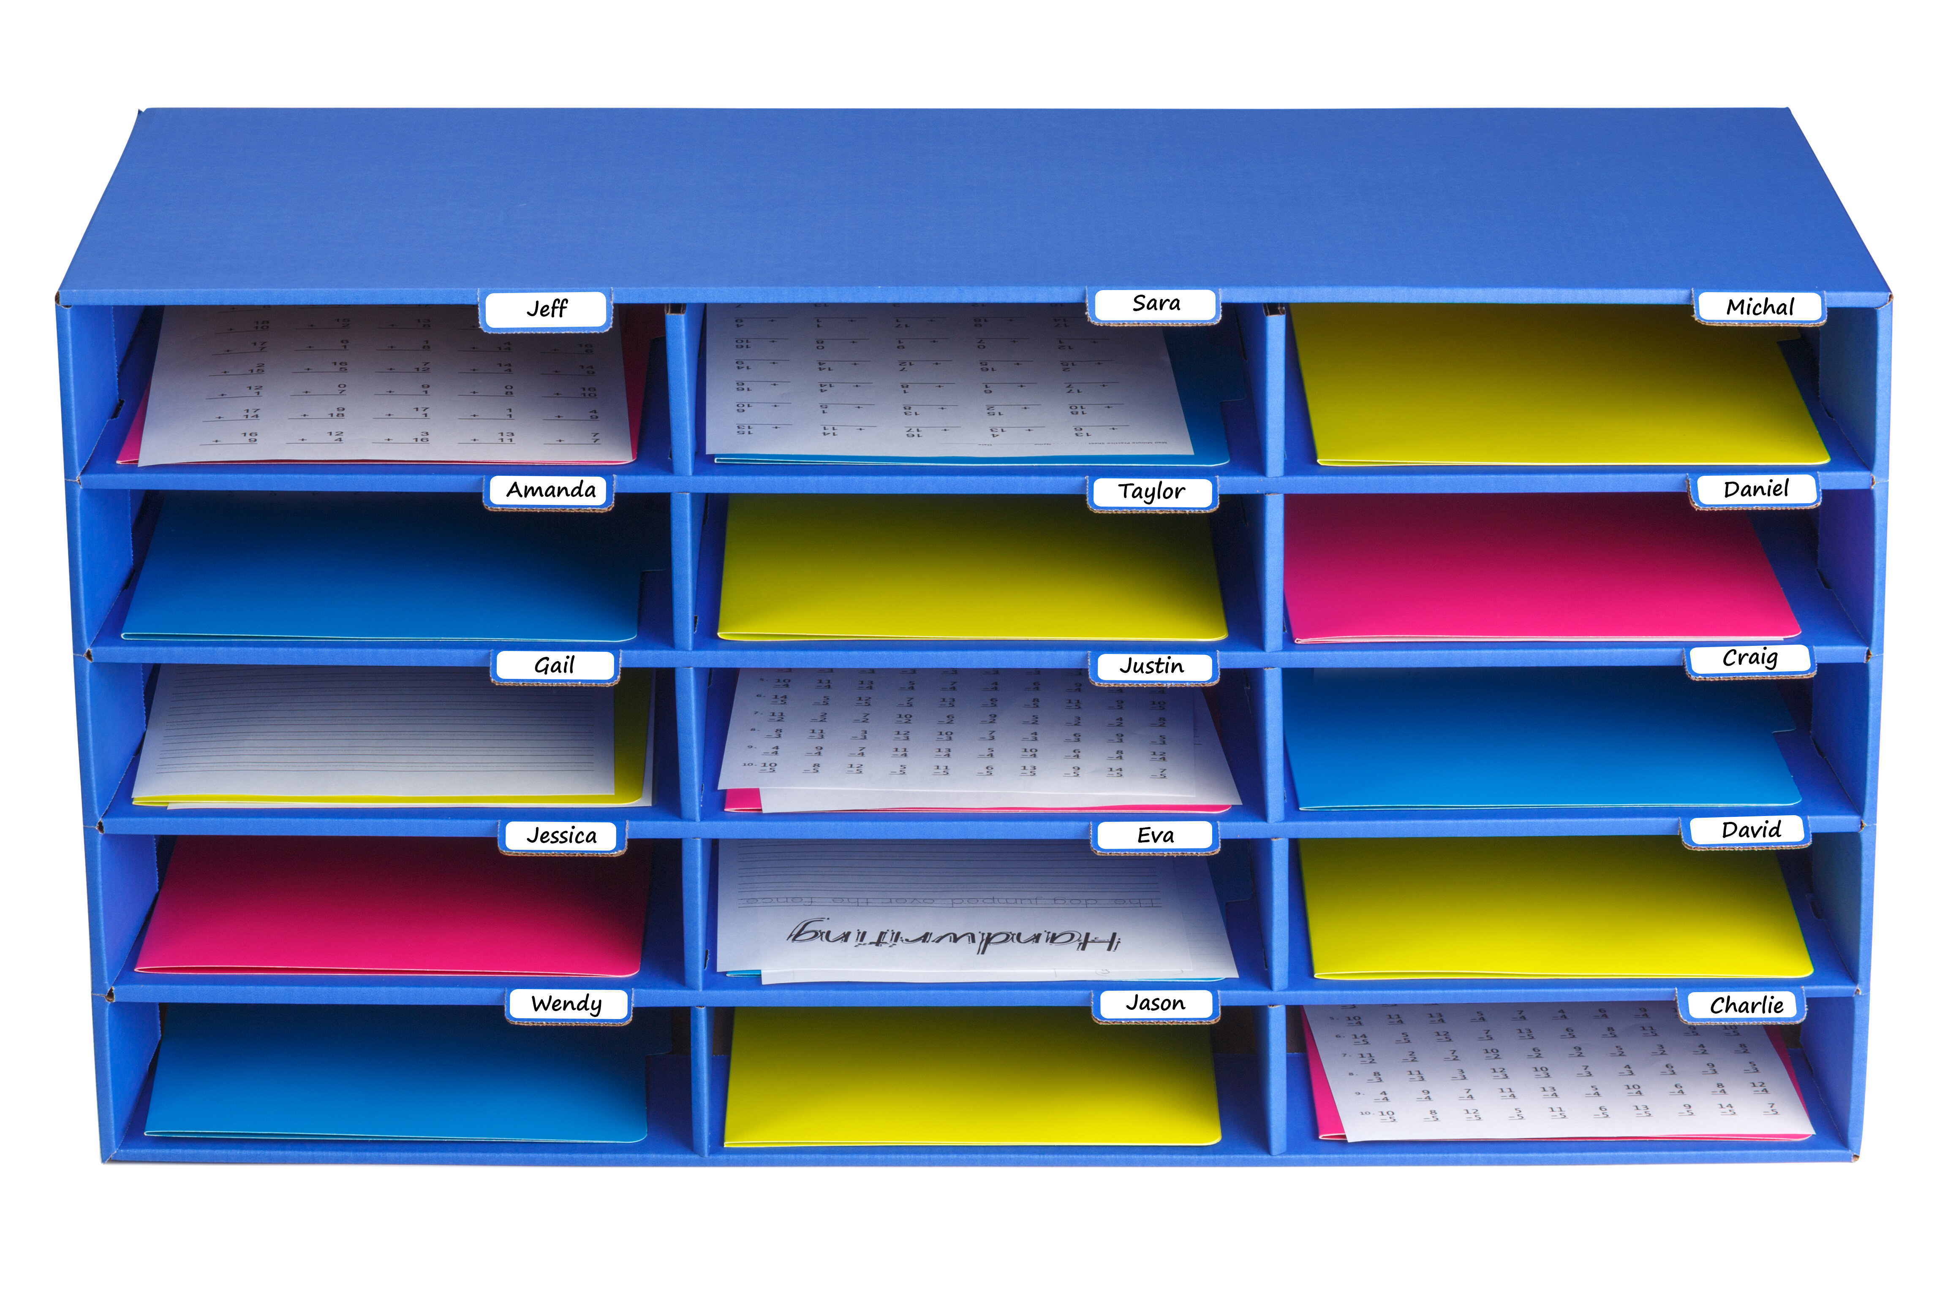
Files and File Systems
A file
is a collection of correlated information
which is recorded on secondary or non-volatile storage like magnetic disks, optical disks, and tapes.
A file system
defines how files are named, stored, and retrieved from a storage device.

Slide 39
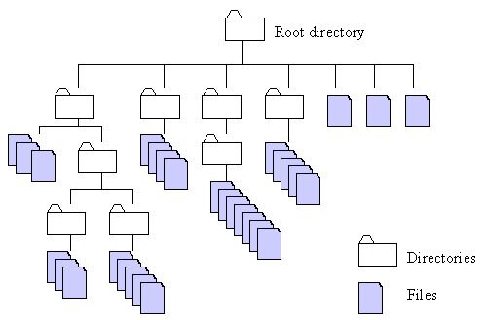
http://home.easy-key.info/images/stories/file_structure.gif

Slide 40


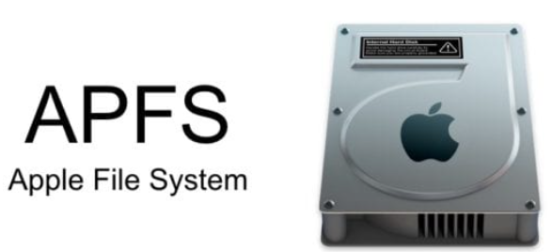

File systems and operating systems
Unix and Unix-like operating systems
Linux: XFS, JFS, and btrfs.
Solaris
macOS:
Hierarchical File System (HFS) + : No support for dates beyond February 6, 2040
Microsoft Windows
FAT: File Allocation Table
NTFS: New Technology File System
extended file system

Slide 41
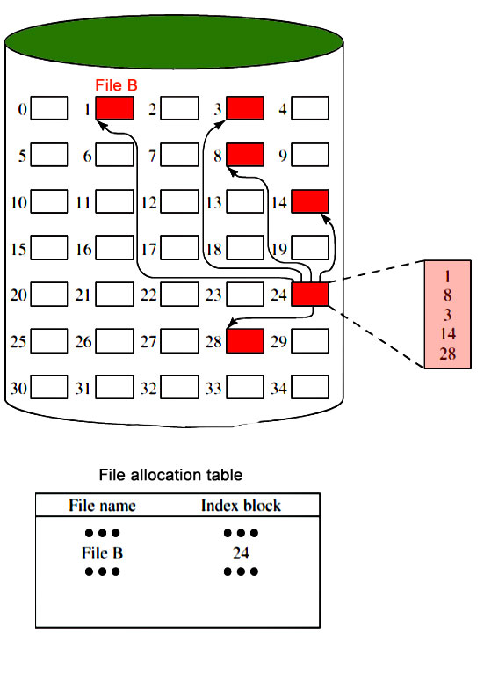
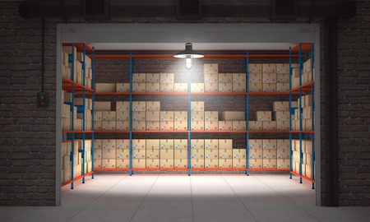
Notes:
https://www.geeksforgeeks.org/file-systems-in-operating-system/

Slide 42
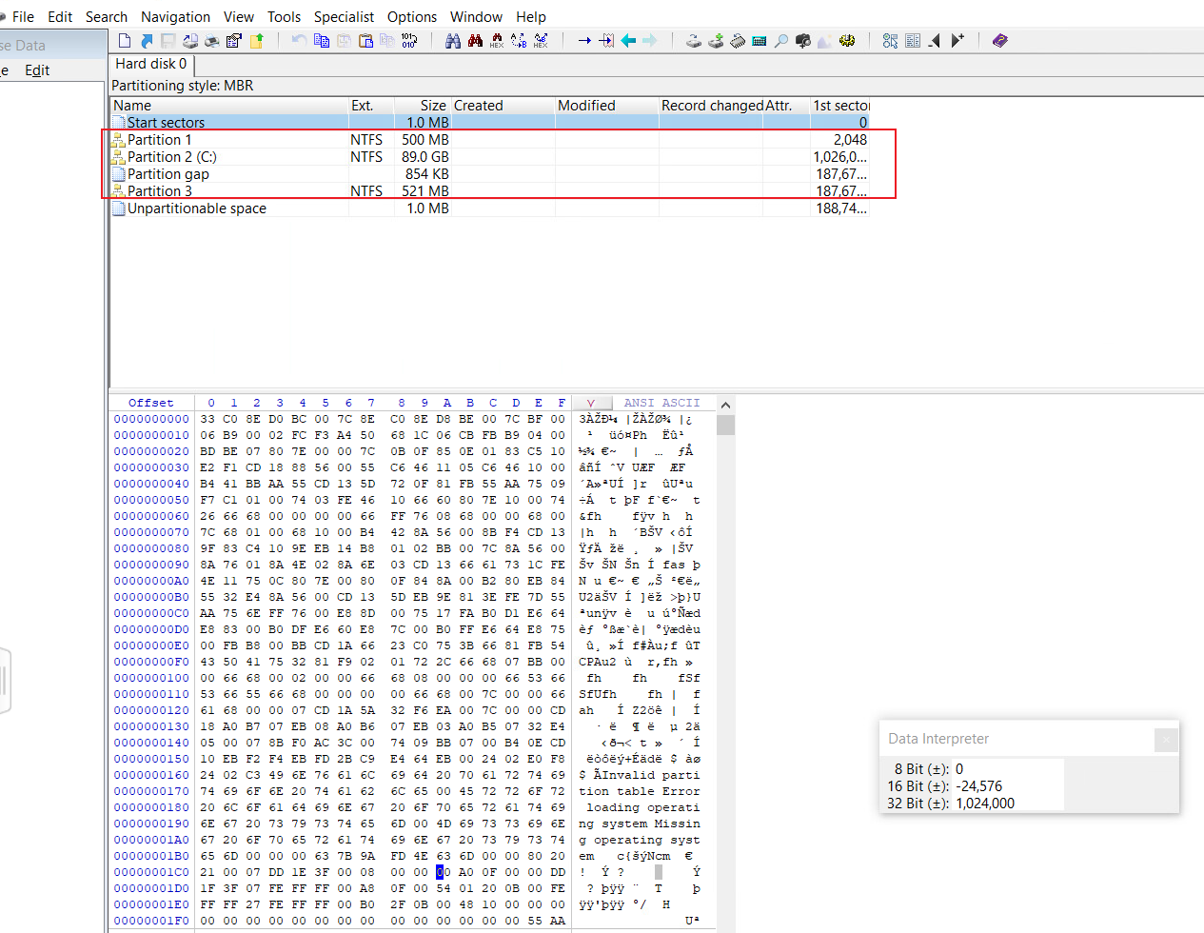
Assignment
Verify the size of partition 1 of any PC using a partition table
Record your verification process step by step
Requirements:
Without using templates
Calculate the size of each disk partition in GB
No points if you don’t use a partition table
Capture screenshots of your partition table (everyone’s partition table is different)
Hints
HxD Software
use Computer Management to verify MBR/GPT
Notes:
1C6:
ID6, 1026048,186646868

Slide 43
