Slide 1
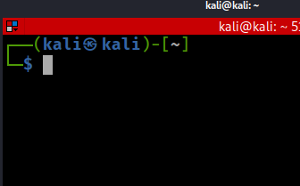
Linux for Digital Forensics

Slide 2
Overview
Introduction to OS and file Systems
Virtual file system
File structure
Path and path variable
Linux commands

Slide 3
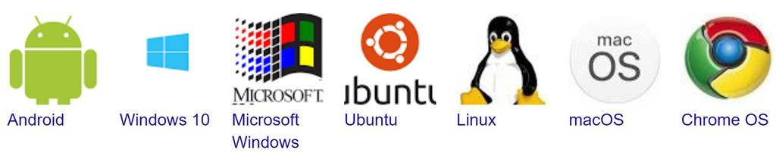
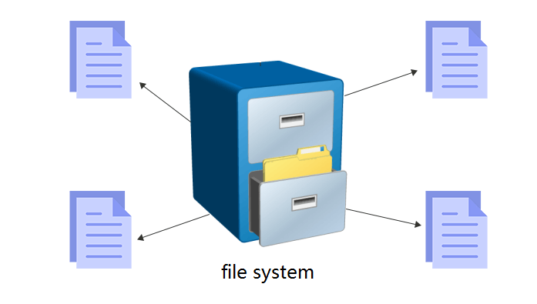
OS and File Systems

Slide 4
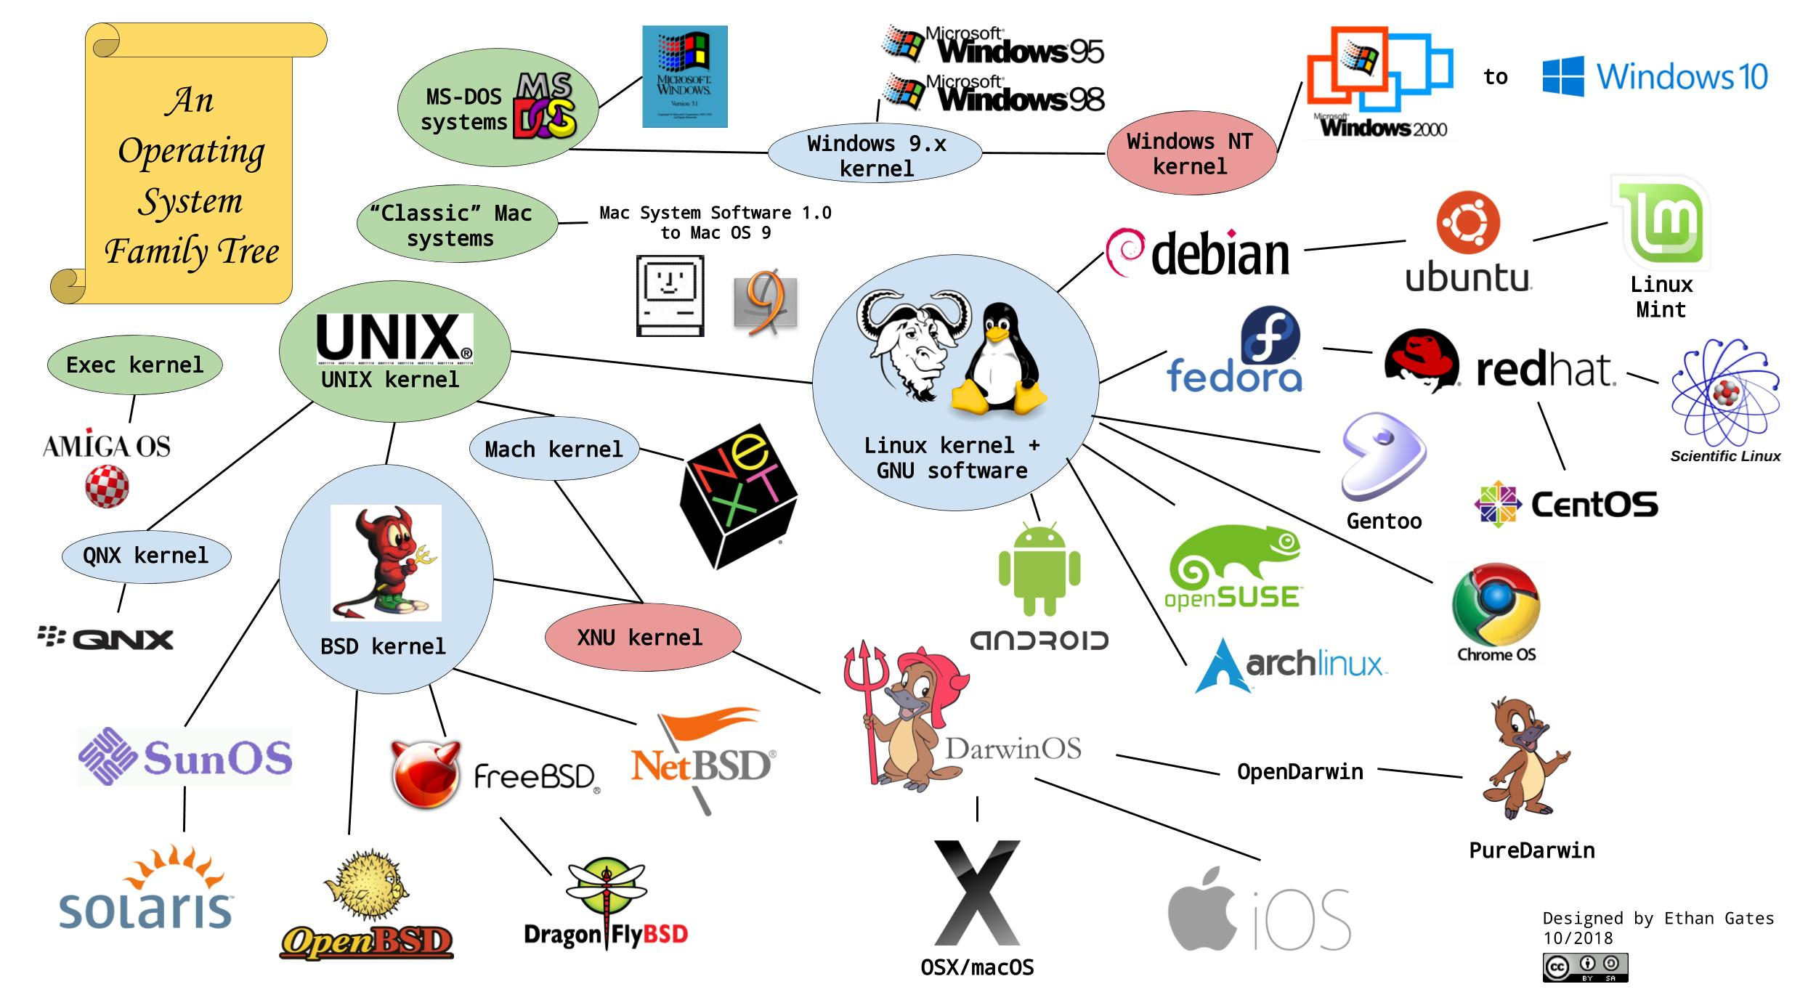

Slide 5
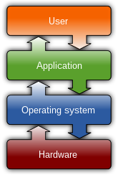


Common features of OS
Process management
Memory management
File system
Device drivers
Networking
Security
I/O
https://en.wikipedia.org/wiki/Operating_system

Slide 6


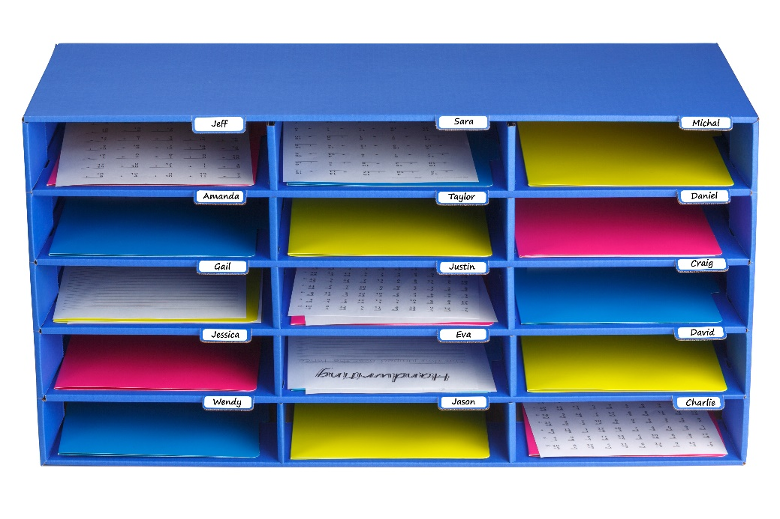
File Systems
A file
is a collection of correlated information
information is recorded on secondary or non-volatile storage like magnetic disks, optical disks, and tapes.
A file system
defines how files are named, stored, and retrieved from a storage device.

Slide 7
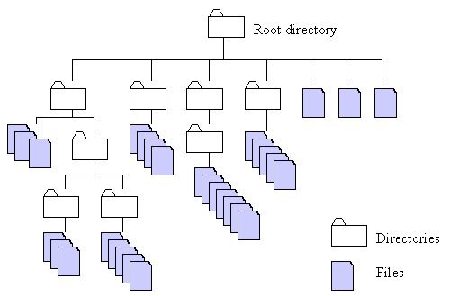
http://home.easy-key.info/images/stories/file_structure.gif

Slide 8

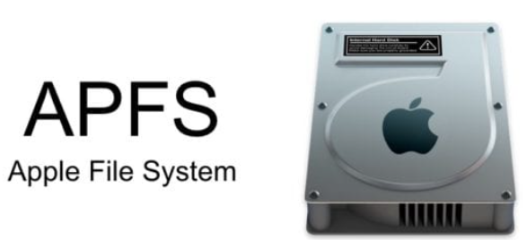

File systems used by operating systems
By Unix and Unix-like operating systems
Linux: XFS, JFS, and btrfs.
Solaris
macOS:
Hierarchical File System (HFS) + : No support for dates beyond February 6, 2040
By Microsoft Windows
FAT: File Allocation Table
NTFS: New Technology File System
extended file system

Slide 9

Manage files vs. manage storage boxes
Assumption: One person rents one or multiple boxes.
Name | Boxes ID
Frank | 1,2,3
… | …
Notes:
https://www.geeksforgeeks.org/file-systems-in-operating-system/

Slide 10
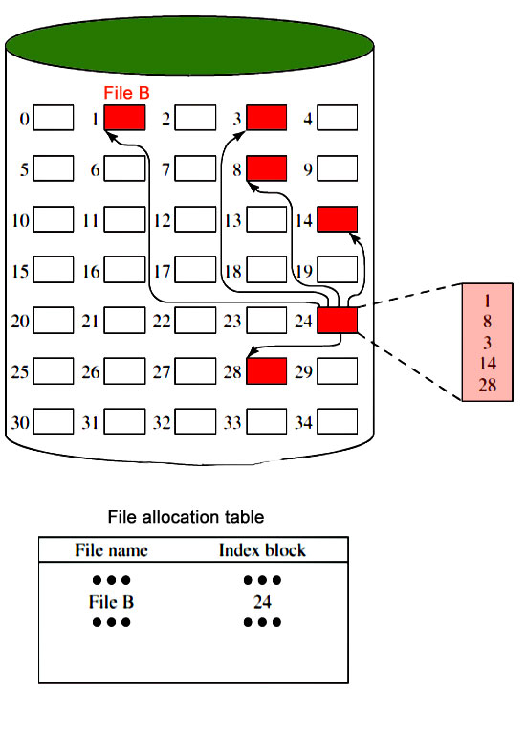


 | Storage | File Storage
Unit | Box | Sector
Usage | Person rents boxes | File uses sectors
Management system | Rental management system | File management system, (e.g., FAT)
Notes:
https://www.geeksforgeeks.org/file-systems-in-operating-system/

Slide 11
Virtual file system (VFS)

Slide 12





Without an interpreter
With an interpreter
File Systems
Virtual file system

Slide 13
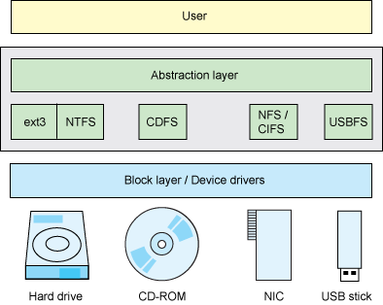
Linux is a VFS
VFS allows client applications to access different types of concrete file systems in a uniform way
provides an abstract layer for upper-layer applications
The same techniques can be utilized to investigate different types of devices
Each and everything in Linux is a file (Everything appears somewhere in the filesystem)
file, directory, hard disks, CD/DVD, NIC, USB
devices can be represented as file-like objects under /dev/ filesystem.
OS recognizes files by
inode (index node)
https://developer.ibm.com/technologies/linux/tutorials/l-virtual-filesystem-switch/
Notes:
The "Everything is a file" phrase defines the architecture of the operating system. It means that everything in the system from processes, files, directories, sockets, pipes, ... is represented by a file descriptor abstracted over the virtual filesystem layer in the kernel
Devices can be represented as file-like object under /dev/ filesystem.
Unix has no direct equivalent of the Windows registry. The same information is scattered through the filesystem, largely in /etc, /proc and /sys.

Slide 14
Linux for digital forensics- Good and Bad
Pro
widely support for many file systems (Virtual file system)
advanced and powerful tools available
free and open-source
compile source code
flexibility
Con
learning curve, e.g., no graphic interface
trustworthiness of open-source tools

Slide 15
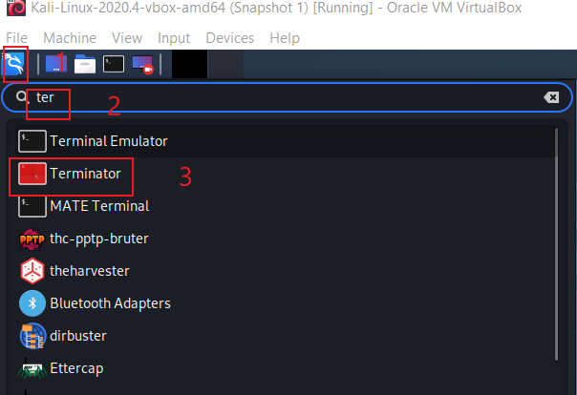

Open a Linux Terminator
same as cmd

Slide 16
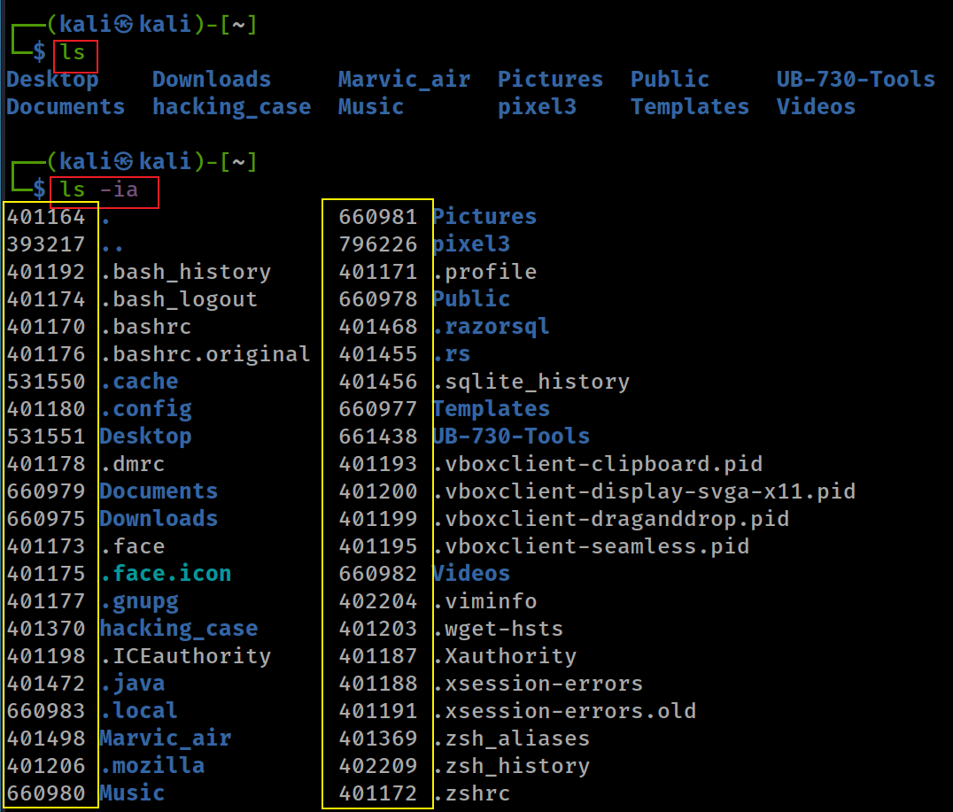
File inode
-i, --inode print the index number of each file
-a, --all do not ignore entries starting with . (hidden file)
dir

Slide 17
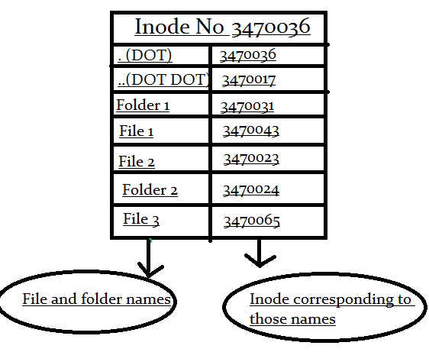
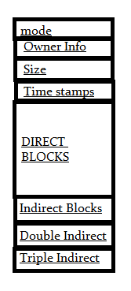
What is inode?
inode is an ID of a file/folder
unique number
inode is a data structure of a file
You store your information in a file, and the operating system stores the information/metadata about a file in an inode
inode points to the content of a file
How to access to a file?
inode ID
file name=>inode ID
permission information
block pointers
https://www.slashroot.in/inode-and-its-structure-linux

Slide 18
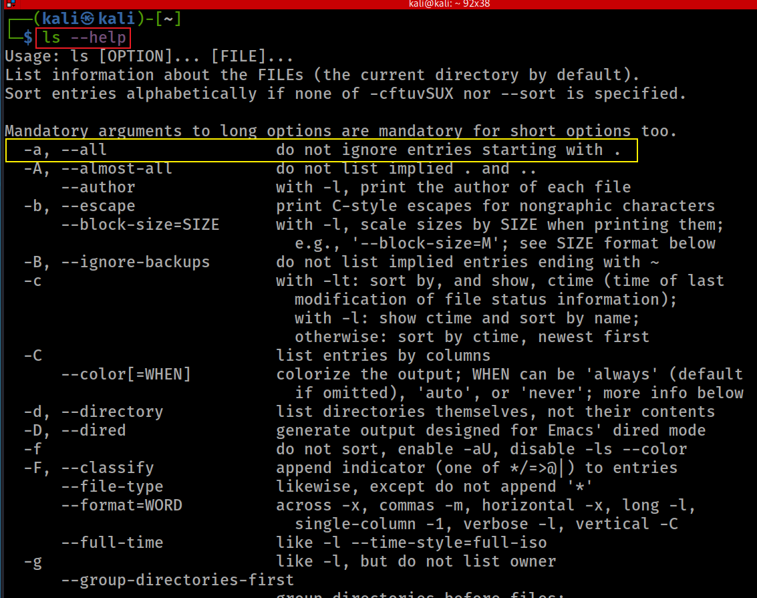

Slide 19
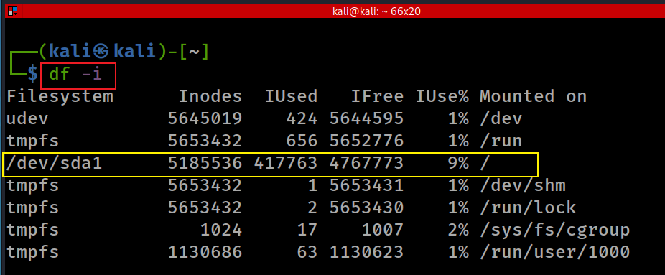
Disk free information (df) inode
-i, --inodes list inode information
wmic logicaldisk get size, freespace, caption
Notes:
Windows cmd:
wmic logicaldisk get size, freespace, caption

Slide 20
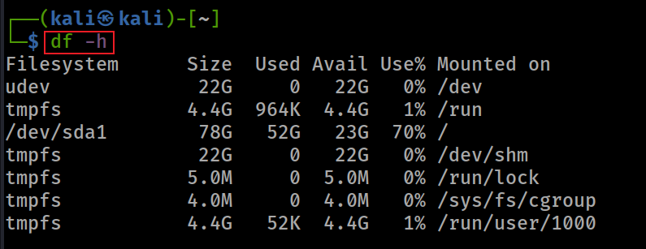
Show human readable format

Slide 21
File Structure

Slide 22
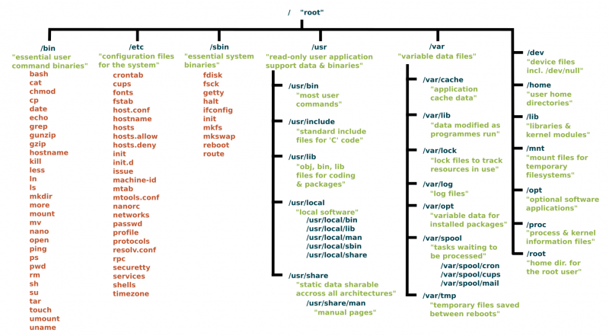
Unix has no direct equivalent of the Windows registry. The same information is scattered through the filesystem, largely in /etc, /proc and /sys.
https://www.linux.com/sites/lcom/files/styles/rendered_file/public/standard-unix-filesystem-hierarchy.png?itok=CVqmyk6P

Slide 23
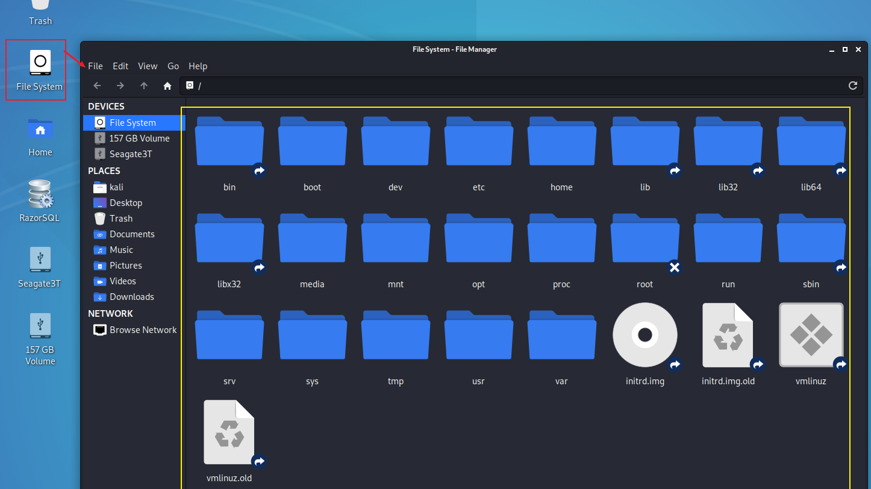

Slide 24
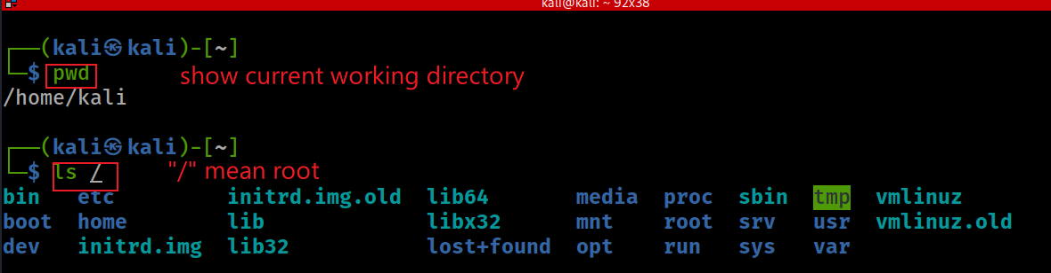

Show Linux file system from root /
Check where you are (impact all the commands you entered)
Clear screen
cd, cls
Notes:
cd

Slide 25
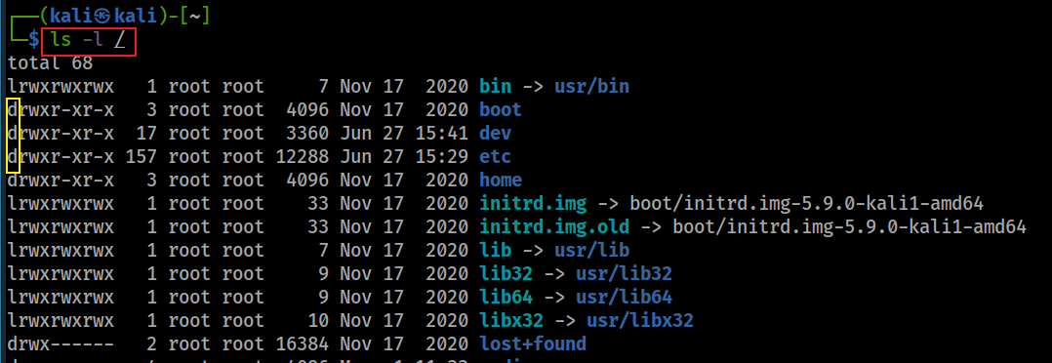
Show details of a file/directory

Slide 26
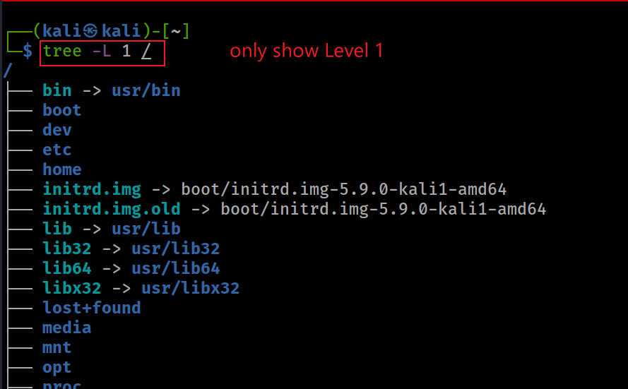
Show Linux file system from root with tree
Remember use following command for help
tree --help

Slide 27
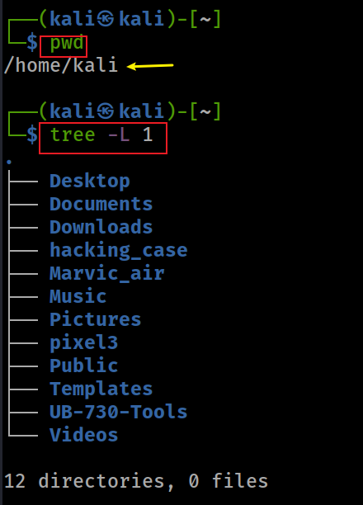
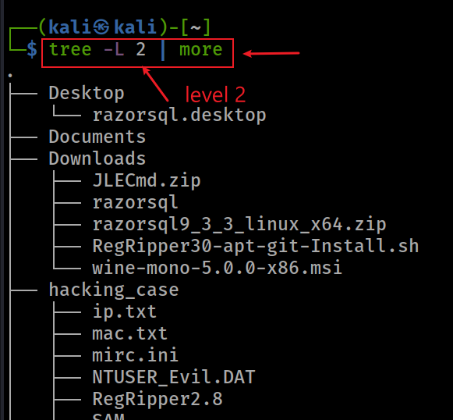
Show current working directory (pwd) with tree

Slide 28
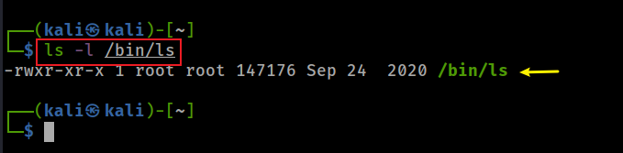
Linux commands are files!
Display ls command under /bin
Why can ls be executed in any folder? => Need to understand path (see next slide)

Slide 29
Path and Path variable

Slide 30

What is path in a file system?
A path is a hierarchical representation of the location (address) of a file or directory within the file system's directory structure.
A path describes the route or sequence of directories (folders) you must navigate through to reach a specific file or directory.
Paths are used to uniquely identify and access files and directories on a computer or storage device.

Slide 31
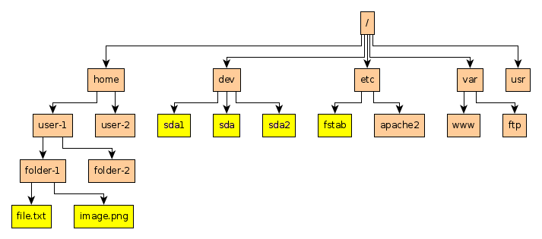
Example of paths
Absolute path to file.txt: /home/user-1/folder-1/file.txt
Relative path to file.txt (Under folder-2): ../folder-1/file.txt

Slide 32
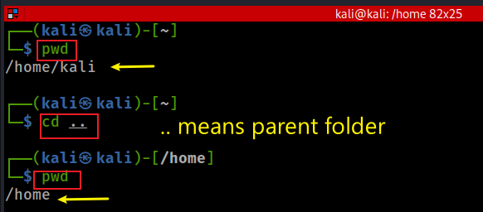
Switch to the parent path using relative path
cd ..

Slide 33
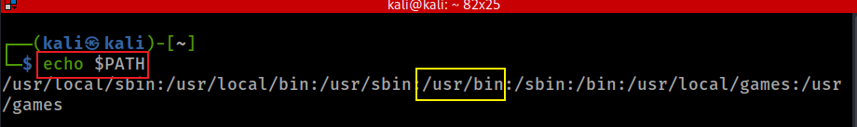

Path variable ($PATH)
How does OS execute a command, e.g., ls?
search the command in the current directory
if can’t find it, search for the command in each path defined in the path variable
if can’t find it, OS throws the command not found error message
path
Notes:
In Windows path

Slide 34
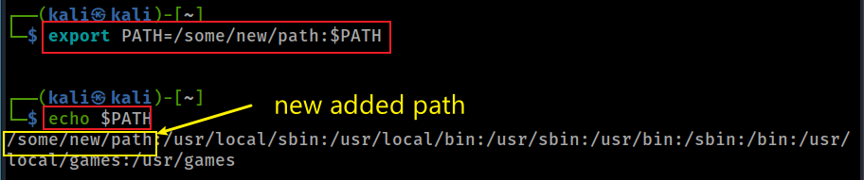
Adding a new path (export)
setx path "%path%;C:\Program Files\Java\jdk1.8.0_202\bin" -m
Notes:
export PATH=/some/new/path:$PATH
In Windows setx path "%path%;C:\Program Files\Java\jdk1.8.0_202\bin" -m

Slide 35
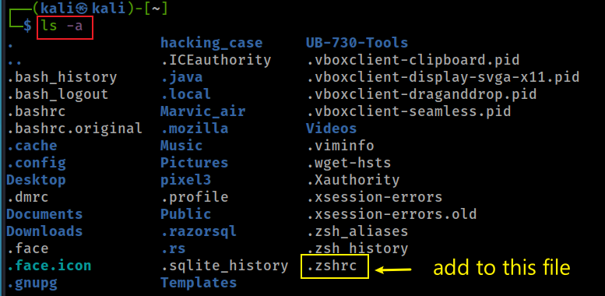
Persisting the new path (.zshrc)
we discuss the details later

Slide 36
Create folders and files

Slide 37

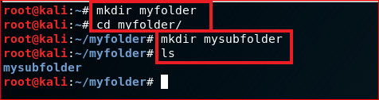
Create folders (mkdir)
home
\myfolder
\mysubfolder
mkdir

Slide 38
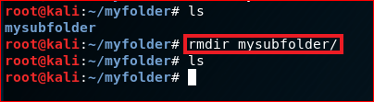
Delete folders (rmdir)
rmdir

Slide 39



Create a new text file (echo)
\user home
\myfolder
Show the content of the file
hello world
my_first_file.txt

Slide 40
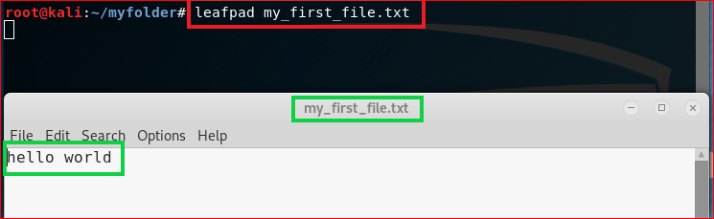
Create a file (leafpad)
or nano command

Slide 41
File Copy & Deletion

Slide 42

Copy a file (cp)
copy

Slide 43

Copy a file to a different location
How to copy a folder? -r recursive
Basic syntax: cp -r source_folder destination_folder
Example: cp -r ~/myfolder ~/myfolder_copy

Slide 44
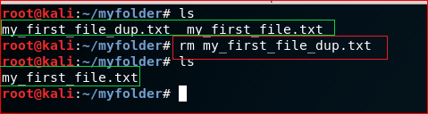
Remove a file (rm)

Slide 45
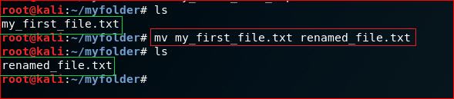
Rename a file (mv)
move/ copy and ren

Slide 46
Search for information

Slide 47
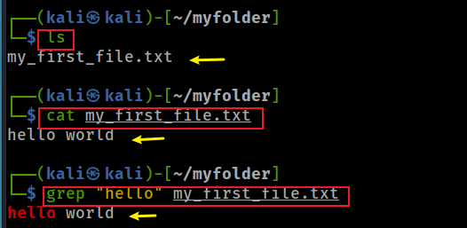
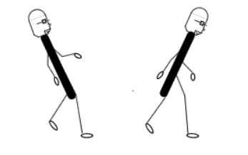


Search for a string in a text file (grep)
grep search
backslash
forward slash
Show line number while displaying the output
type/findstr /c:"error" log.txt
Notes:
cat my_first_file.txt
grep "hello" my_first_file.txt
https://sites.cs.ucsb.edu/~pconrad/topics/BackslashVsForwardSlash/

Slide 48
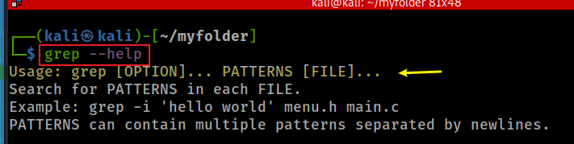
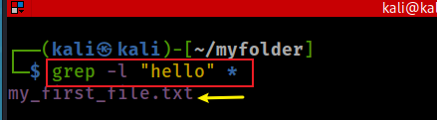
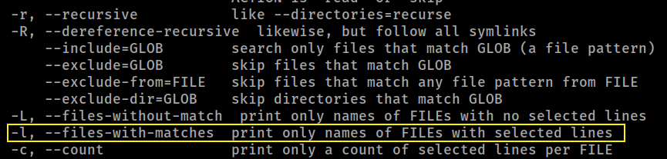
Search for file names that that contains the given string/pattern
grep help
Search for file contains “hello”

Slide 49
Networking

Slide 50
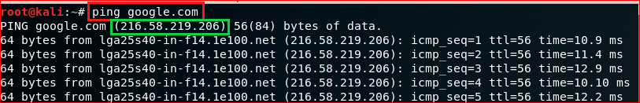
Test network connection using domain name

Slide 51
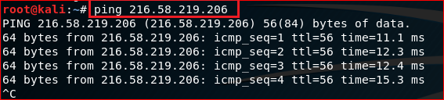
Test network connection using IP

Slide 52
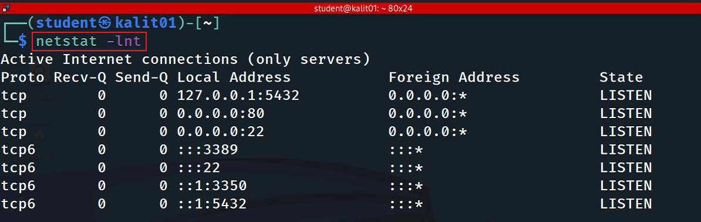
List all open TCP ports
-l, --listening display listening server sockets
-n, --numeric port number (don't resolve names)
-t, --tcp
ssh (22) port is listening

Slide 53
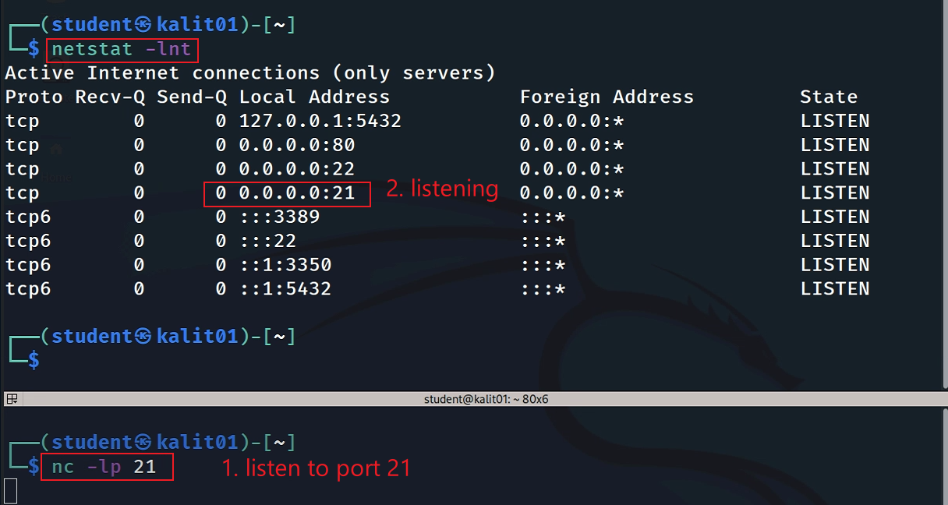
Open port 21 and verify the port is listening
nmap localhost -p 21
Notes:
nmap localhost -p 21

Slide 54
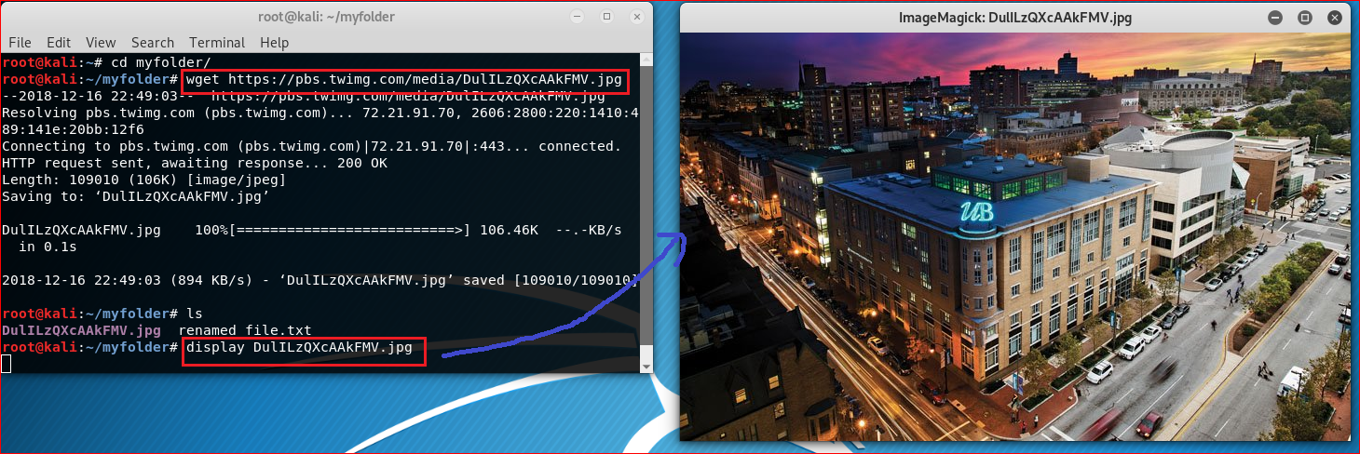
Download a file (wget)
https://pbs.twimg.com/media/DulILzQXcAAkFMV.jpg

Slide 55
Create a script file

Slide 56
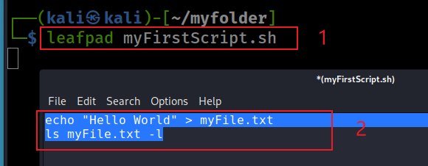
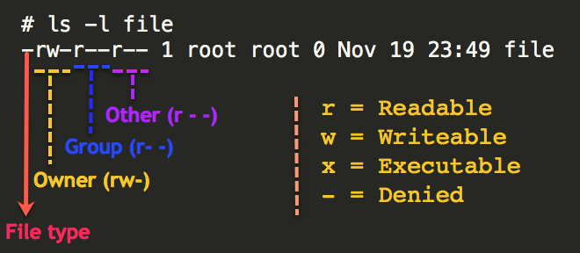
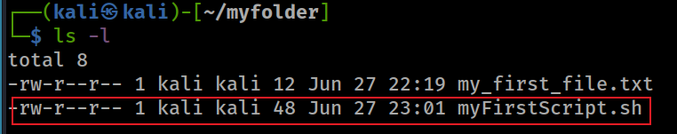
Create a simple script file
Create a script using leafpad
shebang: indicate the interpreter that should be used to execute the script or program that follows
#!/bin/sh
Check permission of files
.bat
Notes:
#!/bin/sh
echo "Hello World" > myFile.txt
ls myFile.txt -l

Slide 57
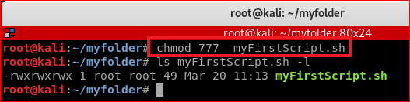
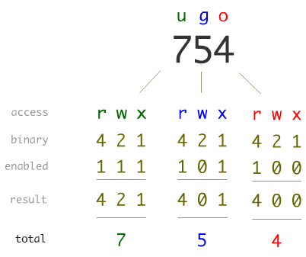

Linux Permissions

Slide 58

Execute a script file in a different folder

Slide 59

Add a path to the path variable
Notes:
export PATH=/home/kali/myfolder:$PATH

Slide 60
Update/Install software
(optional)

Slide 61

Update software

Slide 62


Install terminator

Slide 63


Slide 64

Zip/unzip files

Slide 65

Compress/decompress directory (tar)
compress a folder
-c: Create a new archive.
-z: Compress the archive using gzip (creates a .tar.gz file).
-v: Verbose mode (shows the files being processed).
-f: Specify the archive file name.

Slide 66

compress a folder
-x: Extract files.
-z: Decompress using gzip.

Slide 67


Slide 68


