Slide 1
The Sleuth Kit (TSK)
Version 4.9.0
Notes:
http://www.sleuthkit.org/sleuthkit/docs/api-docs/4.9.0/basicpage.html

Slide 2
Overview
Autopsy vs. The Sleuth Kit
The layer of the TSK architecture
The tools provided by each layer of TSK

Slide 3
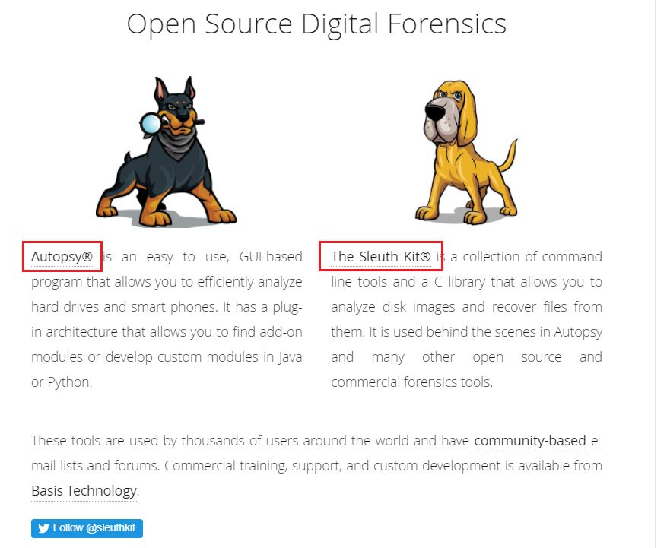

Slide 4
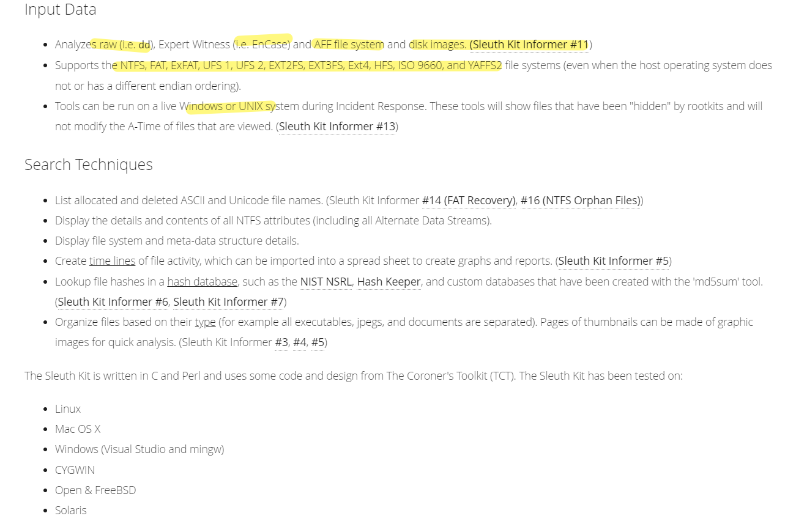
https://www.sleuthkit.org/sleuthkit/desc.php

Slide 5
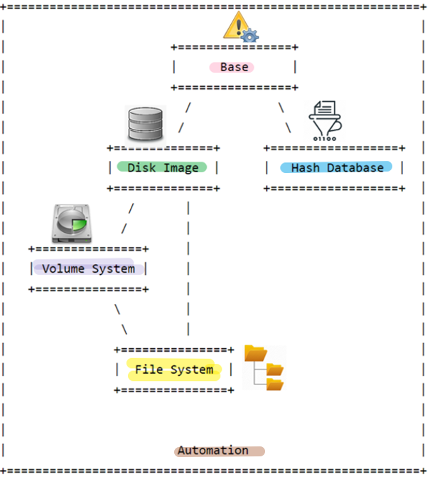


TSK Layers
error handling, types, and convenience functions
Can open and process disk images in various formats
create an index of hashes and perform fast lookups of them
Processing data as a volume system, e.g., DOS partition tables
processing data as a file system, such as FAT or NTFS.
integrates all of the previous layers
Notes:
http://www.sleuthkit.org/sleuthkit/docs/api-docs/4.9.0/basicpage.html

Slide 6


Storage management vs File System management
Customer: Frank
in date: 10/01/2021
out date: 11/01/2021
occupied space: 3
location: B3, B4, B5
https://www.geico.com/living/home/home-protection/storage-units/

Slide 7
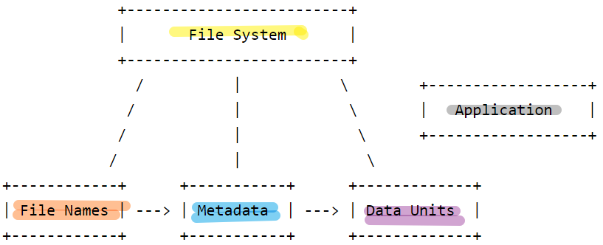
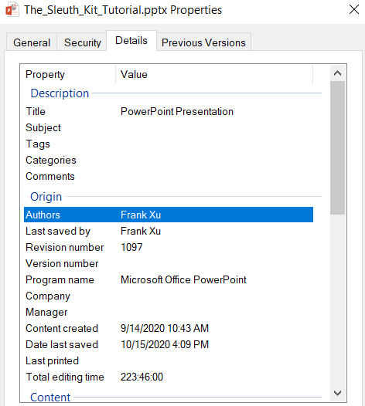
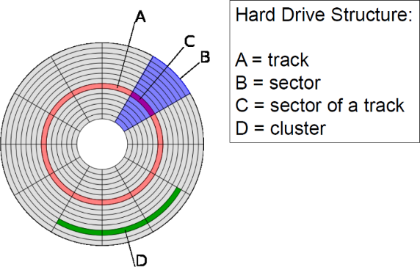
File System Layers
non-essential file system data
journals that record file system updates
lists that record what files have recently been updated
Describe the layout and general features of the file system. Allow others to read, write
File and directory names (FAT file system= FileName+ Metadata)
data units (i.e. blocks and clusters)
files and directories
inode structures in UNIX
MFT entries in NTFS,
directory entry structures in FAT
Notes:
http://www.sleuthkit.org/sleuthkit/docs/api-docs/4.3/fspage.html

Slide 8




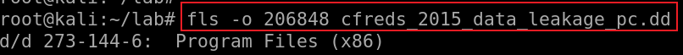
disk
see white envelope
see yellow envelope
see sectors
foo.txt
inode:273
size: 10 Bytes
date: 1/1/23
inode:-144-6
Implication: We can directly read metadata and content without using file systems

Slide 9
TSK Tools
https://github.com/sleuthkit/sleuthkit/wiki/The_Sleuth_Kit_commands
Image Files
img_stat: tool will show the details of the image format
img_cat: This tool will show the raw contents of an image file.
Disk Tools
disk_sreset: This tool will temporarily remove a Host Protected Area (HPA) if one exists. After the disk is reset, the HPA will return.
disk_stat: This tool will show if an HPA exists.
mmls: Displays the layout of a disk, including the unallocated spaces.
mmstat: Display details about a volume system (typically only the type).
mmcat: Extracts the contents of a specific volume to STDOUT.
tsk_comparedir: Compares a local directory hierarchy with the contents of raw device (or disk image). This can be used to detect rootkits.
tsk_gettimes: Extracts all of the temporal data from the image to make a timeline. Equivalent to running fls with the '-m' option.
tsk_loaddb: Loads the metadata from an image into a SQLite database. This allows other tools to be easily written in a variety of languages and give them access to the image contents.
tsk_recover: Extracts the unallocated (or allocated) files from a disk image to a local directory.
Notes:
https://wiki.sleuthkit.org/index.php?title=TSK_Tool_Overview
https://linuxhint.com/kali_linux_top_forensic_tools/
https://linuxhint.com/kali_linux_top_forensic_tools_2020_part_2/
https://github.com/sleuthkit/sleuthkit/wiki/The_Sleuth_Kit_commands

Slide 10
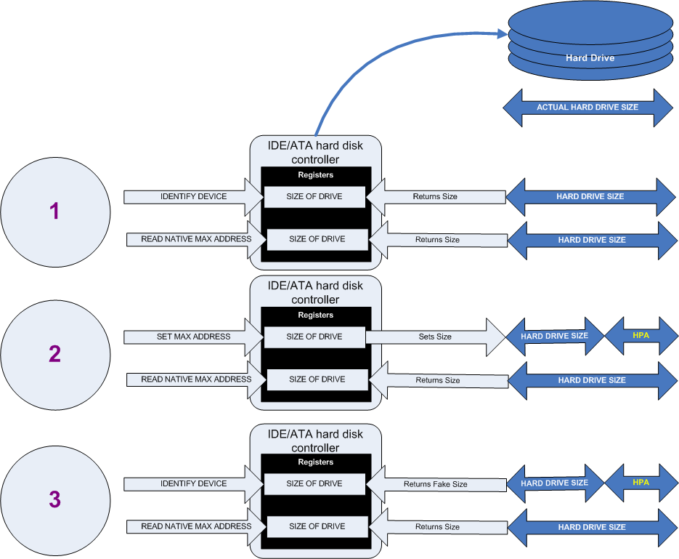
Creation of an HPA. The diagram shows how a host protected area (HPA) is created.
Notes:
https://upload.wikimedia.org/wikipedia/en/5/5f/Hpacreate.png

Slide 11
HPA Usages
firmware company
BIOS
Computer manufacturers
Preloaded OS
Booting and diagnostic utilities
Dell notebooks hide Dell MediaDirect utility in HPA.
Hacker
Some rootkits hide in the HPA to avoid being detected by anti-rootkit and antivirus software
Government
NSA for application persistence.

Slide 12
File System Tools
fsstat: Shows file system details and statistics including layout, sizes, and labels.
blkcat: Extracts the contents of a given data unit.
blkls: Lists the details about data units and can extract the unallocated space of the file system.
blkstat: Displays the statistics about a given data unit in an easy-to-read format.
blkcalc: Calculates where data in the unallocated space image (from blkls) exists in the original image. This is used when evidence is found in unallocated space.
ffind: Finds allocated and unallocated file names that point to a given meta data structure (inode).
fls: Lists allocated and deleted file names in a directory.
icat: Extracts the data units of a file, which is specified by its meta data address (instead of the file name).
ifind: Finds the meta data structure that has a given file name pointing to it or the meta data structure that points to a given data unit.
ils: Lists the meta data structures and their contents in a pipe delimited format.
istat: Displays the statistics and details about a given meta data structure in an easy-to-read format.

Slide 13
Exam files in a disk image using TSK
a deleted file letter1.txt

Slide 14
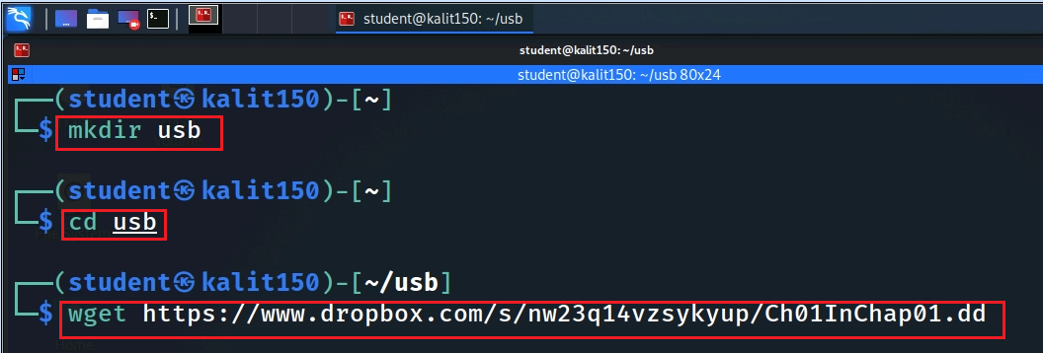
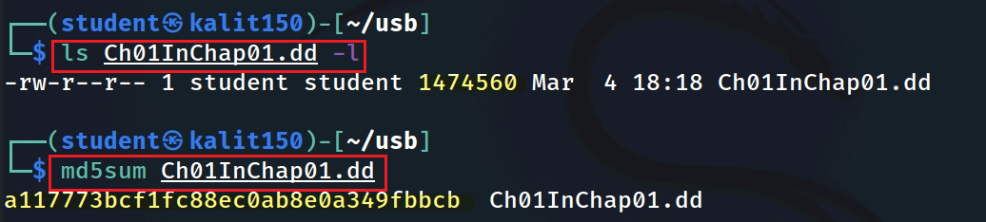
Download a USB (Floppy Disk) image
Notes:
https://www.dropbox.com/s/nw23q14vzsykyup/Ch01InChap01.dd

Slide 15
Disk Image Level
FAT VBR (Volume Boot Record) and NTFS MBR (Master Boot Record)

Slide 16
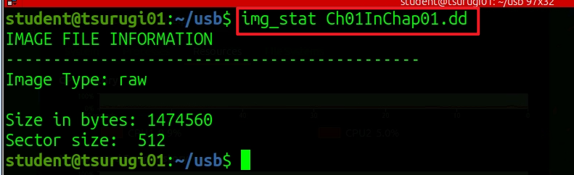
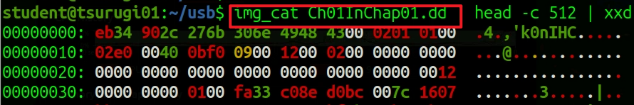





tool will show the details of the image format
reads the first 512 bytes (one sector) of your disk image and prints them as hex

Slide 17
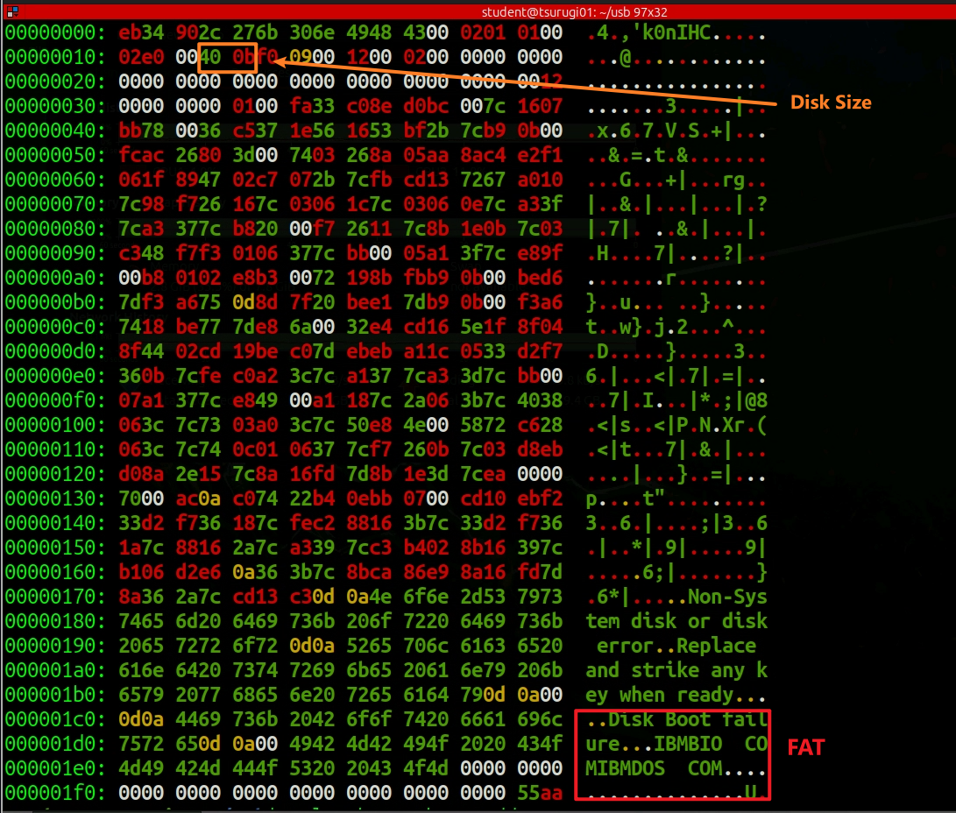
Ch01InChap01.dd
FAT VBR (Volume Boot Record)

Slide 18
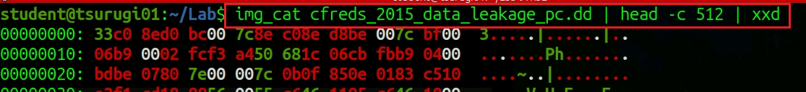
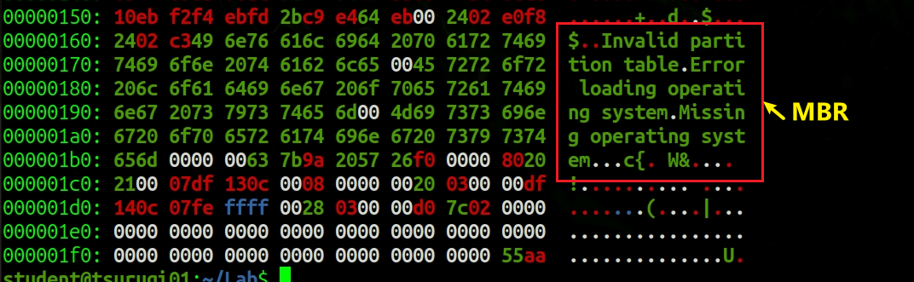
Windows Image (https://cfreds-archive.nist.gov/data_leakage_case/data-leakage-case.html)
Show the sector 0 of NTFS MBR (Master Boot Record)
…

Slide 19
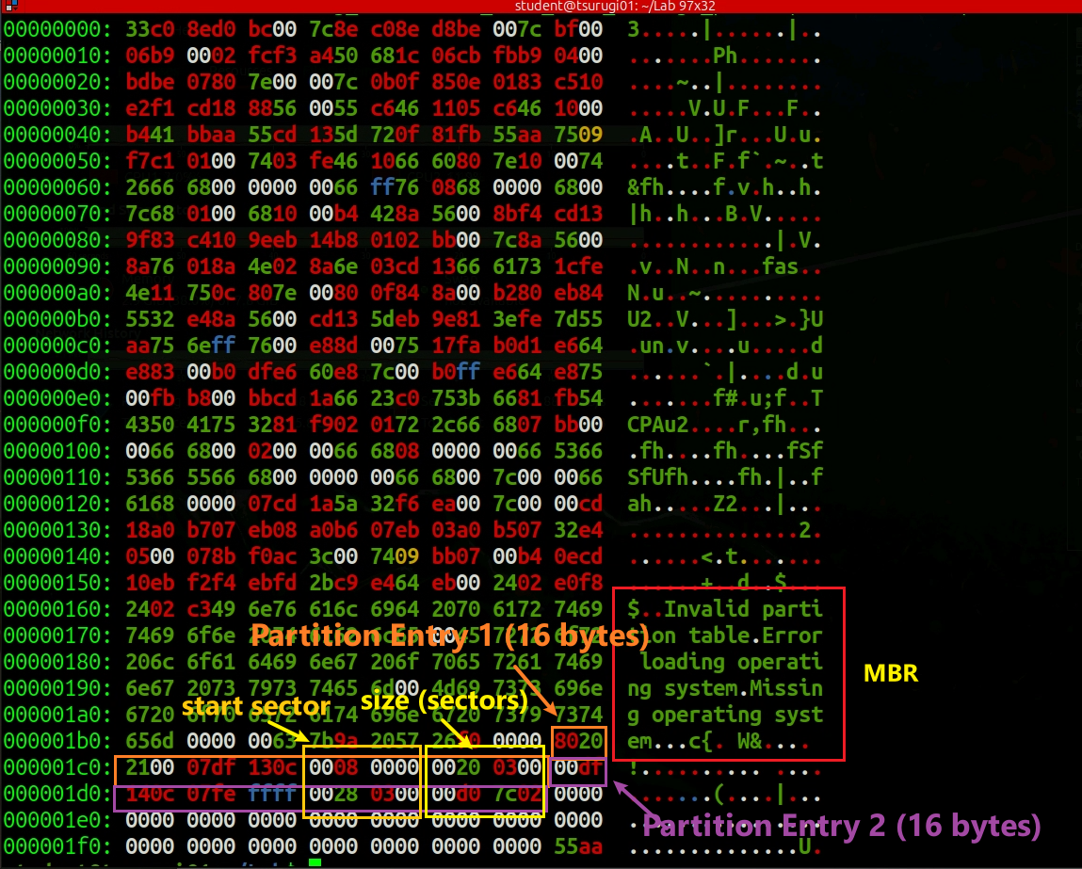
Windows Image (https://cfreds-archive.nist.gov/data_leakage_case/data-leakage-case.html)

Slide 20
Volume system tools (partition level)

Slide 21

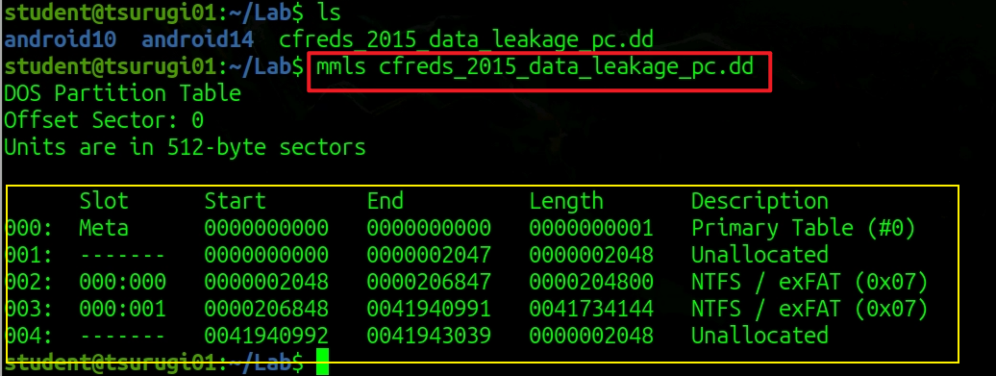
partition layout (volume system)
Windows Image (https://cfreds-archive.nist.gov/data_leakage_case/data-leakage-case.html)
If the image contains a partition table:

Slide 22
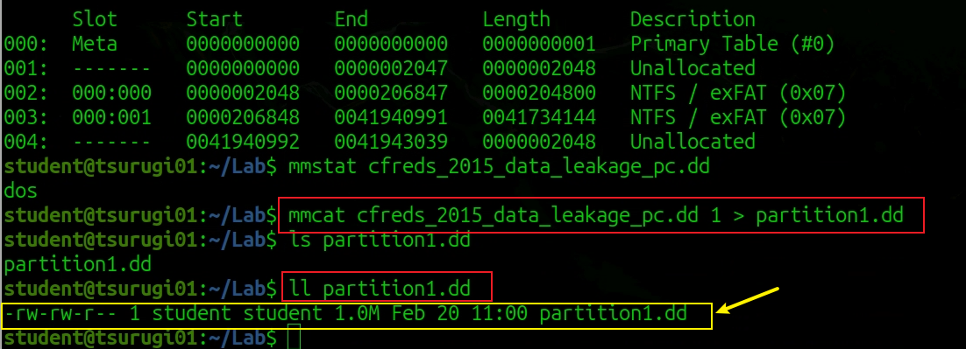
Extracts a specific partition (volume) to stdout.

Slide 23
Filesystem tools (inside partition)

Slide 24
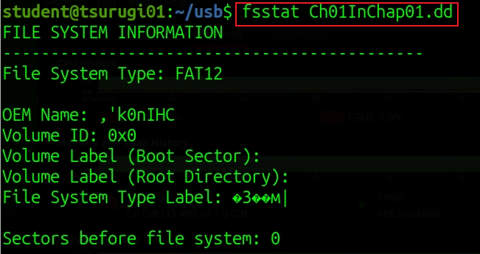
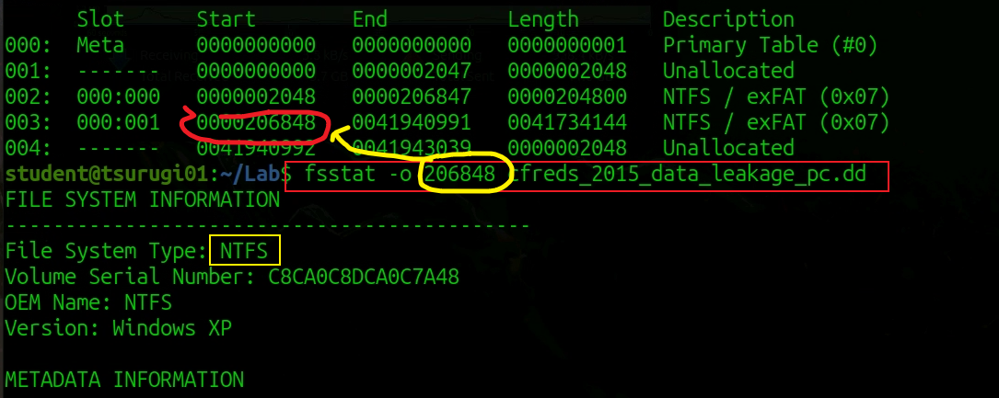
Show file system details and statistics including layout, sizes, and labels.
NTFS File System

Slide 25
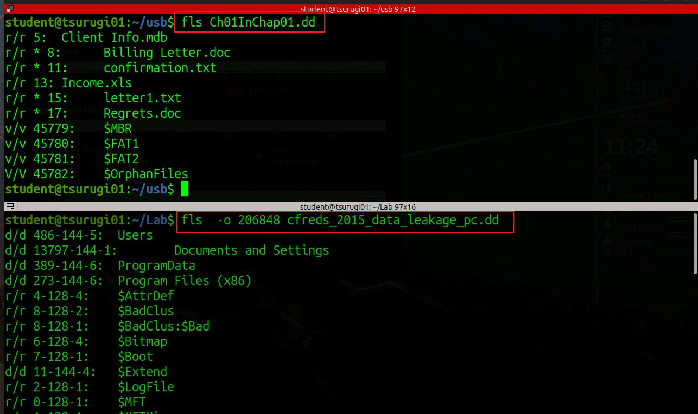


lists directory contents in a filesystem inside a disk image
What is the difference?

Slide 26
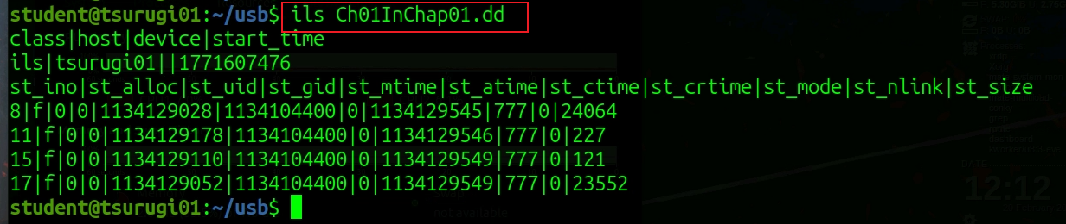
Lists many metadata entries in a raw, pipe delimited table so you can scan or script it.

Slide 27
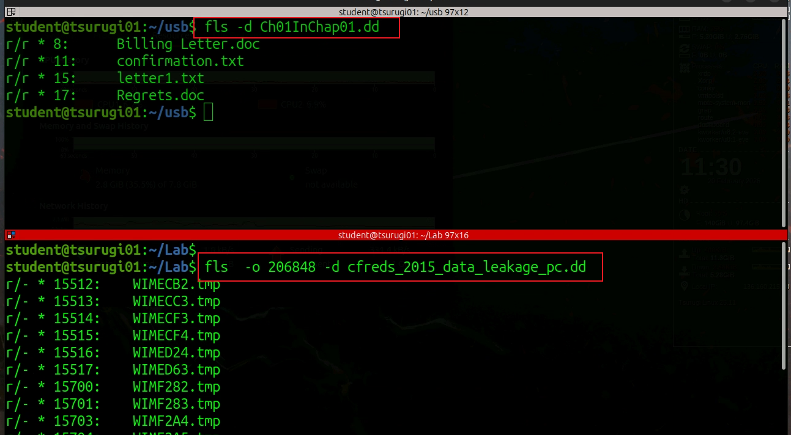
-d Display deleted entries only

Slide 28
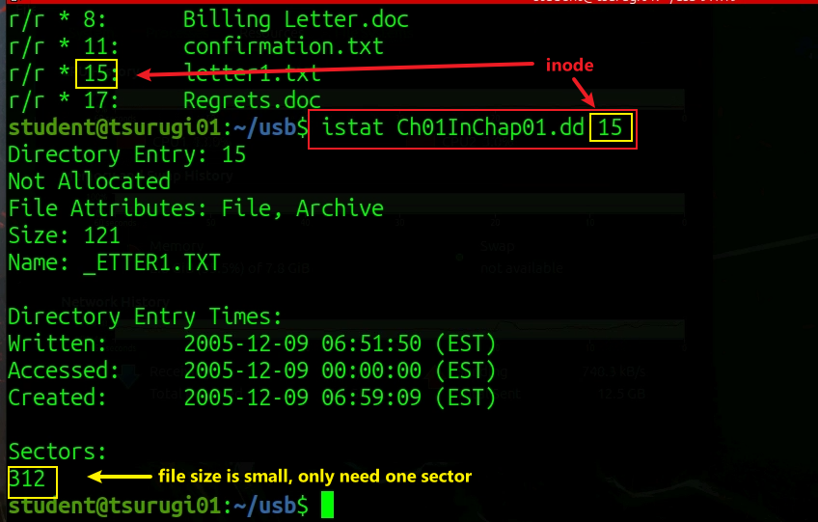
Display the statistics and details about a given meta data structure

Slide 29
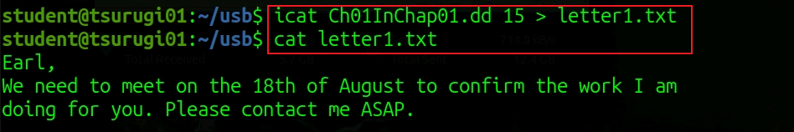
Recover deleted files using inode without specifying a file name

Slide 30
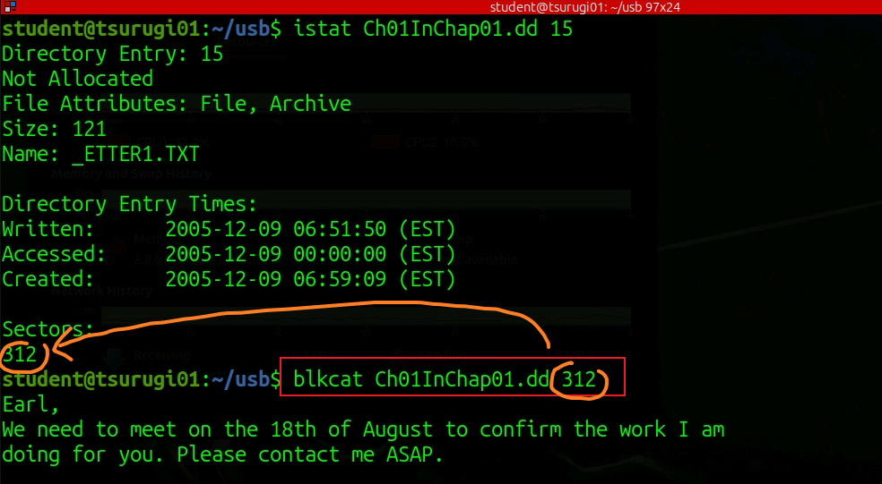
Data Unit
Extract the contents of a given data unit.
Notes:
blkcat Ch01InChap01.dd 313-358 > regets.doc
blkcat Ch01InChap01.dd 287 27 > regets.doc
blkcat will read and output 27 consecutive blocks starting from block 287.

Slide 31
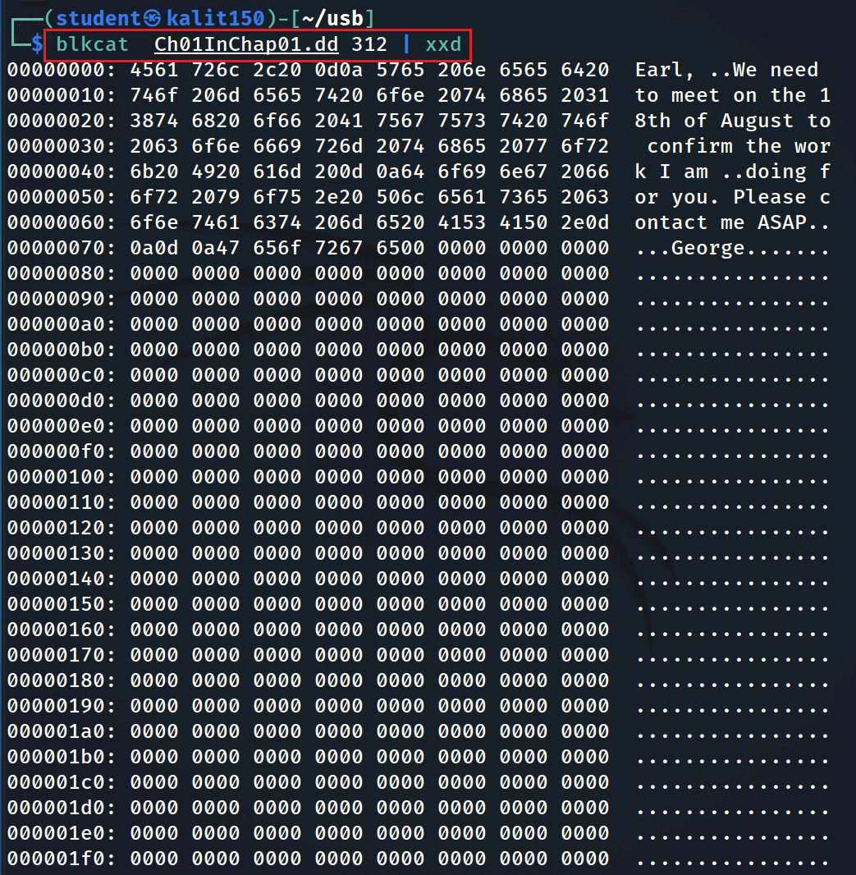
Extract the contents of a given data unit in Hex
What is the size of the sector?
echo "$((16#1ff))"
Notes:
echo "$((16#1ff))"

Slide 32
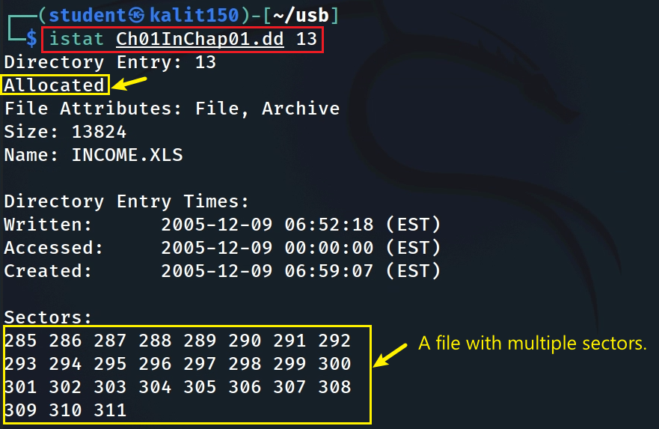
Show A file with multiple sectors

Slide 33
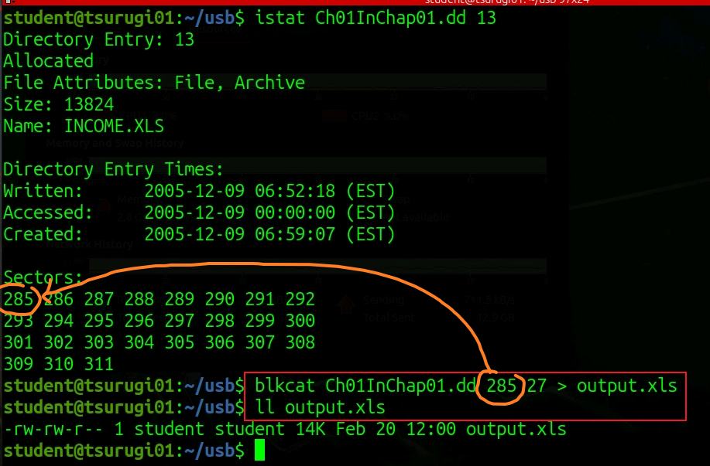
blkcat will read and output 27 consecutive blocks starting from block 287.

Slide 34
Mounting a USB image

Slide 35
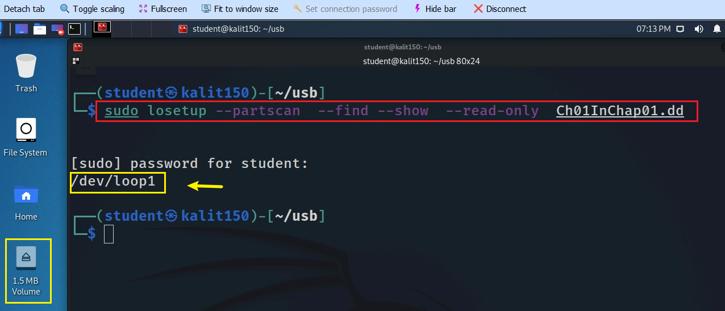
-partscan: This option tells losetup to scan the partition table in the specified disk image (Ch01InChap01.dd) and automatically create loop devices for each partition found. This is useful when dealing with disk images that contain multiple partitions.
--find: This option instructs losetup to find the first available loop device. When combined with --show, it ensures that the command displays the path of the loop device that is being used.
Notes:
sudo losetup --partscan --find --show --read-only Ch01InChap01.dd

Slide 36
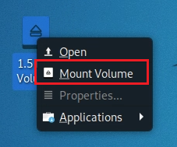
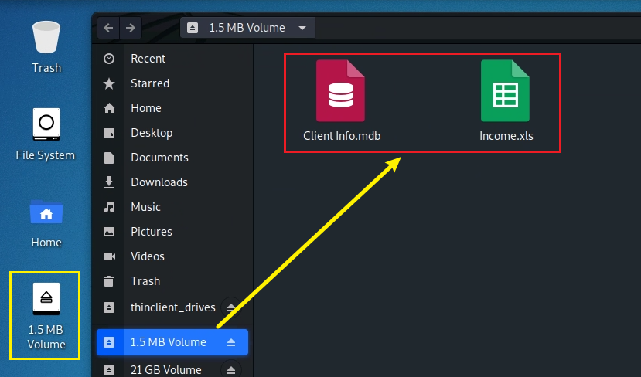
Mount the USB image
Show content

Slide 37
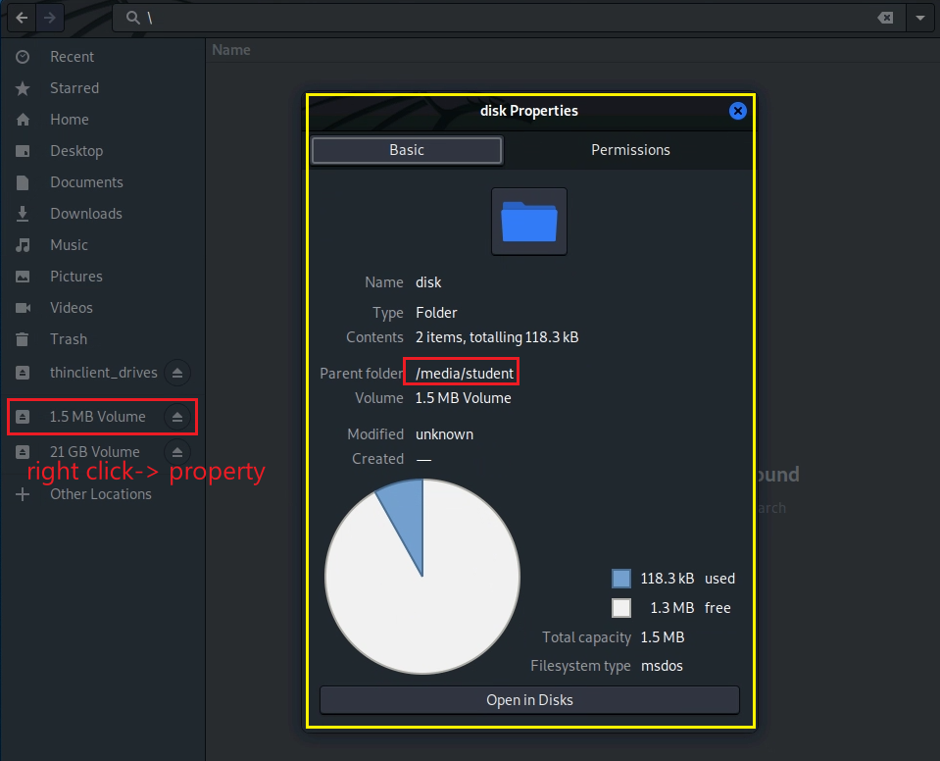
Show the mounted path
student is your account name

Slide 38
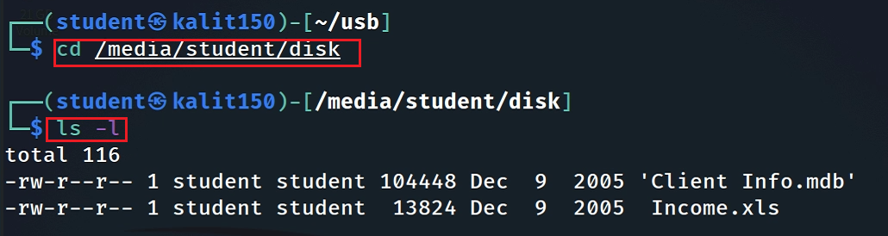
Show the disk content

Slide 39


Assignment (part 1)
How many deleted files are in the disk image Ch01InChap01.dd?
Show evidence
Retrieve INCOME.XLS from dd
Using icat
Using blkcat
Show .xls content
Verify that recovered files are the same

Slide 40
Assignment (part 2) : Try one new command
Pick up any new TSK command we have not covered in the class
What are the inputs?
What are the outputs?
Explain each command.
Capture all screenshots.
If you use your inputs, upload inputs

