Slide 1

Digital Evidence Search with A Pattern Matching Game
The Power of Regular Expression

Slide 2
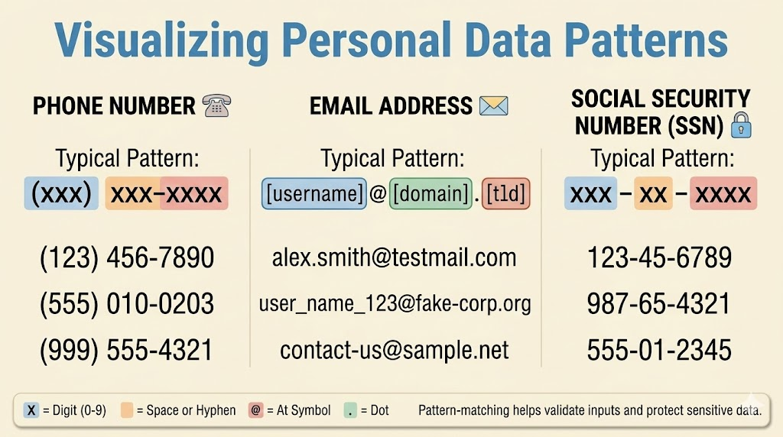

Slide 3
What types of evidence to match?
Personal information
name, phone number, email address, date of birth, zip code, SSN
User account validation
username, password
Source code
HTML, Java
Network
website visited (URL), IP address, Hex, MAC address, timestamp
File
file names, file attributes

Slide 4

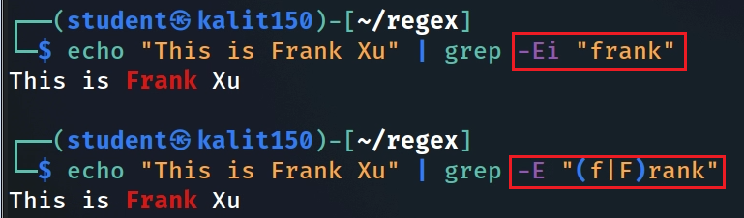
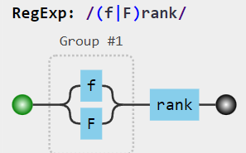
What is regular expression (regex)?
A special text string for describing a search pattern
string is written in an expression language
Extremely useful in extracting information from
text file: source code, log files,
documents: spreadsheets, PowerPoint, Word (need to unzip them)
binary strings in files
Often use with grep command
f, r,a,n,k Literal Characters
| Logic: or
( | ) or relation in a group
https://jex.im/regulex/#!flags=&re=(f%7CF)rank
Notes:
https://staff.washington.edu/weller/grep.html
https://www.regular-expressions.info/
echo "This is Frank Xu" | grep -Ei "frank“
echo "This is Frank Xu" | grep -E "(f|F)rank"
https://jex.im/regulex/#!flags=&re=frank
https://jex.im/regulex/#!flags=&re=(f%7CF)rank

Slide 5
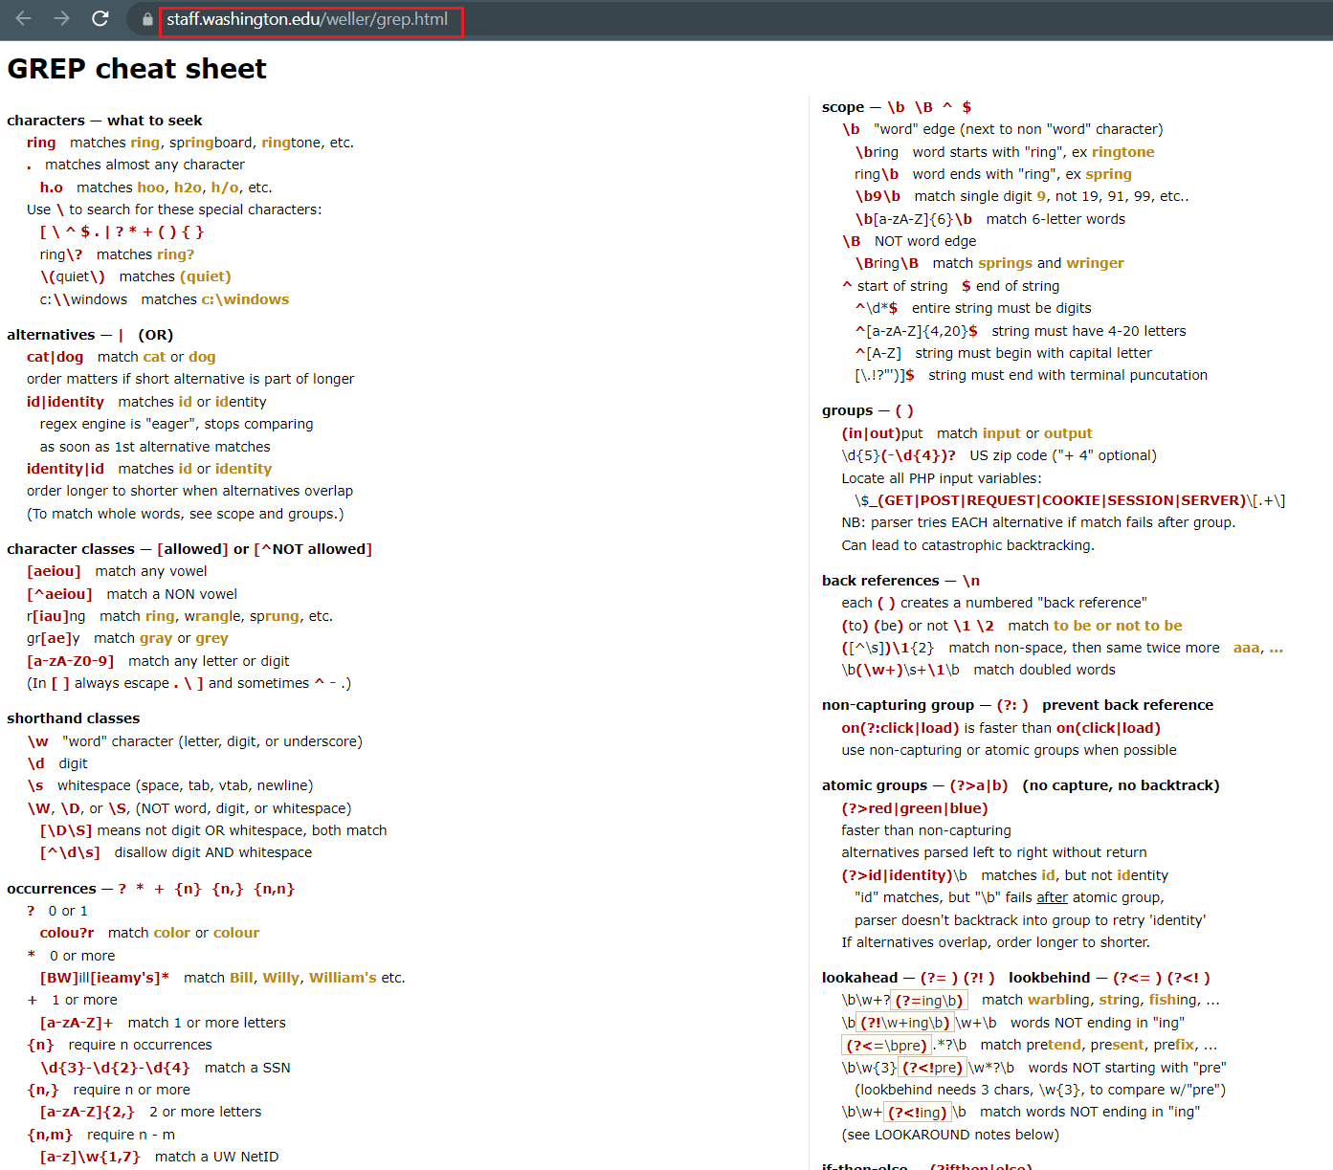
Notes:
https://staff.washington.edu/weller/grep.html

Slide 6
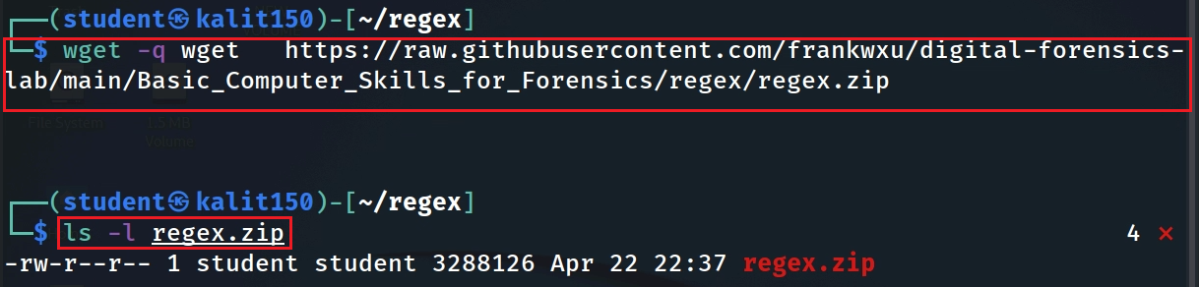
Download lab files
Notes:
wget https://raw.githubusercontent.com/frankwxu/digital-forensics-lab/main/Basic_Computer_Skills_for_Forensics/regex/regex.zip

Slide 7
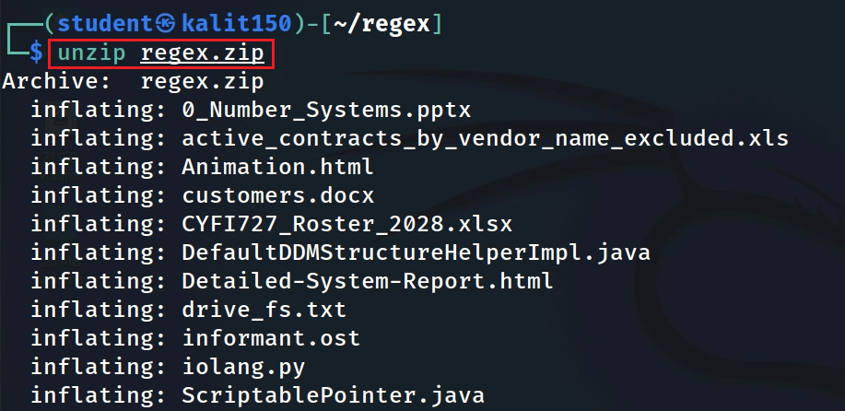
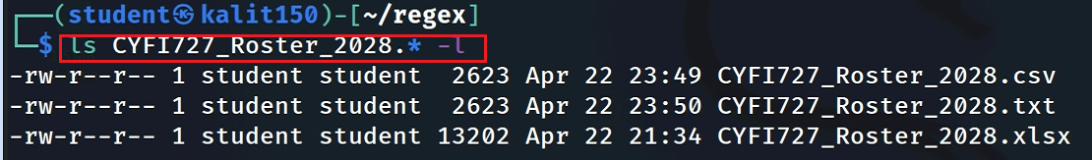
unzip the file
Verify some unzipped files

Slide 8
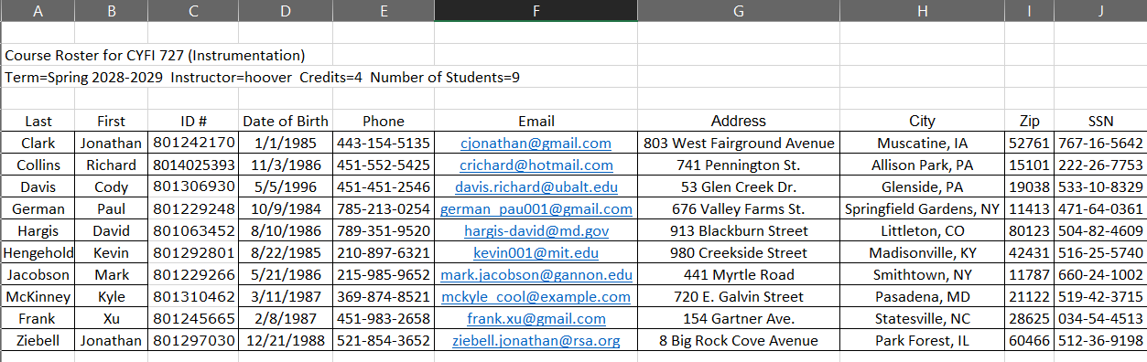
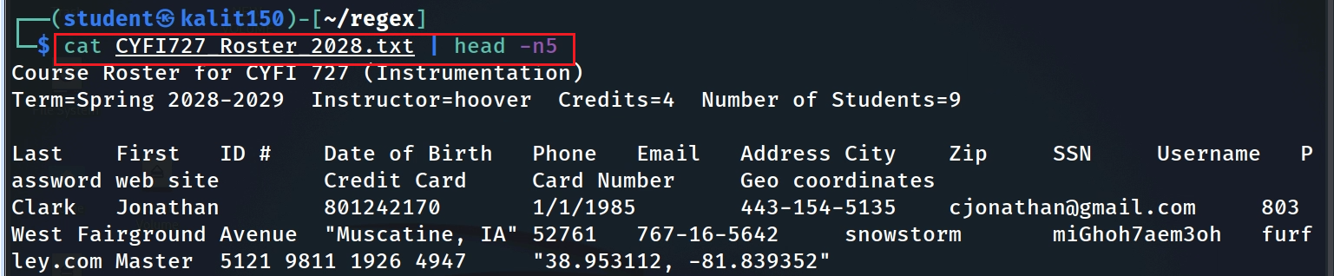
Verify the txt file. We will search the content of the file using regular expression.
Notes:
cat CYFI727_Roster_2028.txt | head -n5
grep -Ei "Frank" CYFI727_Roster_2028.txt

Slide 9
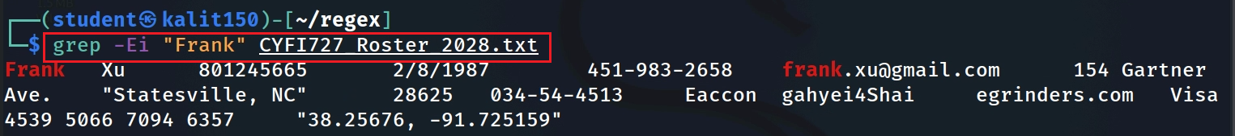
Search for a specific name “Frank”
Notes:
cat CYFI727_Roster_2028.txt | head -n5
grep -Ei "Frank" CYFI727_Roster_2028.txt

Slide 10

A simple pattern of all names
Frank_Xu
Frank
Xu
Space
One Uppercase
1-10 Lowercase
1 or more space
One Uppercase
1-10 Lowercase
space
1 or more
[A-Z]
[a-z]
{1,10}
\s
+

Slide 11
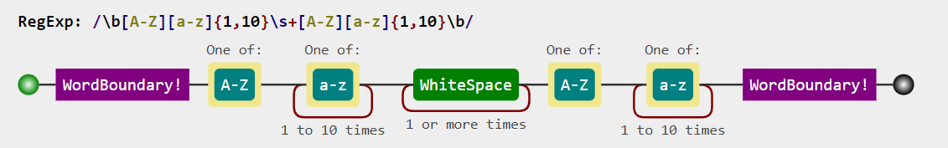
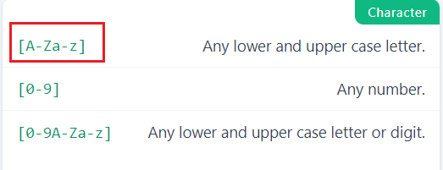
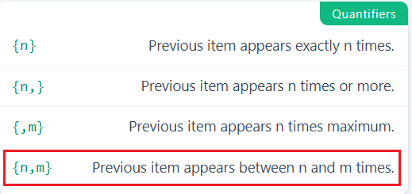
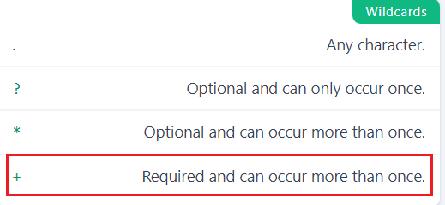
Match all names in a text file
Notes:
echo "I am Frank Xu" | grep -E -o "\b[A-Z][a-z]{1,10}\s+[A-Z][a-z]{1,10}\b“
https://jex.im/regulex/#!flags=&re=%5Cb%5BA-Z%5D%5Ba-z%5D%7B1%2C10%7D%5Cs%2B%5BA-Z%5D%5Ba-z%5D%7B1%2C10%7D%5Cb

Slide 12



Word Character: [a-zA-Z0-9_]
Word string: a list of word characters
Word Boundary: \b
Before the first character in the word string
After the last character in the word string
NOT a Word Character
I |  | am |  | 50 |  | years |  | old | , |  | he |  | is |  | 2 | !
\b
\b
\b
\b
\b
\b
\b
\b
\b
\b
\b
\b
\b
\b
\b
\b
Notes:
echo 'I am 50 years old, he is 2!' | grep -E '\b..\b’
https://learnbyexample.github.io/learn_gnugrep_ripgrep/gotchas-and-tricks.html#:~:text=Word%20boundary%20differences,-The%20%2Dw%20option&text=The%20test%20is%20that%20the,a%20non%2Dword%20constituent%20character.
https://www.regular-expressions.info/wordboundaries.html

Slide 13

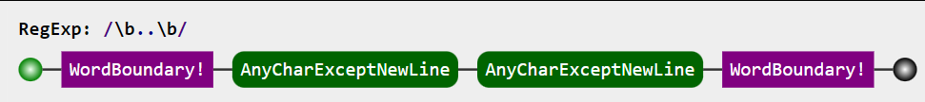
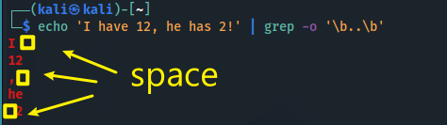
I |  | am |  | 50 |  | years |  | old | , |  | he |  | is |  | 2 | !
\b
\b
\b
\b
\b
\b
\b
\b
\b
\b
\b
\b
\b
\b
\b
\b
Search two characters between any two \b
Notes:
echo 'I am 50 years old, he is 2!' | grep -E '\b..\b’
https://learnbyexample.github.io/learn_gnugrep_ripgrep/gotchas-and-tricks.html#:~:text=Word%20boundary%20differences,-The%20%2Dw%20option&text=The%20test%20is%20that%20the,a%20non%2Dword%20constituent%20character.

Slide 14
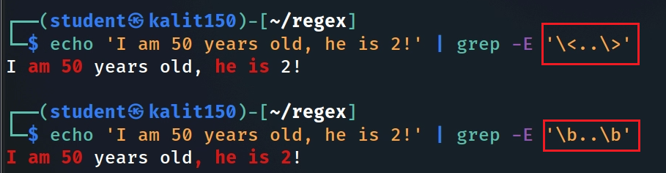



\<..\>: Don’t’ cross \b, AND must include a word string
\b..\b: any boundaries
[a-zA-Z0-9_]
I |  | am |  | 50 |  | years |  | old | , |  | he |  | is |  | 2 | !
\b
\b
\b
\b
\b
\b
\b
\b
\b
\b
\b
\b
\b
\b
\b
\b
Notes:
echo 'I am 50 years old, he is 2!' | grep -E '\<..\>'

Slide 15
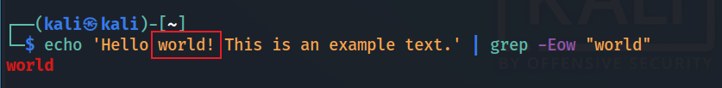
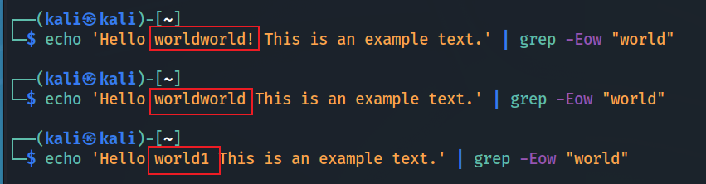
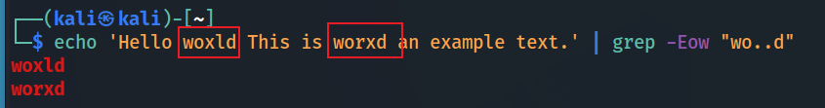
[a-zA-Z0-9_]+
-w : a shortcut of \<agivenword\>
match only whole words
! is not a word character

Slide 16
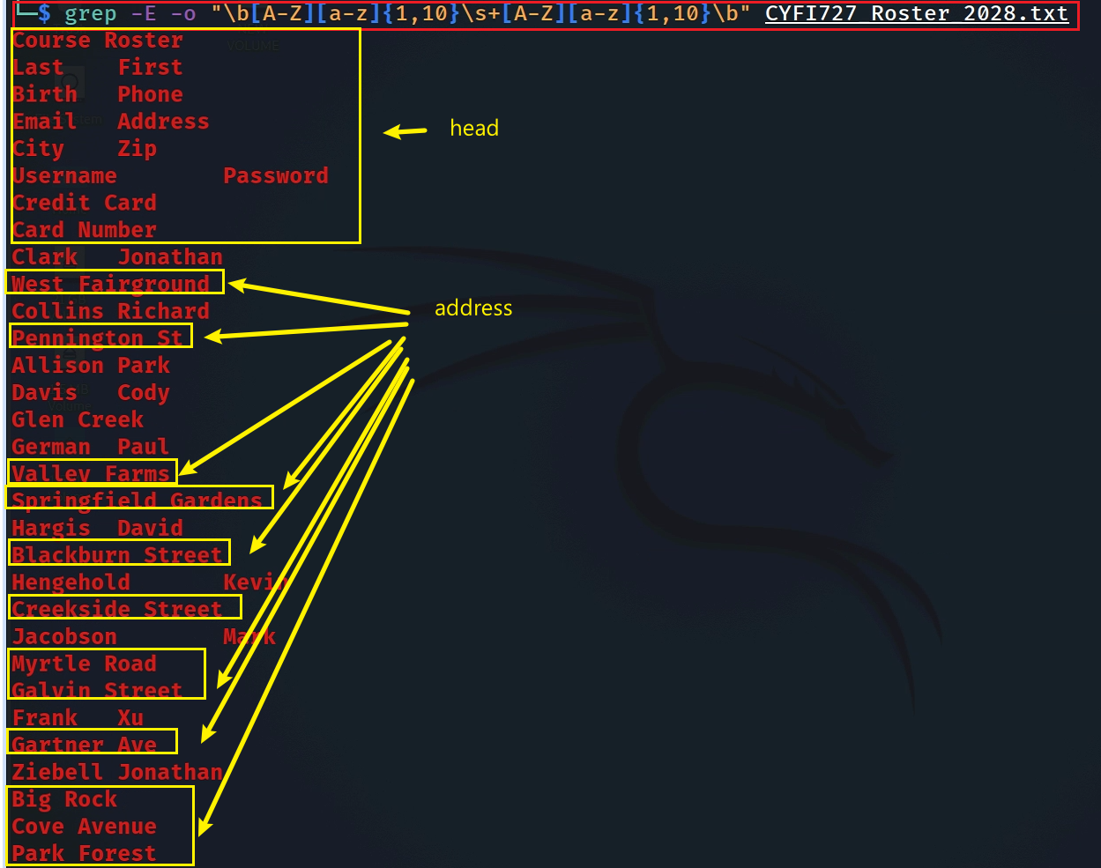

Test the patten in a text file
Search names

Slide 17

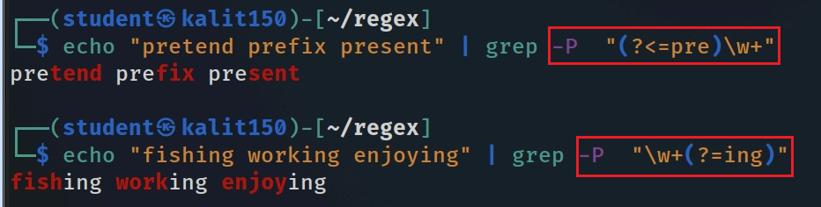



Conditional match ?
look behind
(?<=foo)xxx
look ahead
xxx(?=foo)
Match xxx with a preceding string foo
Match xxx with a following string foo
has to be Perl-compatible
shorthand classes
\w "word" character (letter, digit, or underscore)
[a-zA-Z0-9_]
\d digit
\s whitespace (space, tab, vtab, newline)
-Po
Notes:
echo "pretend prefix present" | grep -P "(?<=pre)\w+“
echo "fishing working enjoying" | grep -P "\w+(?=ing)“

Slide 18
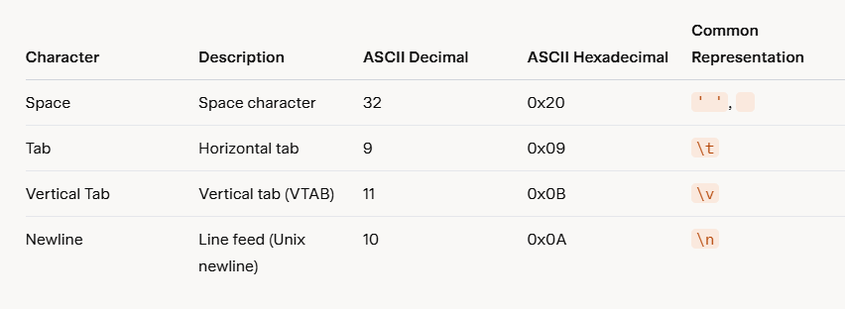
\s represents a list of characters
Aspect | Unix/Linux | Windows
Newline Representation | \n(LF) | \r\n(CR+LF)
Number of Characters | 1 character | 2 characters
Compatibility Issues | Files created on Unix may appear as a single line on Windows if not converted. | Files created on Windows may have extra ^M characters (visible representation of\r) on Unix if not converted.
Notes:
# Convert a file from Windows to Unix format
dos2unix filename.txt
# Convert a file from Unix to Windows format
unix2dos filename.txt

Slide 19
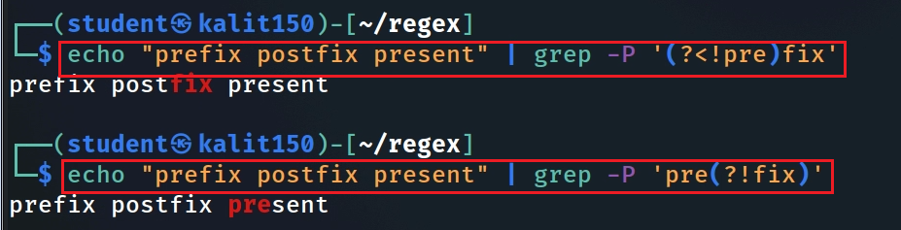
Negative lookup
look behind
(?<!foo)xxx
look ahead
xxx(? !foo)
Match xxx without a preceding string foo
Match xxx without a following string foo
Negative lookup pattern MUST be single quote ‘ ’
a lookup string length must be fixed
Notes:
echo “prefix postfix present" | grep -P ‘?<!pre)fix’
echo "prefix postfix present" | grep -P 'pre(?<!fix)'

Slide 20
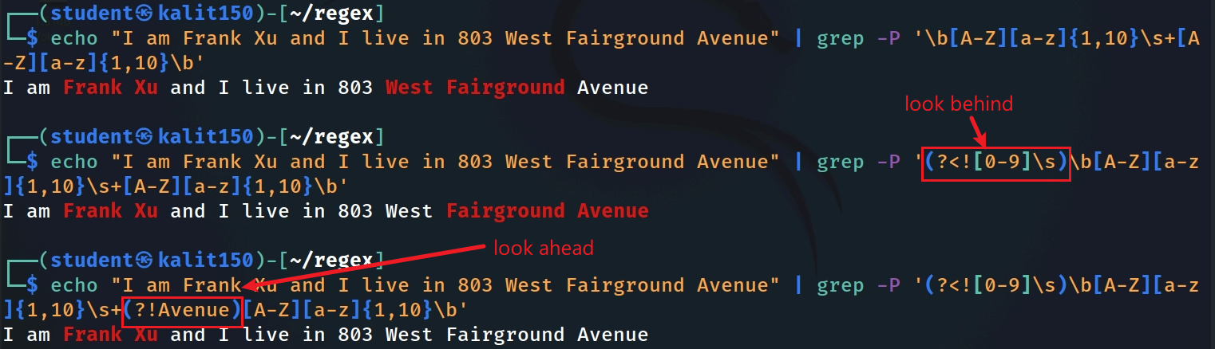


This is not a name! can’t have numbers before a name!
Fix name mismatch problems using lookup
negative
can’t have “avenue” after a name!
negative
Second try. “Ave” can’t be the last name. Need more testing if necessary.
Notes:
echo "I am Frank Xu and I live in 803 West Fairground Avenue" | grep -P '\b[A-Z][a-z]{1,10}\s+[A-Z][a-z]{1,10}\b’
echo "I am Frank Xu and I live in 803 West Fairground Avenue" | grep -P '(?<![0-9]\s)\b[A-Z][a-z]{1,10}\s+[A-Z][a-z]{1,10}\b
echo "I am Frank Xu and I live in 803 West Fairground Avenue" | grep -P '(?<![0-9]\s)\b[A-Z][a-z]{1,10}\s+(?!Avenue)[A-Z][a-z]{1,10}\b'

Slide 21
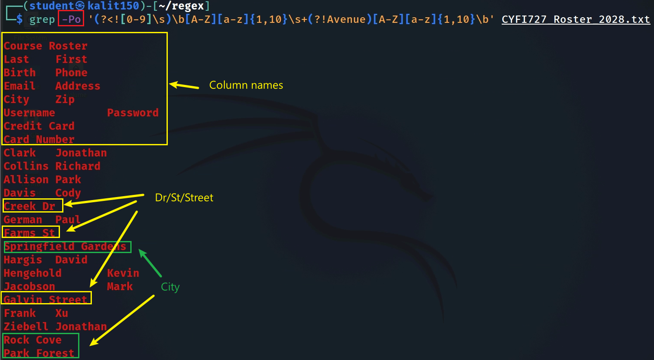
Notes:
grep -Po '(?<![0-9]\s)\b[A-Z][a-z]{1,10}\s+(?!Avenue)[A-Z][a-z]{1,10}\b' CYFI727_Roster_2028.txt

Slide 22
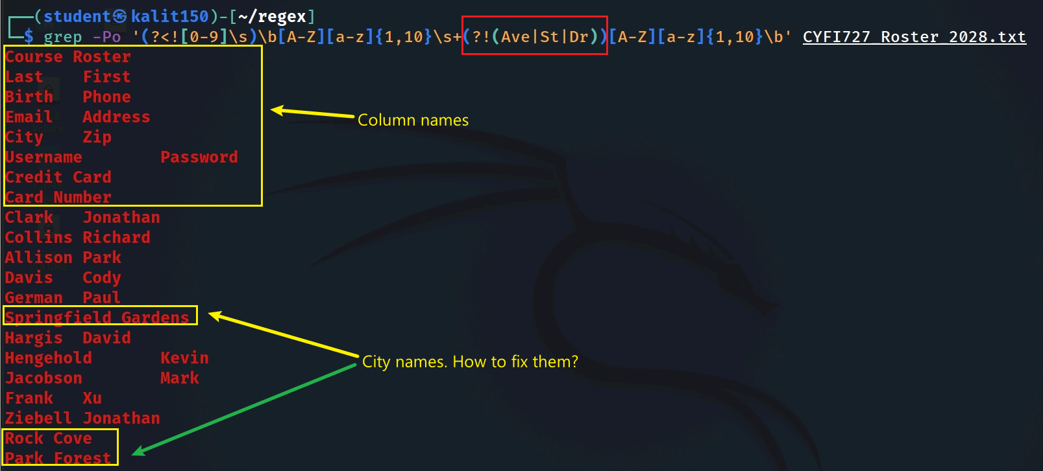
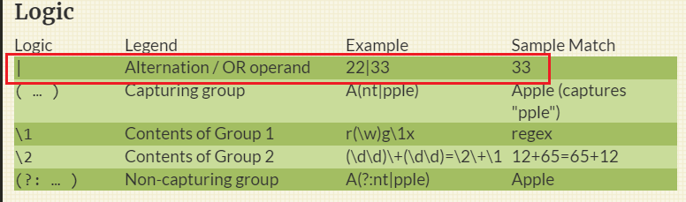
Exclude Ave, St, and Dr from last name
Notes:
grep -Po '(?<![0-9]\s)\b[A-Z][a-z]{1,10}\s+(?![Ave|St|Dr])[A-Z][a-z]{1,10}\b' CYFI727_Roster_2028.txt

Slide 23

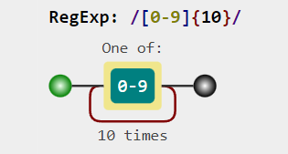
Match phone numbers
1234567890
123.456.7890
123-456-7890
123 456 7890
(123)456-7890
+11234567890
1234567890
[0-9]{10}
Notes:
https://jex.im/regulex/#!flags=&re=%5B0-9%5D%7B10%7D

Slide 24
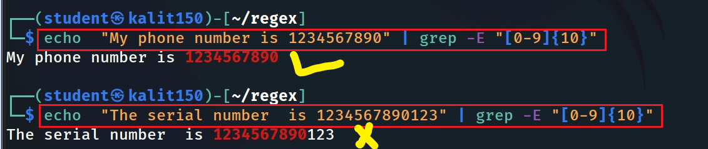
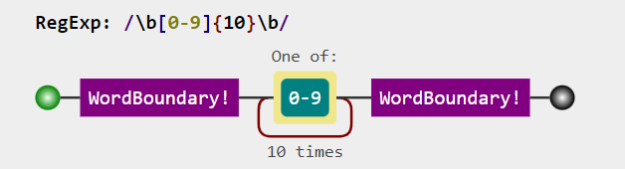
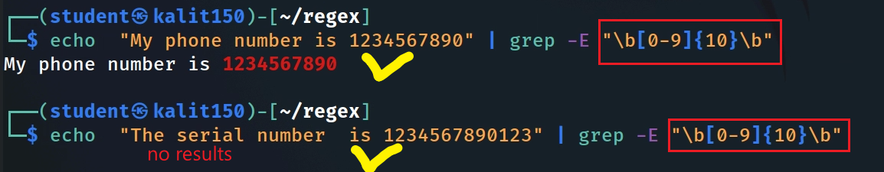
Match any 10 digitals phone numbers (xxxxxxxxxx and x is a digital)
Notes:
echo "My phone number is 1234567890" | grep -E "[0-9]{10}“
echo "The serial number is 1234567890123" | grep -E "[0-9]{10}“
echo "My phone number is 1234567890" | grep -E "\b[0-9]{10}\b“
echo "The serial number is 1234567890123" | grep -E "\b[0-9]{10}\b“
https://jex.im/regulex/#!flags=&re=%5Cb%5B0-9%5D%7B10%7D%5Cb

Slide 25
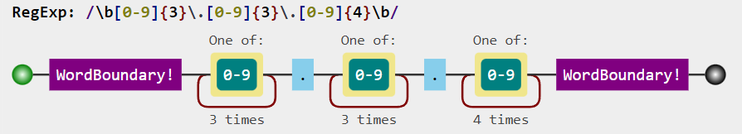
Match any 10 digitals phone numbers with the patten xxx.xxxx.xxx and x is a digital
123.456.7890
\b[0-9]{3} \.[0-9]{3}\.[0-9]{4}\b
Notes:
echo "My phone number is 123.456.7890" | grep -E "\b[0-9]{3}\.[0-9]{3}\.[0-9]{4}\b"
https://jex.im/regulex/#!flags=&re=%5Cb%5B0-9%5D%7B3%7D%5C.%5B0-9%5D%7B3%7D%5C.%5B0-9%5D%7B4%7D%5Cb

Slide 26
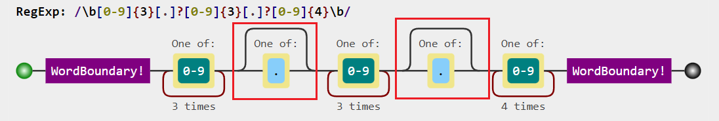
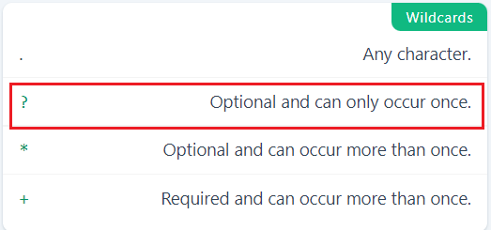
1234567890
Match both?
123.456.7890
{0,1}

Slide 27
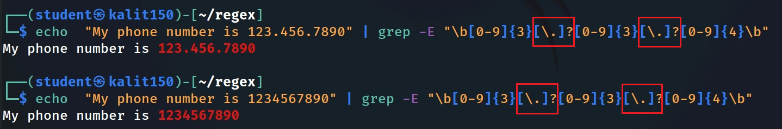
Test both phone number types
Notes:
echo "My phone number is 123.456.7890" | grep -E "\b[0-9]{3}[\.]?[0-9]{3}[\.]?[0-9]{4}\b“
echo "My phone number is 1234567890" | grep -E "\b[0-9]{3}[\.]?[0-9]{3}[\.]?[0-9]{4}\b"

Slide 28
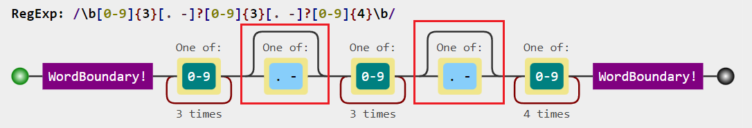
1234567890
123.456.7890
123-456-7890
123 456 7890
Match all four?
Notes:
https://jex.im/regulex/#!flags=&re=%5Cb%5B0-9%5D%7B3%7D%5B.%20-%5D%3F%5B0-9%5D%7B3%7D%5B.%20-%5D%3F%5B0-9%5D%7B4%7D%5Cb

Slide 29
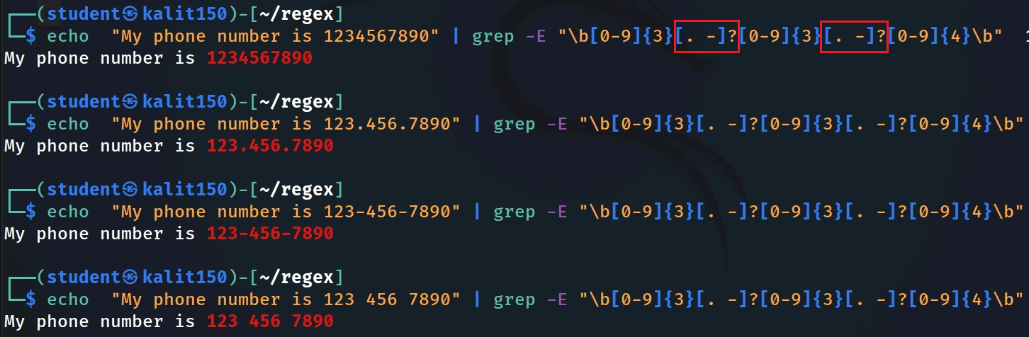

Test all four phone number types
Notes:
echo "My phone number is 1234567890" | grep -E "\b[0-9]{3}[. -]?[0-9]{3}[. -]?[0-9]{4}\b“
echo "My phone number is 123.456.7890" | grep -E "\b[0-9]{3}[. -]?[0-9]{3}[. -]?[0-9]{4}\b“
echo "My phone number is 123-456-7890" | grep -E "\b[0-9]{3}[. -]?[0-9]{3}[. -]?[0-9]{4}\b“
echo "My phone number is 123 456 7890" | grep -E "\b[0-9]{3}[. -]?[0-9]{3}[. -]?[0-9]{4}\b"

Slide 30

1234567890
123.456.7890
123-456-7890
123 456 7890
(123)456-7890
Match all five?
syntax: ?if then|else
(\()? \b[0-9]{3} (?(1) \)|[. -]?) [0-9]{3}[. -]?[0-9]{4}\b
Notes:
https://jex.im/regulex/#!flags=&re=%5Cb%5B0-9%5D%7B3%7D%5B.%20-%5D%3F%5B0-9%5D%7B3%7D%5B.%20-%5D%3F%5B0-9%5D%7B4%7D%5Cb
echo "My phone number is (123)456-7890" | grep -P "(\()?\b[0-9]{3}(?(1)\)?|[. -]?)[0-9]{3}[. -]?[0-9]{4}\b"

Slide 31
Match email addresses
john.doe@gmail.com
john-doe@md.gov
johnDoe001@mozilla.org
Local part
domain name
johndoe@ubalt.edu
.
Consists of letters, digital, -, .
2-15 characters long
[a-zA-Z0-9.-]{2,15}
@
Consists of letters, digital
1-15 characters long
[a-zA-Z0-9]{1,15}
Consists of letters, digital
3-4 characters long
[a-zA-Z0-9]{3,4}
@
\.

Slide 32
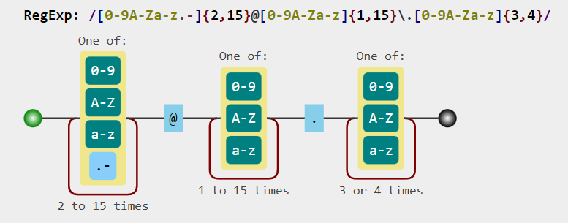
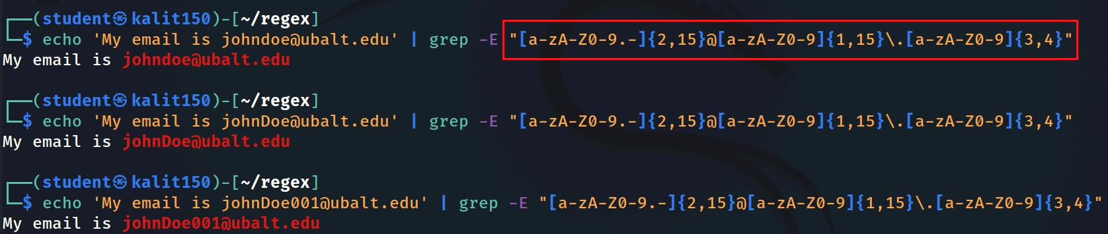
Notes:
https://jex.im/regulex/#!flags=&re=%5Ba-zA-Z0-9.-%5D%7B2%2C15%7D%40%5Ba-zA-Z0-9%5D%7B1%2C15%7D%5C.%5Ba-zA-Z0-9%5D%7B3%2C4%7D
echo 'My email is johndoe@ubalt.edu' | grep -E "[a-zA-Z0-9.-]{2,15}@[a-zA-Z0-9]{1,15}\.[a-zA-Z0-9]{3,4}“
echo 'My email is johnDoe@ubalt.edu' | grep -E "[a-zA-Z0-9.-]{2,15}@[a-zA-Z0-9]{1,15}\.[a-zA-Z0-9]{3,4}“
echo 'My email is johnDoe001@ubalt.edu' | grep -E "[a-zA-Z0-9.-]{2,15}@[a-zA-Z0-9]{1,15}\.[a-zA-Z0-9]{3,4}"

Slide 33
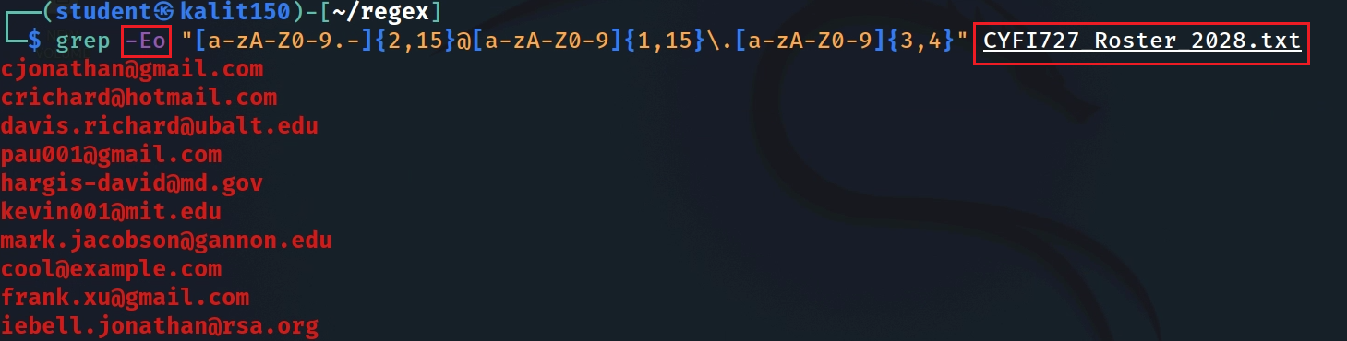
Notes:
grep -Eo "[a-zA-Z0-9.-]{2,15}@[a-zA-Z0-9]{1,15}\.[a-zA-Z0-9]{3,4}" CYFI727_Roster_2028.txt

Slide 34
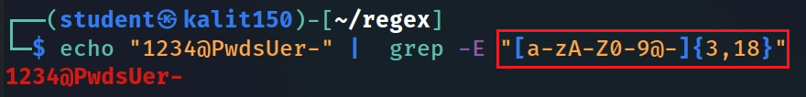
Check if a password is valid
Pattern definition:
Minimum length of 3, maximum length of 18
Composed by letters, numbers or dashes or @
Notes:
echo "1234@PwdsUer-" | grep -E "[a-zA-Z0-9@-]{3,18}"

Slide 35
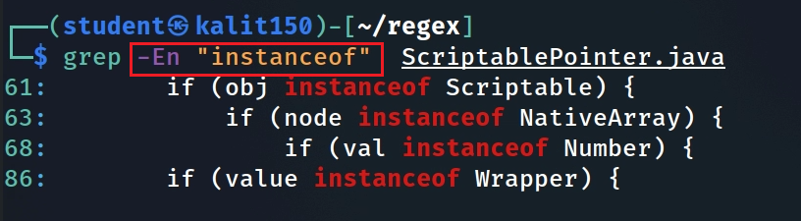
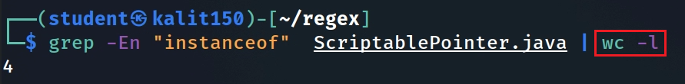
Match Java source code
Search string in Java and show line numbers
Show how many time the key words appears in Java source code
Notes:
grep -En "instanceof" ScriptablePointer.java

Slide 36
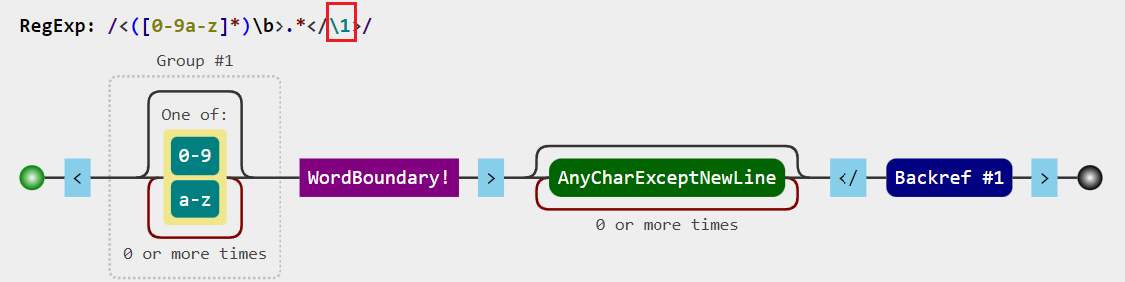

Match HTML code (including tags and content) using Backreference \n
<h1>This is a heading. </h1>
Opening tag
content
Closing tag
Notes:
echo "The following is html code. <h1>This is a heading. </h1>" | grep -E "<([a-z0-9]*)\b>.*</\1>"

Slide 37
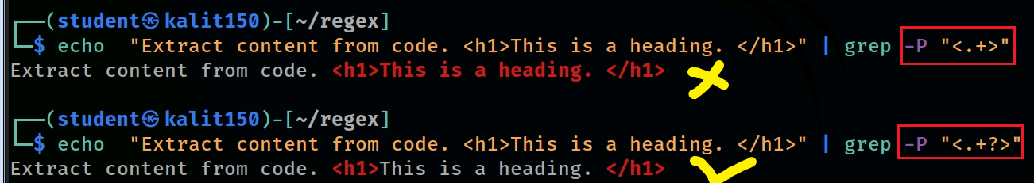
Match HTML tags using Lazy quantifier
<h1>This is a heading. </h1>
MUST use -P
Greedy quantifier | Lazy quantifier | Description
* | * ? | Star Quantifier: 0 or more
+ | + ? | Plus Quantifier: 1 or more
? | ? ? | Optional Quantifier: 0 or 1
{n} | {n} ? | Quantifier: exactly n
{n,} | {n,} ? | Quantifier: n or more
{n,m} | {n,m} ? | Quantifier: between n and m
Notes:
echo "Extract content from code. <h1>This is a heading. </h1>" | grep -P "<.+>“
echo "Extract content from code. <h1>This is a heading. </h1>" | grep -P "<.+?>“
https://stackoverflow.com/questions/3027518/how-to-do-a-non-greedy-match-in-grep

Slide 38

Match content of HTML code
<h1>This is a heading. </h1>
(?<=<([a-z0-9]{2}) >).* (?=</ \1>)
look behind
look ahead
Notes:
echo "Extract content from code. <h1>This is a heading. </h1>" | grep -P "(?<=<([a-z0-9]{2})>).*(?=</\1>)"

Slide 39
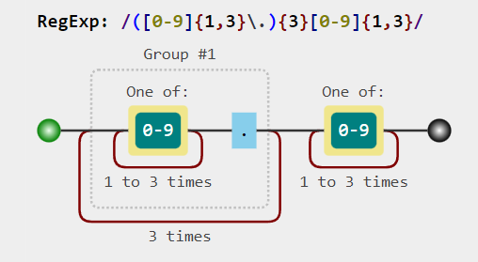
Match IP4 address with group ()
192.168.0.1
443.125.121.1
255.255.255.0
89.25.23.0
Notes:
https://jex.im/regulex/#!flags=&re=(%5B0-9%5D%7B1%2C3%7D%5C.)%7B3%7D%5B0-9%5D%7B1%2C3%7D
echo "The IP address is 443.125.121.1" | grep -E "([0-9]{1,3}\.){3}[0-9]{1,3}"

Slide 40
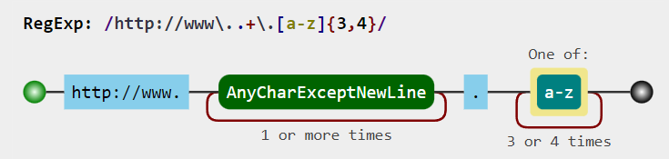
Match HTTP requests
http://www.ubalt.edu
Notes:
echo "It continas a valid url http://www.ubalt.edu" | grep -E "http://www\..+\.[a-z]{3,4}"

Slide 41
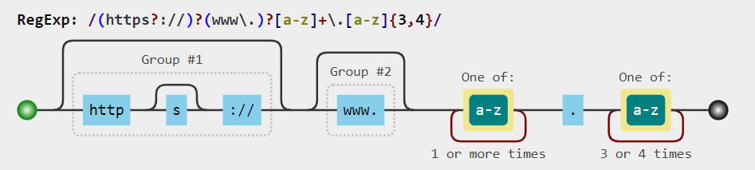
http://www.ubalt.edu
https://www.ubalt.edu
www.ubalt.edu
ubalt.edu
Match variations of website
Notes:
https://jex.im/regulex/#!flags=&re=(https%3F%3A%2F%2F)%3F(www%5C.)%3F%5Ba-z%5D%2B%5C.%5Ba-z%5D%7B3%2C4%7D
echo "It continas a valid url www.ubalt.edu" | grep -E "(https?://)?(www\.)?[a-z]+\.[a-z]{3,4}"

Slide 42
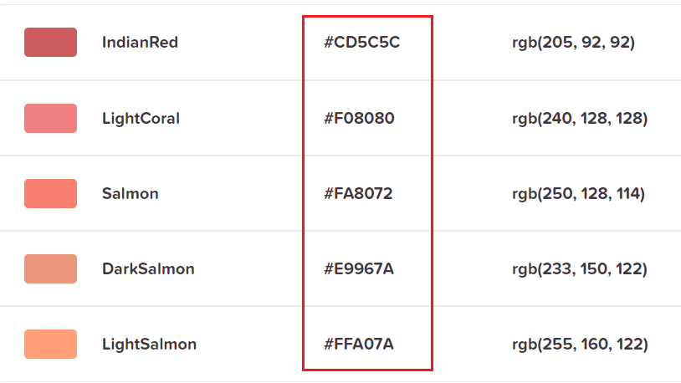


Match Hexadecimal number
Match Hex of colors
Notes:
echo "The hex of a color #CD5C5C" | grep -E "#[a-fA-F0-9]{6}"

Slide 43


Match MAC address
The standard (IEEE 802) format for printing MAC-48 addresses in human-friendly form is six groups of two hexadecimal digits, separated by hyphens - or colons :.
01-23-45-67-89-AB
01:23:45:67:89:AB
Notes:
https://jex.im/regulex/#!flags=&re=(%5B0-9A-Fa-f%5D%7B2%7D%5B%3A-%5D)%7B5%7D(%5B0-9A-Fa-f%5D%7B2%7D)
echo "My MAC address is 01-23-45-67-89-AB" | grep -E "([0-9A-Fa-f]{2}[:-]){5}([0-9A-Fa-f]{2})“
echo "My MAC address is 01:23:45:67:89:AB" | grep -E "([0-9A-Fa-f]{2}[:-]){5}([0-9A-Fa-f]{2})"

Slide 44

PaloAlto_00:0a:30
VMware_86:44:c3
Match MAC patterns
Notes:
https://jex.im/regulex/#!flags=&re=%5Ba-zA-Z%5D%7B1%2C10%7D_(%5B%3A-%5D%5B0-9a-zA-Z%5D%7B2%7D)%7B3%7D
echo "My MAC address is PaloAlto_00:0a:30" | grep -E "[a-zA-Z0-9]{1,10}_[0-9a-zA-Z]{2}(:[0-9a-zA-Z]{2}){2}"

Slide 45


Match MAC from a pcap file (link)
tshark help
-r <infile>, --read-file <infile>:
set the filename to read from (or '-' for stdin)
-e <field>
field to print if -Tfields selected (e.g. tcp.port, _ws.col.Info)
Convert pcap to text
Notes:
tshark -r vm_to_ub_traffic.log -T fields -E header=y -E separator=, -E quote=d -E occurrence=f -e ip.version -e ip.hdr_len -e ip.tos -e ip.id -e ip.flags -e ip.flags.rb -e ip.flags.df -e ip.flags.mf -e ip.frag_offset -e ip.ttl -e ip.proto -e ip.checksum -e ip.src -e ip.dst -e ip.len -e ip.dsfield -e tcp.srcport -e tcp.dstport -e tcp.seq -e tcp.ack -e tcp.len -e tcp.hdr_len -e tcp.flags -e tcp.flags.fin -e tcp.flags.syn -e tcp.flags.reset -e tcp.flags.push -e tcp.flags.ack -e tcp.flags.urg -e tcp.flags.cwr -e tcp.window_size -e tcp.checksum -e tcp.urgent_pointer -e tcp.options.mss_val -e eth.src_resolved -e eth.dst_resolved> output.csv
https://www.linkedin.com/pulse/build-machine-learning-model-network-flow-tao-liu/
https://shantoroy.com/networking/convert-pcap-to-csv-using-tshark/
https://github.com/frankwxu/digital-forensics-lab/blob/main/Basic_Computer_Skills_for_Forensics/file_carving/File_Carving_Manually/vm_to_ub_traffic.log

Slide 46


Match the first pattern in a pcap file
Match the second pattern in a pcap file
Notes:
grep -Eo "([0-9A-Fa-f]{2}[:-]){5}([0-9A-Fa-f]{2})" output.csv | sort | uniq -c| sort -n
grep -Eo "[a-zA-Z0-9]{1,10}_[0-9a-zA-Z]{2}(:[0-9a-zA-Z]{2}){2}" output.csv | sort | uniq -c| sort -n

Slide 47

Grep email from customers.docx

Slide 48

.docx is a compressed file
content

Slide 49

unzip .docx to a directory

Slide 50


The content of .docx is saved in a xml file.
grep “ubalt.edu” but results show many Word format information
Notes:
grep -Ei "ubalt.edu" customers/word/document.xml

Slide 51

Remove xml tag using sed
sed commands
Notes:
echo "111-222-3333" | sed -e 's/1/4/’
echo "111-222-3333" | sed -e 's/1/4/g'

Slide 52



replace character “1” of a phone number with 4
replace character “-” of a phone number with “.”
Remove all “-”
Notes:
echo "111-222-3333" | sed -e 's/1/4/’
echo "111-222-3333" | sed -e 's/1/4/g'

Slide 53

<h1>This is a heading. </h1>
Remove (use lazy match) all html tags first failed attempt due to sed doesn’t support -P
Match any character except the caret symbol ^
Remove all html tags using [^ not allowed character set].
Notes:
echo "Extract content from code. <h1>This is a heading. </h1>" | sed -E "s/<[^>]+>//g“
https://jex.im/regulex/#!flags=&re=%3C%5B%5E%3E%5D%2B%3E

Slide 54

Remove all xml tags
minor issue
Notes:
cat customers/word/document.xml | sed -E 's/<[^>]+>//g'

Slide 55



[^<]*: Match characters up to—but not including—another <don’t cross into nested tags
Replace paragraph (paraID) tag with spaces
grep emails
Notes:
cat customers/word/document.xml | sed -E 's/<[^<]*paraId[^>]*>/ /g ; s/<[^>]+>//g’
sed -E 's/<[^<]*paraId[^>]*>/ /g ; s/<[^>]+>//g' customers/word/document.xml
sed -E 's/<[^<]*paraId[^>]*>/ /g ; s/<[^>]+>//g' customers/word/document.xml | grep -Eo "[a-zA-Z0-9.-]{2,15}@[a-zA-Z0-9]{1,15}\.[a-zA-Z0-9]{3,4}"

Slide 56

Show .docx content without unzip to disk
-p extract files to pipe, no messages
Show .docx props without unzip to disk
Notes:
unzip -p "*.docx" word/document.xml| sed -E 's/<[^<]*paraId[^>]*>/ /g ; s/<[^>]+>//g’
unzip -p "*.docx" docProps/core.xml| sed -E 's/<[^>]+>/ /g'

Slide 57
Summary
grep is a powerful tool to extract digital forensic evidence
sed is a stream editor
grep/sed use regular expression (regex/pattern) to match text
Key regex operations
literal string: cat, character classes: [], [^], or: a|b, group: ()
quantification: ?, *,+, {}
scope: \b, \< \>, \w
greedy vs. lazy: +?, *?, {}?
back reference: \1, \2, …,\n
lookahead and lookbehind: (?=), (?<=)
Need both positive tests and negative tests
Notes:
address: \\d+[ ](?:[A-Za-z0-9.-]+[ ]?)+(?:Avenue|Lane|Road|Boulevard|Drive|Street|Ave|Dr|Rd|Blvd|Ln|St)\\.?

Slide 58


https://staff.washington.edu/weller/grep.html
Notes:
https://staff.washington.edu/weller/grep.html

Slide 59



