Slide 1
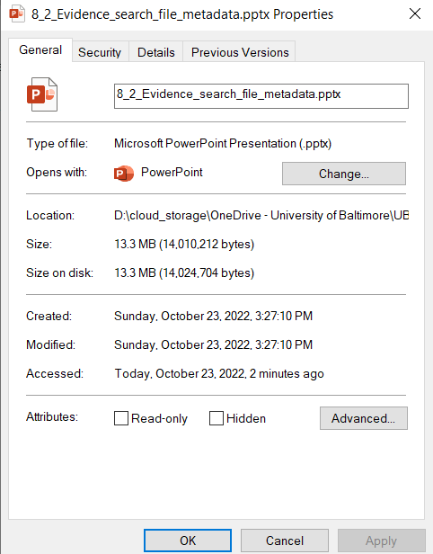
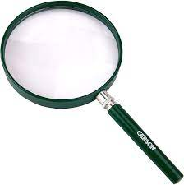
Evidence Search Techniques
Find
File search based on metadata
Notes:
https://www.youtube.com/watch?v=6G3qm60dfA8&ab_channel=PrashantThombre

Slide 2
Objectives
Review the goal of evidence search
Search for files/directories base on names
Search for files/directories base on their metadata
Understand various timestamps
Why should not trust search results

Slide 3
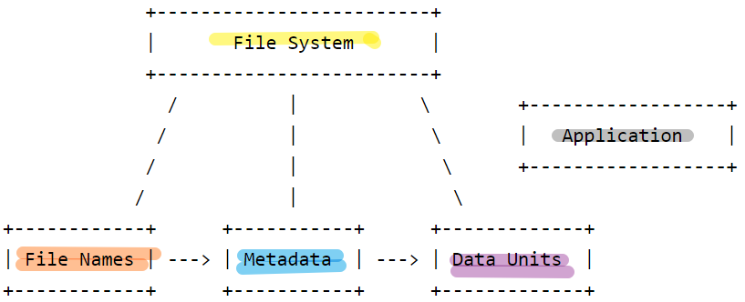





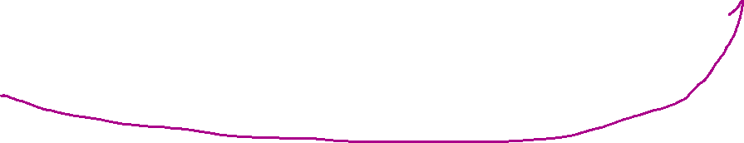
Goal of search
Retrieve all evidence that is related to crime activities
evidence are saved in file systems
Answer questions
who, when, what, how
Many search commands in Linux
ls (list directory contents, simply file name search)
find (search for file names based on file attributes)
grep (search for file content)
locate, which

Slide 4
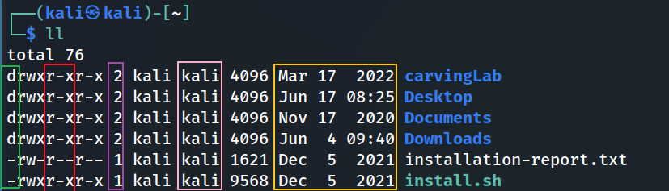
find command
Search for files by
permissions,
users, groups,
file types,
file date (timestamps),
file size, and
other possible criteria
One of the most important commands
in computer forensics
file name ( -name)
last modified ( -time)
size ( -size)
group name
owner name
# of hardlinks
other permission
group permission
user permission (-user -perm)
file type ( -type)

Slide 5
Basic find command usages
name

Slide 6
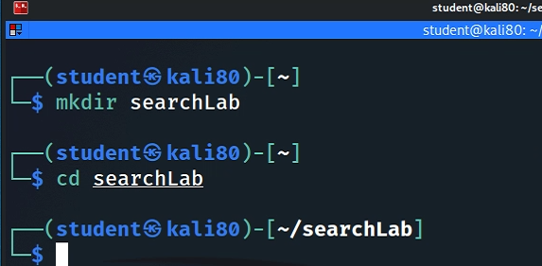
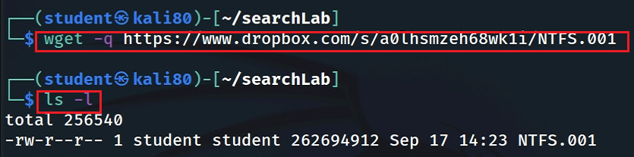

The lab uses a USB image
Create a working folder
Download a USB image
https://www.dropbox.com/s/a0lhsmzeh68wk1i/NTFS.001
Notes:
https://www.dropbox.com/s/a0lhsmzeh68wk1i/NTFS.001?

Slide 7
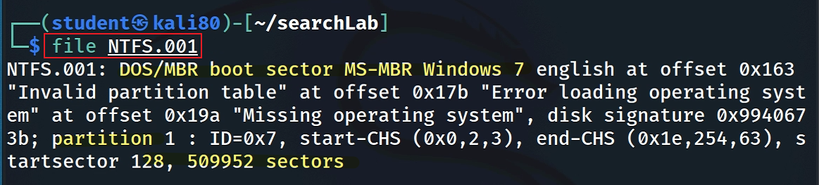
Show image information

Slide 8
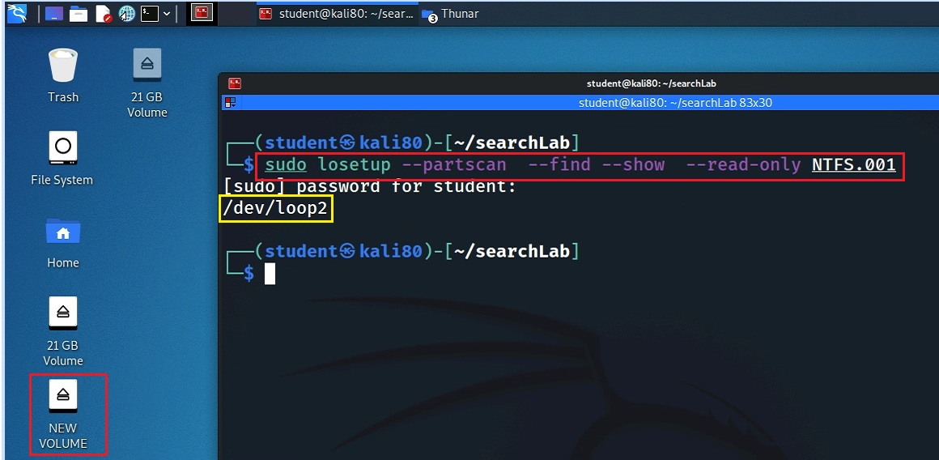
Mount the USB to Linux as a read-only loop device
sudo mount -o ro /dev/loop2p1 /mnt
Notes:
sudo losetup --partscan --find --show --read-only NTFS.001

Slide 9
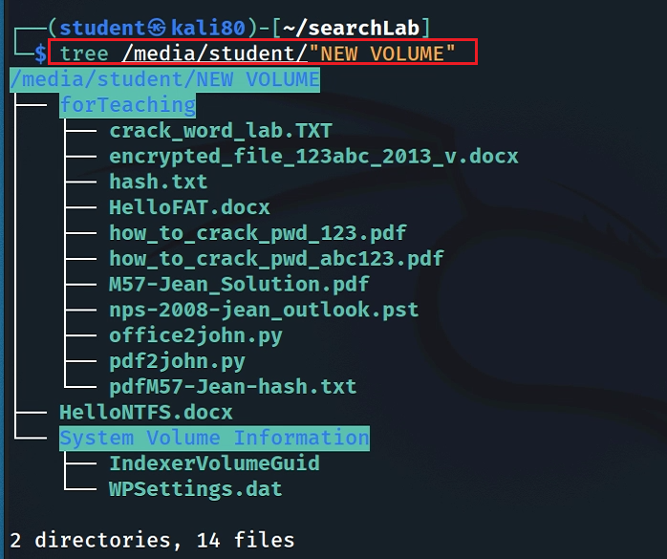
View file structure

Slide 10
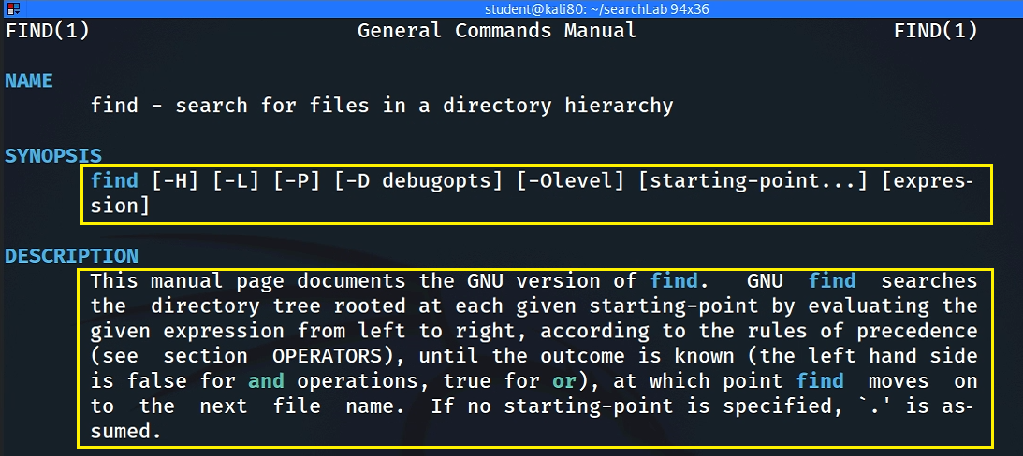
Syntax
$ find [where to start searching from] [expression determines what to find]
Notes:
man find

Slide 11
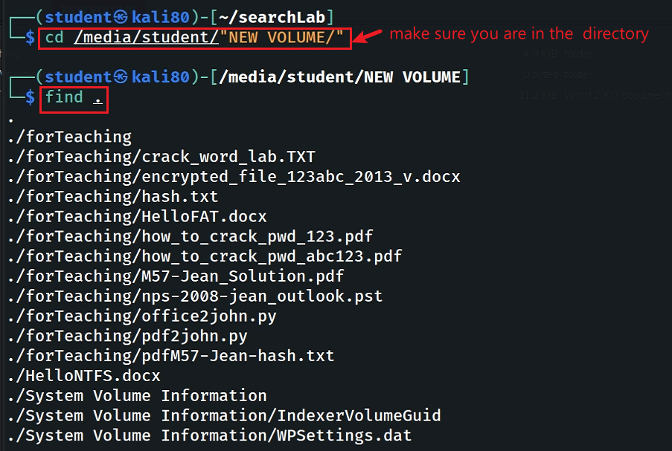

Find Files/directories starts from Current Directory (recursively)
Default is current directory. The command is the same as
include all subfolders, recursively
find /path/to/search -type f | wc -l

Slide 12
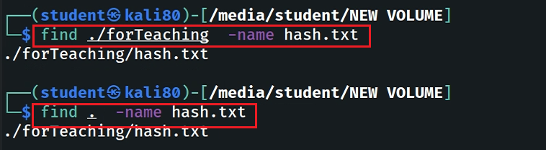
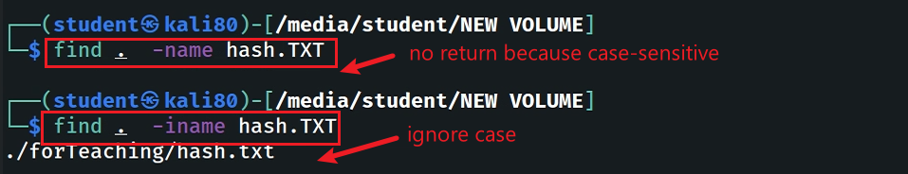

-name and -iname: find file/directory names
find a file
note: only name without path
find a file and ignore case
find a directory

Slide 13
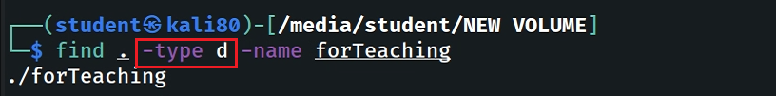
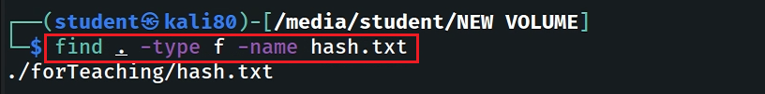

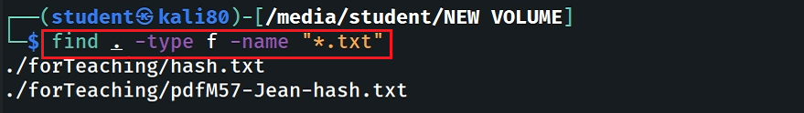
-type: specify string types
Specify the search type d: directory
Specify the search type f: file
Search all files with extension .txt
Symbol | Meaning | Example
? | any single character | A?B
* | any characters | A*
[] | One character in the set | l[pi]st

Slide 14
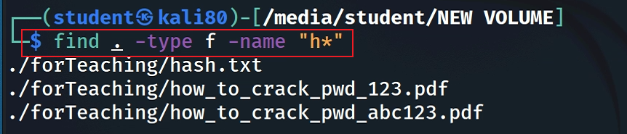
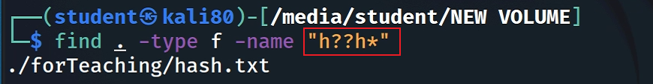
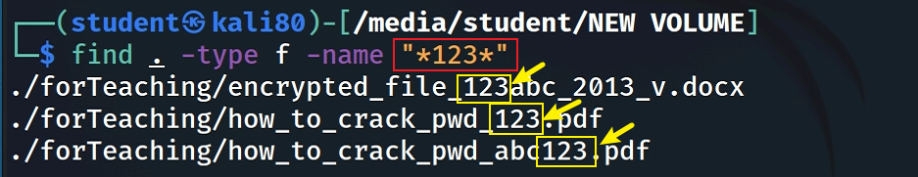
Match all file names starts with the letter “h”
Match all files which first and four letters are “h”
Match all files contains “123” (in the middle of the file name)

Slide 15
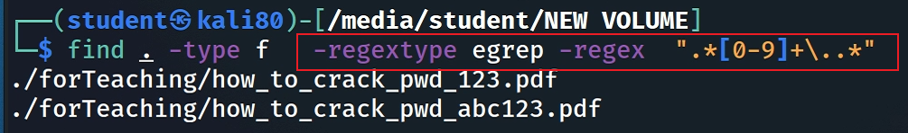
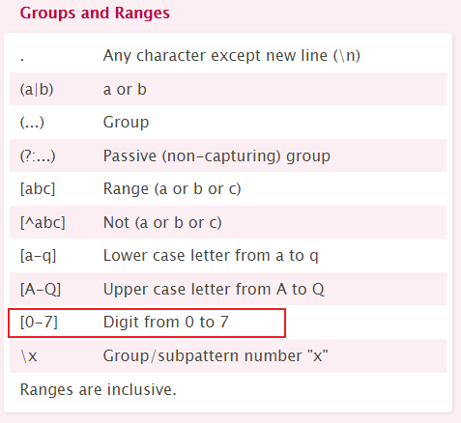
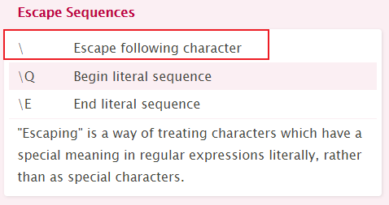
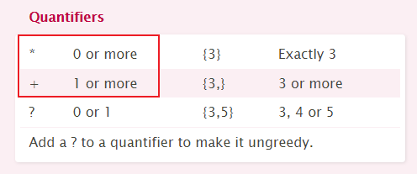
Match on the whole path for -regex
Match all files which name ends with any length of digits
Regex Type | Meta-character
Basic | \? \+ \{ \} \| \( \)
Extend | ? + { } | ( )
Notes:
find . -type f -regextype egrep -regex ".*[0-9]+\..*«
https://cheatography.com/davechild/cheat-sheets/regular-expressions/
https://www.gnu.org/software/grep/manual/html_node/Basic-vs-Extended.html

Slide 16
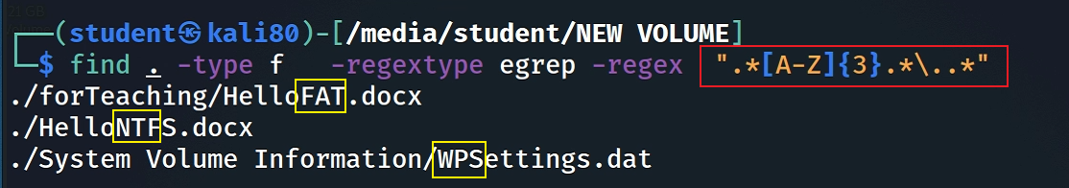
Match exact three consecutive upper-case letters in the path, excluding file extension.
Notes:
find . -type f -regextype egrep -regex ".*[A-Z]{3}.*\..*"

Slide 17
file metadata and find usage
timestamps/permissions/users

Slide 18
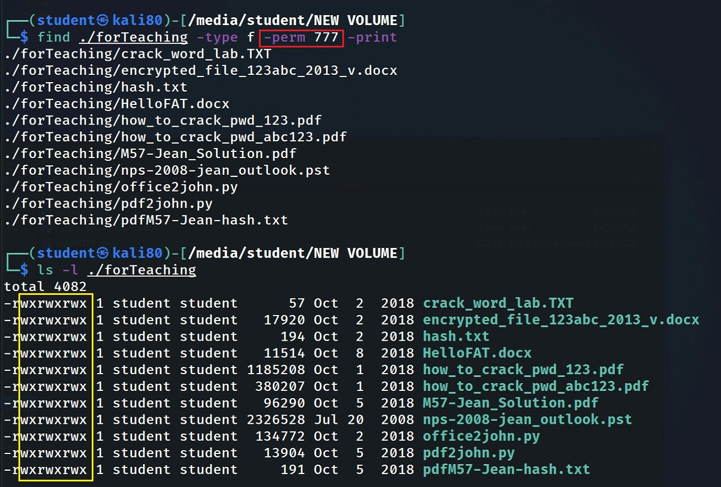
Find Files With 777 Permissions

Slide 19
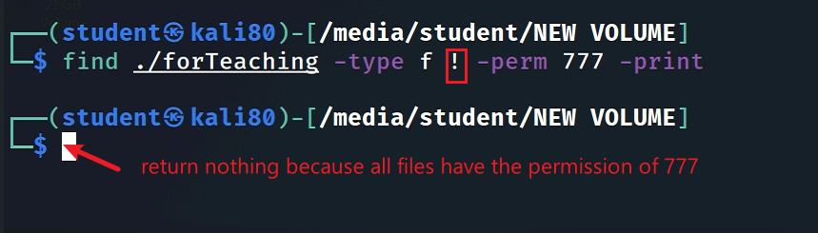
Find Files Without 777 Permissions
Note: we can’t change the permission of files here because we mounted the image as read only

Slide 20
“atime”, “mtime” and “ctime”
Timestamp | When it gets updated?
atime | Access (data units) time gets updated when you open a file or when a file is used for other operations like grep, cat, head and so on (not for stat command!).
mtime | Modify (data units) time gets updated when you whenever update content of a file or save a file.
ctime | Change (file names/metadata) time gets updated when the file attributes are changed, like changing the owner, changing the permission or moving it to another filesystem, but will also be updated when you modify a file.
ctime
atime, mtime

Slide 21
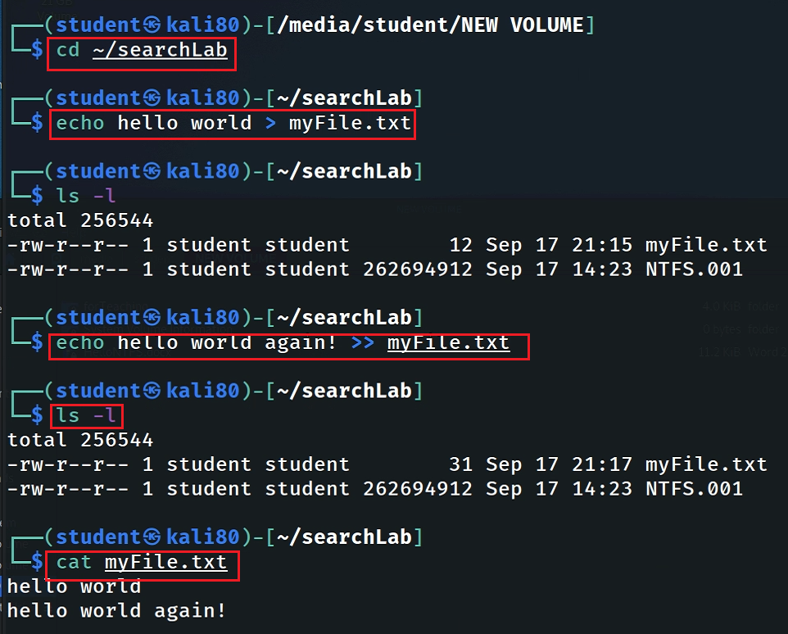
mtime changes -> ctime changes (not vice versa)
Change working directory
Create a new file
birthtime or
&modified time (mtime) if the content has been modified)
Review the permission and timestamps
Modified a line
Review the permission and timestamps
Access the file content

Slide 22
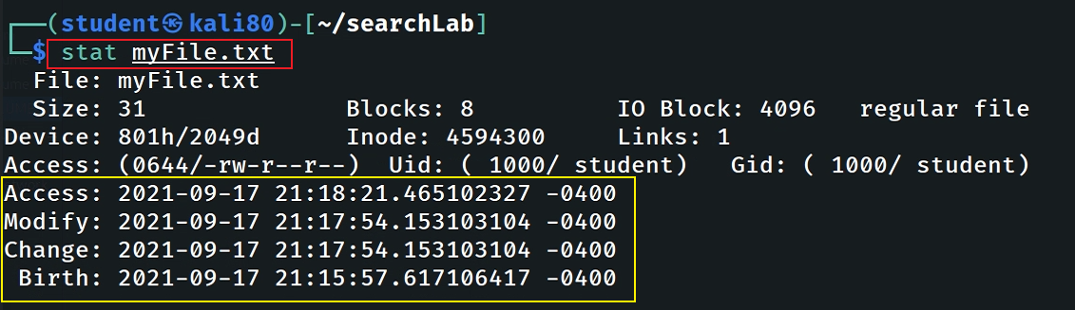
Can you recreate the file changing history?
mtime changes -> ctime changes
Coordinated Universal Time is 4 hours ahead of Eastern Time
Observing the timestamp change after using cp or mv command

Slide 23
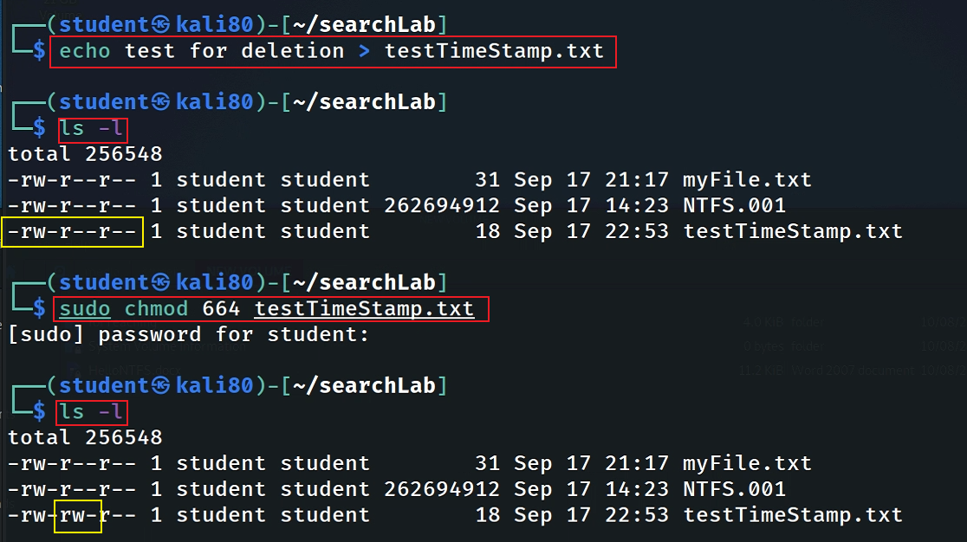
Will the timestamp change when changing permission?
Create a new file
Change permission
Change permission doesn’t change the timestamp (content)

Slide 24
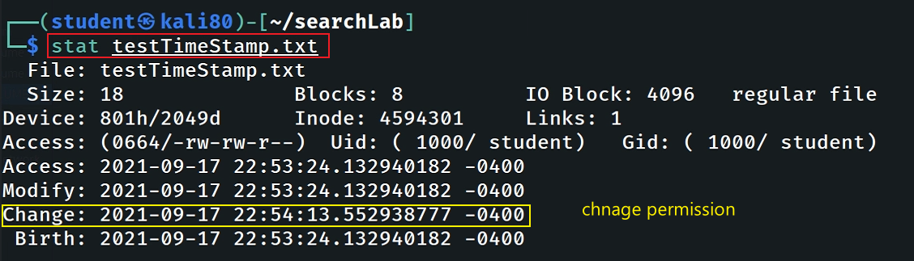
mtime changes !-> ctime changes
note: we did not modify the content of the file, so birth time=Modify time

Slide 25
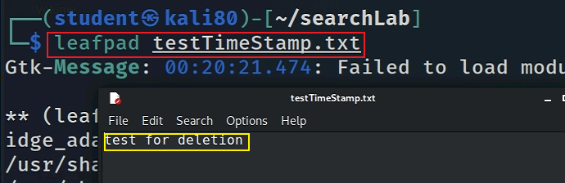
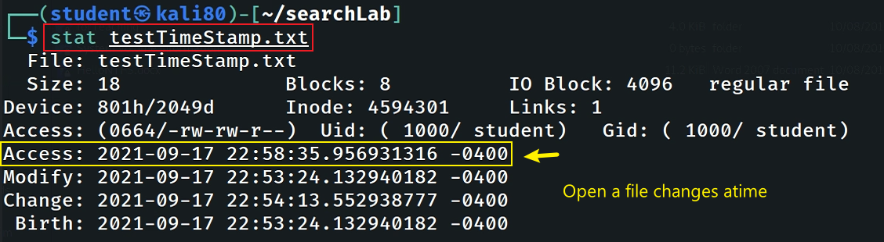
View (Access) the file with leafpad
Note: we did not change the content
Check timestamps
Note: mtime doesn’t change, but atime has been changed

Slide 26
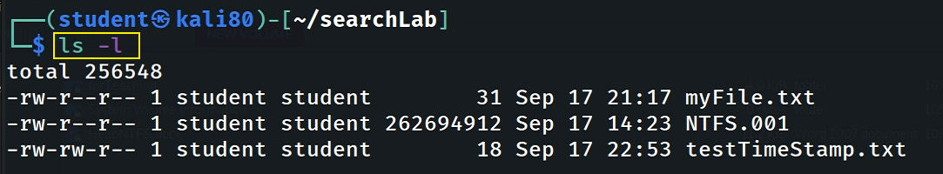
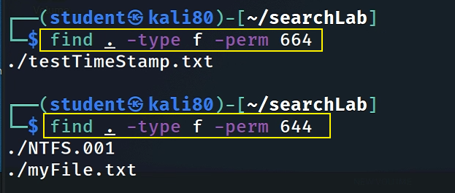
Find Files With –perm=xxx Permissions

Slide 27
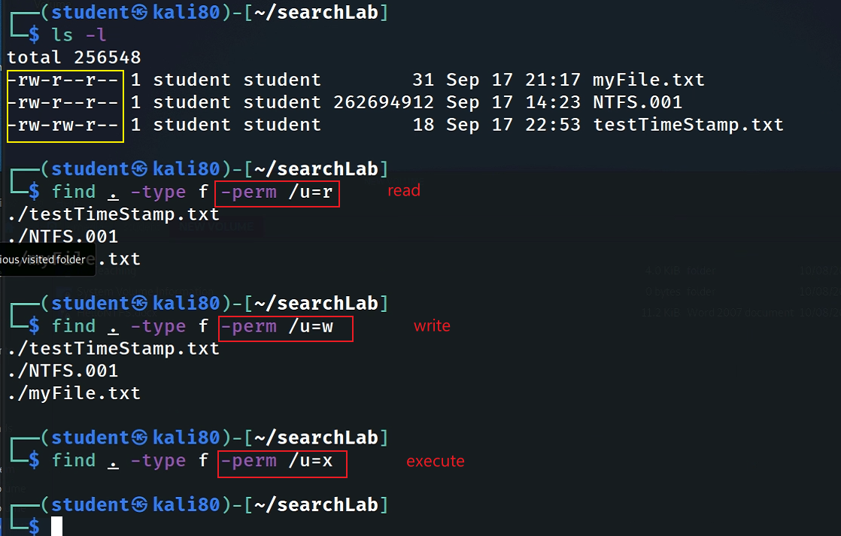
Find Files With /u=r /u=w /u=x Permissions
u: user
g: group
o: other
Example with multiple match
/u=rwx,g=rw,o=r

Slide 28
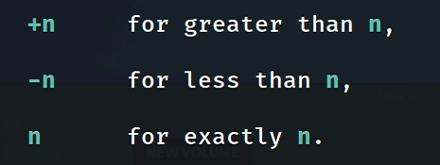
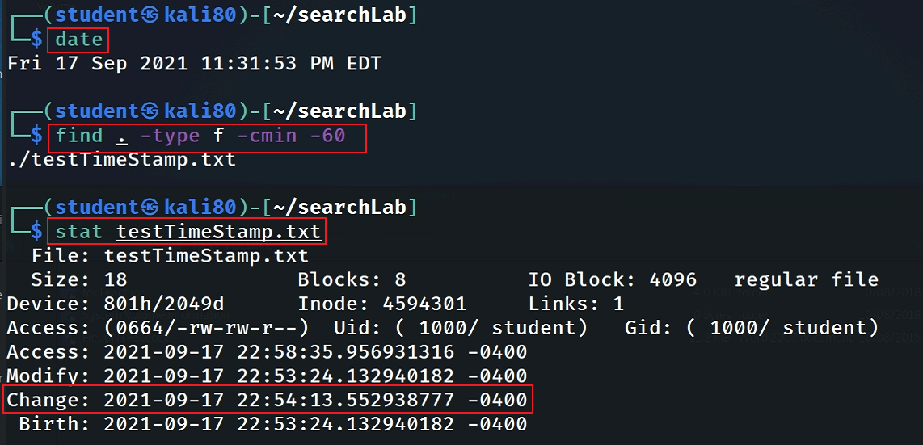

Find Changed Files in Last 1 Hour

Slide 29
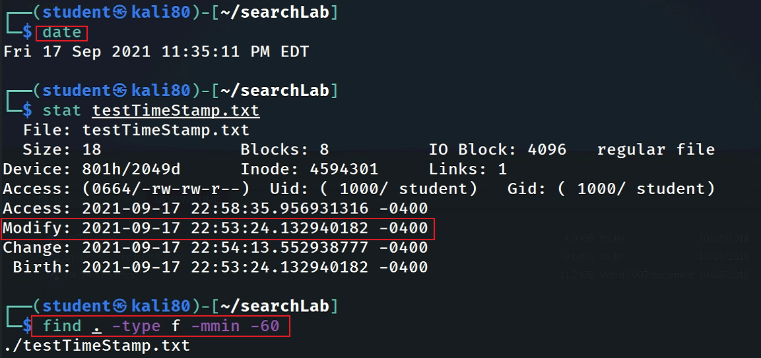
Find Modified Files in Last 1 Hour

Slide 30
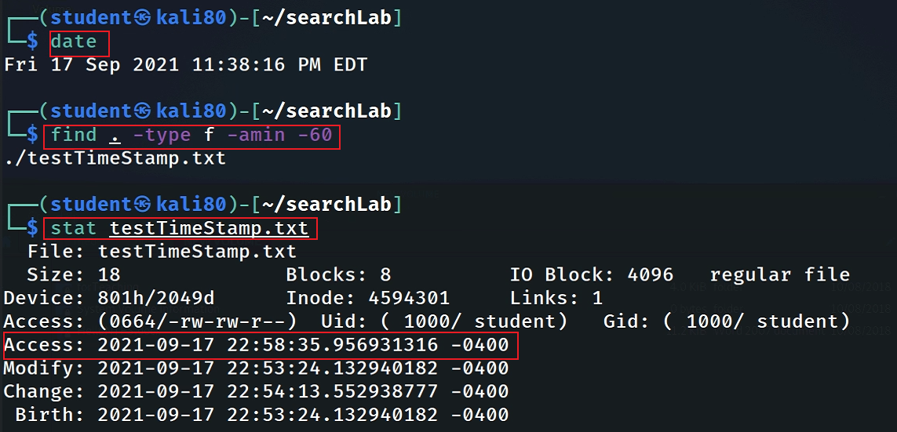
Find Accessed Files in Last 1 Hour

Slide 31
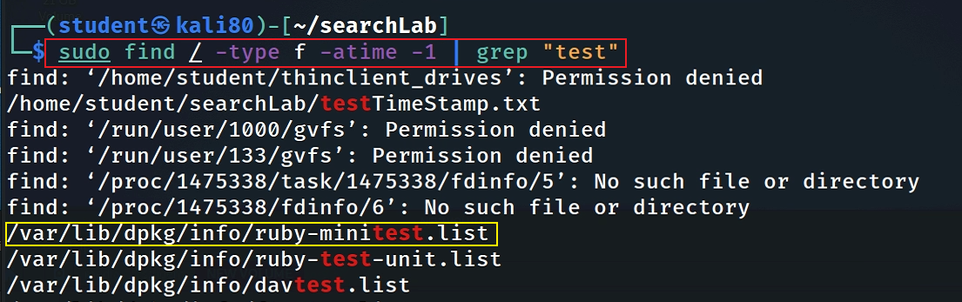
Find files that were last accessed less than n*24 hours ago
2> /dev/null; To redirect error messages to /dev/null
Notes:
2> /dev/null

Slide 32
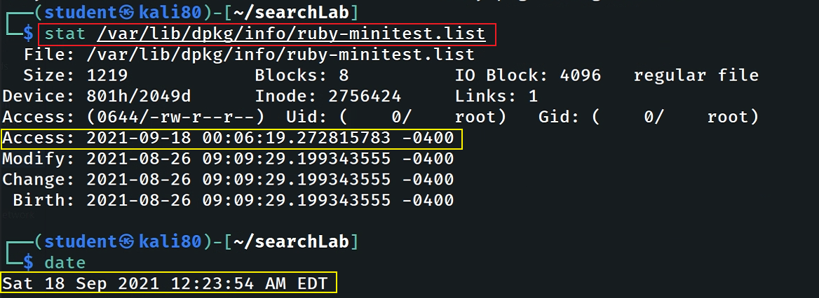
Verify file was last accessed less than n*24 hours ago

Slide 33
Find files that were modified/changed less than n*24 hours ago
try by yourself and verify your command!

Slide 34
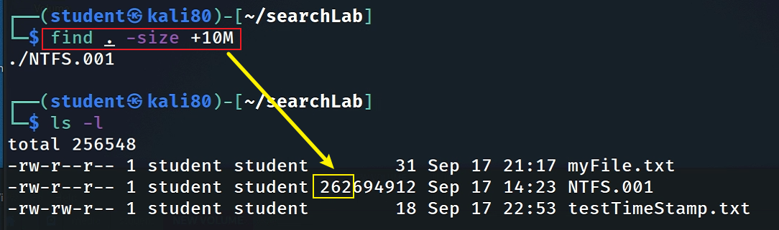
Find files that size that is great than 10MB

Slide 35
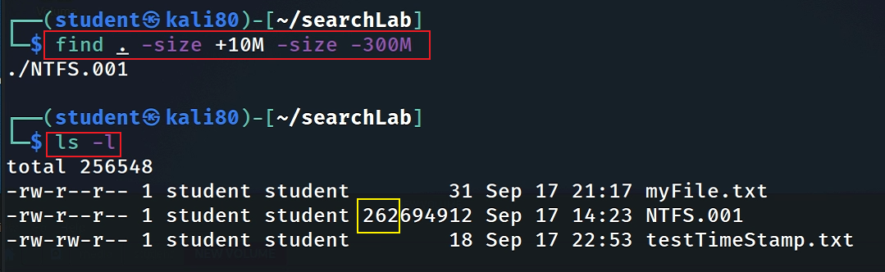
Find files that size between 10MB and 300MB

Slide 36
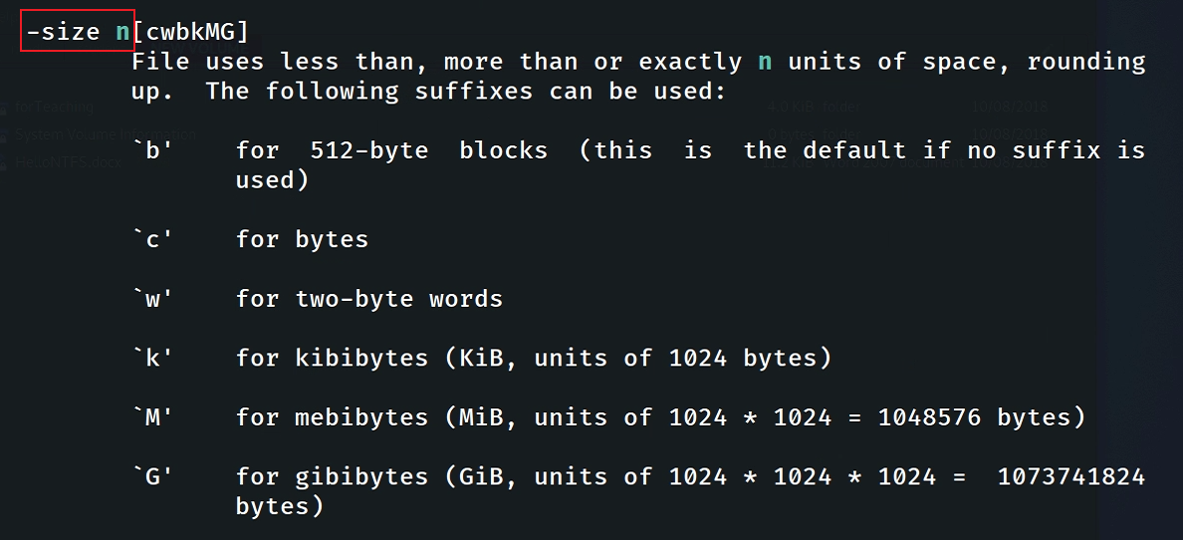

Slide 37
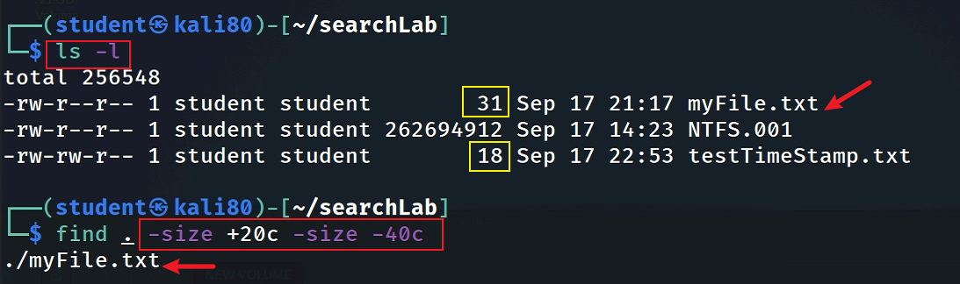
Find files that size between 20 – 40 bytes

Slide 38
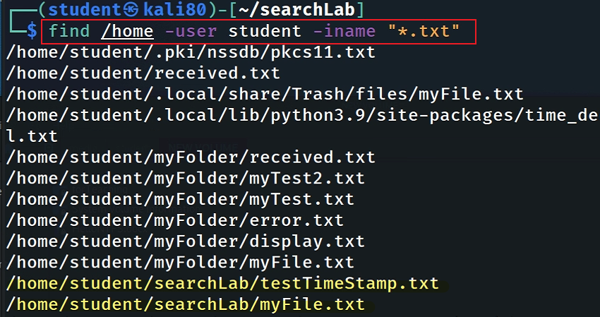
Find Particular Files of User
To find all .txt files of user student under /home directory.

Slide 39
Why should not trust search results?
anti-forensic
Notes:
https://www.shellhacks.com/fake-file-access-modify-change-timestamps-linux/

Slide 40
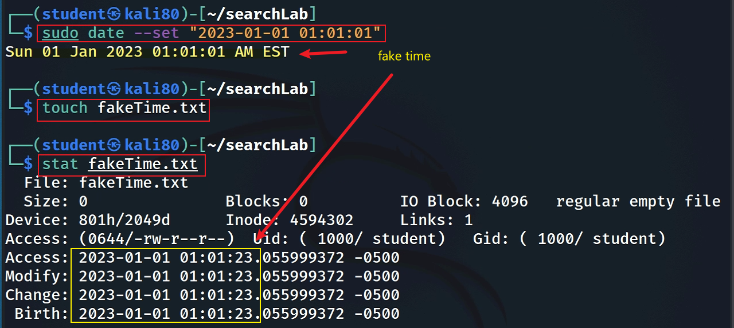
Set a fake [amc]time by changing system time
Notes:
sudo date --set “2023-01-01 01:01:01”

Slide 41
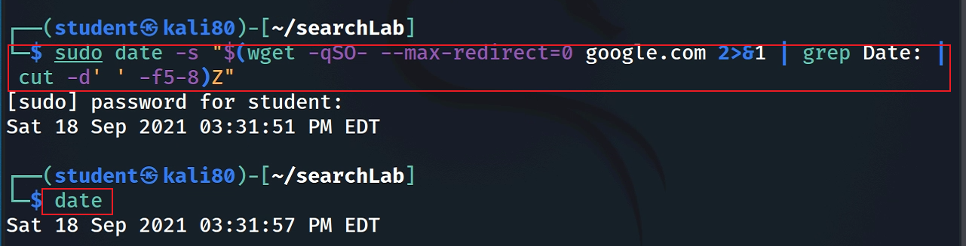
Reset time back to correct time
sudo date -s "$(wget -qSO- --max-redirect=0 google.com 2>&1 | grep Date: | cut -d' ' -f5-8)Z"
Notes:
sudo date -s "$(wget -qSO- --max-redirect=0 google.com 2>&1 | grep Date: | cut -d' ' -f5-8)Z“
https://askubuntu.com/questions/81293/what-is-the-command-to-update-time-and-date-from-internet

Slide 42
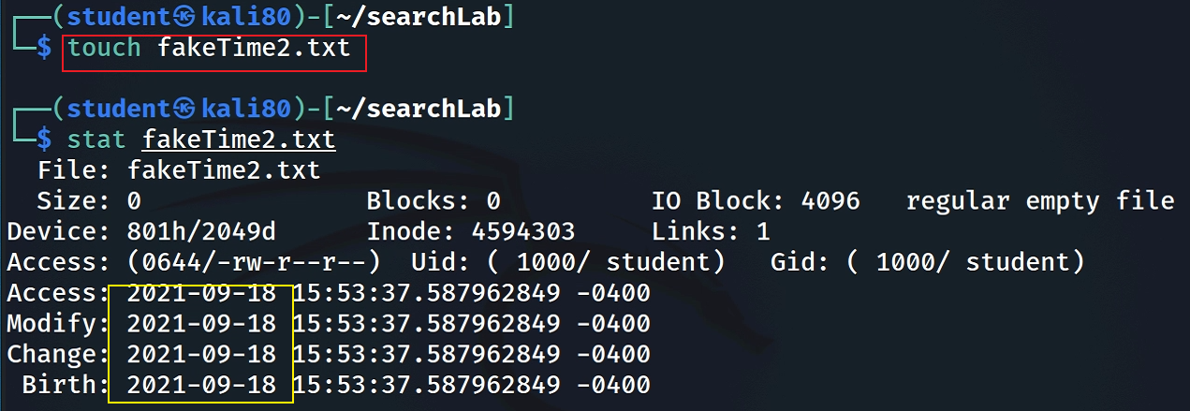
Set a fake time using touch -t
Create a normal file

Slide 43

touch -t [[CC]YY]MMDDhhmm[.SS]
Create a file with the fake system time
touch -a -m -t 203501231145.20 fakeTime2.txt

Slide 44

Copy a fake timestamp -r
Create a normal file
Copy a timestamp from fakeTimes2.txt

Slide 45

Anti-anti-forensics

Slide 46
Real Word Examples
Find a Picture of QR Code: Celebrate Catch the flag competition 2025

Slide 47
Count how many .jpg files in the current directory (and all subdirectories) were last modified between June 1, 2025 and October 1, 2025.
Part | Meaning
find . | Start searching in the current directory (.) and all its subfolders recursively.
-type f | Restrict the search to regular files only (not directories, devices, or symlinks).
-name "*.jpg" | Match filenames that end in .jpg (the quotes protect the * from shell expansion).
-newermt "2025-06-01 00:00:00" | Select files modified after June 1 2025 at 00:00:00. 🔹 -newermt = “newer than modification time” — it lets you specify human-readable timestamps.
! -newermt "2025-10-01 23:59:59" | The ! negates the test → excludes files modified after Oct 1 2025 at 23:59:59. So together, the two -newermt conditions mean: “files modified between June 1 and Oct 1 2025.”
| | Next task
wc -l | Counts the number of lines in the output — since each file path is printed on its own line, this gives the number of JPG files found in that date range.
Notes:
find . -type f -name "*.jpg" -newermt "2025-06-01 00:00:00" ! -newermt "2025-10-01 23:59:59" | wc -l

Slide 48
Follow-up questions
Can we find file based on creation time
find . -type f -name "*.jpg" -newerct "2025-06-01" ! -newerct "2025-10-01“?
Why not?
Can we automatically find the QR code using AI (computer vision)?

Slide 49
A small research project (extra credits)
Assume someone faked timestamps. How can you automatically detect the fake timestamps?
Can AI approach solve the problem?
I will hire a student to work on the project.
Notes:
https://news.ycombinator.com/item?id=8820808

Slide 50
Copy a whole folder
For a folder containing multiple files, what is the difference between “before” and “after” copying in terms of timestamps

