Slide 1
The Sleuth Kit (TSK)
Command-line digital forensics workflow
Notes:
http://www.sleuthkit.org/sleuthkit/docs/api-docs/4.9.0/basicpage.html

Slide 2
Learning Objectives
Explain the relationship between Autopsy and The Sleuth Kit (TSK).
Describe TSK analysis layers: image, volume system, file system, metadata, file names, and data units.
Use core TSK tools to inspect a disk image, locate deleted files, and recover content.
Document commands, offsets, inodes, data units, and recovered output as forensic evidence.

Slide 3
The Sleuth Kit (TSK) for Investigation

Slide 4
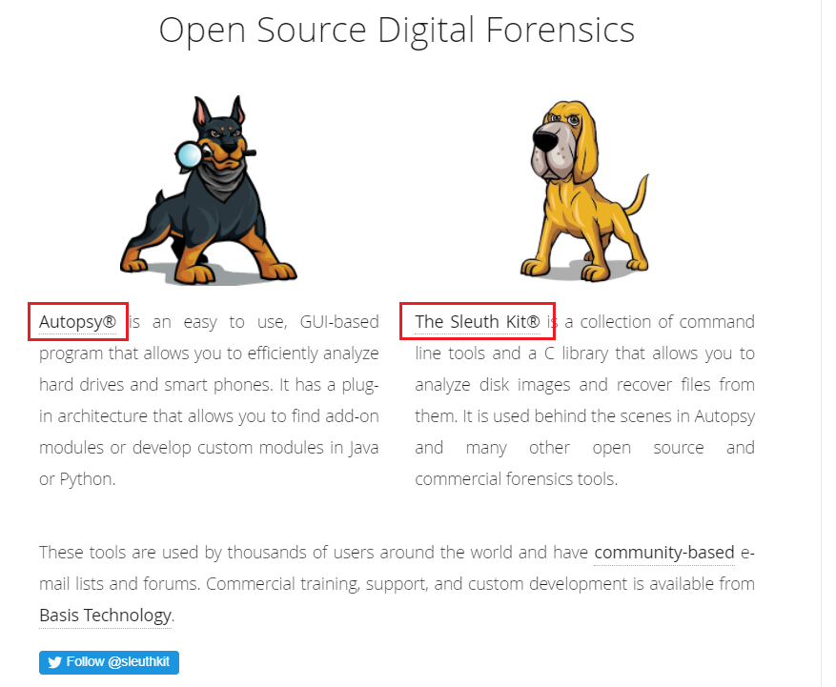

Slide 5
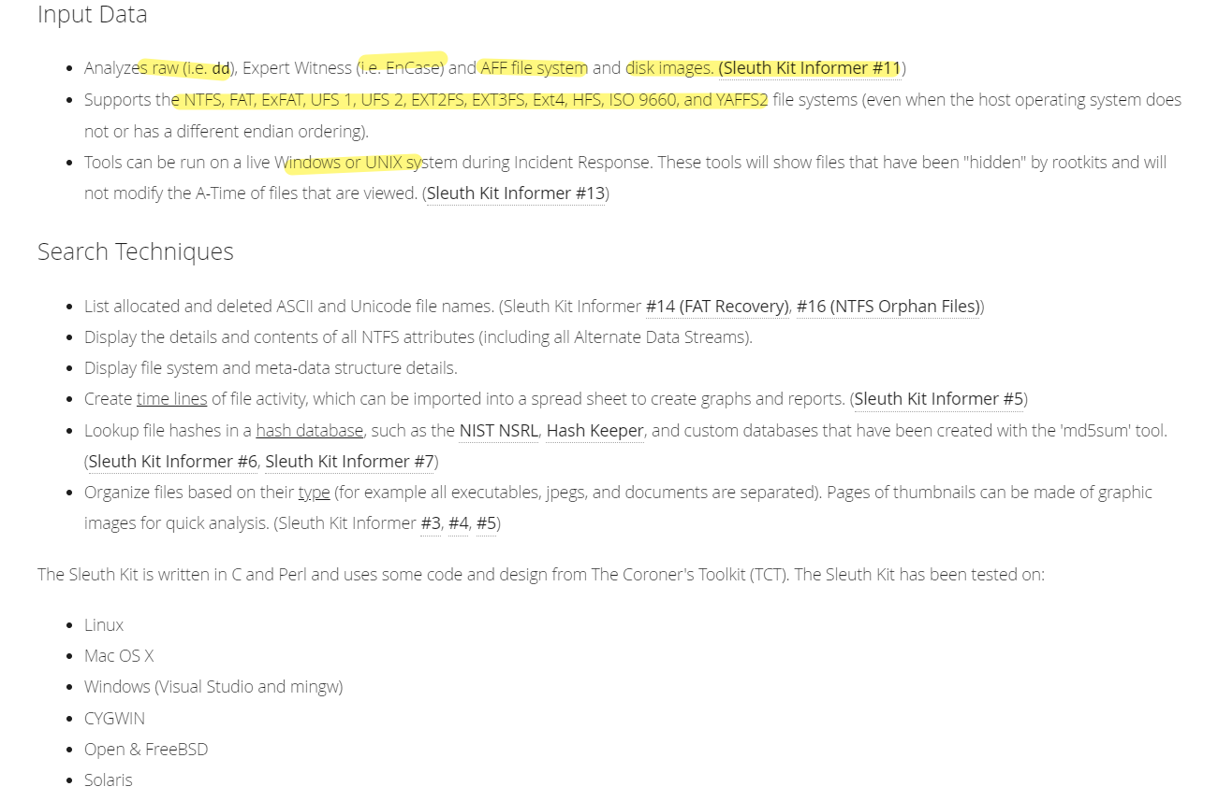
https://www.sleuthkit.org/sleuthkit/desc.php

Slide 6
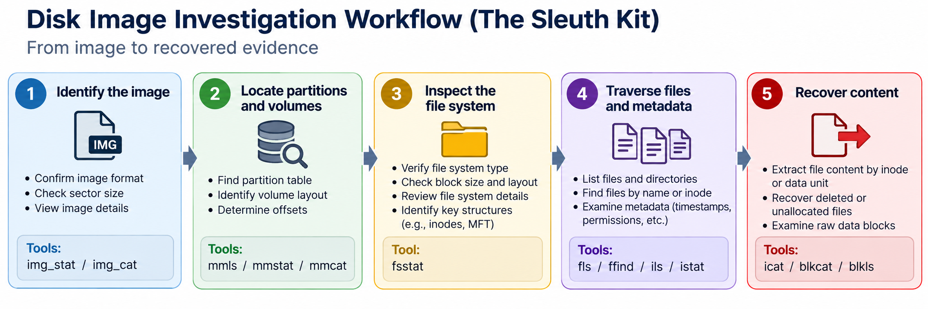

Slide 7
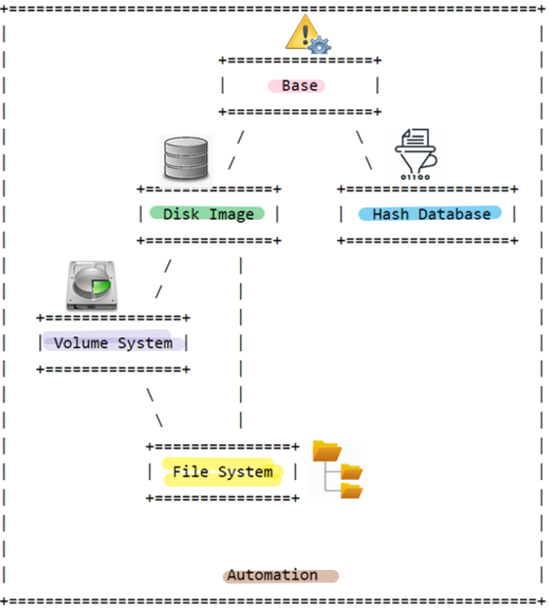


TSK Architecture Layers
Support layer: error handling, data types, and shared utility functions.
Image layer: opens disk images and raw devices in supported formats.
Hash database layer: supports fast hash lookups for known/unknown files.
Volume-system layer: interprets partition tables and locates volumes.
File-system layer: interprets file systems such as FAT, NTFS, Ext, and others.
Application layer: combines lower layers into command-line tools and libraries.
Notes:
http://www.sleuthkit.org/sleuthkit/docs/api-docs/4.9.0/basicpage.html

Slide 8


Storage Management vs. File-System Management
Storage-management view: which physical units are occupied and where they are located.
File-system view: which file owns those units and what metadata describes the file.
Forensics connects both views: location on media → file-system metadata → user-visible file.
Analogy image source shown for teaching use

Slide 9
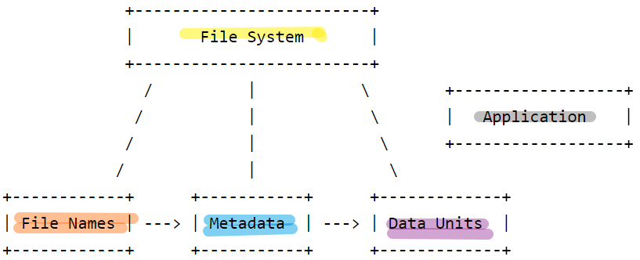
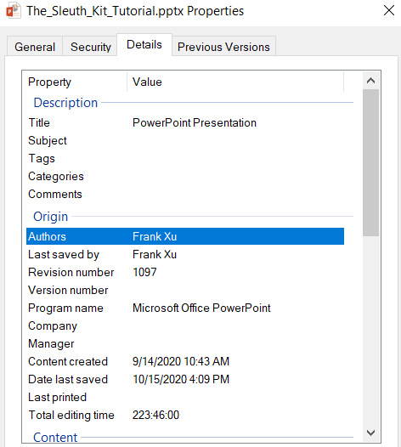
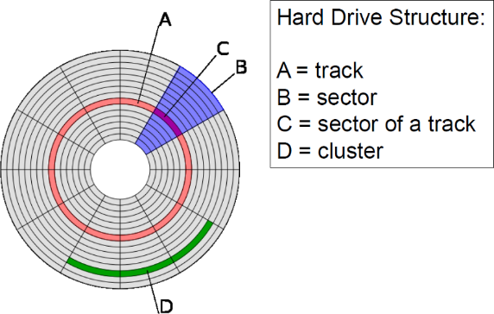
File-System Layers Used by TSK
File-system category
Overall layout, sizes, labels, and feature flags.
Journal / metadata support
Records of file-system updates and recent activity, when available.
File-name category
Directory entries that map names to metadata addresses.
Data-unit category
Blocks/clusters that store file content.
Metadata category
Inodes, NTFS MFT entries, timestamps, permissions, and pointers to content.
Notes:
http://www.sleuthkit.org/sleuthkit/docs/api-docs/4.3/fspage.html

Slide 10




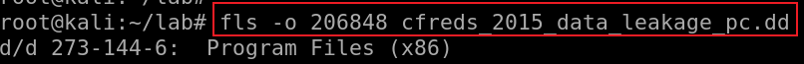
Disk image
Metadata layer
Size, timestamps, and pointers to content.
Data-unit layer
Sectors/blocks contain the bytes.
File-name layer
Directory entry points to metadata.
User-visible name
foo.txt
Example metadata
size: 10 bytes
date: 1/1/23
metadata address
273
deleted metadata
144-6
Forensic takeaway: TSK can follow names → metadata → data units, or recover content directly when file names are gone.

Slide 11
TSK Tool Families
Image and disk tools
img_stat — identify image format and size details
img_cat — output raw image contents
disk_stat / disk_sreset — inspect or temporarily reset Host Protected Area (HPA) information
Volume tools
mmls — list partition layout and unallocated gaps
mmstat — show volume-system details
mmcat — extract a volume/partition to stdout
Case-level tools
tsk_gettimes — collect temporal data for timeline analysis
tsk_loaddb — load metadata into SQLite for scripting
tsk_recover — export allocated or unallocated files from an image
Notes:
https://wiki.sleuthkit.org/index.php?title=TSK_Tool_Overview
https://linuxhint.com/kali_linux_top_forensic_tools/
https://linuxhint.com/kali_linux_top_forensic_tools_2020_part_2/
https://github.com/sleuthkit/sleuthkit/wiki/The_Sleuth_Kit_commands

Slide 12
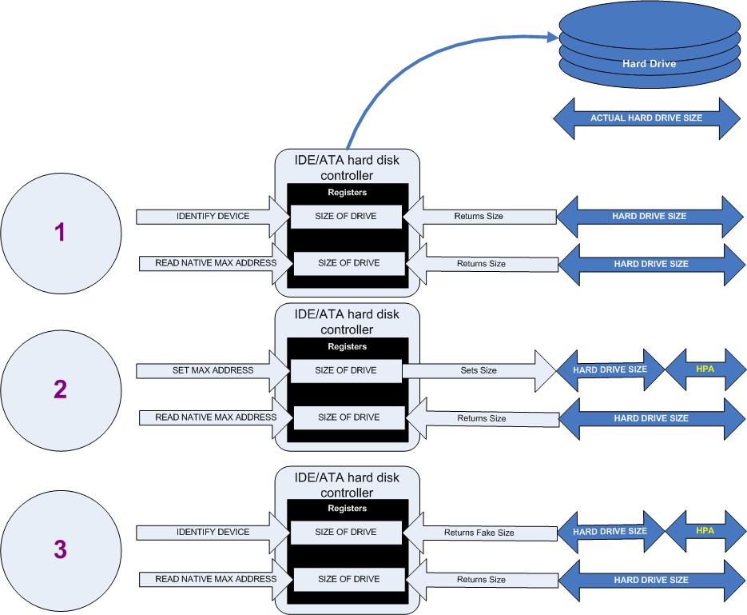
Host Protected Area (HPA): disk area hidden from normal OS access.
Notes:
https://upload.wikimedia.org/wikipedia/en/5/5f/Hpacreate.png

Slide 13
Why HPA Matters in Forensics
Legitimate uses: firmware support, diagnostics, recovery partitions, and manufacturer utilities.
Forensic concern: data stored in an HPA may be invisible to ordinary operating-system tools.
Anti-forensic concern: malware or rootkits may attempt to hide files outside the visible disk area.
Investigation step: check for HPA/DCO before concluding that a physical device has no additional hidden sectors.

Slide 14
Core File-System Tools
fsstat: summarize file-system layout, size, block/cluster size, and labels.
Data-unit tools
blkcat — extract data units
blkls — extract/list unallocated space
blkstat — inspect a data unit
blkcalc — map unallocated-space offsets back to original image offsets
Name and metadata navigation
fls — list directory entries, including
deleted entries
ffind — find names pointing to a metadata address
Metadata-centered recovery
icat — extract file content by metadata address
ifind — identify metadata by file name or data unit
ils / istat — list or inspect metadata records

Slide 15
Hands-on Scenario: Deleted File Recovery
Goal: locate and recover a deleted file, then explain the evidence path from directory entry to metadata address to file content.

Slide 16
Disk Image Level
Start by identifying what kind of image you have and what structure begins at sector 0.

Slide 17
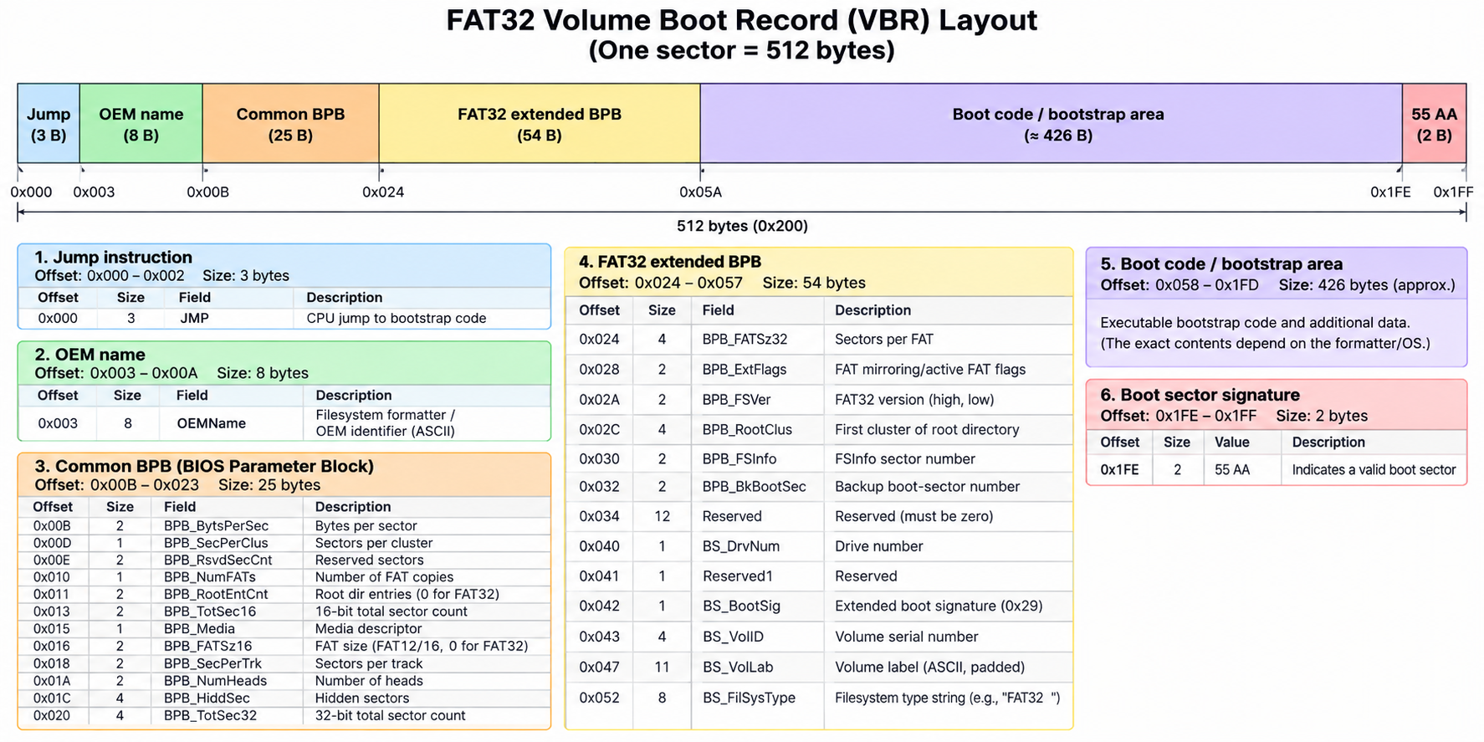

Slide 18
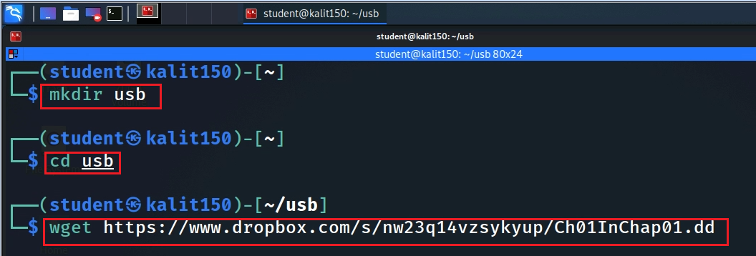
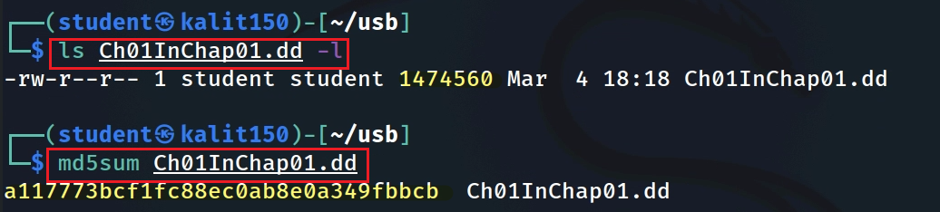
Download / prepare the practice disk image
Notes:
https://www.dropbox.com/s/nw23q14vzsykyup/Ch01InChap01.dd

Slide 19
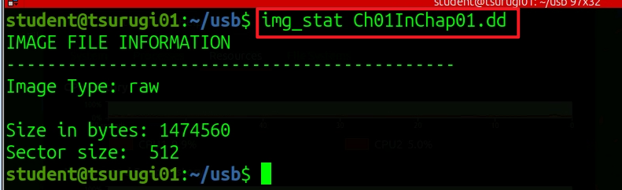
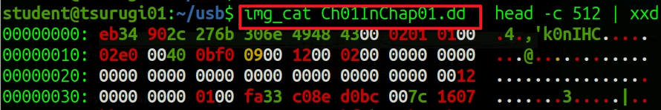





FAT Volume Boot Record (VBR) Example
img_stat: identify image format and basic properties
img_cat + hexdump: inspect the first sector when you need
to verify boot-sector or MBR/VBR bytes.

Slide 20
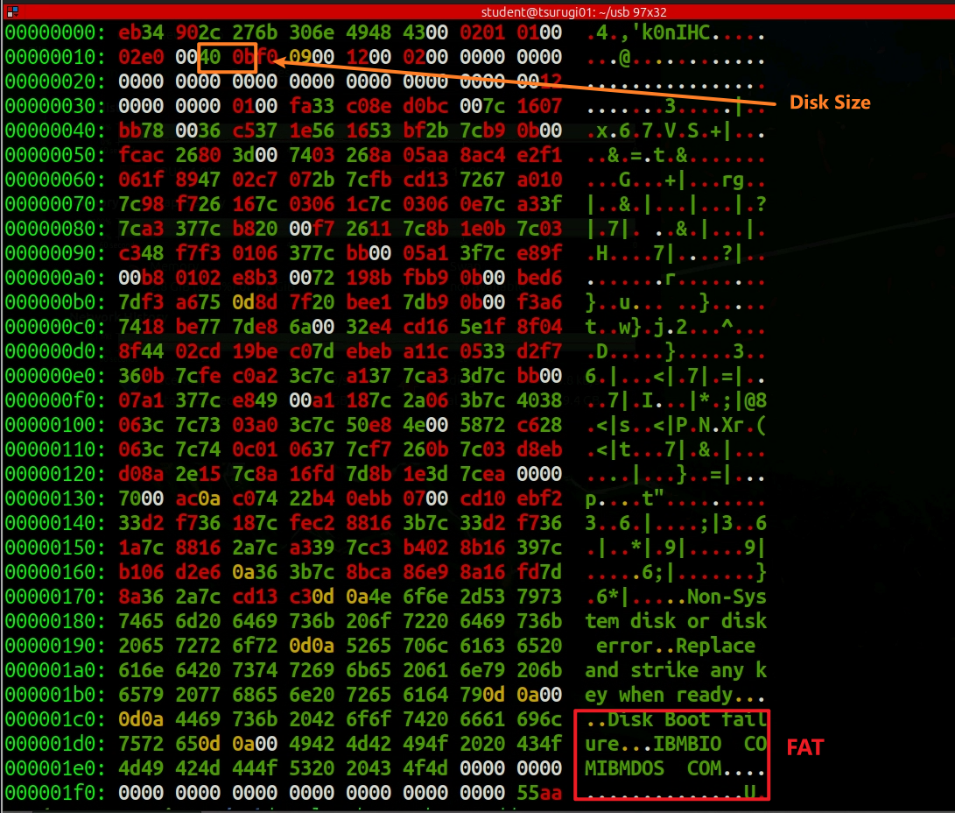
Practice image: Ch01InChap01.dd
Sector 0 contains a FAT Volume Boot Record (VBR).

Slide 21
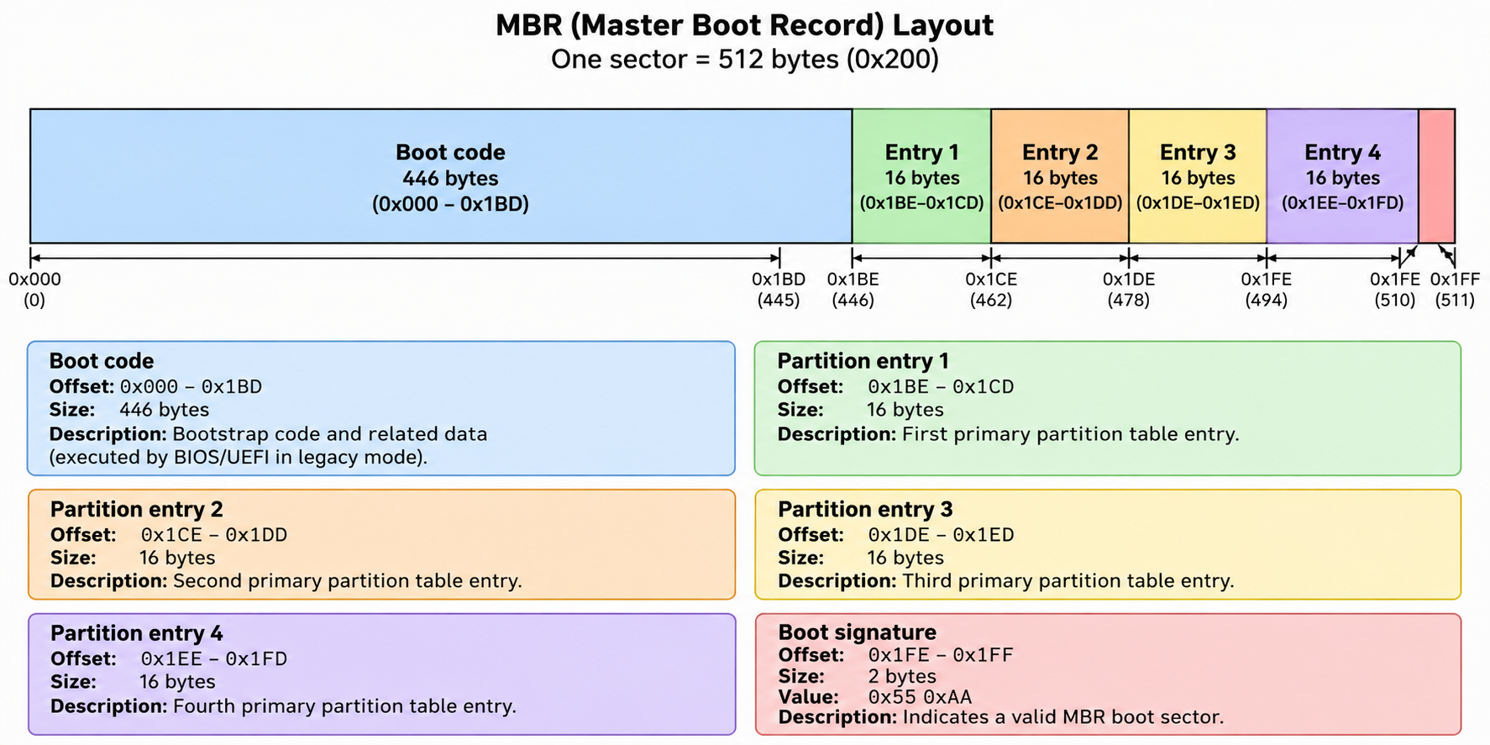

Slide 22
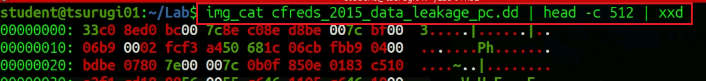
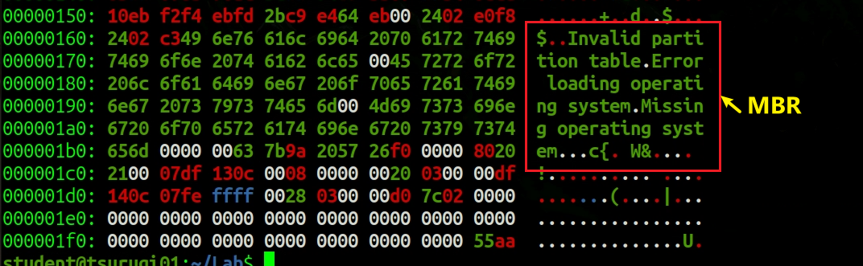
Example source: NIST CFReDS data leakage image (https://cfreds-archive.nist.gov/data_leakage_case/data-leakage-case.htm)
Sector 0 in an NTFS image: Master Boot Record (MBR)
...

Slide 23
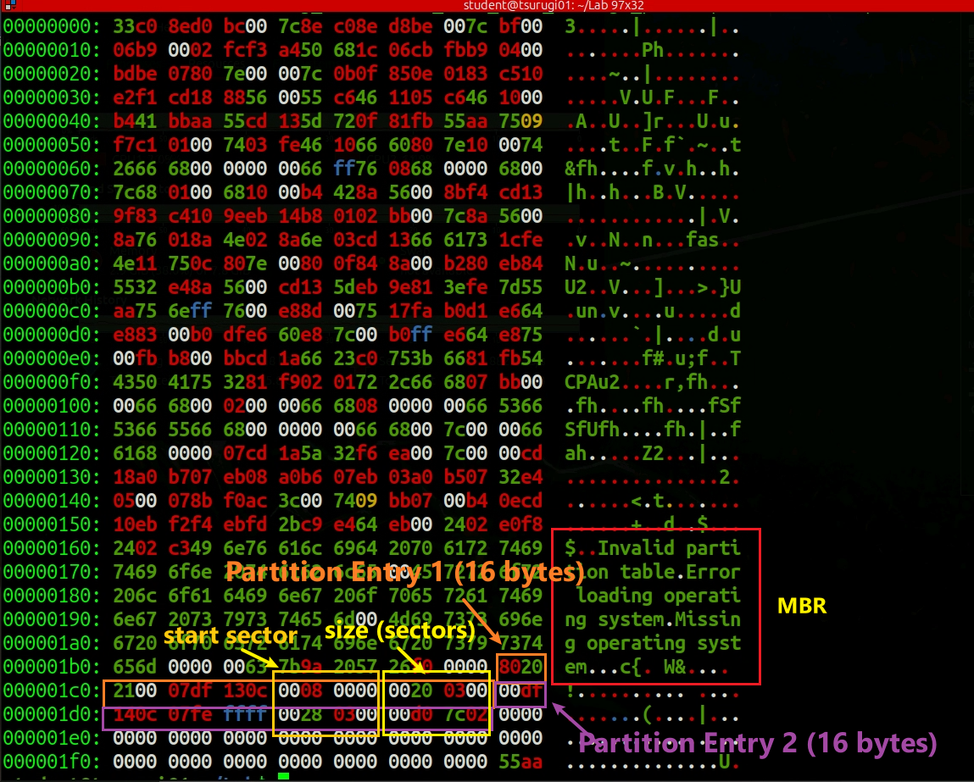
Example image source: NIST CFReDS data leakage image

Slide 24
Volume-System Tools: Partition Level
Use volume tools when the image contains a partition table or multiple volumes.

Slide 25

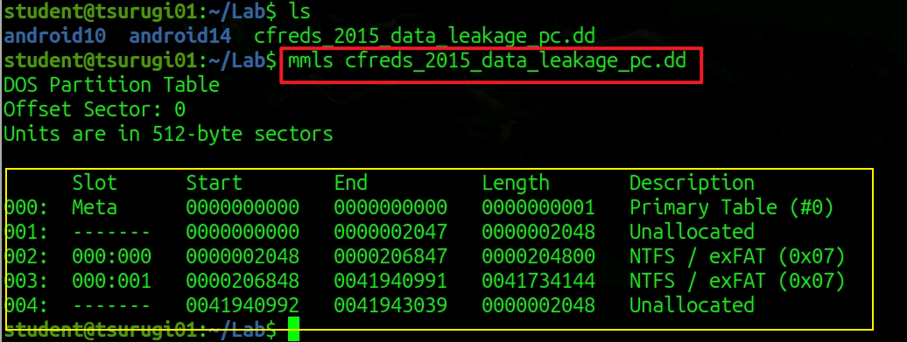
mmls: identify partition layout and offsets
Example source: NIST CFReDS data leakage image (download from https://cfreds-archive.nist.gov/data_leakage_case/data-leakage-case.html)
If the image contains a partition table, use the start sector as the offset for later file-system commands.

Slide 26
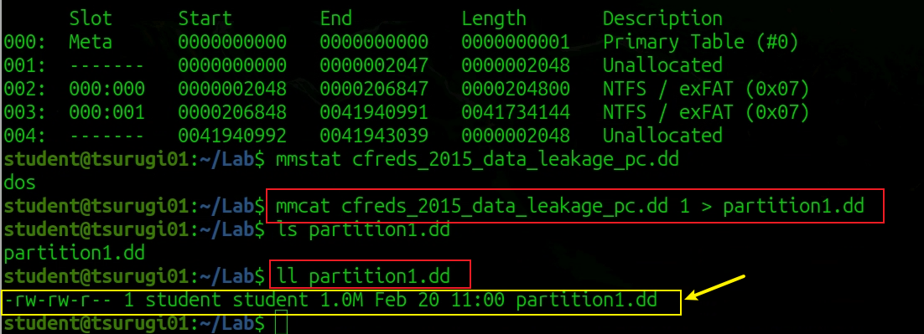
mmcat: extract a selected volume/partition to stdout

Slide 27
File-System Tools: Inside a Partition
Once the correct offset is known, file-system tools can list, inspect, and recover files.

Slide 28
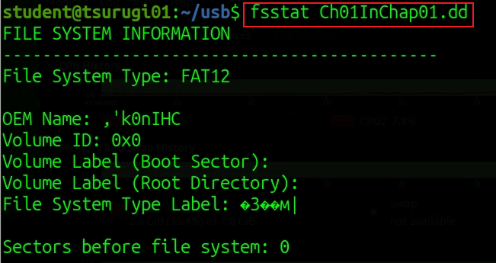
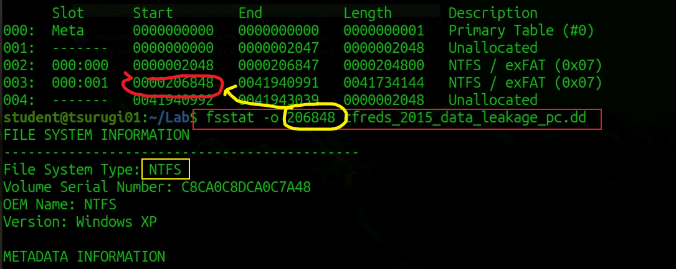
fsstat: verify file-system type, layout, and block size
Example: NTFS file-system statistics

Slide 29
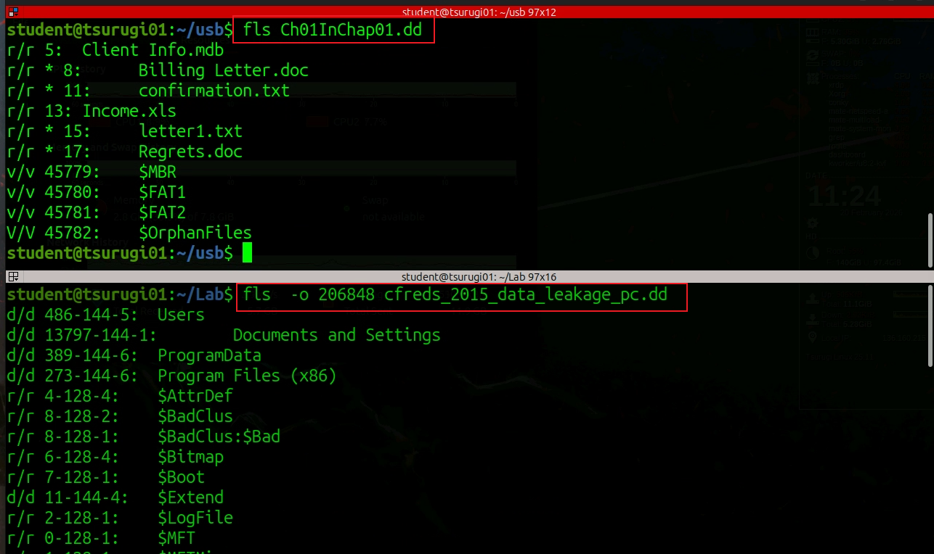


fls: list directory entries in the file system
Key interpretation: allocated vs. deleted entries, directory vs. file entries, and metadata address.

Slide 30
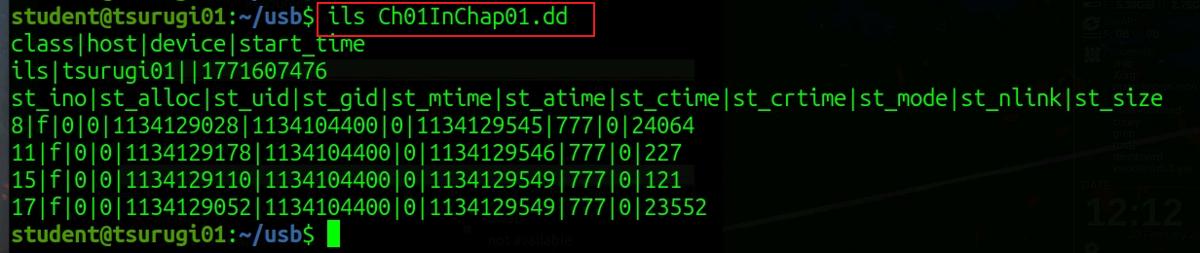
ils: list metadata records in a pipe-delimited format for scanning or scripting.

Slide 31
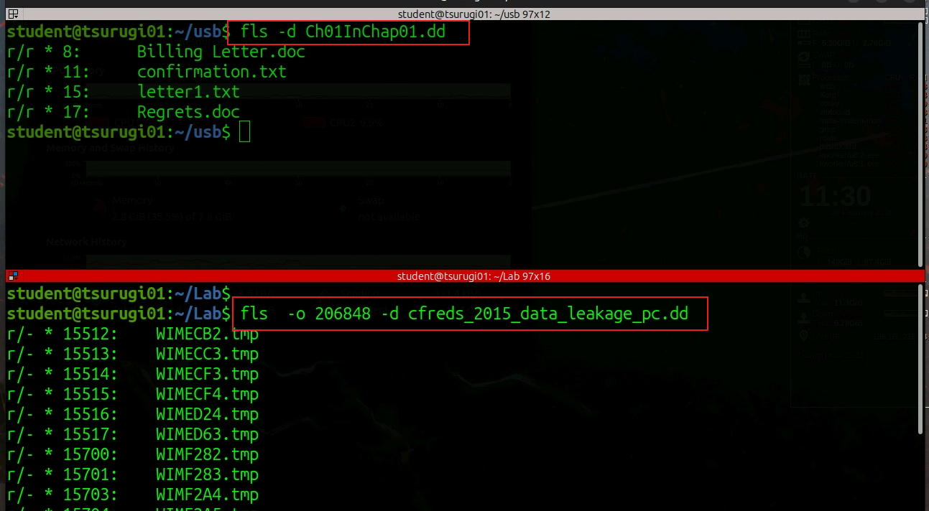
fls -d: display deleted directory entries only (FAT vs MBR)

Slide 32
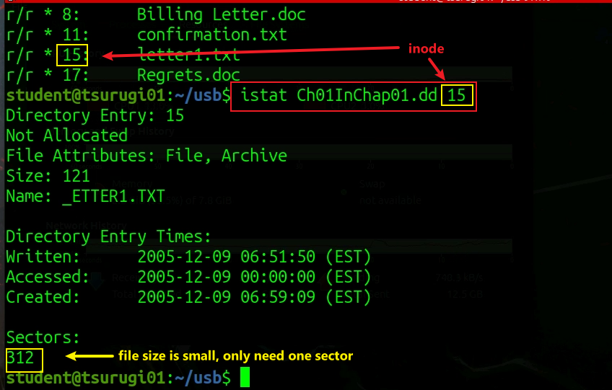
istat: inspect a metadata record / inode

Slide 33
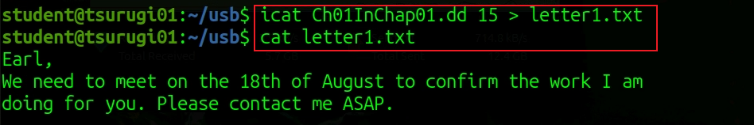
icat: recover file content by metadata address, even without using the file name

Slide 34
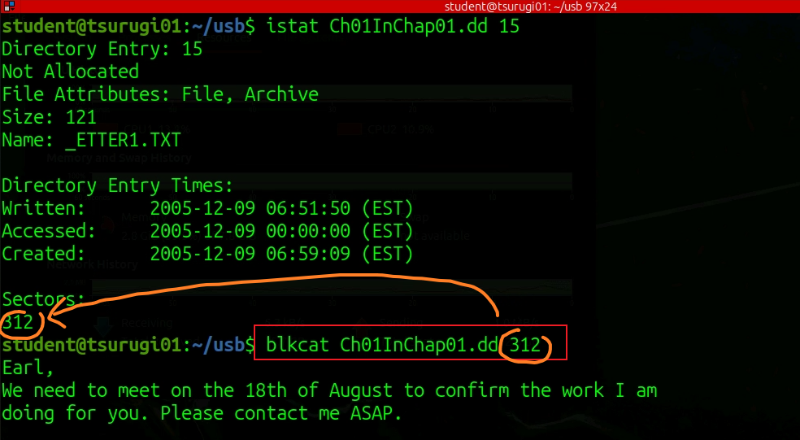
Data Unit Level
blkcat: extract raw content from a specified file-system data unit.
Notes:
blkcat Ch01InChap01.dd 313-358 > regets.doc
blkcat Ch01InChap01.dd 287 27 > regets.doc
blkcat will read and output 27 consecutive blocks starting from block 287.

Slide 35
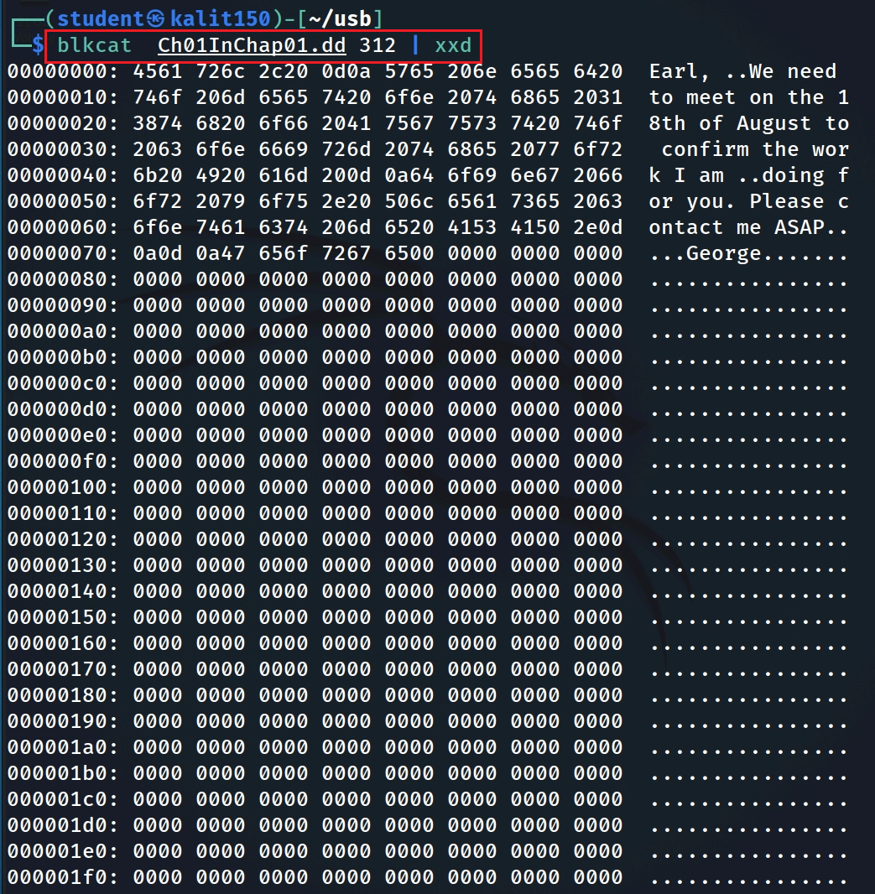
blkcat + hex view: inspect raw data-unit bytes
Question: what is the maximum offset within a 512-byte sector?
echo "$((16#1ff))" # 0x1ff = 511; offsets 0–511 are 512 bytes total
Notes:
echo "$((16#1ff))"

Slide 36
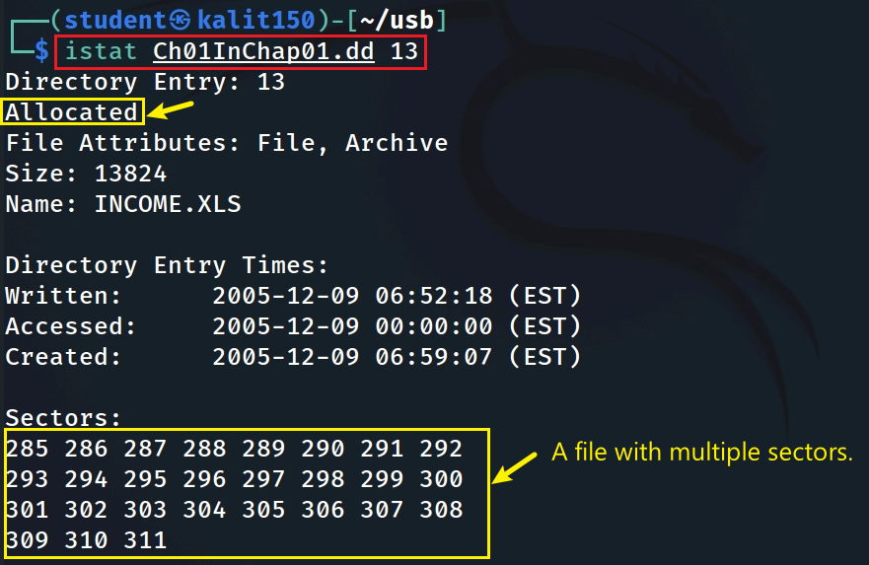
A file may occupy multiple data units

Slide 37
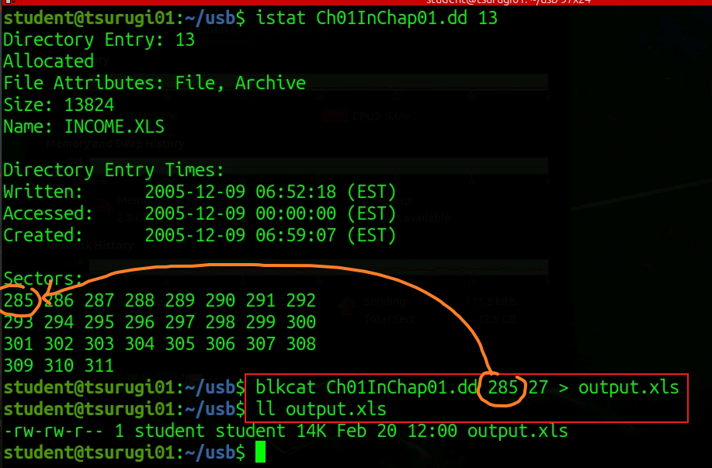
Example: blkcat reads 27 consecutive blocks starting at block 287.

Slide 38
Mounting a Disk Image Read-Only
Mount only after you understand the evidence structure, and keep the image read-only to avoid changing evidence.

Slide 39
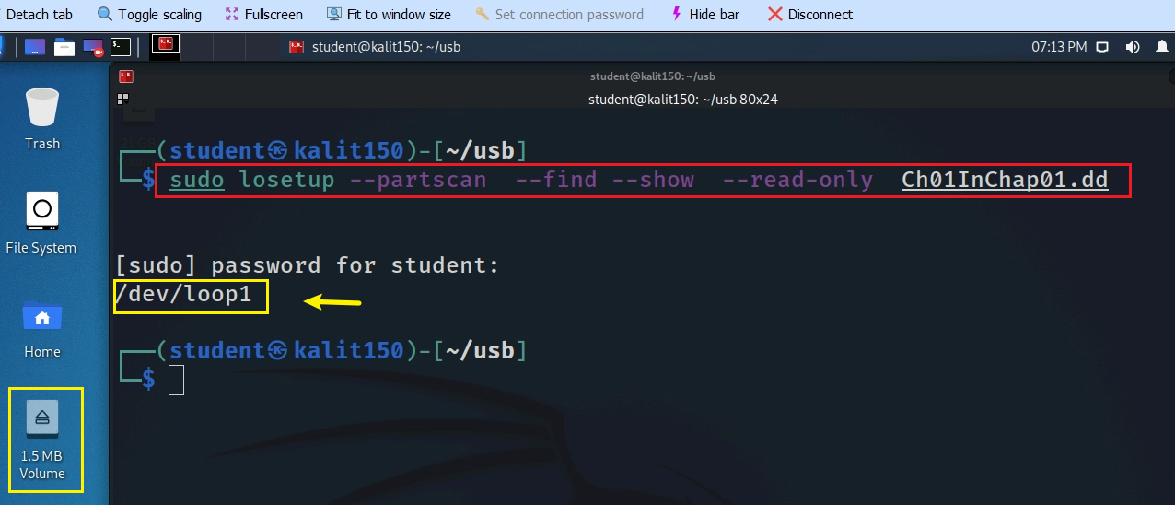
-partscan: scan the image partition table and create loop devices for detected partitions.
--find: use the first available loop device.
--show: print the loop device path so later commands can reference it.
--read-only: protect the evidence image from accidental writes.
Notes:
sudo losetup --partscan --find --show --read-only Ch01InChap01.dd

Slide 40
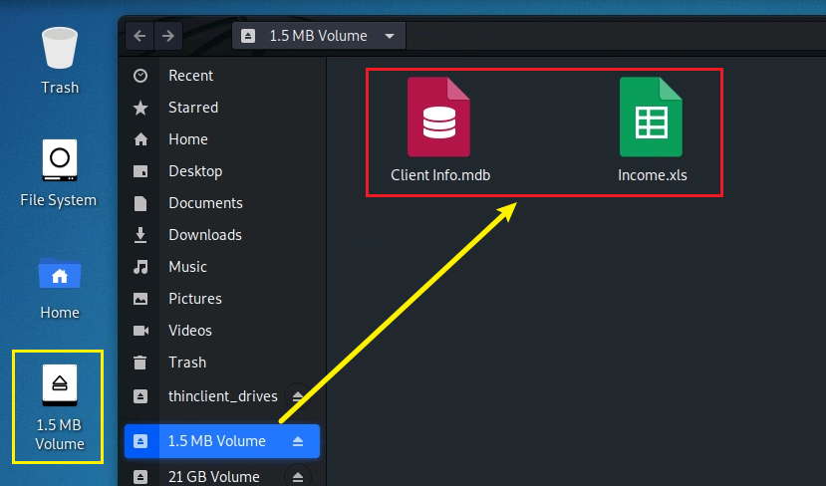
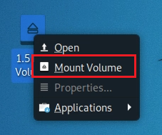
1. Mount the image read-only
2. Inspect mounted content

Slide 41
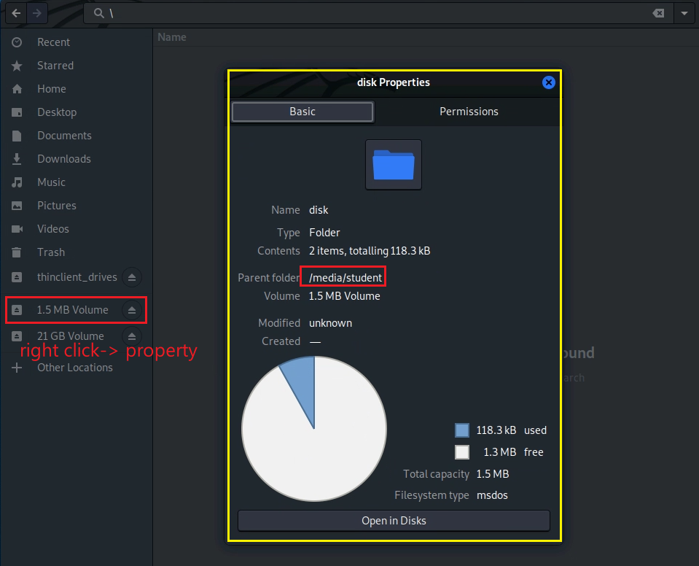
Verify the mounted path
Replace “student” with your actual Linux username.

Slide 42
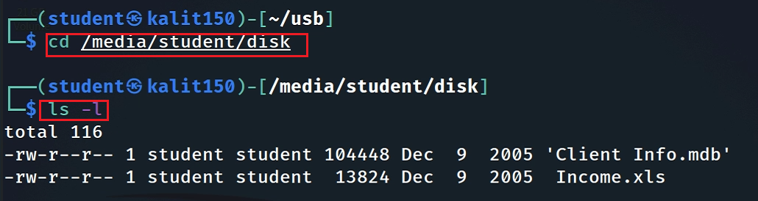
Inspect the mounted disk content

Slide 43
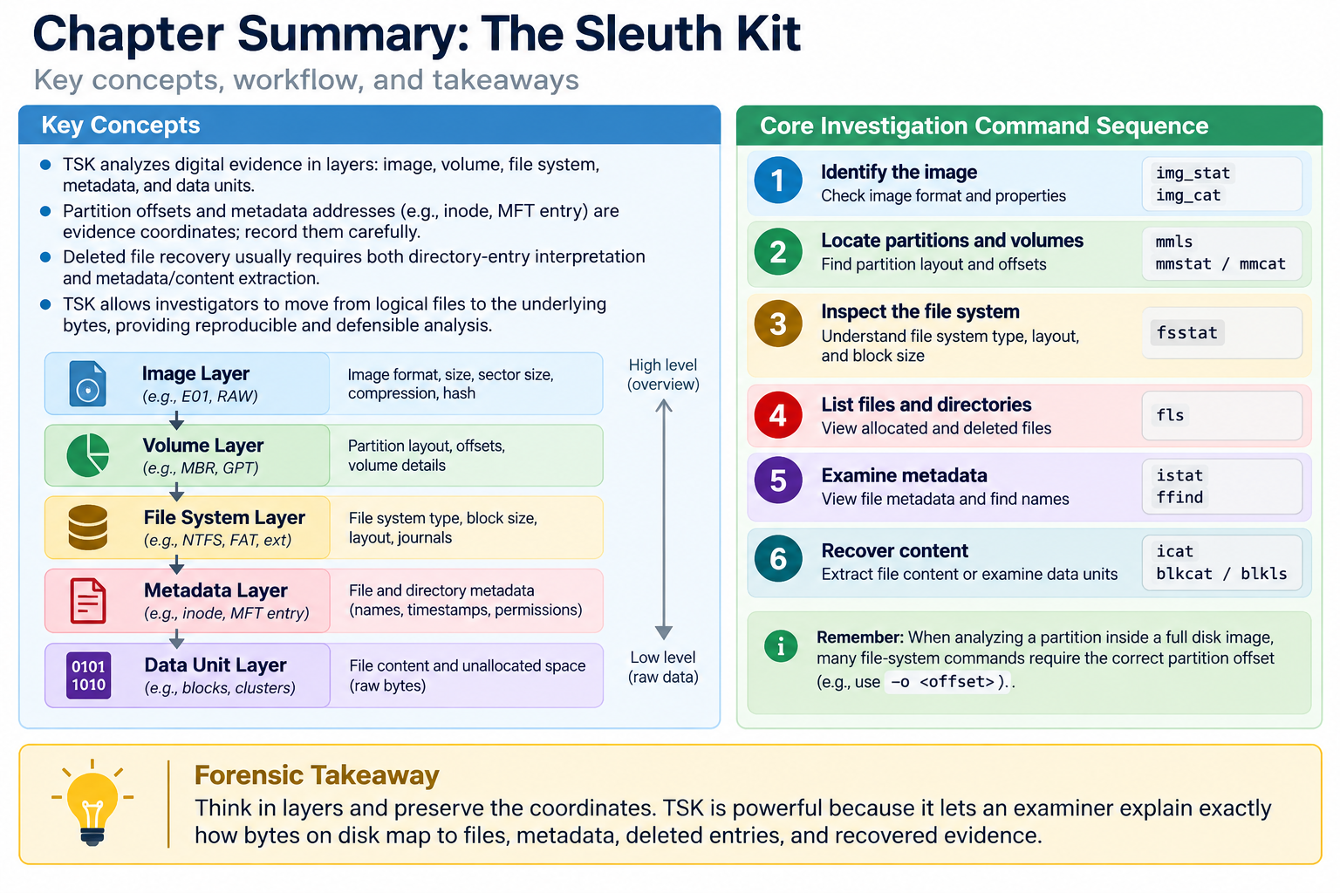

Slide 44


Assignment Part 1: Deleted File Recovery
Count deleted files in Ch01InChap01.dd and show supporting evidence.
Recover INCOME.XLS with icat; document the metadata address.
Recover the same file with blkcat; document the data units.
Open or inspect the recovered .xls file and capture the result.
Verify that both recovered outputs are equivalent.

Slide 45
Assignment Part 2: Explore One New TSK Command
Choose one TSK command not covered in class.
Explain its purpose, required inputs, important options, and expected output.
Run the command on a provided or self-selected image and capture screenshots.
Interpret the result in forensic terms, not just as command output.
If you use your own input files, submit those inputs with the report.

