Slide 1
Computer Systems and Digital Evidence

Slide 2
Overview
Computer-system layers and forensic artifacts
Programs, processes, threads, and memory
Why computer forensics is technically hard
Disk geometry, sectors, and disk-size calculation
MBR/GPT partitions and the PC boot process

Slide 3
Computer systems

Slide 4
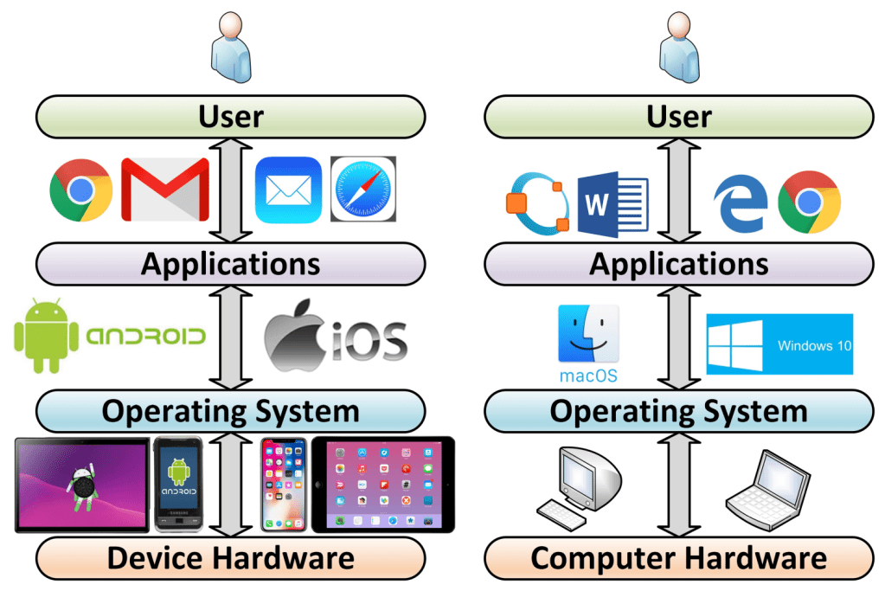
Layers of a computer system
Forensic view:
User actions create artifacts across layers.
Evidence can appear in apps, OS logs, file systems, disk sectors, and memory.
https://windsongtraining.ca/the-technology-layer-cake-users-apps-os-and-hardware/

Slide 5
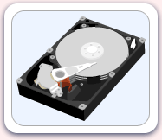
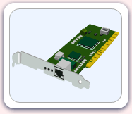
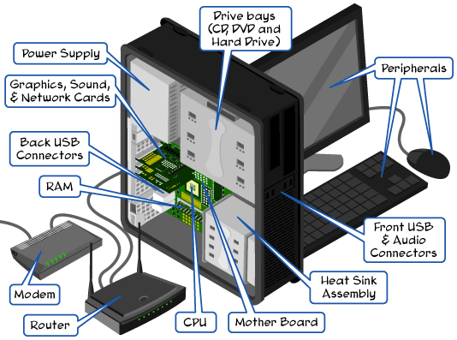
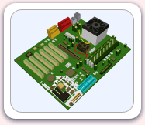
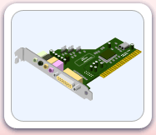
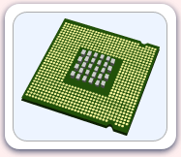
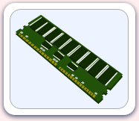



Parts of the computer
http://www.carnegiecyberacademy.com/facultyPages/computer/computers.html

Slide 6
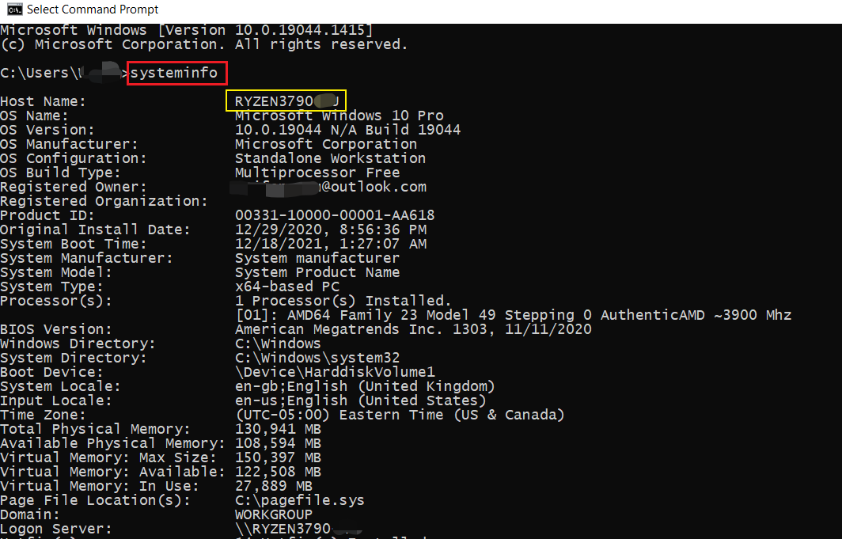
Check system specifications

Slide 7
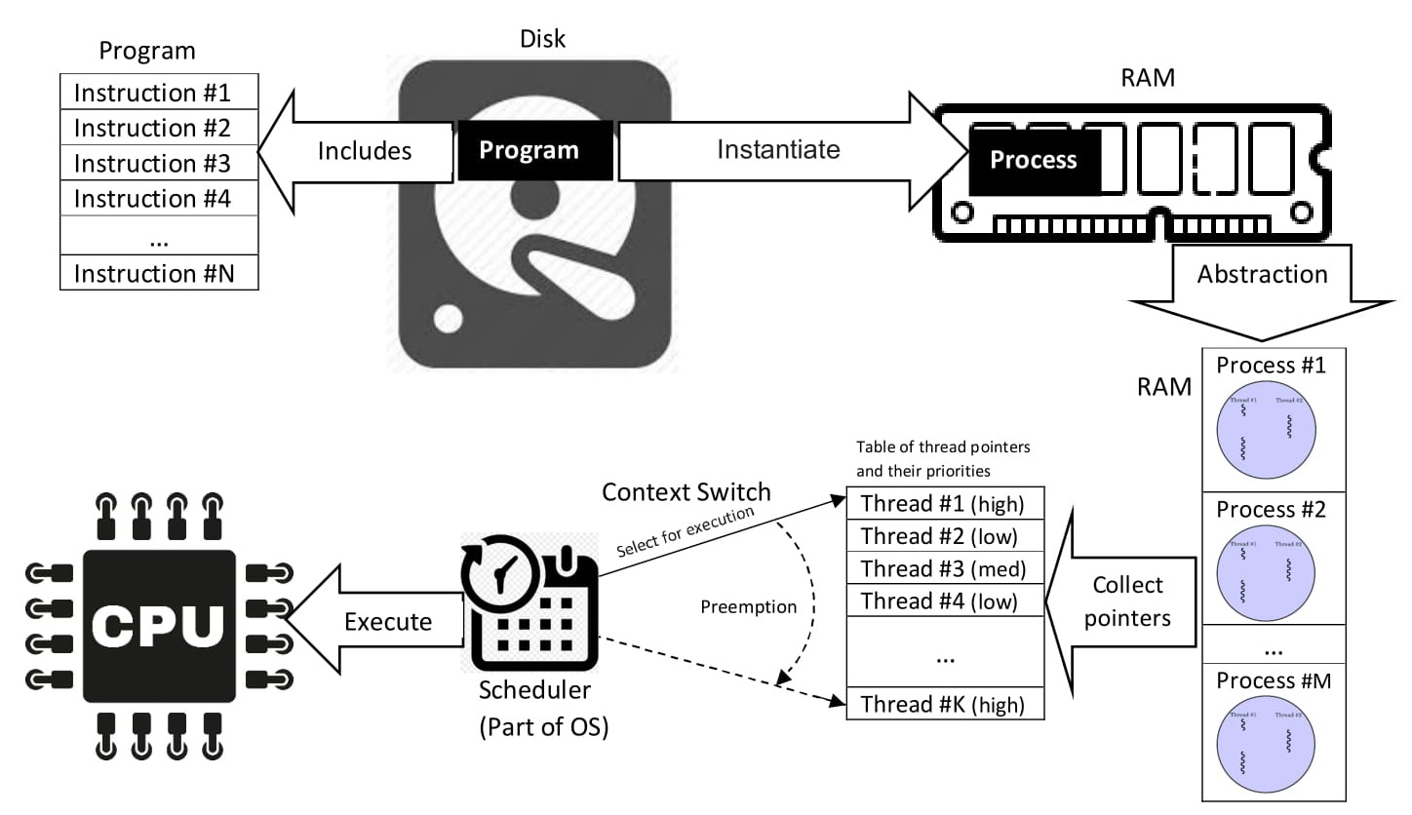
How do computers work?
Program vs. Process vs. Thread
Program: code stored on disk.
Process: a running instance loaded into memory.
Thread: an execution path inside a process.
Forensics: connect disk artifacts to runtime behavior.
Malware / behavior analysis
https://en.wikipedia.org/wiki/Process_(computing)

Slide 8
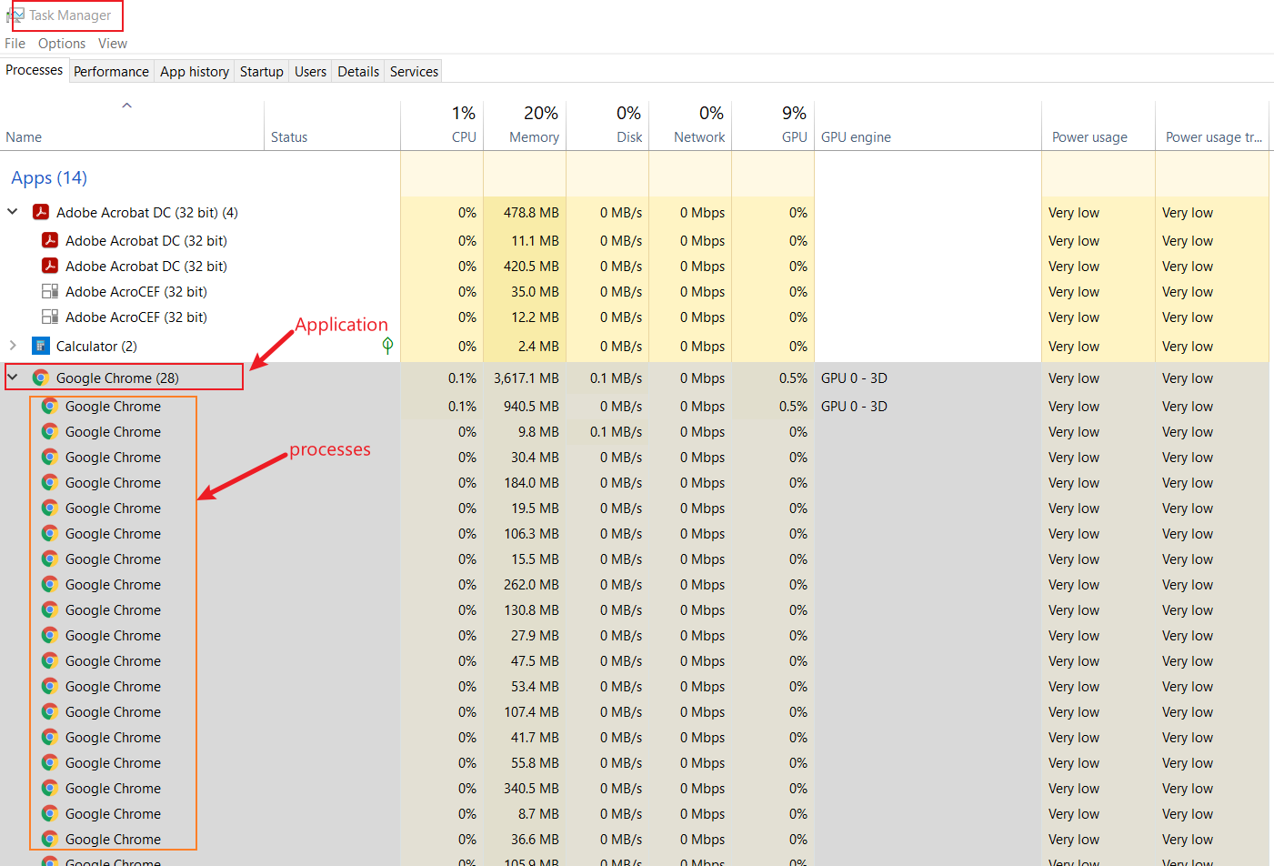
Example: one application can create many processes
Task Manager evidence: process names, PIDs, memory, CPU, disk, network use

Slide 9
Why is computer forensics hard?
Technical diversity
  Different operating systems, versions, applications, and hardware.
Rapidly changing devices and data formats
  Mobile, IoT, cloud, vehicles, and app/database updates change artifacts.
Volume and correlation
  Examiners must collect, filter, analyze, and validate large heterogeneous evidence sets.
Interdisciplinary requirements
  Forensics combines computing, cybersecurity, law, and criminal justice.

Slide 10
Areas of digital forensics
OS logs and application logs
Memory forensics
Static / low-level analysis:
program code and malware bytes
Dynamic analysis:
processes, PIDs, and runtime state
CPU execution context

Slide 11
Hard disk drives

Slide 12
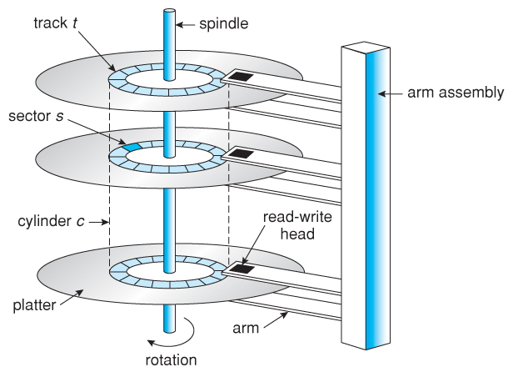
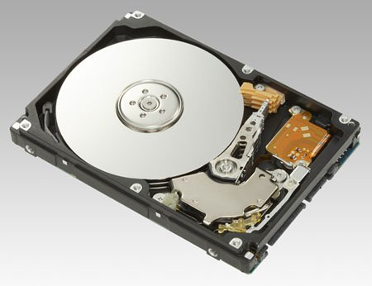
Understand disk drives
https://regmedia.co.uk/2006/12/12/fujitsu_300gb_1.jpg
Abraham Silberschatz, Greg Gagne, and Peter Baer Galvin, "Operating System Concepts, Ninth Edition"

Slide 13
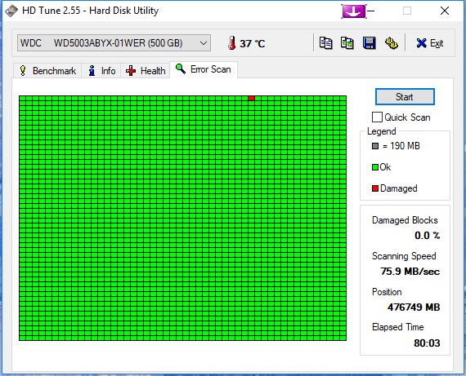
What is a disk sector?
A sector is the smallest addressable storage unit exposed by a disk interface.
Common logical sector size: 512 bytes; many modern disks use 4 KiB physical sectors.
Files consume space in clusters; a cluster is one or more sectors.
Forensics uses sector/LBA offsets to locate partitions and recover data.
https://i.imgur.com/26BalHW.png
Notes:
LBA = Logical Block Addressing.

Slide 14
Calculate total sectors using CHS
# sectors = Cylinders × Heads × Sectors per track
Example values:
  Sectors per track = 400
  Heads = 12
  Cylinders = 17,000
Total sectors = 17,000 × 12 × 400 = 81,600,000

Slide 15
Calculate disk size
1 KiB = 1,024 bytes; 1 MiB = 1,024 KiB; 1 GiB = 1,024 MiB
Bytes = number of sectors × bytes per sector
81,600,000 sectors × 512 bytes = 41,779,200,000 bytes
41,779,200,000 ÷ 1,024³ = 38.91 GiB
Decimal display: ≈ 41.78 GB

Slide 16
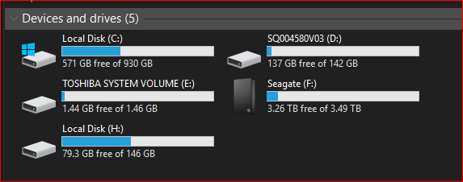
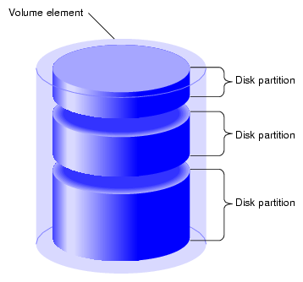
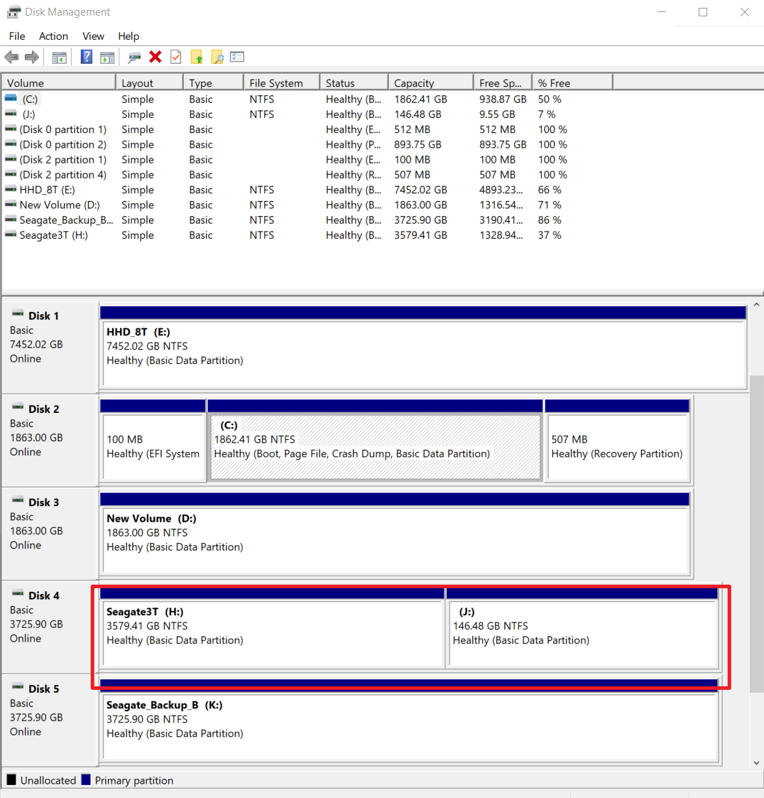
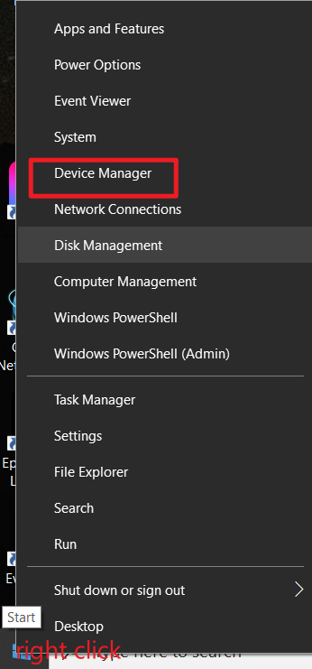
What is a partition?
A partition is a defined region of a disk. The partition table records where each region starts, ends, and what file system it uses.
https://www.maketecheasier.com/assets/uploads/2012/05/partitions-partition-diagram.png

Slide 17
PC boot process

Slide 18
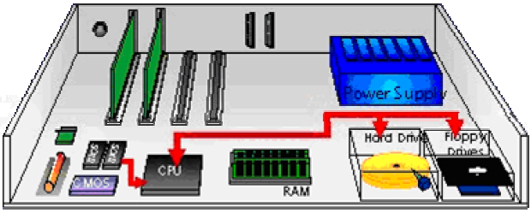
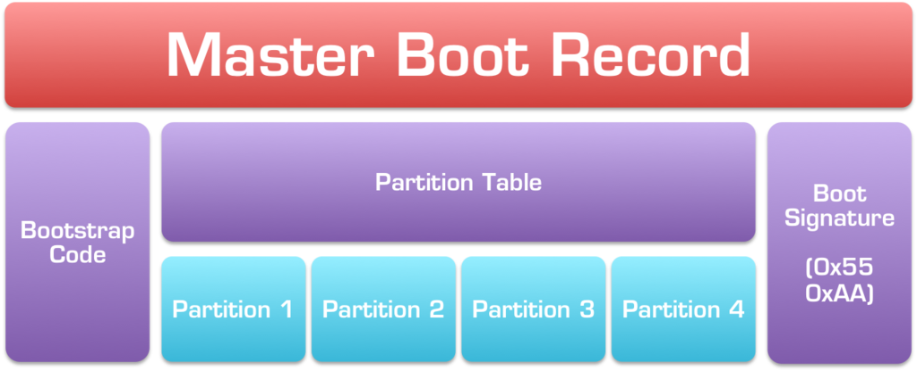
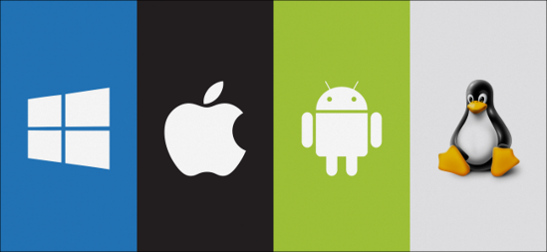



Booting a computer
Power on → firmware performs POST.
Firmware selects a boot device from the configured boot order.
Legacy BIOS reads the MBR from sector 0.
MBR code reads the partition table and jumps to the active partition boot record.
The boot loader loads the OS kernel; the operating system then takes control.
Windows note: the “system” volume stores boot files; the “boot” volume stores the OS files.
Jump to the bootable partition
http://www.c-jump.com/CIS24/Slides/Booting/Booting.html
https://i2.wp.com/neosmart.net/wiki/wp-content/uploads/sites/5/2015/01/Master-Boot-Record.png?resize=1024%2C416&ssl=1

Slide 19
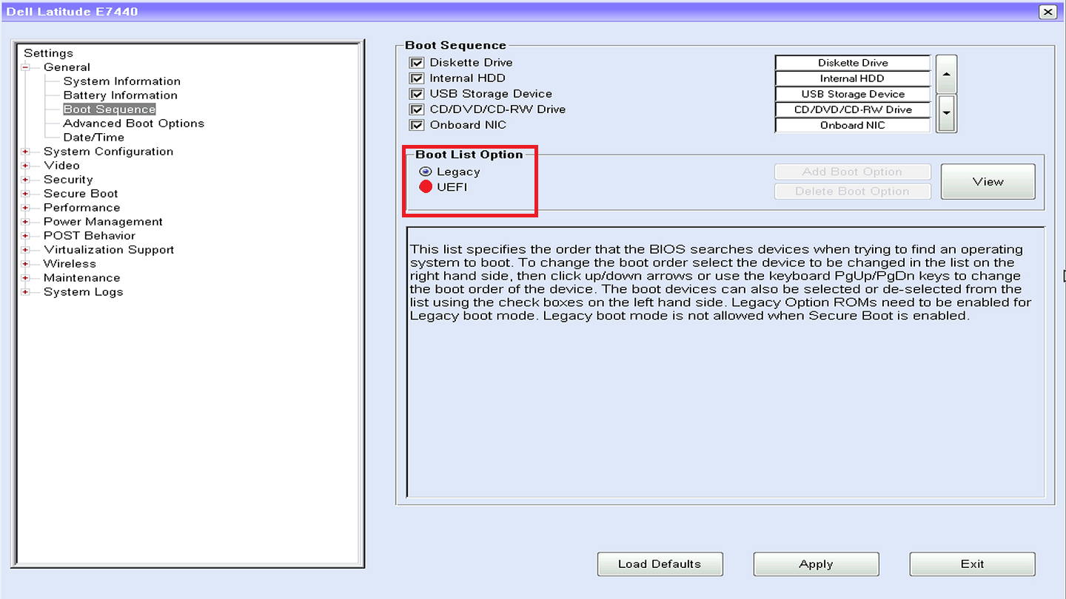
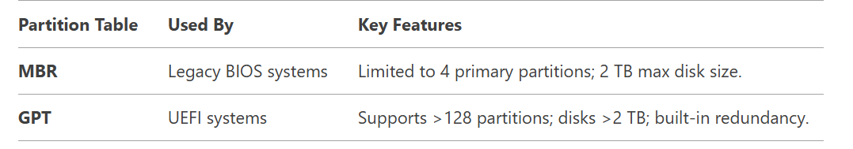
Two different boot options
Legacy BIOS usually pairs with MBR.
UEFI usually pairs with GPT.

Slide 20
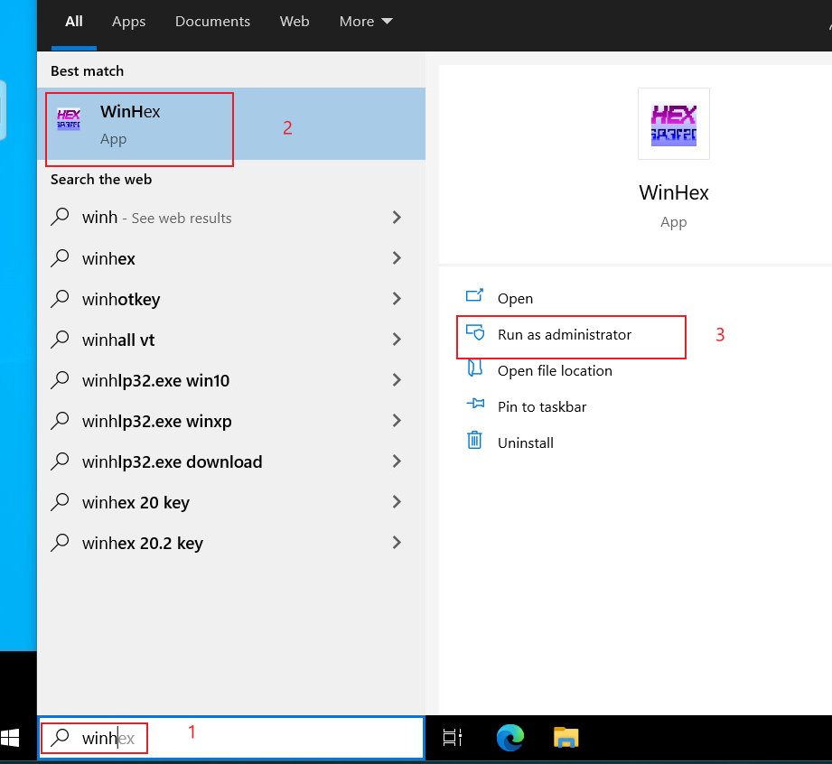
What does the Master Boot Record look like?
Open WinHex or HxD as administrator
Tool example: HxD
https://mh-nexus.de/en/hxd/

Slide 21
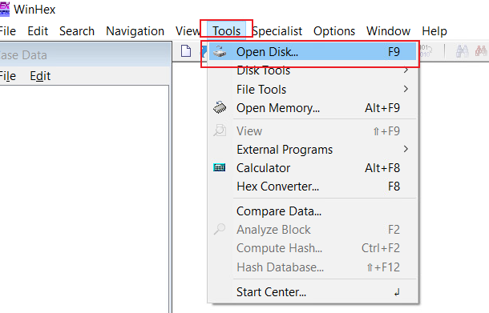
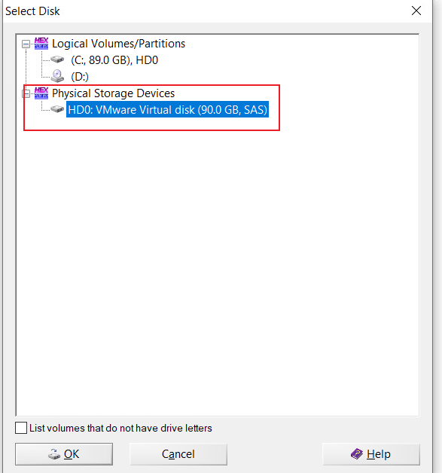
Step 1: open the physical storage device

Slide 22
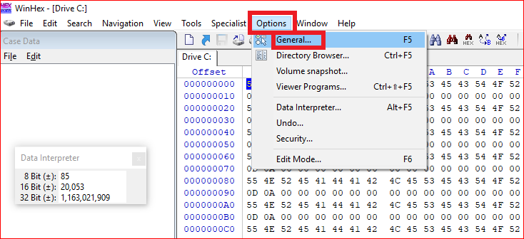
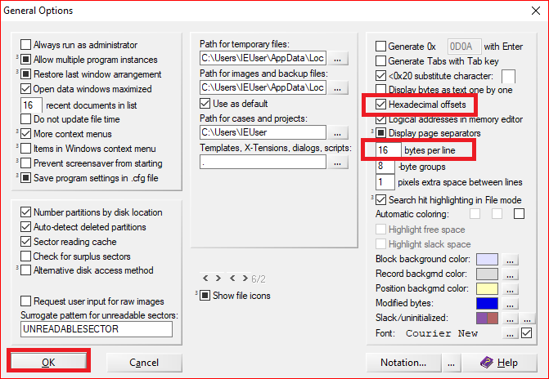
Step 2: set hexadecimal offsets and 16 bytes per line

Slide 23
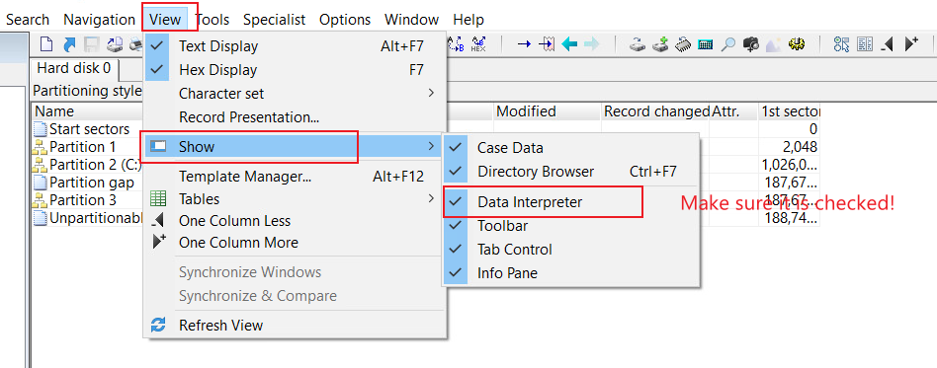
Step 3: enable the Data Interpreter pane

Slide 24
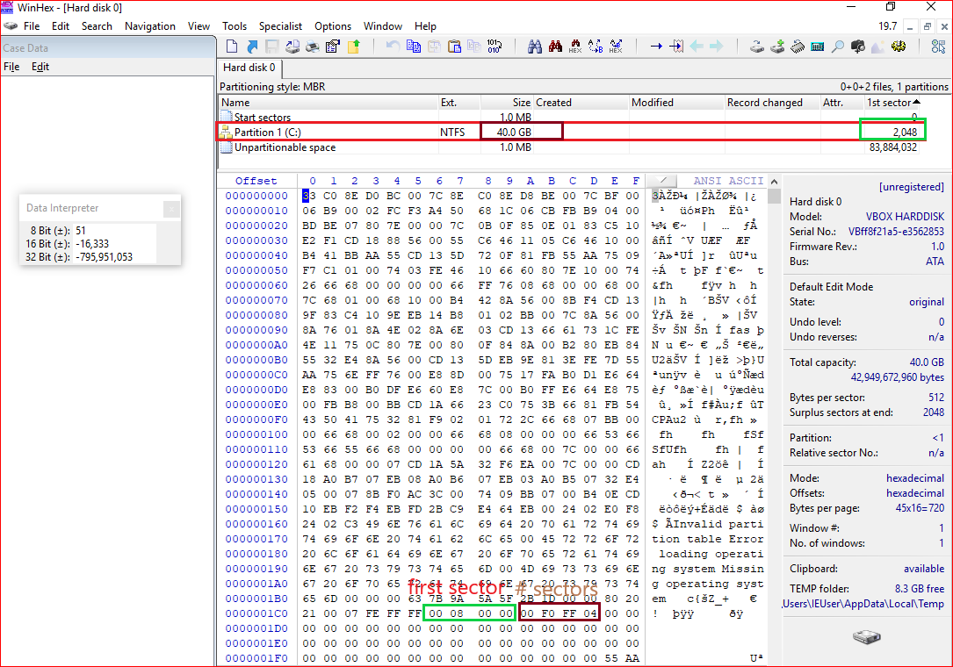
Master Boot Record (MBR):
• Legacy partition scheme
• Sector 0 of the disk
• Up to 2 TiB with 512-byte sectors
Find in the MBR:
(1) first sector of partition 1
(2) total sectors in partition 1

Slide 25
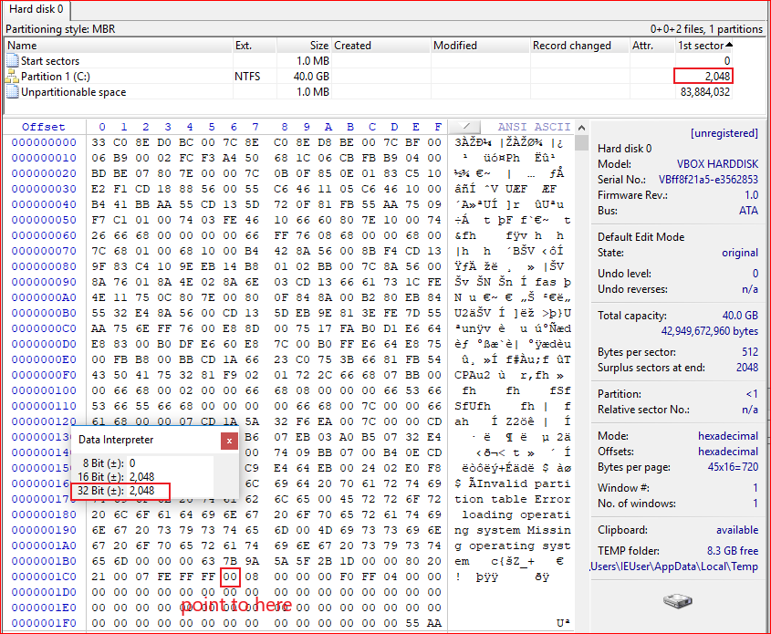
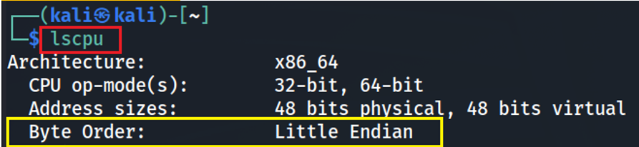
Convert hex to decimal
(00000800)₁₆ = (2048)₁₀
0x01C6
0x01CA

Slide 26
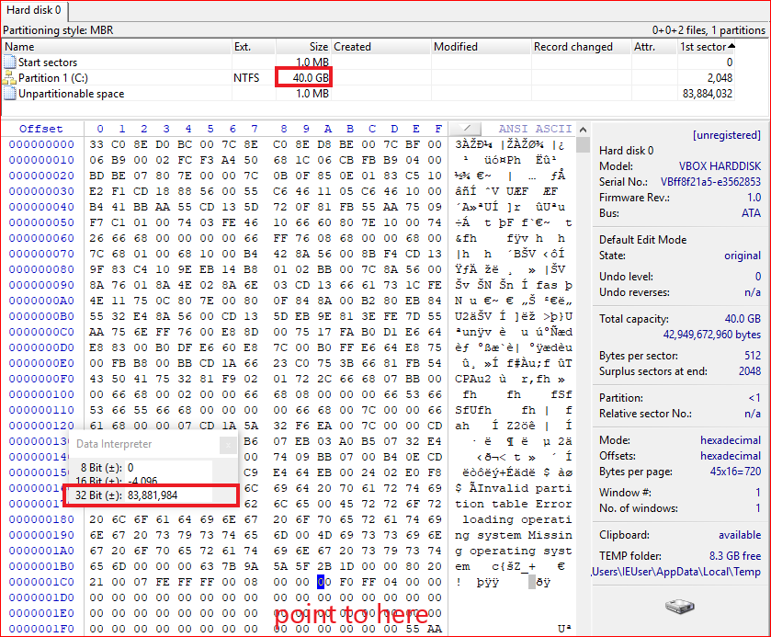
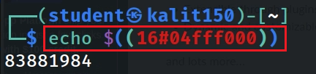
Convert the sector count
from hex to decimal
0x01CA
Partition size =
sector count × bytes/sector
83,881,984 sectors × 512 bytes/sector ≈ 39.99 GiB
Notes:
1024000*512/1024/1024=500
echo $((16#04fff000))

Slide 27
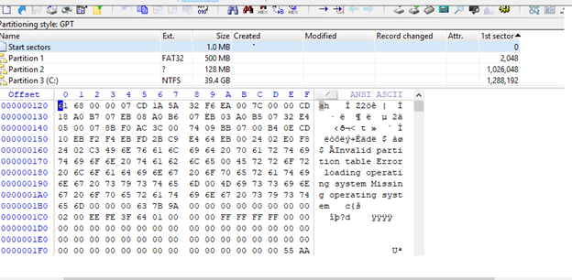
GUID Partition Table (GPT)

Slide 28
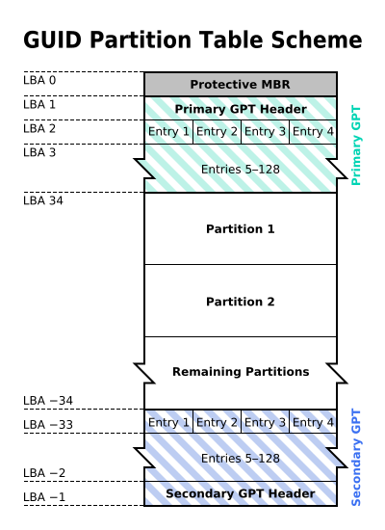
Why GPT
MBR is a legacy scheme from the PC BIOS era.
MBR is limited by 32-bit LBA fields; with 512-byte sectors, this is about 2 TiB.
GPT supports much larger disks and many more partitions.
GPT uses Logical Block Addressing (LBA) instead of CHS.
GPT stores a primary header near the beginning and a backup header at the end of the disk.
By the original uploader Kbolino at English Wikipedia; transferred to Wikimedia Commons; CC BY-SA 2.5. https://commons.wikimedia.org/w/index.php?curid=3036588

Slide 29
Protective MBR:
backward compatibility
Partition-entry array:
128 bytes per entry
Backup GPT header and entries
at the end of the disk

Slide 30
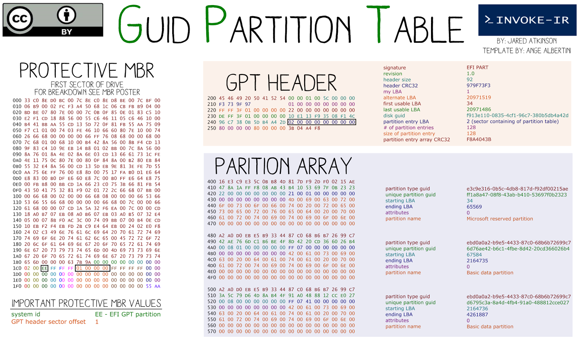
Partition-entry array usually starts at LBA 2 in the primary GPT copy
Why 0x400?
Sector 2 starts at byte offset 0x400 because 2 × 512 = 1024.
Notes:
21

Slide 31
Calculate GPT partition size
Confirm protective MBR: partition type 0xEE at MBR offset 0x1C2.
Read the GPT header at LBA 1.
Locate the partition-entry array from GPT-header offset 0x48; it is usually LBA 2.
Each GPT partition entry is 128 bytes.
Read the starting LBA and ending LBA from the target partition entry.
Partition size = (ending LBA − starting LBA + 1) × bytes per sector.
Notes:
Example conversion:
echo $((0x010021)) = 65569

Slide 32
Show MBR/GPT details using a template

Slide 33
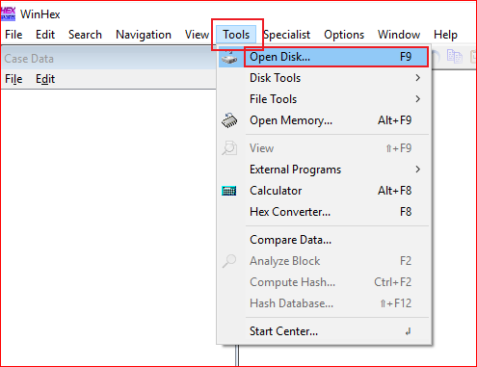
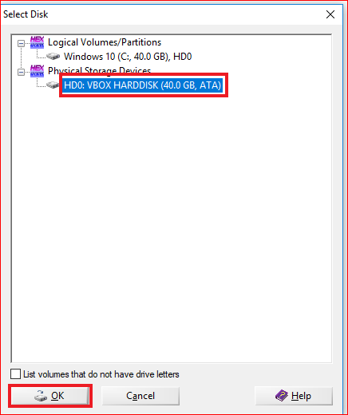
Open Physical Devices

Slide 34
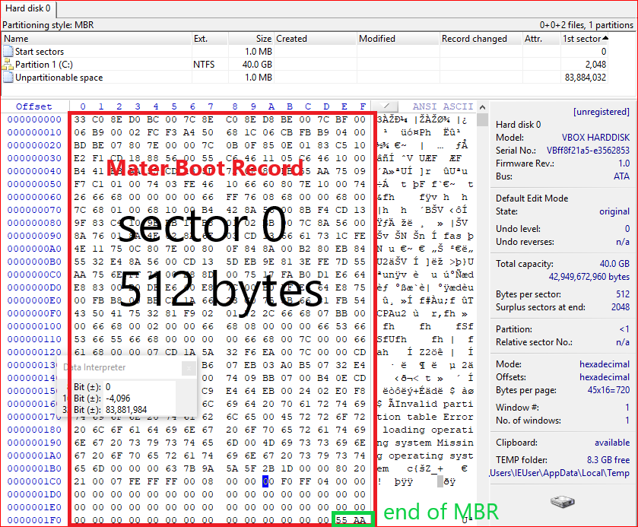
Show MBR sector

Slide 35
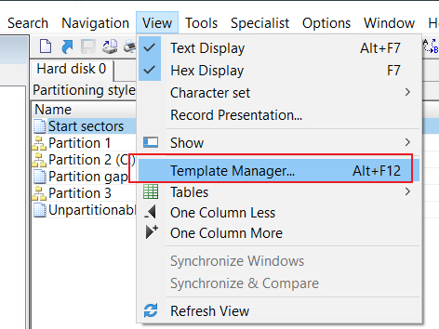
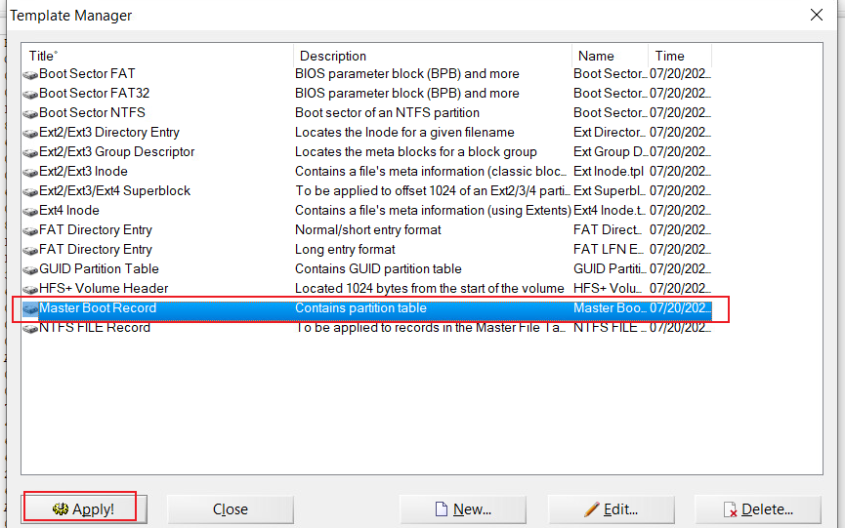
Apply the Master Boot Record template

Slide 36
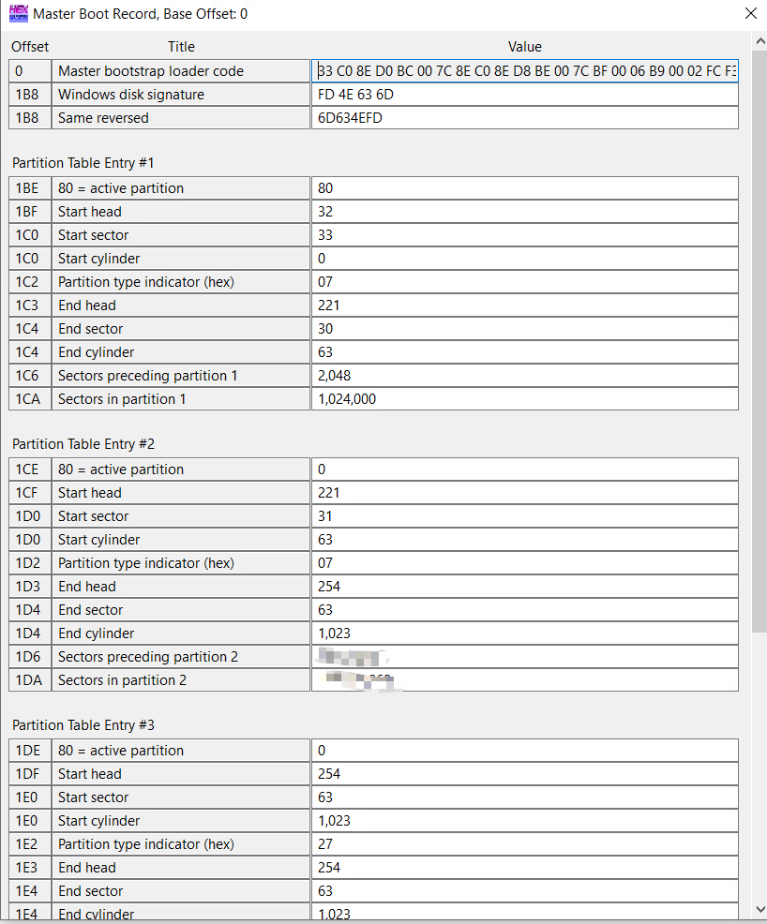


Example: MBR template output
with multiple partitions

Slide 37
Computer Systems and Digital Evidence
Computer systems have multiple layers: applications, operating system, memory, and storage can all contain forensic evidence.
Programs execute as processes and threads: examining processes and memory can reveal what was running on a system.
Storage devices organize data into addressable sectors/blocks: investigators must understand how raw storage maps to higher-level structures.
Partitions describe how a disk is divided: MBR and GPT store information needed to locate and calculate partition boundaries.
Boot structures matter: BIOS/UEFI, MBR/GPT, boot managers, and operating-system loaders determine how a computer starts.
Forensic takeaway: To interpret digital evidence correctly, understand how the evidence moves from hardware → storage structures → operating system → applications → user activity.

Slide 38
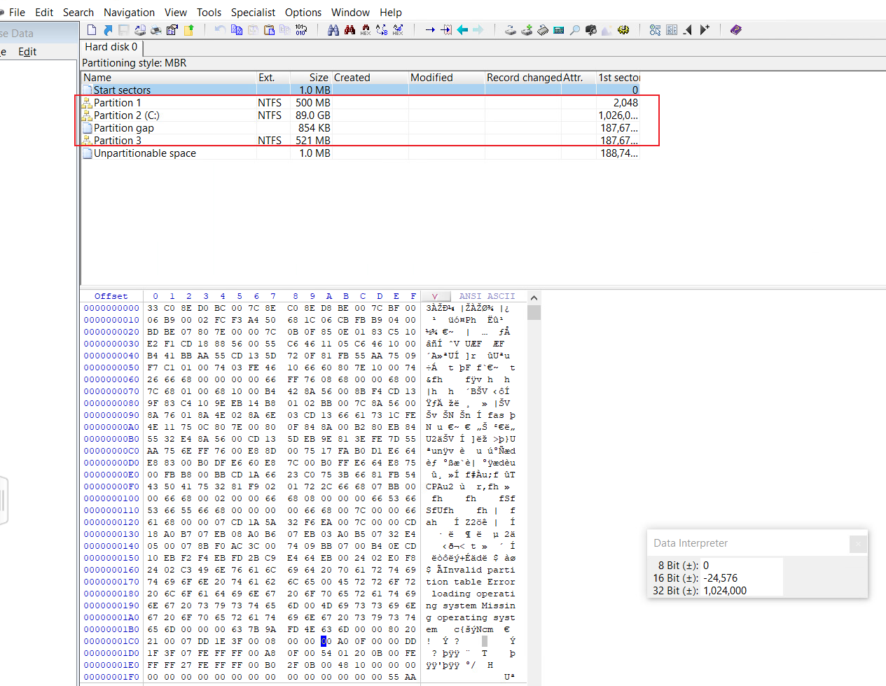
Assignment
Goal: verify the size of partition 1 on a PC using its partition table.
Record the verification process step by step.
Requirements:
  Do not use WinHex/HxD templates for the calculation.
  Identify whether the disk uses MBR or GPT.
  Calculate each partition size in GB/GiB from partition-table values.
  Include screenshots of your own partition table.
Hint: use HxD/WinHex to inspect bytes and Windows Disk Management to verify MBR/GPT.
Notes:
1C6:
ID6, 1026048,186646868

Slide 39
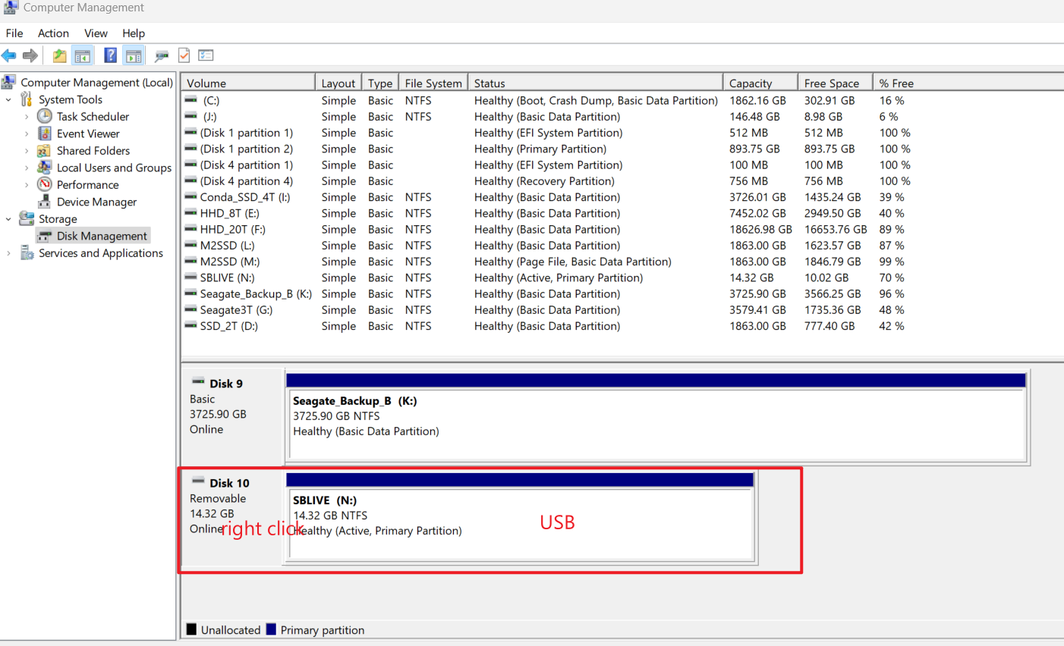
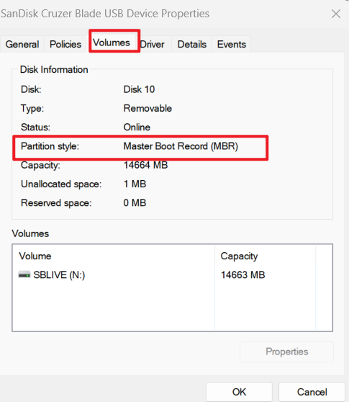
Verify partition style in Windows Disk Management
Use Properties → Volumes to confirm MBR/GPT.

