Slide 1
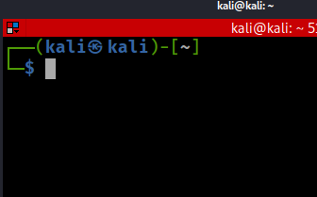
Linux for Digital Forensics

Slide 2
Overview
Operating systems and file systems
Virtual File System (VFS) and forensic relevance
Linux filesystem hierarchy, inodes, and metadata
Paths, relative paths, and the $PATH variable
Core Linux commands for digital forensic work

Slide 3
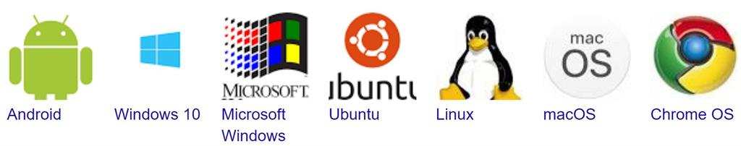
Operating Systems

Slide 4
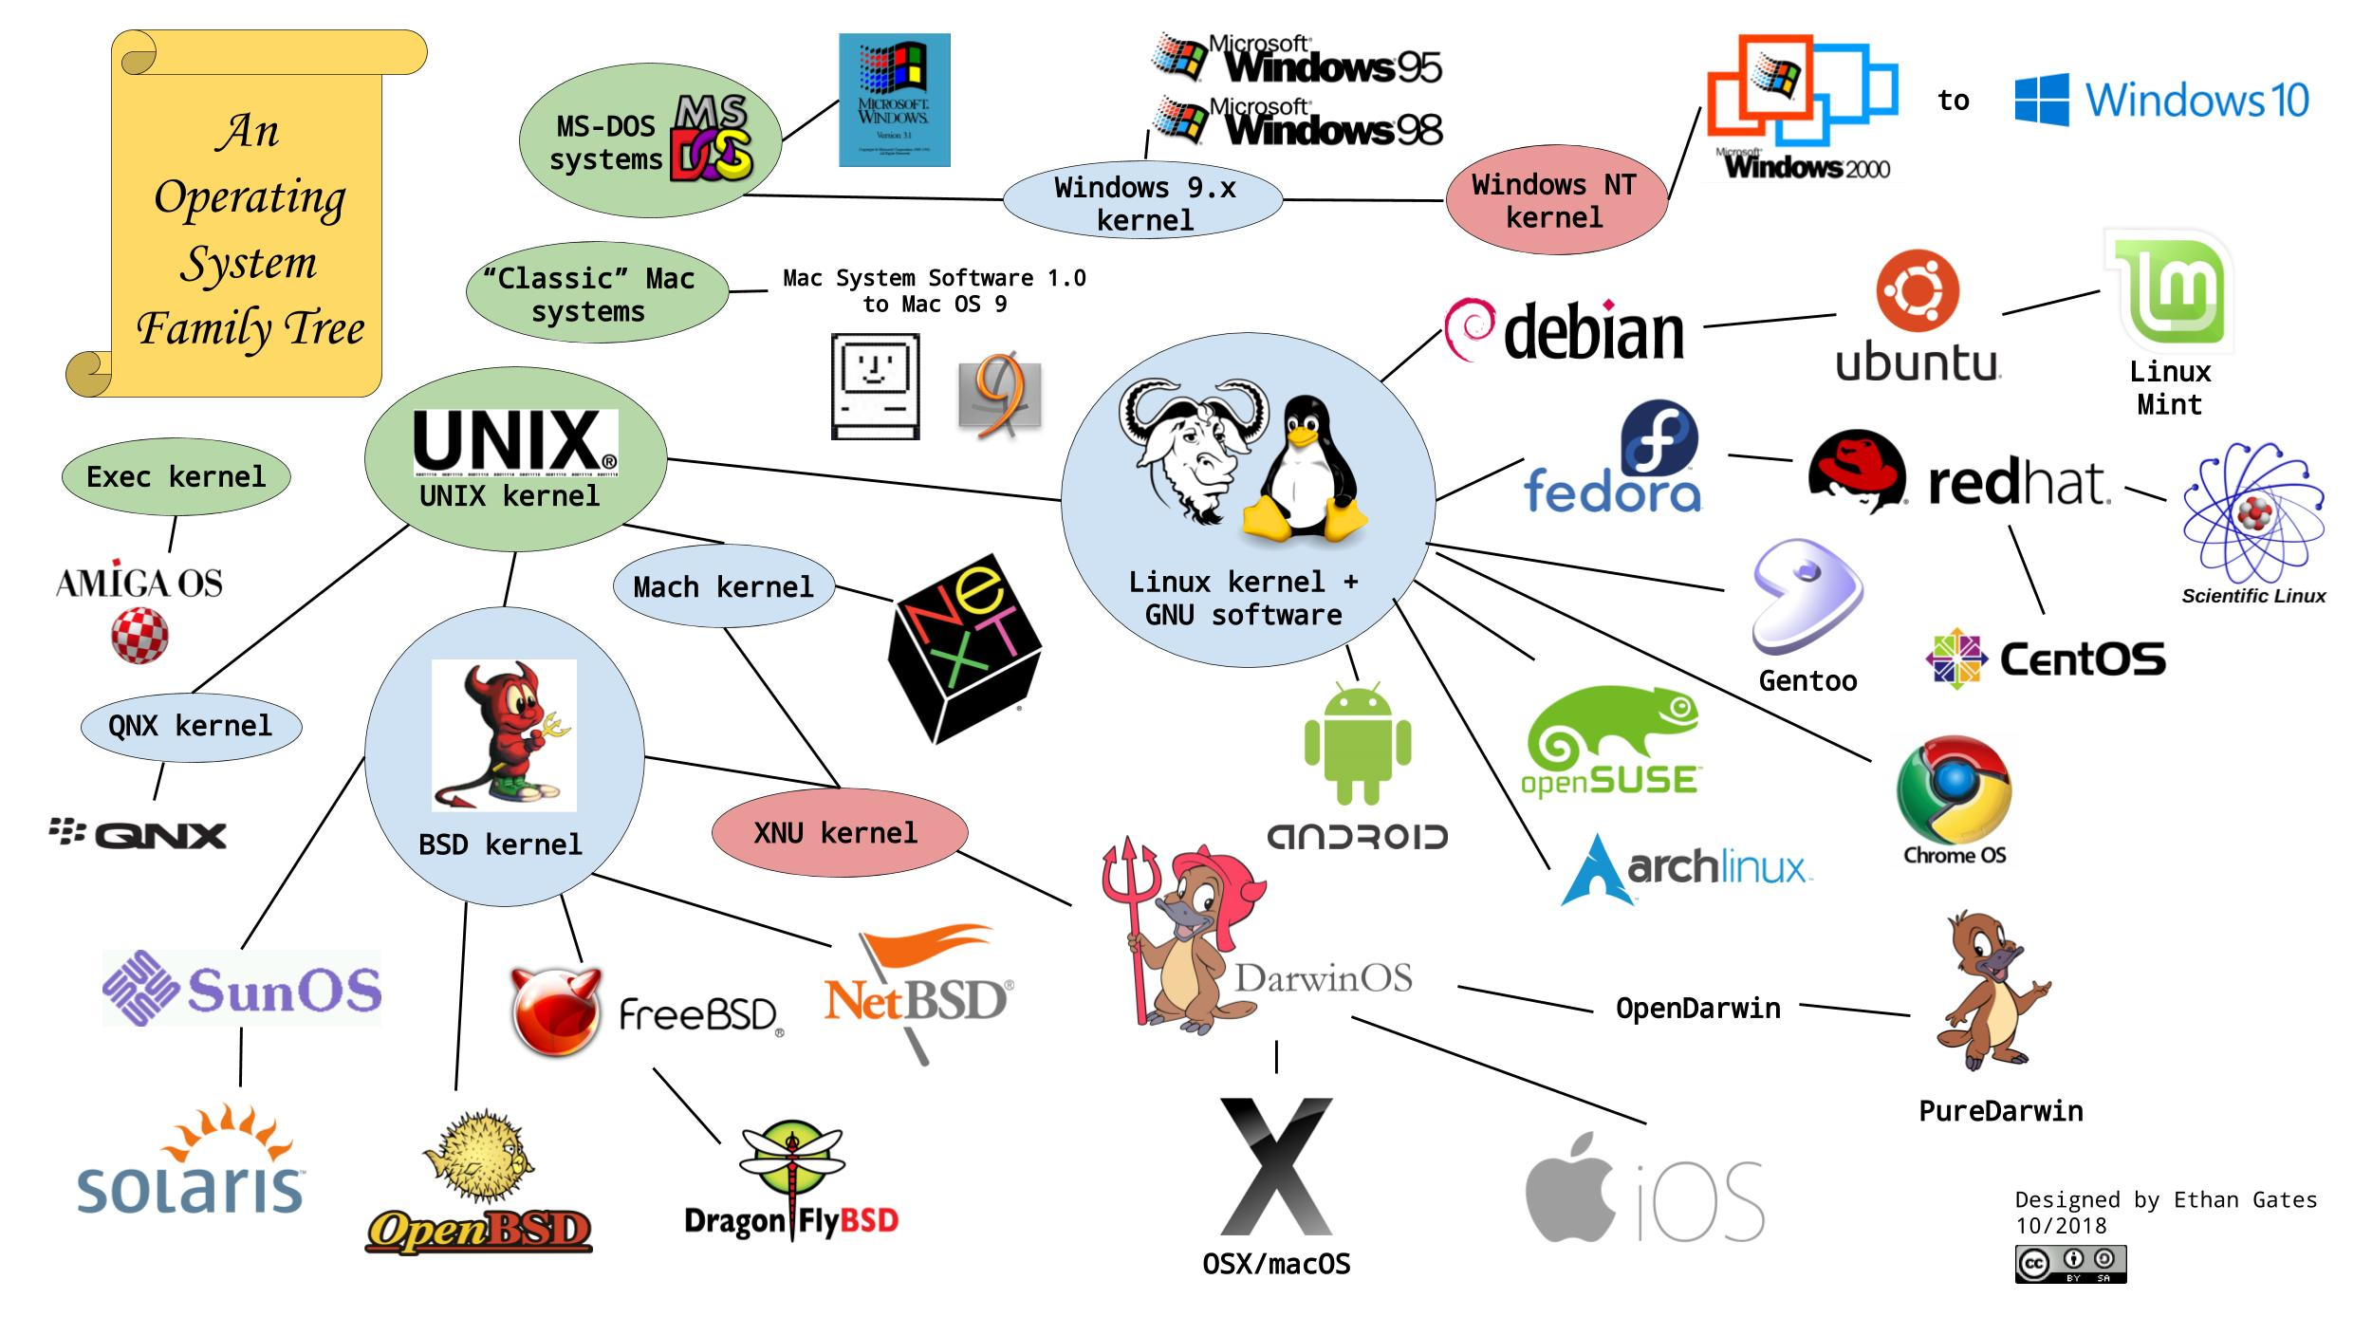

Slide 5
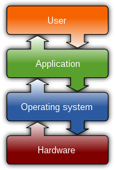


What an operating system manages
Processes and threads
Memory and virtual memory
File systems and storage access
Device drivers and hardware I/O
Networking and services
Security, users, and permissions
Forensic focus: OS services generate artifacts such as logs, metadata, process state, network state, and file access traces.
https://en.wikipedia.org/wiki/Operating_system

Slide 6
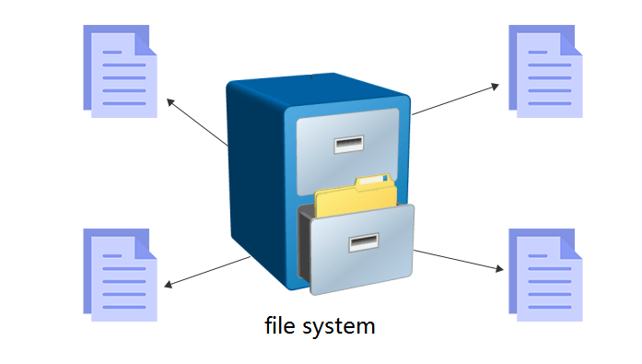
File and File Systems

Slide 7

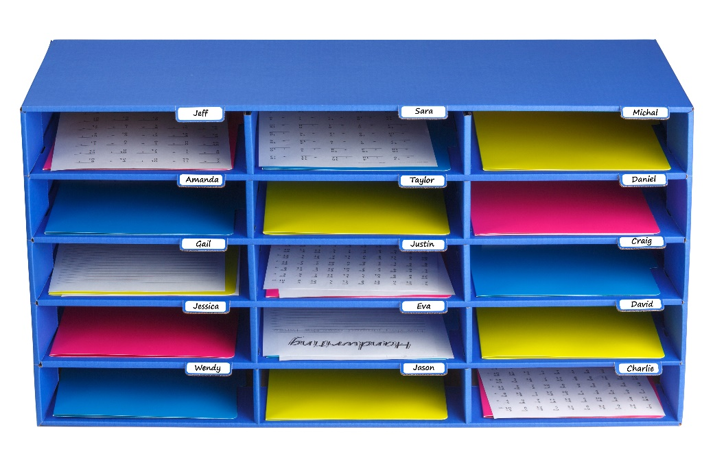
Files and file systems
A file is a named collection of bytes plus metadata.
Files are stored on non-volatile media such as disks, SSDs, optical media, and removable storage.
A file system defines how files are named, located, allocated, stored, deleted, and recovered.
Forensics depends on file-system metadata such as timestamps, paths, allocation status, and deleted-record structures.

Slide 8
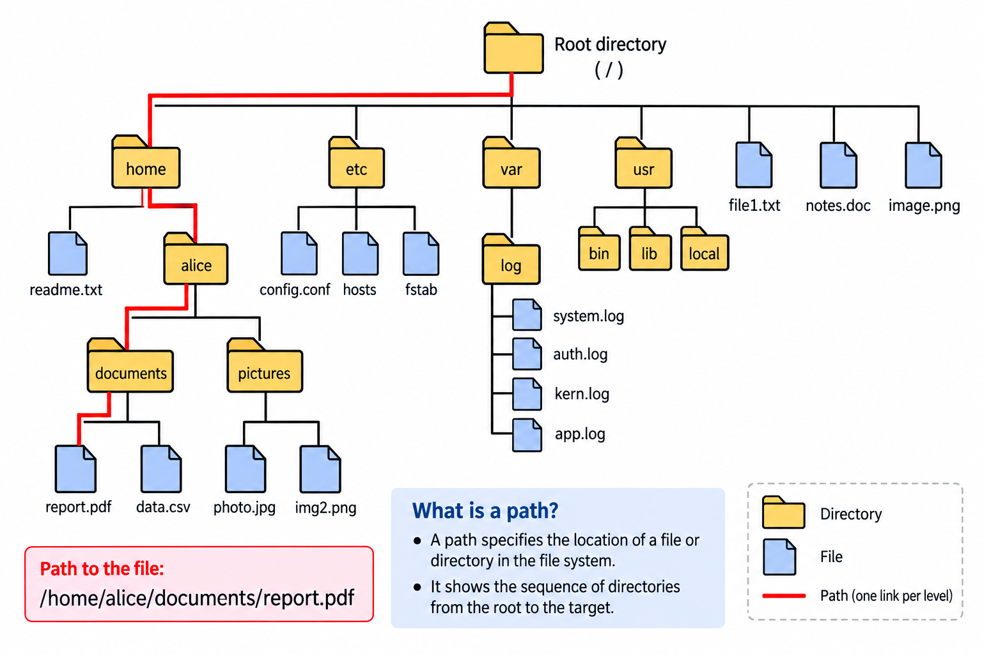
How are files organized?

Slide 9


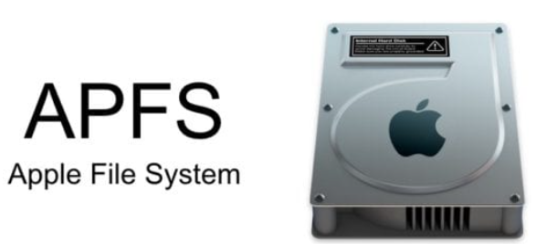

File system types
Unix and Unix-like systems
  Linux: ext2/3/4, XFS, Btrfs, and others
  Solaris: UFS/ZFS
macOS
  APFS is current; HFS+ is legacy.
Microsoft Windows
  NTFS is the main Windows file system; FAT/exFAT are common on removable media.
Forensic impact: file-system type controls timestamps, metadata, allocation, deletion, and recovery behavior.
Extended file system family

Slide 10
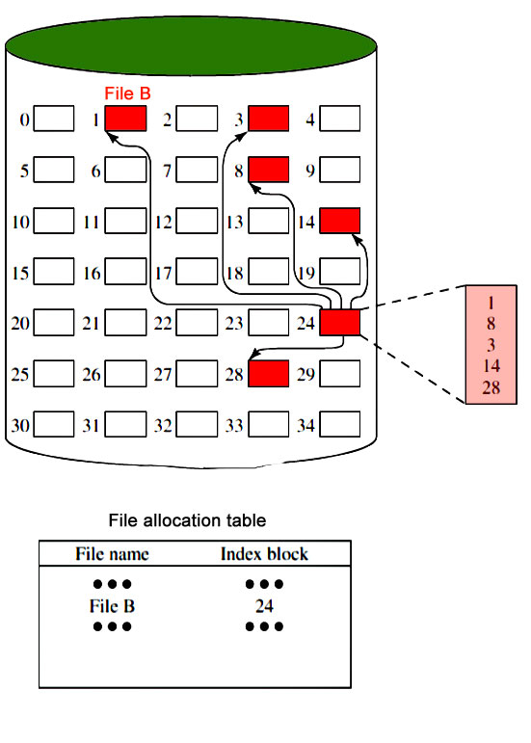

File allocation: a file may occupy non-contiguous blocks
The allocation table/map tells the system which blocks belong to the file.
Notes:
https://www.geeksforgeeks.org/file-systems-in-operating-system/

Slide 11
Manage files vs. manage storage boxes
Managing files vs. managing storage blocks
Name | Boxes ID
Frank | 1,2,3
… | …
Notes:
https://www.geeksforgeeks.org/file-systems-in-operating-system/

Slide 12


Analogy: a rental system maps person → boxes; a file system maps file name → data blocks/sectors.
 | Storage | File Storage
Unit | Box | Sector
Usage | Person rents boxes | File uses sectors
Management system | Rental management system | File management system, (e.g., FAT)
Notes:
https://www.geeksforgeeks.org/file-systems-in-operating-system/

Slide 13
Virtual file system (VFS)

Slide 14





Without an interpreter
With an interpreter
File Systems
Virtual file system

Slide 15
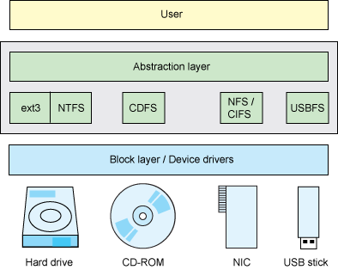
Linux implements a Virtual File System (VFS)
VFS provides a common interface above concrete file systems.
  Examples: ext4, NTFS, ISO/CD-ROM, NFS/CIFS, USB storage
Applications can use the same system calls across different file systems.
Linux exposes many resources as file-like objects.
  Examples: regular files, directories, disks, USB devices, /dev, /proc, /sys
Inodes store file metadata and pointers to data blocks.
https://developer.ibm.com/technologies/linux/tutorials/l-virtual-filesystem-switch/
Notes:
The "Everything is a file" phrase defines the architecture of the operating system. It means that everything in the system from processes, files, directories, sockets, pipes, ... is represented by a file descriptor abstracted over the virtual filesystem layer in the kernel
Devices can be represented as file-like object under /dev/ filesystem.
Unix has no direct equivalent of the Windows registry. The same information is scattered through the filesystem, largely in /etc, /proc and /sys.

Slide 16
Why Linux is useful for digital forensics
Strengths
  Supports many file systems through VFS and forensic tools
  Powerful command-line workflows for repeatable analysis
  Free/open-source tools; source code can be inspected and validated
  Flexible scripting for large-scale evidence processing
Limitations
  Steep learning curve and command-line precision required
  Tool trustworthiness must be documented and validated
  Commands can alter evidence if run on the original media

Slide 17
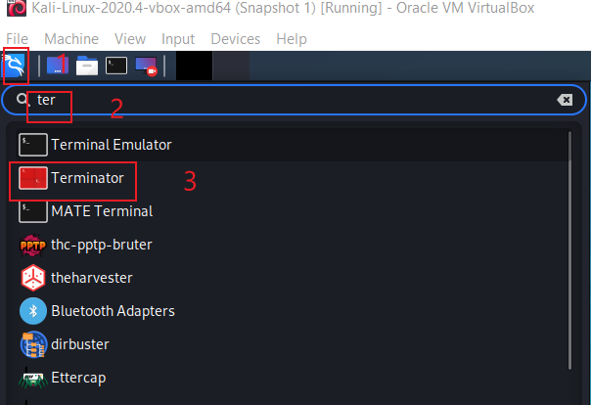

Open a Linux terminal
Windows comparison: Command Prompt / PowerShell

Slide 18
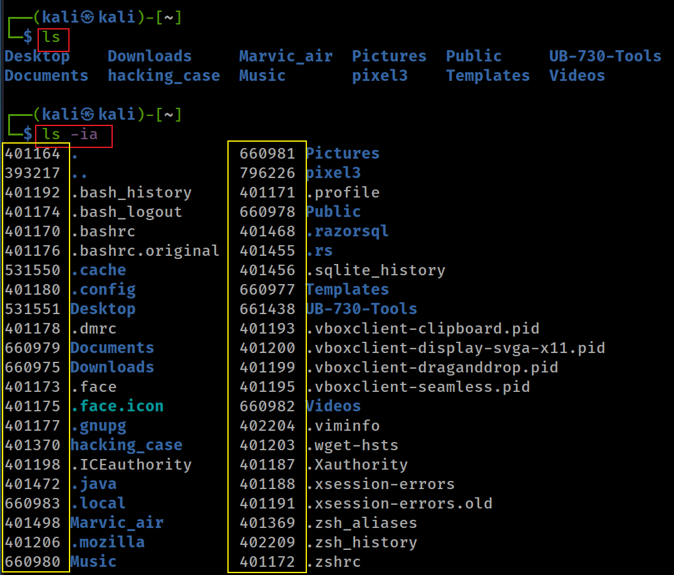
Viewing inode numbers
ls -i: print inode number
ls -a: include hidden entries
Forensics: hidden files and inode numbers help correlate names, metadata, and disk structures.
Windows comparison: dir /a shows hidden files; file IDs require other tools.

Slide 19
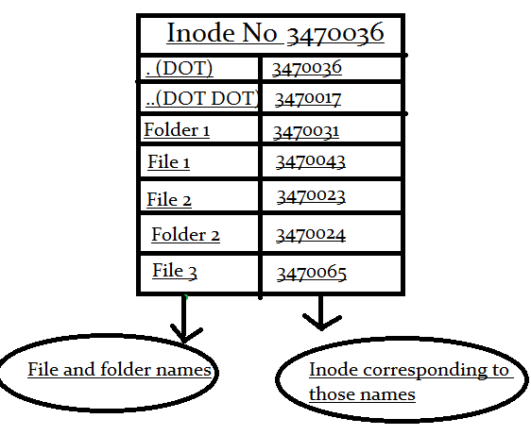
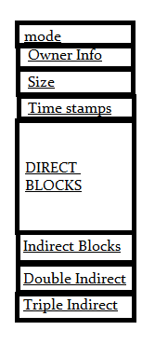
What is an inode?
An inode is a file-system data structure, not the file name itself.
  It has a unique inode number within the file system.
It stores metadata: owner, permissions, size, timestamps, and block pointers.
A directory maps file names to inode numbers.
Forensics: inode metadata helps reconstruct file activity even when names change.
permission information
block pointers
https://www.slashroot.in/inode-and-its-structure-linux

Slide 20
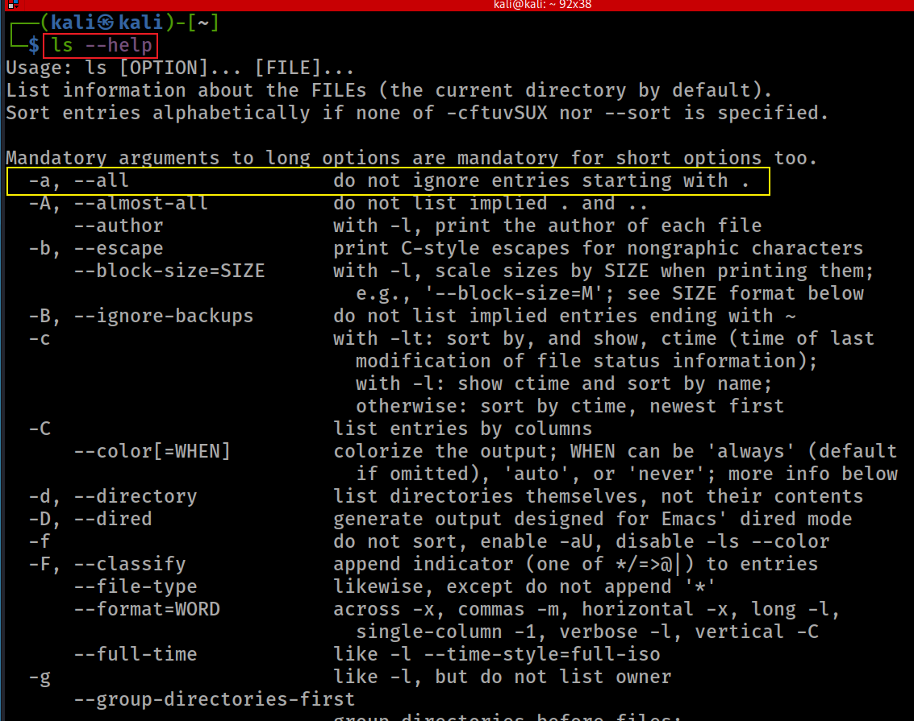

Slide 21
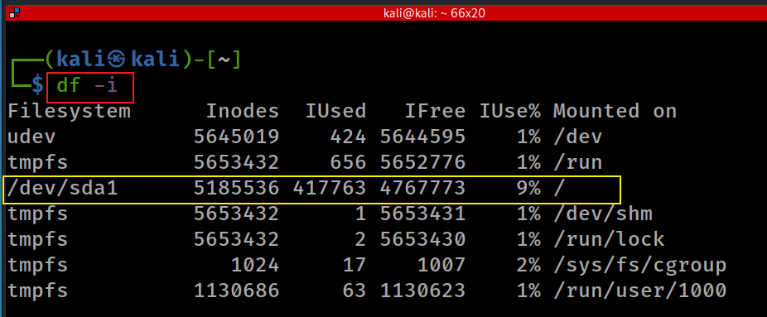
Check inode usage with df -i
-i, --inodes list inode information
wmic logicaldisk get size, freespace, caption
Notes:
Windows cmd:
wmic logicaldisk get size, freespace, caption

Slide 22
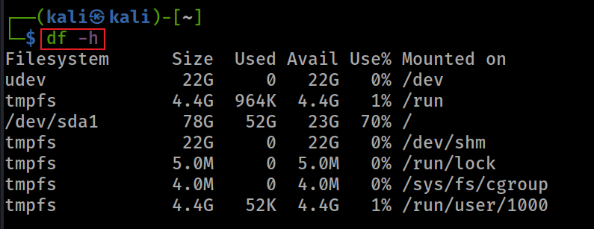
Check disk space with df -h

Slide 23
File Structure

Slide 24
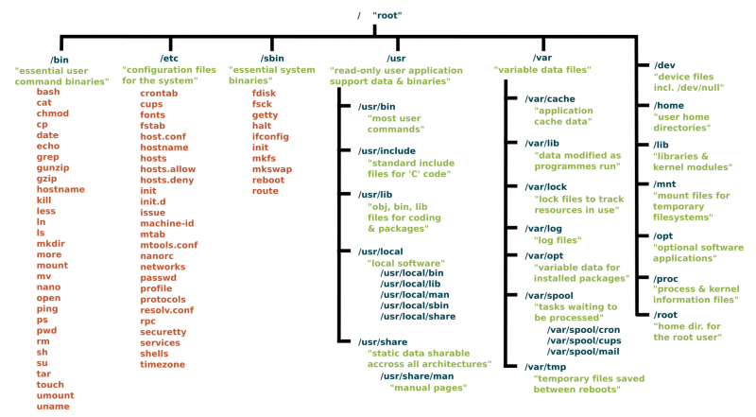
Unix has no direct equivalent of the Windows registry. The same information is scattered through the filesystem, largely in /etc, /proc and /sys.
https://www.linux.com/sites/lcom/files/styles/rendered_file/public/standard-unix-filesystem-hierarchy.png?itok=CVqmyk6P

Slide 25
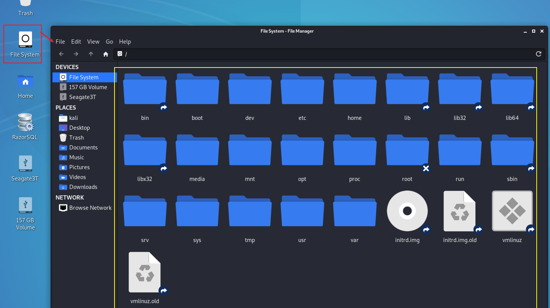

Slide 26
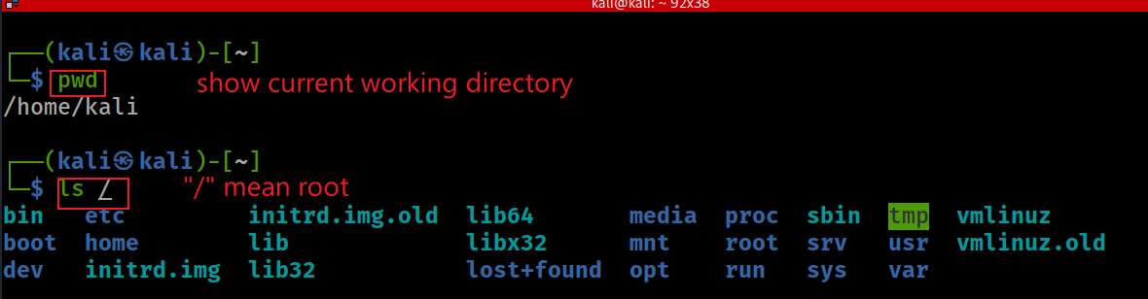

List the Linux file system from root /
Use pwd first: many commands depend on the current working directory.
Clear the terminal screen
Windows comparison: cd, cls
Notes:
cd

Slide 27
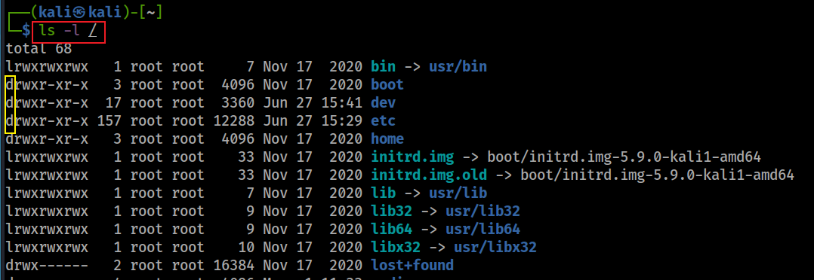
Show details of a file/directory
ls -l shows permissions, link count, owner/group, size, timestamp, and name.

Slide 28
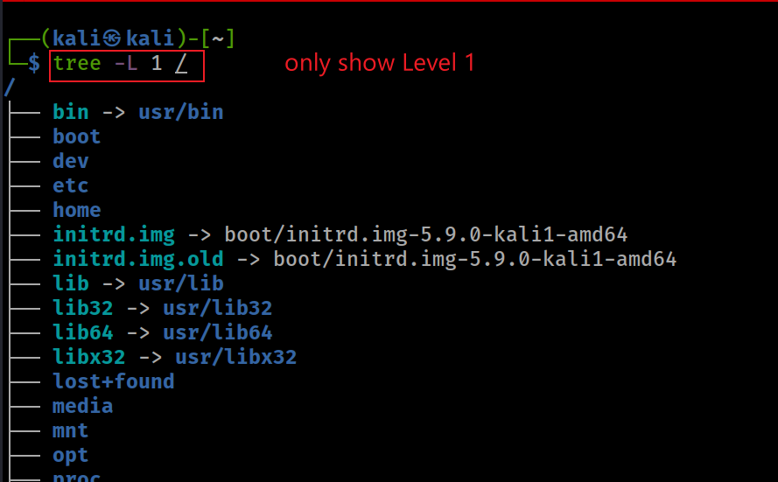
Show the Linux file system from root with tree
Use tree --help to inspect available options.
-L controls depth.

Slide 29
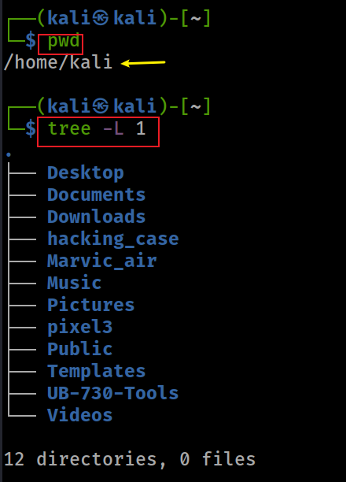
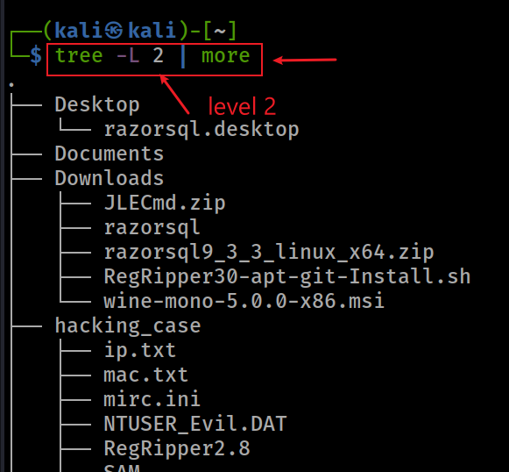
Show the current working directory with tree

Slide 30
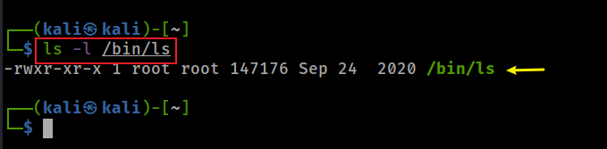
Linux commands are executable files
Display the ls executable under /bin
The shell can run ls from any directory because /bin or /usr/bin is listed in $PATH.

Slide 31
Path and Path variable

Slide 32

What is a path in a file system?
A path identifies the location of a file or directory.
It describes the sequence of directories from a starting point to the target.
Absolute paths start at root /.
Relative paths start from the current working directory.
Forensics: record exact paths so another analyst can reproduce your steps.

Slide 33
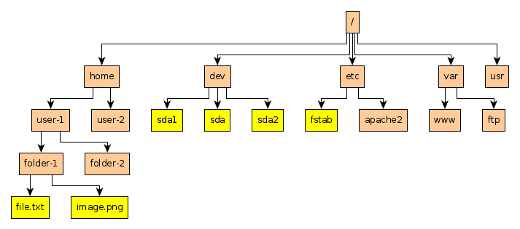
Absolute and relative paths
Absolute path to file.txt: /home/user-1/folder-1/file.txt
Relative path from folder-2 to file.txt: ../folder-1/file.txt

Slide 34
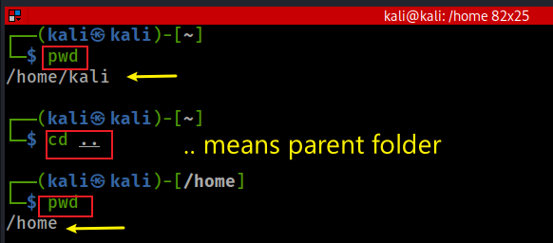
Move to the parent directory with a relative path
cd ..

Slide 35
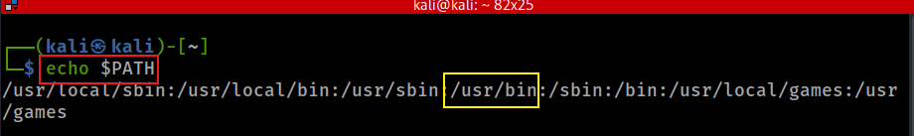

The PATH variable ($PATH)
The shell searches $PATH from left to right.
Current directory is not searched unless . ls in $PATH.
No match → command not found.
Shell searches $PATH left-to-right.
Use ./script.sh for current directory.
Windows comparison: PATH
Notes:
In Windows path

Slide 36
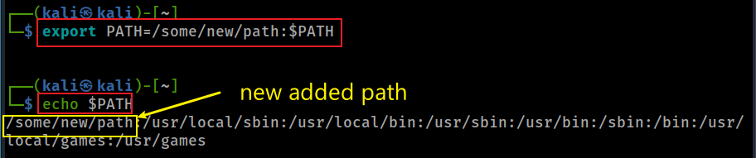

Temporarily add a directory to $PATH
export changes the current shell session. To make it persistent, add the export line to a shell startup file.
Windows persistent PATH example: setx path "%path%;C:\Program Files\Java\jdk1.8.0_202\bin" -m
Notes:
export PATH=/some/new/path:$PATH
In Windows setx path "%path%;C:\Program Files\Java\jdk1.8.0_202\bin" -m

Slide 37
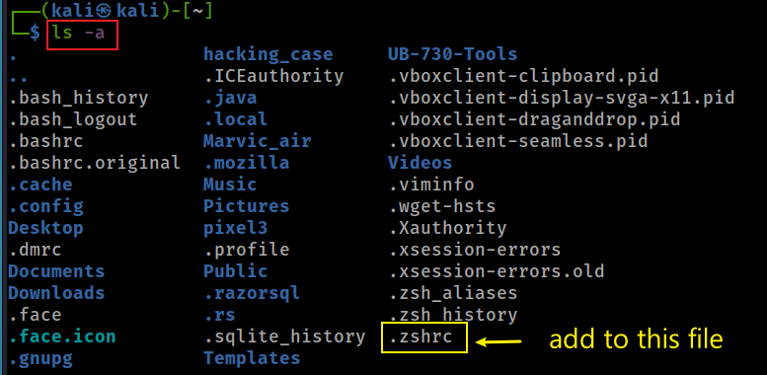
Persist PATH changes in ~/.zshrc
Add export PATH=/new/path:$PATH to ~/.zshrc, then open a new terminal or run source ~/.zshrc.

Slide 38
Create folders and files

Slide 39

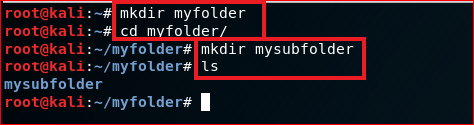
Create directories with mkdir
home
\myfolder
Linux paths use forward slashes: /home/kali/myfolder/mysubfolder
\mysubfolder
mkdir

Slide 40
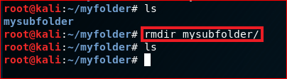
Delete empty directories with rmdir
rmdir removes only empty directories. Use rm -r carefully and only on lab copies.
rmdir

Slide 41



Create a text file with echo
\user home
\myfolder
Show the content of the file
hello world
my_first_file.txt
The > operator writes output to a file and overwrites existing content.

Slide 42
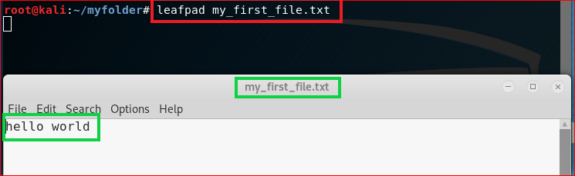
Create or edit a file with leafpad or nano
or nano command

Slide 43
File Copy & Deletion

Slide 44

Copy a file with cp
copy

Slide 45

Copy files and directories
Copy a directory recursively: use -r
  Basic syntax: cp -r source_folder destination_folder
  Example: cp -r ~/myfolder ~/myfolder_copy
Forensics: copying may change timestamps unless preservation options/tools are used.

Slide 46
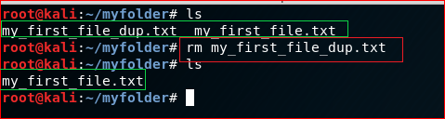
Remove a file with rm
rm does not move files to Trash. In forensic work, avoid destructive commands on original evidence.

Slide 47
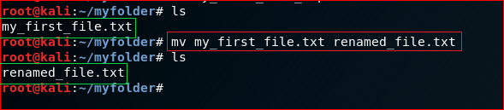
Rename or move a file with mv
mv can rename a file or move it to another directory.
move/ copy and ren

Slide 48
Search for information

Slide 49
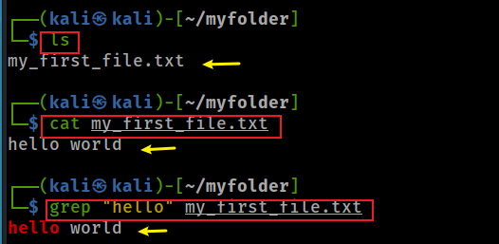
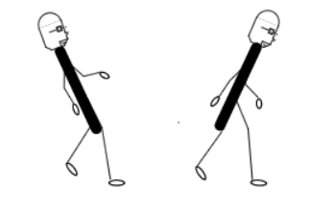


Search text inside files with grep
Basic grep search
backslash
forward slash
Show line numbers with -n
Windows comparison: type, findstr /c:"error" log.txt
Notes:
cat my_first_file.txt
grep "hello" my_first_file.txt
https://sites.cs.ucsb.edu/~pconrad/topics/BackslashVsForwardSlash/

Slide 50
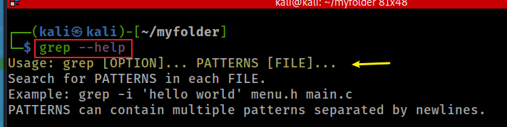
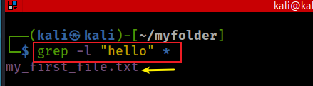
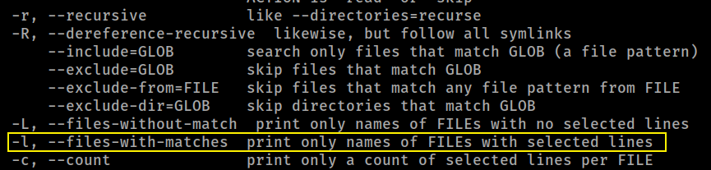
Find files containing a string or pattern
Relevant grep option: -l
List files that contain “hello”

Slide 51
Networking

Slide 52
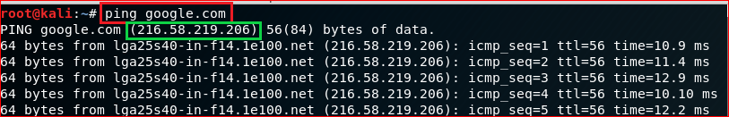
Test network connection using a domain name
ping google.com tests DNS resolution plus ICMP reachability.

Slide 53
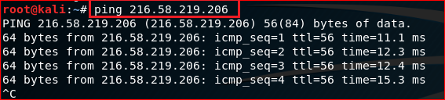
Test network connection using an IP address
ping an IP address bypasses DNS and tests basic reachability.

Slide 54
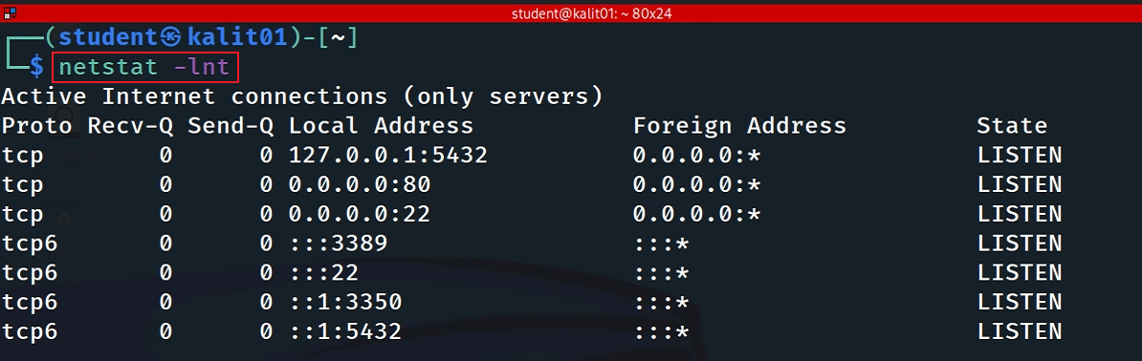
List listening TCP ports
-l, --listening show listening server sockets
-n, --numeric show numeric addresses/ports
-t, --tcp show TCP sockets
Port 22 is listening for SSH connections.
Modern Linux often uses ss -lnt; netstat may still appear in older labs.

Slide 55
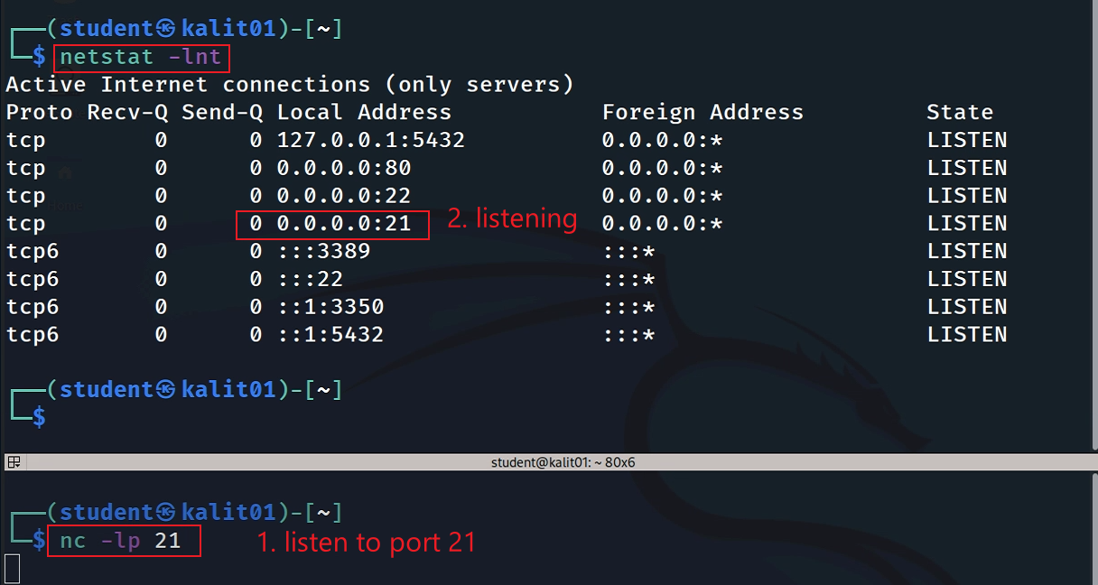
Start a listener on port 21 and verify it is open
Verify: nmap localhost -p 21
Notes:
nmap localhost -p 21

Slide 56
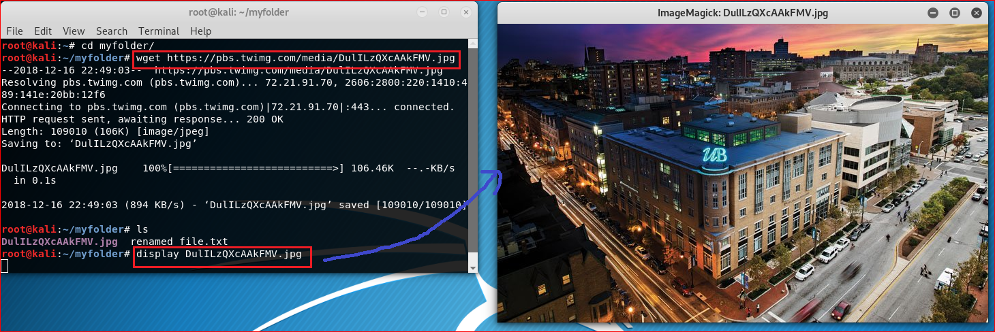
Download a file (wget)
Forensic practice: record source URL, timestamp, hash value, and storage path.
Download a file with wget

Slide 57
Create a script file

Slide 58
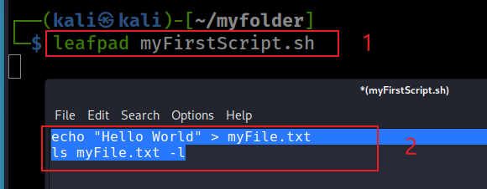
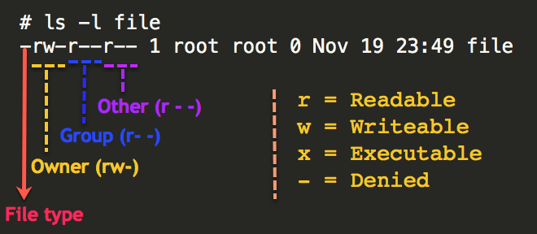
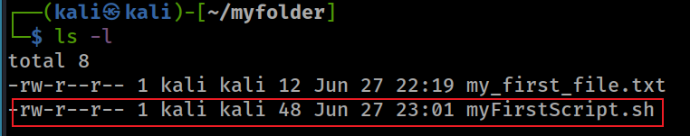
Create a simple shell script
Create a script using leafpad
shebang: tells the shell which interpreter should execute the script, e.g., #!/bin/sh
#!/bin/sh
Check permission of files
Windows comparison: .bat / .cmd scripts
Notes:
#!/bin/sh
echo "Hello World" > myFile.txt
ls myFile.txt -l

Slide 59
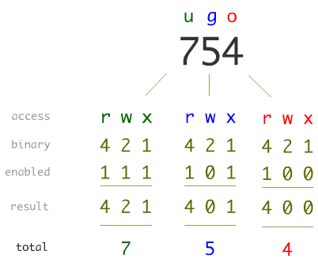
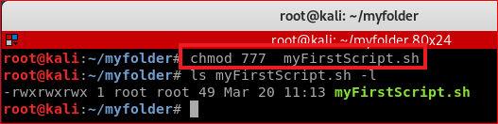

Linux permissions
Forensic caution: chmod 777 gives everyone read/write/execute access. Prefer chmod +x in labs and never change original evidence.

Slide 60

Execute a script from another directory
Because the current directory is usually not in $PATH, include ./, ../, or an absolute path.

Slide 61

Run a script through $PATH
After adding /home/kali/myfolder to $PATH, the shell can find myFirstScript.sh without typing its full path.
Notes:
export PATH=/home/kali/myfolder:$PATH

Slide 62
Update/Install software
(optional)

Slide 63

Update the package index
apt-get update downloads package metadata; it does not upgrade installed packages by itself.

Slide 64


Install Terminator

Slide 65


Slide 66

Zip and unzip files

Slide 67

Compress/decompress directory (tar)
Create a compressed archive
-c: Create a new archive.
-z: Compress the archive using gzip (creates a .tar.gz file).
-v: Verbose mode (shows the files being processed).
-f: Specify the archive file name.

Slide 68

Extract a compressed archive with tar
Extract archive
-x: extract files
-z: decompress using gzip
-v: verbose output
-f: archive file name

Slide 69


Slide 70


