Slide 1
Introduction to Digital Forensics
Chapter 1 • Evidence handling, forensic imaging, analysis, reporting, and Autopsy lab workflow
Slides are modified from Guide to Computer Forensics and Investigations. Sixth Edition. Cengage Learning, 2018, ISBN-13: 978-1-337-56894-4. Chapter 1

Slide 2
Learning objectives
Define digital forensics and explain why process discipline matters.
Distinguish forensic evidence recovery from ordinary data recovery.
Describe the investigation workflow from collection to reporting.
Use Autopsy to add an image, locate deleted files, tag evidence, search keywords, and generate a report.
Core message: digital forensics is not just finding data; it is finding, preserving, validating, interpreting, and explaining evidence.

Slide 3
Roadmap
What is digital forensics?
  Definition, scope, related disciplines
Investigation workflow
  Collection, acquisition, analysis, report, review
Autopsy lab
  Evidence image, deleted files, keyword search, report

Slide 4
What is digital forensics

Slide 5
Definition
Digital forensics is the application of computer science and investigative procedures to identify, preserve, examine, analyze, and report digital evidence for a legal or organizational purpose.
Evidence value depends on process: authority, integrity, chain of custody, validated methods, repeatability, and reporting.
  Proper search authority or authorization
  Documented chain of custody
  Mathematical validation, such as cryptographic hashes
  Validated tools and repeatable steps
  Clear reporting and possible expert presentation

Slide 6
NIST definition: evidence lifecycle
Identification: determine what devices, accounts, or data may contain evidence.
Collection: preserve and collect relevant sources with minimal alteration.
Examination: process the data so artifacts can be reviewed.
Analysis: interpret artifacts and connect them to case questions.
Two controls must persist across the entire lifecycle: information integrity and strict chain of custody.

Slide 7
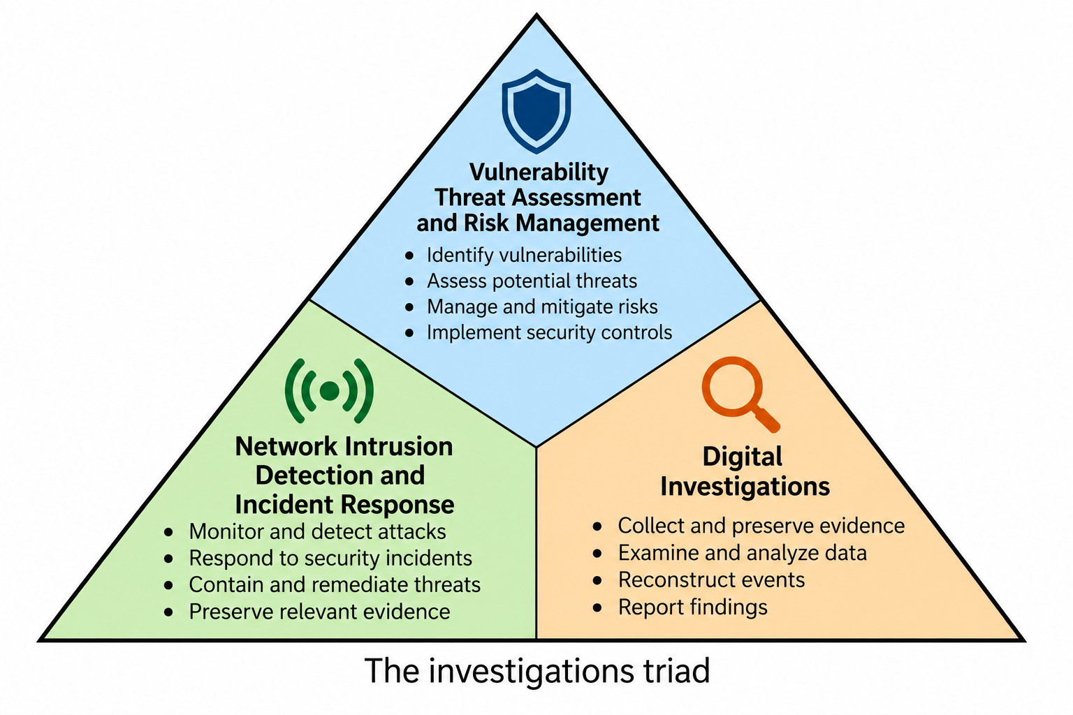
Digital Forensics and related Disciplines
Vulnerability/Threat Assessment and Risk Management:
identify vulnerabilities, assess threats, and reduce risk before an incident occurs.
Network Intrusion Detection and Incident Response
detect attacks, contain and remediate incidents, and preserve relevant evidence.
Digital Investigations
collect, preserve, examine, and analyze digital evidence to reconstruct and explain what happened.
Digital Investigation/Forensics overlaps with security operations, but its primary focus is producing reliable, traceable, and defensible digital evidence

Slide 8
Digital Investigation Types
Public-sector
Government-led criminal or civil investigations
Requires legal process and evidentiary discipline
Often supports prosecution or court proceedings
Private-sector
Internal policy, compliance, or incident investigations
Examples: harassment, data falsification, embezzlement, sabotage, espionage
Results may support HR action, litigation, or remediation
Different context; same need for integrity, documentation, and reproducible findings.

Slide 9
Digital forensics vs. data recovery
Data recovery asks: “Can we get the data back?”
Digital forensics asks: “Can we prove where the data came from, what it means, and whether it is reliable evidence?”
Forensic work preserves the original media whenever possible.
Examiners often start without knowing whether evidence exists.
The final product must be explainable, repeatable, and defensible.

Slide 10
Steps of digital investigation
A defensible investigation moves evidence through a controlled workflow.

Slide 11
Investigation workflow: from source to report
Identify &
authorize
Preserve &
collect
Acquire
image
Examine &
analyze
Report &
review
Scope and authority
Custody and packaging
Bit-stream copy + hash
Artifacts and interpretation
Findings and critique
Hash values, notes, tool versions, timestamps, and custody records connect every step.

Slide 12
Step checklist
1. Gather the evidence media using documented procedures.
2. Acquire a forensic image of the evidence media.
3. Analyze the image and relevant artifacts.
4. Produce a final report with findings and methods.
5. Critique the case to improve future performance.
Every step should preserve evidence integrity and create documentation that another examiner can follow.

Slide 13
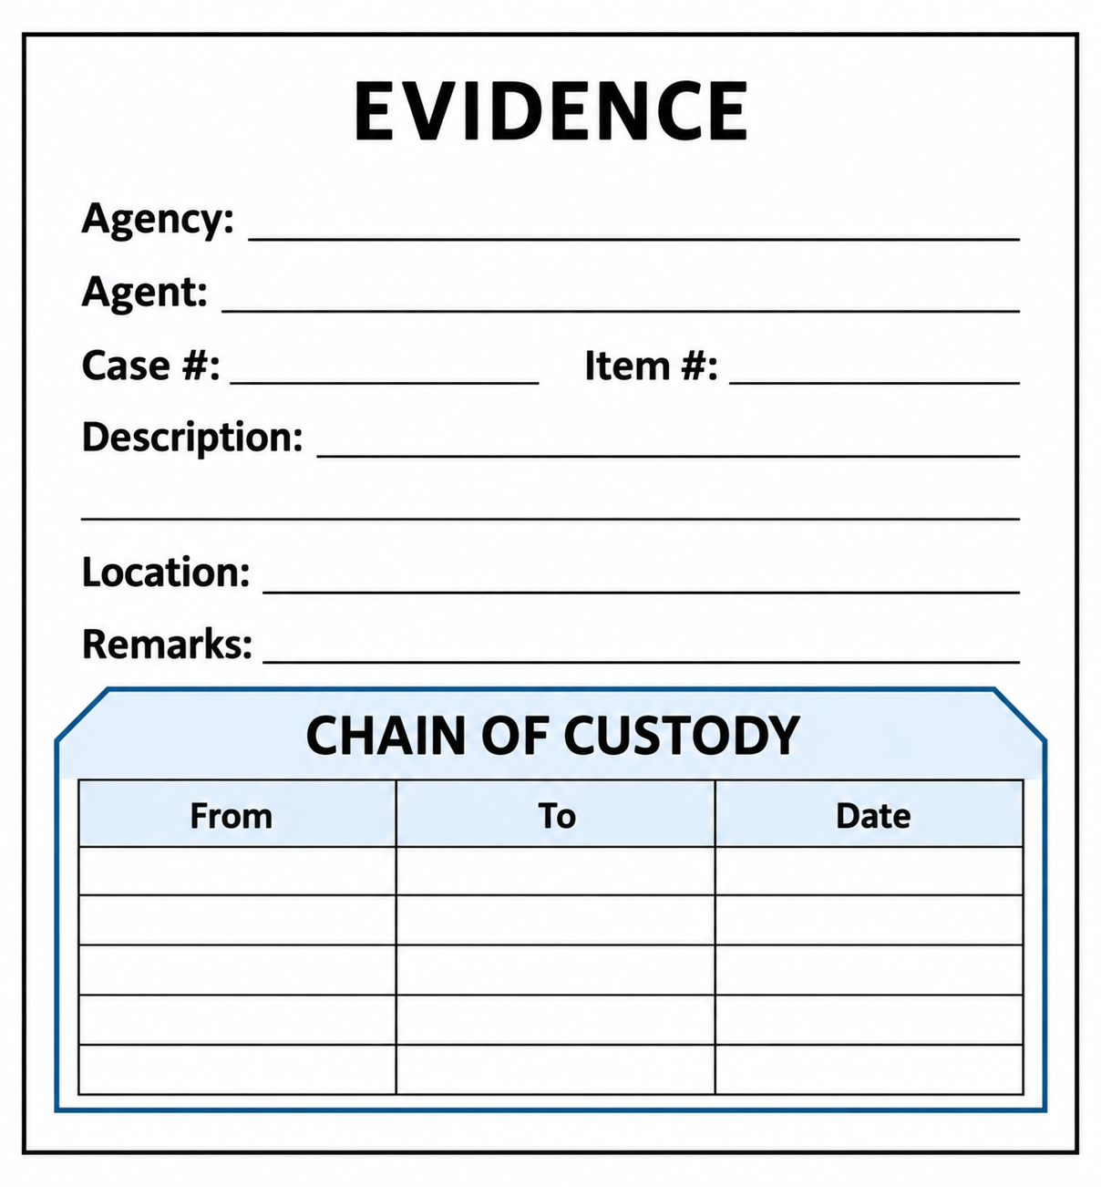
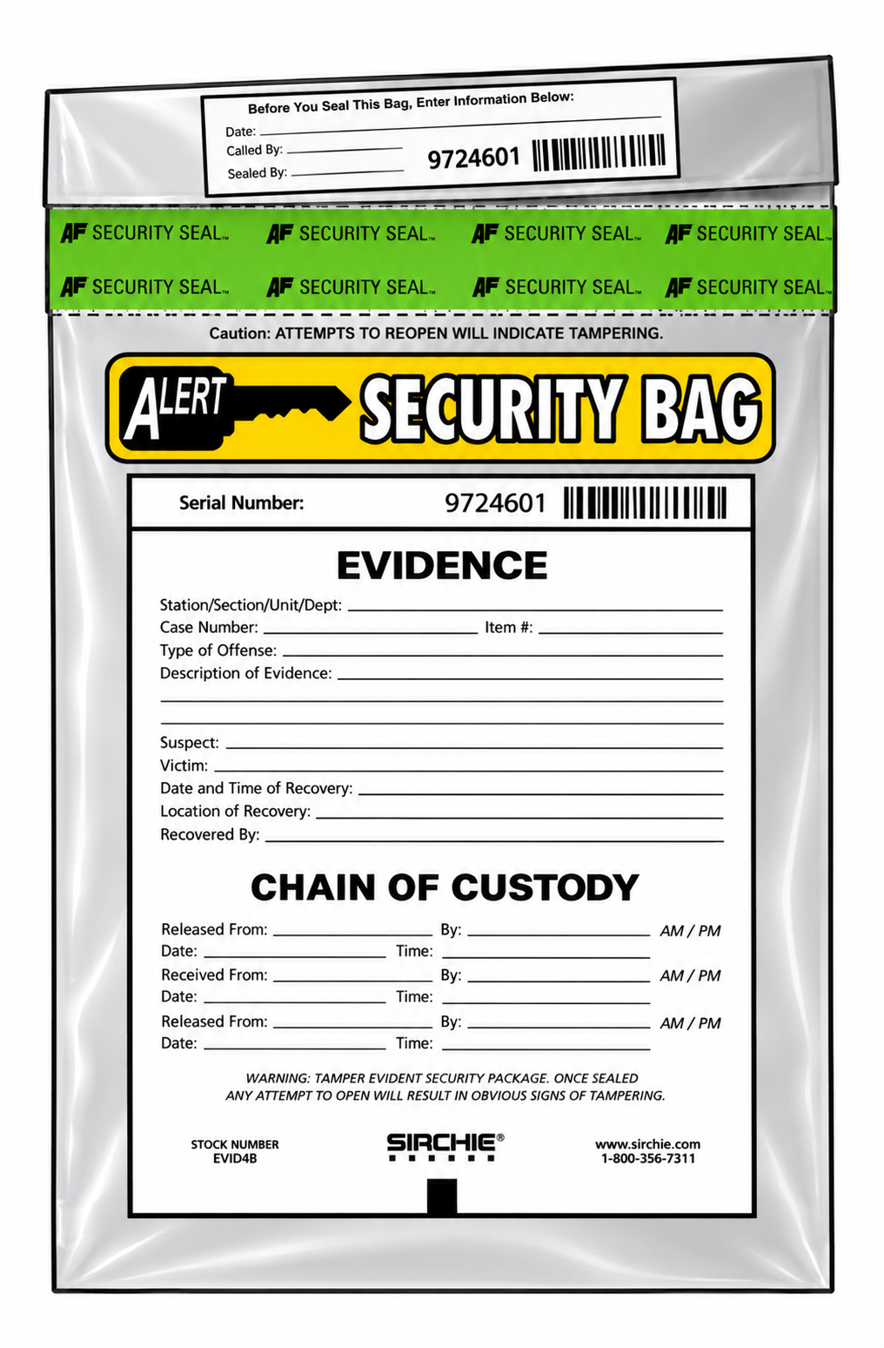
Procedure of gathering the Evidence
Interview the responsible custodian or IT manager.
Complete the evidence form and obtain signatures.
Place evidence in a secure, labeled container.
Transport to the forensic lab and complete custody documentation.
Lock the container and control access.
Evidence form example
Evidence security bag example
Evidence security bag example
Do not “just take the device.” Document who transferred it, when, where, why, and under what authority.

Slide 14
Acquisition: forensic image vs. backup copy
Forensic image
Backup copy
Bit-by-bit copy of the storage medium
Includes deleted files, slack/unallocated space, and fragments
Validated with hash values
Copies selected known files
Typically misses deleted files and fragments
Useful for restoration, not sufficient by itself for forensic evidence
Forensic imaging preserves the whole address space; a backup usually preserves only selected live files.

Slide 15
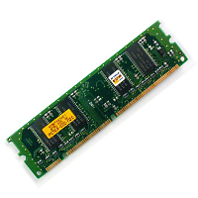

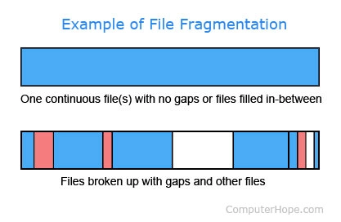
Analyzing digital Evidence
Operating-system artifacts and user profiles
Application data, logs, configuration files, and metadata
Deleted files and file fragments
Memory or volatile artifacts when collected
Memory can contain volatile evidence.
Deleted files may remain recoverable.
Analysis turns artifacts into answers to case questions.
Fragments can break continuity and complicate recovery.

Slide 16
Final report: methods + findings
Document the scope, evidence items, tools, versions, and procedures.
Report repeatable findings and the evidence that supports them.
Address who, what, when, where, why, and how when the evidence permits.
Separate conclusions from assumptions, uncertainties, and limitations.
Optional: formalize artifacts and relationships, for example with STIX-style representation.
A strong report is defensible: another examiner can understand how each conclusion was reached.

Slide 17
Case critique: improve the next investigation
Were the results expected? What changed during the case?
Was the documentation complete enough for review?
What feedback came from the requesting source?
Did the case reveal new problems, tool limitations, or training gaps?
Should any procedures, checklists, or lab practices be updated?
Critique is quality assurance, not blame. It converts case experience into better forensic practice.

Slide 18

Autopsy lab
Hands-on workflow: create a case, add an evidence image, find artifacts, and generate a report.

Slide 19
Lab scenario and goals
Starting point: a forensic disk image from the textbook lab dataset.
Main tasks: recover Word files and images, search keywords, and document findings.
Evidence handling goal: verify the file and work from an image rather than the original source.
Reporting goal: tag relevant items so they appear clearly in the report.
In a real case, record the acquisition source, hash values, examiner, time zone, tool version, and case notes.

Slide 20
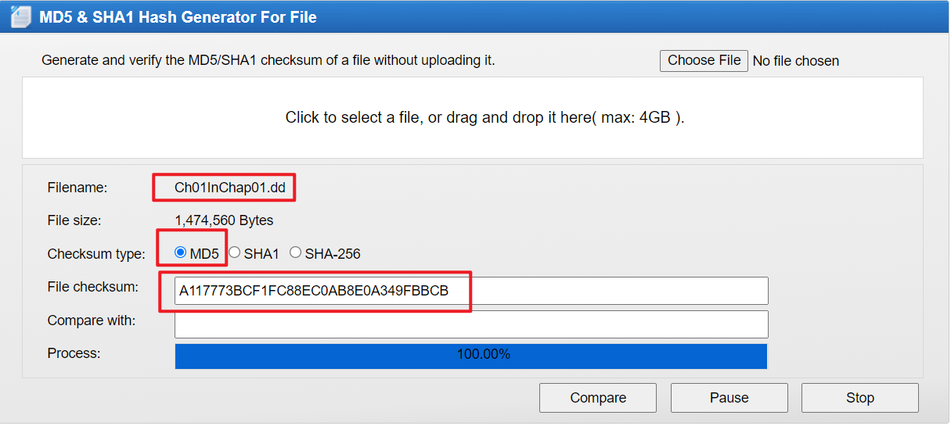
Verify the evidence hash
Action
• Compute MD5/SHA-1/SHA-256 before analysis.
• Compare against the provided reference value, if one exists.
• Prefer local hashing tools for real evidence; avoid unnecessary online handling.
https://www.dropbox.com/s/nw23q14vzsykyup/Ch01InChap01.dd (from book Guide to Computer Forensics and Investigations. Sixth Edition)

Slide 21
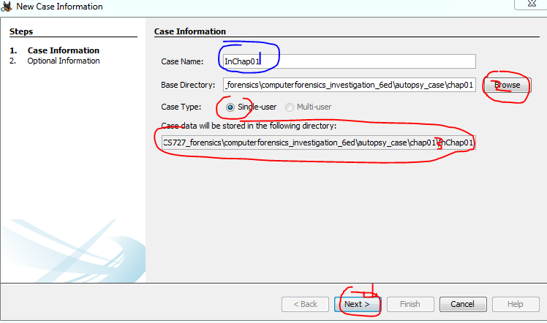
Create a new Autopsy case
Action
• Set a descriptive case name.
• Choose a case directory that will store Autopsy output.
• Use single-user mode for this introductory lab.

Slide 22
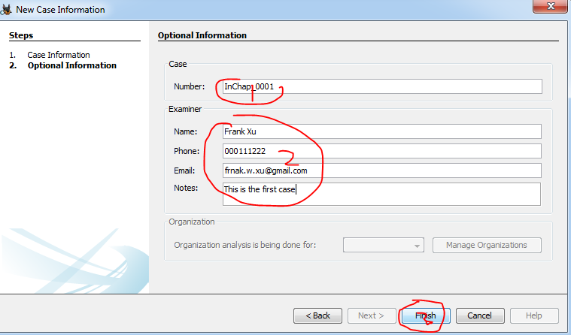
Enter case metadata
Action
• Add a case number, examiner name, and notes.
• Use training data only in classroom screenshots.
• Case metadata should make later review easier.

Slide 23
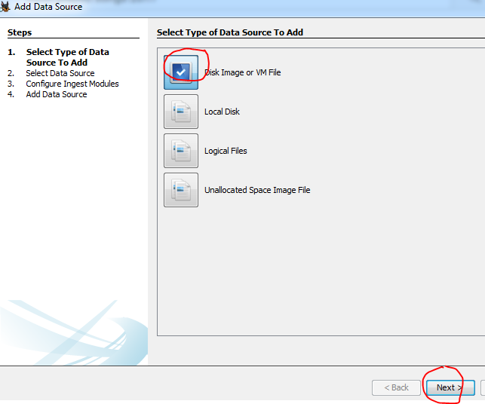
Add the evidence image as a data source
Action
• Select “Disk Image or VM File.”
• This option is appropriate for a forensic image file such as .dd, .img, .E01, or a VM disk.
• Proceed to choose the image file.

Slide 24
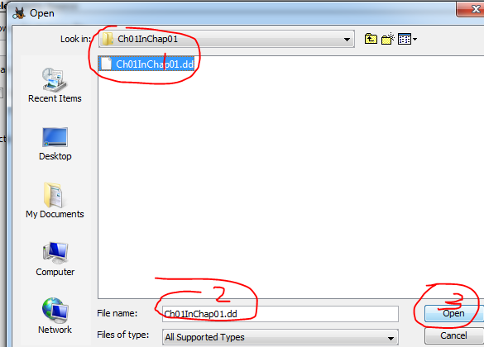
Select the image file
Action
• Browse to the lab image directory.
• Select the evidence image file.
• Confirm the filename before opening.

Slide 25
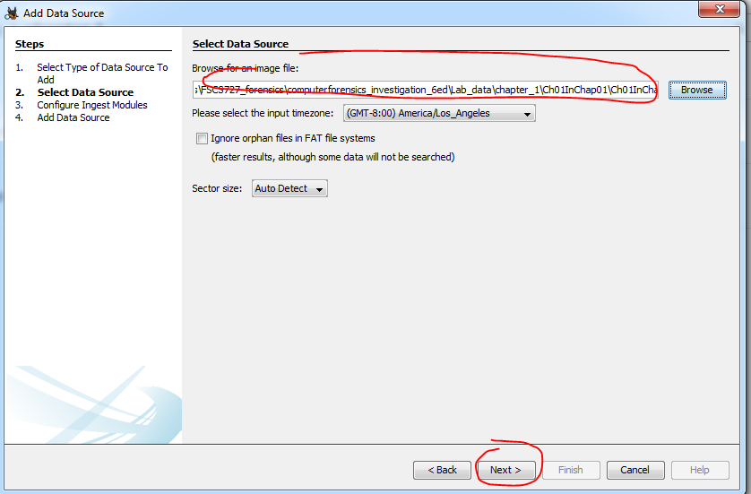
Confirm source settings
Action
• Verify the image path.
• Select the correct time zone for timestamp interpretation.
• Use auto-detect sector size unless the evidence requires a specific value.

Slide 26
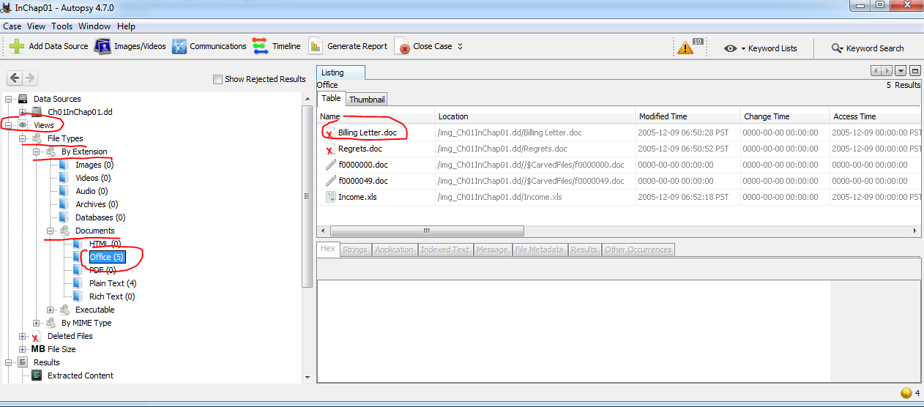
Locate deleted files
Action
• Browse by file type and extension.
• Deleted items are marked in the file listing.
• Start with Office documents, images, and other case-relevant file types.

Slide 27
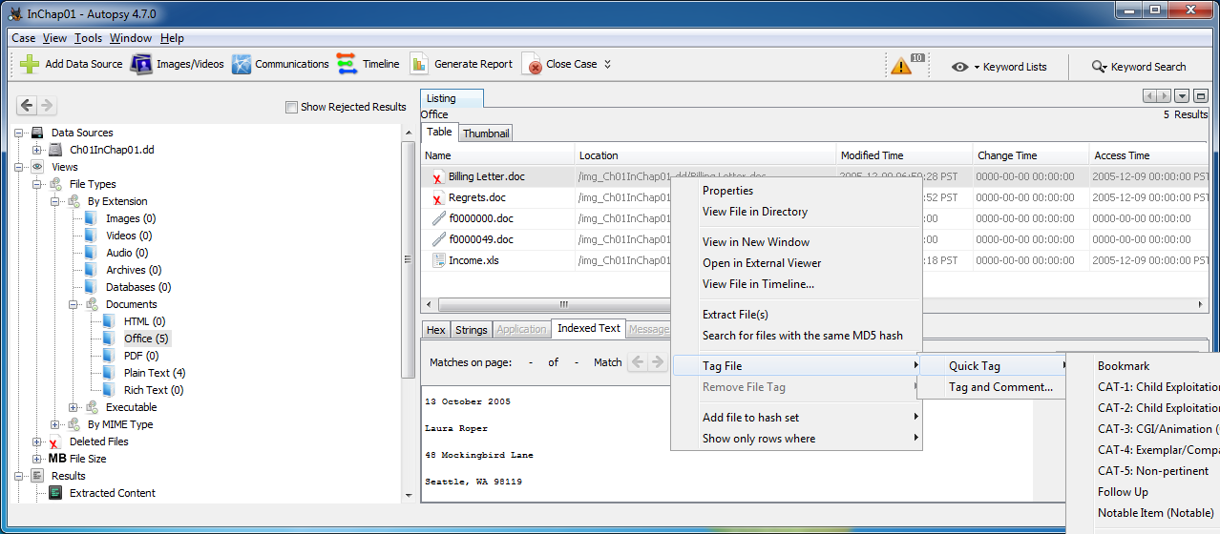
evidence items
Action
• Right-click an item of interest.
• Choose Tag File and either select an existing tag or create a new one.
• Tags organize findings for review and reporting.
Right click

Slide 28
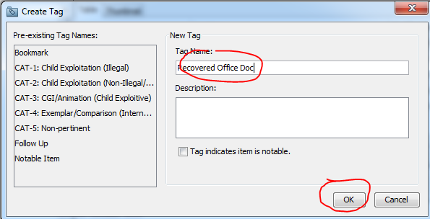
Create a reporting tag
Action
• Use a tag name that describes why the item matters.
• Example: “Recovered Office Doc.”
• Use consistent names so the final report is easy to read.

Slide 29
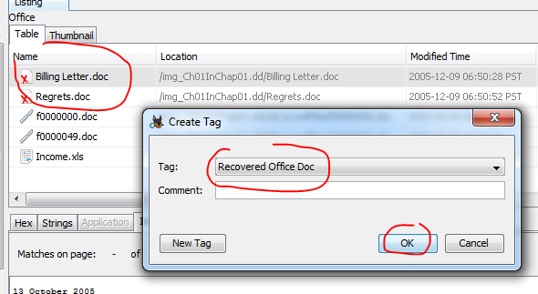
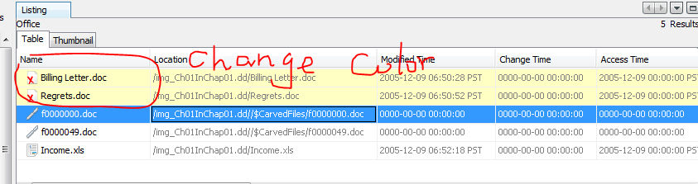
Apply the tag to both deleted files
Action
• Tag each relevant deleted file.
• Check that the tagged items appear as expected.
• Tags create a trace from discovery to report output.

Slide 30
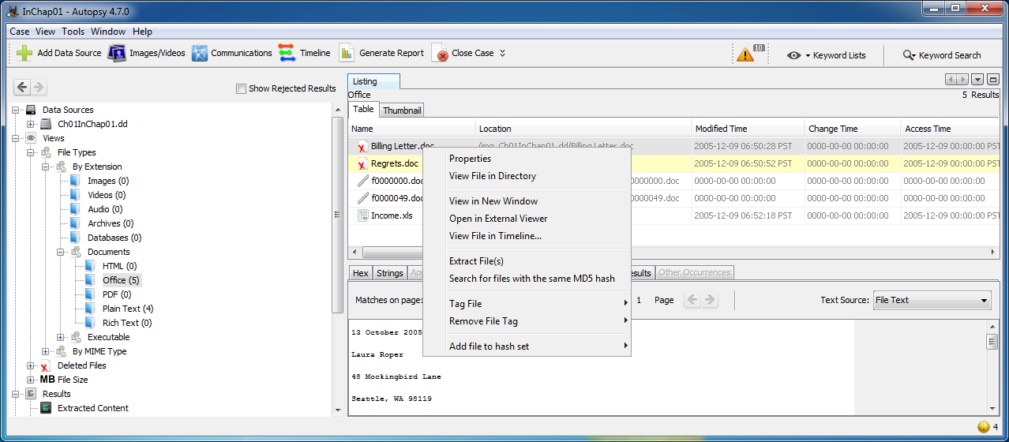
Extract recovered files
Action
• Right-click the item and choose Extract File(s).
• Save extracted files to a controlled output directory.
• Document the extraction location and any limitations.

Slide 31
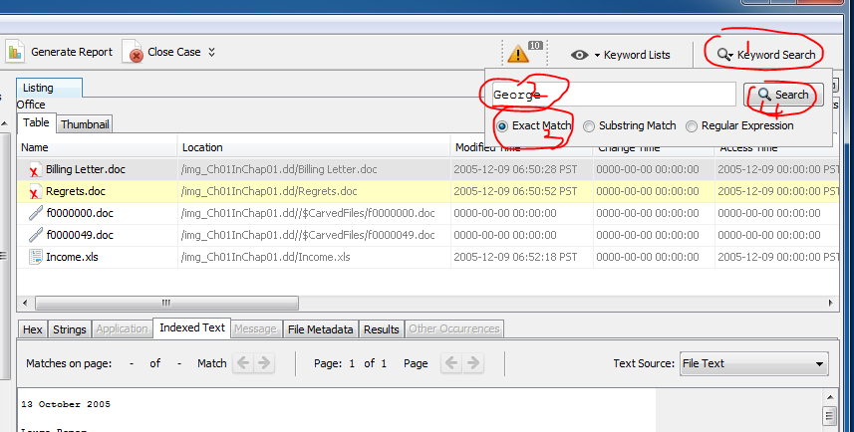
Search keywords
Action
• Open Keyword Search.
• Use exact match, substring, or regular expression as appropriate.
• Record the search term and match mode in the case notes.

Slide 32
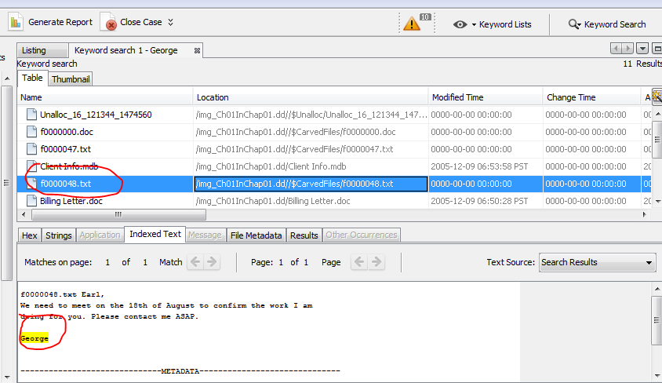
Interpret search results
Action
• Review hit count and file paths.
• Open each hit in context; do not rely on keyword hits alone.
• Decide whether each hit is relevant, irrelevant, or needs follow-up.

Slide 33
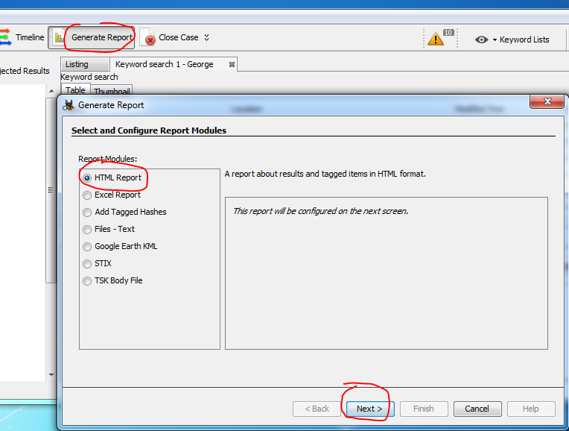
Generate the report
Action
• Choose an appropriate report module, such as HTML Report.
• Include tagged items and relevant search results.
• Review the generated report for completeness before submission.

Slide 34
Lab deliverables
Hash values for the evidence image or archive.
List of deleted files found, including paths and file types.
Recovered files, if recovery is possible and permitted by the lab instructions.
Keyword and regex search results, including search terms and match modes.
Autopsy report or concise finding summary with screenshots when appropriate.
A complete submission should show what you found and how you found it.

Slide 35
Assignment
Evidence image archive
https://raw.githubusercontent.com/frankwxu/Digital-Forensics-Basic-Book/main/files/120M.7z
Tasks
1. Find all deleted files, if any.
2. Find all phone numbers or email addresses, if any.
3. Document the evidence path, hash values, search terms, and results.
4. Submit a concise report with relevant screenshots or Autopsy report output.

Slide 36
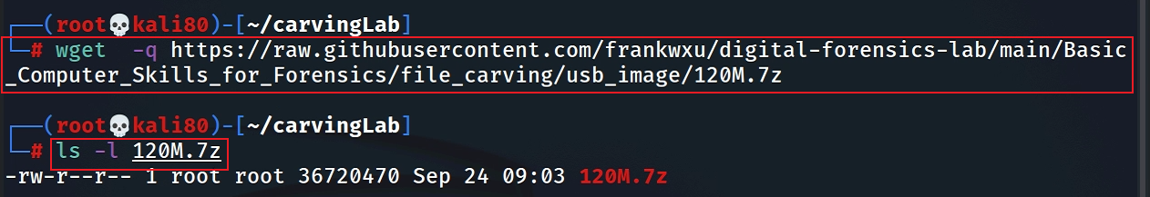
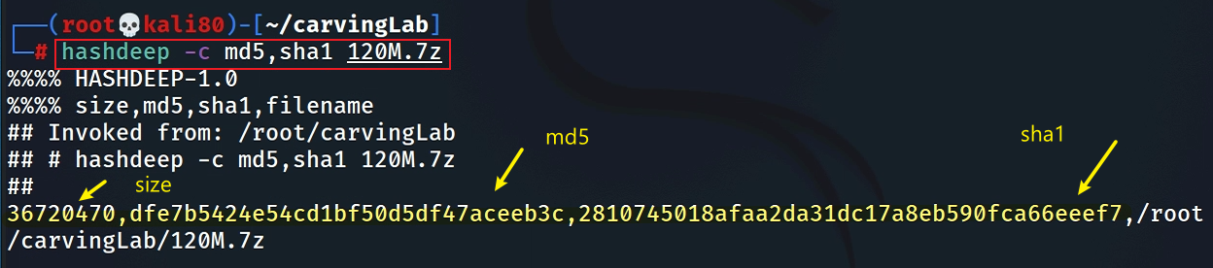
Prepare a USB image and compute hashes
(optional)
Download the zipped USB image or go to website download the compressed file
Compute hashes
Notes:
wget -q https://raw.githubusercontent.com/frankwxu/digital-forensics-lab/main/Basic_Computer_Skills_for_Forensics/file_carving/usb_image/120M.7z
https://github.com/frankwxu/Digital-Forensics-Basic-Book/blob/main/files/120M.7z

Slide 37
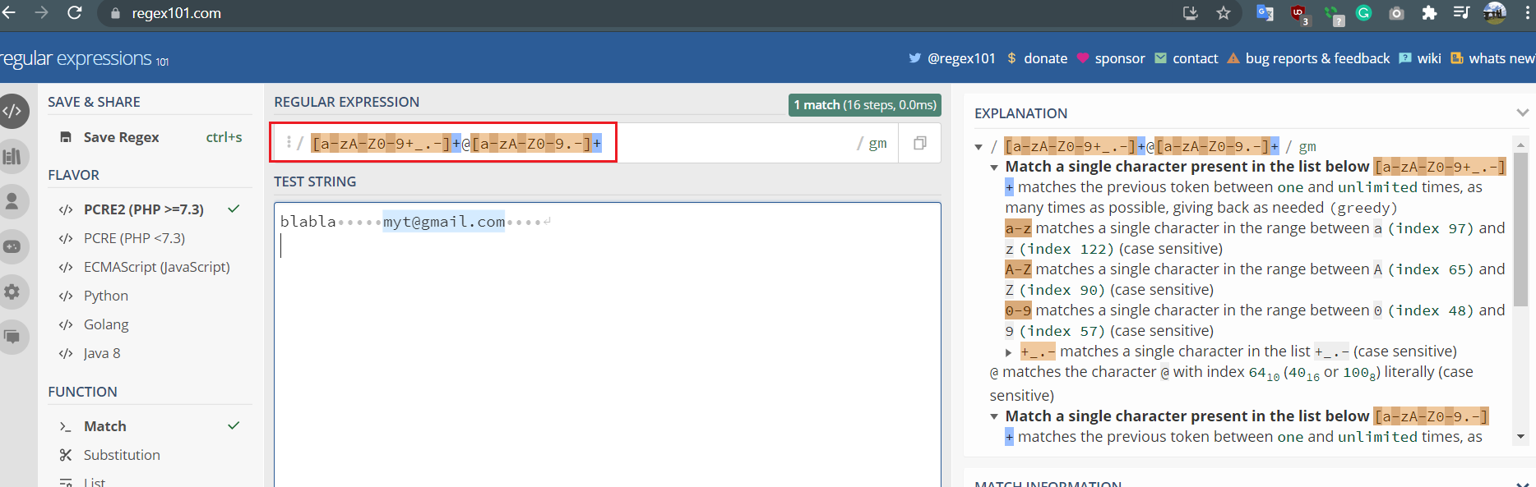
Regex search: email addresses
Pattern: [a-zA-Z0-9+_.-]+@[a-zA-Z0-9.-]+
Suggested phone regex for the assignment: (\+?1[-.\s]?)?\(?\d{3}\)?[-.\s]?\d{3}[-.\s]?\d{4}

