Slide 1
The RSA Cryptosystem

Slide 2
Review
https://planetcalc.com/8326/
Encryption: 14³ mod 33 =? 5
Decryption: 5⁷ mod 33 =? 14
How to get 3 and 7?
Where 33 comes from? (next lecture)
3 . 7 ≡ 1 mod 20
Pick 3, and compute t, such that
3 . t ≡ 1 mod 20
Public key
Private key
33 is part of public key, 20 is not
So: more precisely: (3, 33) is a public key, 7 is a private key

Slide 3



Step 2: (3, 33)
Step 3: Encrypt using 3
Step 1:
20=f(33)
3 . 7 ≡ 1 mod 20
How to get private key for given
3 . ? ≡ 1 mod ?
33
Relation between ?=f(33)
Step: 4: Decrypt using 7
Both Alice and Oscar want to solve f(33)

Slide 4
What is the problem?
3 . 7 ≡ 1 mod 20
Big problem: If one can compute 20 from 33, one can find the private key 7?
function: F(33) =20?
Design goal: To design an algorithm such that
Function algorithm is known
We (good guy) can compute f(33)=20
Other people (bad guy) are difficult to compute f(33)=20 X
Public key
Private key
Encryption: 14³ mod 33 =? 5
Decryption: 5⁷ mod 33 =? 14

Slide 5
Principle to design Public-Key Algorithms

Slide 6
Math Principle to design Public-Key Algorithms
3 . 7 ≡ 1 mod 20
f(m)?
M=33
Three math functions
Phi Function is based on prime factors formular
It is difficult to solve
F(33)->20 (difficult)
It is easy if a good guy is able to determine the input
If the good guy can pick 33, it will easy to solve F(33)->20.
Public key
Private key

Slide 7
Euler‘s Phi Function
One way function

Slide 8
A simple math problem
Given the set of the m integers {0, 1, 2, …, m -1}, how many numbers in the set are relatively prime to m ?
Euler‘s Phi Function: Φ(m) = ?

Slide 9
Solve Euler‘s Phi Function: Φ(m) = ?

Slide 10
Option 1 (hard way)
The set {0,1,2,3,4,5} (m=6)
gcd(0, 6) =6
gcd(1, 6) =1
gcd(2, 6) =2
gcd(3, 6) =3
gcd(4, 6) =2
gcd(5, 6) =1
1 and 5 relatively prime to m=6
Φ(6) = 2
Testing one gcd per number in the set is extremely slow for large m.

Slide 11
Another example
The set {0,1,2,3,4,,,,35}, where m=36
gcd(1, 36) =1 gcd(19, 36) =1
gcd(5, 36) =1 gcd(23, 36) =1
gcd(7, 36) =1 gcd(25, 36) =1
gcd(11, 36) =1 gcd(29, 36) =1
gcd(13, 36) =1 gcd(31, 36) =1
gcd(17, 36) =1 gcd(35, 36) =1
Φ(36) = 12

Slide 12
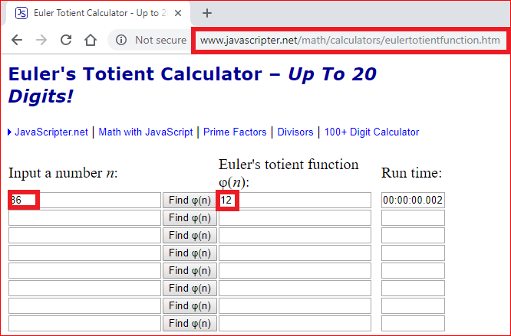

Slide 13
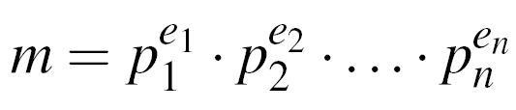
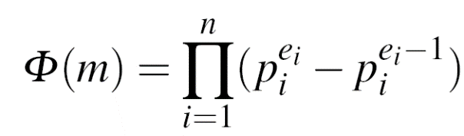
Option 2 (hard way)
Step 1: factorization
Step 2:

Slide 14
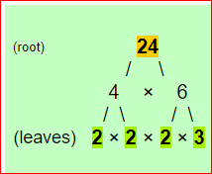
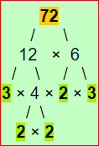

Step 1: factorization (1)
24=2³*3¹
Factoring is complicated (and often infeasible) for large numbers

Slide 15
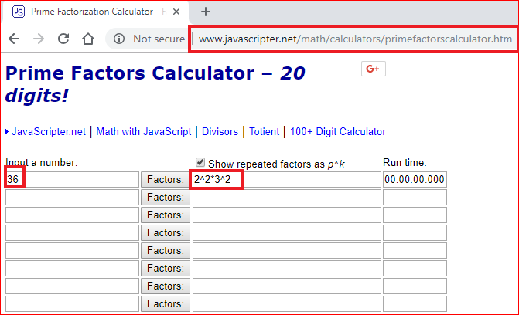
Step 1: factorization (2):
Factoring is complicated (and often infeasible) for large numbers

Slide 16
Step 2:
(2²-2¹)x(3²-3¹) =2x6=12

Slide 17
What if m is a prime number
Φ(3) = ?
{0,1,2)
Φ(11) = ?
{0,1,2,3,4,5,6,7,8,9,10}

Slide 18
Interesting property of Euler‘s Phi Function: Φ(m) = ?
If m is a big number
If is very difficult to compute Φ(m)
Factorization is hard!
However, if you knew the factorization of m, i.e., m = p¹*q¹ and p and q are prime numbers
Φ(m) =(q-1)*(q-1)
6=2x3, Φ(6) = (2-1) . (3-1) =2
Φ(33)=3*11=(3-1)(11-1)=20
Integer factorizaiton is difficut, multiple two numbers is easy.

Slide 19
RSA Algorithm

Slide 20
RSA scheme
Choose two prime numbers p and q,
Compute the modulus in which the arithmetic will be done: n=pq,
Pick a public encryption key e ∈Z_{n}, gcd(e, Φ(n) ) = 1 (why)?
Compute the private decryption key as d such that ed=1 mod ϕ(n),
Encryption of message m: c= m ^{e} mod n,
Decryption of crypto message c: m=c ^{d} mod n.

Slide 21
Example: RSA with small numbers
ALICE
Message x = 4
y = x^{e} ≡ 4³ ≡ 31 mod 33
BOB
Choose p = 3 and q = 11
Compute n = p * q = 33
Φ(n) = (3-1) * (11-1) = 20
Choose e = 3
d ≡ e⁻¹ ≡7 mod 20
y^{d} = 31⁷ ≡ 4 = x mod 33
K_{pub} = (33,3)
y = 31
Notes:
e^Φ(n) = 1 mod n
e^-1=e^[Φ(n) -1]
3^19

Slide 22
Questions
Explain why it is very difficult for hackers to compute the private key based on the design of the RSA algorithm?
Explain why it is very easy for good people to derive the private key based on the design of the RSA algorithm?

Slide 23
Prove RSA correctness
(optional)

Slide 24
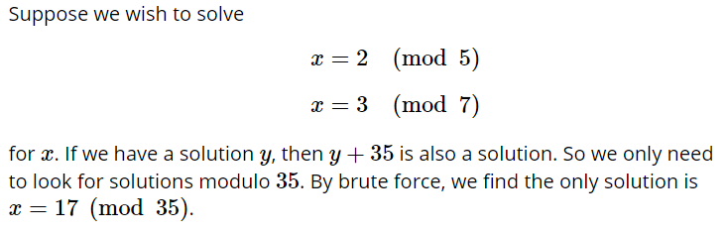
Prove it
X=7, 12, 17
X=10, 17, 24

Slide 25
Prove: Chinese Remainder Theorem
If m ≡ 17 mod 35
Then
m ≡ 17 mod 5
m ≡ 17 mod 7
m ≡ a mod p*q , where p and q are primes
m ≡ a mod p
m ≡ a mod q

Slide 26
Prove : Fermat's little theorem
1⁴= 1 mod 5
2⁴= 1 mod 5
3⁴= 1 mod 5
4⁴= 1 mod 5
a ^{p-1}= 1 mod p, where p is a prime

Slide 27
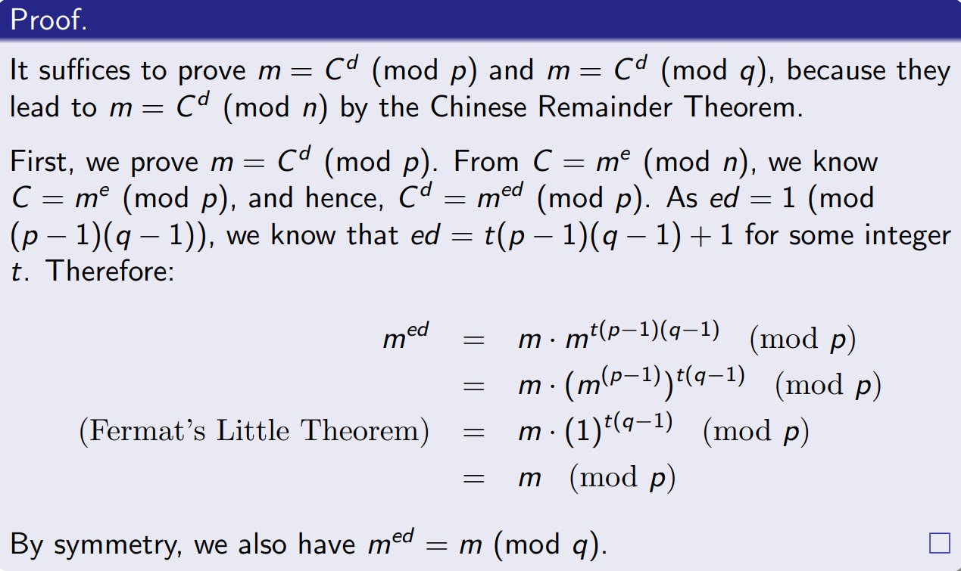
Prove it
Choose two prime numbers p and q,
Compute the modulus in which the arithmetic will be done: n=pq,
Pick a public encryption key e ∈Z_{n},
Compute the private decryption key as d such that ed=1 mod ϕ(n),
Encryption of message m: c= m ^{e} mod n,
Decryption of crypto message c: m=c ^{d} mod n.

Slide 28
Lab

Slide 29
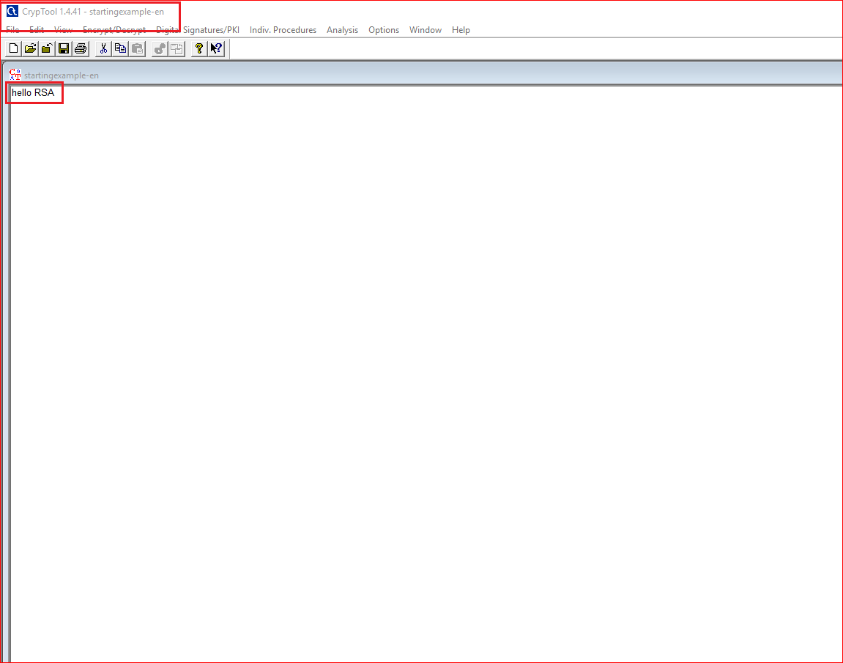

Slide 30
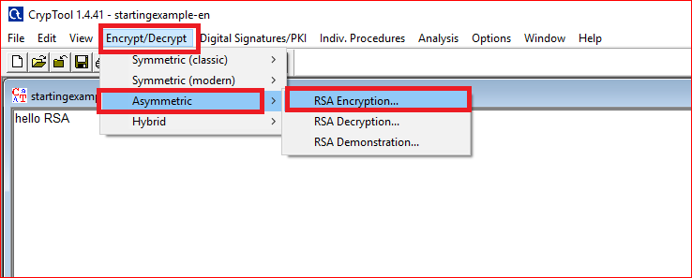

Slide 31
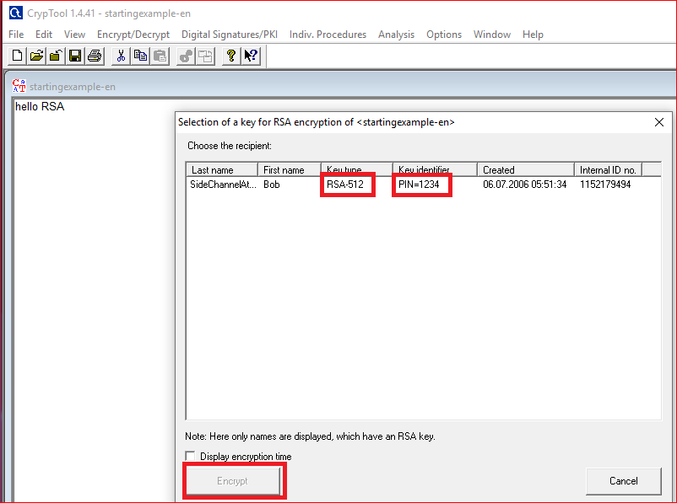

Slide 32
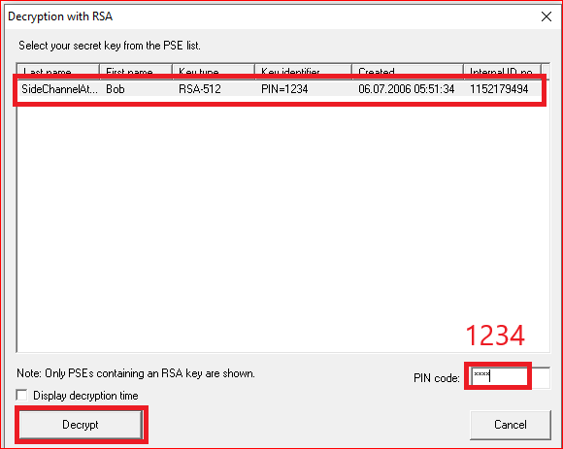
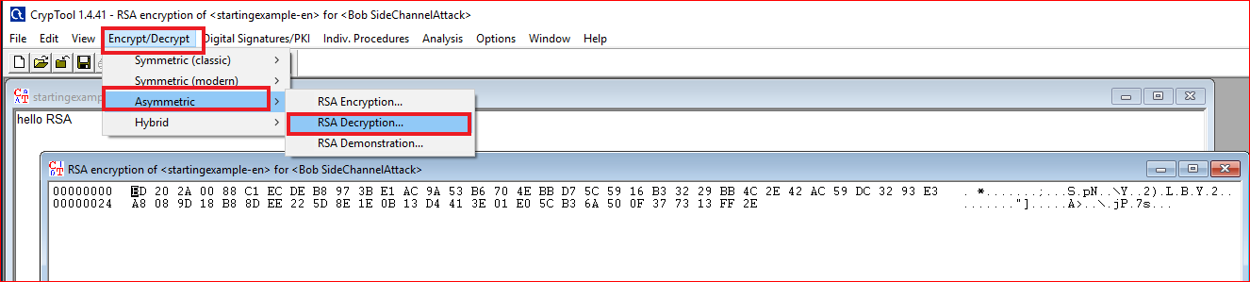
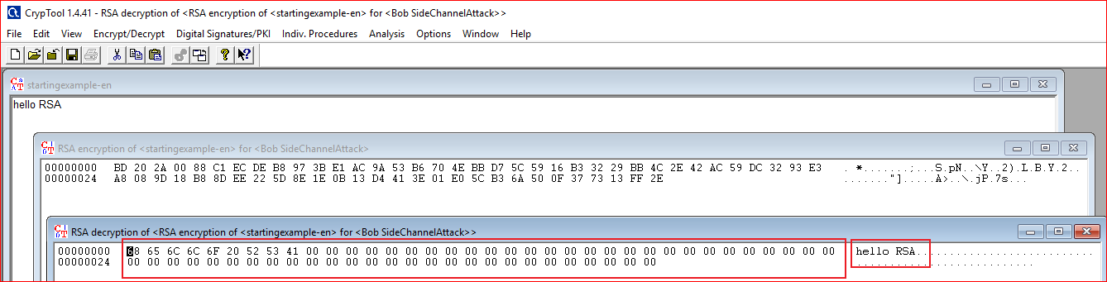

Slide 33
Question: Your need to answer
Design a message with length of 65. What is the size of encrypted message? Why?
Example
01234567890123456789012345678901234567890123456789012345678901234

Slide 34
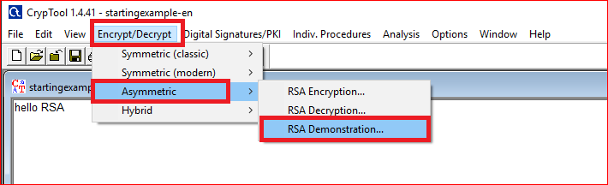
How RSA work?

Slide 35
Generate key

Slide 36
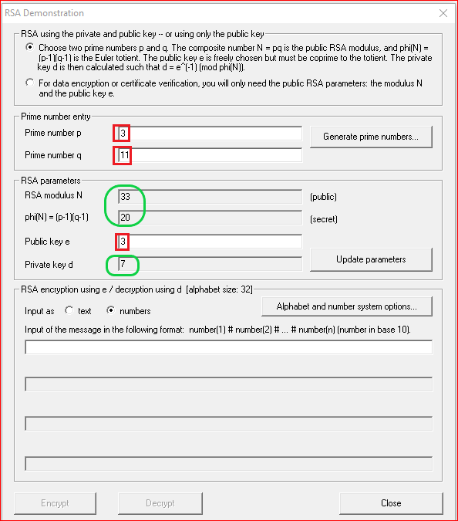
Question: Your need to do
Can we pick up 4 as the private key?
Why?

Slide 37
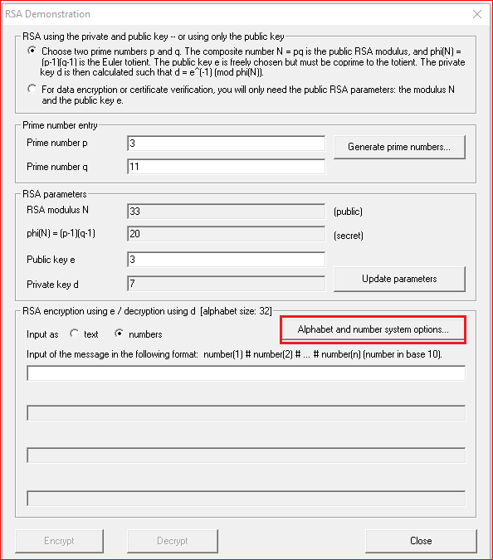
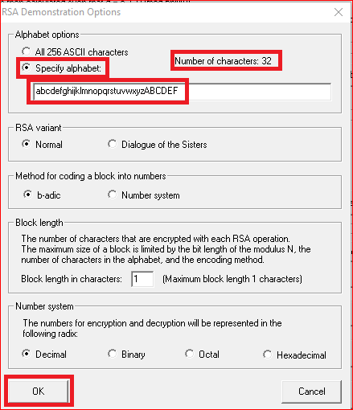
Question: why 32?

Slide 38
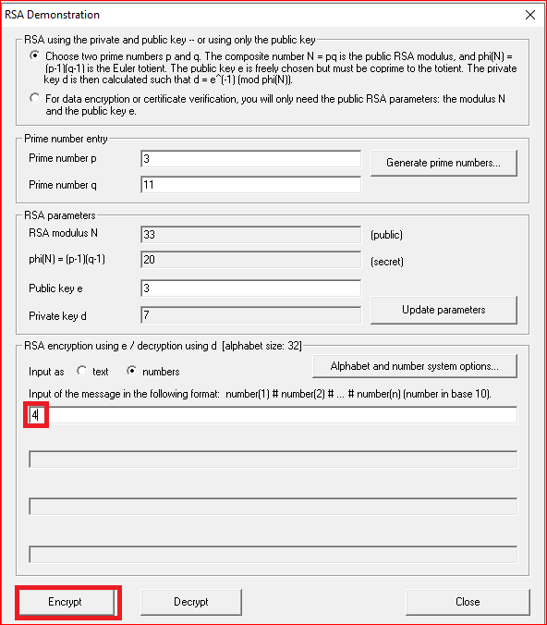


Slide 39
RSA Encryption

Slide 40
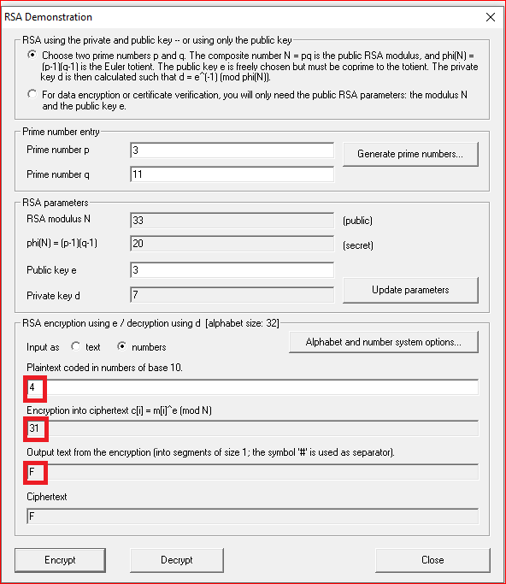


Slide 41
RSA Decryption

Slide 42
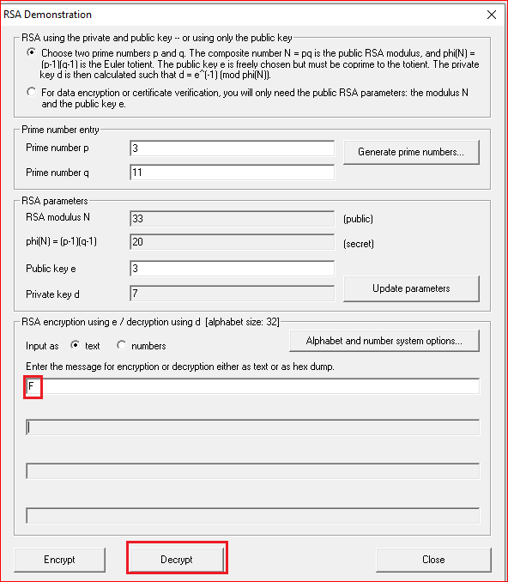


Slide 43
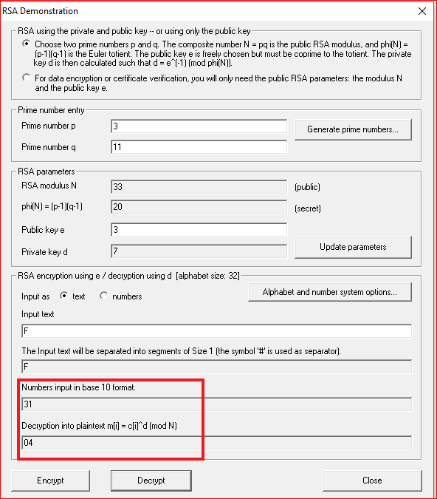

Slide 44
Three hard math problems
Three hard math problems
Factoring integers: Given a composite integer n, find its prime factors
Discrete Logarithm: Given a, y and m, find x such that a^{x} = y mod m (Exponentiation a^{x} : easy)
Elliptic Curves
One-way function
Computing y = f(x) is computationally easy
Computing x = f-1(y) is computationally infeasible

Slide 45
Your work
Pick up a different public key
Manually compute the private key
Encrypt the letter “F”
Manually
Using the tool
Encrypt and decrypt a message “hello rsa” using tool and record your observation

