Slide 1
Diffie–Hellman Key Exchange
Note: only for key exchange, not for encryption

Slide 2
Overview
Public-Key Cryptosystems Based on the Discrete Logarithm Problem

Slide 3
Diffie and Martin Hellman Key exchange protocol
Whitfield Diffie and Martin Hellman
Widely used, e.g. in Secure Shell, Transport Layer Security, and Internet Protocol Security
Both parties involve to generate the key
Not encryption
RSA can encrypt message directly
Ransomware: don’t care of speed.

Slide 4
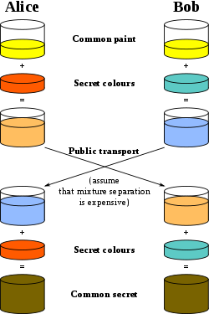
secret
https://en.wikipedia.org/wiki/Diffie%E2%80%93Hellman_key_exchange

Slide 5
Discrete Logarithm Problem
Easy
3 ¹⁰⁰ mod 7 = 4
Difficult to find n
Find n for 3 ^{n} ≡ 4 mode 7

Slide 6


Alice and Bob agree to use a modulus p = 23 and base g = 5
a = 4
A = 5⁴ mod 23 = 4
B = 5³ mod 23 = 10
b = 3
s = 10⁴ mod 23 = 18
S=18
s = 4³ mod 23 = 18
S=18
Proof of correctness:
Alice computes: Bª = (g^{b})ª mod p Bob computes: A^{b} = (gª)^{b} mod p
i.e., Alice and Bob compute the same key k_{AB} !
https://en.wikipedia.org/wiki/Diffie%E2%80%93Hellman_key_exchange

Slide 7
Lab

Slide 8
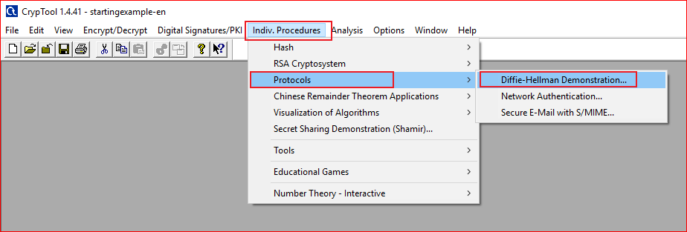

Slide 9
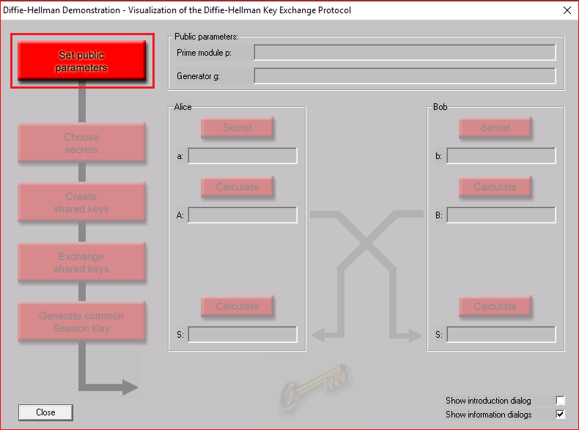
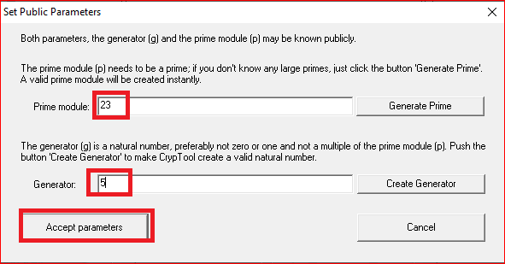

Slide 10
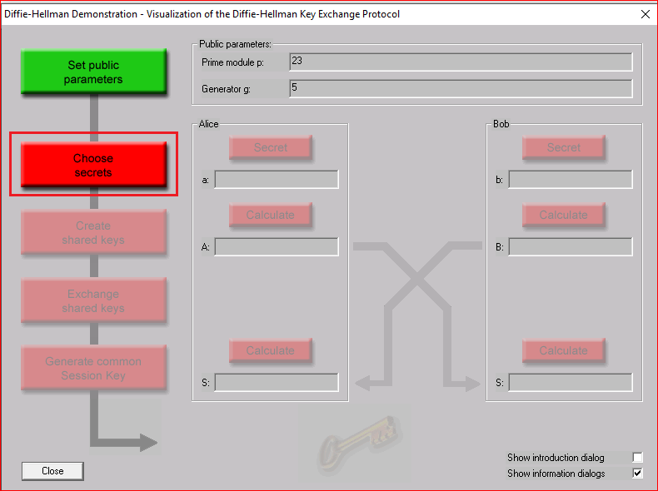
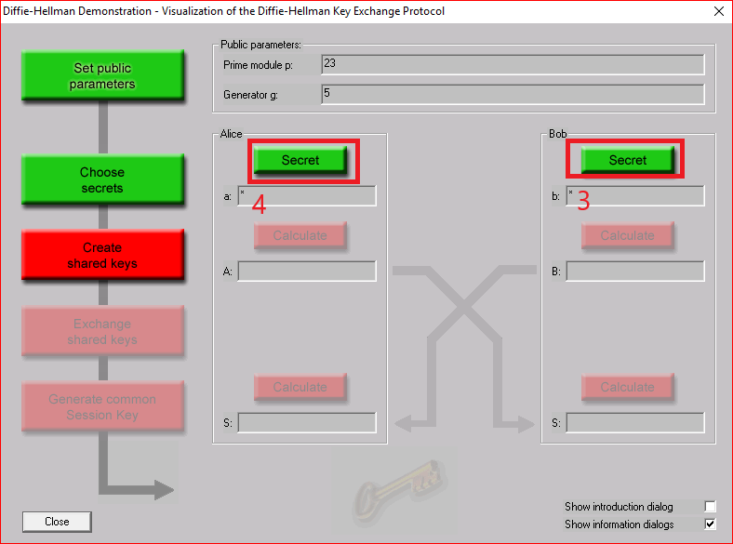

Slide 11
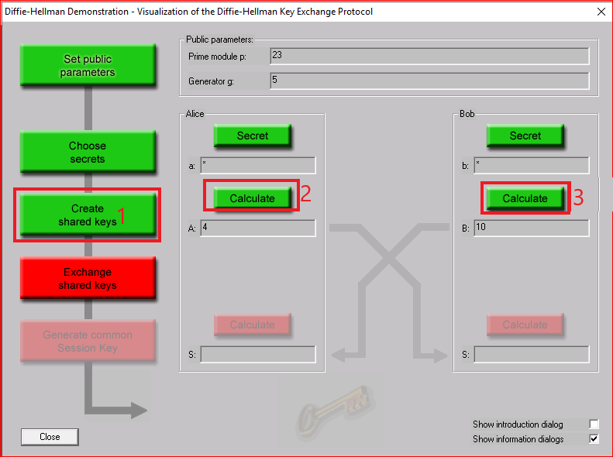
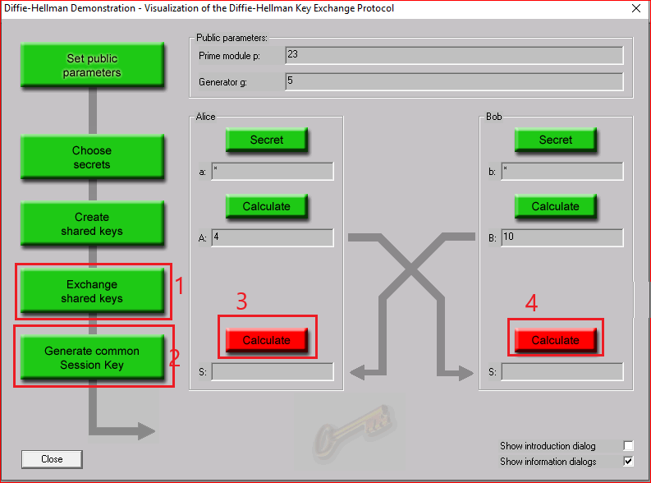

Slide 12
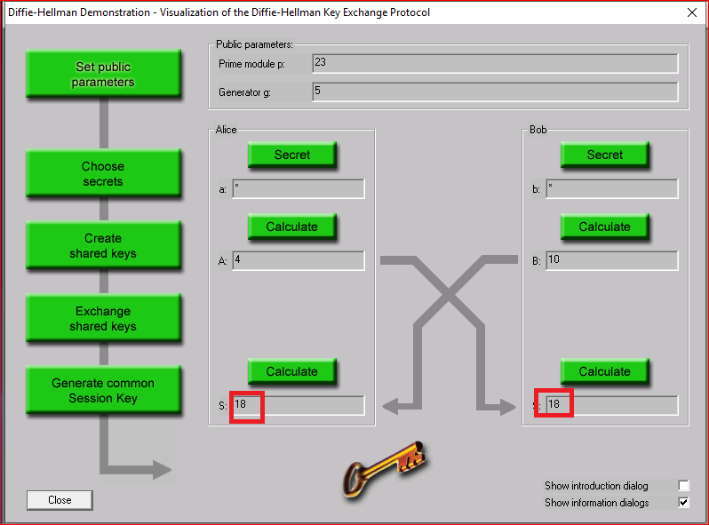

Slide 13
Question
Choose different secrets for Alice and Bob to generate session key.
Manually compute the session key and using the tool to verify your session key.

