Slide 1
Kali 2020 Installation
https://www.youtube.com/watch?v=SsUXQHHmTNc&t=966s
Modified based on https://samsclass.info/126/126_F13.shtml

Slide 2
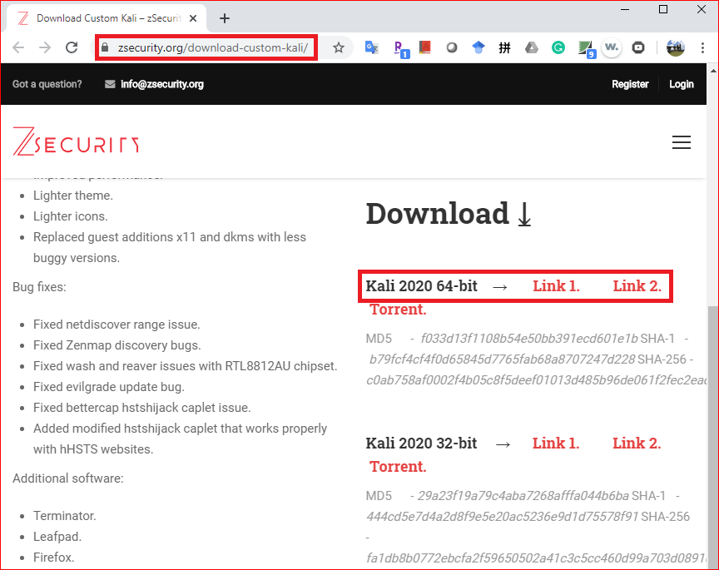
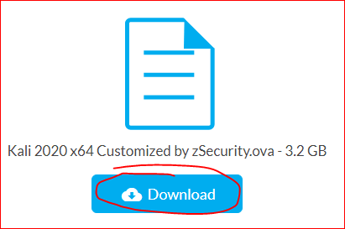
Download: https://zsecurity.org/download-custom-kali/

Slide 3
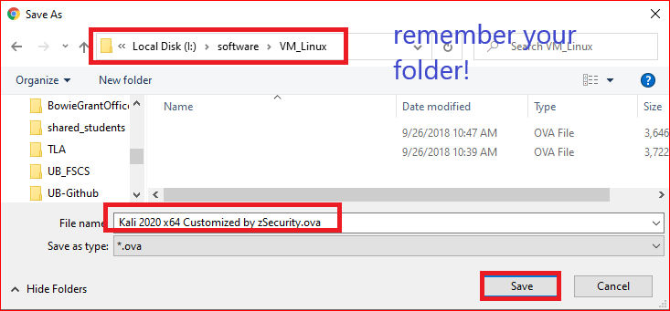
Remember your download folder!

Slide 4

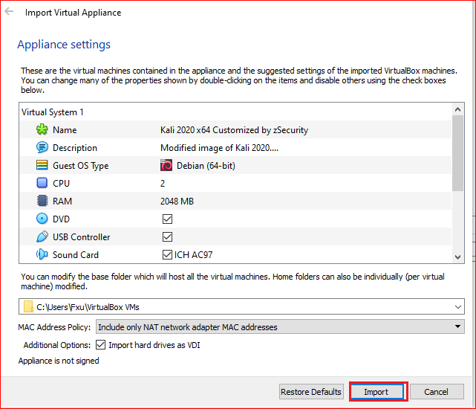
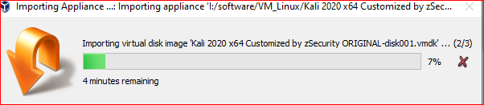
Installation

Slide 5
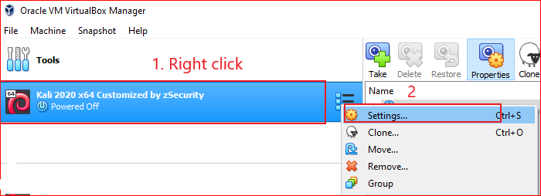
Change setting

Slide 6
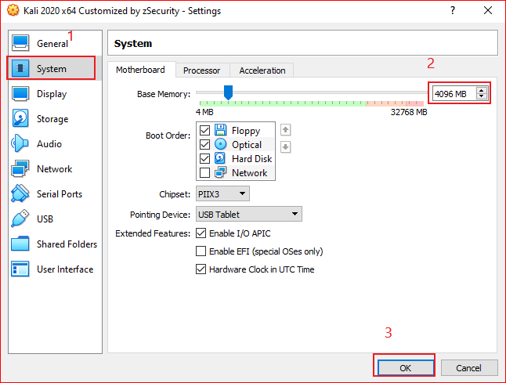
Memory setting

Slide 7
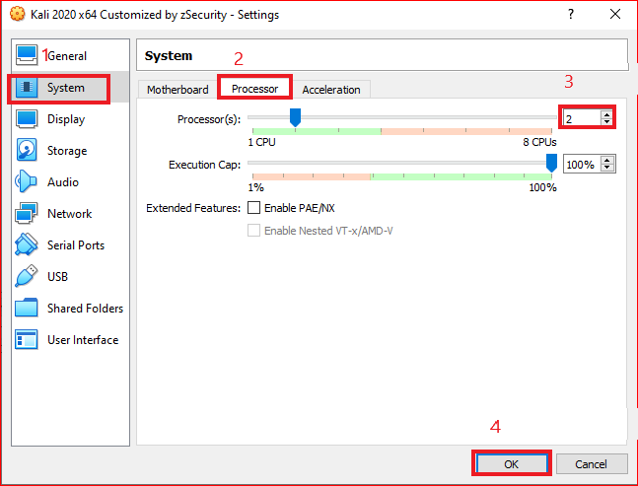
Processor setting

Slide 8
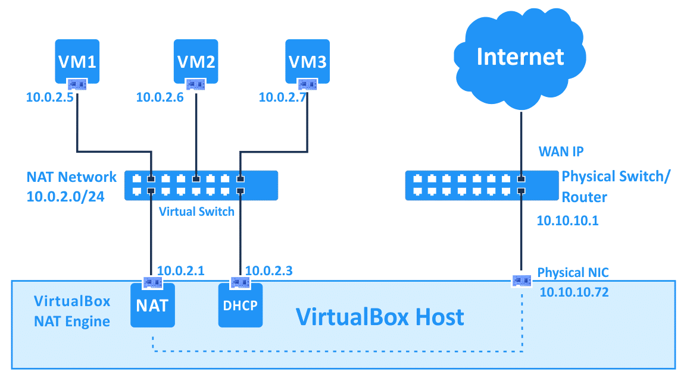
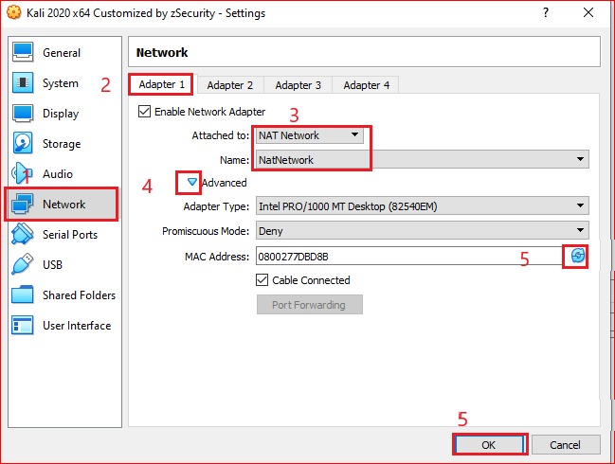
Network setting
https://www.nakivo.com/blog/virtualbox-network-setting-guide/

Slide 9
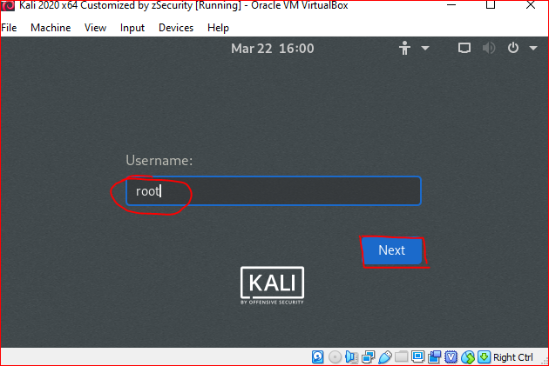
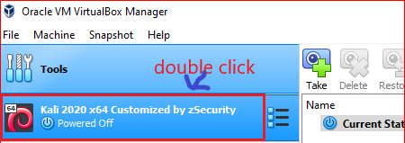
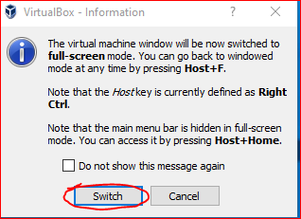
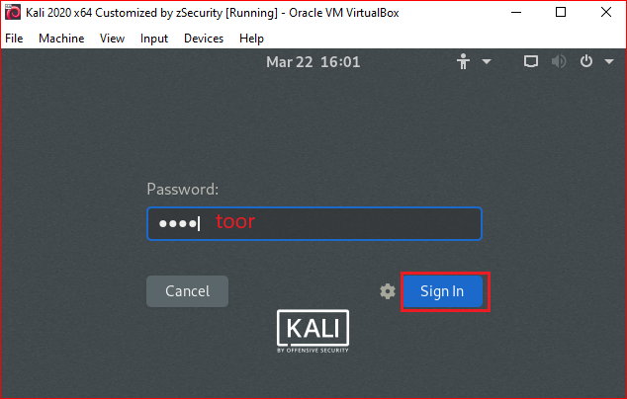
Start Kali 2020

Slide 10
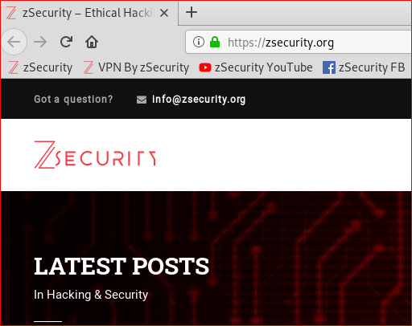
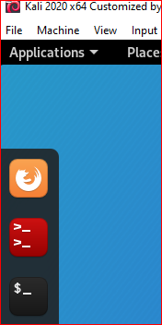
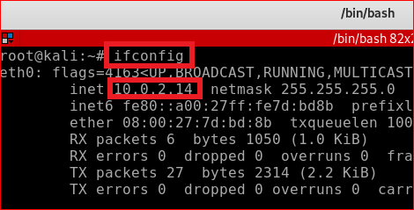
Test all settings
Your PC IP maybe different

Slide 11
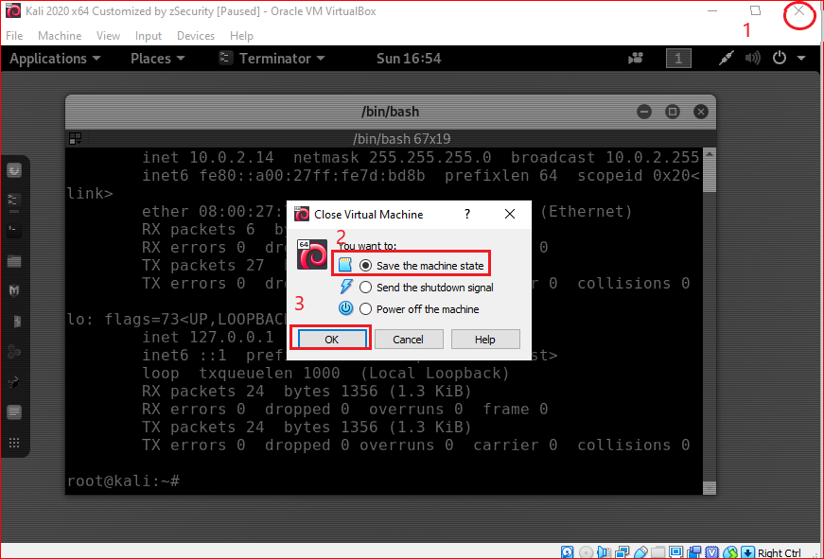
Shut down Kali: save the machine state

Slide 12
Snapshot

Slide 13
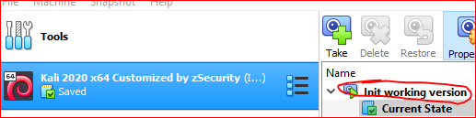
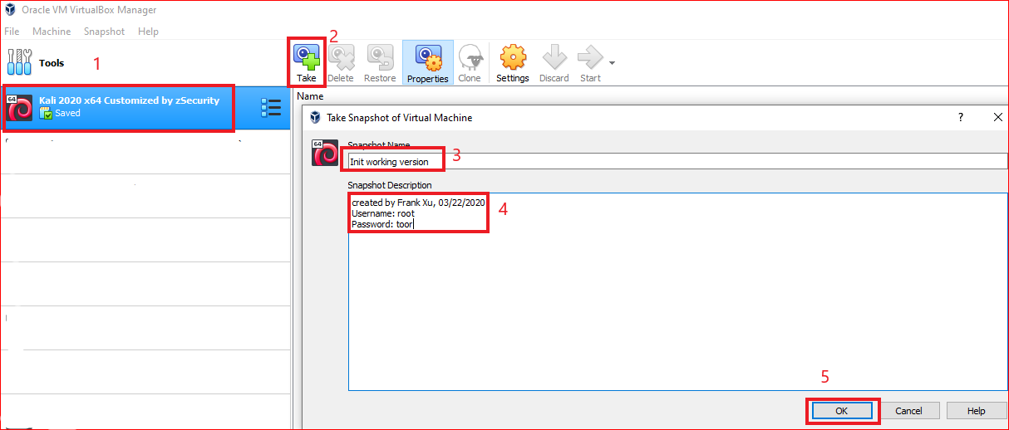
Take a snapshot

Slide 14
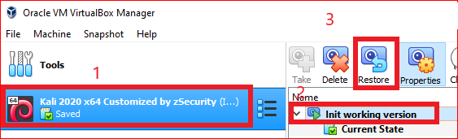
Restore a snapshot

Slide 15
reference
https://www.youtube.com/channel/UCGQqv63CQL847iLDOwdZ3fA/

