Slide 1
The Birthday Paradox
July 2011

Slide 2
Definition
Birthday attacks are a class of brute-force techniques that target the cryptographic hash functions. The goal is to take a cryptographic hash function and find two different inputs that produce the same output.

Slide 3
The Birthday Problem
What is the probability that at least two of k randomly selected people have the same birthday? (Same month and day, but not necessarily the same year.)

Slide 4
The Birthday Paradox
How large must k be so that the probability is greater than 50 percent?
The answer is 23
It is a paradox in the sense that a mathematical truth contradicts common intuition.

Slide 5
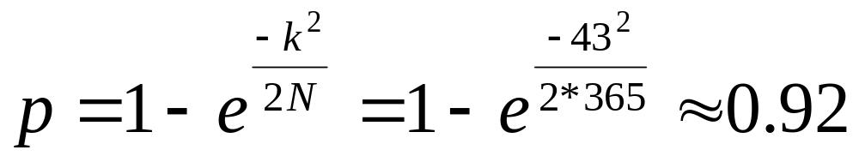
Birthday paradox in our class
What’s the chances that two people in our class of 43 have the same birthday?
Approximate solution:
Where k = 43 people, and N = 365 choices

Slide 6
Birthday Calendar Wall
Equivalence to our hashing space
Jan | 1 | 2 | 3 | 4 | 5 | 6 | 7 | 8 | 9 | 10 | 11 | 12 | 13 | 14 | 15 | 16 | 17 | 18 | 19 | 20 | 21 | 22 | 23 | 24 | 25 | 26 | 27 | 28 | 29 | 30 | 31
Feb | 1 | 2 | 3 | 4 | 5 | 6 | 7 | 8 | 9 | 10 | 11 | 12 | 13 | 14 | 15 | 16 | 17 | 18 | 19 | 20 | 21 | 22 | 23 | 24 | 25 | 26 | 27 | 28
Mar | 1 | 2 | 3 | 4 | 5 | 6 | 7 | 8 | 9 | 10 | 11 | 12 | 13 | 14 | 15 | 16 | 17 | 18 | 19 | 20 | 21 | 22 | 23 | 24 | 25 | 26 | 27 | 28 | 29 | 30 | 31
Apr | 1 | 2 | 3 | 4 | 5 | 6 | 7 | 8 | 9 | 10 | 11 | 12 | 13 | 14 | 15 | 16 | 17 | 18 | 19 | 20 | 21 | 22 | 23 | 24 | 25 | 26 | 27 | 28 | 29 | 30
May | 1 | 2 | 3 | 4 | 5 | 6 | 7 | 8 | 9 | 10 | 11 | 12 | 13 | 14 | 15 | 16 | 17 | 18 | 19 | 20 | 21 | 22 | 23 | 24 | 25 | 26 | 27 | 28 | 29 | 30
Jun | 1 | 2 | 3 | 4 | 5 | 6 | 7 | 8 | 9 | 10 | 11 | 12 | 13 | 14 | 15 | 16 | 17 | 18 | 19 | 20 | 21 | 22 | 23 | 24 | 25 | 26 | 27 | 28 | 29 | 30
Jul | 1 | 2 | 3 | 4 | 5 | 6 | 7 | 8 | 9 | 10 | 11 | 12 | 13 | 14 | 15 | 16 | 17 | 18 | 19 | 20 | 21 | 22 | 23 | 24 | 25 | 26 | 27 | 28 | 29 | 30 | 31
Aug | 1 | 2 | 3 | 4 | 5 | 6 | 7 | 8 | 9 | 10 | 11 | 12 | 13 | 14 | 15 | 16 | 17 | 18 | 19 | 20 | 21 | 22 | 23 | 24 | 25 | 26 | 27 | 28 | 29 | 30 | 31
Sep | 1 | 2 | 3 | 4 | 5 | 6 | 7 | 8 | 9 | 10 | 11 | 12 | 13 | 14 | 15 | 16 | 17 | 18 | 19 | 20 | 21 | 22 | 23 | 24 | 25 | 26 | 27 | 28 | 29 | 30
Oct | 1 | 2 | 3 | 4 | 5 | 6 | 7 | 8 | 9 | 10 | 11 | 12 | 13 | 14 | 15 | 16 | 17 | 18 | 19 | 20 | 21 | 22 | 23 | 24 | 25 | 26 | 27 | 28 | 29 | 30 | 31
Nov | 1 | 2 | 3 | 4 | 5 | 6 | 7 | 8 | 9 | 10 | 11 | 12 | 13 | 14 | 15 | 16 | 17 | 18 | 19 | 20 | 21 | 22 | 23 | 24 | 25 | 26 | 27 | 28 | 29 | 30
Dec | 1 | 2 | 3 | 4 | 5 | 6 | 7 | 8 | 9 | 10 | 11 | 12 | 13 | 14 | 15 | 16 | 17 | 18 | 19 | 20 | 21 | 22 | 23 | 24 | 25 | 26 | 27 | 28 | 29 | 30 | 31

Slide 7
Calculating the Probability-1
Assumptions
  Nobody was born on February 29
  People's birthdays are equally distributed over the other 365 days of the year

Slide 8
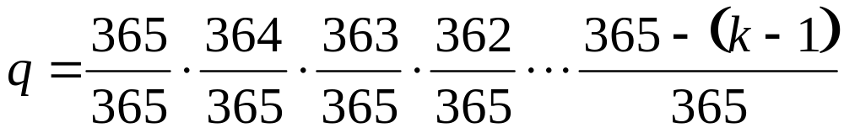
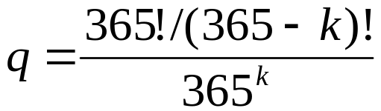

Calculating the Probability-2
In a room of k people
  q: the prob. all people have different birthdays
p: the prob. at least two of them have the same birthdays

Slide 9
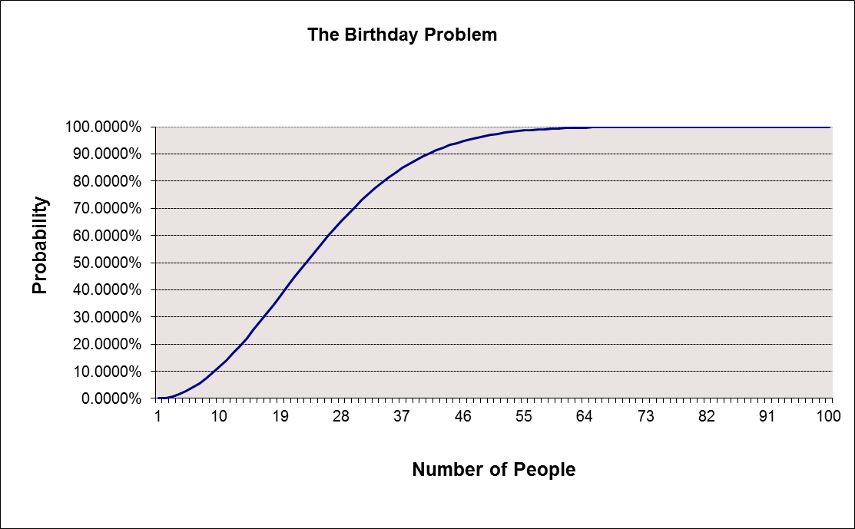
Calculating the Probability-3
Shared Birthday Probabalities

Slide 10
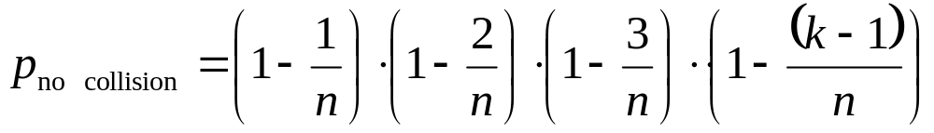
Collision Search-1
For collision search, select distinct inputs x_{i} for i=1, 2, ... , n, where n is the number of hash bits and check for a collision in the h(x_{i}) values
The prob. that no collision is found after selecting k inputs is
(In the case of the birthday paradox k is the number of people randomly selected and the collision condition is the birthday of the people and n=365.)

Slide 11
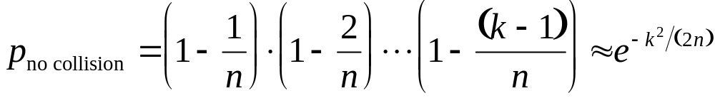
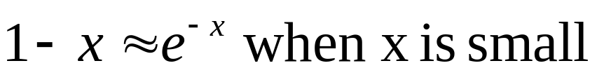
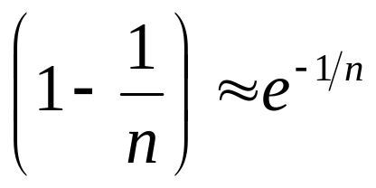
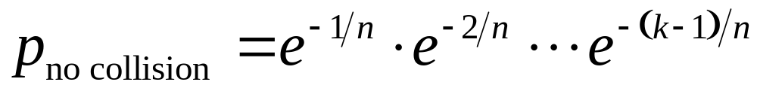
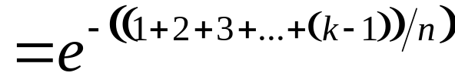

Collision Search-2
For large n

Slide 12
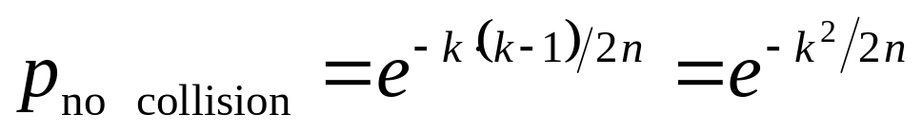
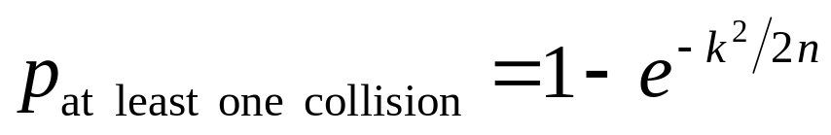
Collision Search-3
When k is large, the percentage difference between k and k-1 is small, and we may approximate k-1 ≈ k.

Slide 13


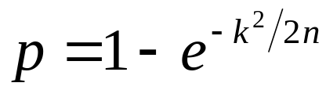
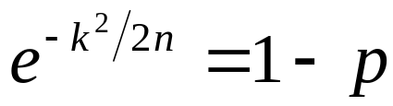
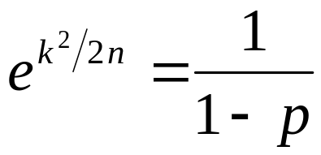

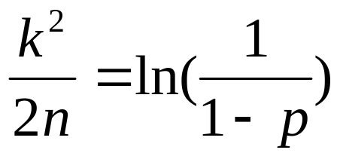


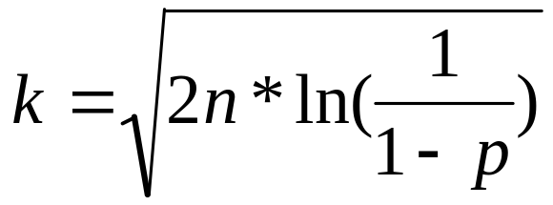
Collision Search-4
For the birthday case, the value of k that makes the probability closest to 1/2 is 23

Slide 14


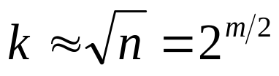
Attack Prevention
The important property is the length in bits of the message digest produced by the hash function.
If the number of m bit hash , the cardinality n of the hash function is
The 0.5 probability of collision for m bit hash, expected number of operation k before finding a collision is very close to
m should be large enough so that it’s not feasible to compute hash values!!!

Slide 15
Q& A

