Slide 1
Chapter 12 – Message Authentication Codes (MACs)
These slides were prepared by Christof Paar and Jan Pelzl

Slide 2
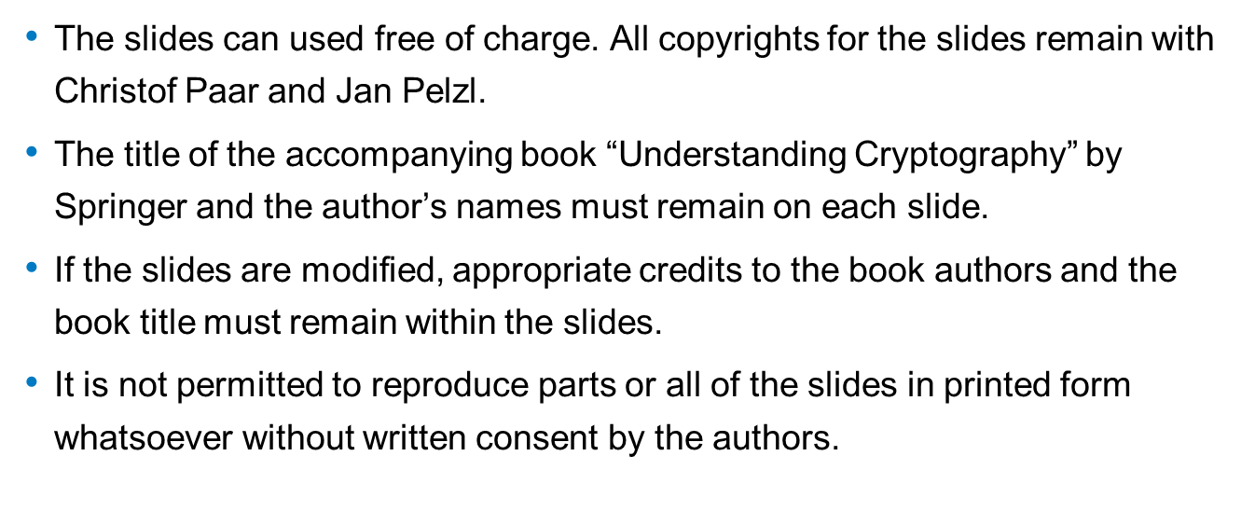
Some legal stuff (sorry): Terms of Use
<number>/10
Chapter 12 of Understanding Cryptography by Christof Paar and Jan Pelzl

Slide 3
Content of this Chapter
The principle behind MACs
The security properties that can be achieved with MACs
How MACs can be realized with hash functions and with block ciphers
<number>/10
Chapter 12 of Understanding Cryptography by Christof Paar and Jan Pelzl

Slide 4
Motivation
Asymmetric algorithms is slow
MACs are much faster as they are based on symmetric algorithms.
Can be use MAC to Asymmetric approach?
  No, MACs do not provide nonrepudiation.
<number>/10
Chapter 12 of Understanding Cryptography by Christof Paar and Jan Pelzl

Slide 5
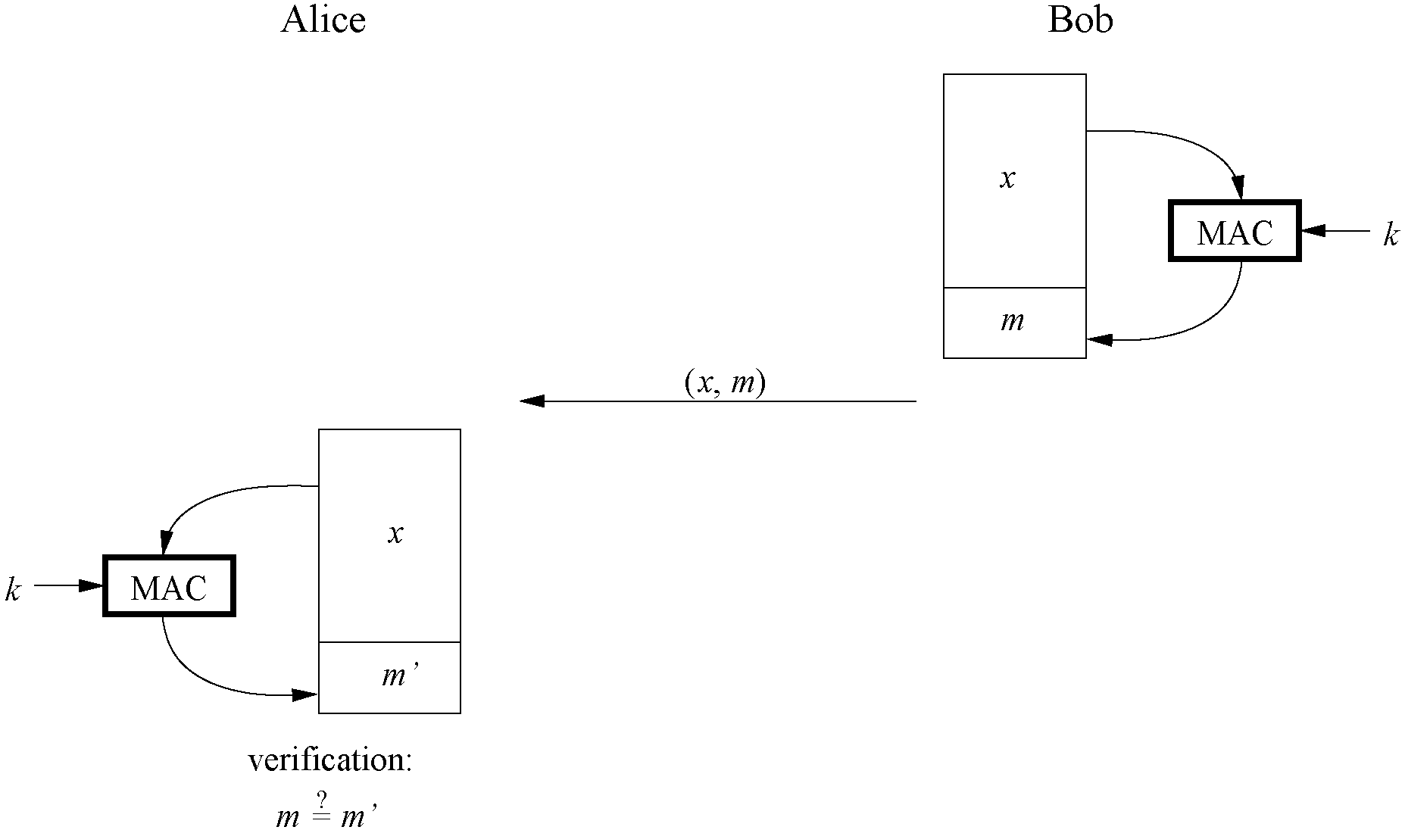
Principle of Message Authentication Codes
Similar to digital signatures, MACs append an authentication tag to a message
MACs use a symmetric key k for generation and verification
Computation of a MAC: m = MAC_{k}(x)
<number>/10
Chapter 12 of Understanding Cryptography by Christof Paar and Jan Pelzl

Slide 6
Properties of Message Authentication Codes
Cryptographic checksum
A MAC generates a cryptographically secure authentication tag for a given message.
Symmetric
MACs are based on secret symmetric keys. The signing and verifying parties must share a secret key.
Arbitrary message size
MACs accept messages of arbitrary length.
Fixed output length
MACs generate fixed-size authentication tags.
Message integrity
MACs providemessage integrity: Any manipulations of a message during transit will be detected by the receiver.
Message authentication
The receiving party is assured of the origin of the message.
No nonrepudiation
Since MACs are based on symmetric principles, they do not provide nonrepudiation.
<number>/10
Chapter 12 of Understanding Cryptography by Christof Paar and Jan Pelzl

Slide 7
MACs from Hash Functions
MAC is realized with cryptographic hash functions (e.g., SHA-1)
HMAC is such a MAC built from hash functions
Basic idea: Key is hashed together with the message
Two possible constructions:
  secret prefix MAC: m =MAC_{k}(x) = h(k||x)
  secret suffix MAC: m =MAC_{k}(x) = h(x||k)
Attacks:
  secret prefix MAC: Attack MAC for the message x = (x1,x2, . . . ,xn,xn+1), where xn+1 is an arbitrary additional block, can be constructed from m without knowing the secret key
  secret suffix MAC: find collision x and xO such that h(x) = h(xO), then m = h(x||k) = h(x_{O}||k)
Idea: Combine secret prefix and suffix: HMAC (cf. next slide)
<number>/10
Chapter 12 of Understanding Cryptography by Christof Paar and Jan Pelzl

Slide 8
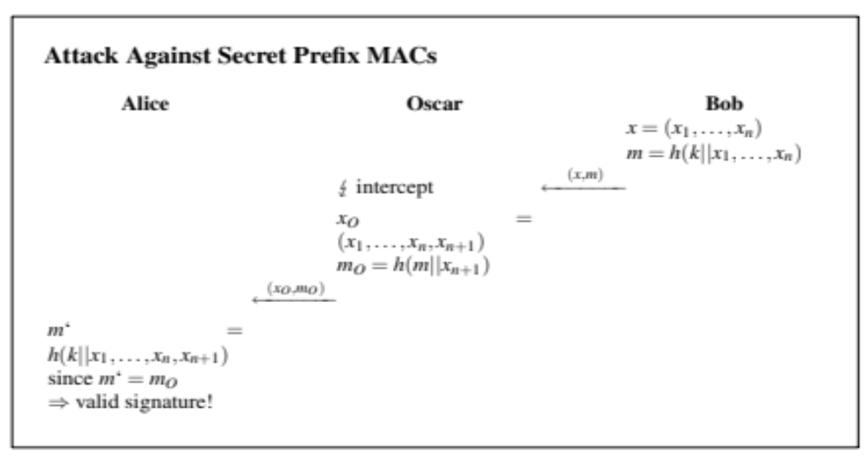
Attack on secret prefix MAC: adding a message at the end of the orignial message
<number>/10
Chapter 12 of Understanding Cryptography by Christof Paar and Jan Pelzl

Slide 9
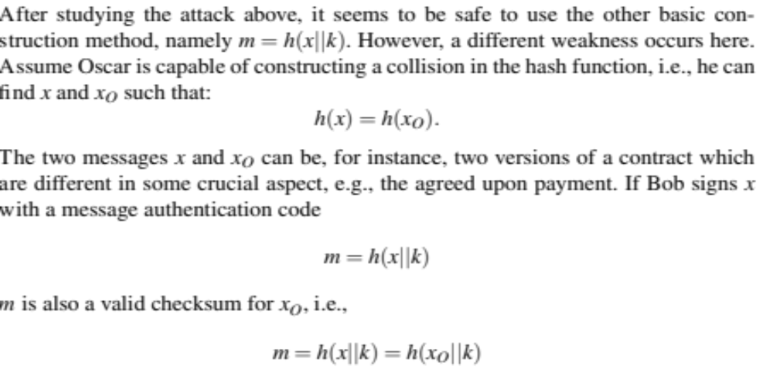
Attack on secret suffix MAC: h(x) = h(xO)
<number>/10
Chapter 12 of Understanding Cryptography by Christof Paar and Jan Pelzl

Slide 10
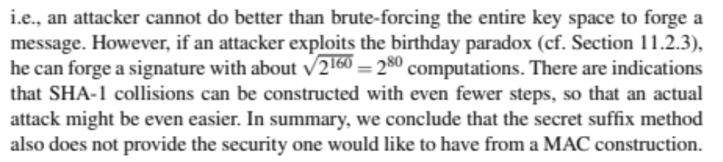
Effort Estimation
<number>/10
Chapter 12 of Understanding Cryptography by Christof Paar and Jan Pelzl

Slide 11
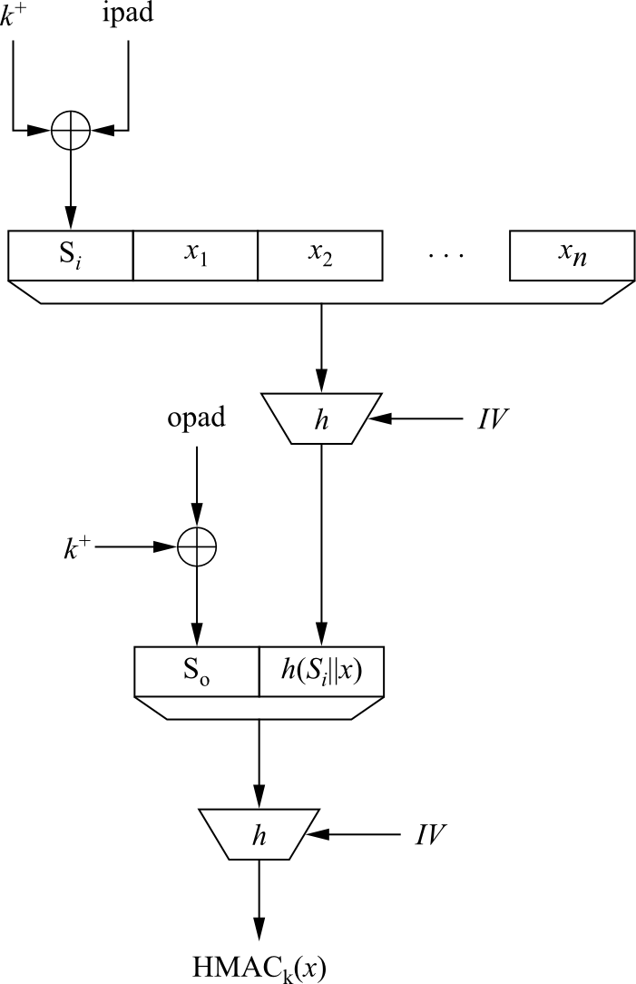
HMAC
Proposed by Mihir Bellare, Ran Canetti and Hugo Krawczyk in 1996
Scheme consists of an inner and outer hash
  k⁺ is expanded key k
  expanded key k⁺ is XORed with the inner pad
  ipad = 00110110,00110110, . . .,00110110
  opad = 01011100,01011100, . . .,01011100
  HMAC_{k}(x) = h[(k⁺⊕opad)||h[(k⁺⊕ipad)||x]]
HMAC is provable secure which means (informally speaking): The MAC can only be broken if a collision for the hash function can be found.
<number>/10
Chapter 12 of Understanding Cryptography by Christof Paar and Jan Pelzl

Slide 12
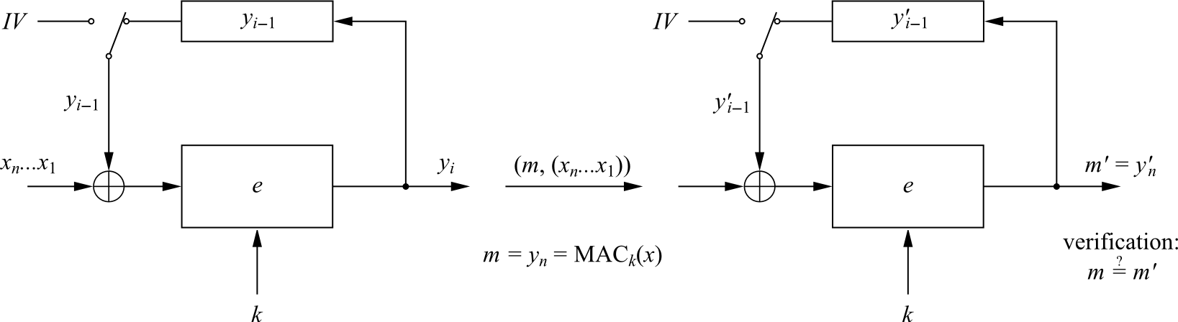
MACs from Block Ciphers
MAC constructed from block ciphers (e.g. AES)
Popular: Use AES in CBC mode
CBC-MAC:
<number>/10
Chapter 12 of Understanding Cryptography by Christof Paar and Jan Pelzl

Slide 13
CBC-MAC
MAC Generation
  Divide the message x into blocks x_{i}
  Compute first iteration y₁ = e_{k}(x₁⊕IV)
  Compute y_{i} = e_{k}(x_{i}⊕y_{i−1}) for the next blocks
  Final block is the MAC value: m =MAC_{k}(x) = y_{n}
MAC Verification
  Repeat MAC computation (m‘)
  Compare results:In case m’ = m, the message is verified as correct
  In case m’ ≠ m, the message and/or the MAC value m have been altered during transmission
<number>/10
Chapter 12 of Understanding Cryptography by Christof Paar and Jan Pelzl

Slide 14
Lessons Learned
MACs provide two security services, message integrity and message authentication, using symmetric techniques. MACs are widely used in protocols.
Both of these services also provided by digital signatures, but MACs are much faster as they are based on symmetric algorithms.
MACs do not provide nonrepudiation.
In practice, MACs are either based on block ciphers or on hash functions.
HMAC is a popular and very secure MAC, used in many practical protocols such as TLS.
<number>/10
Chapter 12 of Understanding Cryptography by Christof Paar and Jan Pelzl

