Slide 1
Chapter 13 – Key Establishment
ver. Jan 7, 2010
These slides were prepared by Christof Paar and Jan Pelzl

Slide 2
Some legal stuff (sorry): Terms of Use
The slides can used free of charge. All copyrights for the slides remain with Christof Paar and Jan Pelzl.
The title of the accompanying book “Understanding Cryptography” by Springer and the author’s names must remain on each slide.
If the slides are modified, appropriate credits to the book authors and the book title must remain within the slides.
It is not permitted to reproduce parts or all of the slides in printed form whatsoever without written consent by the authors.
<number>/27
Chapter 13 of Understanding Cryptography by Christof Paar and Jan Pelzl

Slide 3
Content of this Chapter
Introduction
The n² Key Distribution Problem
Symmetric Key Distribution
Asymmetric Key Distribution
  Man-in-the-Middle Attack
  Certificates
  Public-Key Infrastructure
<number>/27
Chapter 13 of Understanding Cryptography by Christof Paar and Jan Pelzl

Slide 4
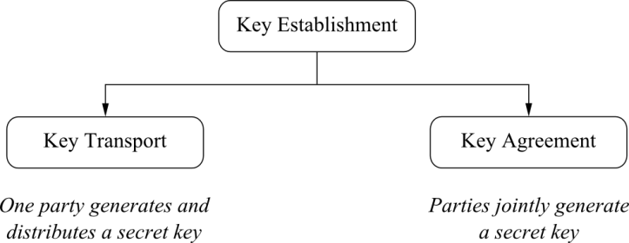
Classification of Key Establishment Methods
In an ideal key agreement protocol, no single party can control what the key value will be.
<number>/27
Chapter 13 of Understanding Cryptography by Christof Paar and Jan Pelzl

Slide 5
Key Freshness
It is often desirable to frequently change the key in a cryptographic system.
Reasons for key freshness include:
  If a key is exposed (e.g., through hackers), there is limited damage if the key is changed often
  Some cryptographic attacks become more difficult if only a limited amount of ciphertext was generated under one key
  If an attacker wants to recover long pieces of ciphertext, he has to recover several keys which makes attacks harder
<number>/27
Chapter 13 of Understanding Cryptography by Christof Paar and Jan Pelzl

Slide 6
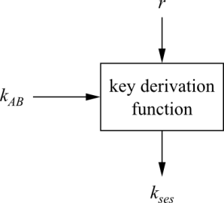
Key Derivation
In order to achieve key freshness, we need to generate new keys frequently.
Rather than performing a full key establishment every time (which is costly in terms of computation and/or communication), we can derive multiple session keys k_{ses} from a given key k_{AB}.
The key k_{AB} is fed into a key derivation function together with a nonce r („number used only once“).
Every different value for r yields a different session key
<number>/27
Chapter 13 of Understanding Cryptography by Christof Paar and Jan Pelzl

Slide 7
Key Derivation
The key derivation function is a computationally simple function, e.g., a block cipher or a hash function
Example for a basic protocol:
Alice
Bob
generate nonce r
r
derive session key
K_{ses}= e_{kAB} (r)
derive session key
K_{ses}= e_{kAB} (r)
<number>/27
Chapter 13 of Understanding Cryptography by Christof Paar and Jan Pelzl

Slide 8
Content of this Chapter
Introduction
The n² Key Distribution Problem
Symmetric Key Distribution
Asymmetric Key Distribution
  Man-in-the-Middle Attack
  Certificates
  Public-Key Infrastructure
<number>/27
Chapter 13 of Understanding Cryptography by Christof Paar and Jan Pelzl

Slide 9
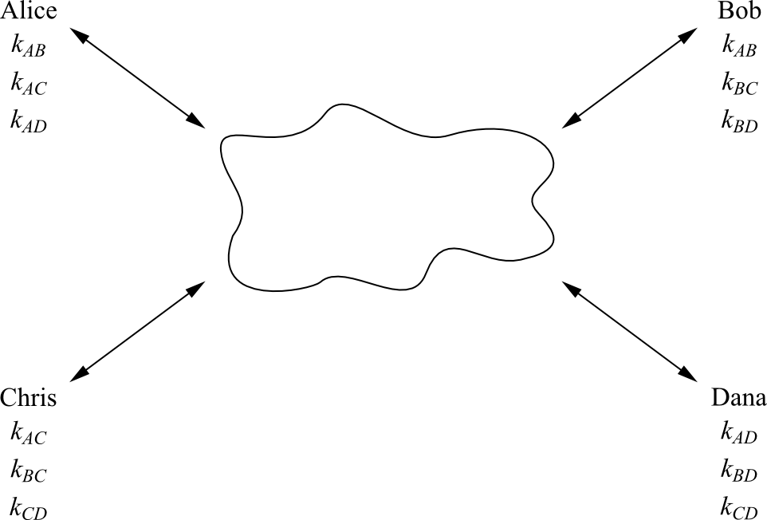
The n² Key Distribution Problem
Simple situation: Network with n users. Every user wants to communicate securely with every of the other n-1 users.
Naïve approach: Every pair of users obtains an individual key pair
<number>/27
Chapter 13 of Understanding Cryptography by Christof Paar and Jan Pelzl
Notes:
Analogy for symmetric-key algorithms: Symmetric-key schemes are analogous to a safe box with a strong lock.
Everyone with the key can deposit messages in it and retrieve messages.

Slide 10
The n² Key Distribution Problem
Shortcomings
There are n (n-1) ≈ n² keys in the system
There are n (n-1)/2 key pairs
If a new user Esther joins the network, new keys k_{XE} have to be transported via secure channels (!) to each of the existing usersa
⇒ Only works for small networks which are relatively static
Example: mid-size company with 750 employees
750 x 749 = 561,750 keys must be distributed securely
<number>/27
Chapter 13 of Understanding Cryptography by Christof Paar and Jan Pelzl
Notes:
Analogy for symmetric-key algorithms: Symmetric-key schemes are analogous to a safe box with a strong lock.
Everyone with the key can deposit messages in it and retrieve messages.

Slide 11
Content of this Chapter
Introduction
The n² Key Distribution Problem
Symmetric Key Distribution
Asymmetric Key Distribution
  Man-in-the-Middle Attack
  Certificates
  Public-Key Infrastructure
<number>/27
Chapter 13 of Understanding Cryptography by Christof Paar and Jan Pelzl

Slide 12
Key Establishment with Key Distribution Center
Key Distribution Center (KDC) = Central party, trusted by all users
KDC shares a key encryption key (KEK) with each user
Principle: KDC sends session keys to users which are encrypted with KEKs
Alice
KDC
Bob
KEK: k_{A}
KEKs: k_{A} , k_{B}
KEK: k_{B}
RQST (ID_{A} ,ID_{B})
generate session key k_{ses}
y_{A} = e_{KA} (k_{ses})
y_{B} = e_{KB} (k_{ses})
y_{A}
y_{B}
derive session key
K_{ses}= e_{KA} (y_{A})
derive session key
K_{ses}= e_{KB} (y_{B})
message y
y= e_{Kses} (x)
y
x= e⁻¹_{Kses} (y)
<number>/27
Chapter 13 of Understanding Cryptography by Christof Paar and Jan Pelzl

Slide 13
Key Establishment with Key Distribution Center
Advantages over previous approach:
  Only n long-term key pairs are in the system
  If a new user is added, a secure key is only needed between the user and the KDC (the other users are not affected)
  Scales well to moderately sized networks
Kerberos (a popular authentication and key distribution protocol) is based on KDCs
More information on KDCs and Kerberos: Section 13.2 of Understanding Cryptography
<number>/27
Chapter 13 of Understanding Cryptography by Christof Paar and Jan Pelzl

Slide 14
Key Establishment with Key Distribution Center
Remaining problems:
  No Perfect Forward Secrecy: If the KEKs are compromised, an attacker can decrypt past messages if he stored the corresponding ciphertext
  Single point of failure: The KDC stores all KEKs. If an attacker gets access to this database, all past traffic can be decrypted.
  Communication bottleneck: The KDC is involved in every communication in the entire network (can be countered by giving the session keys a long life time)
  For more advanced attacks (e.g., key confirmation attack): Cf. Section 13.2 of Understanding Cryptography
<number>/27
Chapter 13 of Understanding Cryptography by Christof Paar and Jan Pelzl

Slide 15
Content of this Chapter
Introduction
The n² Key Distribution Problem
Symmetric Key Distribution
Asymmetric Key Distribution
  Man-in-the-Middle Attack
  Certificates
  Public-Key Infrastructure
<number>/27
Chapter 13 of Understanding Cryptography by Christof Paar and Jan Pelzl

Slide 16
Recall: Diffie–Hellman Key Exchange (DHKE)
Alice
Public parameters α, p
Bob
Choose random private key
k_{prA} = a ∈ {1, 2,…, p-1}
Choose random private key
k_{prB} = b ∈ {1, 2,…, p-1}
Compute public key
k_{pubA} = A = αª mod p
Compute public key
k_{pubB} = B = α^{b} mod p
A
B
Compute common secret
k_{AB} = Bª = (αª)^{b} mod p
Compute common secret
k_{AB} = A^{b} = (α^{b})ª mod p
Widely used in practice
If the parameters are chosen carefully (especially a prime p > 2¹⁰²⁴), the DHKE is secure against passive (i.e., listen-only) attacks
However: If the attacker can actively intervene in the communciation,
the man-in-the-middle attack becomes possible
<number>/27
Chapter 13 of Understanding Cryptography by Christof Paar and Jan Pelzl

Slide 17
Man-in-the-Middle Attack
Alice
Oscar
Bob
k_{prA} = a
k_{prB} = b
k_{pubA} = A = αª mod p
A
A´
k_{pubB} = B = α^{b} mod p
substitute A´ = αº mod p
B´
B
substitute B´ = αº mod p
k_{AO} = (B´)ª mod p
k_{AO} = Aº mod p
k_{BO} = Bº mod p
k_{BO} = (A´)^{b} mod p
Oscar computes a session key k_{AO} with Alice, and k_{BO} with Bob
However, Alice and Bob think they are communicationg with each other !
The attack efficiently performs 2 DH key-exchanges: Oscar-Alice and Oscar-Bob
Here is why the attack works:
Alice computes: k_{AO} = (B´)ª = (αº)ª
Oscar computes: k_{AO} = Aº = (αª)º
Bob computes: k_{BO} = (A´)^{b} = (αº)^{b}
Oscar computes: k_{BO} = Bº = (αª)º
<number>/27
Chapter 13 of Understanding Cryptography by Christof Paar and Jan Pelzl

Slide 18
Implications of the Man-in-the-Middle Attack
Alice
Oscar
Bob
k_{prA} = a
k_{prB} = b
k_{pubA} = A = αª mod p
A
A´
k_{pubB} = B = α^{b} mod p
substitute A´ = αº mod p
B´
B
substitute B´ = αº mod p
k_{AO} = (B´)ª mod p
k_{AO} = Aº mod p
k_{BO} = Bº mod p
k_{BO} = (A´)^{b} mod p
Oscar has no complete control over the channel, e.g., if Alice wants to send an encrypted message x to Bob, Oscar can read the message:
y
y = AES_{kA,O} (x)
decrypt x = AES⁻¹_{kA,O} (y)
re-encrypt y´= AES_{kB,O} (x)
y´
x = AES⁻¹_{kB,O} (y´)
<number>/27
Chapter 13 of Understanding Cryptography by Christof Paar and Jan Pelzl

Slide 19
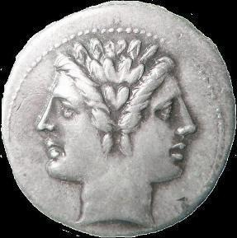
Very, very important facts about the Man-in-the-Middle Attack
The man-in-the-middle-attack is not restricted to DHKE; it is applicable to any public-key scheme, e.g. RSA encryption. ECDSA digital signature, etc. etc.
The attack works always by the same pattern: Oscar replaces the public key from one of the parties by his own key.
The attack is also known as MIM attack or Janus attack
Q: What is the underlying problem that makes the MIM attack possible?
A: The public keys are not authenticated: When Alice receives a public key which is allegedly from Bob, she has no way of knowing whether it is in fact his. (After all, a key consists of innocent bits; it does not smell like Bob‘s perfume or anything like that)
Even though public keys can be sent over unsecure channels, they require authenticated channels.
<number>/27
Chapter 13 of Understanding Cryptography by Christof Paar and Jan Pelzl

Slide 20
Content of this Chapter
Introduction
The n² Key Distribution Problem
Symmetric Key Distribution
Asymmetric Key Distribution
  Man-in-the-Middle Attack
  Certificates
  Public-Key Infrastructure
<number>/27
Chapter 13 of Understanding Cryptography by Christof Paar and Jan Pelzl

Slide 21
Certificates
In order to authenticate public keys (and thus, prevent the MIM attack) , all public keys are digitally signed by a central trusted authority.
Such a construction is called certificate
certificate = public key + ID(user) + digital signature over public key and ID
In its most basic form, a certificate for the key k_{pub} of user Alice is:
Cert(Alice) = (k_{pub}, ID(Alice), sig_{KCA}(k_{pub},ID(Alice) )
Certificates bind the identity of user to her public key
The trusted authority that issues the certificate is referred to as certifying authority (CA)
„Issuing certificates“ means in particular that the CA computes the signature sig_{KCA}(k_{pub}) using its (super secret!) private key k_{CA}
The party who receives a certificate, e.g., Bob, verifies Alice‘s public key using the public key of the CA
<number>/27
Chapter 13 of Understanding Cryptography by Christof Paar and Jan Pelzl
Notes:
Identifier -> means the algorithm and parameters that were used to sign this certificate

Slide 22
Diffie–Hellman Key Exchange (DHKE) with Certificates
CA
Cert(Bob)
Cert(Alice)
Alice
Bob
k_{prA} = a
k_{pubA} = A
Cert(Alice) = ((A, ID_{A}), sig_{KCA} (A,ID_{A}))
k_{prB} = b
k_{pubB} = B = α^{b} mod p
Cert(Bob) = ((B, ID_{B}), sig_{KCA} (B,ID_{B}))
Cert(Alice)
Cert(Bob)
verify certificate
ver_{Kpub,CA} (Cert(Bob))
verify certificate
ver_{Kpub,CA} (Cert(Alice))
if verification is correct:
Compute common secret
k_{AB} = Bª = (αª)^{b} mod p
if verification is correct:
Compute common secret
k_{AB} = A^{b} = (α^{b})ª mod p
<number>/27
Chapter 13 of Understanding Cryptography by Christof Paar and Jan Pelzl

Slide 23
Certificates
Note that verfication requires the public key of the CA for ver_{Kpub,CA}
In principle, an attacker could run a MIM attack when k_{pub,CA} is being distributed
  ⇒ The public CA keys must also be distributed via an authenticated channel!
Q: So, have we gained anything?
After all, we try to protect a public key (e.g., a DH key) by using yet another public-key scheme (digital signature for the certificate)?
A: YES! The difference from before (e.g., DHKE without certificates) is that we only need to distribute the public CA key once, often at the set-upt time of the system
Example: Most web browsers are shipped with the public keys of many CAs. The „authenticated channel“ is formed by the (hopefully) correct distribution of the original browser software.
<number>/27
Chapter 13 of Understanding Cryptography by Christof Paar and Jan Pelzl

Slide 24
Content of this Chapter
Introduction
The n² Key Distribution Problem
Symmetric Key Distribution
Asymmetric Key Distribution
  Man-in-the-Middle Attack
  Certificates
  Public-Key Infrastructure
<number>/27
Chapter 13 of Understanding Cryptography by Christof Paar and Jan Pelzl

Slide 25
Public-Key Infrastructure
Definition: The entire system that is formed by CAs together with the necessary support mechanisms is called a public-key infrastructure (PKI).
<number>/27
Chapter 13 of Understanding Cryptography by Christof Paar and Jan Pelzl

Slide 26
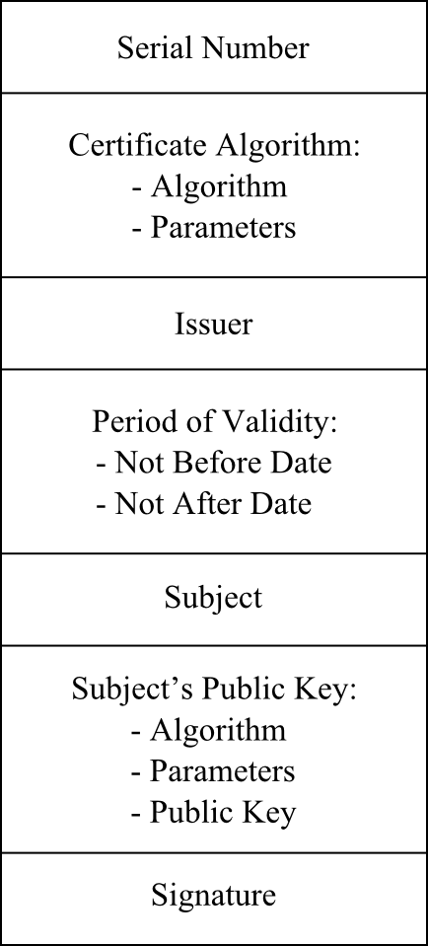
Certificates in the Real World
In the wild certificates contain much more information than just a public key and a signature.
X509 is a popular signature standard. The main fields of such a certificate are shown to the right.
Note that the „Signature“ at the bottom is computed over all other fields in the certifcate (after hashing of all those fields).
It is important to note that there are two public-key schemes involved in every certificate:
  The public-key that actually is protected by the signature („Subject‘s Public Key“ on the right). This was the public Diffie-Hellman key in the earlier examples.
  The digital signature algorithm used by the CA to sign the certificate data.
For more information on certificates, see Section 13.3 of Understanding Cryptography
<number>/27
Chapter 13 of Understanding Cryptography by Christof Paar and Jan Pelzl

Slide 27
Remaining Issues with PKIs
There are many additional problems when certificates are to be used in systems with a large number of participants. The more pressing ones are:
Users communicate which other whose certificates are issued by different CAs
  This requires cross-certification of CAs, e.g.. CA1 certifies the public-key of CA2. If Alice trusts „her“ CA1, cross-certification ensures that she also trusts CA2. This is called a „chain of trust“ and it is said that „trust is delegated“.
Certificate Revocation Lists (CRLs)
  Another real-world problem is that certificates must be revoced, e.g., if a smart card with certificate is lost or if a user leaves an organization. For this, CRLs must be sent out periodically (e.g., daily) which is a burden on the bandwidth of the system.
More information on PKIs and CAs can be found in Section 13.3 of Understanding Cryptography
<number>/27
Chapter 13 of Understanding Cryptography by Christof Paar and Jan Pelzl

