Slide 1

Understanding Cryptography – A Textbook for Students and Practitioners by Christof Paar and Jan Pelzl www.crypto-textbook.com
Chapter 3 – The Data Encryption Standard (DES) ver. Sep 22, 2015
These slides were prepared by Markus Kasper, Christof Paar and Jan Pelzl

Slide 2
Some legal stuff (sorry): Terms of Use
The slides can used free of charge. All copyrights for the slides remain with the authors.
The title of the accompanying book “Understanding Cryptography” by Springer and the author’s names must remain on each slide.
If the slides are modified, appropriate credits to the book authors and the book title must remain within the slides.
It is not permitted to reproduce parts or all of the slides in printed form whatsoever without written consent by the authors.
<number>/29
Chapter 3 of Understanding Cryptography by Christof Paar and Jan Pelzl

Slide 3
Content of this Chapter
Introduction to DES
Overview of the DES Algorithm
Internal Structure of DES
Decryption
Security of DES
<number>/29
Chapter 3 of Understanding Cryptography by Christof Paar and Jan Pelzl

Slide 4
Content of this Chapter
Introduction to DES
Overview of the DES Algorithm
Internal Structure of DES
Decryption
Security of DES
<number>/29
Chapter 3 of Understanding Cryptography by Christof Paar and Jan Pelzl

Slide 5
Classification of DES in the Field of Cryptology
Cryptology
Cryptography
Cryptanalysis
Symmetric Ciphers
Asymmetric Ciphers
Protocols
Block Ciphers
Stream Ciphers
You are here!
<number>/29
Chapter 3 of Understanding Cryptography by Christof Paar and Jan Pelzl

Slide 6
DES Facts
Data Encryption Standard (DES) encrypts blocks of size 64 bit.
Developed by IBM based on the cipher Lucifer under influence of the National Security Agency (NSA), the design criteria for DES have not been published
Standardized 1977 by the National Bureau of Standards (NBS)
today called National Institute of Standards and Technology (NIST)
Most popular block cipher for most of the last 30 years.
By far best studied symmetric algorithm.
Nowadays considered insecure due to the small key length of 56 bit.
But: 3DES yields very secure cipher, still widely used today.
Replaced by the Advanced Encryption Standard (AES) in 2000
For a more detailed history see Chapter 3.1 in Understanding Cryptography
<number>/29
Chapter 3 of Understanding Cryptography by Christof Paar and Jan Pelzl

Slide 7
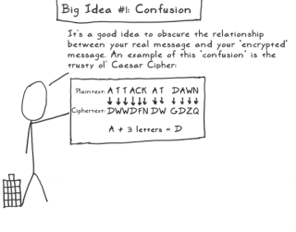
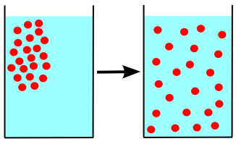
Block Cipher Primitives: Confusion and Diffusion
Claude Shannon: There are two primitive operations with which strong encryption algorithms can be built:
  Confusion: An encryption operation where the relationship between key and ciphertext is obscured.
  Today, a common element for achieving confusion is substitution, which is found in both AES and DES.
  Diffusion: An encryption operation where the influence of one plaintext symbol is spread over many ciphertext symbols with the goal of hiding statistical properties of the plaintext.
  A simple diffusion element is the bit permutation, which is frequently used within DES.
Both operations by themselves cannot provide security. The idea is to concatenate confusion and diffusion elements to build so called product ciphers.
<number>/29
Chapter 3 of Understanding Cryptography by Christof Paar and Jan Pelzl

Slide 8
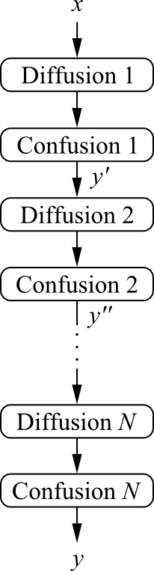

Product Ciphers
Most of today‘s block ciphers are product ciphers as they consist of rounds which are applied repeatedly to the data.
Can reach excellent diffusion: changing of one bit of plaintext results on average in the change of half the output bits.
Example:
single bit flip
many bit flips
<number>/29
Chapter 3 of Understanding Cryptography by Christof Paar and Jan Pelzl

Slide 9
Content of this Chapter
Introduction to DES
Overview of the DES Algorithm
Internal Structure of DES
Decryption
Security of DES
<number>/29
Chapter 3 of Understanding Cryptography by Christof Paar and Jan Pelzl

Slide 10
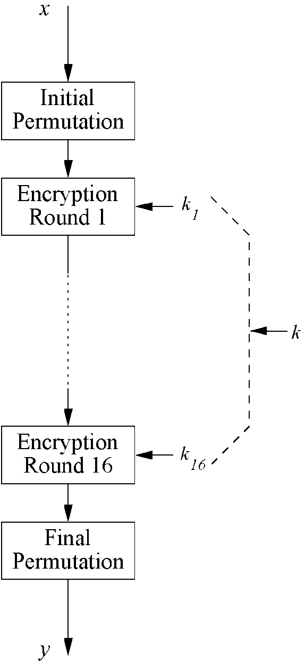
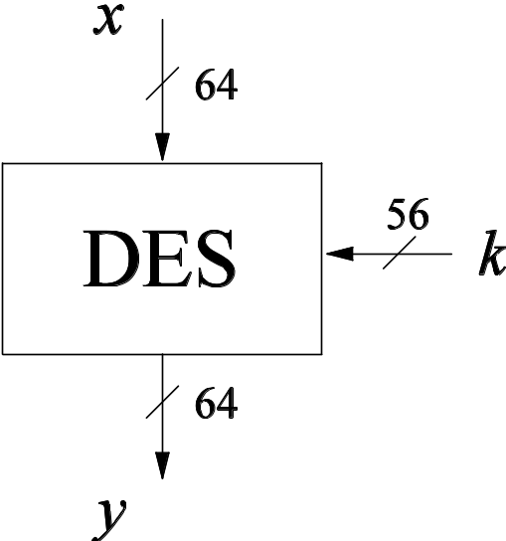
Overview of the DES Algorithm
Encrypts blocks of size 64 bits.
Uses a key of size 56 bits.
Symmetric cipher: uses same key for encryption and decryption
Uses 16 rounds which all perform the identical operation
Different subkey in each round derived from main key
<number>/29
Chapter 3 of Understanding Cryptography by Christof Paar and Jan Pelzl

Slide 11
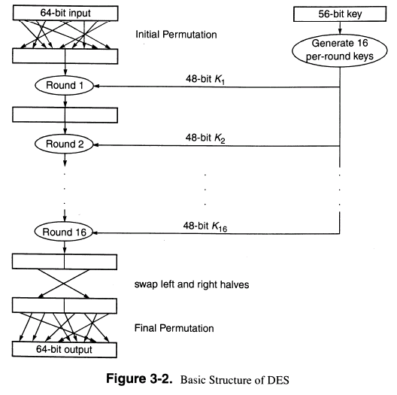
<number>/29
Chapter 3 of Understanding Cryptography by Christof Paar and Jan Pelzl

Slide 12
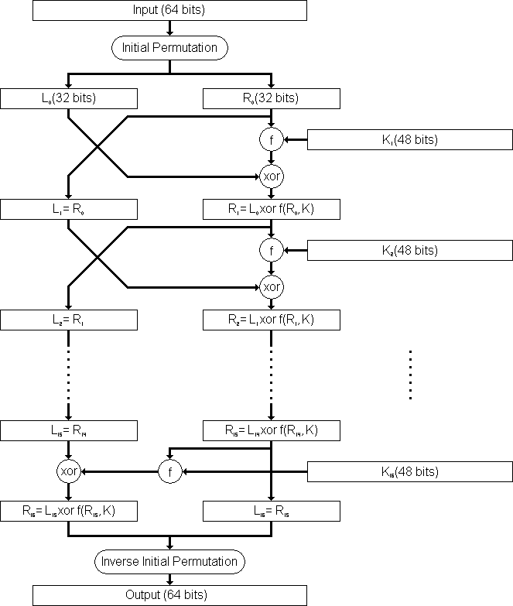
<number>/29
Chapter 3 of Understanding Cryptography by Christof Paar and Jan Pelzl

Slide 13
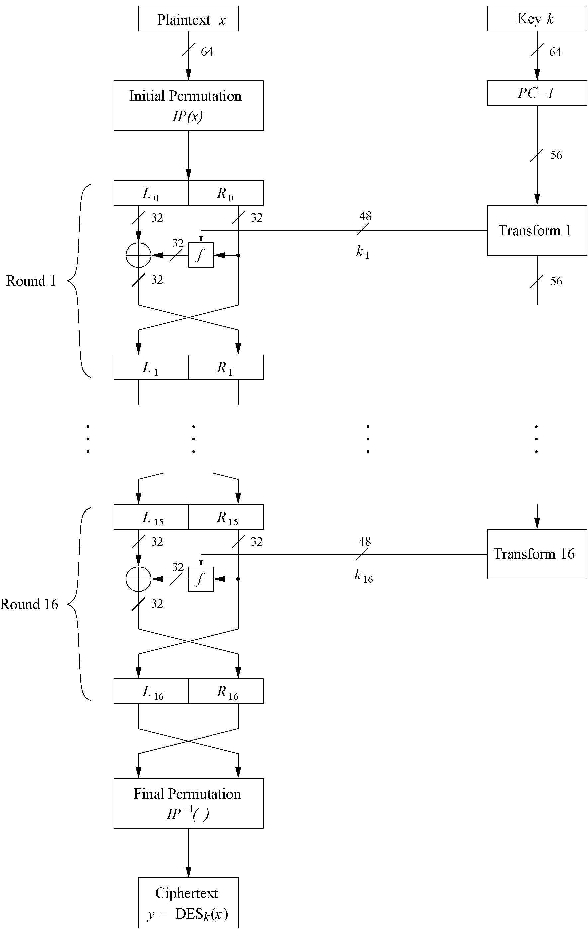
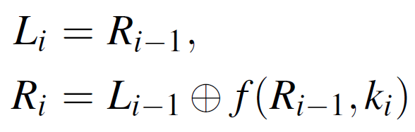
The DES Feistel Network (1)
DES structure is a Feistel network
Advantage: encryption and decryption differ only in keyschedule
Bitwise initial permutation, then 16 rounds
  Plaintext is split into 32-bit halves L_{i} and R_{i}
  R_{i} is fed into the function f, the output of which is then XORed with L_{i}
  Left and right half are swapped
Rounds can be expressed as:
<number>/29
Chapter 3 of Understanding Cryptography by Christof Paar and Jan Pelzl

Slide 14
The DES Feistel Network (2)
L and R swapped again at the end of the cipher, i.e., after round 16 followed by a final permutation
<number>/29
Chapter 3 of Understanding Cryptography by Christof Paar and Jan Pelzl

Slide 15
Content of this Chapter
Introduction to DES
Overview of the DES Algorithm
Internal Structure of DES
Decryption
Security of DES
<number>/29
Chapter 3 of Understanding Cryptography by Christof Paar and Jan Pelzl

Slide 16
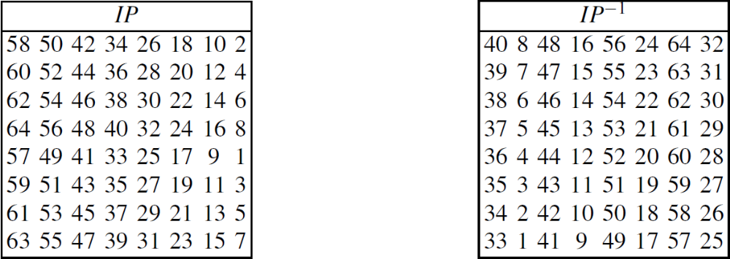
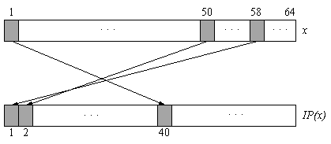
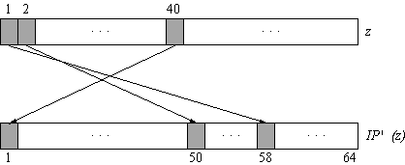
Initial and Final Permutation
Bitwise Permutations.
Inverse operations.
Described by tables IP and IP⁻¹.
Initial Permutation
Final Permutation
<number>/29
Chapter 3 of Understanding Cryptography by Christof Paar and Jan Pelzl
Notes:
Note that both permutations do not increase
the security of DES at all. The exact rationale for the existence of these two permutations
is not known, but it seems likely that their original purpose was to arrange
the plaintext, ciphertext and bits in a bytewise manner to make data fetches easier
for 8-bit data busses, which were the state-of-the-art register size in the early 1970s.

Slide 17
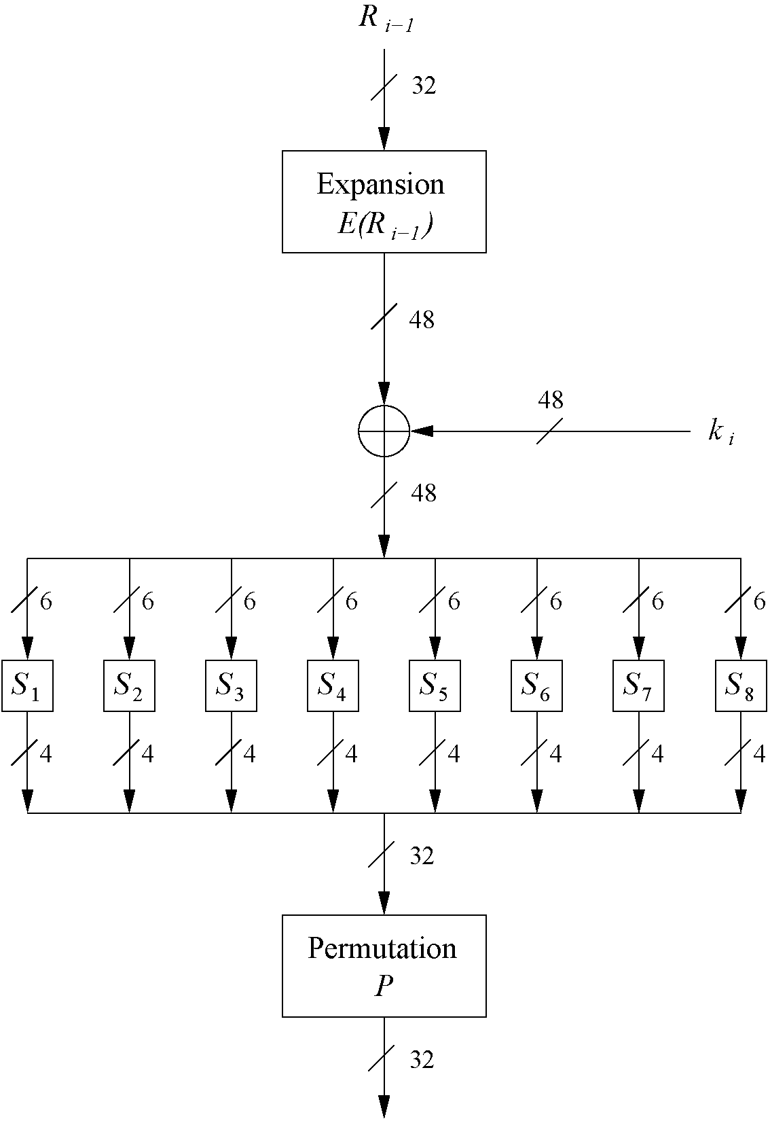
The f-Function
main operation of DES
f-Function inputs:
R_{i-1} and round key k_{i}
4 Steps:
  Expansion E
  XOR with round key
  S-box substitution
  Permutation
<number>/29
Chapter 3 of Understanding Cryptography by Christof Paar and Jan Pelzl

Slide 18
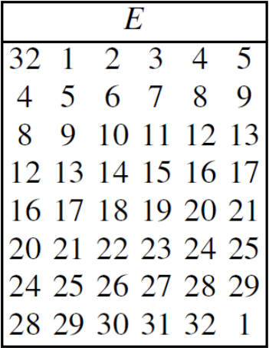
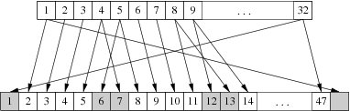
The Expansion Function E
  Expansion E
  main purpose: increases diffusion
!
<number>/29
Chapter 3 of Understanding Cryptography by Christof Paar and Jan Pelzl
Notes:
exactly 16 of the 32 input bits appear twice in
the output. However, an input bit never appears twice in the same 6-bit output block.
The expansion box increases the diffusion behavior of DES since certain input bits
influence two different output locations.

Slide 19
Add Round Key
  XOR Round Key
  Bitwise XOR of the round key and the output of the expansion function E
  Round keys are derived from the main key in the DES keyschedule (in a few slides)
<number>/29
Chapter 3 of Understanding Cryptography by Christof Paar and Jan Pelzl

Slide 20
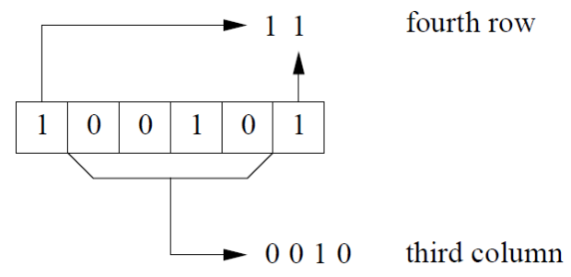
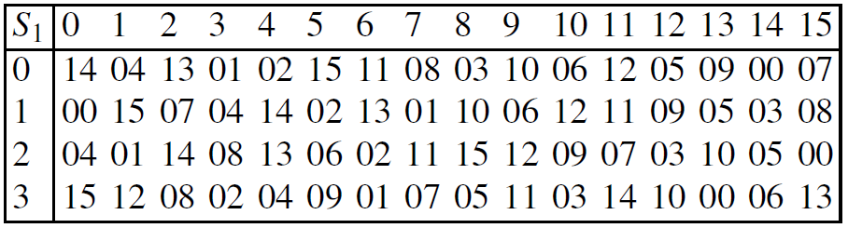
The DES S-Boxes
S-Box substitution
Eight substitution tables.
6 bits of input, 4 bits of output.
Non-linear and resistant to differential cryptanalysis.
Crucial element for DES security!
Find all S-Box tables and S-Box design criteria in Understanding Cryptography Chapter 3.
<number>/29
Chapter 3 of Understanding Cryptography by Christof Paar and Jan Pelzl
Notes:
S-box: one bit flips and two bits changes.

Slide 21
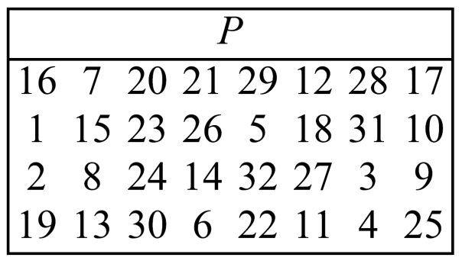
The Permutation P
Permutation P
  Bitwise permutation.
  Introduces diffusion.
  Output bits of one S-Box effect several S-Boxes in next round
  Diffusion by E, S-Boxes and P guarantees that after Round 5 every bit is a function of each key bit and each plaintext bit.
<number>/29
Chapter 3 of Understanding Cryptography by Christof Paar and Jan Pelzl

Slide 22
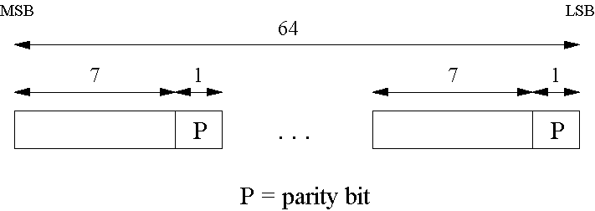
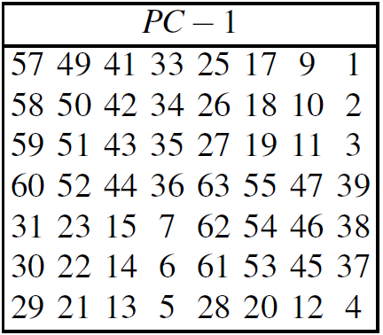
Key Schedule (1)
Derives 16 round keys (or subkeys) k_{i} of 48 bits each from the original 56 bit key.
The input key size of the DES is 64 bit: 56 bit key and 8 bit parity:
Parity bits are removed in a first permuted choice PC-1:
(note that the bits 8, 16, 24, 32, 40, 48, 56 and 64 are not used at all)
!
<number>/29
Chapter 3 of Understanding Cryptography by Christof Paar and Jan Pelzl
Notes:
For applications with long term security needs, 128 bit keys should be considered. For thwarting against attacks with to-be-developed quantum computers, 256 bits are believed to be appropriate. Since a longer key usually does no carry a performance penality for symmetric algorithms, it is a prudent choice to use ciphers with a key lengths of around 128 bits.

Slide 23
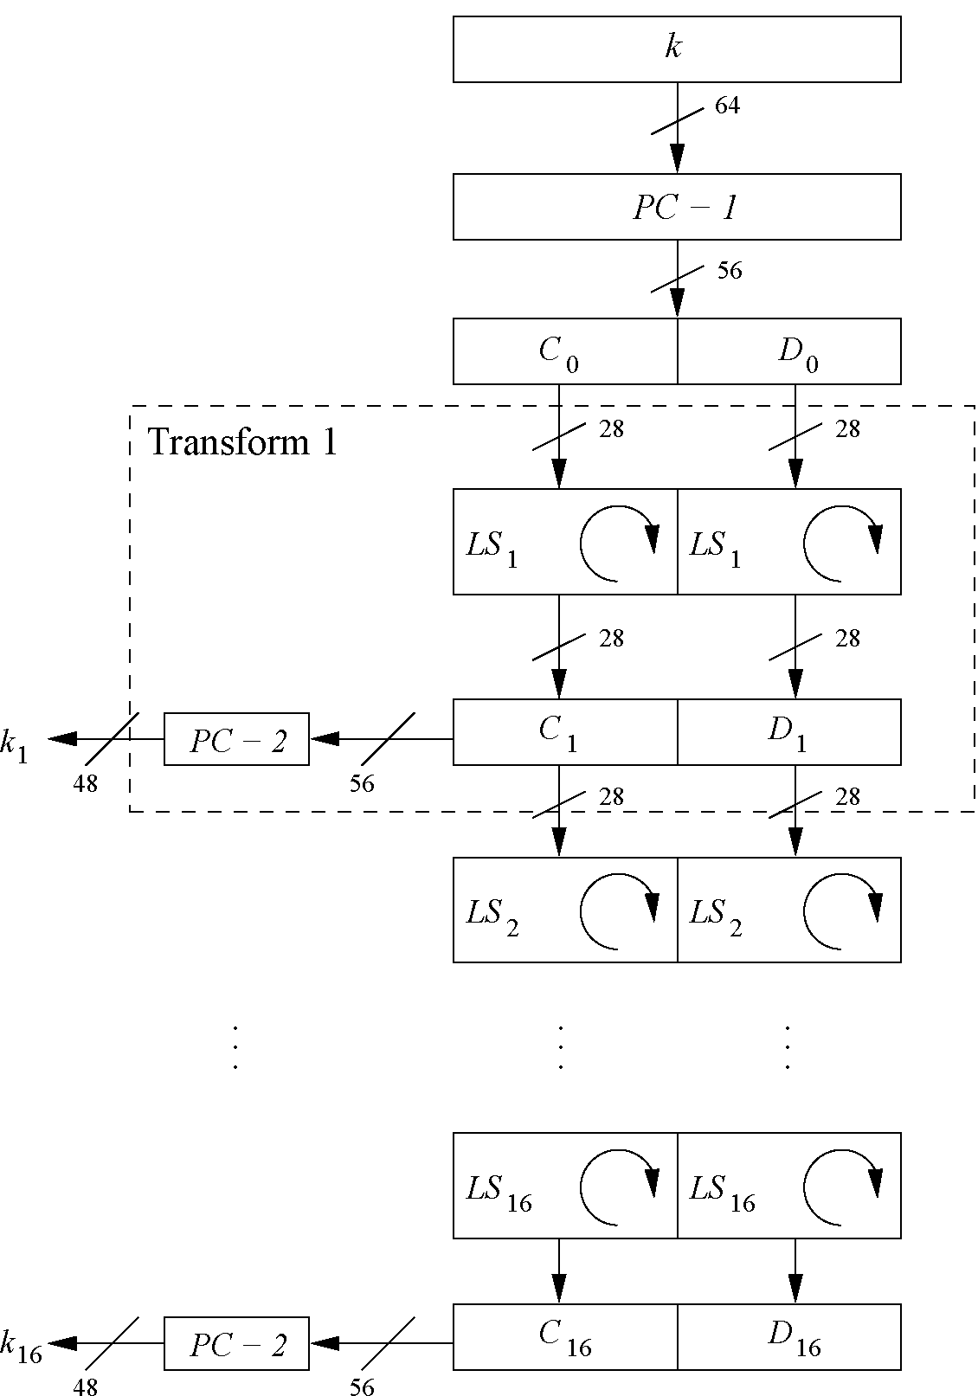
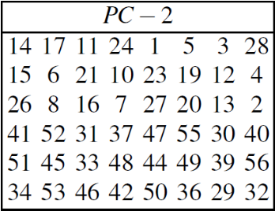
Key Schedule (2)
Split key into 28-bit halves C₀ and D₀.
In rounds i = 1, 2, 9 ,16, the two halves are each rotated left by one bit.
In all other rounds where the two halves are each rotated left by two bits. (Left Shift)
In each round i permuted choice PC-2
selects a permuted subset of 48 bits of C_{i} and D_{i} as round key k_{i}, i.e. each k_{i} is a permutation of k!
Note: The total number of rotations:
4 x 1 + 12 x 2 = 28 ⇒ D₀ = D₁₆ and C₀ = C₁₆!
<number>/29
Chapter 3 of Understanding Cryptography by Christof Paar and Jan Pelzl
Notes:
For applications with long term security needs, 128 bit keys should be considered. For thwarting against attacks with to-be-developed quantum computers, 256 bits are believed to be appropriate. Since a longer key usually does no carry a performance penality for symmetric algorithms, it is a prudent choice to use ciphers with a key lengths of around 128 bits.

Slide 24
Content of this Chapter
Introduction to DES
Overview of the DES Algorithm
Internal Structure of DES
Decryption
Security of DES
<number>/29
Chapter 3 of Understanding Cryptography by Christof Paar and Jan Pelzl

Slide 25
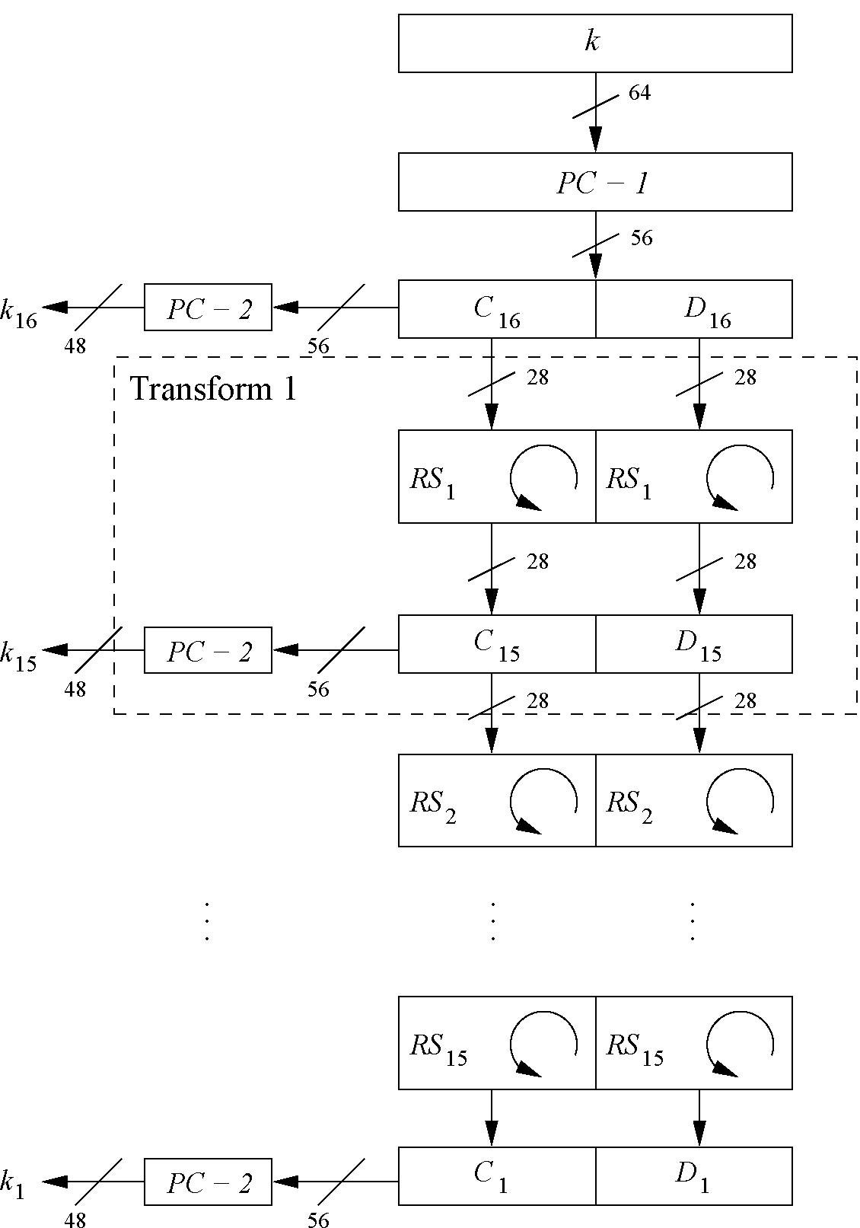
Decryption
In Feistel ciphers only the keyschedule has to be modified for decryption.
Generate the same 16 round keys in reverse order.
(for a detailed discussion on why this works see Understanding Crptography Chapter 3)
Reversed key schedule:
As D₀=D₁₆ and C₀=C₁₆ the first round key can be generated by applying PC-2 right after PC-1 (no rotation here!).
All other rotations of C and D can be reversed to reproduce the other round keys resulting in:
  No rotation in round 1.
  One bit rotation to the right in rounds 2, 9 and 16.
  Two bit rotations to the right in all other rounds.
<number>/29
Chapter 3 of Understanding Cryptography by Christof Paar and Jan Pelzl

Slide 26
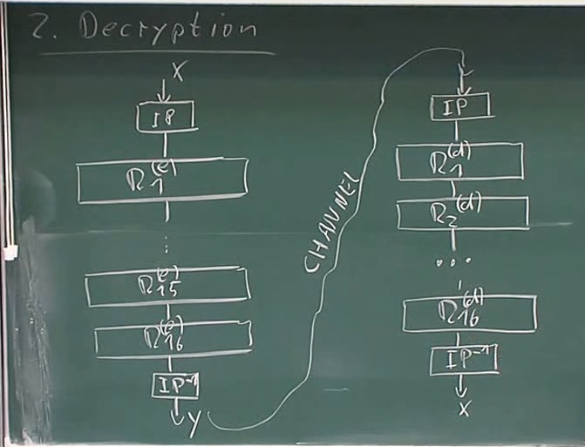
<number>/29
Chapter 3 of Understanding Cryptography by Christof Paar and Jan Pelzl

Slide 27
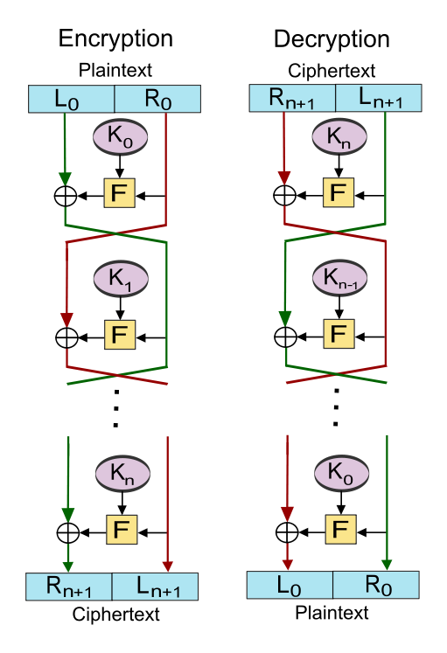
X and Y are input of encryption
X’ and Y’ are output of decryption
We want to show x’=x and Y’=Y
Y’=Ln+1=Y
X’=Rn+1 xor f(Ln+1,Kn)
=X xor f(Y, Kn) xor f(Ln+1,Kn) ;//X=Rn
=X xor f(Ln+1, Kn) f(Ln+1,Kn)
=X
X’
Y’
X=Rn
Y
<number>/29
Chapter 3 of Understanding Cryptography by Christof Paar and Jan Pelzl
Notes:
Last around doesn’t swap

Slide 28
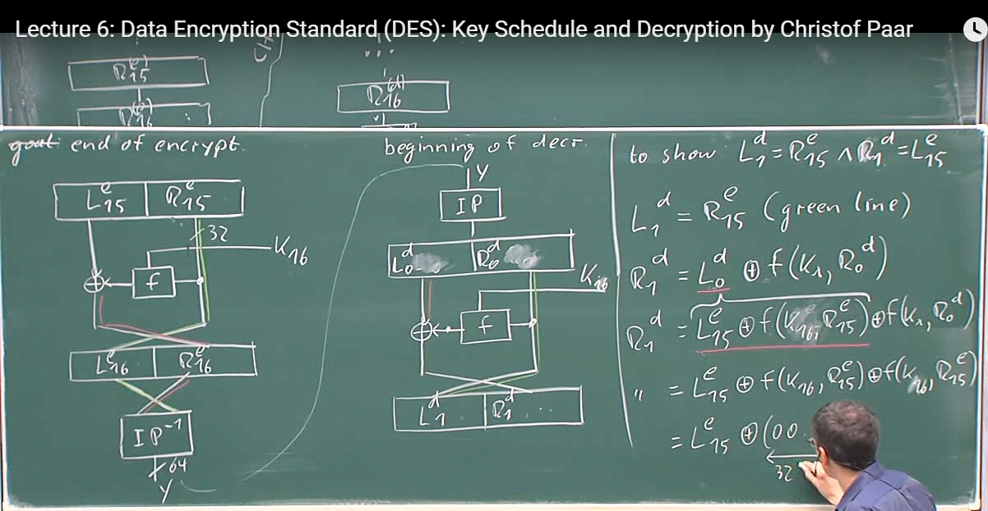
<number>/29
Chapter 3 of Understanding Cryptography by Christof Paar and Jan Pelzl
Notes:
Last around doesn’t swap

Slide 29
Content of this Chapter
Introduction to DES
Overview of the DES Algorithm
Internal Structure of DES
Decryption
Security of DES
<number>/29
Chapter 3 of Understanding Cryptography by Christof Paar and Jan Pelzl

Slide 30
Security of DES
After proposal of DES two major criticisms arose:
  Key space is too small (2⁵⁶ keys)
  S-box design criteria have been kept secret: Are there any hidden analytical attacks (backdoors), only known to the NSA?
Analytical Attacks: DES is highly resistent to both differential and linear cryptanalysis, which have been published years later than the DES. This means IBM and NSA had been aware of these attacks for 15 years!
So far there is no known analytical attack which breaks DES in realistic scenarios. 2 ⁴⁷ pair of (x,y)
Exhaustive key search: For a given pair of plaintext-ciphertext (x, y) test all 2⁵⁶ keys until the condition DES_{k}⁻¹(x)=y is fulfilled.
⇒ Relatively easy given today’s computer technology!
<number>/29
Chapter 3 of Understanding Cryptography by Christof Paar and Jan Pelzl
Notes:
The major weakness of the method is that each plaintext symbol always maps to the same ciphertext symbol. That means that the statistical properties of the plaintext are preserved in the ciphertext. For practical attacks, the following properties of language can be exploited:
Determine the frequencies of every ciphertext letter. The frequency distribution (even of relatively short pieces of encrypted text) will be close to that of the given language in general. In particular, the most frequent letters (for instance, in English: „e“ is the most frequent one with about 13%, „t“ is the second most frequent one with about 9%, „a“ is the third most frequent one with about 8%, ...) can often easily be spotted in ciphertext.
The method above can be generalized by looking at pairs (or triples, or quadruples, or ...) of ciphertext symbols. For instance, in English (and German and other European languages), the letter „q“ is almost always followed by a „u“. This behavior can be exploited for detecting the substitution of the letter „q“ and the letter „u“.
If we assume that word separators (blanks) have been found (which is often an easy task), one can often detect frequent short words such as „the“, „and“, ... , which leaks all the letters in the words involved in those words

Slide 31
History of Attacks on DES
Year | Proposed/ implemented DES Attack
1977 | Diffie & Hellman, (under-)estimate the costs of a key search machine
1990 | Biham & Shamir propose differential cryptanalysis (2⁴⁷ chosen ciphertexts)
1993 | Mike Wiener proposes design of a very efficient key search machine: Average search requires 36h. Costs: $1.000.000
1993 | Matsui proposes linear cryptanalysis (2⁴³ chosen ciphertexts)
Jun. 1997 | DES Challenge I broken, 4.5 months of distributed search
Feb. 1998 | DES Challenge II--1 broken, 39 days (distributed search)
Jul. 1998 | DES Challenge II--2 broken, key search machine Deep Crack built by the Electronic Frontier Foundation (EFF): 1800 ASICs with 24 search engines each, Costs: $250 000, 15 days average search time (required 56h for the Challenge)
Jan. 1999 | DES Challenge III broken in 22h 15min (distributed search assisted by Deep Crack)
2006-2008 | Reconfigurable key search machine COPACOBANA developed at the Universities in Bochum and Kiel (Germany), uses 120 FPGAs to break DES in 6.4 days (avg.) at a cost of $10 000.
<number>/29
Chapter 3 of Understanding Cryptography by Christof Paar and Jan Pelzl

Slide 32

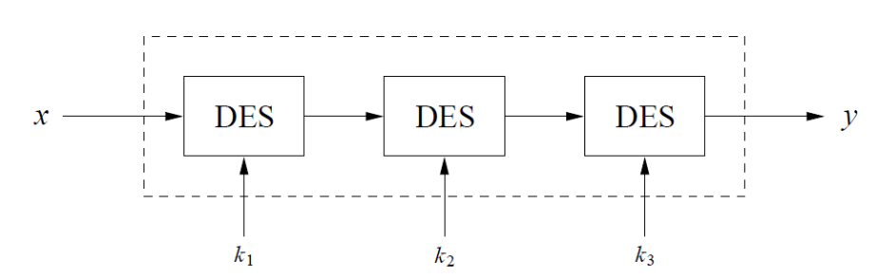

Triple DES – 3DES
Triple encryption using DES is often used in practice to extend the effective key length of DES to 112. For more info on multiple encryption and effective key lengths see Chapter 5 of Understanding Cryptography.
Alternative version of 3DES:
Advantage: choosing k₁=k₂=k₃ performs single DES encryption.
No practical attack known today.
Used in many legacy applications, i.e., in banking systems.
<number>/29
Chapter 3 of Understanding Cryptography by Christof Paar and Jan Pelzl

Slide 33
Alternatives to DES
Algorithm | I/O Bit | key lengths | remarks
AES / Rijndael | 128 | 128/192/256 | DES ''replacement'', worldwide used standard
Triple DES | 64 | 112 (effective) | conservative choice
Mars | 128 | 128/192/256 | AES finalist
RC6 | 128 | 128/192/256 | AES finalist
Serpent | 128 | 128/192/256 | AES finalist
Twofish | 128 | 128/192/256 | AES finalist
IDEA | 64 | 128 | (Patented till 2011)
<number>/29
Chapter 3 of Understanding Cryptography by Christof Paar and Jan Pelzl

Slide 34
Lessons Learned
DES was the dominant symmetric encryption algorithm from the mid-1970s to the mid-1990s. Since 56-bit keys are no longer secure, the Advanced Encryption Standard (AES) was created.
Standard DES with 56-bit key length can be broken relatively easily nowadays through an exhaustive key search.
DES is quite robust against known analytical attacks: In practice it is very difficult to break the cipher with differential or linear cryptanalysis.
By encrypting with DES three times in a row, triple DES (3DES) is created, against which no practical attack is currently known.
The “default” symmetric cipher is nowadays often AES. In addition, the other four AES finalist ciphers all seem very secure and efficient.
<number>/29
Chapter 3 of Understanding Cryptography by Christof Paar and Jan Pelzl

