Slide 1

Understanding Cryptography by Christof Paar and Jan Pelzl www.crypto-textbook.com
Chapter 4 – The Advanced Encryption Standard (AES) ver. October 28, 2009
These slides were prepared by Daehyun Strobel, Christof Paar and Jan Pelzl

Slide 2
Some legal stuff (sorry): Terms of Use
The slides can used free of charge. All copyrights for the slides remain with Christof Paar and Jan Pelzl.
The title of the accompanying book “Understanding Cryptography” by Springer and the author’s names must remain on each slide.
If the slides are modified, appropriate credits to the book authors and the book title must remain within the slides.
It is not permitted to reproduce parts or all of the slides in printed form whatsoever without written consent by the authors.
<number>/28
Chapter 4 of Understanding Cryptography by Christof Paar and Jan Pelzl

Slide 3
Content of this Chapter
Overview of the AES algorithm
Internal structure of AES
  Byte Substitution layer
  Diffusion layer
  Key Addition layer
  Key schedule
Decryption
Practical issues
<number>/28
Chapter 4 of Understanding Cryptography by Christof Paar and Jan Pelzl

Slide 4
Content of this Chapter
Overview of the AES algorithm
Internal structure of AES
  Byte Substitution layer
  Diffusion layer
  Key Addition layer
  Key schedule
Decryption
Practical issues
<number>/28
Chapter 4 of Understanding Cryptography by Christof Paar and Jan Pelzl

Slide 5
Some Basic Facts
AES is the most widely used symmetric cipher today
The algorithm for AES was chosen by the US National Institute of Standards and Technology (NIST) in a multi-year selection process
The requirements for all AES candidate submissions were:
  Block cipher with 128-bit block size
  Three supported key lengths: 128, 192 and 256 bit
  Security relative to other submitted algorithms
  Efficiency in software and hardware
<number>/28
Chapter 4 of Understanding Cryptography by Christof Paar and Jan Pelzl

Slide 6
Chronology of the AES Selection
The need for a new block cipher announced by NIST in January, 1997
15 candidates algorithms accepted in August, 1998
5 finalists announced in August, 1999:
  Mars – IBM Corporation
  RC6 – RSA Laboratories
  Rijndael – J. Daemen & V. Rijmen
  Serpent – Eli Biham et al.
  Twofish – B. Schneier et al.
In October 2000, Rijndael was chosen as the AES
AES was formally approved as a US federal standard in November 2001
<number>/28
Chapter 4 of Understanding Cryptography by Christof Paar and Jan Pelzl

Slide 7
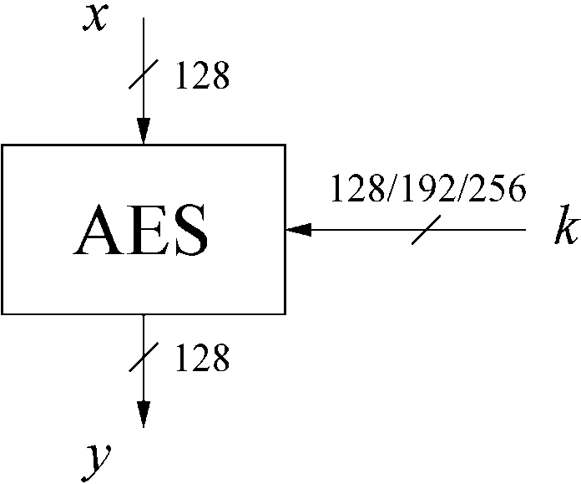
AES: Overview
The number of rounds depends on the chosen key length:
Key length (bits) | Number of rounds
128 | 10
192 | 12
256 | 14
<number>/28
Chapter 4 of Understanding Cryptography by Christof Paar and Jan Pelzl

Slide 8
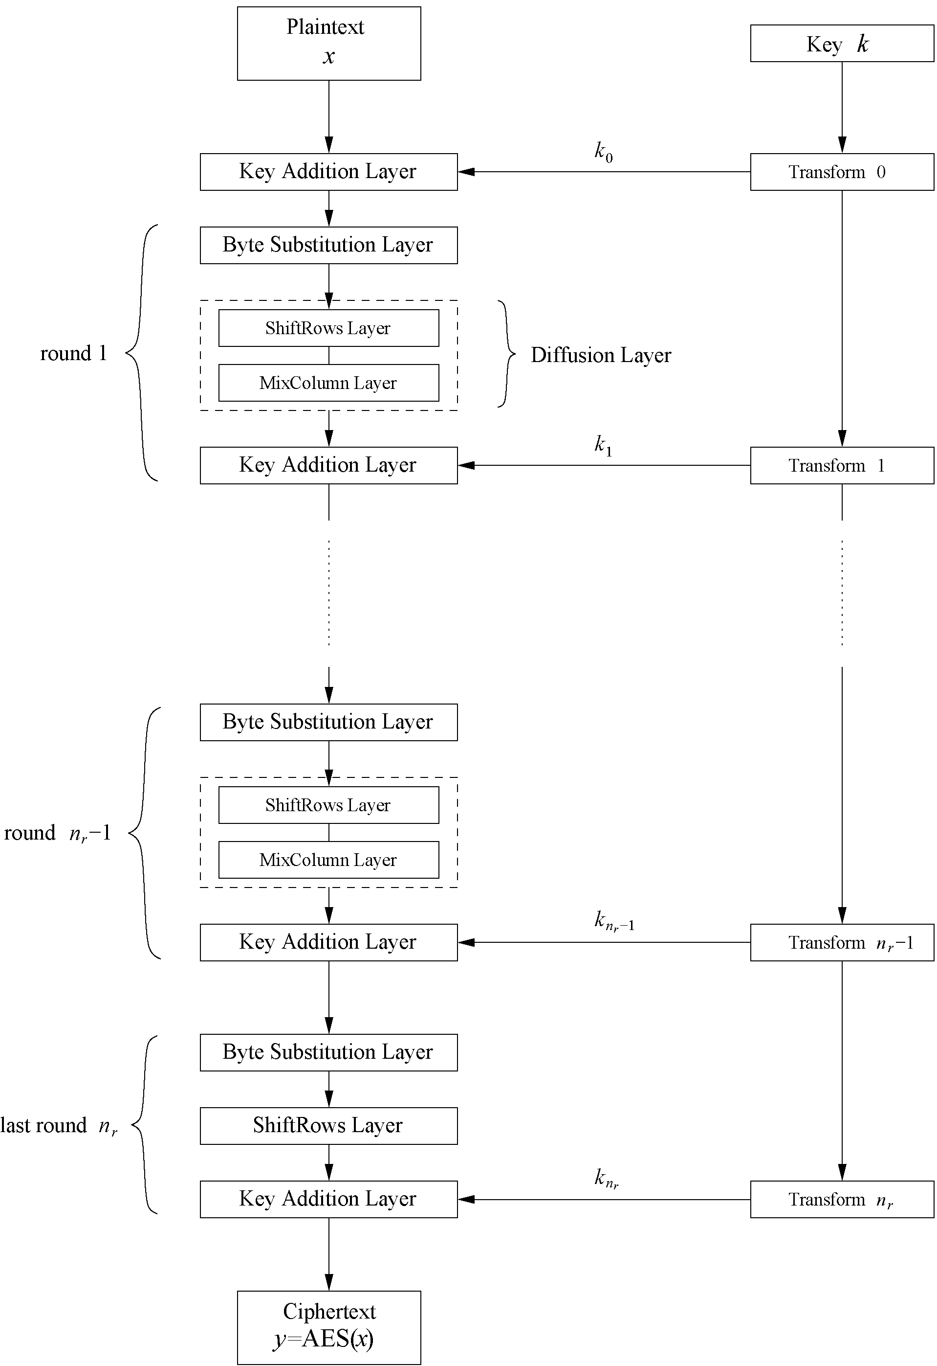
AES: Overview
Iterated cipher with 10/12/14 rounds
Each round consists of “Layers”
<number>/28
Chapter 4 of Understanding Cryptography by Christof Paar and Jan Pelzl

Slide 9
Content of this Chapter
Overview of the AES algorithm
Internal structure of AES
  Byte Substitution layer
  Diffusion layer
  Key Addition layer (key whitenling)
  Key schedule
Decryption
Practical issues
<number>/28
Chapter 4 of Understanding Cryptography by Christof Paar and Jan Pelzl

Slide 10
Internal Structure of AES
AES is a byte-oriented cipher
The state A (i.e., the 128-bit data path) can be arranged in a 4x4 matrix:
with A₀,…, A₁₅ denoting the 16-byte input of AES
A₀ | A₄ | A₈ | A₁₂
A₁ | A₅ | A₉ | A₁₃
A₂ | A₆ | A₁₀ | A₁₄
A₃ | A₇ | A₁₁ | A₁₅
<number>/28
Chapter 4 of Understanding Cryptography by Christof Paar and Jan Pelzl

Slide 11
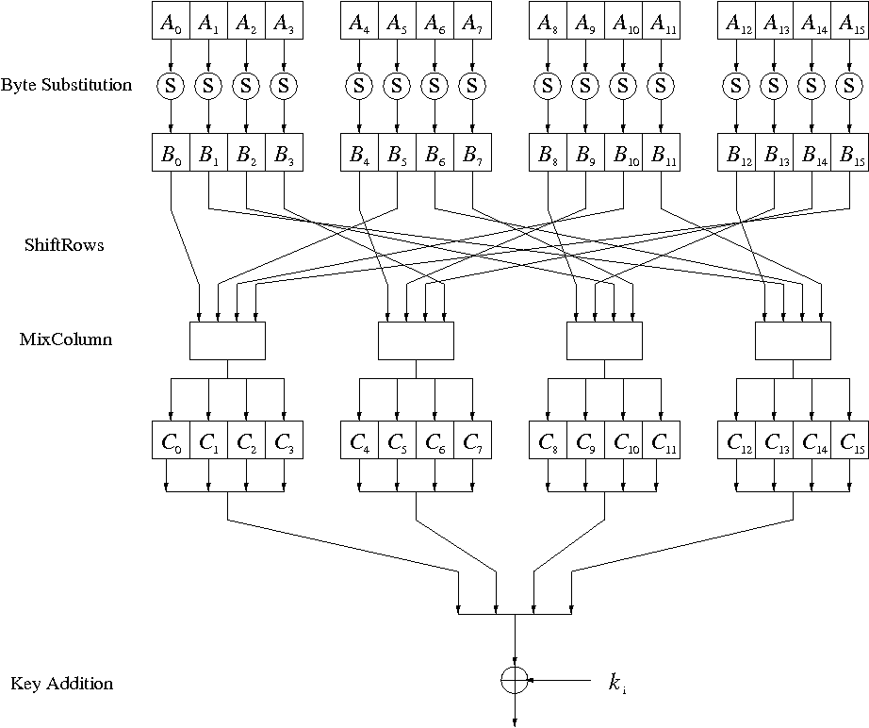
Internal Structure of AES
Round function for rounds 1,2,…,n_{r-1}:
Note: In the last round, the MixColumn tansformation is omitted
<number>/28
Chapter 4 of Understanding Cryptography by Christof Paar and Jan Pelzl

Slide 12
Byte Substitution Layer
The Byte Substitution layer consists of 16 S-Boxes with the following properties:
  The S-Boxes are
  identical
  the only nonlinear elements of AES, i.e.,
  ByteSub(A_{i}) + ByteSub(A_{j}) ≠ ByteSub(A_{i} + A_{j}), for i,j = 0,…,15
  bijective, i.e., there exists a one-to-one mapping of input and output bytes
  ⇒ S-Box can be uniquely reversed
In software implementations, the S-Box is usually realized as a lookup table
<number>/28
Chapter 4 of Understanding Cryptography by Christof Paar and Jan Pelzl

Slide 13
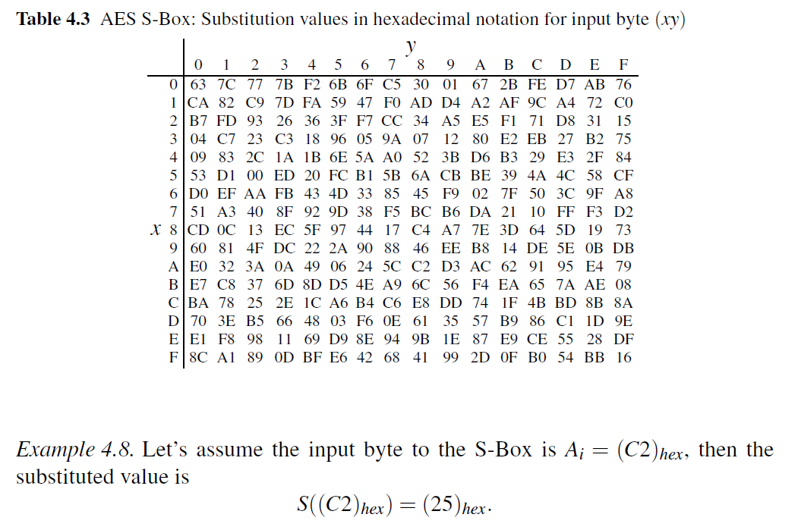
<number>/28
Chapter 4 of Understanding Cryptography by Christof Paar and Jan Pelzl

Slide 14
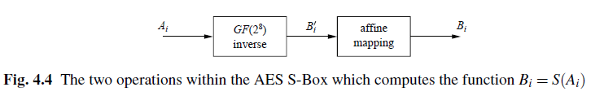
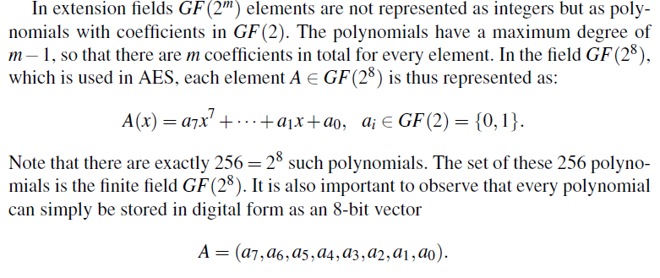
<number>/28
Chapter 4 of Understanding Cryptography by Christof Paar and Jan Pelzl

Slide 15
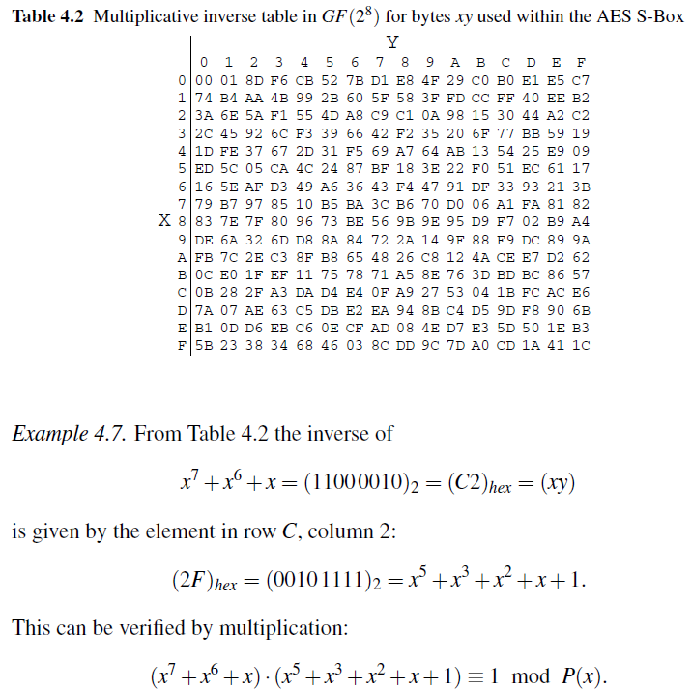
Where the table comes from?
<number>/28
Chapter 4 of Understanding Cryptography by Christof Paar and Jan Pelzl

Slide 16
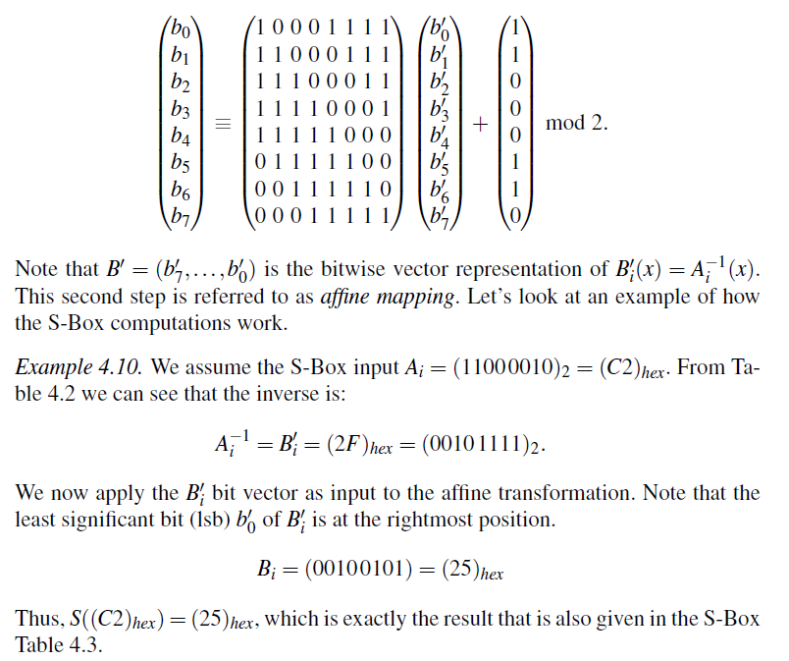
<number>/28
Chapter 4 of Understanding Cryptography by Christof Paar and Jan Pelzl

Slide 17
Diffusion Layer
The Diffusion layer
provides diffusion over all input state bits
consists of two sublayers:
  ShiftRows Sublayer: Permutation of the data on a byte level
  MixColumn Sublayer: Matrix operation which combines (“mixes”) blocks of four bytes
performs a linear operation on state matrices A, B, i.e.,
DIFF(A) + DIFF(B) = DIFF(A + B)
<number>/28
Chapter 4 of Understanding Cryptography by Christof Paar and Jan Pelzl

Slide 18
ShiftRows Sublayer
Rows of the state matrix are shifted cyclically:
Input matrix
Output matrix
B₀ | B₄ | B₈ | B₁₂
B₁ | B₅ | B₉ | B₁₃
B₂ | B₆ | B₁₀ | B₁₄
B₃ | B₇ | B₁₁ | B₁₅
B₀ | B₄ | B₈ | B₁₂
B₅ | B₉ | B₁₃ | B₁
B₁₀ | B₁₄ | B₂ | B₆
B₁₅ | B₃ | B₇ | B₁₁
no shift
← one position left shift
← two positions left shift
← three positions left shift
<number>/28
Chapter 4 of Understanding Cryptography by Christof Paar and Jan Pelzl

Slide 19
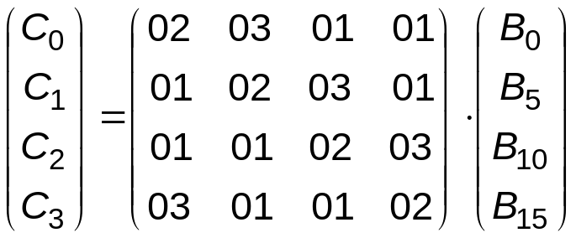
MixColumn Sublayer
Linear transformation which mixes each column of the
state matrix
Each 4-byte column is considered as a vector and multiplied
by a fixed 4x4 matrix, e.g.,
where 01, 02 and 03 are given in hexadecimal notation
All arithmetic is done in the Galois field GF(2⁸) (for more information see Chapter 4.3 in Understanding Cryptography)
<number>/28
Chapter 4 of Understanding Cryptography by Christof Paar and Jan Pelzl

Slide 20
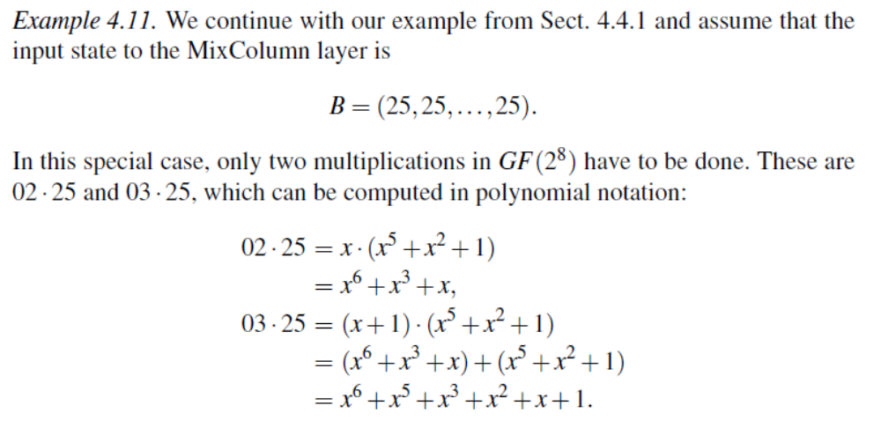
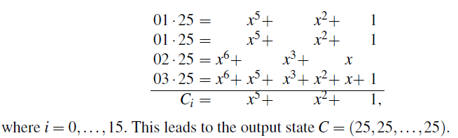
<number>/28
Chapter 4 of Understanding Cryptography by Christof Paar and Jan Pelzl

Slide 21
Key Addition Layer
Inputs:
  16-byte state matrix C
  16-byte subkey k_{i}
Output: C ⊕ k_{i}
The subkeys are generated in the key schedule
<number>/28
Chapter 4 of Understanding Cryptography by Christof Paar and Jan Pelzl

Slide 22
Key Schedule
Subkeys are derived recursively from the original 128/192/256-bit input key
Each round has 1 subkey, plus 1 subkey at the beginning of AES
Key whitening: Subkey is used both at the input and output of AES
⇒ # subkeys = # rounds + 1
There are different key schedules for the different key sizes
Key length (bits) | Number of subkeys
128 | 11
192 | 13
256 | 15
<number>/28
Chapter 4 of Understanding Cryptography by Christof Paar and Jan Pelzl

Slide 23
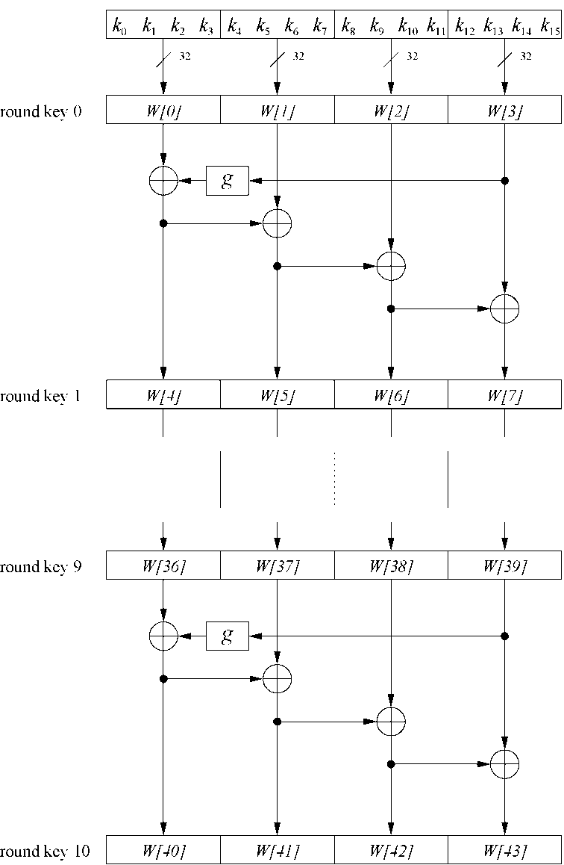
Key Schedule
Example: Key schedule for 128-bit key AES
Word-oriented: 1 word = 32 bits
11 subkeys are stored in W[0]…W[3], W[4]…W[7], … , W[40]…W[43]
First subkey W[0]…W[3] is the original AES key
<number>/28
Chapter 4 of Understanding Cryptography by Christof Paar and Jan Pelzl

Slide 24
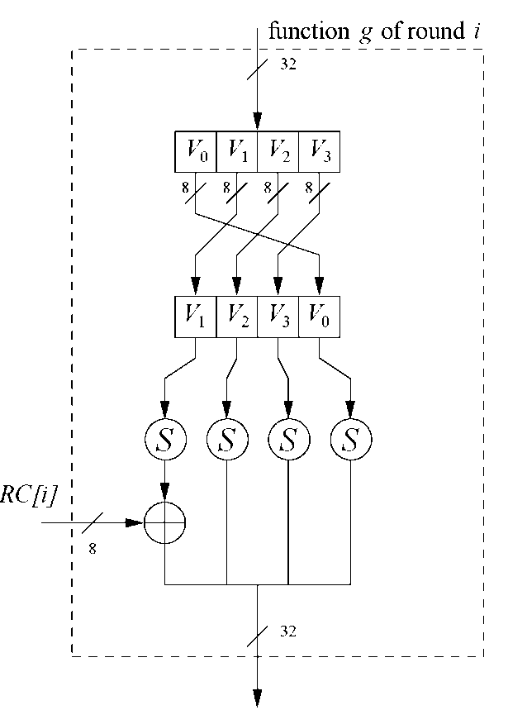
Key Schedule
Function g rotates its four input bytes and performs a bytewise S-Box substitution
⇒ nonlinearity
The round coefficient RC is only added to the leftmost
byte and varies from round to round:
RC[1] = x⁰ = (00000001)₂
RC[2] = x¹ = (00000010)₂
RC[3] = x² = (00000100)₂
...
RC[10] = x⁹ = (00110110)₂
x^{i} represents an element in a Galois field
(again, cf. Chapter 4.3 of Understanding Cryptography)
<number>/28
Chapter 4 of Understanding Cryptography by Christof Paar and Jan Pelzl
Notes:
X9/x8 +x4 +x3 +x+1 =00110110

Slide 25
Content of this Chapter
Overview of the AES algorithm
Internal structure of AES
  Byte Substitution layer
  Diffusion layer
  Key Addition layer
  Key schedule
Decryption
Practical issues
<number>/28
Chapter 4 of Understanding Cryptography by Christof Paar and Jan Pelzl

Slide 26
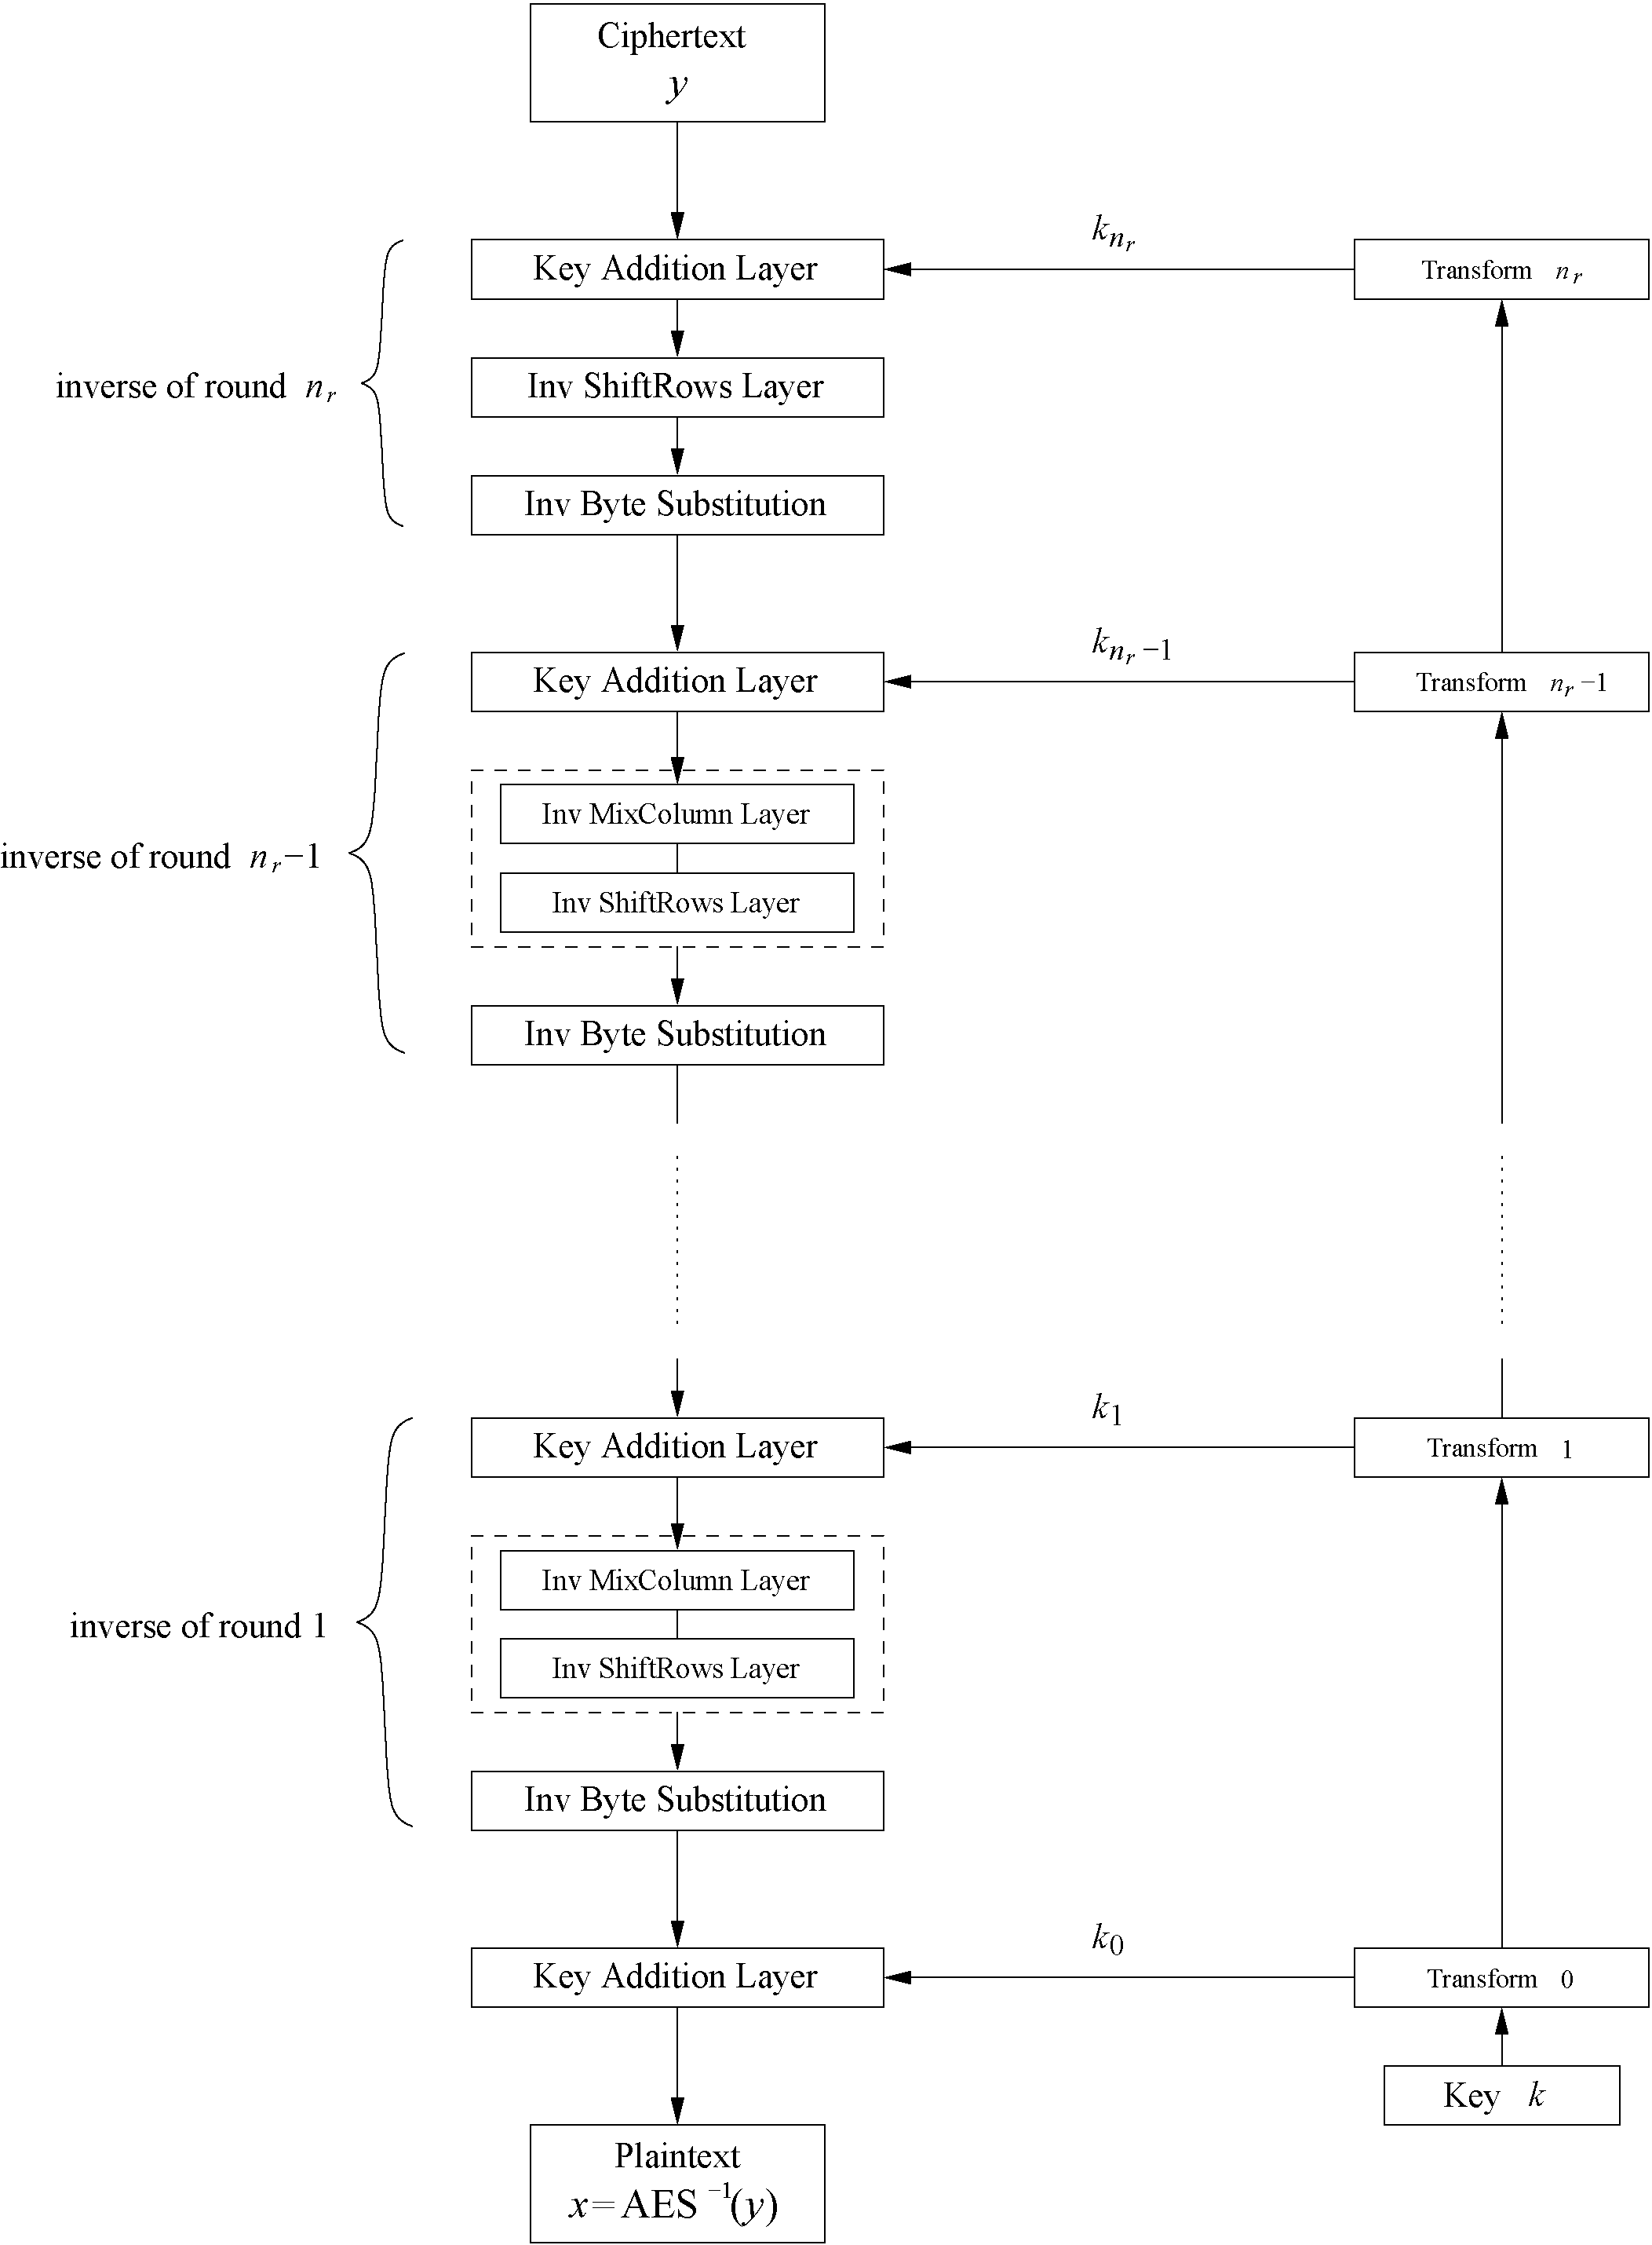
Decryption
AES is not based on a Feistel network
⇒ All layers must be inverted for decryption:
  MixColumn layer → Inv MixColumn layer
  ShiftRows layer→ Inv ShiftRows layer
  Byte Substitution layer → Inv Byte Substitution layer
  Key Addition layer is its own inverse
<number>/28
Chapter 4 of Understanding Cryptography by Christof Paar and Jan Pelzl

Slide 27
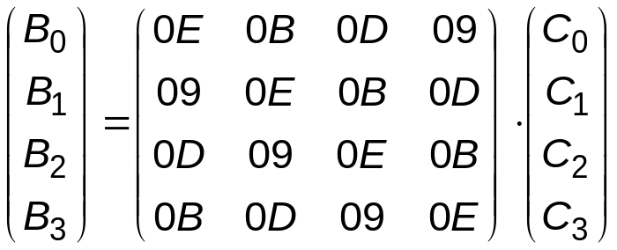
Decryption
Inv MixColumn layer:
  To reverse the MixColumn operation, each column of the state matrix C must be multiplied with the inverse of the 4x4 matrix, e.g.,
  where 09, 0B, 0D and 0E are given in hexadecimal notation
Again, all arithmetic is done in the Galois field GF(2⁸) (for more information see Chapter 4.3 in Understanding Cryptography)
<number>/28
Chapter 4 of Understanding Cryptography by Christof Paar and Jan Pelzl

Slide 28
Decryption
Inv ShiftRows layer:
  All rows of the state matrix B are shifted to the opposite direction:
  Input matrix
  Output matrix
B₀ | B₄ | B₈ | B₁₂
B₁ | B₅ | B₉ | B₁₃
B₂ | B₆ | B₁₀ | B₁₄
B₃ | B₇ | B₁₁ | B₁₅
B₀ | B₄ | B₈ | B₁₂
B₁₃ | B₁ | B₅ | B₉
B₁₀ | B₁₄ | B₂ | B₆
B₇ | B₁₁ | B₁₅ | B₃
no shift
→ one position right shift
→ two positions right shift
→ three positions right shift
<number>/28
Chapter 4 of Understanding Cryptography by Christof Paar and Jan Pelzl

Slide 29
Decryption
Inv Byte Substitution layer:
  Since the S-Box is bijective, it is possible to construct an inverse, such that
  A_{i} = S⁻¹(B_{i}) = S⁻¹(S(A_{i}))
  ⇒ The inverse S-Box is used for decryption. It is usually realized as a lookup table
Decryption key schedule:
  Subkeys are needed in reversed order (compared to encryption)
  In practice, for encryption and decryption, the same key schedule is used. This requires that all subkeys must be computed before the encryption of the first block can begin
<number>/28
Chapter 4 of Understanding Cryptography by Christof Paar and Jan Pelzl

Slide 30
Content of this Chapter
Overview of the AES algorithm
Internal structure of AES
  Byte Substitution layer
  Diffusion layer
  Key Addition layer
  Key schedule
Decryption
Practical issues
<number>/28
Chapter 4 of Understanding Cryptography by Christof Paar and Jan Pelzl

Slide 31
Implementation in Software
One requirement of AES was the possibility of an efficient software implementation
Straightforward implementation is well suited for 8-bit processors (e.g., smart cards), but inefficient on 32-bit or 64-bit processors
A more sophisticated approach: Merge all round functions (except the key addition) into one table look-up
  This results in four tables with 256 entries, where each entry is 32 bits wide
  One round can be computed with 16 table look-ups
Typical SW speeds are more than 1.6 Gbit/s on modern 64-bit processors
<number>/28
Chapter 4 of Understanding Cryptography by Christof Paar and Jan Pelzl

Slide 32
Security
Brute-force attack: Due to the key length of 128, 192 or 256 bits, a brute-force attack is not possible
Analytical attacks: There is no analytical attack known that is better than brute-force
Side-channel attacks:
  Several side-channel attacks have been published
  Note that side-channel attacks do not attack the underlying algorithm but the implementation of it
<number>/28
Chapter 4 of Understanding Cryptography by Christof Paar and Jan Pelzl

Slide 33
Lessons Learned
AES is a modern block cipher which supports three key lengths of 128, 192 and 256 bit. It provides excellent long-term security against brute-force attacks.
AES has been studied intensively since the late 1990s and no attacks have been found that are better than brute-force.
AES is not based on Feistel networks. Its basic operations use Galois field arithmetic and provide strong diffusion and confusion.
AES is part of numerous open standards such as IPsec or TLS, in addition to being the mandatory encryption algorithm for US government applications. It seems likely that the cipher will be the dominant encryption algorithm for many years to come.
AES is efficient in software and hardware.
<number>/28
Chapter 4 of Understanding Cryptography by Christof Paar and Jan Pelzl

