Slide 1
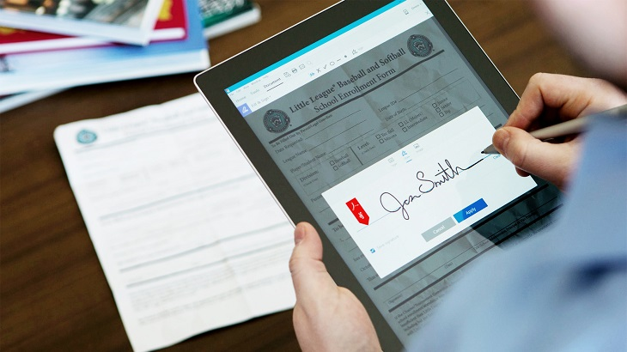
RSA digital signature scheme
https://www.4point.com/blog/2017/06/what_is_an_e-signatu.html

Slide 2
digital signature overview

Slide 3
Definition: digital signature
A digital signature is a mathematical scheme for presenting the authenticity of digital messages or documents
Authenticity
Proof of who actually signed the document.
This links the digital signatures to an actual identifiable entity.
https://en.wikipedia.org/wiki/Digital_signature

Slide 4
Other requirements of digital signature
Data integrity
Proof that the document has not been tampered with since signing.
The digital signature depends on every binary bit in the document and therefore can’t be re-attached to any other document.
Non-repudiation
The signer should not be able to falsely deny having signed their signature.
That is, it should be possible to prove in a court that the signer in fact created the signature.

Slide 5
Main idea of the RSA signature scheme
To generate the signature
“encrypt” the hash value h with the private key
s = h ^{d} mod n //d = the private key
To verify the signature
h’=s^{e} mod n // e = the public key
If h = h’, the signature is valid

Slide 6
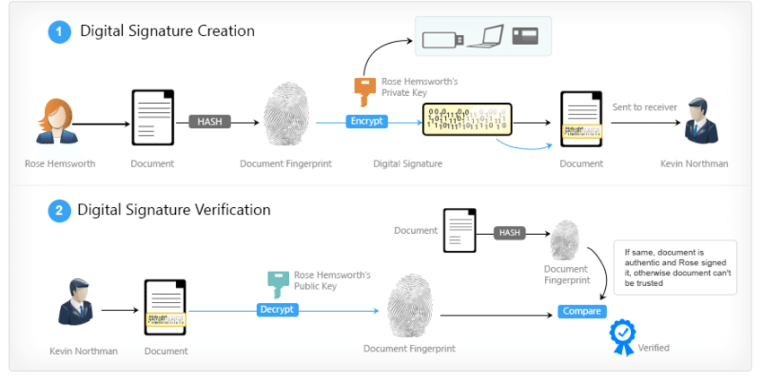

Slide 7
Important Question
How to prove Authenticity?
Provide a public certificate to Kevin (Bob)
How to prove Data integrity?
Hash
How to prove Non-repudiation?
Only Rose (Alice) has the private key

Slide 8
Sign a document

Slide 9
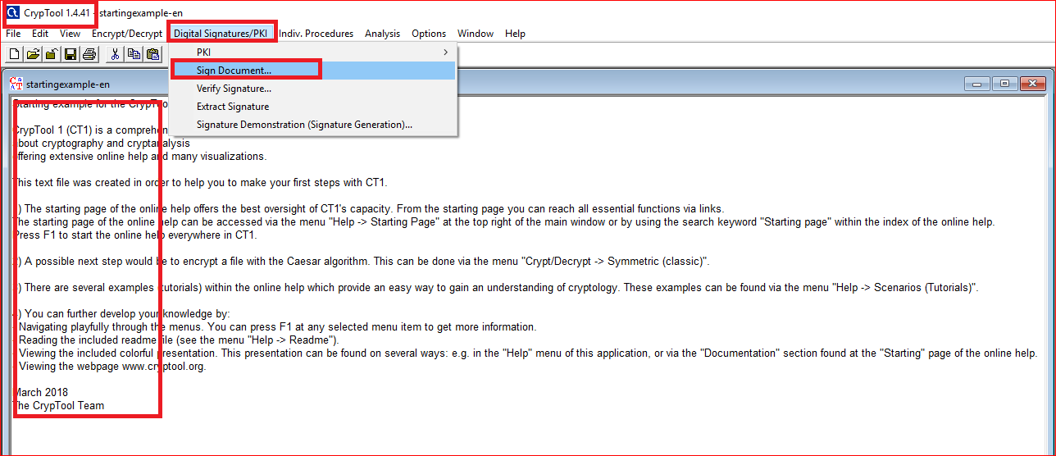

Slide 10
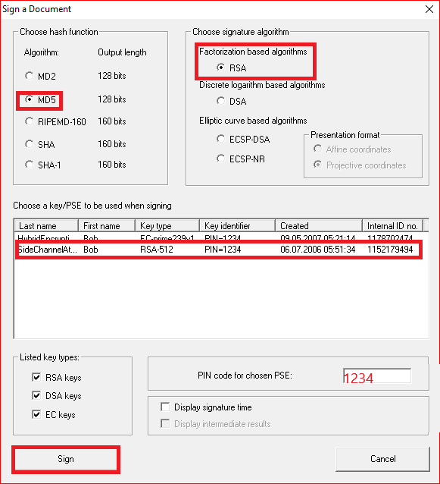

Slide 11
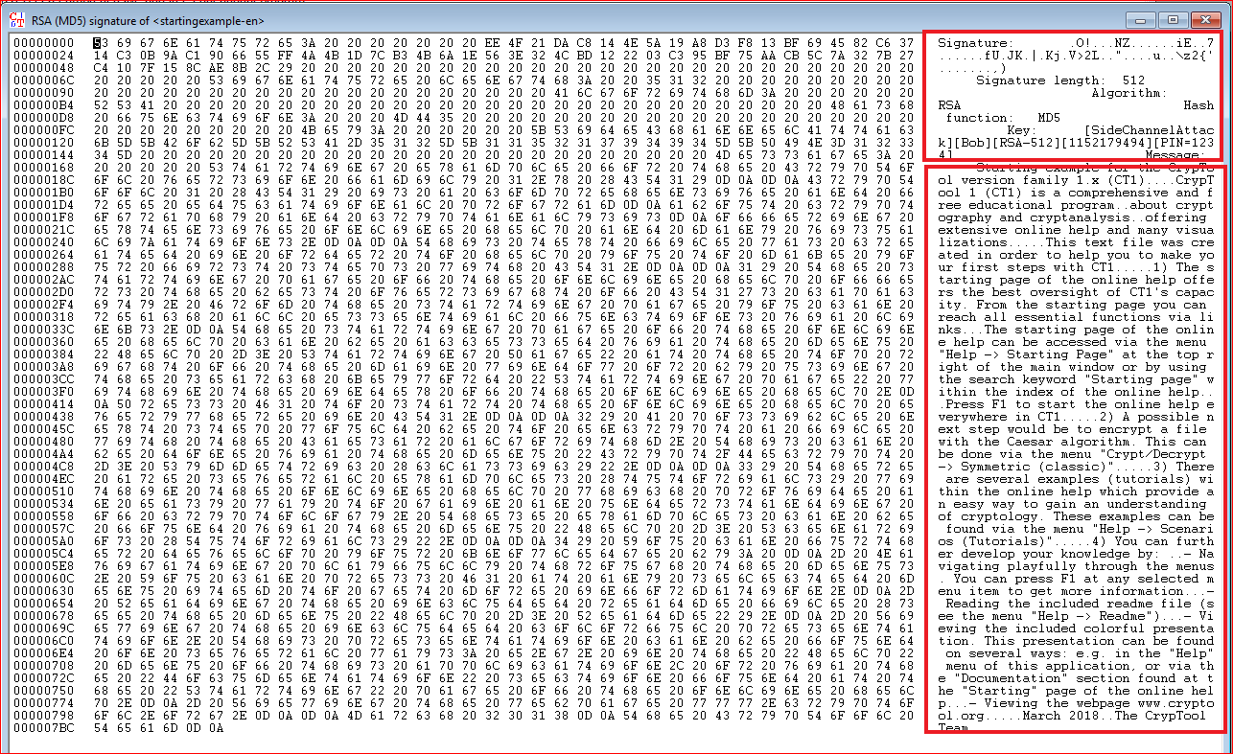

Slide 12
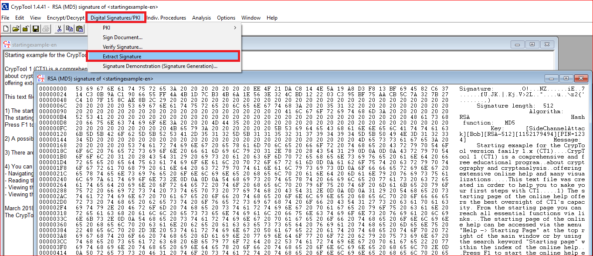

Slide 13
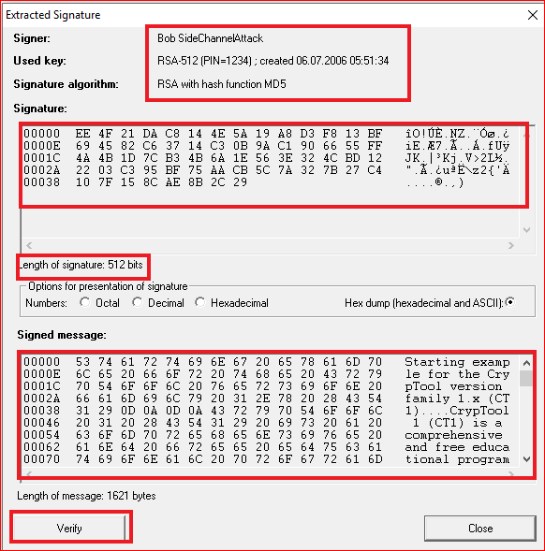

Slide 14
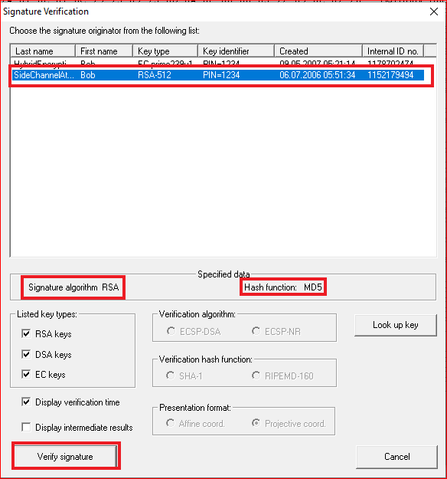
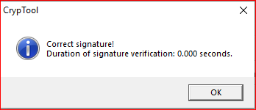

Slide 15
Digital Signature Visualized

Slide 16
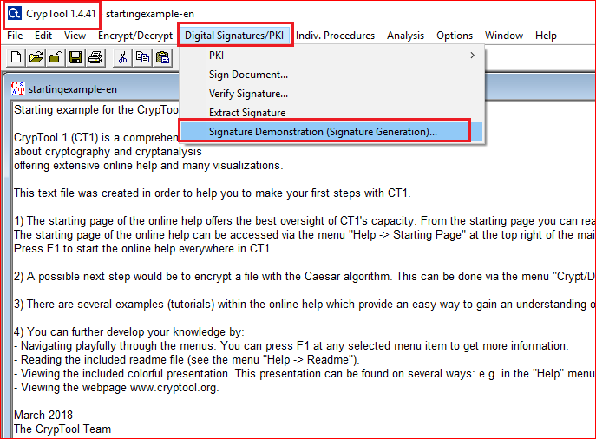

Slide 17
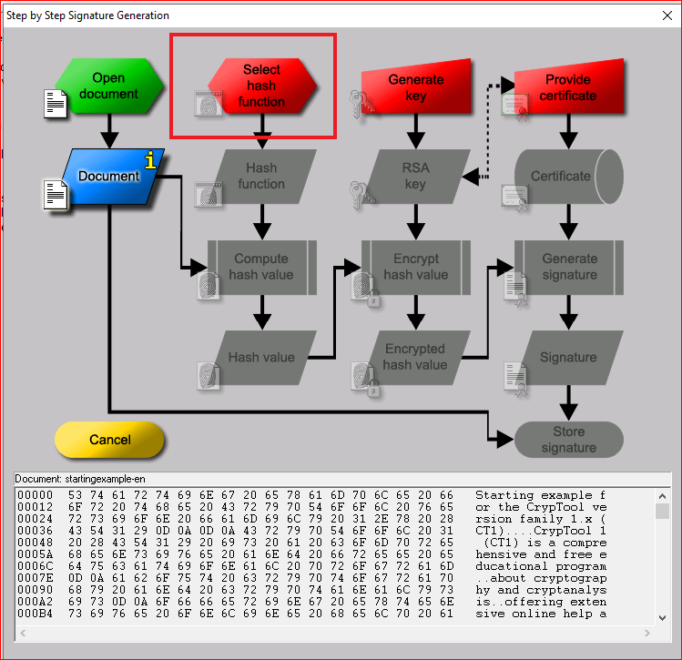
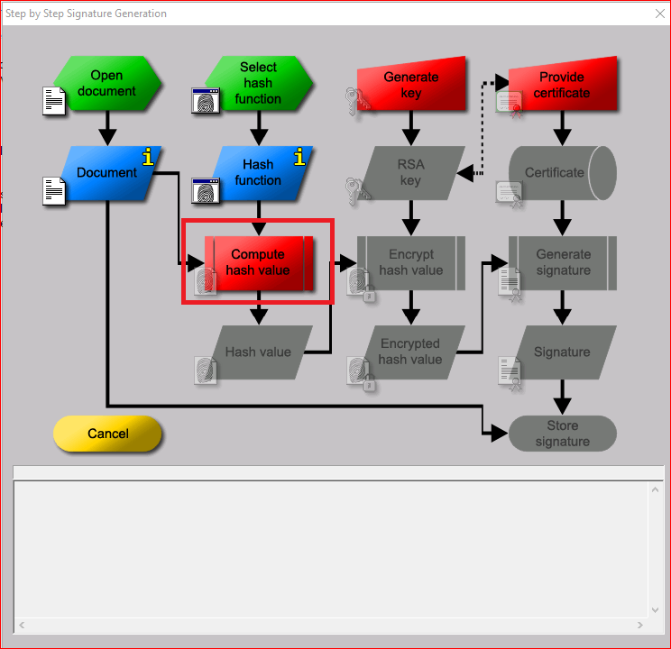
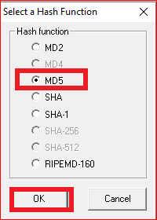

Slide 18
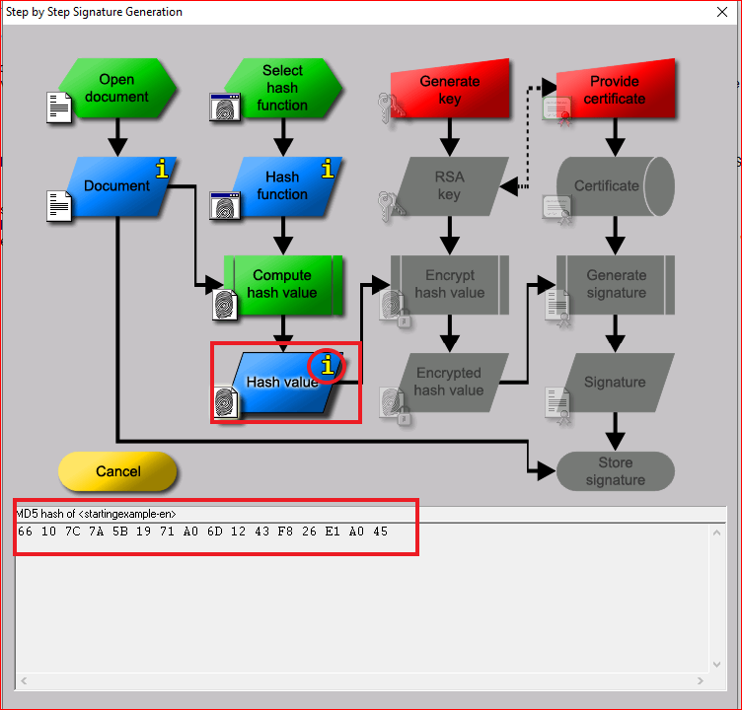
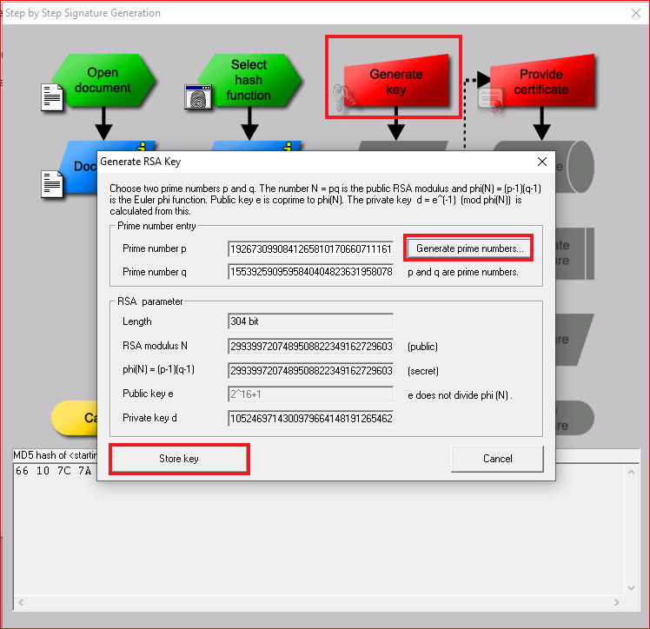

Slide 19
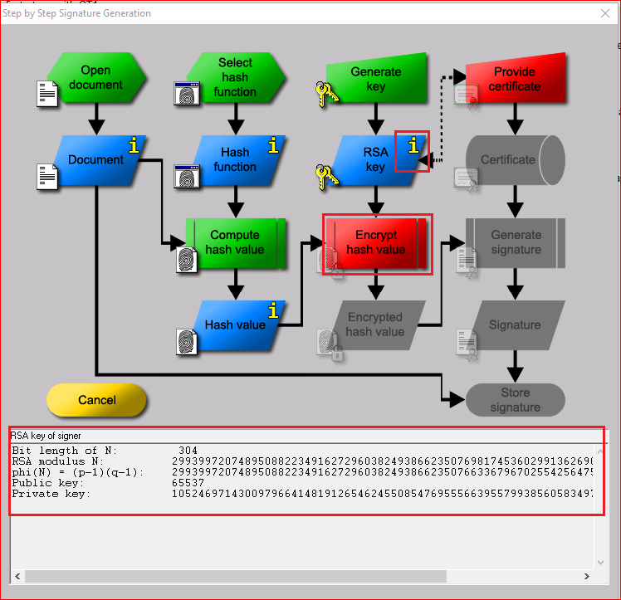
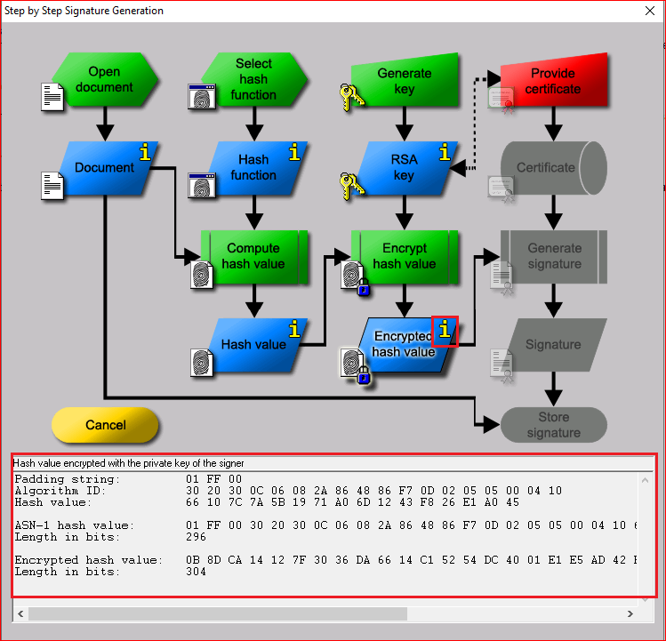

Slide 20
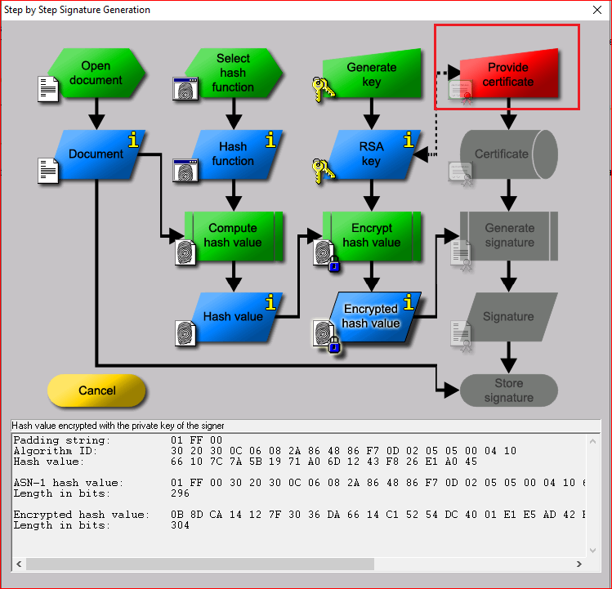

Slide 21
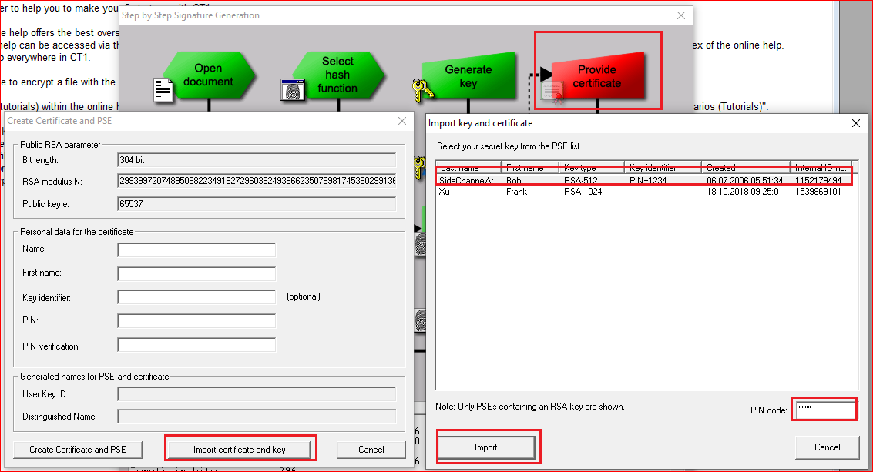

Slide 22
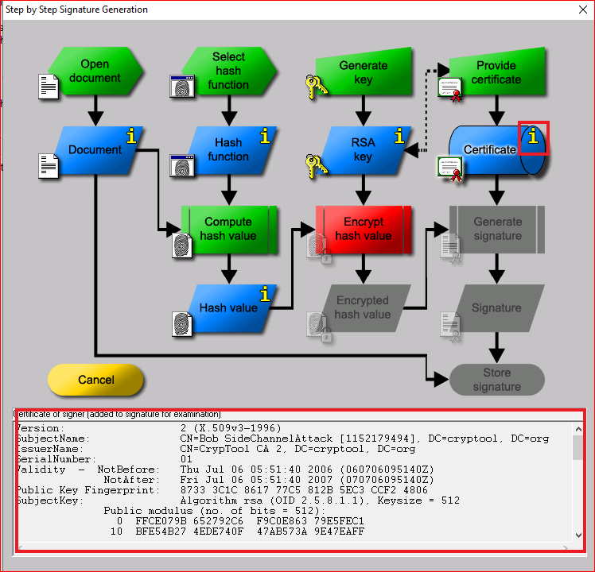
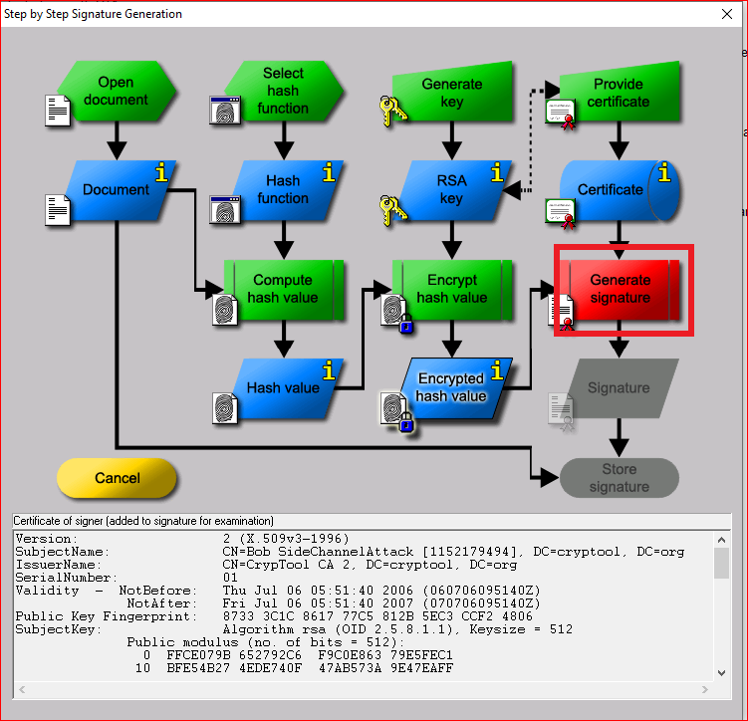

Slide 23
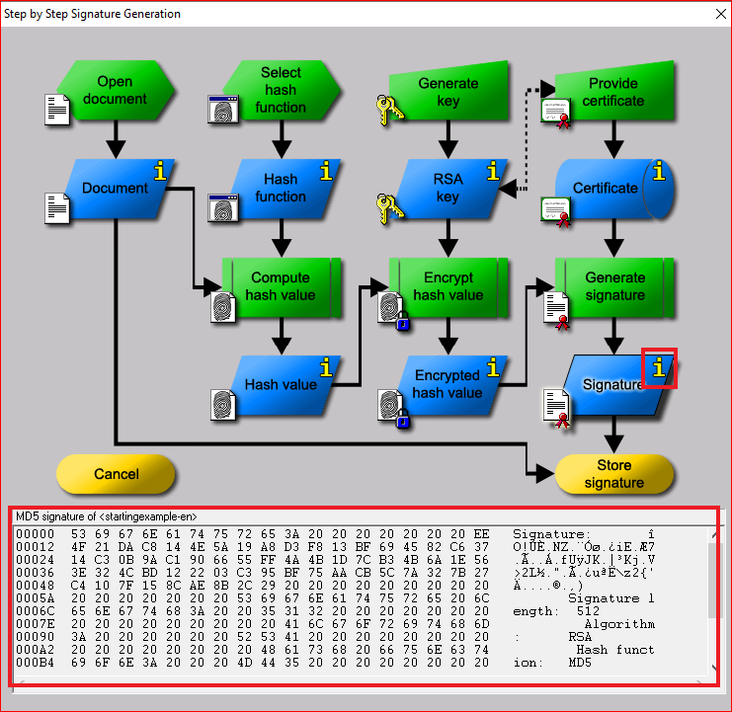
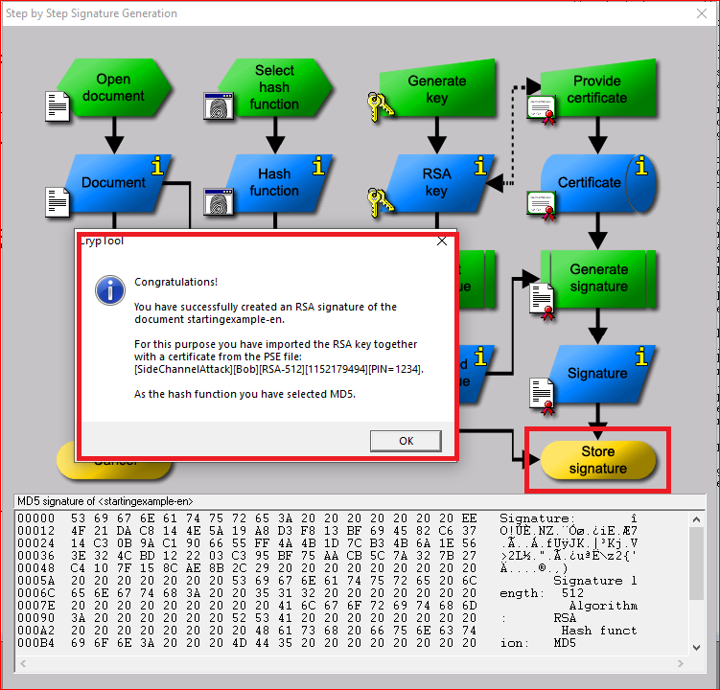

Slide 24
Your work
Create one file.
Sign the file with your signature.
Describe how your signature provides following properties (include screenshots)
Authenticity?
Data integrity?
Non-repudiation?

