Slide 1
Hash Function

Slide 2
Overview
“digest” function

Slide 3
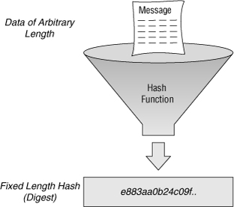
Definition
A hash function is any function that can be used to map data of arbitrary size to data of a fixed size.
The values returned by a hash function are called
hash values, hash codes, digests, or simply hashes
https://en.wikipedia.org/wiki/Hash_function

Slide 4
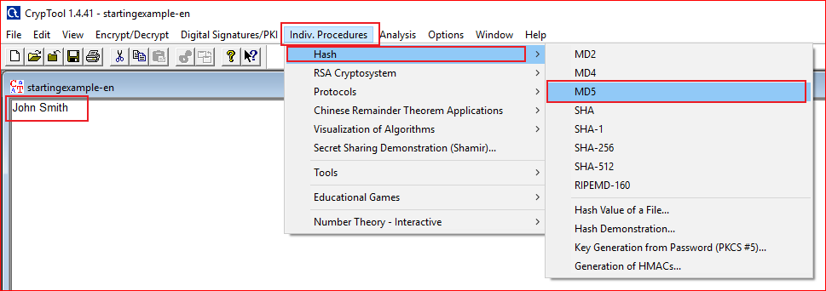

Slide 5
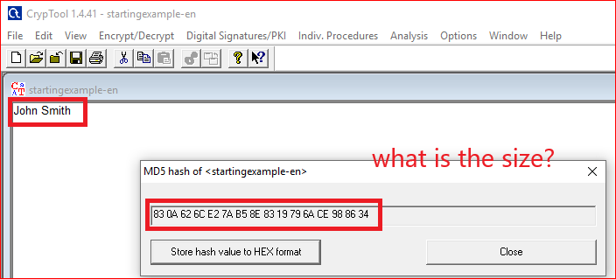
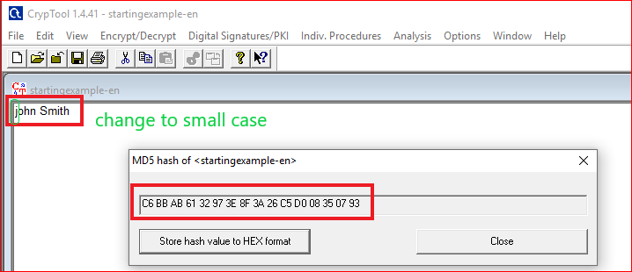

Slide 6
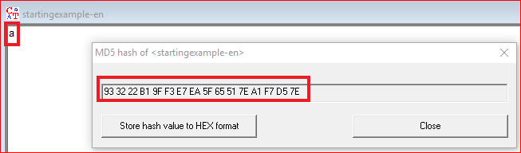
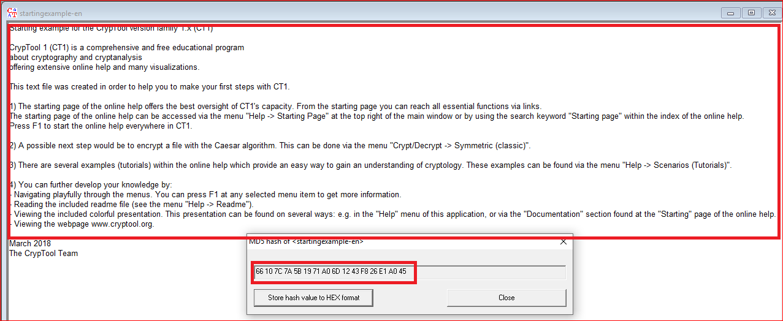

Slide 7

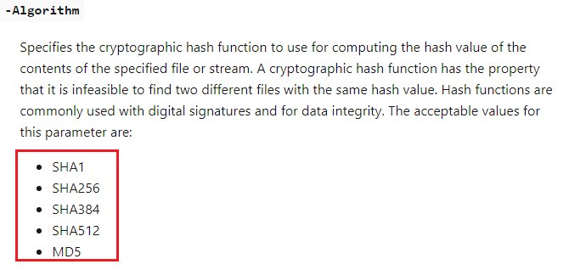

Slide 8
Question: You need to answer
Hash texts with different size using the tool
What is the size (in bits) of MD5 hash value?
Does the length of the MD5 hash value change when inputs change?

Slide 9
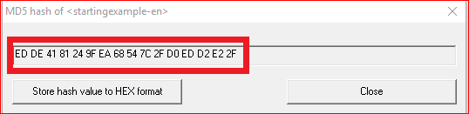
Question: Can you produce the follow MD5 hash value?
If you can, show the text and its MD5 hash value.
If you can’t, how difficult to produce the hash value? Or estimate how many time you have to try to guarantee produce the same hash value.
Notes:
2^128

Slide 10
Hash Demo

Slide 11
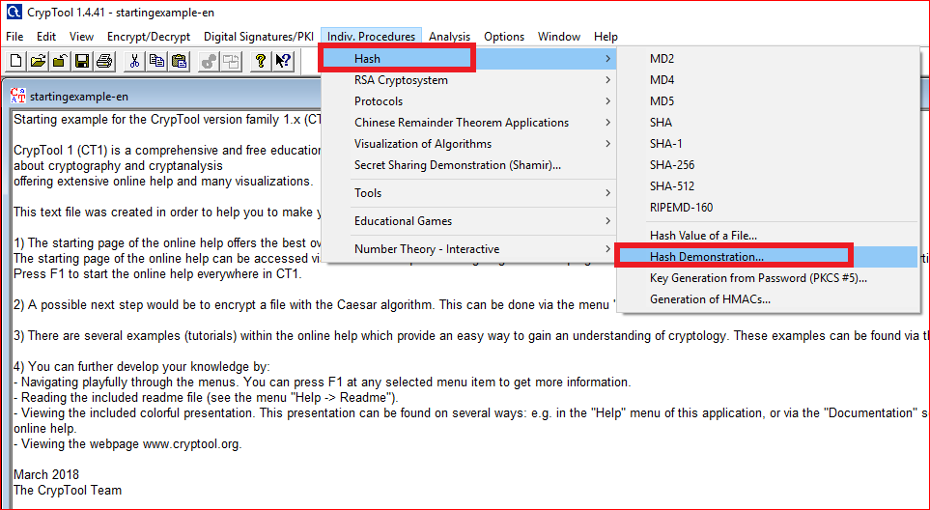

Slide 12
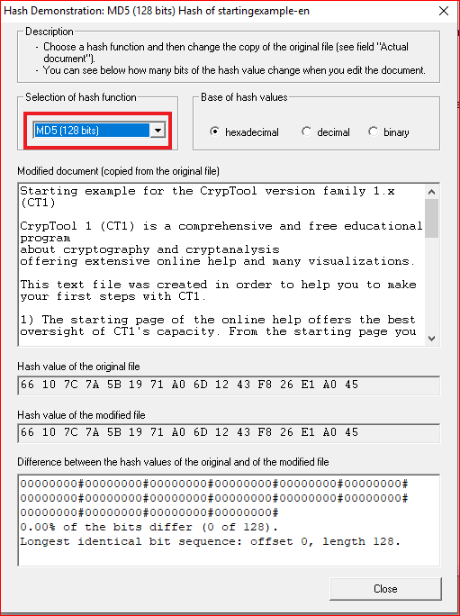
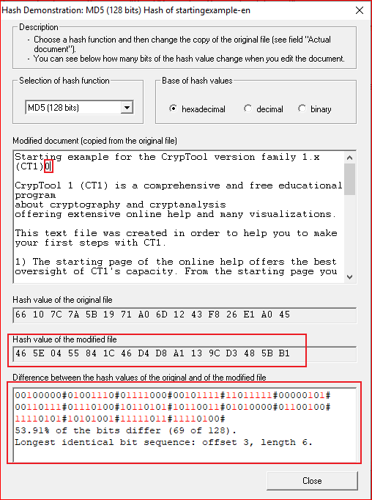

Slide 13
Questions
Change the document and record your observation a few times. Pay attention to the percentage of bits differ.
Are the percentages close to 50%?
Why the percentages close to 50%?
Change to a different hash algorithm, i.e., SHA-256. What is the size of hash code?

Slide 14
An evil pair of files have the same MD5 hash
http://web.archive.org/web/20071226014140/http://www.cits.rub.de/MD5Collisions/

Slide 15
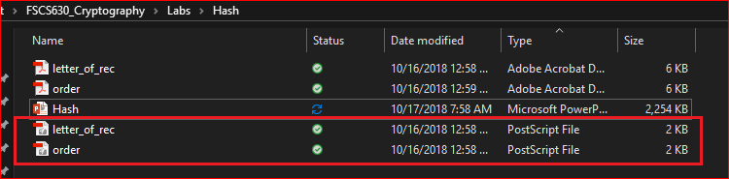
Two PostScript files
Note: You can view PostScript file by double clicking them. Adobe will convert PostScript to pdf
http://web.archive.org/web/20071226014140/http://www.cits.rub.de/MD5Collisions/

Slide 16
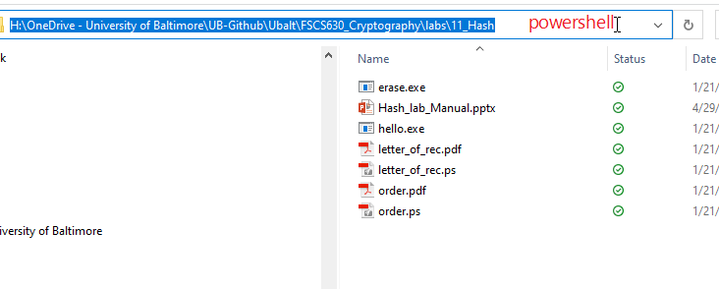
Open powershell terminal

Slide 17
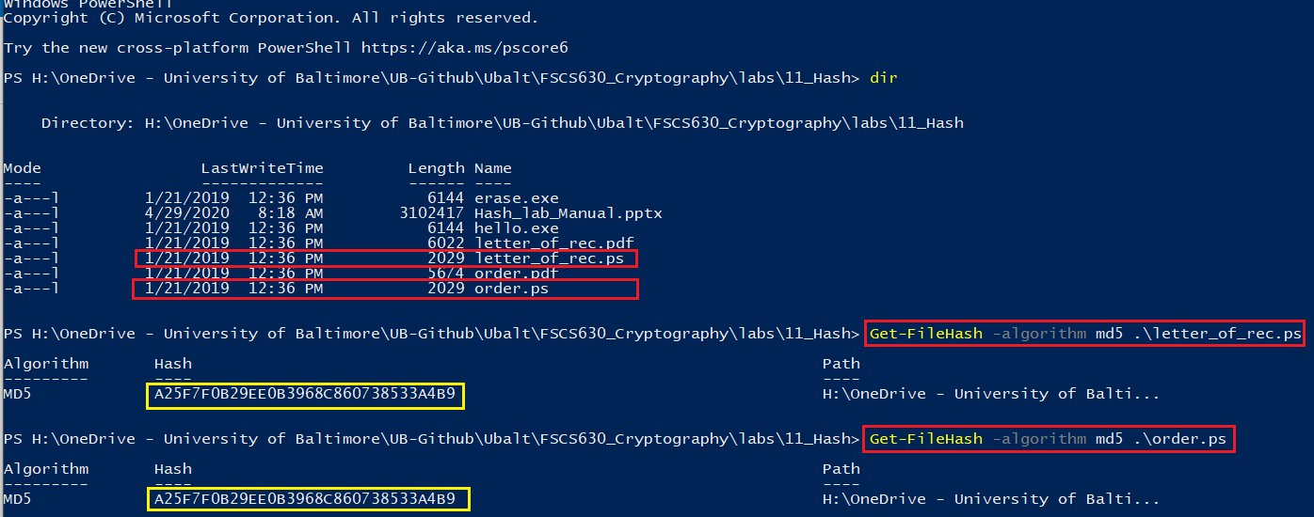
Two files with same MD5

Slide 18
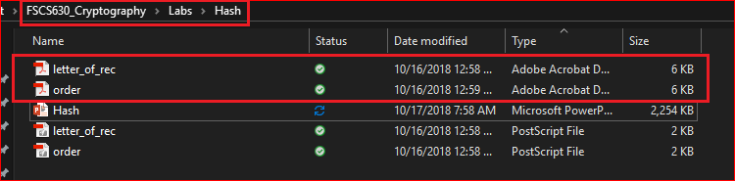
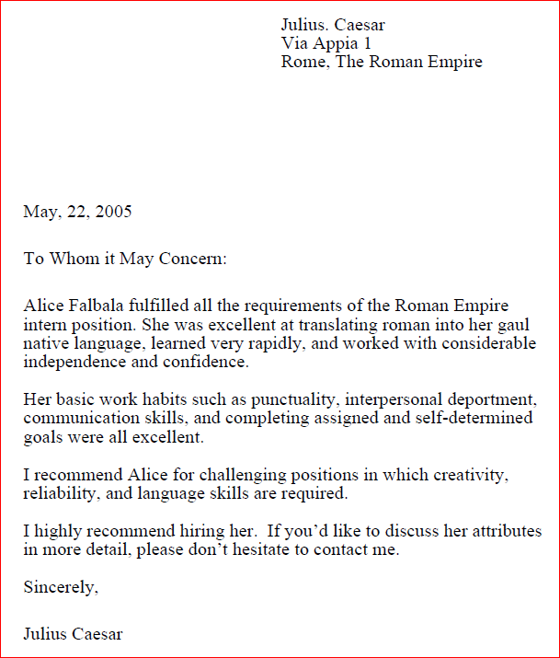
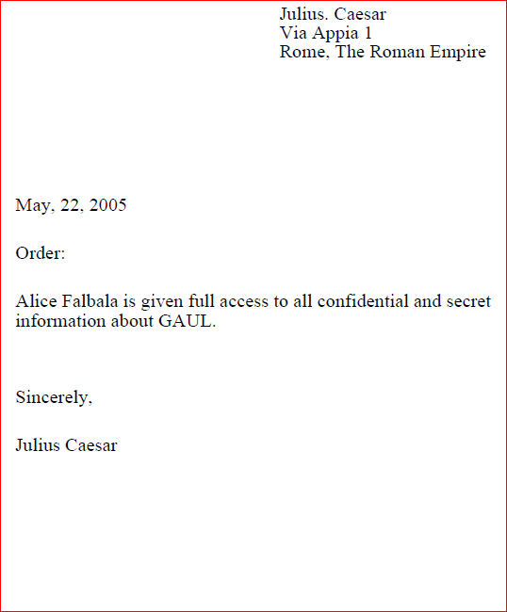
View the corresponding Pdf files

Slide 19
MD5 Collision
Collision-resistance is an essential property for one-way hash functions, but several widely-used one-way hash functions have trouble maintaining this property.
In 2004, Xiaoyun Wang and co-authors demonstrated a collision attack against MD5.
In 2017, CWI Amsterdam and Google Research announced the SHAttered attack, which breaks the collision-resistant property of SHA-1.

Slide 20
Question
Will two files have the same SHA256?

Slide 21
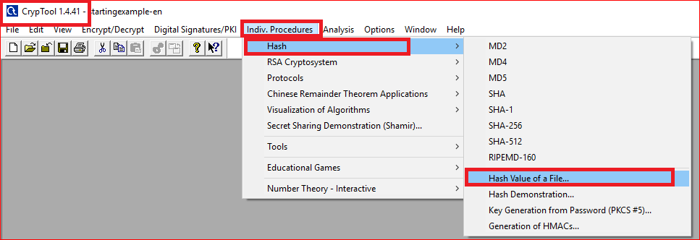
Computing MD5 hash values of two Postscript files (method 1)

Slide 22
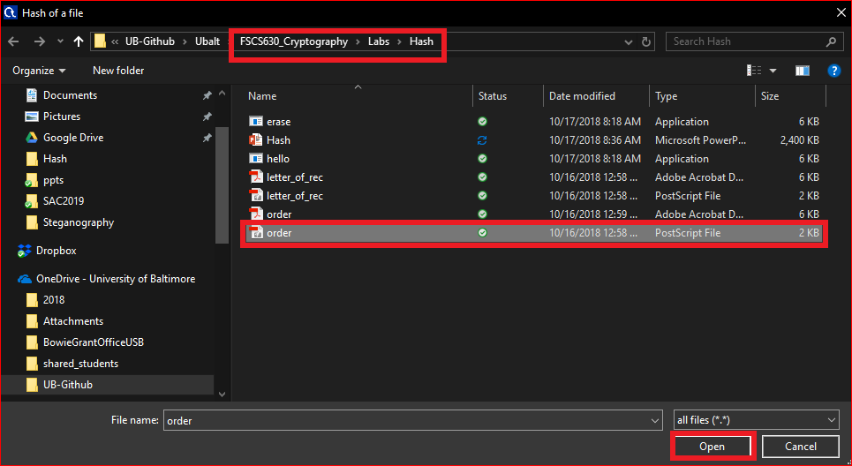
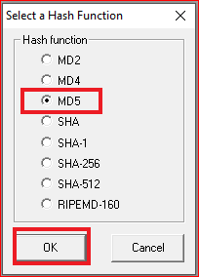
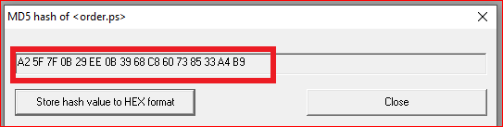

Slide 23
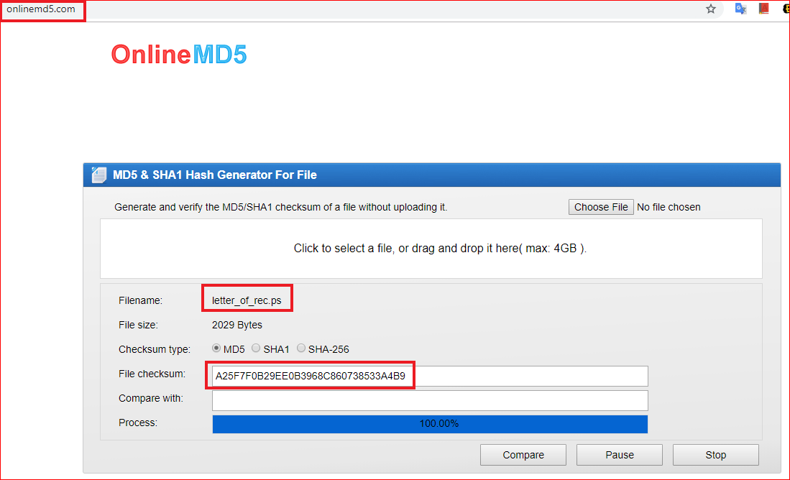
Computing the MD5 hash values of two Postscript files (method 2)

Slide 24
Question
Record both MD5 hash values
Are the two hash values same?

Slide 25
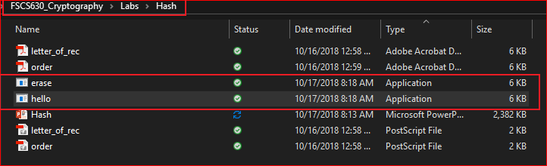
An evil pair of executable programs
https://www.mscs.dal.ca/~selinger/md5collision/

Slide 26
Question
Record both MD5 hash values of executable files
Are the two MD5 hash values same?
Are the two SHA256 hash values same?

Slide 27
Attack on digital signature
Generate a malicious file with the same hash (some digits) of another file

Slide 28
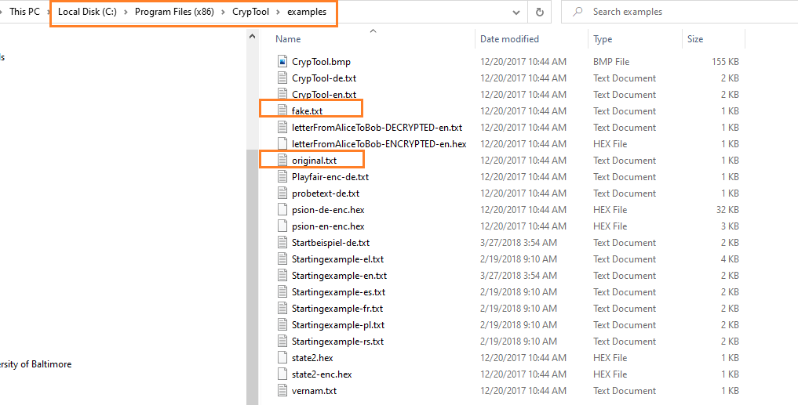
Two files

Slide 29
Goal
Original.txt
Original.txt
Same hashes
fake.txt
fake.txt

Slide 30
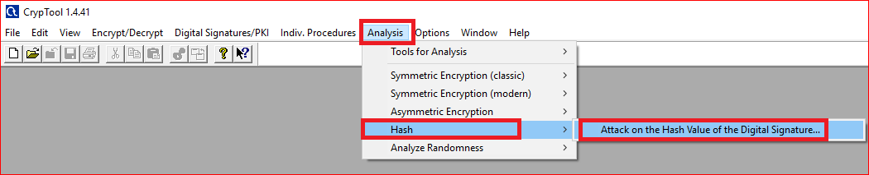

Slide 31
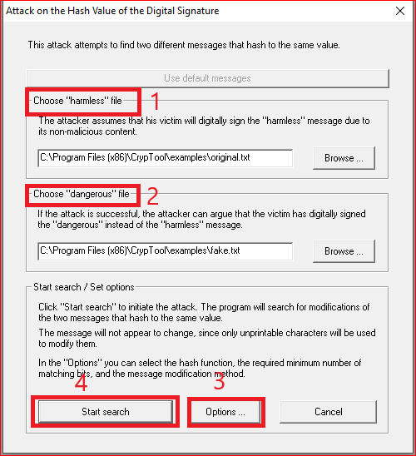
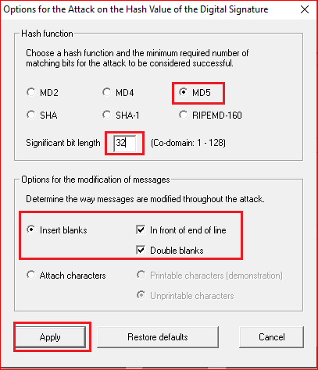

Slide 32
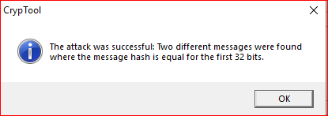
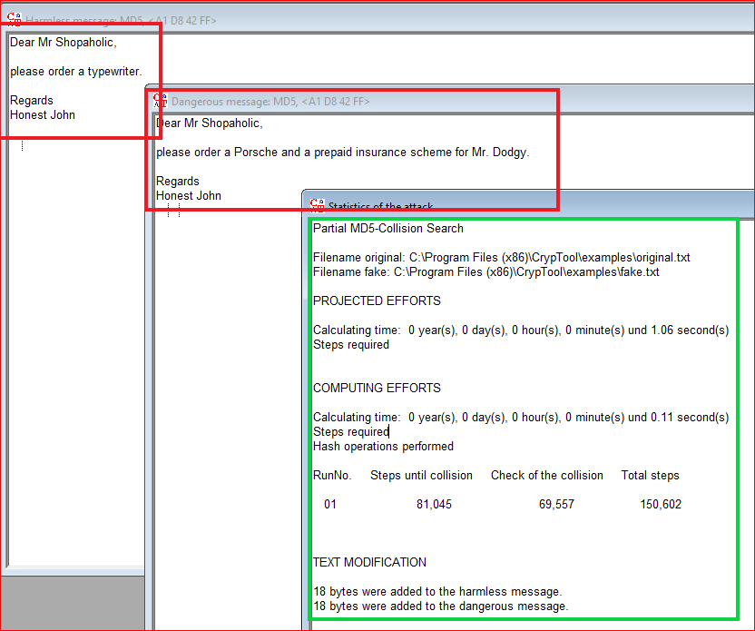
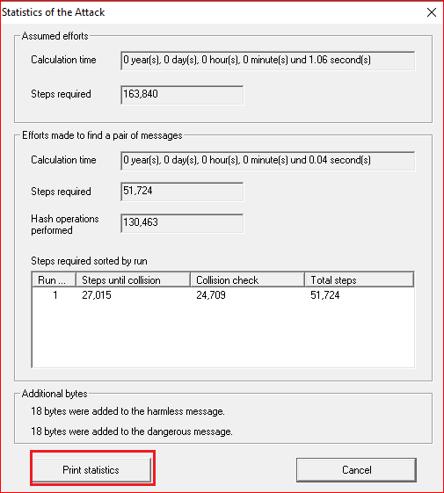

Slide 33
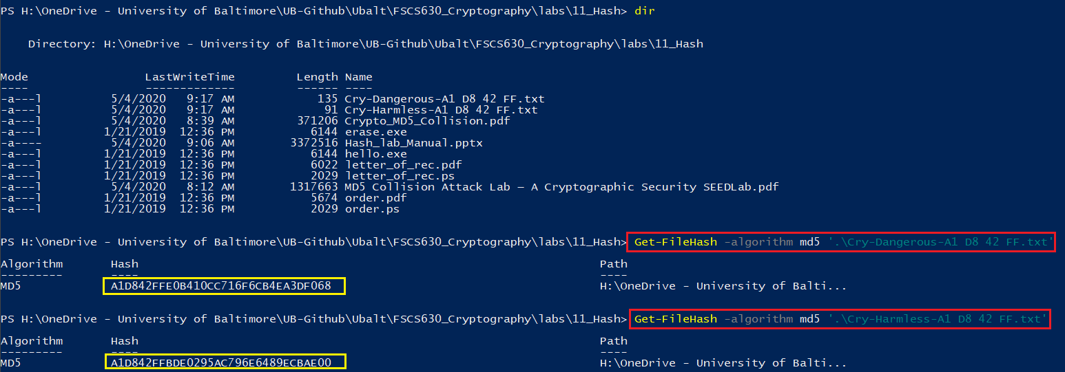

Slide 34
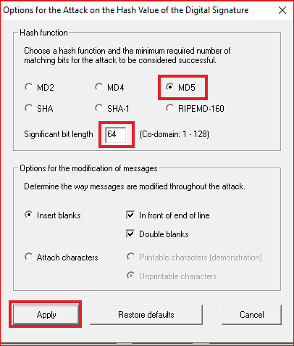
Questions
Change the significate bit length to 64 and 128 bits.
How much time do you need to generate the significant bit length of 64 and 128 bits?

Slide 35
Internal structure of MD5
https://www.slideshare.net/HarryPotter40/hash-crypto?from_action=save

Slide 36
Merkle-Damgard Scheme

Slide 37
MD5

Slide 38
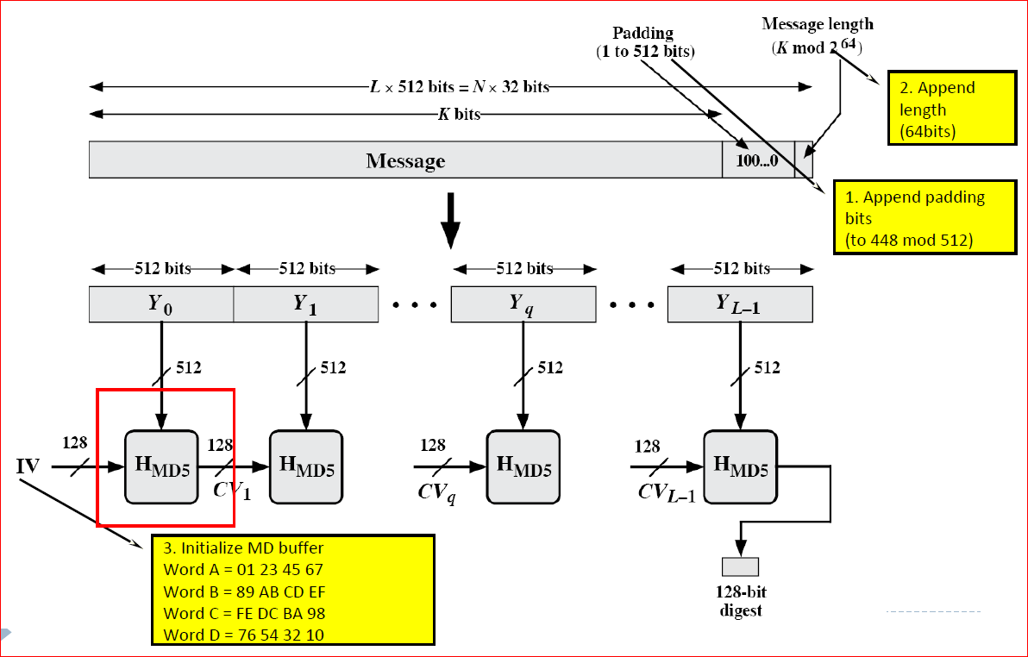

Slide 39
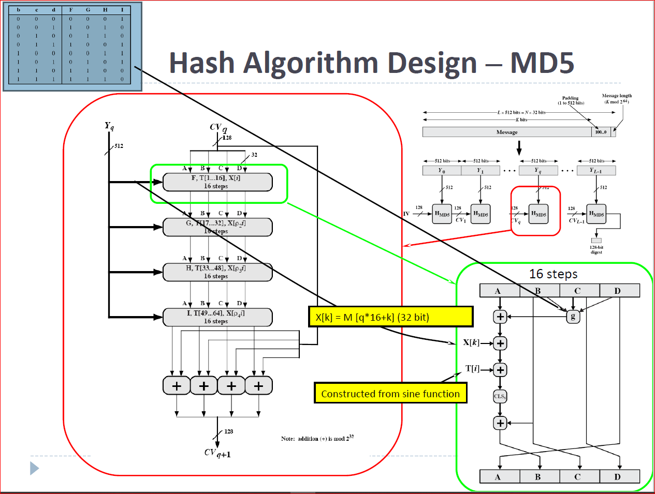

Slide 40
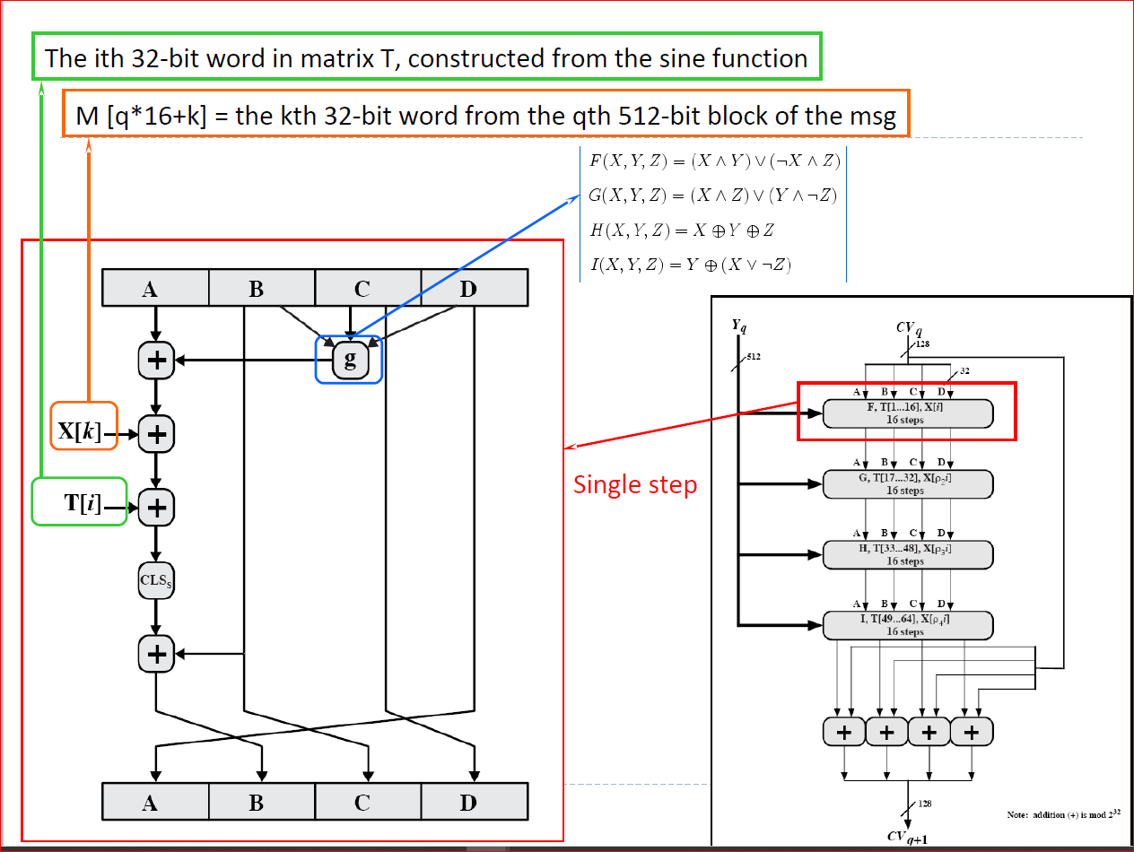

Slide 41
Hash passwords
http://www.unixwiz.net/techtips/iguide-crypto-hashes.html

Slide 42
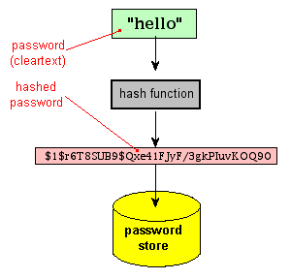
Storing a hash instead of a password (cleartext)

Slide 43
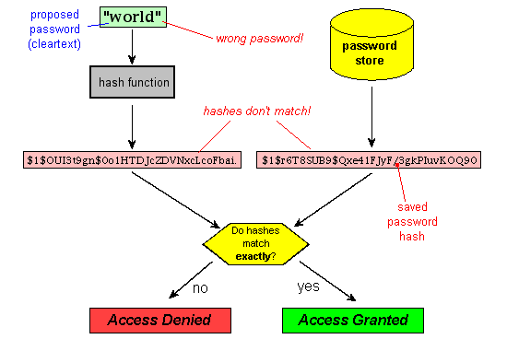
Testing a proposed password against the stored hash

Slide 44
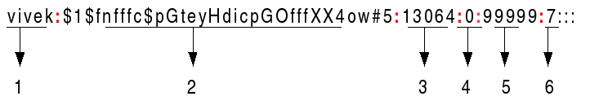
Linux passwords: cat etc/shadow
Username : It is your login name.
Password : It is your encrypted password. The password should be minimum 8-12 characters long including special characters, digits, lower case alphabetic and more. Usually password format is set to $id$salt$hashed, The $id is the algorithm used On GNU/Linux as follows:
$1$ is MD5
$2a$ is Blowfish
$2y$ is Blowfish
$5$ is SHA-256
$6$ is SHA-512

Slide 45
Last password change (lastchanged) : Days since Jan 1, 1970 that password was last changed
Minimum : The minimum number of days required between password changes i.e. the number of days left before the user is allowed to change his/her password
Maximum : The maximum number of days the password is valid (after that user is forced to change his/her password)
Warn : The number of days before password is to expire that user is warned that his/her password must be changed
Inactive : The number of days after password expires that account is disabled
Expire : days since Jan 1, 1970 that account is disabled i.e. an absolute date specifying when the login may no longer be used.

Slide 46
Lab use command line

Slide 47
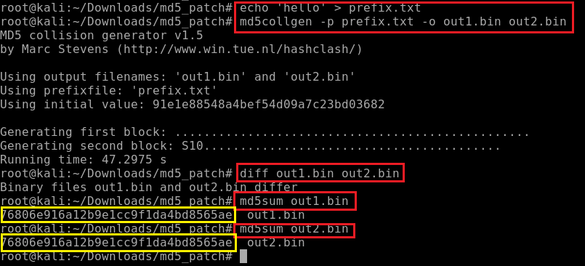

Slide 48


Slide 49
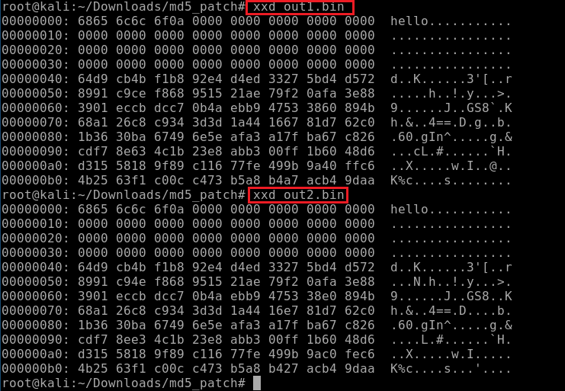

Slide 50
Reference
https://medium.com/@shrutiavinodh/md5-collision-attack-lab-a-cryptographic-security-seedlab-448329a57f9b

