Slide 1
Elliptic Curve Cryptography

Slide 2
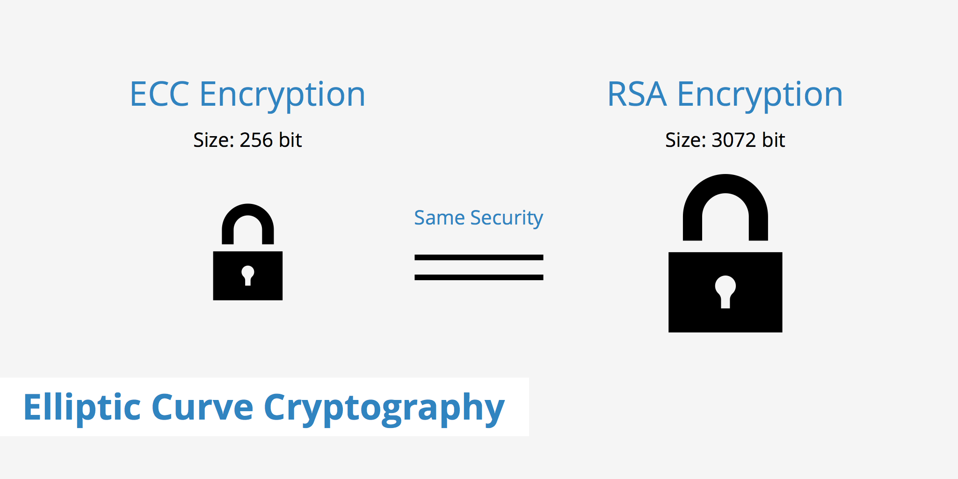
Motivation

Slide 3
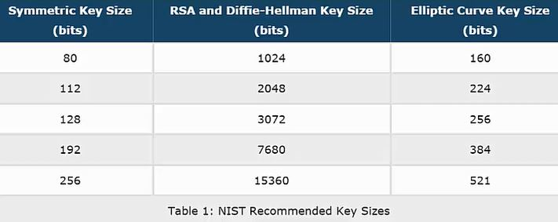

Slide 4
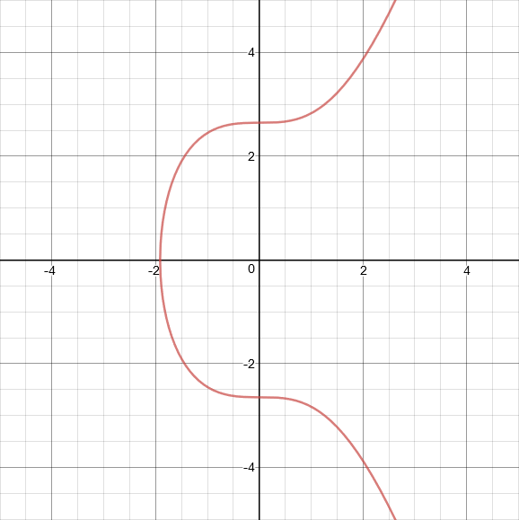
Elliptic Curves for Bitcoin
The elliptic curve used by Bitcoin, Ethereum, and many other cryptocurrencies is called secp256k1. The equation for the secp256k1 curve is y² = x³+7. This curve looks like:
Satoshi chose secp256k1 for no particular reason.

Slide 5
Elliptic Curves In cryptography
Definition: Elliptic Curves over prime fields
The elliptic curve over Z_{p}, p>3 is the set of all pairs (x,y) Z_{p} which fulfill y² = x³ + ax + b mod p together with an imaginary point of infinity θ, where a,b Z_{p} and the condition 4a³+27b² ≠ 0 mod p.
Z_{p} = {0,1,…, p -1} is a set of integers with modulo p arithmetic

Slide 6
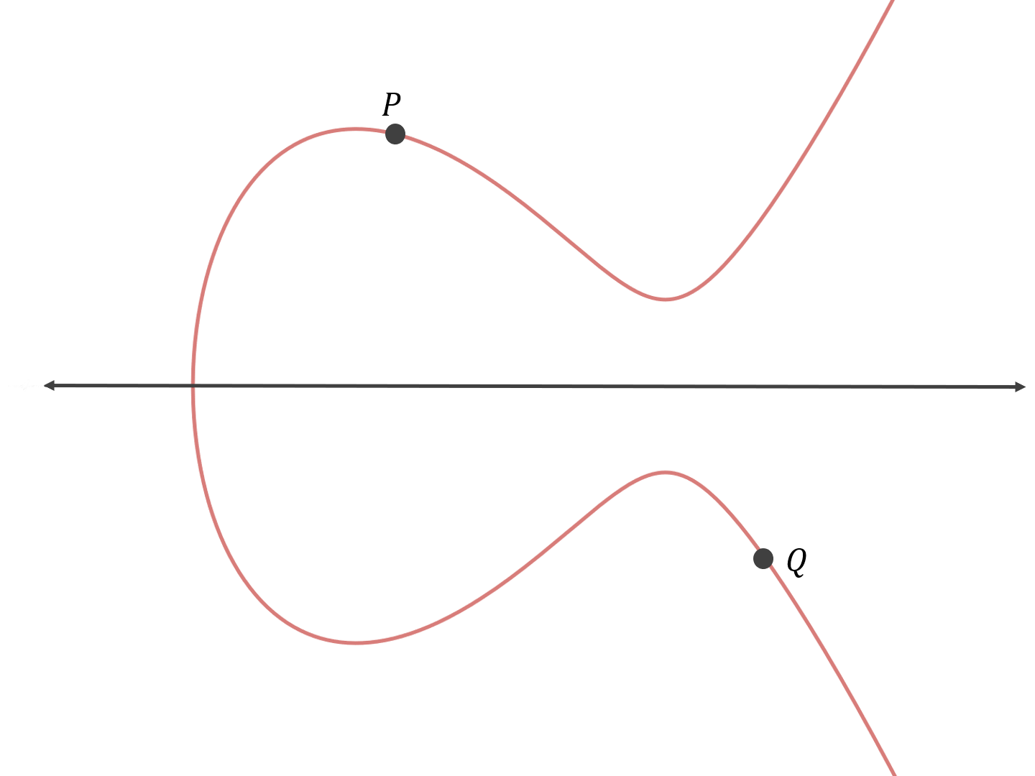
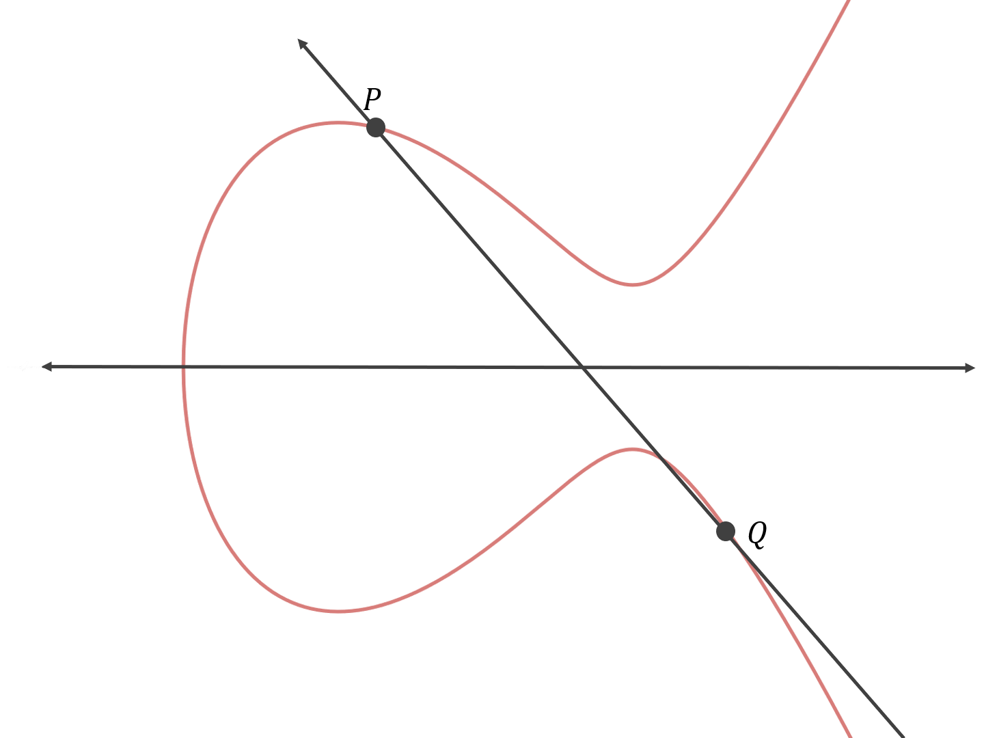
Point addition (P + Q)
find the line that goes through the two points

Slide 7
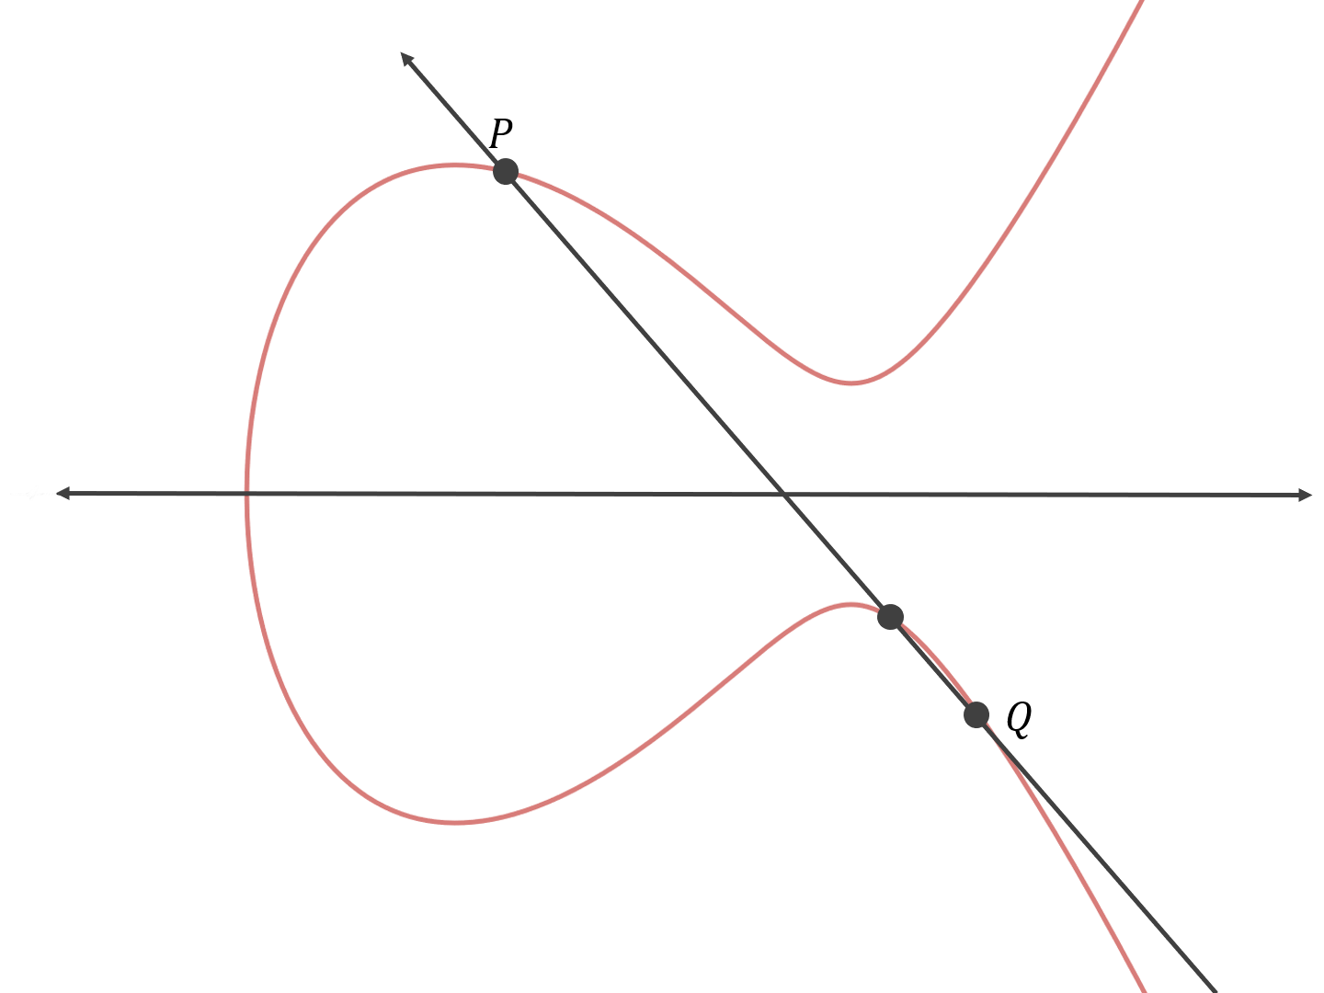
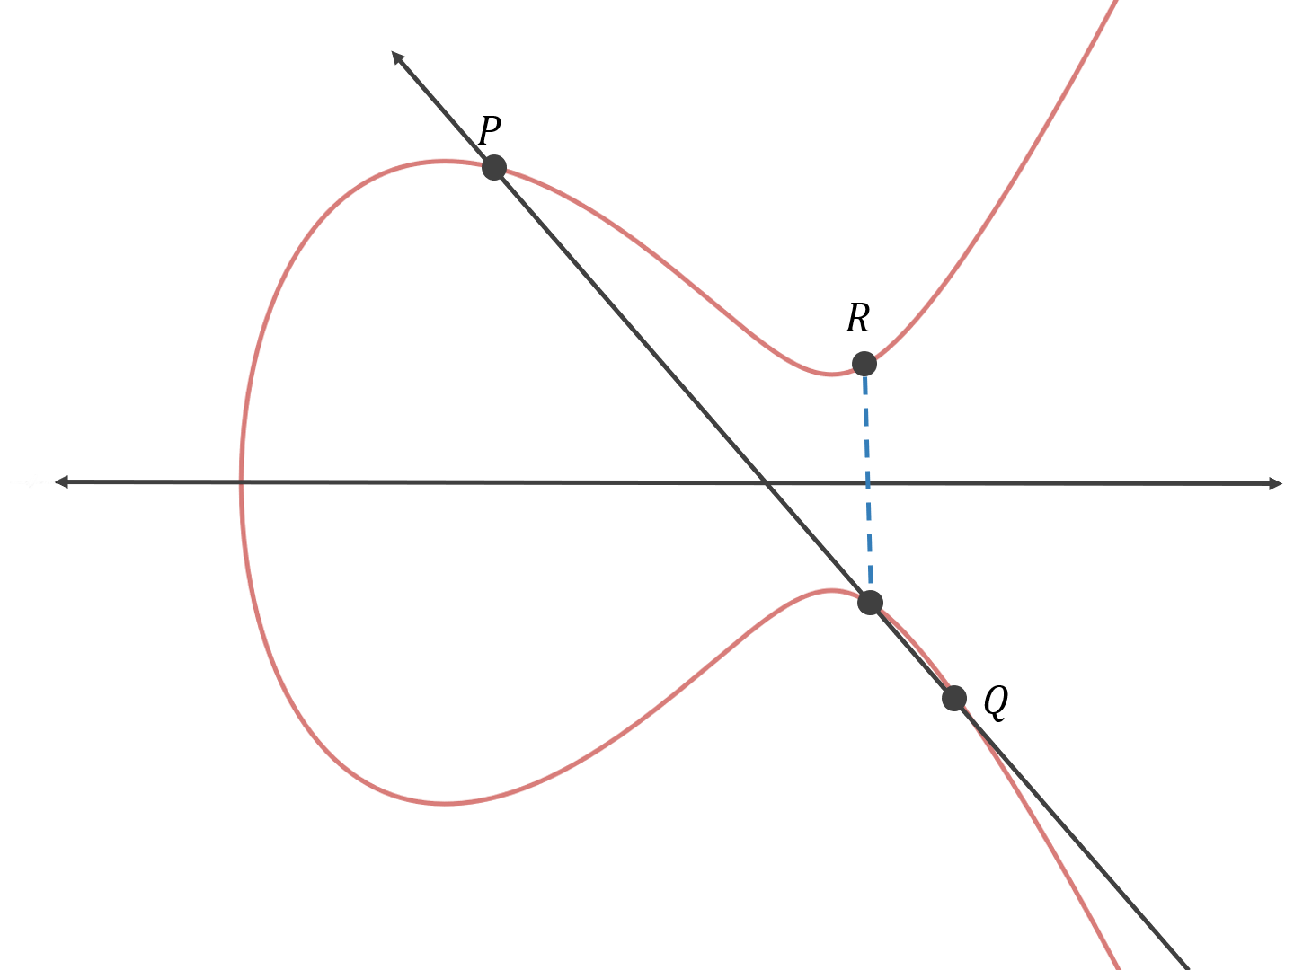
P+Q=R
find the third point on the curve that the line intersects
reflect that point across the x-axis

Slide 8
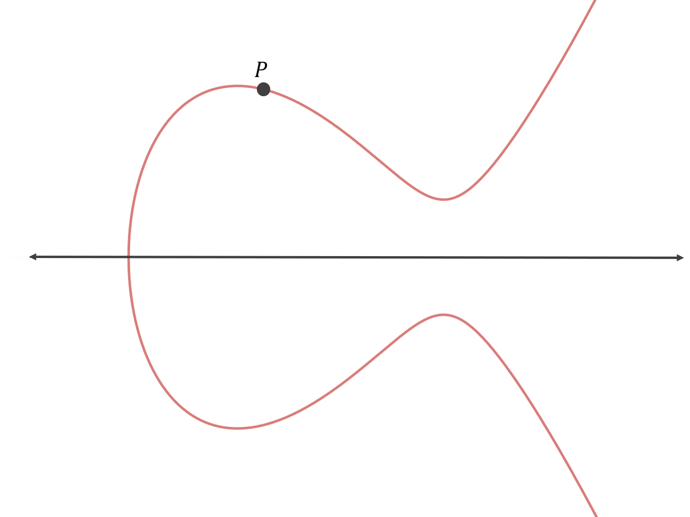
Point addition (P + P)
1•P
To do elliptic curve cryptography properly, rather than adding two arbitrary points together, we specify a base point on the curve and only add that point to itself.

Slide 9
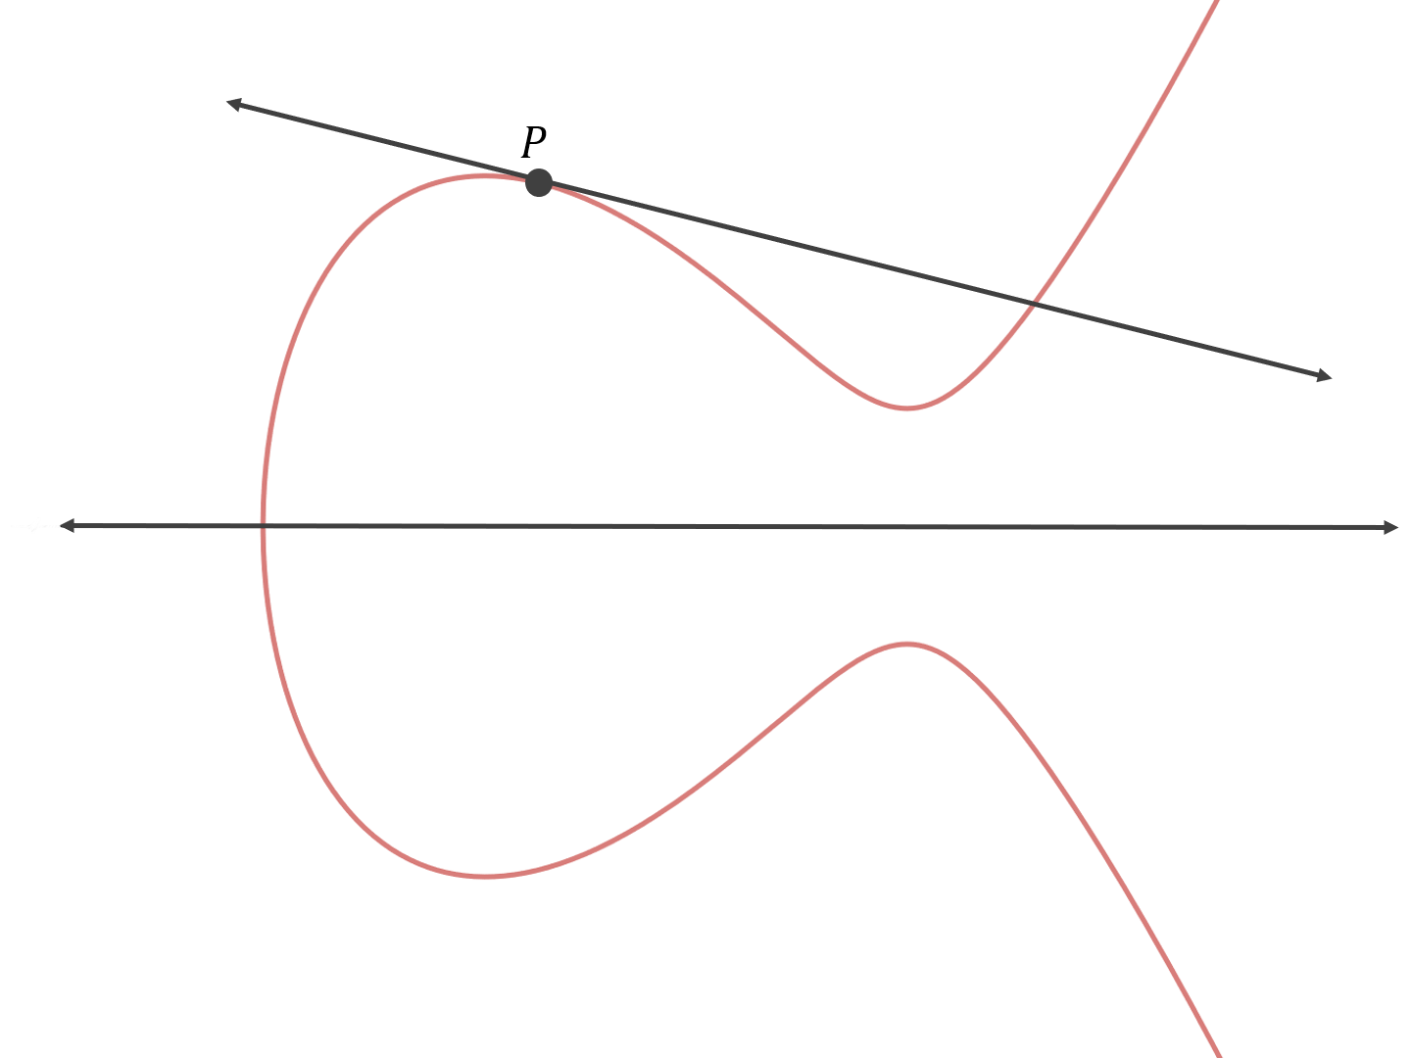
P + P =>tangent line
First, we have to find the equation of the line that goes through P and P. There are infinite such lines! In this special case, we opt for the tangent line.

Slide 10
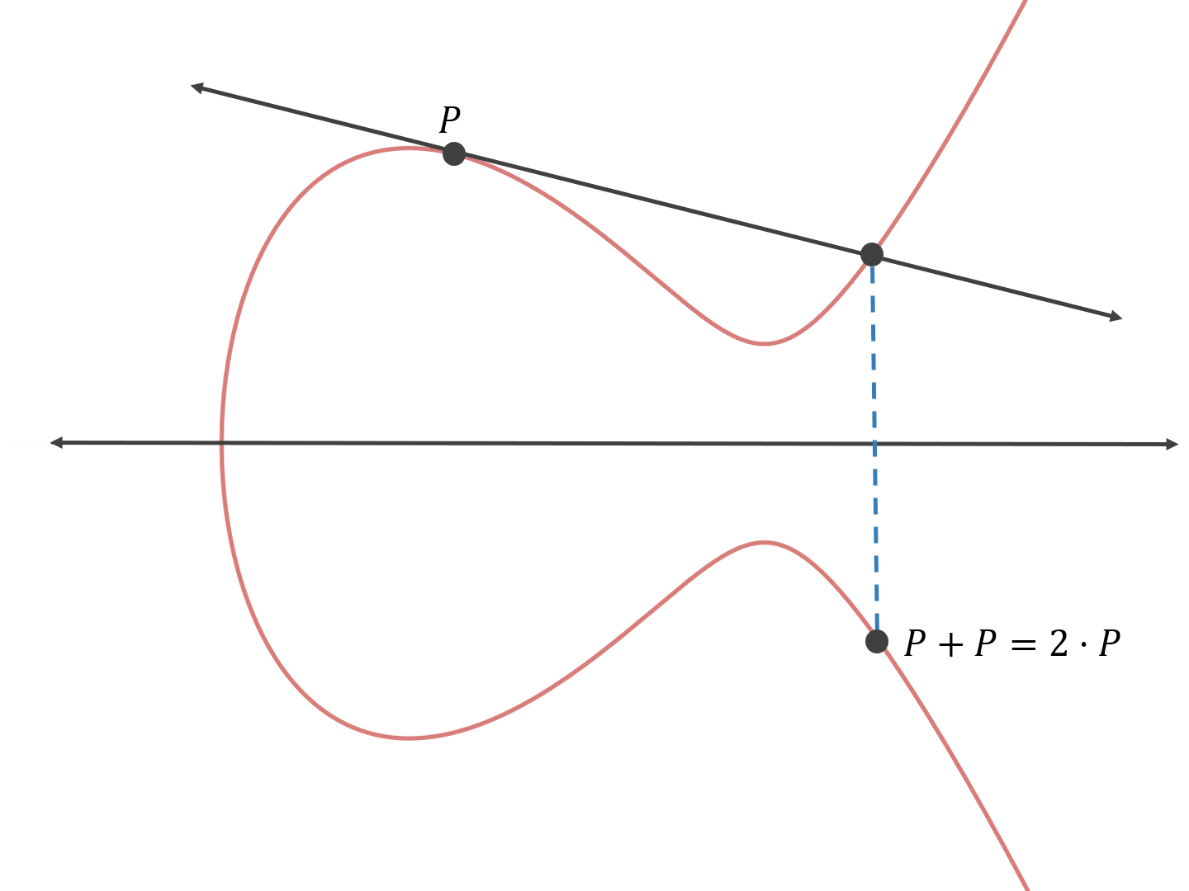
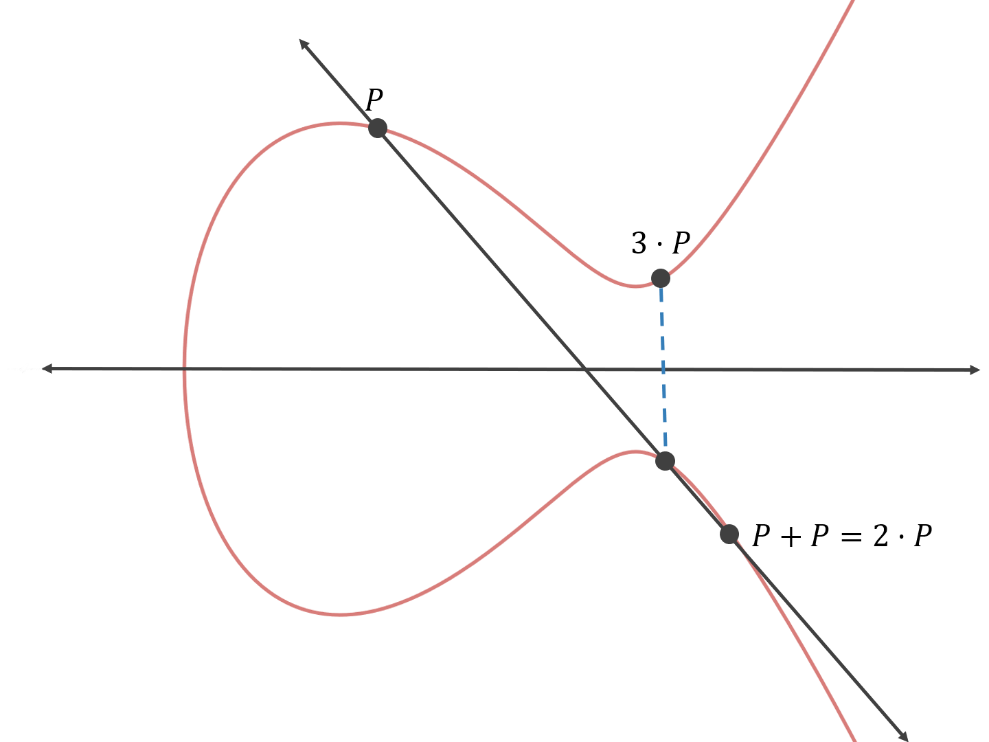
Compute 2P and 3P

Slide 11
Base point for bitcoin
The base point used by secp256k1 curve has the following x- and y- coordinates
x-coordinate: 55066263022277343669578718895168534326250603453777594175500187360389116729240
y-coordinate: 32670510020758816978083085130507043184471273380659243275938904335757337482424

Slide 12
Speeding up point addition
How many steps would it take to compute 10•P?
P+P = 2•P
2•P+2•P = 4•P
4•P+4•P = 8•P
2•P+8•P=10•P

Slide 13
Question
How many steps would it take to compute x•P,
where x is a random 256-bit integer?
x = {0 , 1.1579209e+77}
Steps
2⁰•P, 2¹•P, 2²•P, 2³•P, 2⁴•P, 2⁵•P, 2⁶•P, … , 2²⁵⁵•P.
For example,
if x is 246, the binary expansion will be 2⁷ + 2⁶ + 2⁵ + 2⁴ +2² + 2¹ = 246.
2⁷•P + 2⁶•P + 2⁵•P + 2⁴•P + 2²•P + 2¹•P = 246P

Slide 14
Private and public keys in elliptic curve cryptography
X=n•P
n :private key
X: public key
Given X and P
Could you determine x?
Could you determine how many times I added P to itself to get the point X on the curve?
Not feasible to figure out x, even if you had a super computer.

Slide 15
Why not feasible to figure out x
X=n•P
There is no known algorithm
Only option is to keep adding P to itself until you get X or keep subtracting P from X until you get P.
On average, x will be somewhere between 0 and 2²⁵⁶-1
take on average 2¹²⁸ point addition operations to determine x

Slide 16
Reference
https://hackernoon.com/what-is-the-math-behind-elliptic-curve-cryptography-f61b25253da3

