Slide 1
Share Folders between Host and Guest OS in VirtualBox

Slide 2
Introduction

Slide 3
Goal
What is a host machine?
What is guest OS?
Share files between Guest OS and Host in VirtualBox

Slide 4
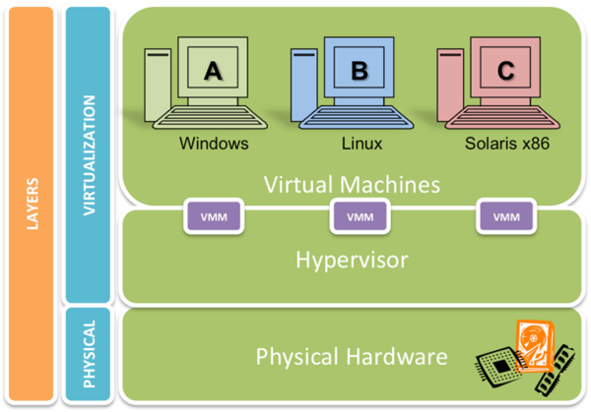
A hypervisor/Virtual machine manager is a process that separates a computer's operating system and applications from the underlying physical hardware.
C:\Users\Fxu\Desktop\FrankShared
https://wiki.xenproject.org/images/thumb/0/01/HelloXenProject-1-4.png/600px-HelloXenProject-1-4.png

Slide 5
Crate a folder on Host

Slide 6
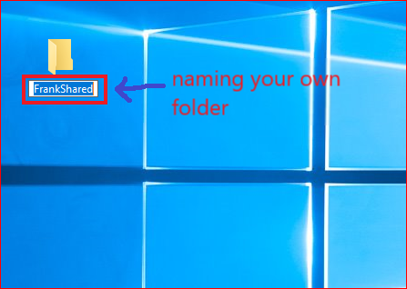
Host machine

Slide 7
Share folders between Windows 10 Guest VM and Host

Slide 8
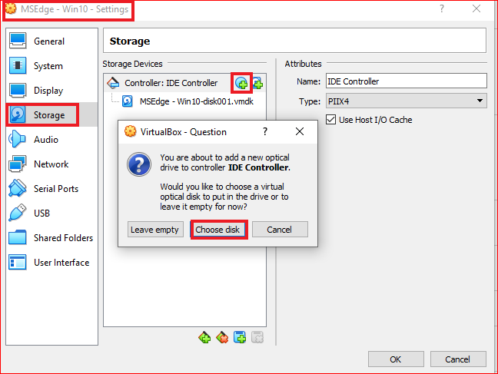
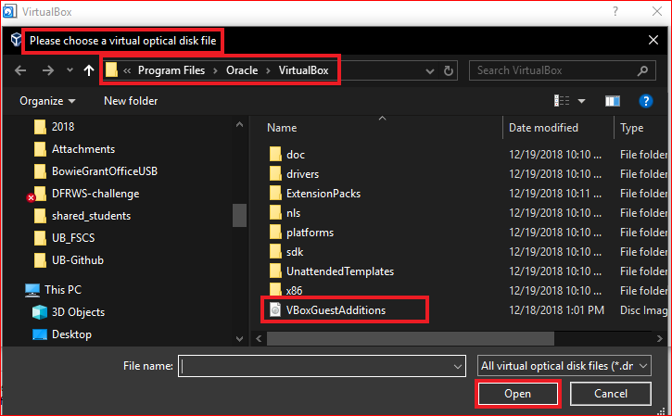
Install an optical disk

Slide 9
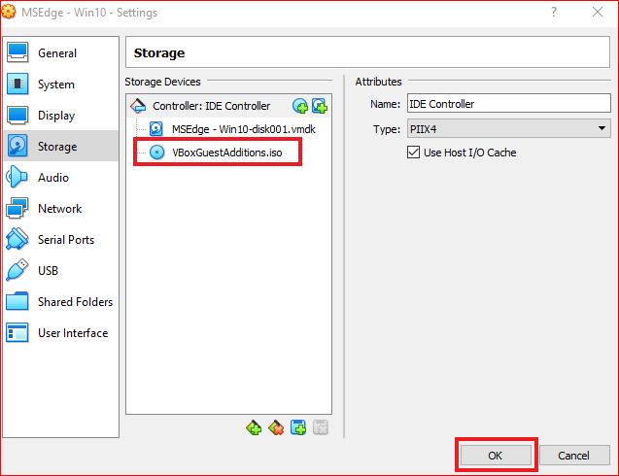

Slide 10
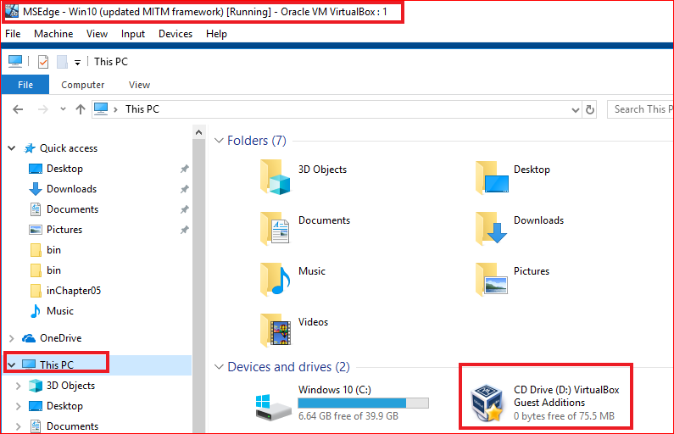
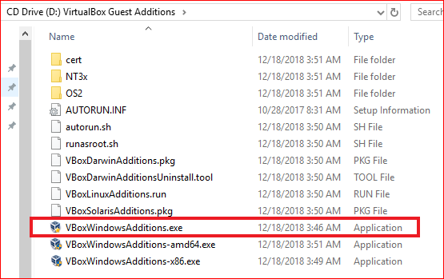
Install Guest Additions

Slide 11
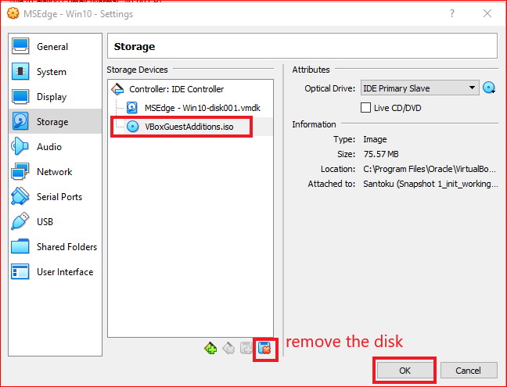
Remove the disk after installation

Slide 12
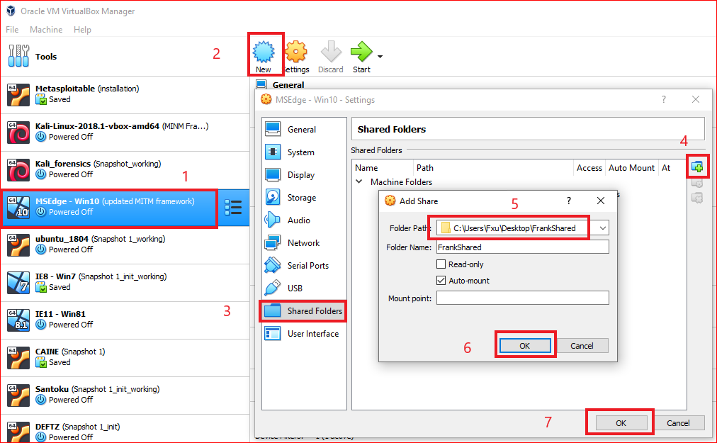
Link the shared folder to Windows Guest

Slide 13
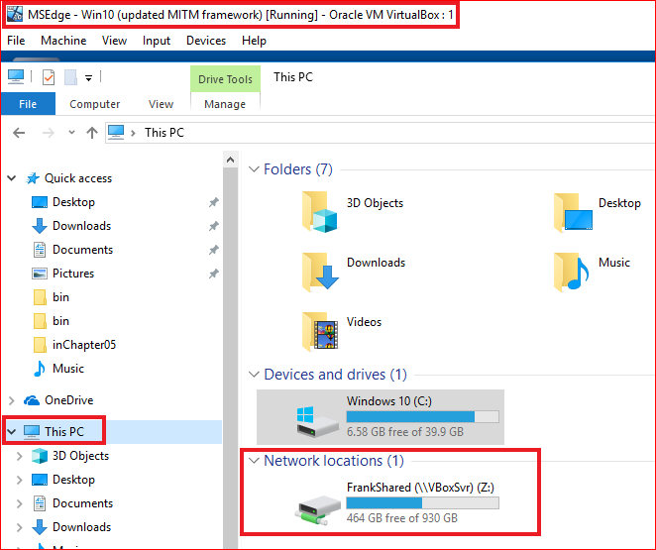

Slide 14
Share folders between Kali Guest VM and Host

Slide 15
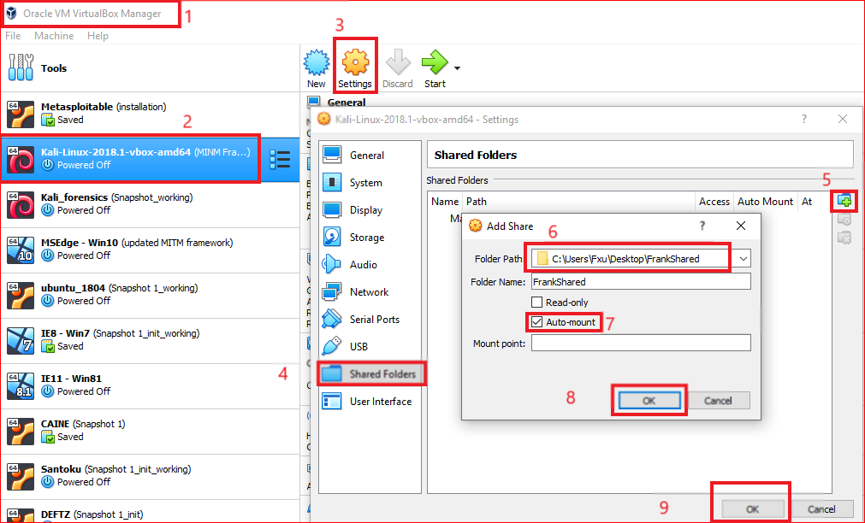

Slide 16
Move VBoxGuestAdditions.iso to Kali using a USB
Find VBoxGuestAdditions.iso location
Copy VBoxGuestAdditions.iso to a USB
Connect USB to Kali
Copy VBoxGuestAdditions.iso to Kali \Desktop

Slide 17
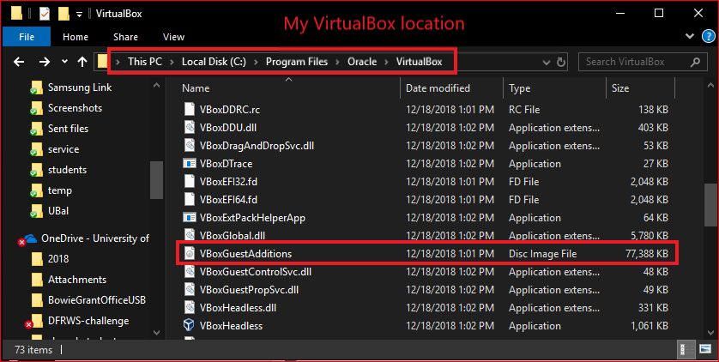
Find the virtualBox location in Host

Slide 18
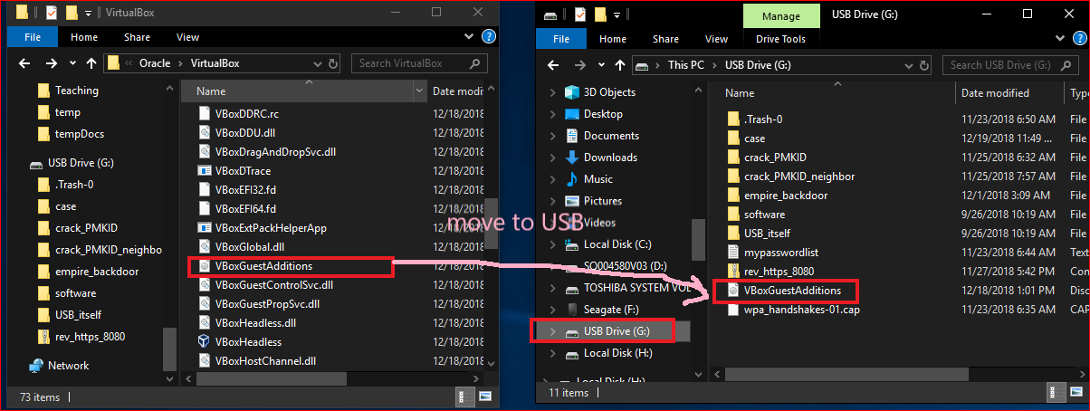
Copy VBoxGuestAdditions.iso to a USB

Slide 19
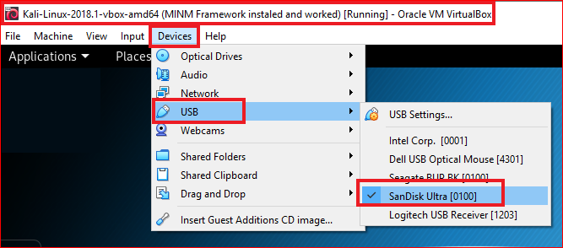
Connect USB to Kali

Slide 20
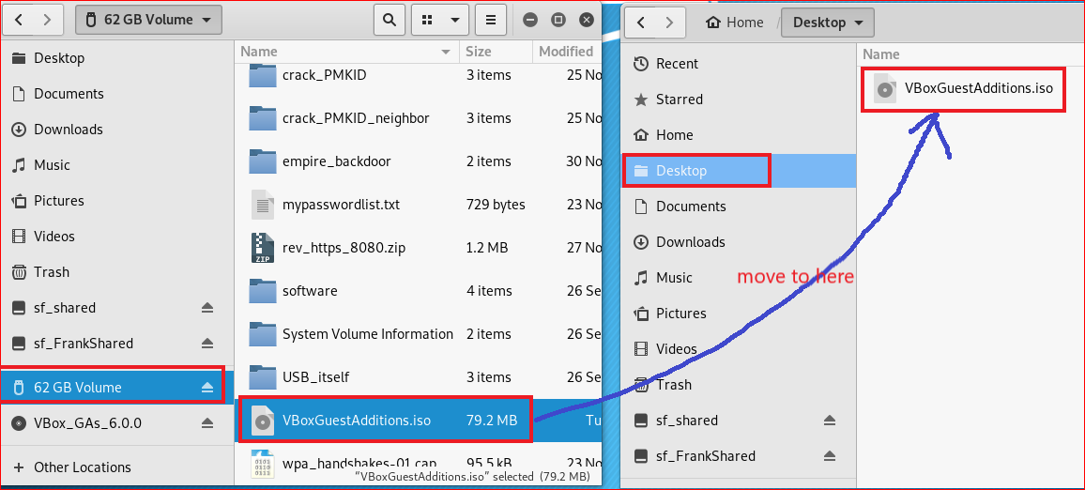
Copy VBoxGuestAdditions.iso to Kali \Desktop

Slide 21
Install Guest addition for Kali
Mount .iso to Kali (Similar to attack an optical disk)
Install Guest additions software

Slide 22
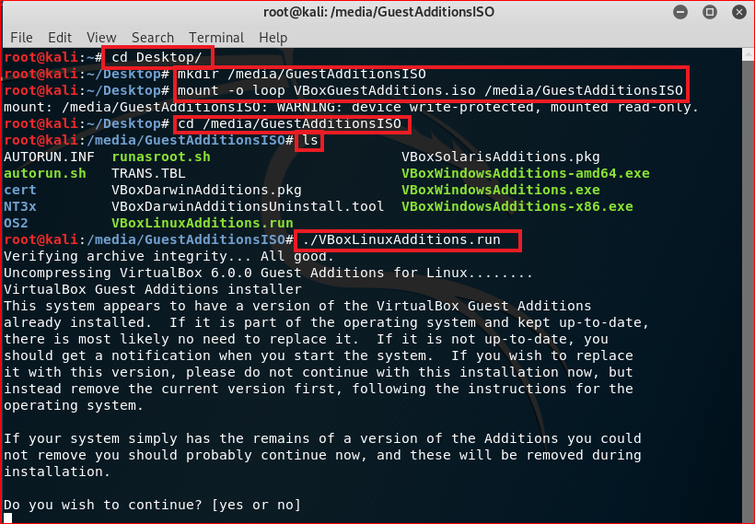
Notes:
mkdir /media/GuestAdditionsISO
mount -o loop path/to/VBoxGuestAdditions.iso /media/GuestAdditionsISO
cd /media/GuestAdditionsISO
./VBoxLinuxAdditions.run

Slide 23
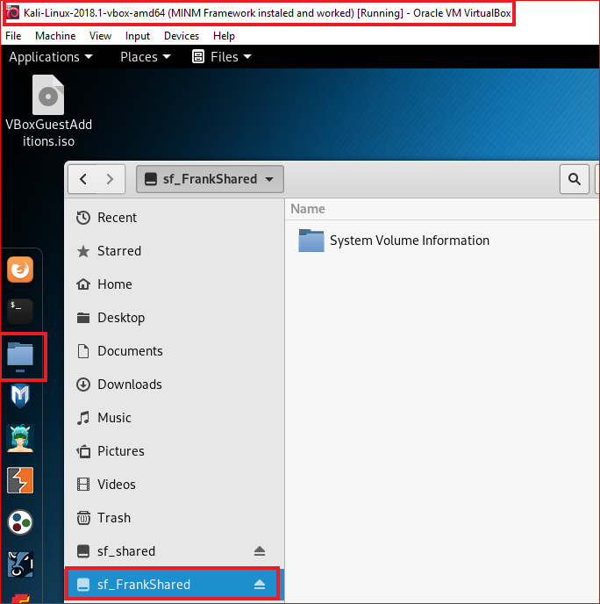
The shared folder is an external hard disk

Slide 24
Reference
https://helpdeskgeek.com/virtualization/virtualbox-share-folder-host-guest/
https://askubuntu.com/questions/161759/how-to-access-a-shared-folder-in-virtualbox
https://www.blackmoreops.com/2017/01/24/install-virtualbox-guest-additions-in-kali-linux/

