Slide 1
Keylogger

Slide 2
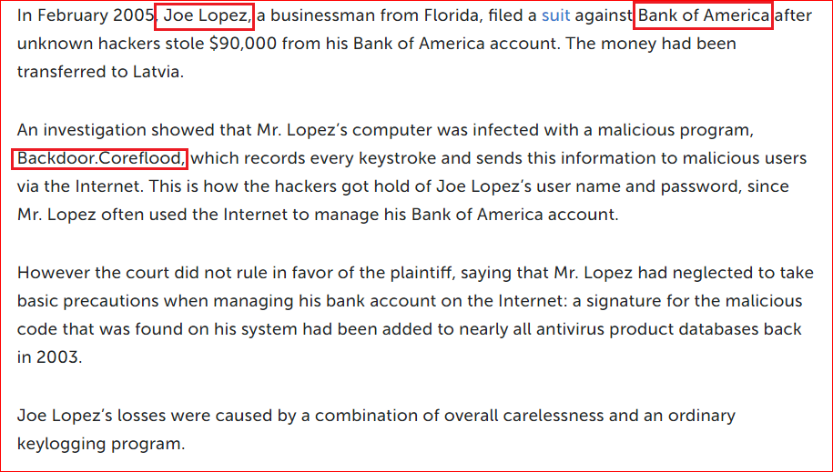
Case study: Bank of America vs. Joe Lopez
https://securelist.com/keyloggers-how-they-work-and-how-to-detect-them-part-1/36138/

Slide 3
Introduction

Slide 4
What is keylogger?
Keystroke logging
keylogging or keyboard capturing,
the action of recording the keys struck on a keyboard
Person using the keyboard is unaware that their actions are being monitored.
Data can then be retrieved by the person operating the logging program.
A keylogger can be either software or hardware.

Slide 5
Lab

Slide 6
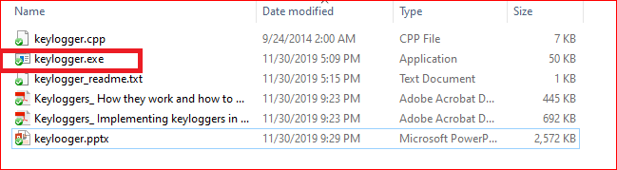
Trigger the keylogger
Click the keylogger
Open your browser, type anything
Keylogger will capture your typing and save it in a file

Slide 7
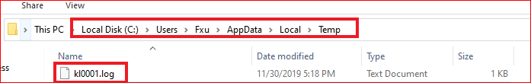
Location of the saved file
In your local folder

Slide 8
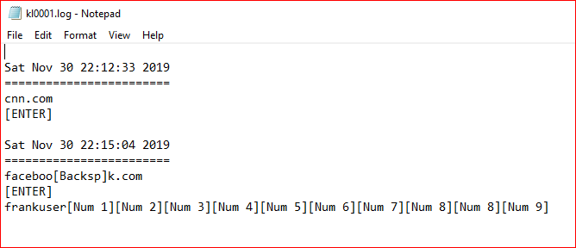
Logged file

Slide 9

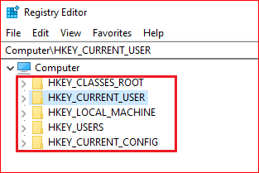
Backdoor Persistence

Slide 10
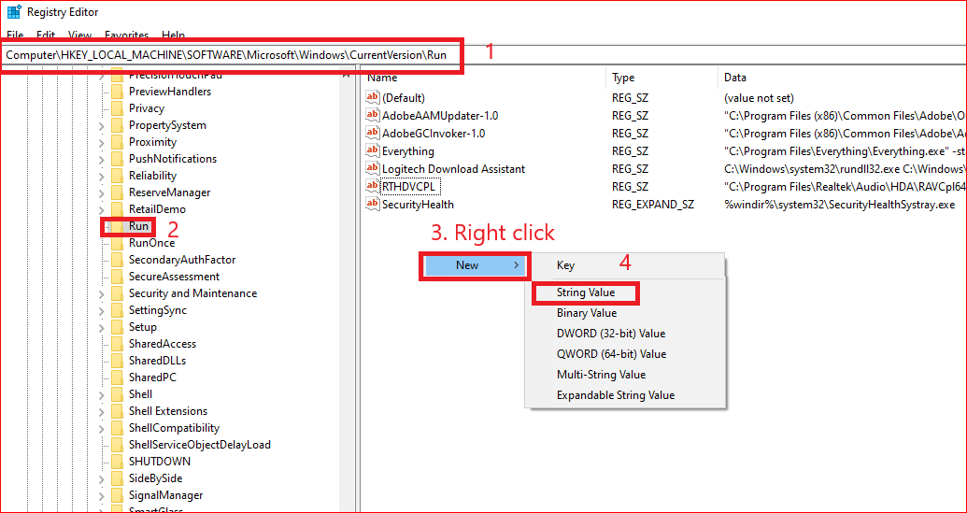
Add autorun for the backdoor

Slide 11
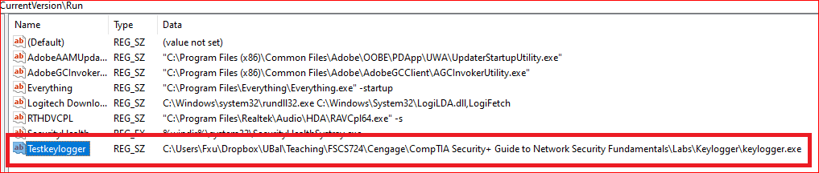
Add a key

Slide 12
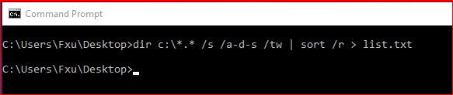
How to detect? (Method 1– Monitor files)
/s | search
/a | attribute
/a-d | Not include directory
/a-d-s | Not include system files
/t | Timestamp
/tw | Last write time

Slide 13
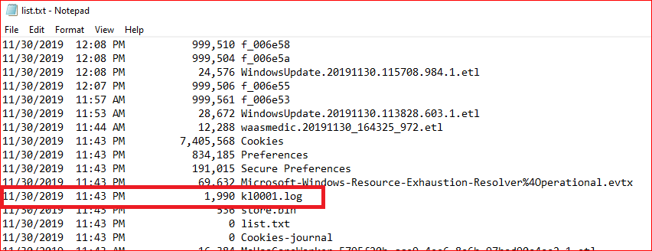

Slide 14
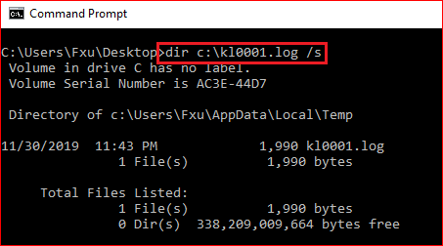
Where is the log file located?

Slide 15
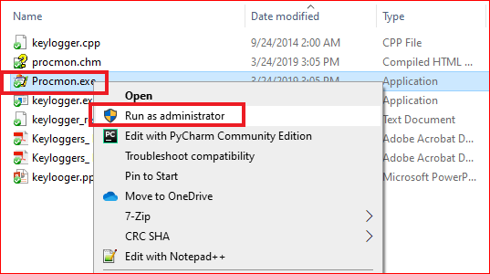
How to detect? (Method 2– Monitor process)
Download procmon
https://docs.microsoft.com/en-us/sysinternals/downloads/procmon

Slide 16
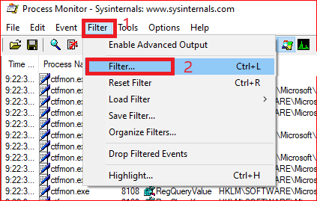
Filter process by path

Slide 17
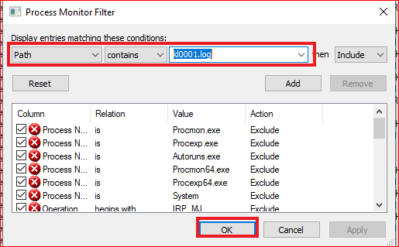
Add conditions

Slide 18
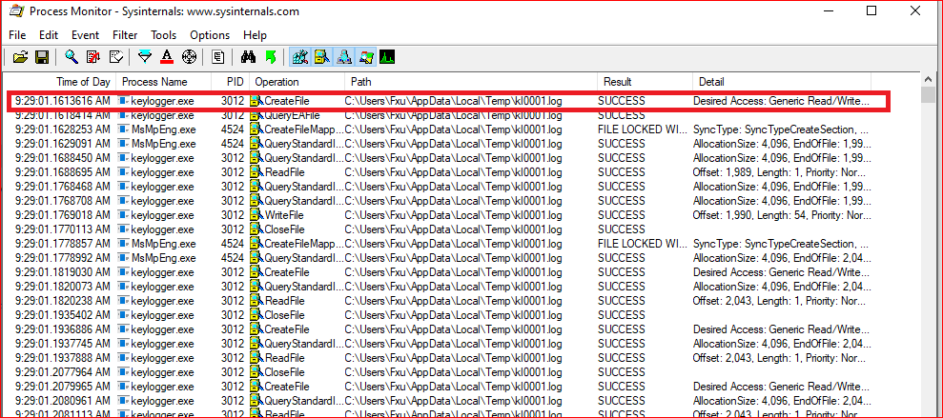
Show processes

Slide 19
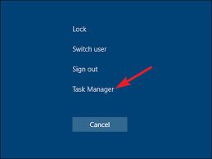
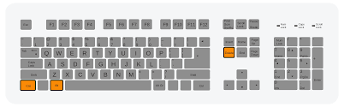
Find the keylogger (Method 3– Monitor files)

Slide 20
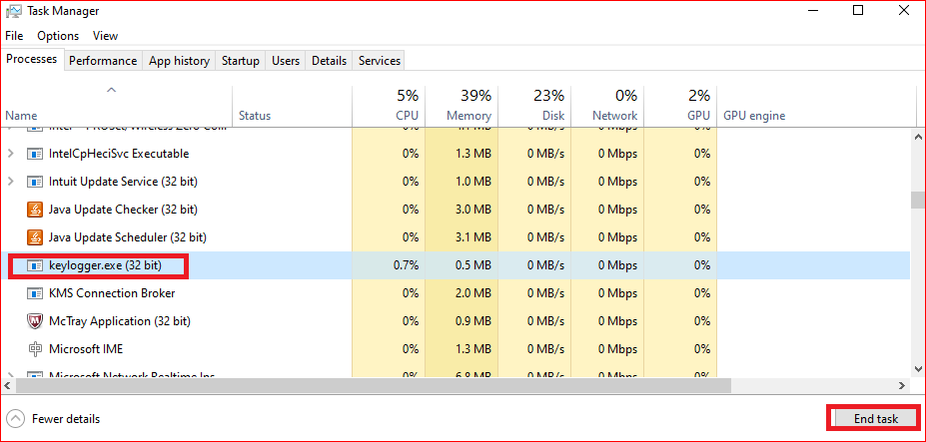
Stop the keylogger

Slide 21
Reading
http://winsec.se/?cat=173

