Slide 1
APR Spoofing using arpspoof commands

Slide 2
What is ARP spoof

Slide 3
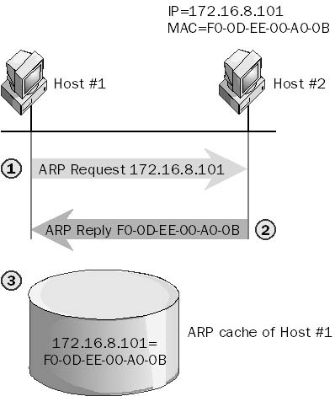
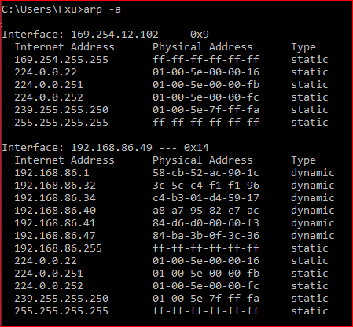
Address Resolution Protocol (ARP)
If the I P address for a device is known but the M A C address is not, the sending computer sends an A R P packet to determine the M A C address
M A C addresses are stored in an A R P cache for future reference
All computers that “hear” the A R P reply also cache the data
https://www.youtube.com/watch?v=RTXAUJ2yqCg

Slide 4




Address Resolution Protocol (ARP) Poisoning
I am at
Victim: 10.0.2.15
Kali: 10.0.2.10
I am at
10.0.2.1
10.0.2.1
The root cause of ARP
Client accept any response even if they did not send a request
Client doesn’t verify any response
Victim: 10.0.2.15

Slide 5
Information gathering

Slide 6
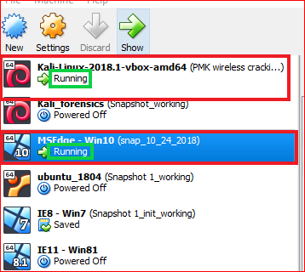

Slide 7
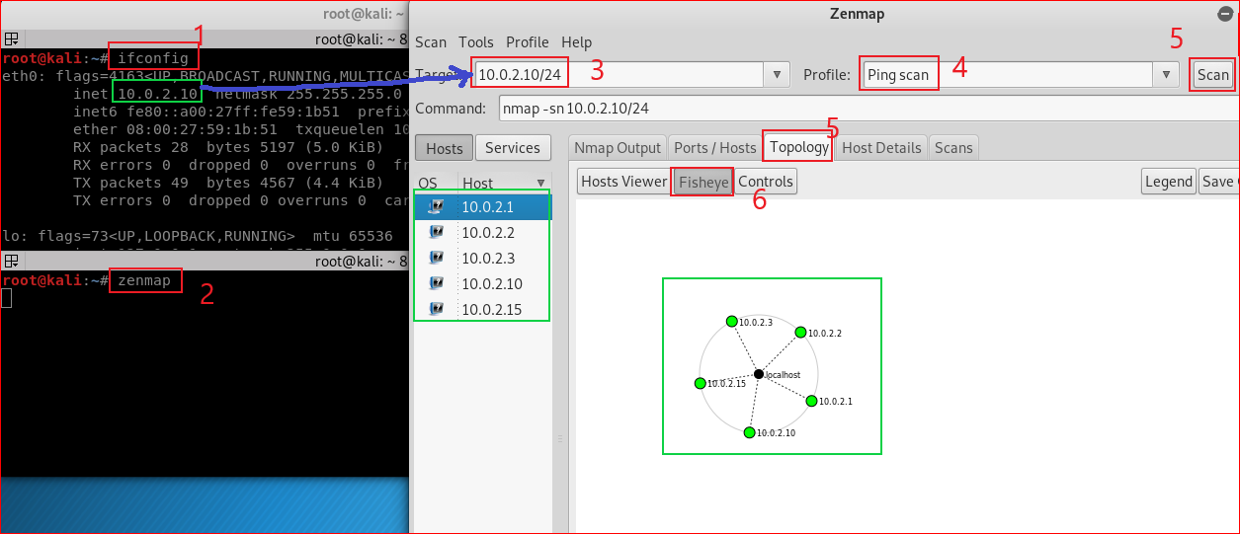

Slide 8
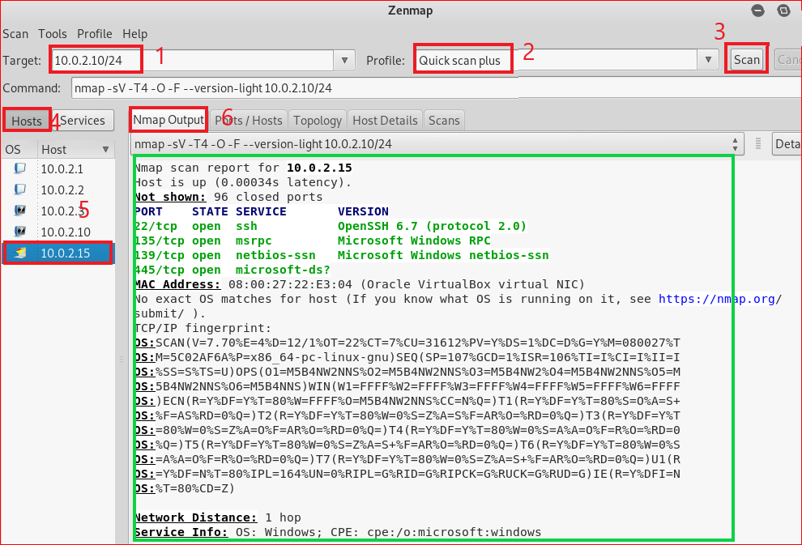

Slide 9
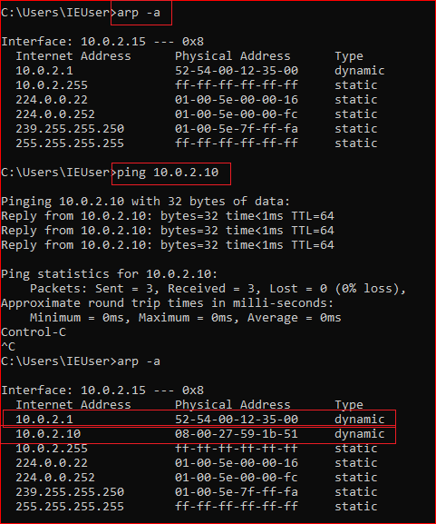
Windows 10 ARP table
Before MINT attack

Slide 10
ARP MITM attack

Slide 11
Address Resolution Protocol (ARP) Poisoning
arpspoof [-i interface] [-c own|host|both] [-t target] [-r] host
arpspoof -i eth0 -t 10.0.2.1 10.0.2.15
I am at
Victim: 10.0.2.15
Kali: 10.0.2.10
I am at
10.0.2.1
arpspoof -i eth0 -t 10.0.2.15 10.0.2.1
10.0.2.1
Victim: 10.0.2.15

Slide 12
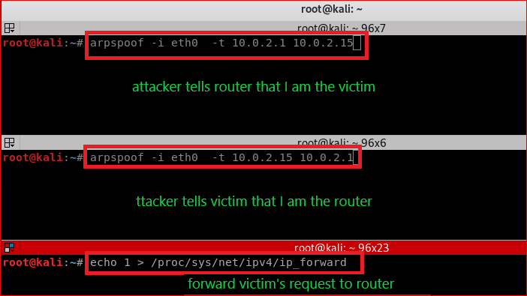
enter
enter

Slide 13
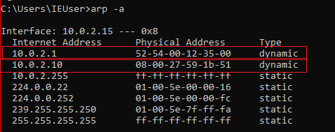
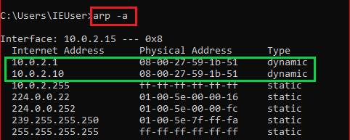
Before MINT attack
After MINT attack

Slide 14
Question: Can you access ubalt.edu now?
NO!
Why?
How to fix it?
Forward the victim’s request to router
echo 1 > /proc/sys/net/ipv4/ip_forward
Notes:
Attacker receives the requests from the victim. Nothing more!

Slide 15
