Slide 1
Detecting APR Spoofing using xarp

Slide 2
What is ARP spoof

Slide 3




Normal Routing Operation
user
gateway
ARP Poisoned Routing
user
gateway
Malicious user

Slide 4
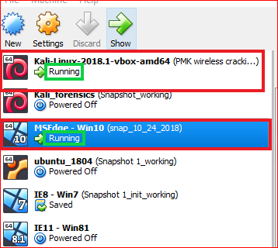

Slide 5
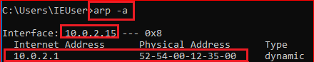

Normal Routing Operation
user
gateway
ARP Poisoned Routing
user
gateway
Malicious user

Slide 6
Detecting ARP poisoning

Slide 7
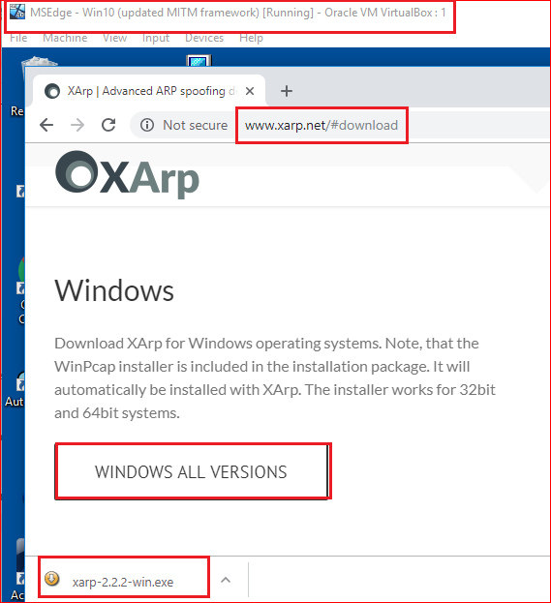

Slide 8
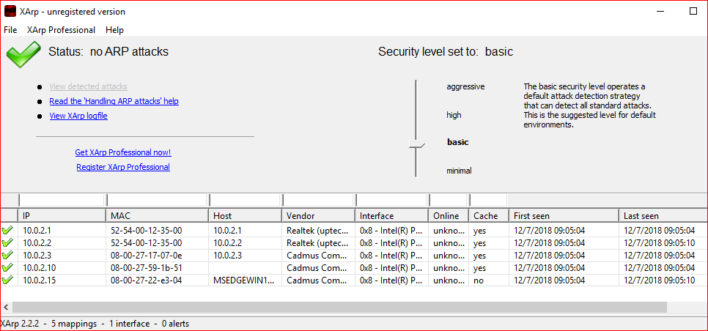

Slide 9
ARP MITM attack

Slide 10
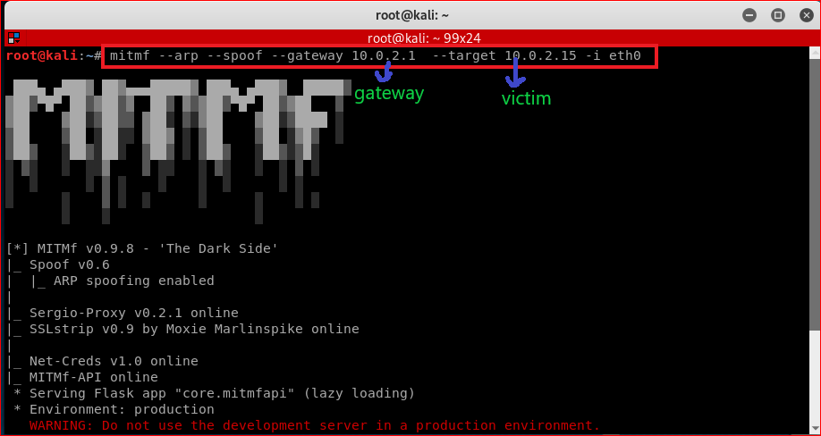
Attacking

Slide 11
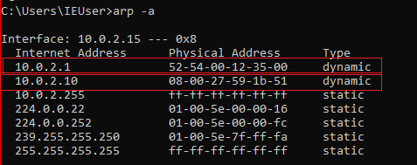
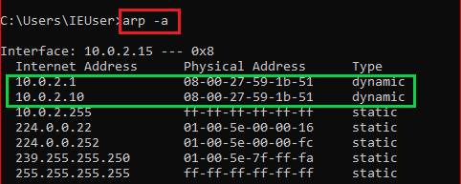
MAC address use Victim’s PC (Before and after attack)

Slide 12
ARP Detection

Slide 13
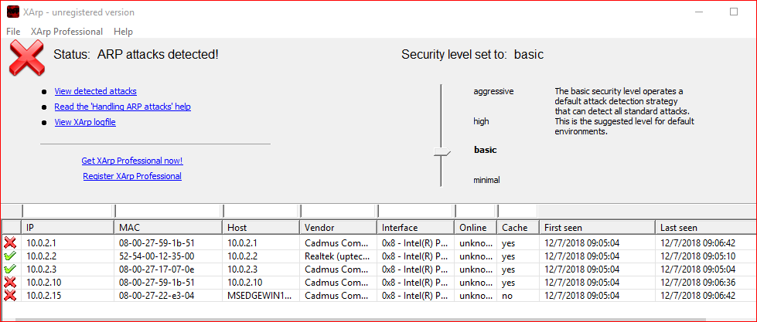

Slide 14
Trouble shootings

