Slide 1
APR Spoofing using mitm Framework

Slide 2
What is ARP spoof

Slide 3
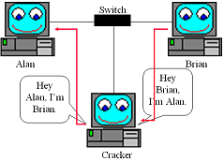
Address Resolution Protocol (ARP)

Slide 4
Information gathering

Slide 5
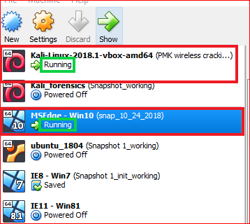

Slide 6
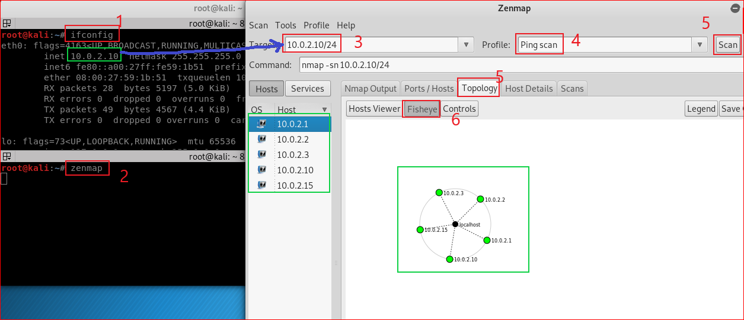

Slide 7
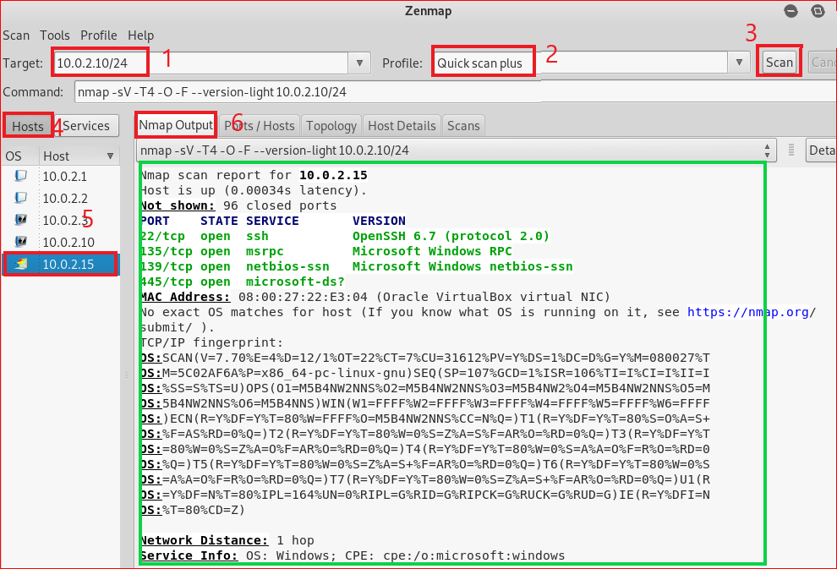

Slide 8
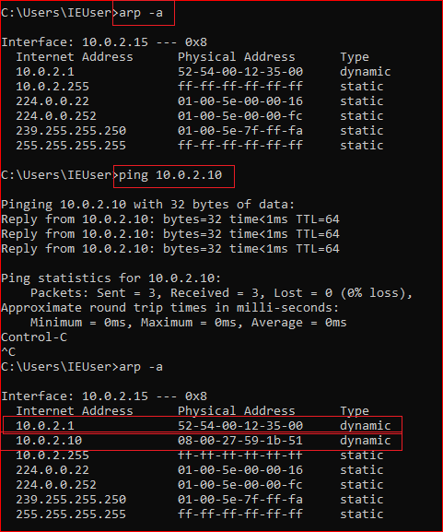
Windows 10 ARP table
Before the attack

Slide 9
ARP MITM attack

Slide 10
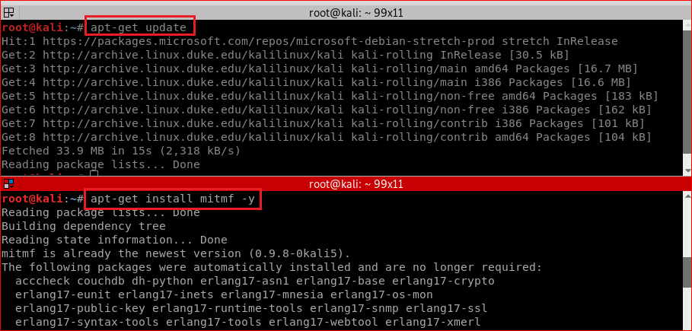
mitm framework installation

Slide 11
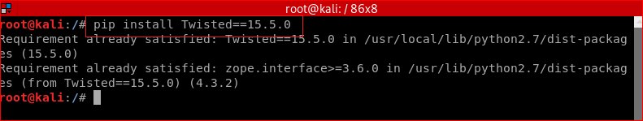
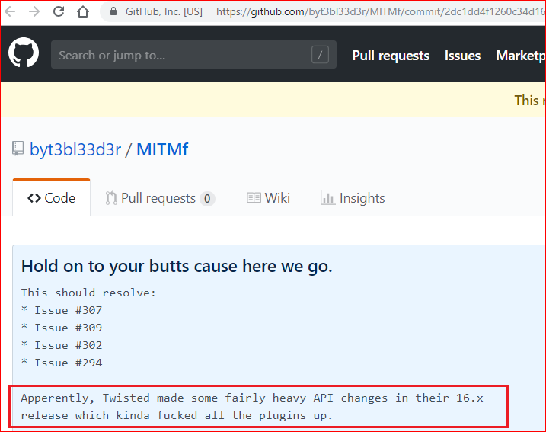
(optional)Use an old version of Twisted (new version has problem)
AttributeError: ClientRequest instance has no attribute 'headers'

Slide 12
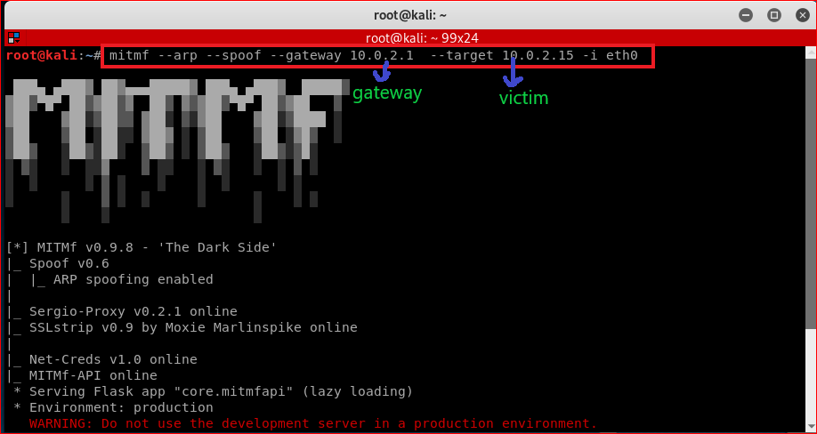
Attacking

Slide 13
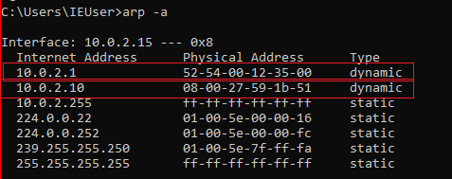
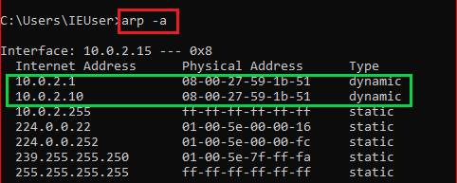
MAC address use Victim’s PC (Before and after attack)

Slide 14
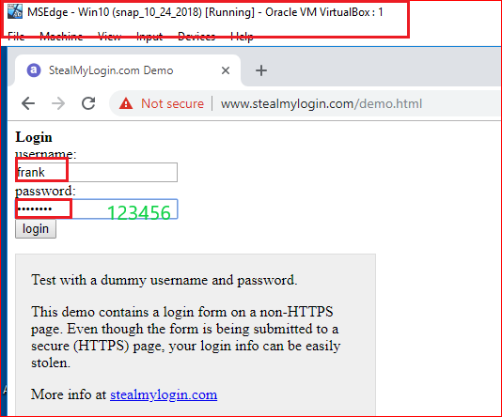

Slide 15
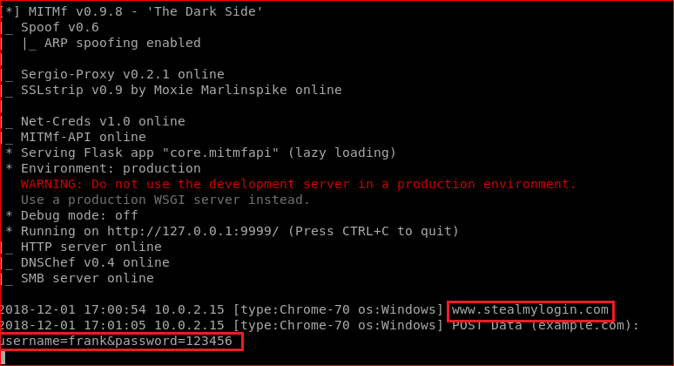

Slide 16
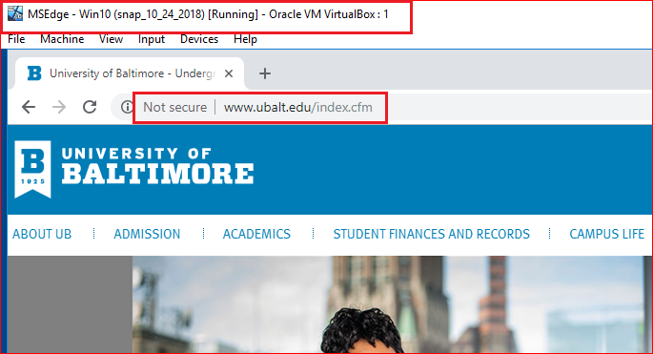

Slide 17
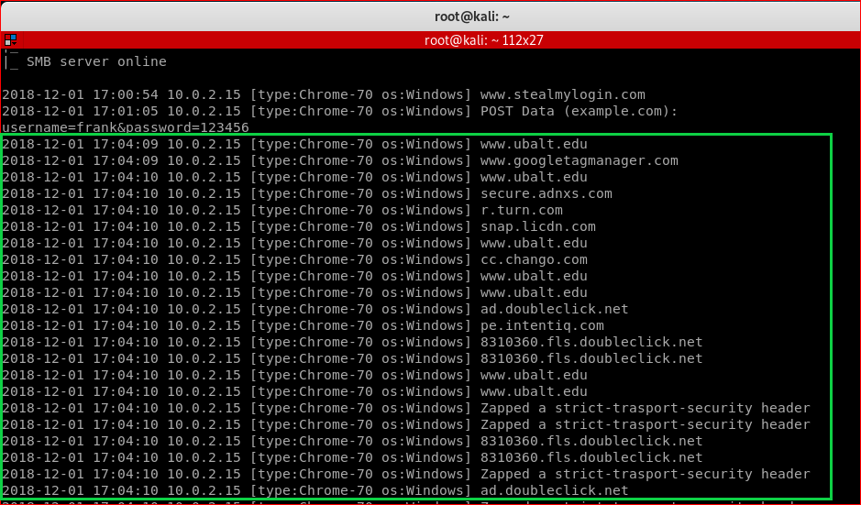

Slide 18
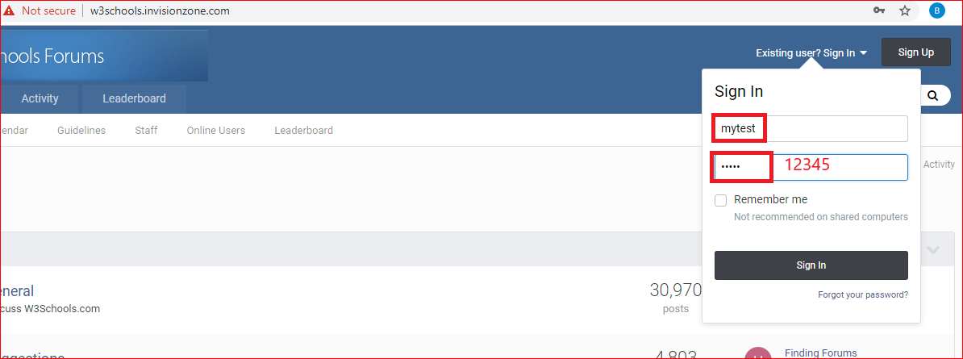
Try http://w3schools.invisionzone.com/

Slide 19
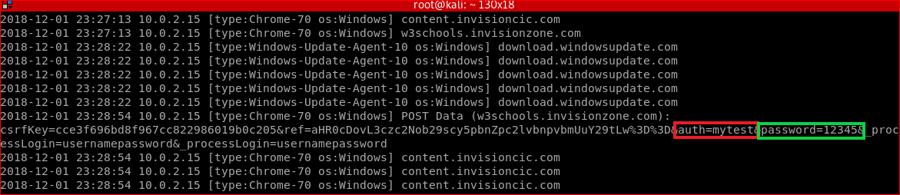

Slide 20
HTTPS downgrade to HTTP

Slide 21
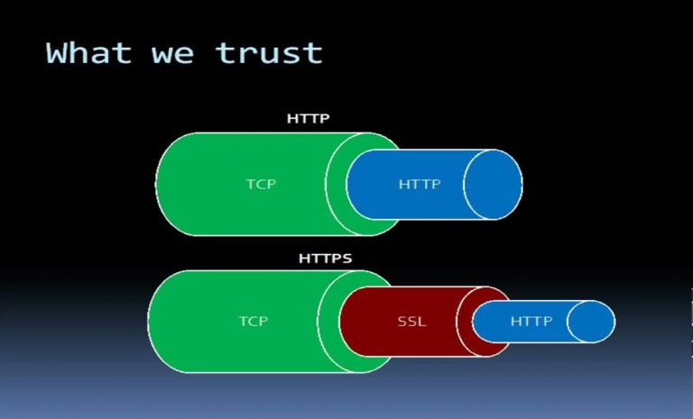

Slide 22
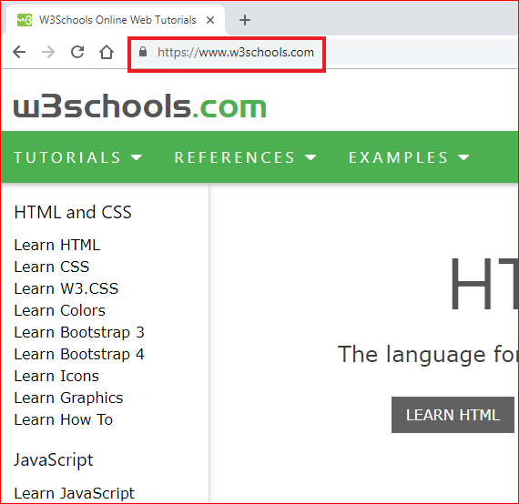
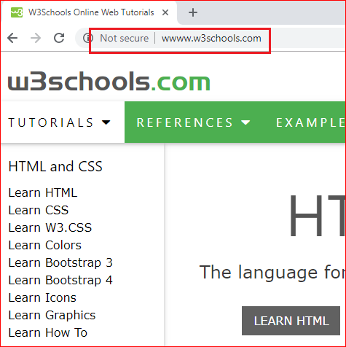
Before and after strip HTTPS

Slide 23
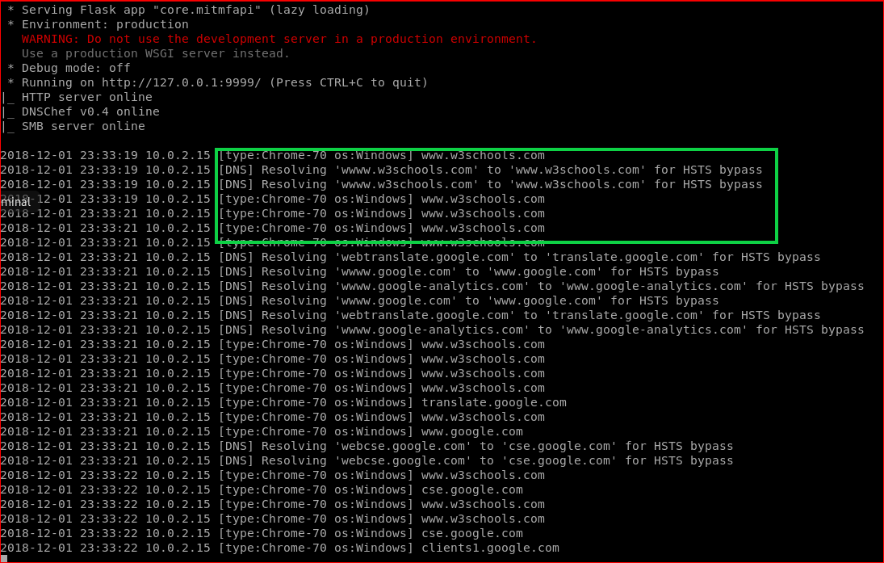

Slide 24
Trouble shooting
Try Edge/Firefox if https strip does not work.

Slide 25
Take Screenshots of Victim’s PC

Slide 26
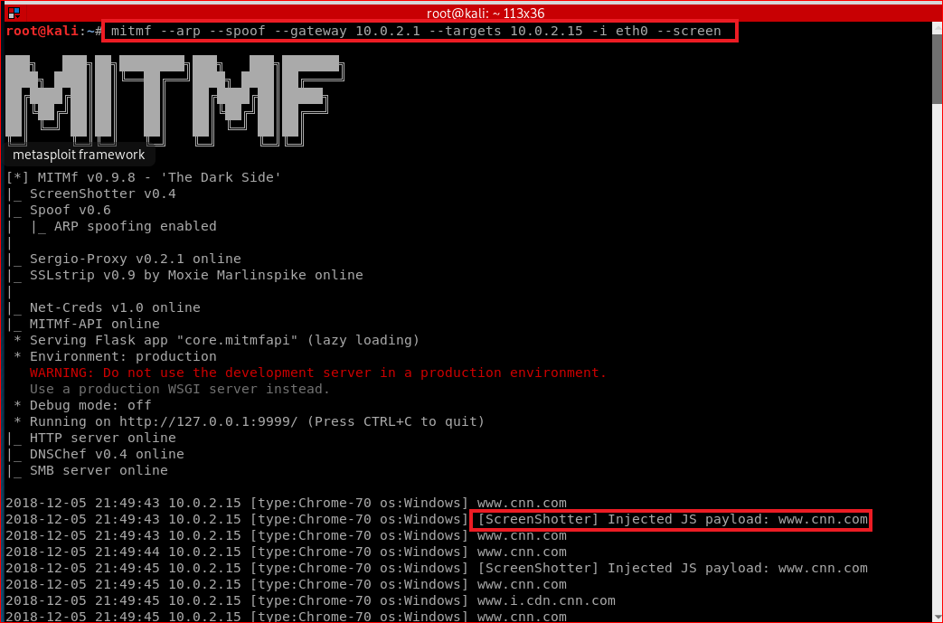

Slide 27
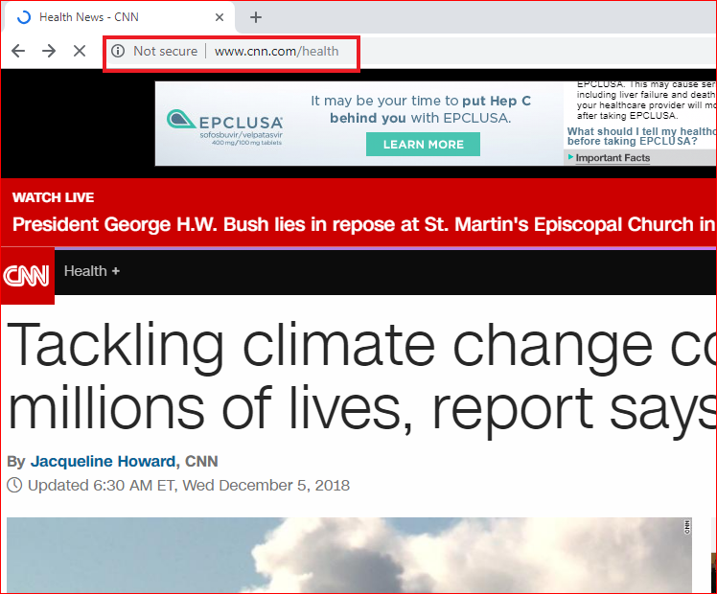
Victim's PC

Slide 28
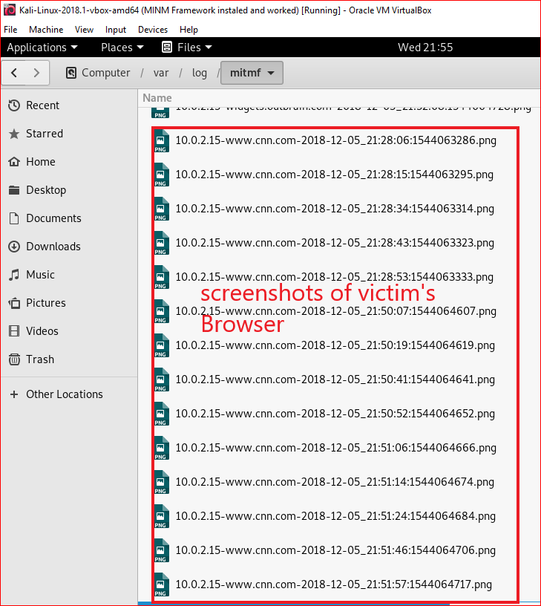
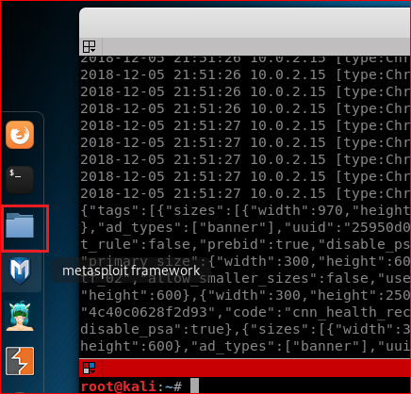
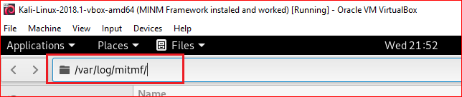

Slide 29
Trouble shootings
Chrome is more secure than Firefox and Edge.
Try use Firefox/Edge is you can’t capture the screens
Reboot Virtualbox

