Slide 1
DNS Spoofing using mitm Framework

Slide 2
Domain Name System Security

Slide 3
Call a person vs. connect to a website
 | Call a person | connect to a website
Something easy to remember | Person’s name | URL
Directory | Phone book | DNS server
digits | Phone number | IP

Slide 4
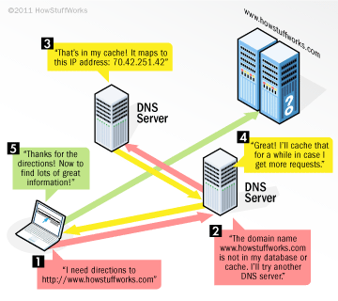
How Domain Name Servers Work
©HOWSTUFFWORKS.COM

Slide 5
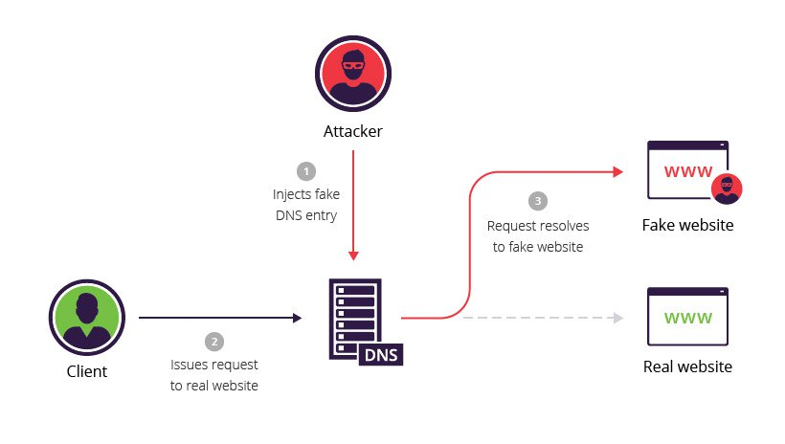
DNS SPOOFING
https://www.incapsula.com/web-application-security/dns-spoofing.html

Slide 6
Create a web page

Slide 7
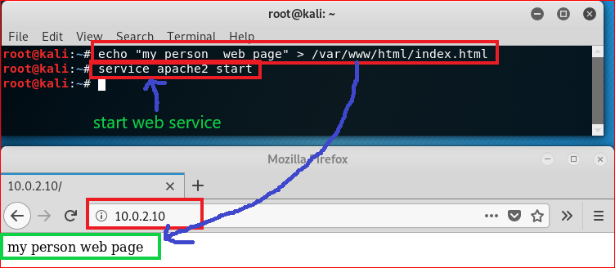

Slide 8
DNS Attack

Slide 9
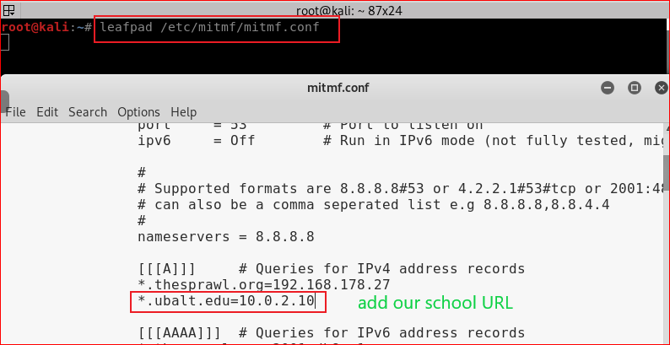

Slide 10
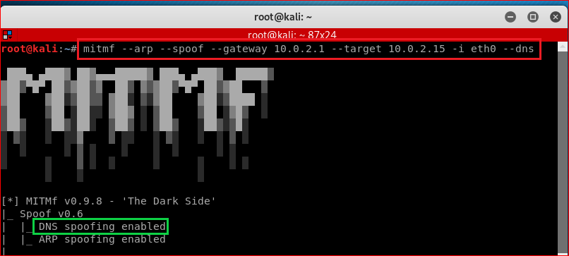

Slide 11
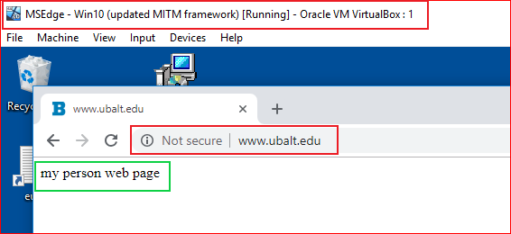

Slide 12
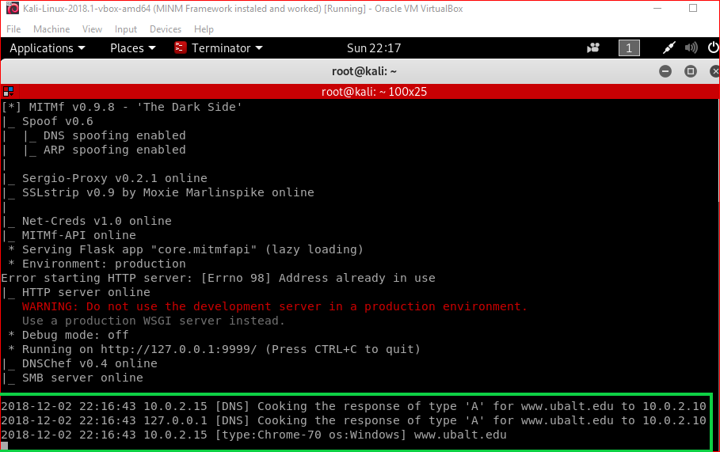

Slide 13
Clean up
Remember to remove the added line from the file.

