Slide 1
Exploiting Server misconfiguration vulnerabilities

Slide 2
Overview
Client server
Client server attack
Demo: Server misconfiguration vulnerabilities
'rlogin' Remote Login Service Enabled
Remote Login to server

Slide 3
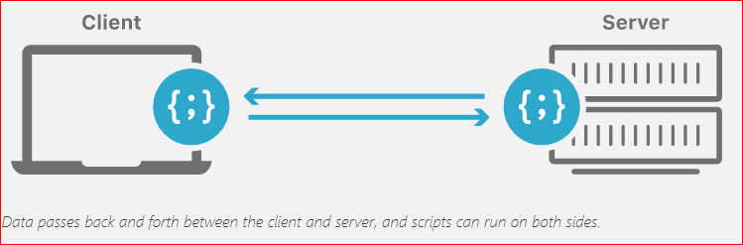
Client and server model

Slide 4
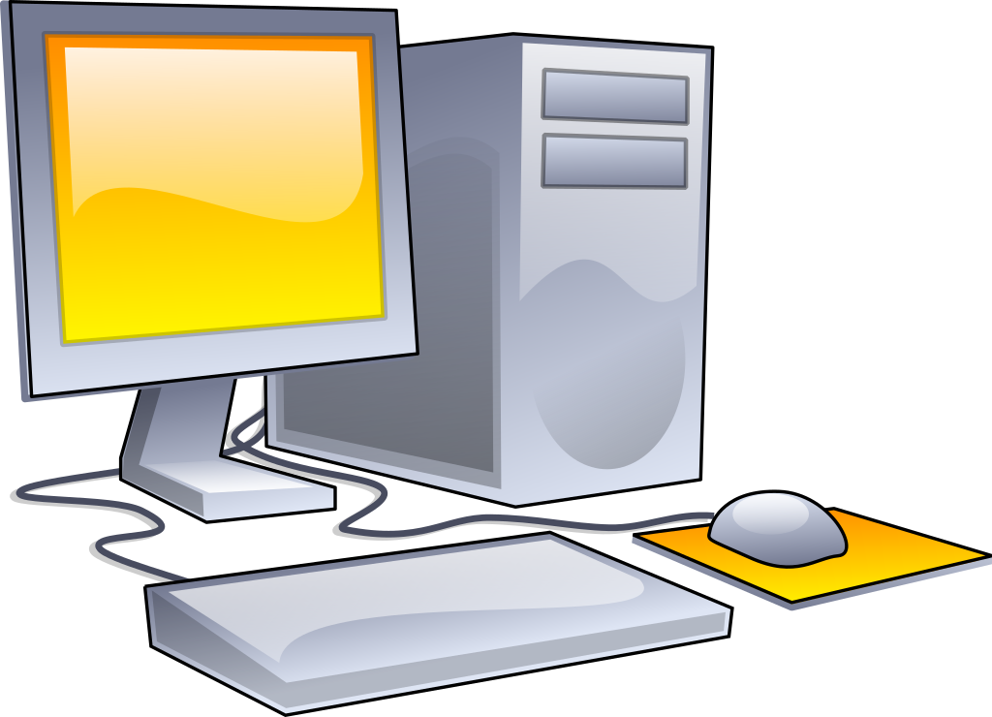
Server side attack
Attack server indirectly
Attack server directly
compromise and breach the data and applications that are present on a server

Slide 5
Server Attacks
A compromised server can provide threat actors with its privileged contents or provide an opening for attacking any of the devices that access that server
Server Attacks
Denial of service
Web server application attacks
Hijacking
Overflow attacks
Advertising attacks
Exploiting browser vulnerabilities
Exploiting server vulnerabilities
Server misconfiguration vulnerabilities

Slide 6
Denial of Service (DoS)
Server Attacks
Denial of service
Web server application attacks
Hijacking
Overflow attacks
Advertising attacks
Exploiting browser vulnerabilities
Smurf attack/ IP spoofing
DNS amplification attack
SYN flood attack

Slide 7
Web server application attacks
Server Attacks
Denial of service
Web server application attacks
Hijacking
Overflow attacks
Advertising attacks
Exploiting browser vulnerabilities
Cross-site attacks
Injection attacks
cross-site scripting (XSS)
Cross-Site Request Forgery (XSRF)
SQL injection

Slide 8
Hijacking
Several server attacks are the result of threat actors “commandeering” a technology and then using it for an attack
Server Attacks
Denial of service
Web server application attacks
Hijacking
Overflow attacks
Advertising attacks
Exploiting browser vulnerabilities
Session hijacking
URL hijacking
Domain hijacking
Clickjacking

Slide 9
Overflow Attacks
Overflow attacks
Designed to “overflow” areas of memory with instructions from the attacker
Server Attacks
Denial of service
Web server application attacks
Hijacking
Overflow attacks
Advertising attacks
Exploiting browser vulnerabilities
Buffer overflow attacks
Integer overflow attacks

Slide 10
Lab: Exploiting misconfiguration vulnerabilities

Slide 11
target information gathering

Slide 12
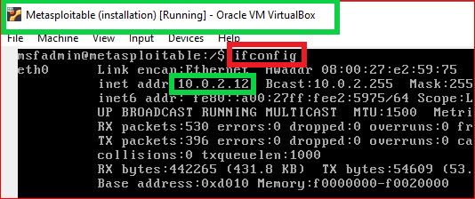
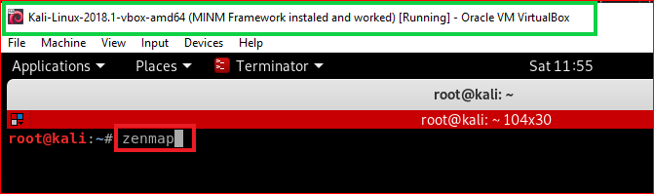
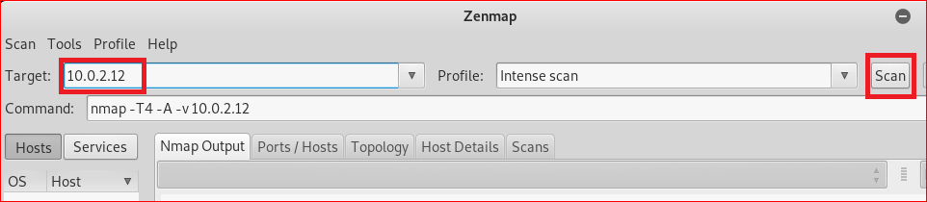
1
2
3

Slide 13
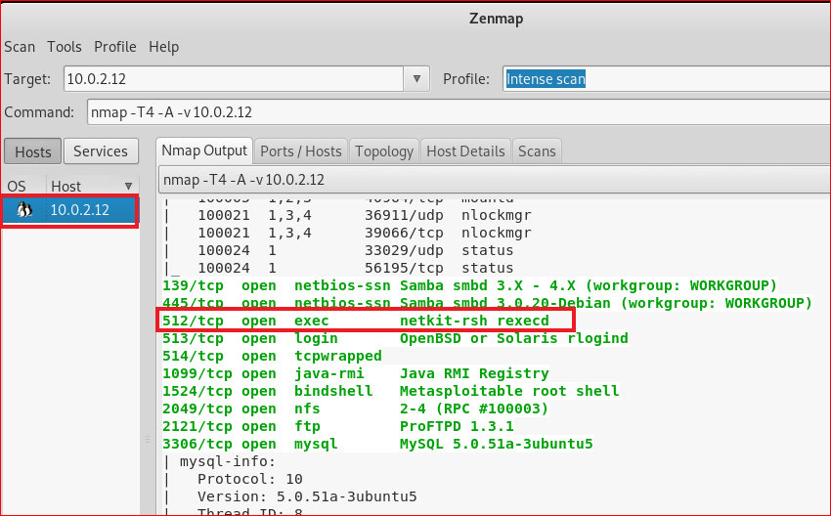

Slide 14
search possible vulnerabilities

Slide 15
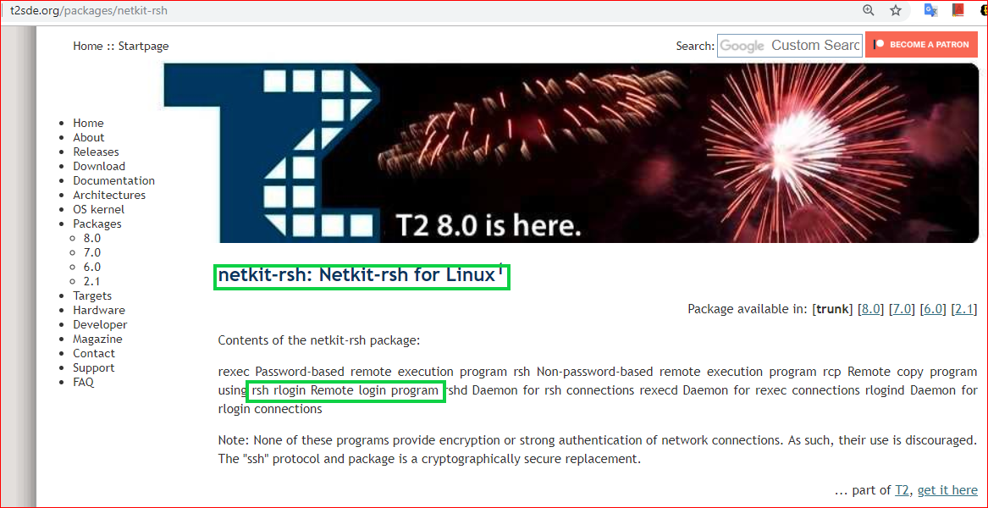

Slide 16
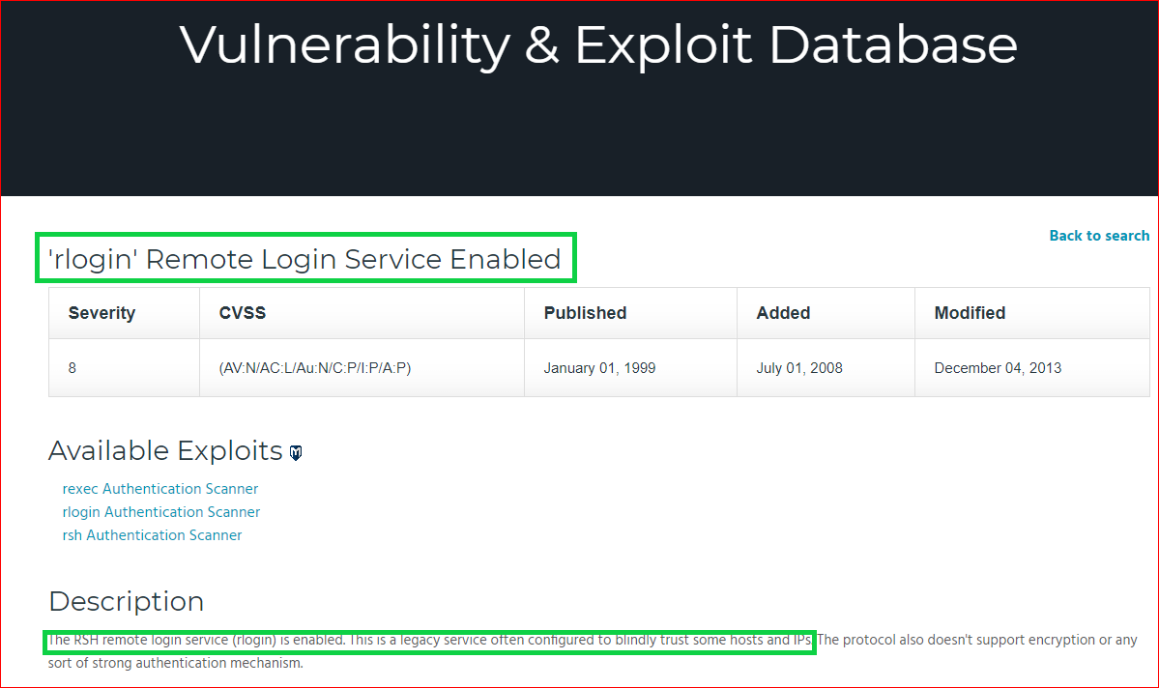

Slide 17
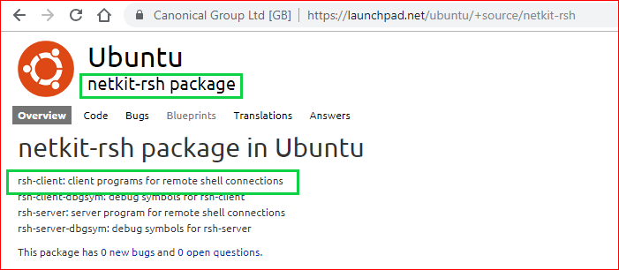

Slide 18
Remote Login

Slide 19
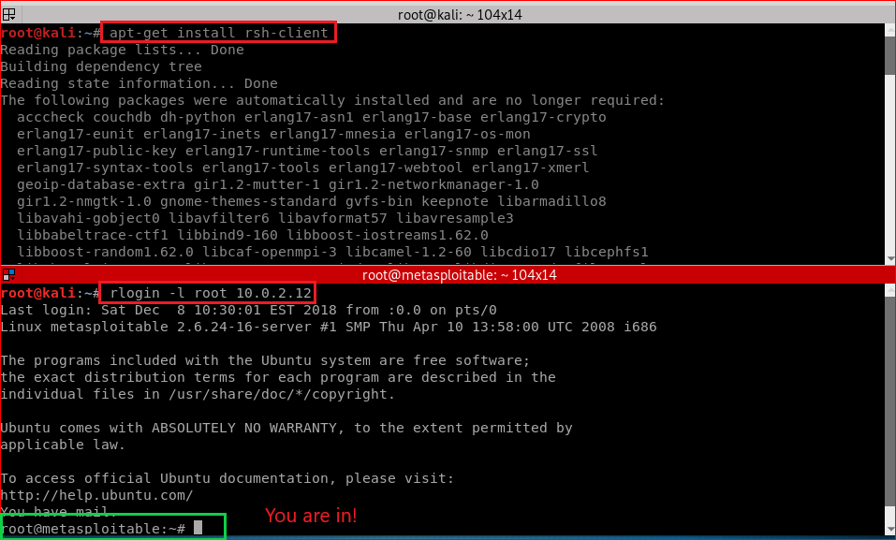
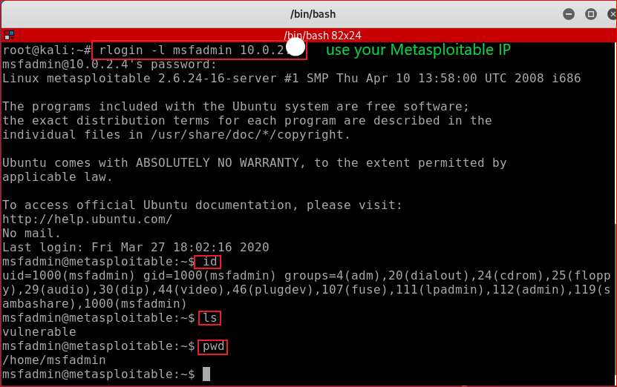
Kali 2018.19
Kali 2020
Password: msfadmin

Slide 20
Forensic Investigation

Slide 21
