Slide 1
Discover and Investigate Hidden Webpage (path traversal attack)

Slide 2
overview
Websites, files, and webpages
Path traversal attack
dirb tool
Discover hidden files
Investigate hidden files

Slide 3
Websites, files, and webpages

Slide 4
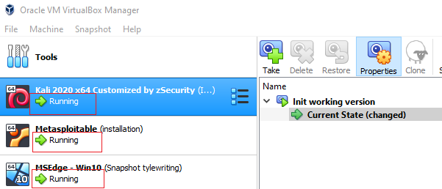
Start Kali and Metasploitable VMs
 | Username | Password
Kali | root | toor
Metasploitable | msfadmin | msfadmin
Win 10 |  | Pass

Slide 5
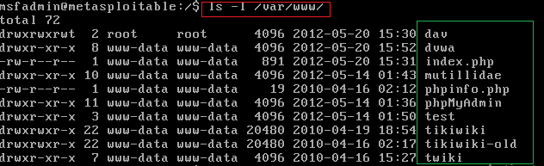
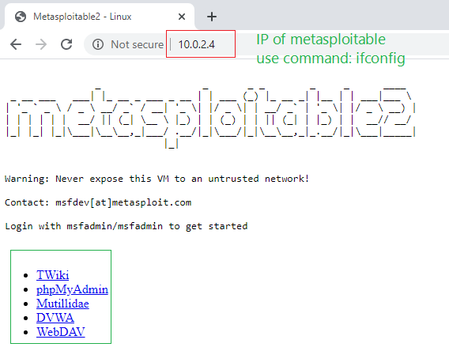
Websites, files, and webpages

Slide 6
Path traversal attack
Known as “directory traversal”
Aims to access files and directories that are stored outside the web root folder.
Manipulating variables with reference files with “dot-dot-slash (…/)” sequences and its variations or by using absolute file paths
Possible to access arbitrary files and directories stored on file system
including application source code, configuration, and critical system files.

Slide 7
Dirb Tool
DIRB is a Web Content Scanner.
It looks for existing (and/or hidden) Web Objects.
It basically works by launching a dictionary-based attack against a web server and analyzing the response.

Slide 8
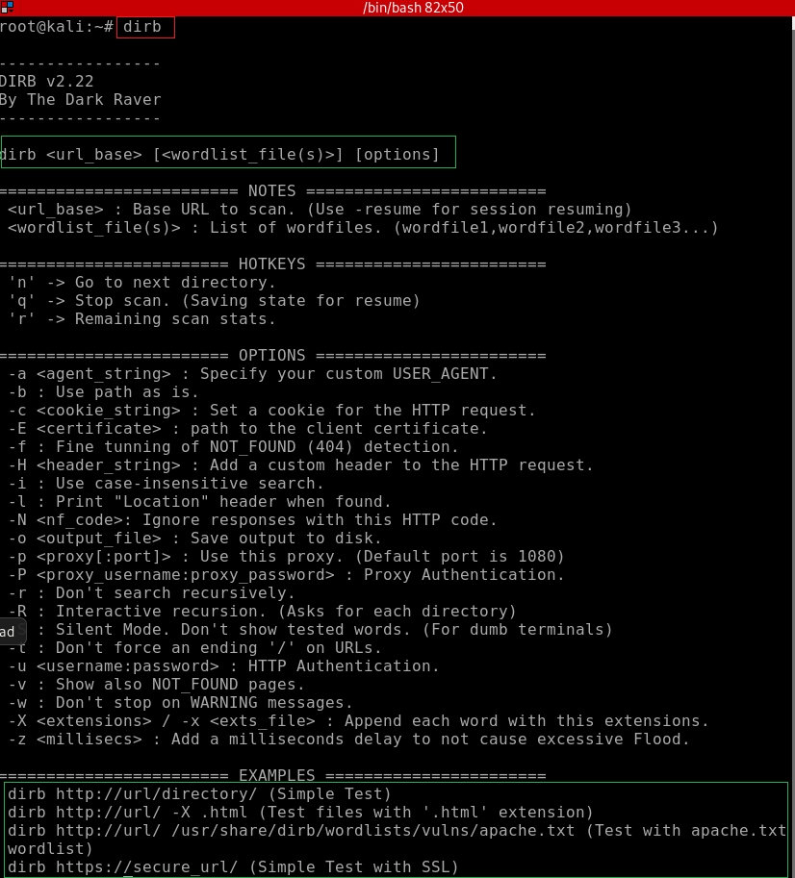
List commands
dictionary

Slide 9
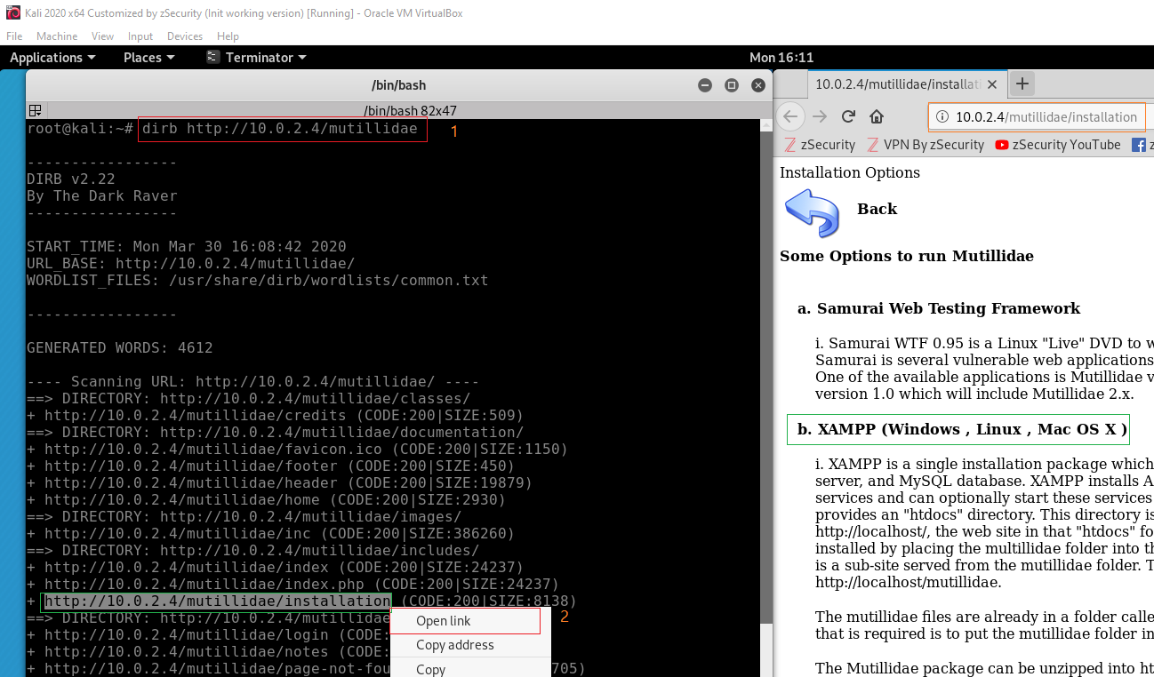
Example 1

Slide 10
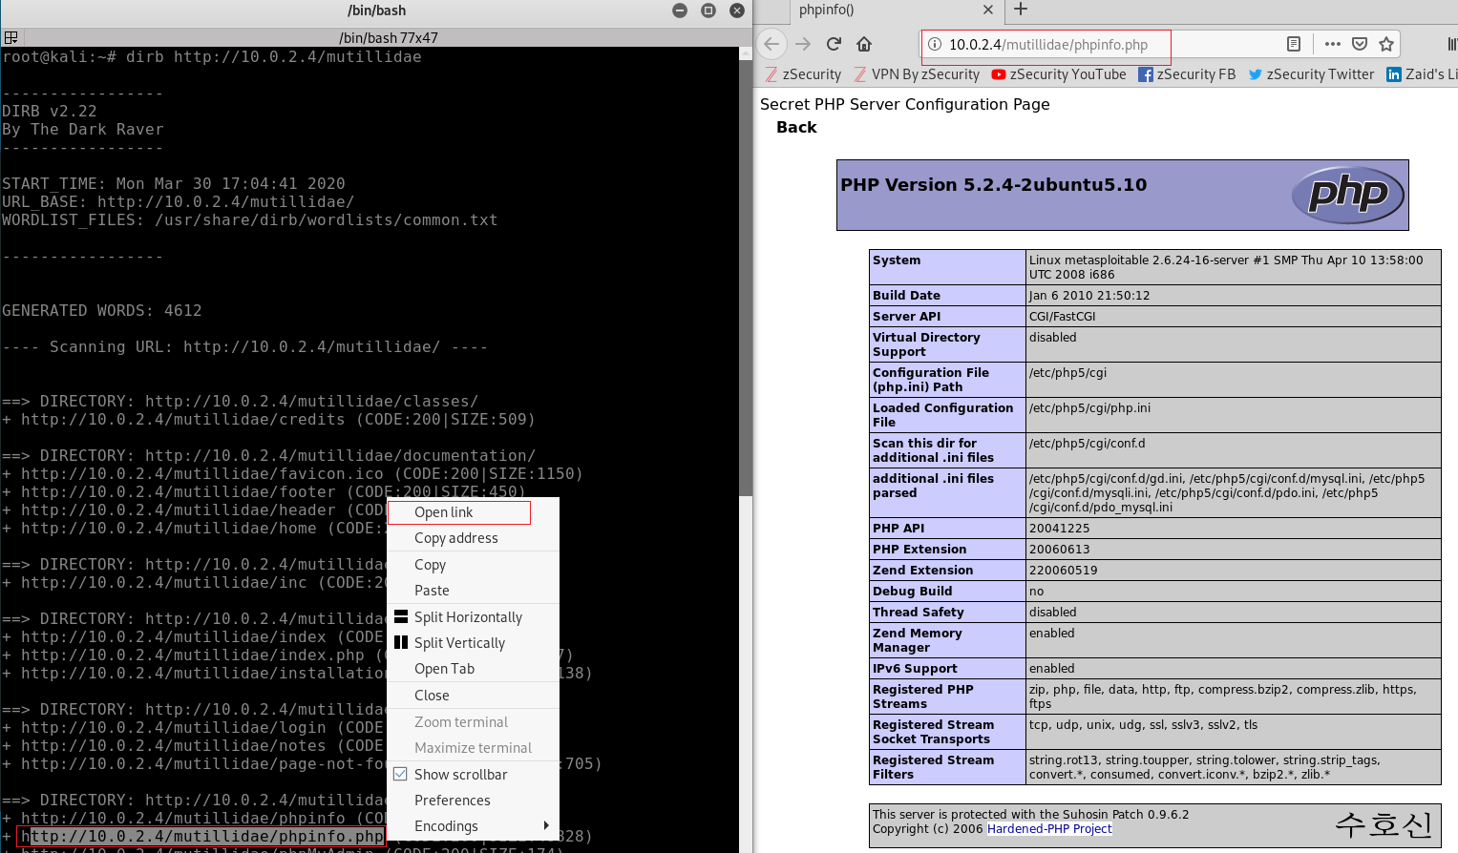
Example 2

Slide 11
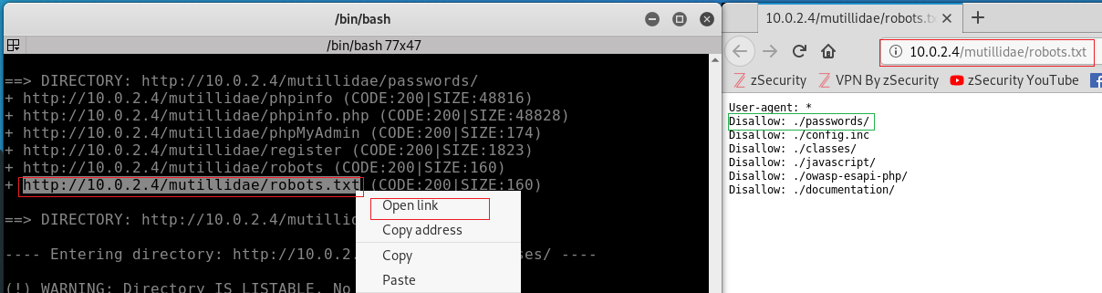
Example 3

Slide 12
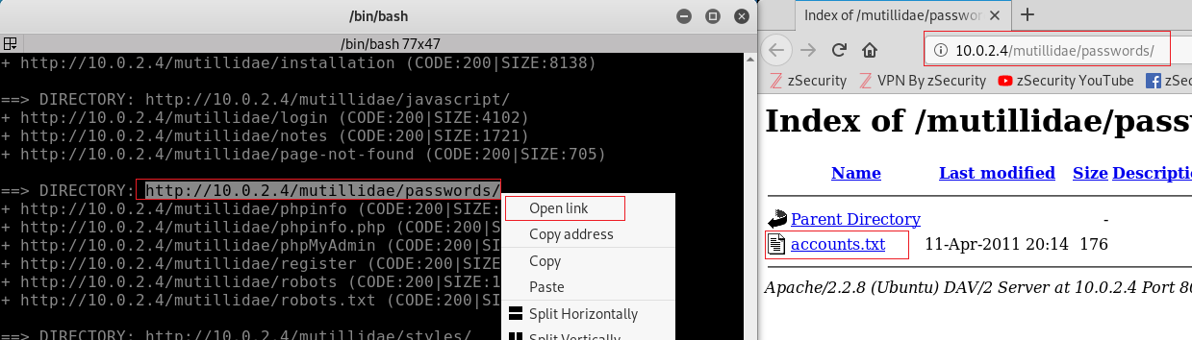
Example 4

Slide 13
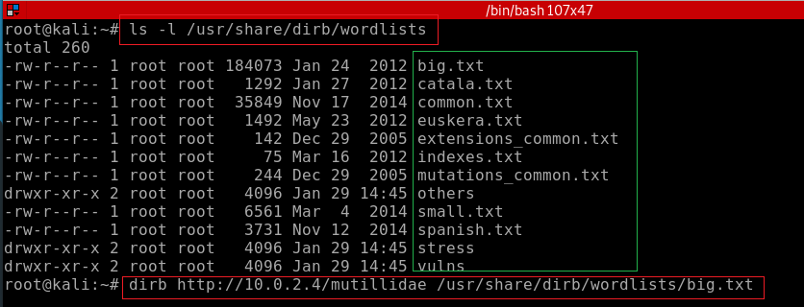
Utilizing Multiple Wordlist for Directory Traversing

Slide 14
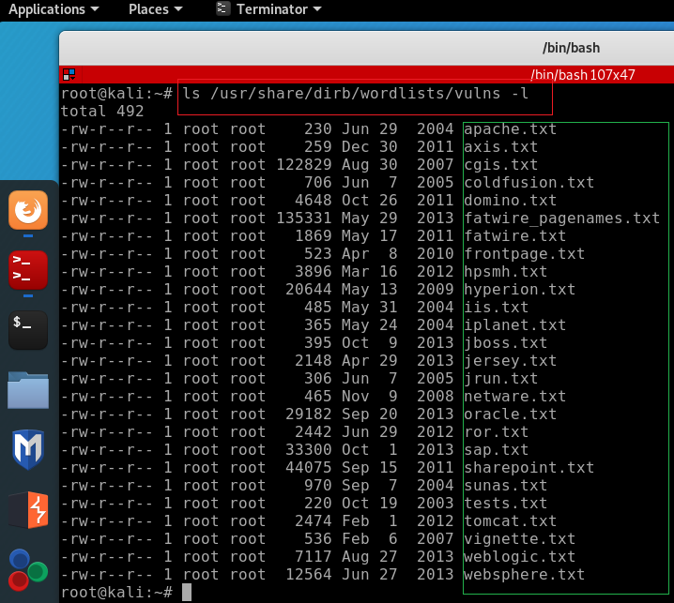
Utilizing Multiple Wordlist for Directory Traversing

Slide 15
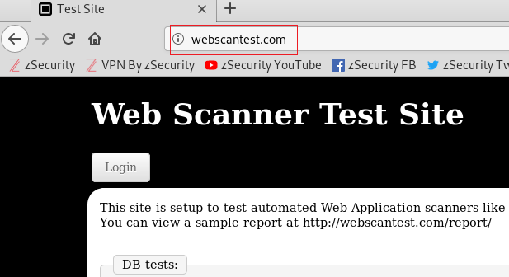
Scan the website and report your findings
Notes:
Userlog, /soap/demo/api, traiffic

Slide 16
reference
https://www.hackingarticles.in/comprehensive-guide-on-dirb-tool/

