Slide 1
SQL Injection

Slide 2
overview
What is SQL
SQL commands
SQL injection lab

Slide 3
What is SQL

Slide 4
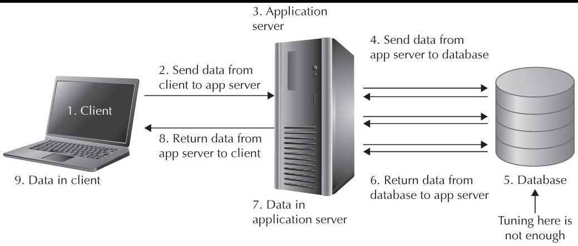
SQL
Structured Query Language
Designed for managing data held in a relational database management system
Webpage, web application, and database

Slide 5
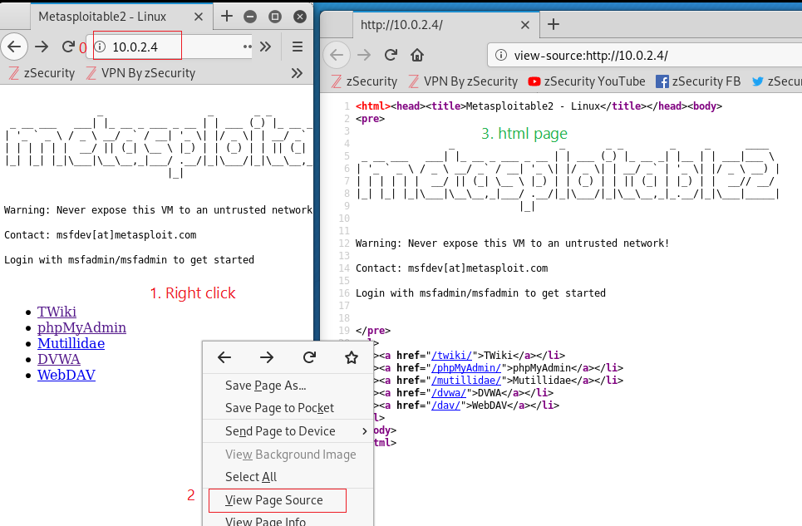
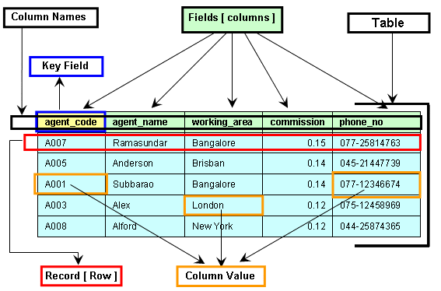
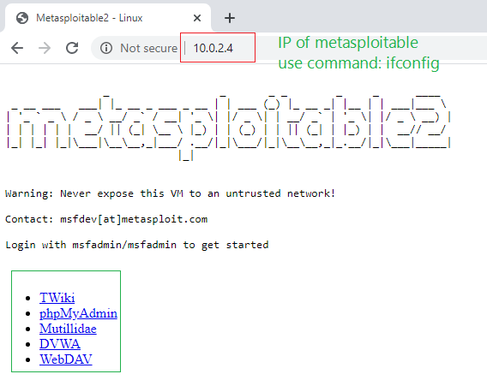

Slide 6
One database = multiple SQL Tables

Slide 7
SQL Commands

Slide 8

User can manipulate SQL database directly
SQL command

Slide 9
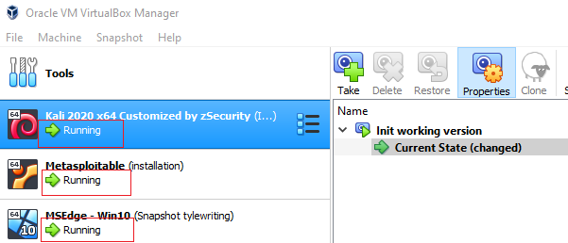
Start Kali and Metasploitable VMs
 | Username | Password
Kali | root | toor
Metasploitable | msfadmin | msfadmin
Win 10 |  | Pass

Slide 10
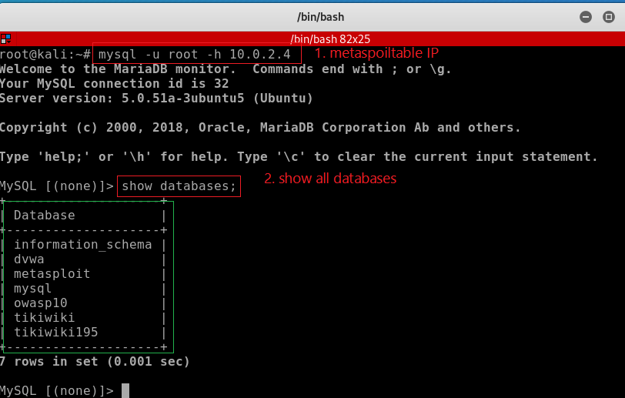
Connect to databases in Metasploitable

Slide 11
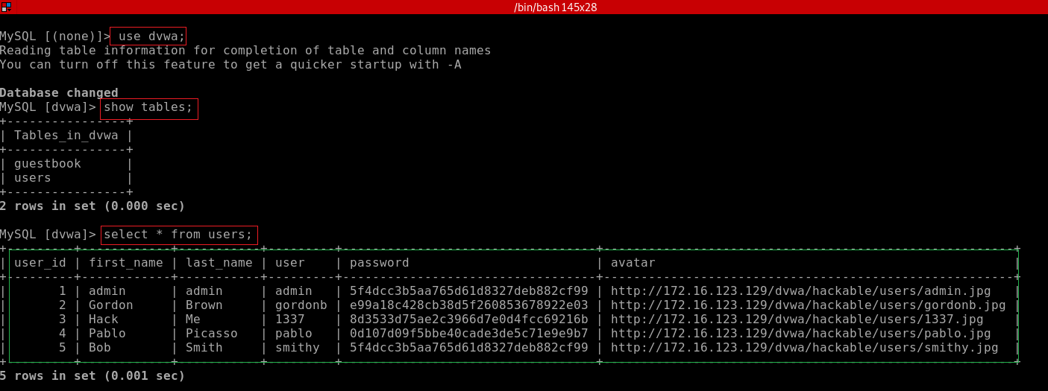
Show tables used by DVWA web application
Damn Vulnerable Web Application (DVWA)

Slide 12
Show tables used by OWASP Mutillidae web application
What is Mutillidae?
Mutillidae is a free, open source web application provided to allow security enthusiast to pen-test and hack a web application.
Mutillidae contains all of the vulnerabilties from the OWASP Top 10.
OWASP Top 10
Open Web Application Security Project (OWASP)
The OWASP Top 10 is a standard awareness document for developers and web application security.
It represents a broad consensus about the most critical security risks to web applications.
https://owasp.org/www-project-top-ten/

Slide 13
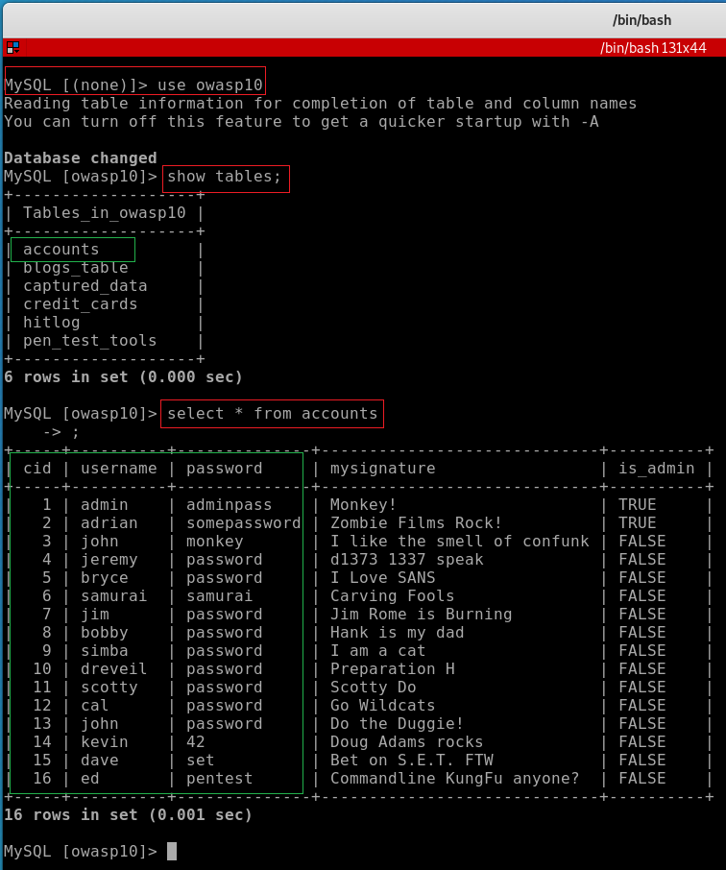
Connect to the database used by Mutillidae (owasp10)

Slide 14
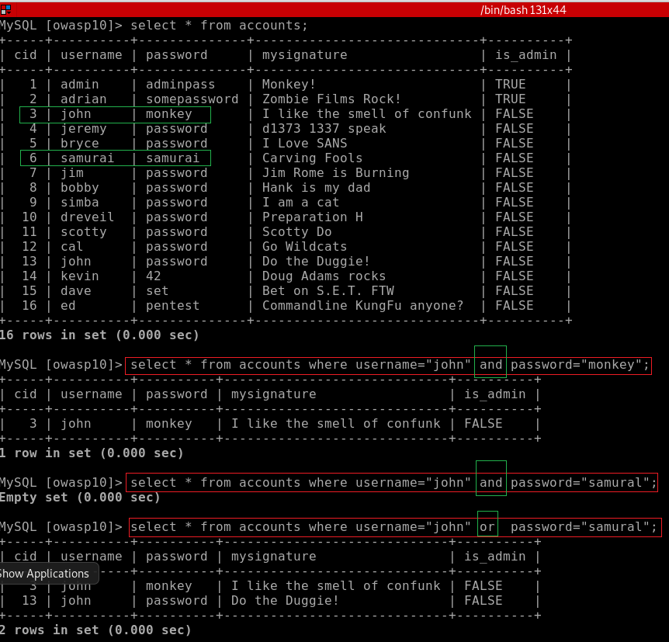
and and or in SQL statements

Slide 15
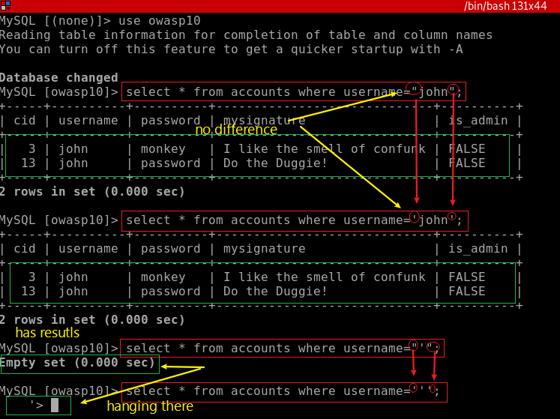
single quote (') is a reserved SQL character may break the below query

Slide 16
SQL injection lab

Slide 17
SQL Injection
A technique often used to attack data driven applications
Web applications
Inject malicious code (commands) in SQL statements, via web page input.
Happens when user input is either incorrectly filtered
Commands embedded in SQL statements

Slide 18

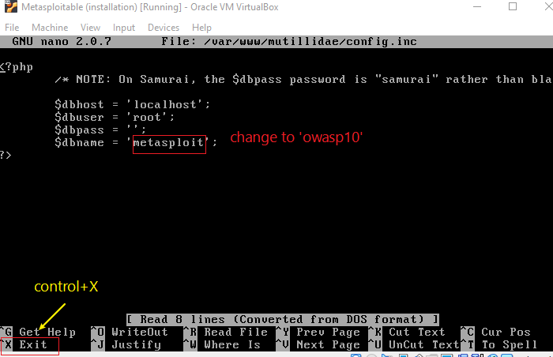
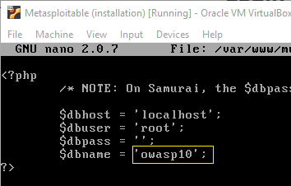
Make mutillidae points to owasp10 database

Slide 19
Animation:
Break system using
single quote (')

Slide 20
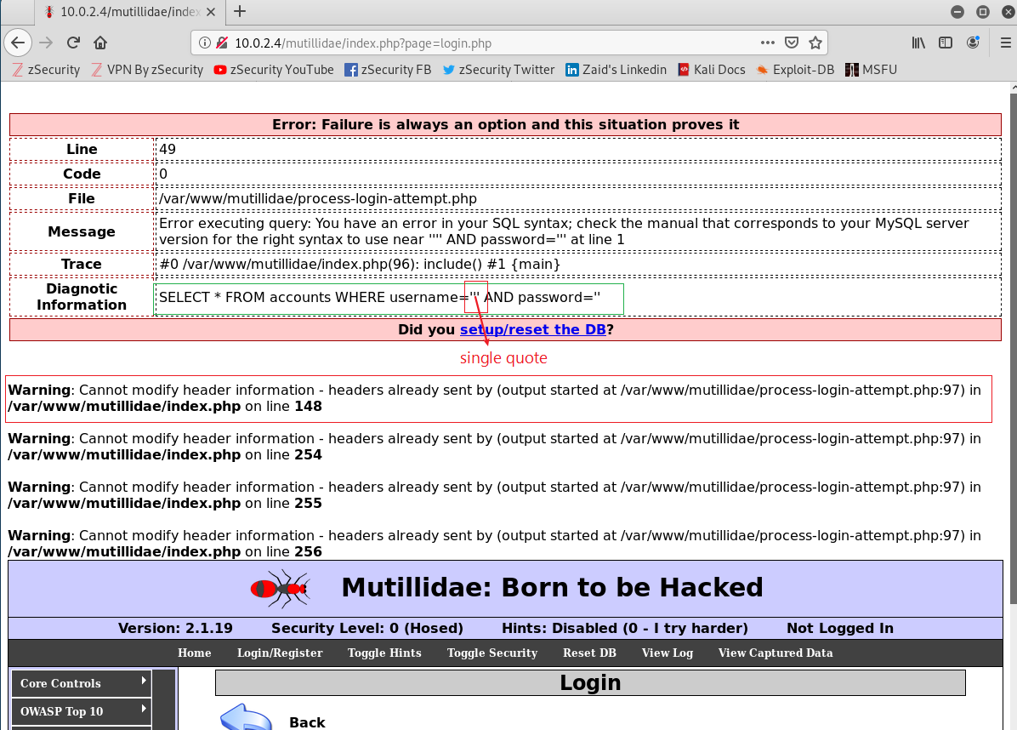

Slide 21
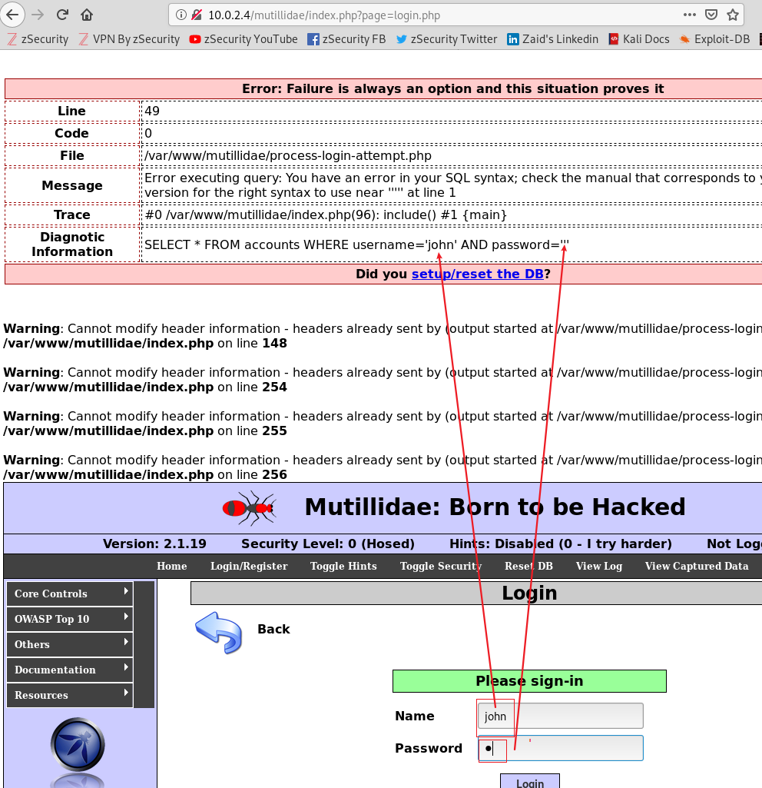
Observation
using single quote (') break system
Whatever user’s type can be inserted into SQL statement (inside the a pair of '')

Slide 22
Code injection goal
Bypass user name and password check
Craft input strings for name and password text fields to fool the SQL statement
Where condition is evaluated as true
SQL statement returns at least one row

Slide 23
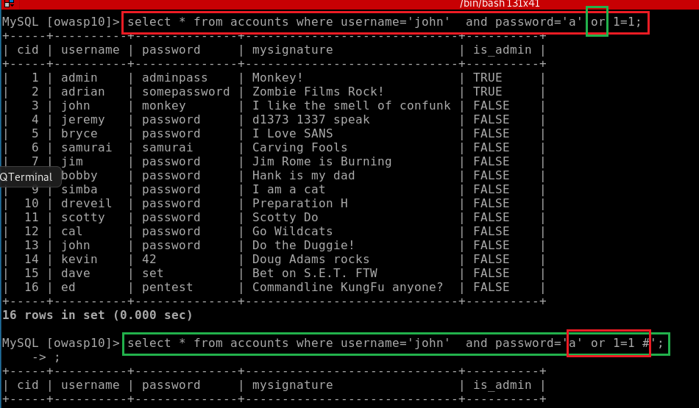

Slide 24
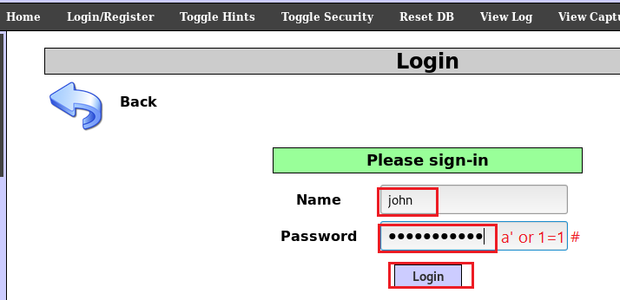
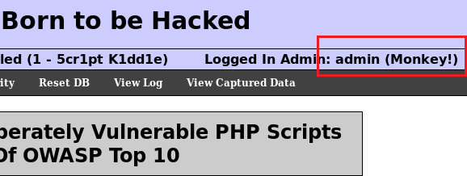
Bypass login
a’_or_1=1_#
_ is a space

Slide 25
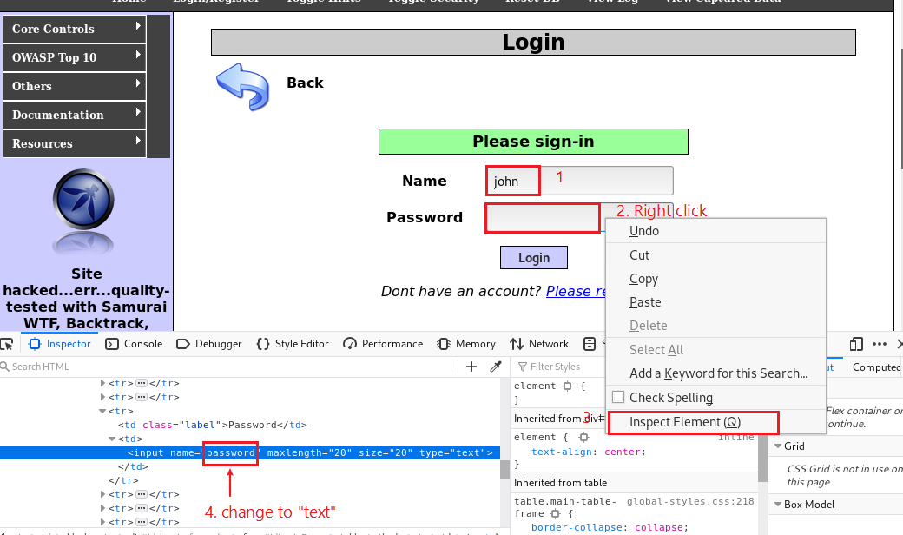
Trick to make password field visible

Slide 26
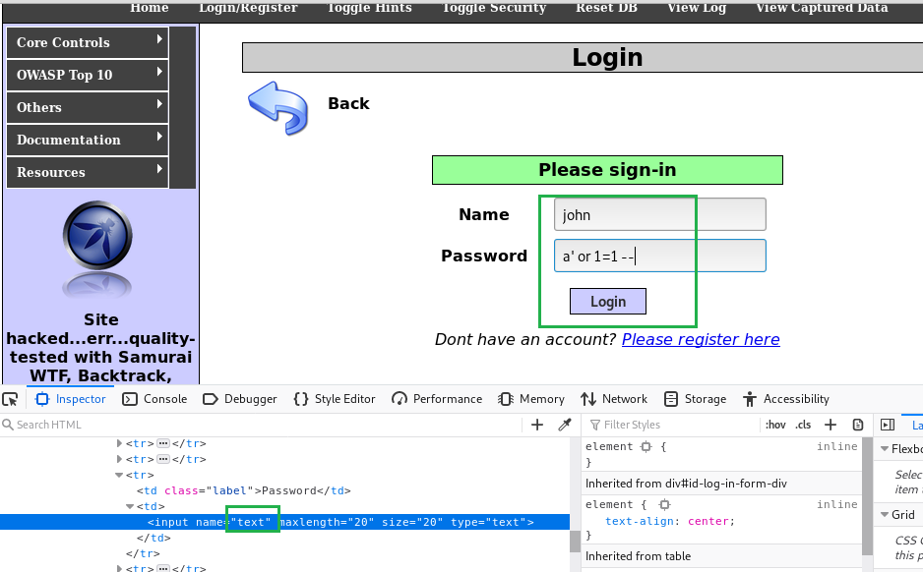
a’_or_1=1_--_
_ is a space

Slide 27
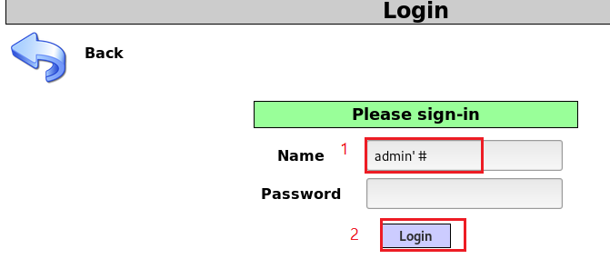
Will the string bypasses the login? Why or why not?

Slide 28
reference
https://www.computersecuritystudent.com/SECURITY_TOOLS/MUTILLIDAE/MUTILLIDAE_2511/lesson5/index.html

