Slide 1
Ccross-site scripting (XSS) attack
https://owasp.org/www-community/attacks/xss/

Slide 2
Overview
What is XSS
Discover XSS
Hooking vulnerable-page visitors to BeEF

Slide 3
What is XSS

Slide 4
XSS
A type of injection attack
Attacker injects malicious scripts into otherwise benign and trusted websites.
Whenever (any) victim visits injected Web site
Malicious instructions are sent to victim’s browser

Slide 5
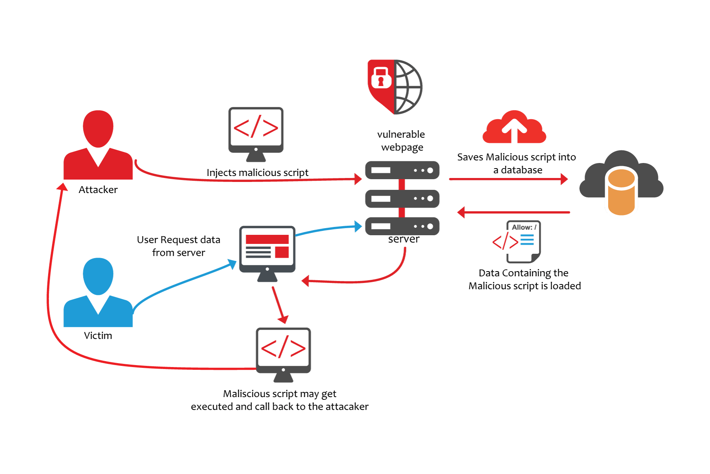

Slide 6
Discover XSS

Slide 7
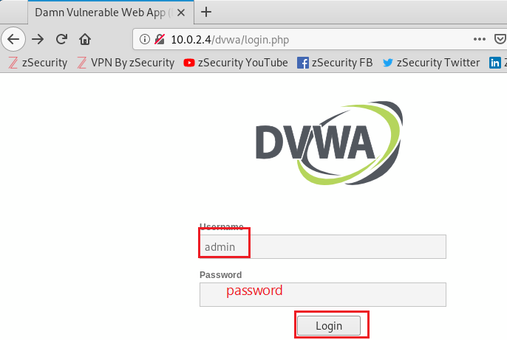
Damn Vulnerable Web App (DVWA)

Slide 8
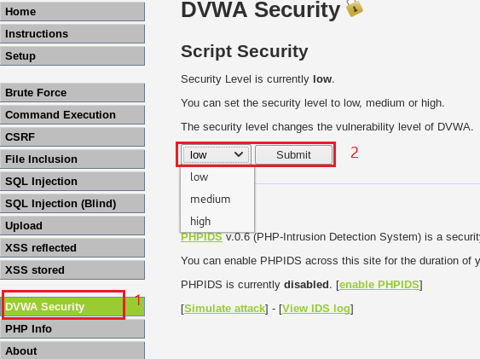
Set script security to low

Slide 9
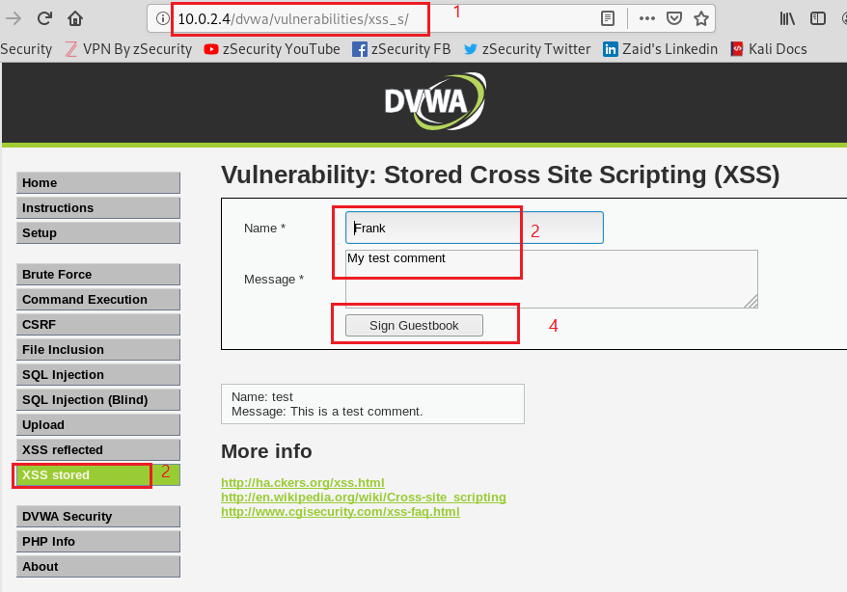
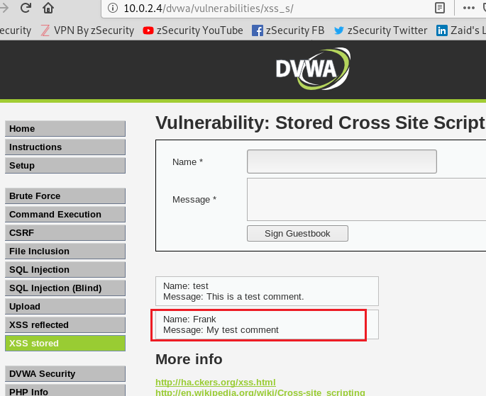
Test normal post message function

Slide 10
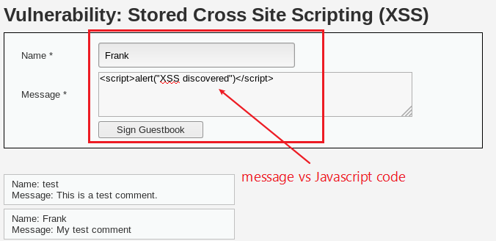
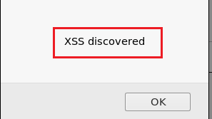
Discover XSS using Javascript alert function

Slide 11
Hooking vulnerable-page visitors to BeEF

Slide 12
What is BeEF
Browser Exploitation Framework.
It is a penetration testing tool that focuses on the web browser.
Web-borne attacks against clients
will hook one or more web browsers and use them as beachheads for launching directed command modules and further attacks against the system from within the browser context.

Slide 16
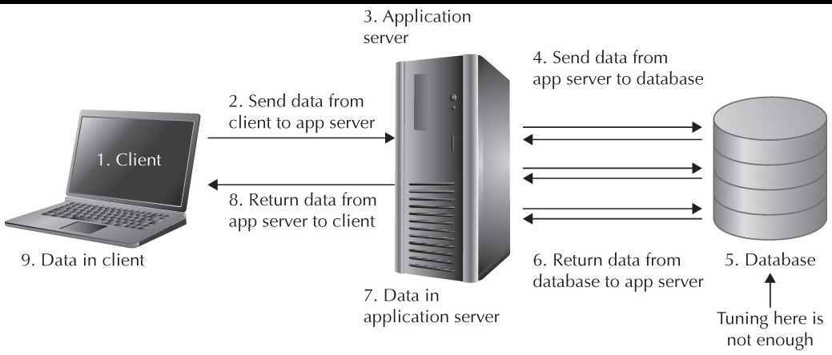
SQL
Structured Query Language
Designed for managing data held in a relational database management system
Webpage, web application, and database

Slide 17
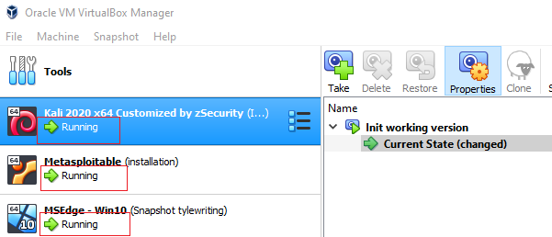
Start Kali and Metasploitable VMs
 | Username | Password
Kali | root | toor
Metasploitable | msfadmin | msfadmin
Win 10 |  | Pass

Slide 19
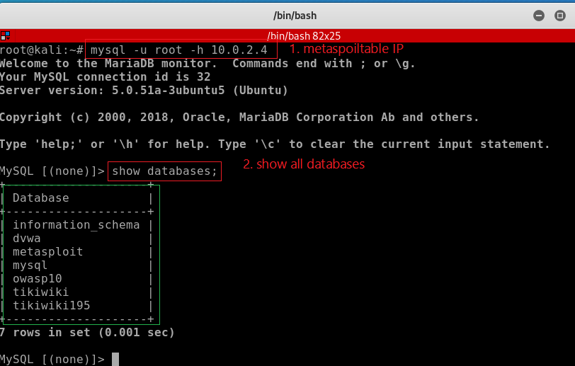
Connect to databases in Metasploitable

Slide 20
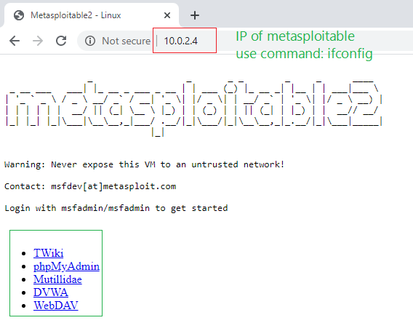
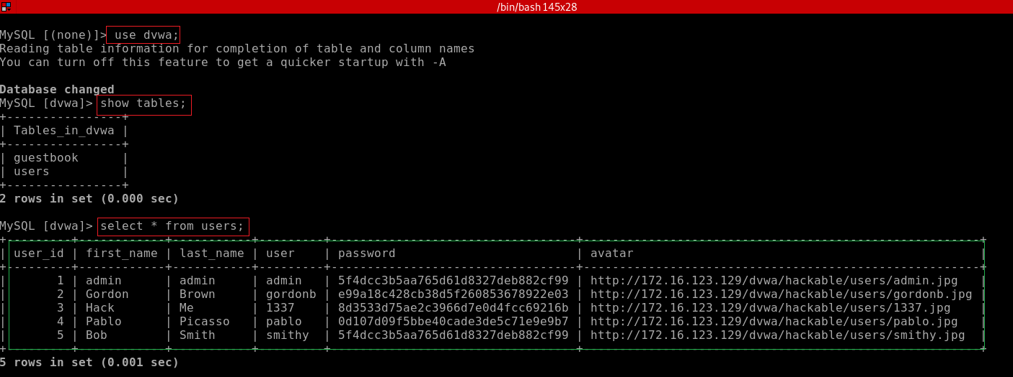
Show tables used by DVWA web application
Damn Vulnerable Web Application (DVWA)

Slide 21
Show tables used by OWASP Mutillidae web application
What is Mutillidae?
Mutillidae is a free, open source web application provided to allow security enthusiast to pen-test and hack a web application.
Mutillidae contains all of the vulnerabilties from the OWASP Top 10.
OWASP Top 10
Open Web Application Security Project (OWASP)
The OWASP Top 10 is a standard awareness document for developers and web application security.
It represents a broad consensus about the most critical security risks to web applications.
https://owasp.org/www-project-top-ten/

Slide 22
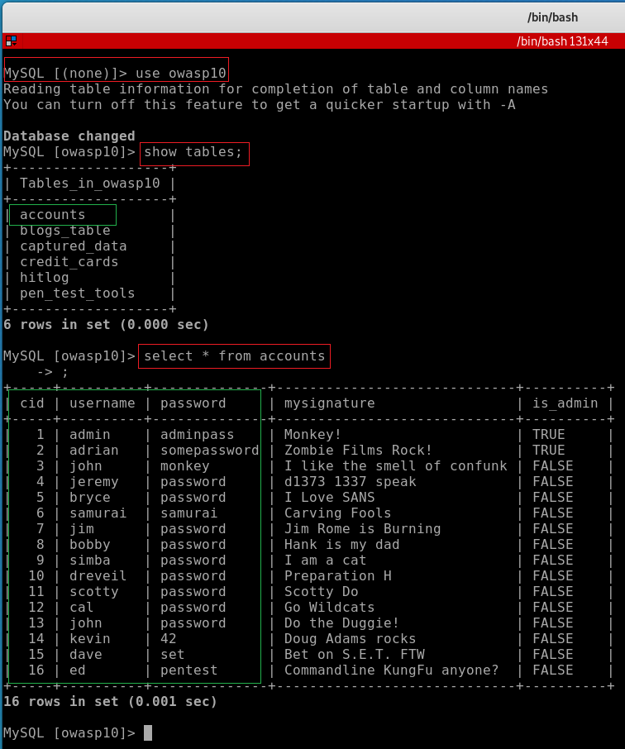
Connect to the database used by Mutillidae (owasp10)

Slide 23
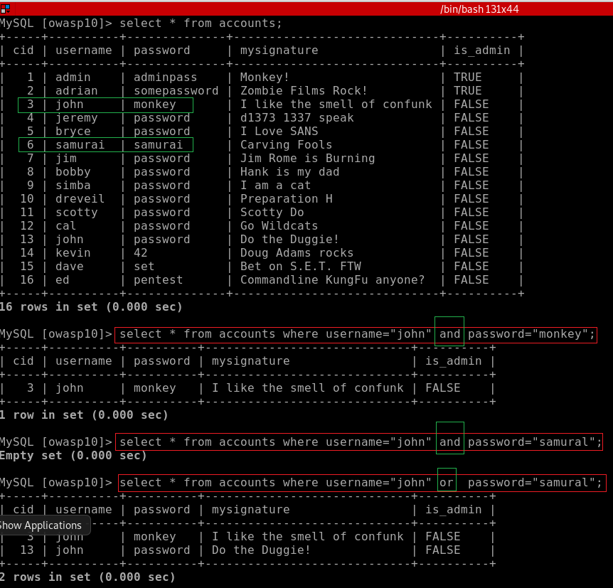
and and or in SQL statements

Slide 24
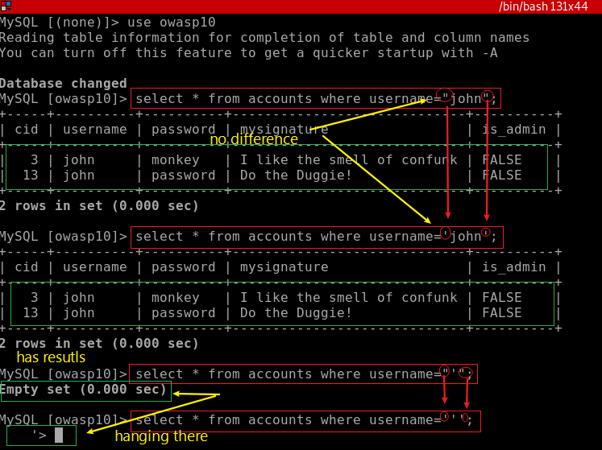
single quote (') is a reserved SQL character may break the below query

Slide 25
SQL injection lab

Slide 26
SQL Injection
A technique often used to attack data driven applications
Web applications
Inject malicious code (commands) in SQL statements, via web page input.
Happens when user input is either incorrectly filtered
Commands embedded in SQL statements

Slide 27

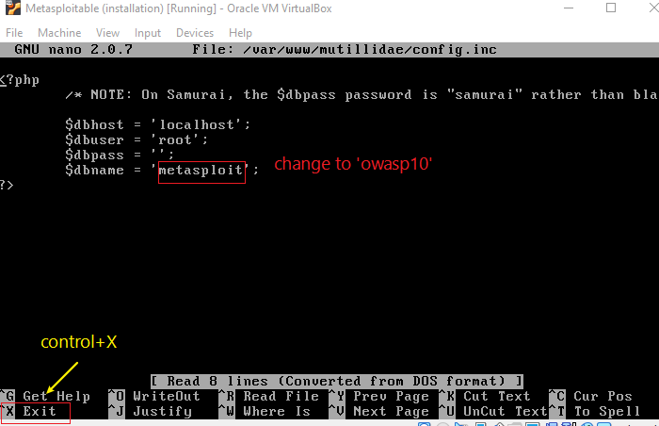
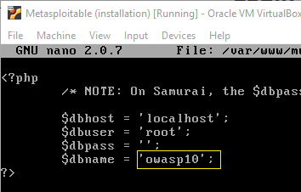
Make mutillidae points to owasp10 database

Slide 28
Animation:
Break system using
single quote (')

Slide 29
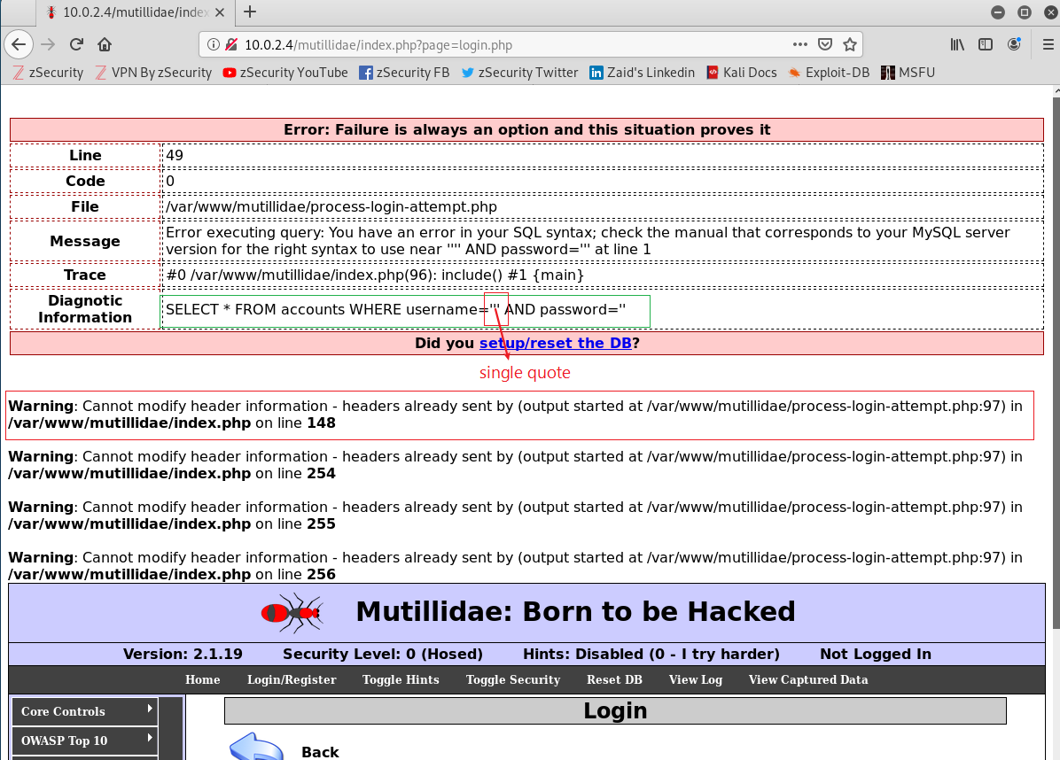

Slide 30
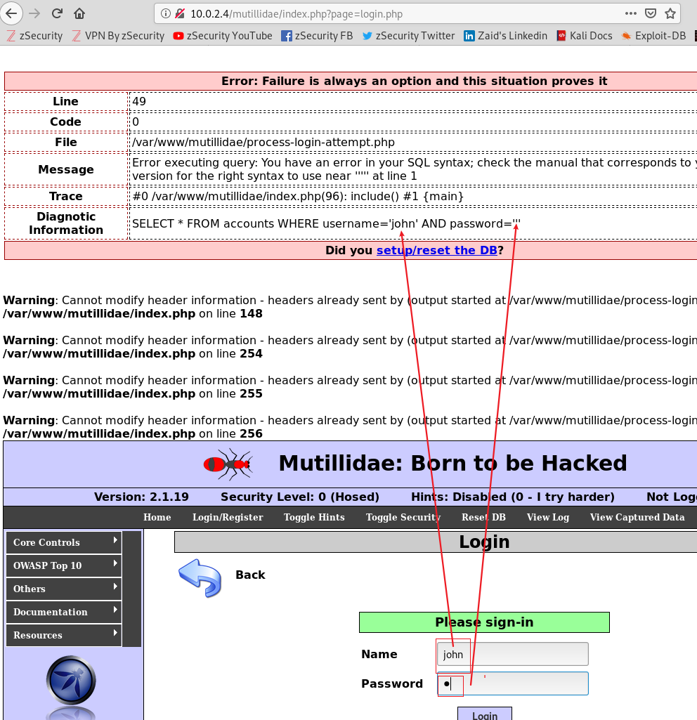
Observation
using single quote (') break system
Whatever user’s type can be inserted into SQL statement (inside the a pair of '')

Slide 31
Code injection goal
Bypass user name and password check
Craft input strings for name and password text fields to fool the SQL statement
Where condition is evaluated as true
SQL statement returns at least one row

Slide 32
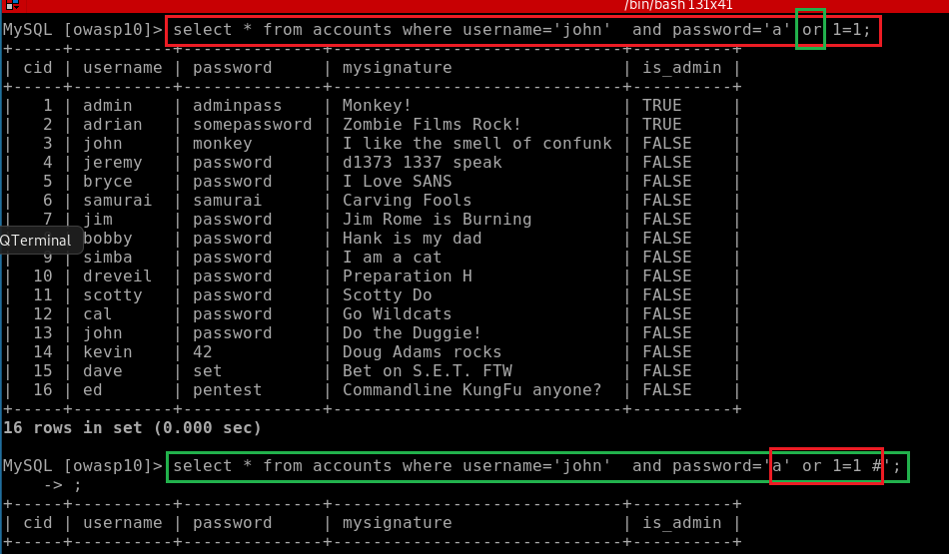

Slide 33
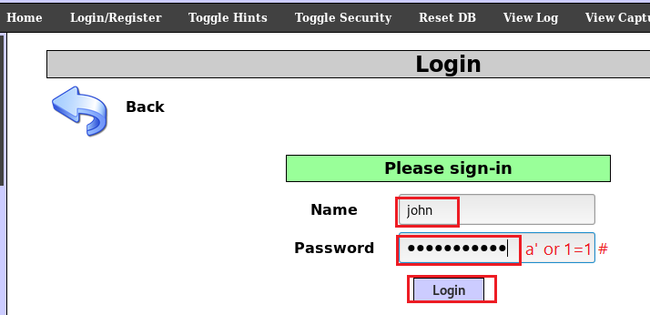
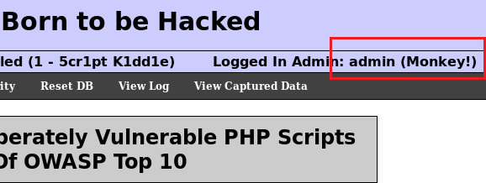
Bypass login
a’_or_1=1_#
_ is a space

Slide 34
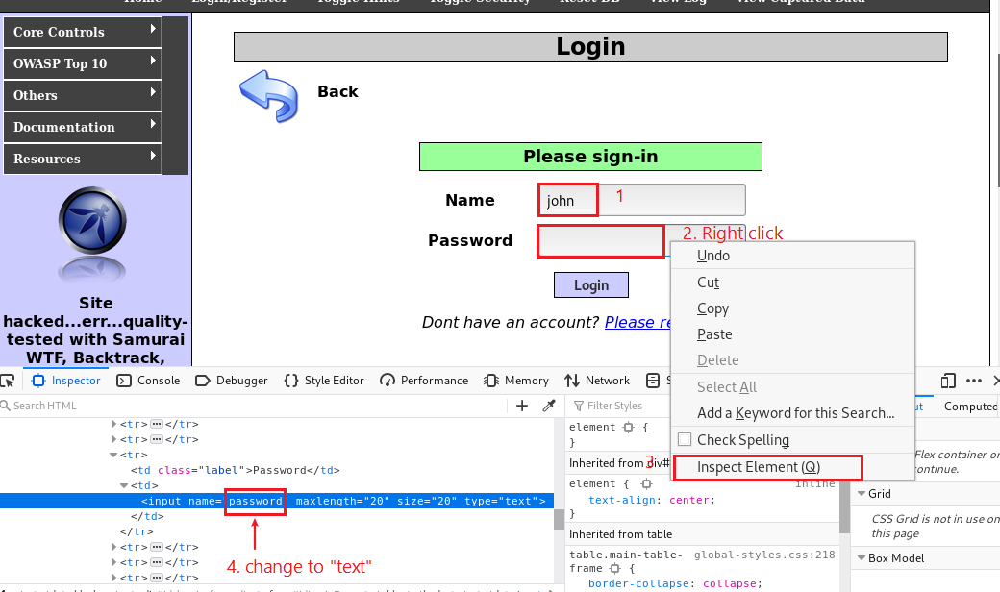
Trick to make password field visible

Slide 35
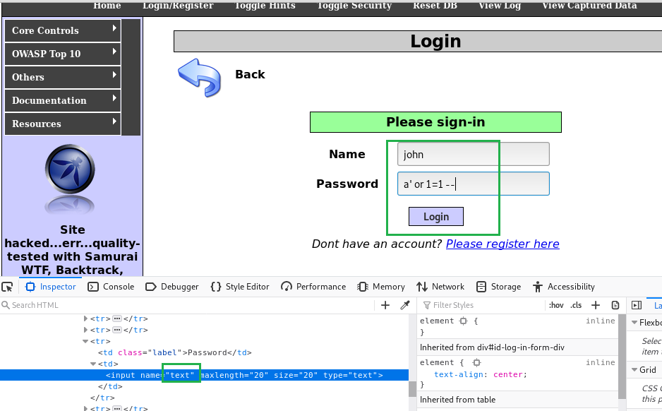
a’_or_1=1_--_
_ is a space

Slide 36
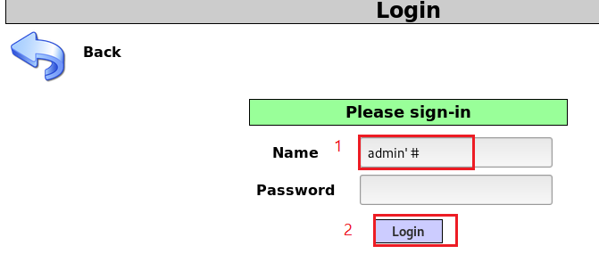
Will the string bypasses the login? Why or why not?

Slide 37
reference
https://www.computersecuritystudent.com/SECURITY_TOOLS/MUTILLIDAE/MUTILLIDAE_2511/lesson5/index.html

