Slide 1
Public key Certificate

Slide 2
Problem of RSA: public keys are not authenticated

Slide 3
Unauthenticated public keys
When Alice receives a public key which is allegedly from Bob, she has no way of knowing whether it is in fact his.

Slide 4
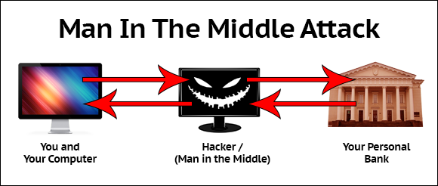
Implication of Unauthenticated public keys
https://www.deepdotweb.com/wp-content/uploads/2016/10/word-image-19.png

Slide 5
MITM example
Suppose Alice wishes to communicate with Bob. Meanwhile, Oscar wishes to intercept the conversation to eavesdrop and optionally to deliver a false message to Bob.

Slide 6



Alice
Bob (k1)
Hi Bob, it's Alice. Give me your Public key.
Here is the public key k1
Here is the public key k2
Oscar <- k2, K1<-
Encrypt message using k2
“Meet me at the bus stop!”
Decrypt using private key of k2
encrypt “Meet me at the van down by the river! ” using k1
Here is the encrypted message
Bob thinks that this message is a secure communication from Alice.
Bob goes to the van down by the river and gets robbed by Oscar.
Alice does not know that Bob was robbed by Mallory thinking Bob is late.
https://en.wikipedia.org/wiki/Man-in-the-middle_attack

Slide 7
Certificates
A technique can help defend against MITM attacks

Slide 8
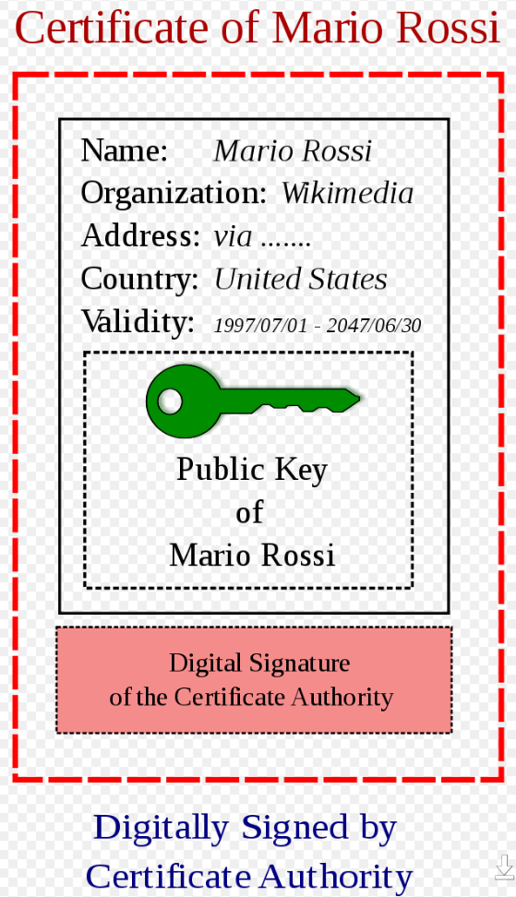
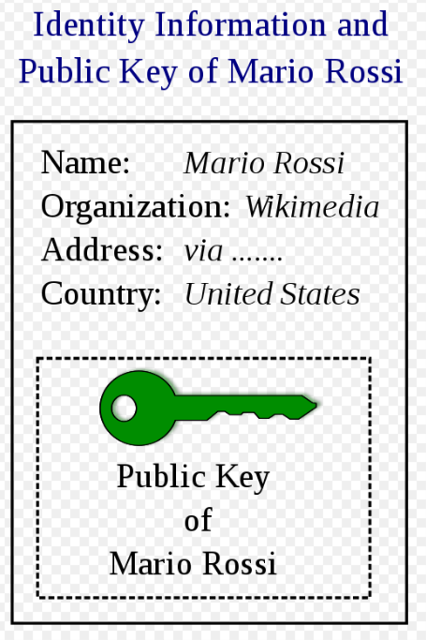
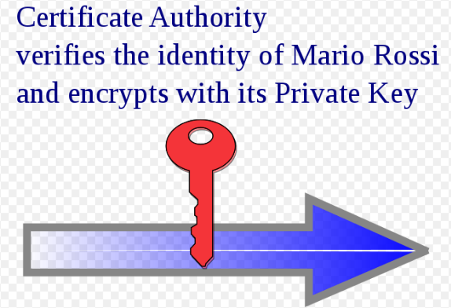
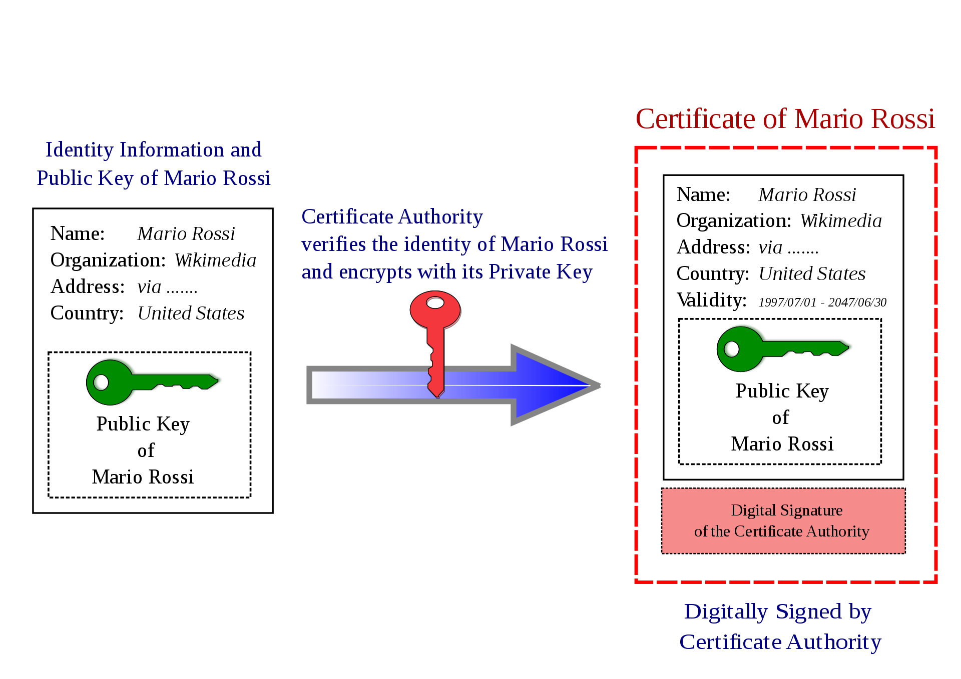

Public key certificate: Definition
An electronic document used to prove the ownership of a public key
K1 => Bob? //does k1 really belong to Bob?
How to prove?
All public keys are digitally signed by a central trusted authority.
The trusted authority that issues the certificate is referred to as certifying authority (CA)
A certificate for the public key k1 of Bob is
Cert(Bob) = (k1, ID(Bob), sig _{kCA} (k1 ,ID(Bob) )
CA

Slide 9
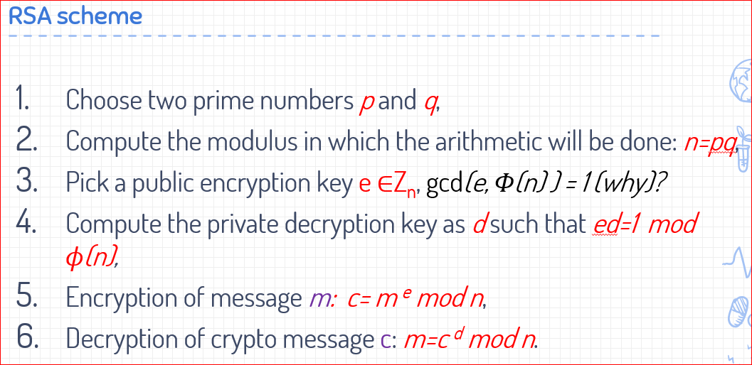
How does CA sign a certificate?
Signing process
Let o= k1, ID(Bob) //Bob owns the public key k1
s = o ^{kca} mod n //kca = the private key of a CA
To verify the public key
o’=s^{pca} mod n // pca = the public key
If o = o’, the public key is valid
=> Bob has the public key k1

Slide 10
Very important!
Why should Alice trust Bob’s public key after authority (CA) signed o= k1, ID(Bob) ?

Slide 11
Public-key infrastructure (PKI)
https://en.wikipedia.org/wiki/Public_key_infrastructure
The entire system that is formed by CAs together with the necessary support mechanisms
A public key infrastructure (PKI) is a set of roles, policies, and procedures needed to create, manage, distribute, use, store, and revoke digital certificates and manage public-key encryption.

Slide 12
HTTPS/SSL certificate

Slide 13
Establishing a secure SSL connection
https://www.cryptool.org/images/ct1/presentations/CrypTool1-Presentation-en.pdf

Slide 14
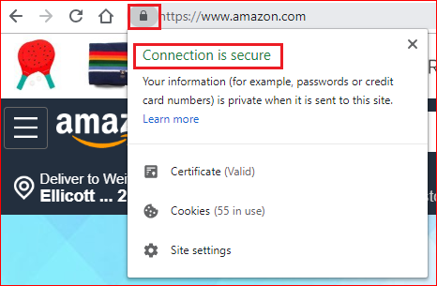
HTTPS/SSL certificate in Chrome
Bob owns an online business
Bob applies SSL certificate from GlobalSign
Bob install SSL in his web server
When customers visit his online website
https://www.youtube.com/watch?time_continue=101&v=dsuVPxuU_hc

Slide 15
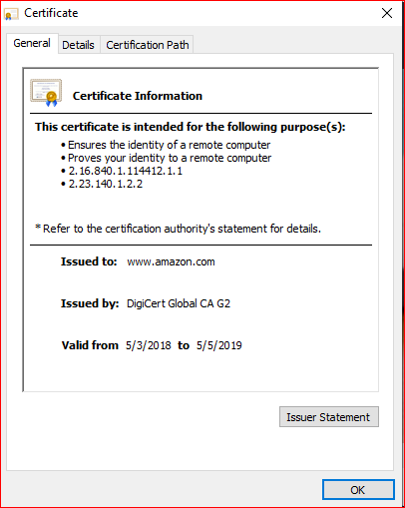
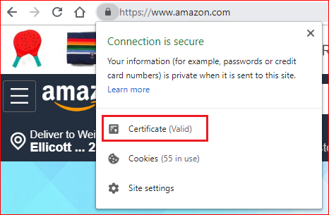
Amazon certificate

Slide 16
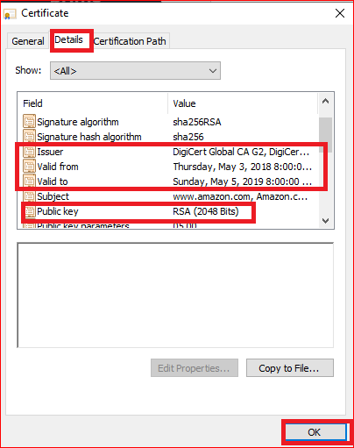
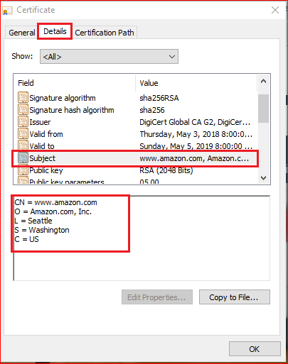
Amazon certificate

Slide 17
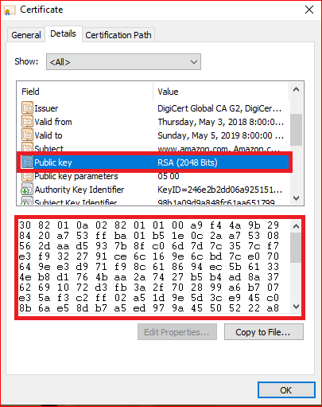
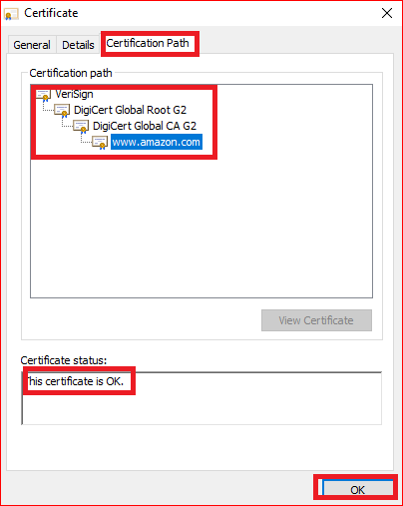
Amazon certificate

Slide 18
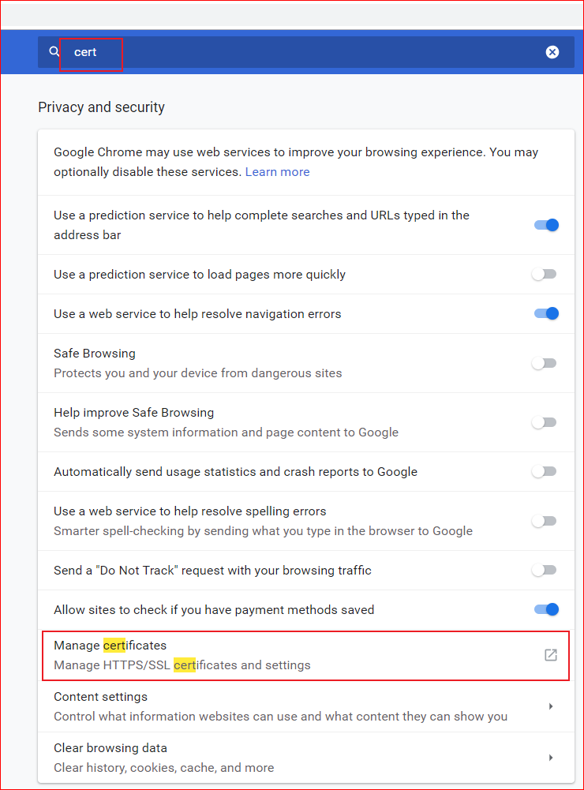
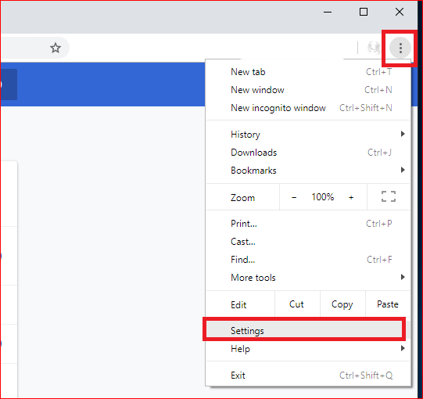
How does Chrome verify the SSL?

Slide 19
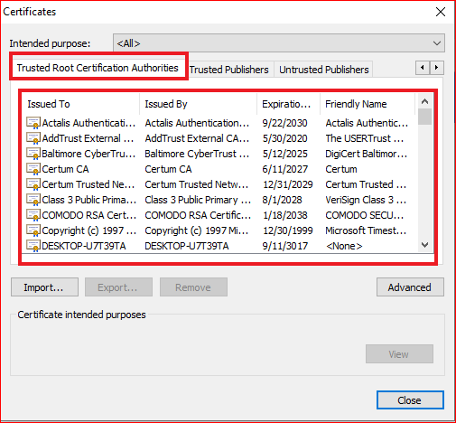

Slide 20
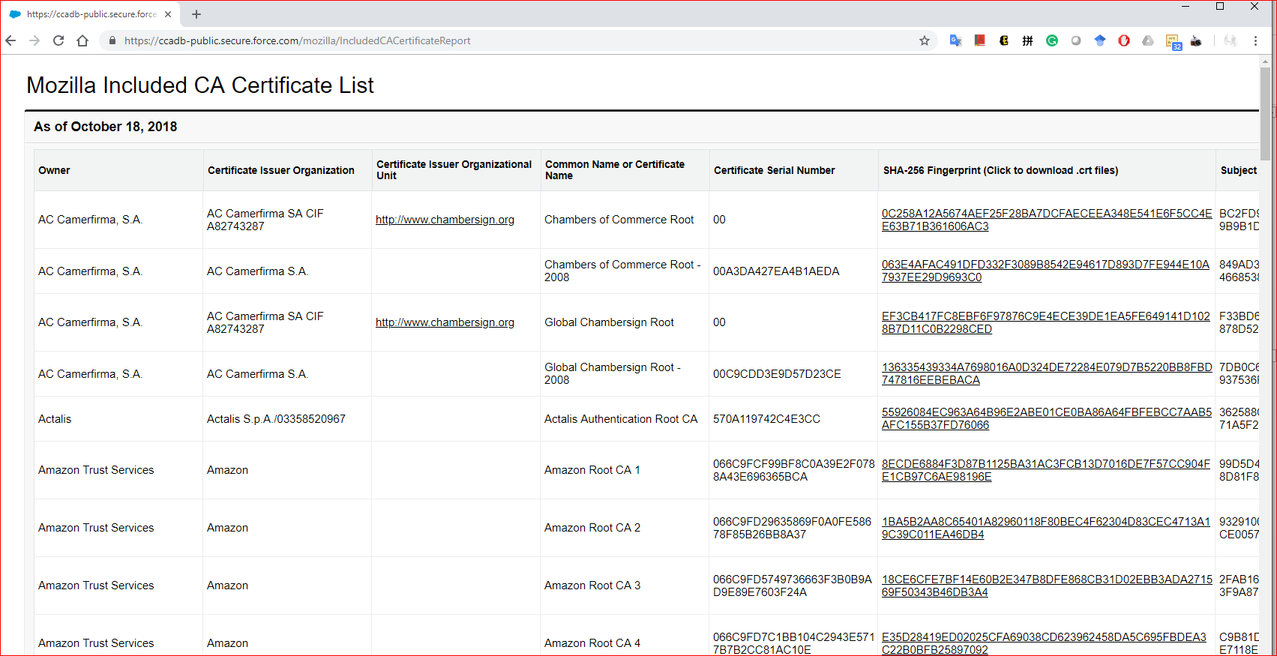

Slide 21
Question
What is a digital certificate?
Describe the MITM attack.
What does it mean when Chrome says “the connection is secure”?
What if Amazon doesn’t use HTTPS?
Should we trust www.ubalt.edu? Why?

Slide 22
PKI Demo

Slide 23
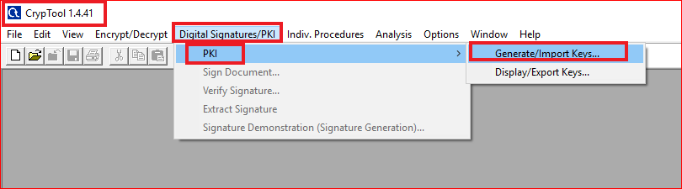
Generate certificates

Slide 24

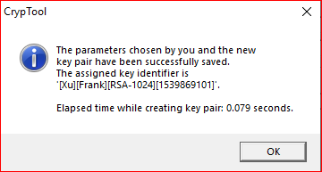

Slide 25
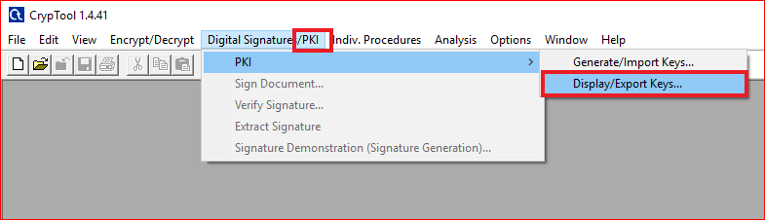
Display certificate

Slide 26
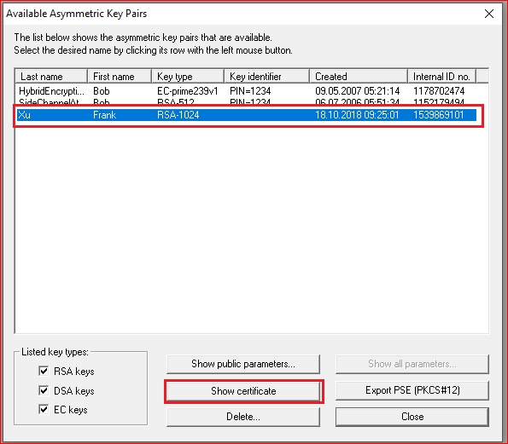

Slide 27
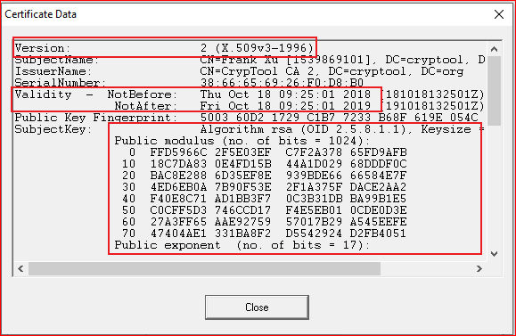
Size=(70)h=(7*32=254)

Slide 28
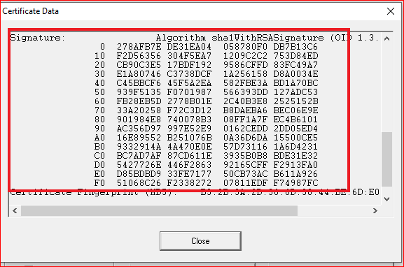

Slide 29
Managing certification stored on the user account

Slide 30
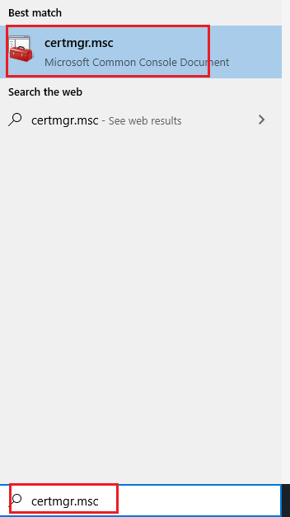
Open certificate manager

Slide 31
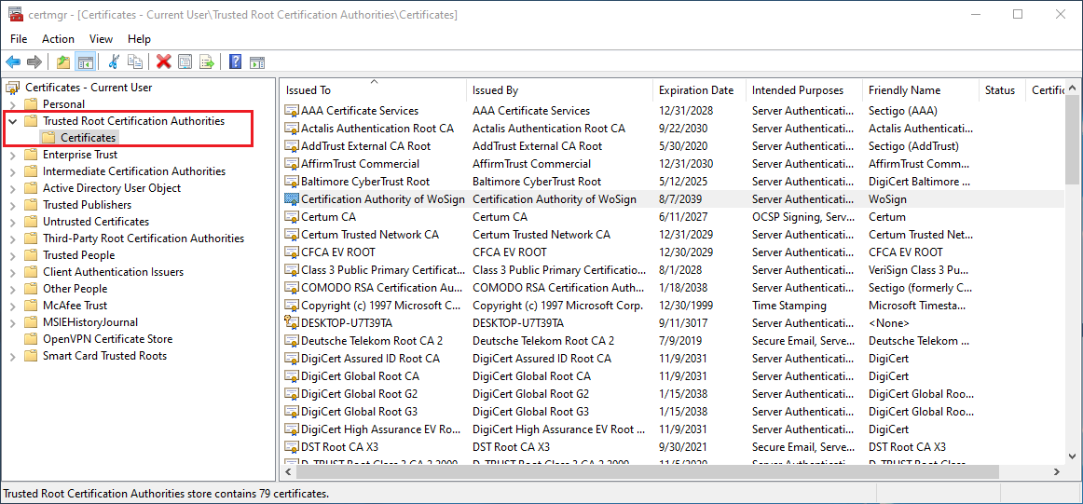

Slide 32
Question
Assume you are a security officer in your company and want to apply for SSL for your website. Write the whole process of applying SSL.

