Slide 1
Install metasploitable

Slide 2
What is metasploitable

Slide 3
Metasploitable vs Metasploit
Metasploitable
A virtual machine that is intentionally vulnerable for testing Metasploit
Metasploit
a penetration testing framework for penetration testing/security assessment

Slide 4
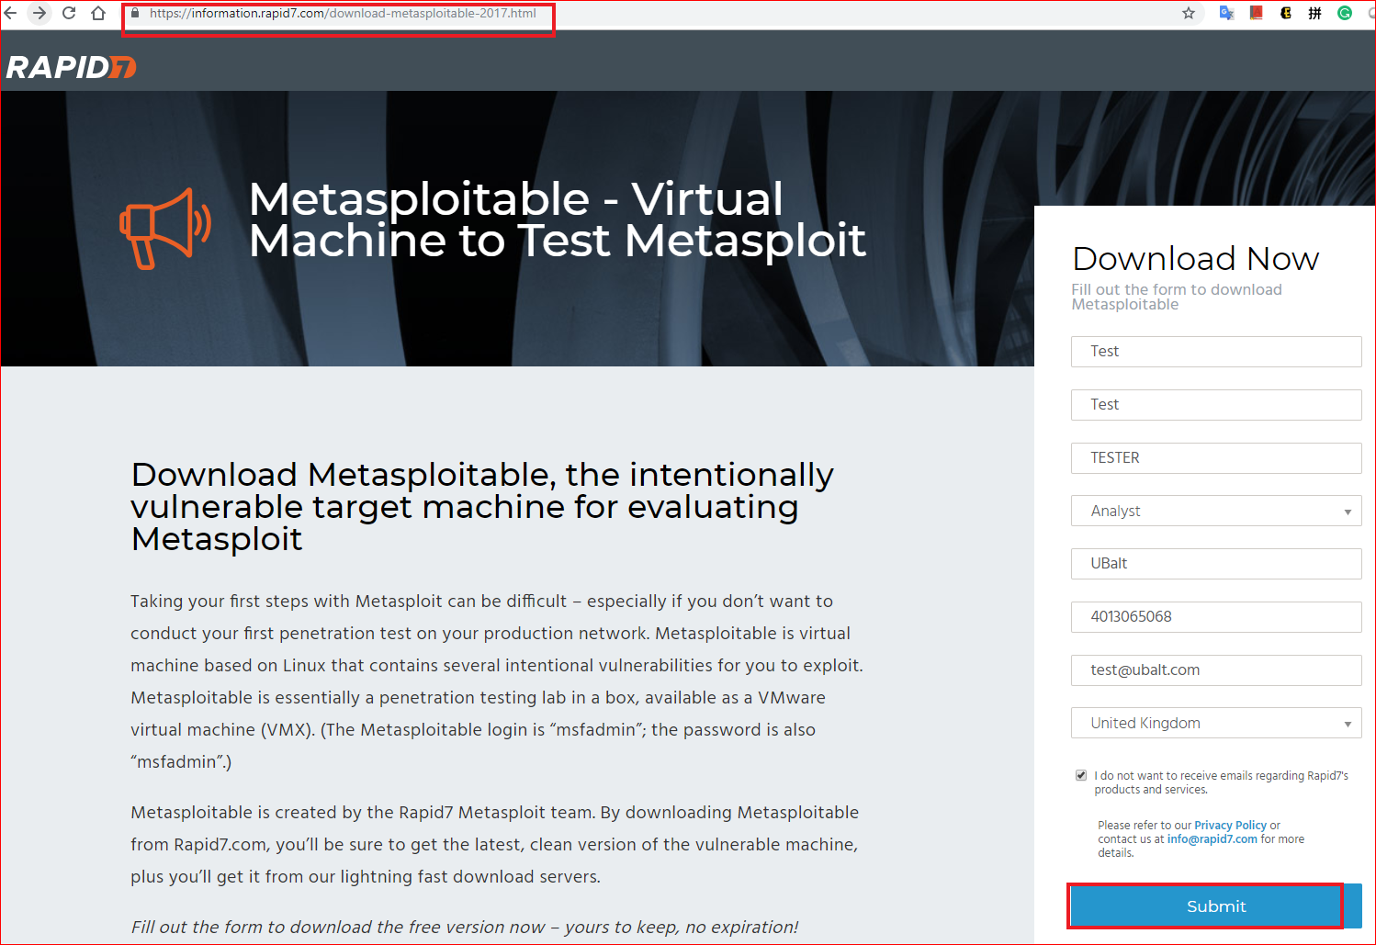

Slide 5
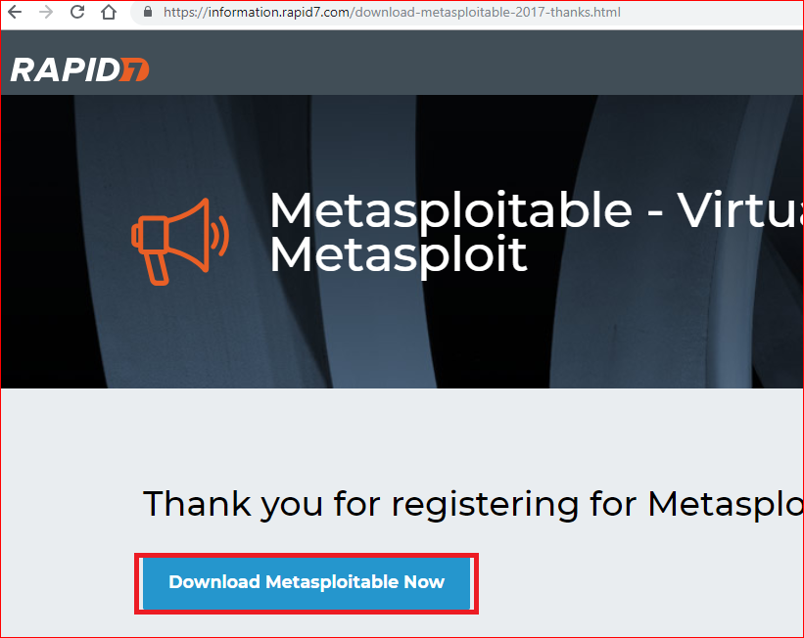

Slide 6

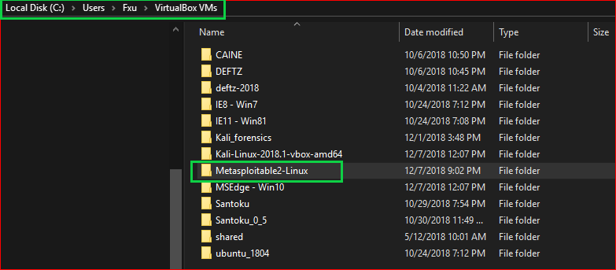
unzip

Slide 7
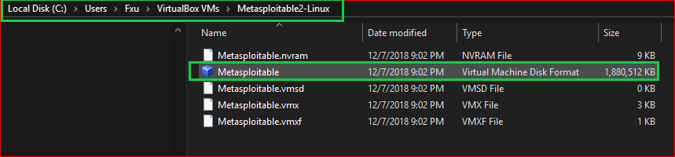

Slide 8
.vmdk: describes containers for virtual hard disk drives

Slide 9
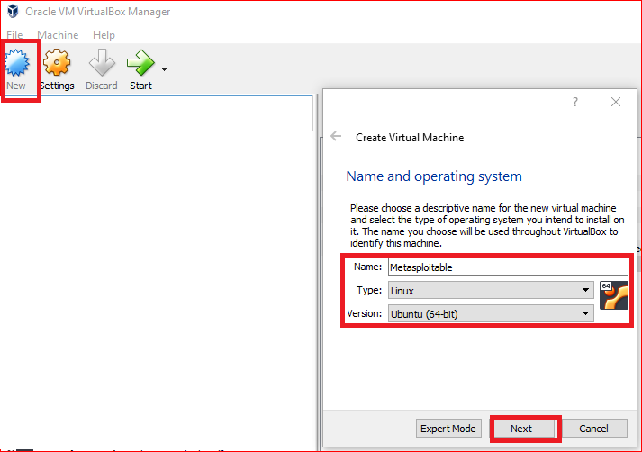

Slide 10
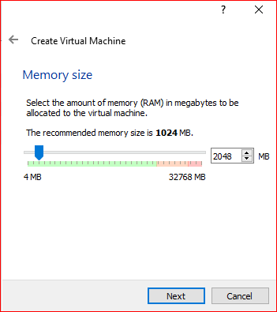

Slide 11
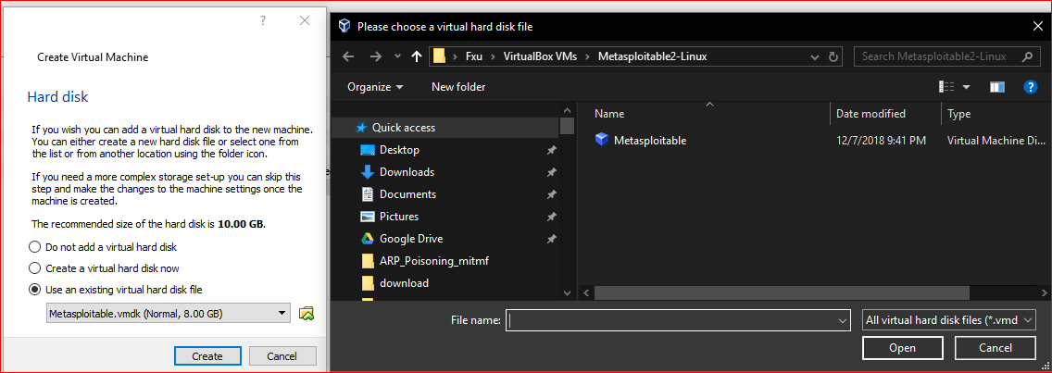

Slide 12
Network Configuration

Slide 13
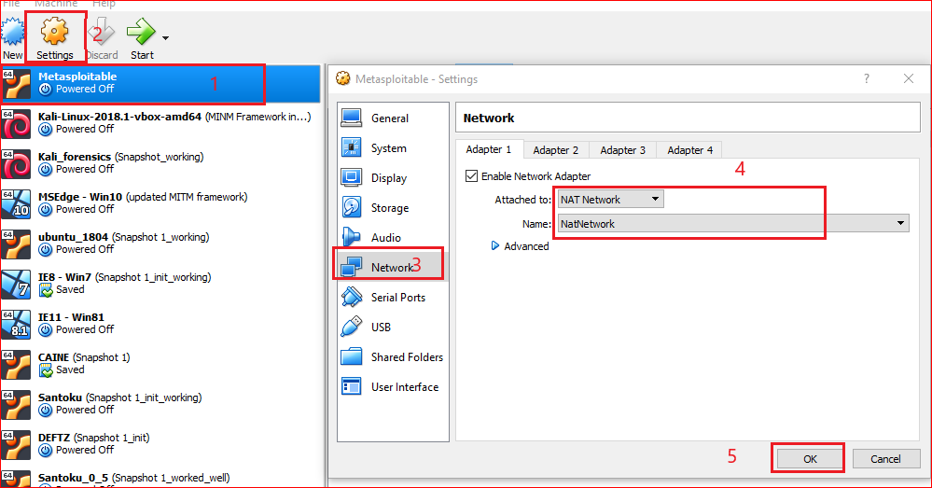

Slide 14
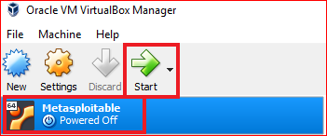
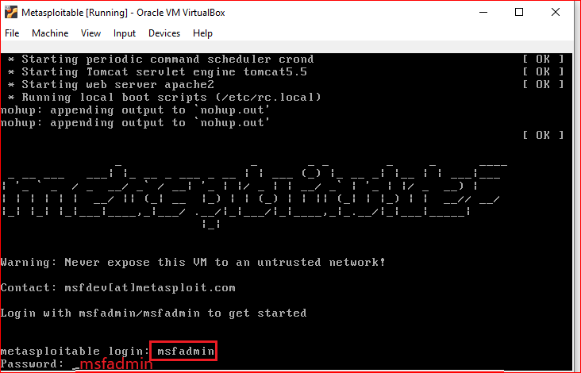

Slide 15
Testing

Slide 16
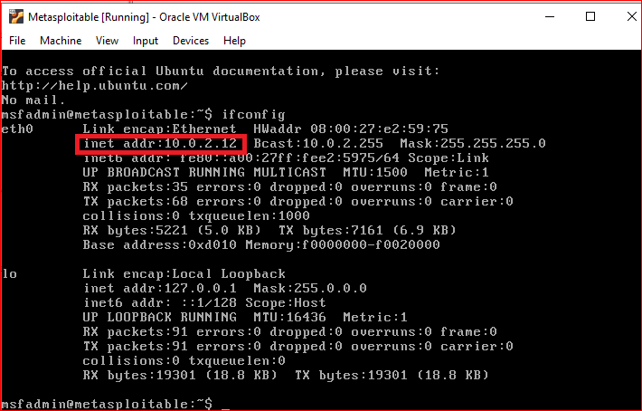

Slide 17
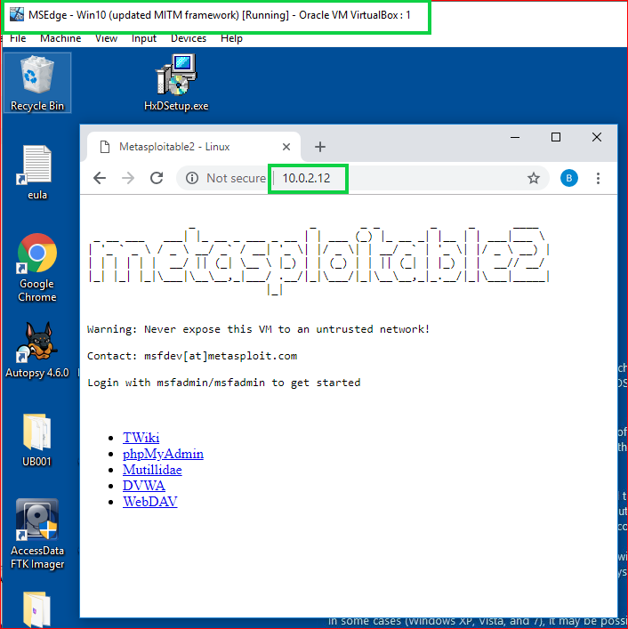

Slide 18
Take snapshots

Slide 19
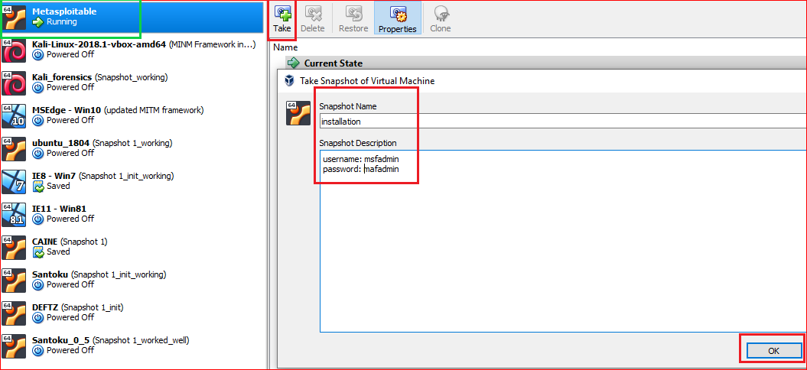

Slide 20
