Slide 1
'rlogin' Remote Login Service Enabled

Slide 2
target information gathering

Slide 3
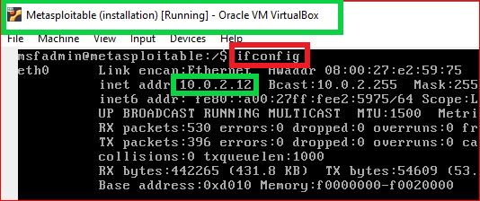


1
2
3

Slide 4
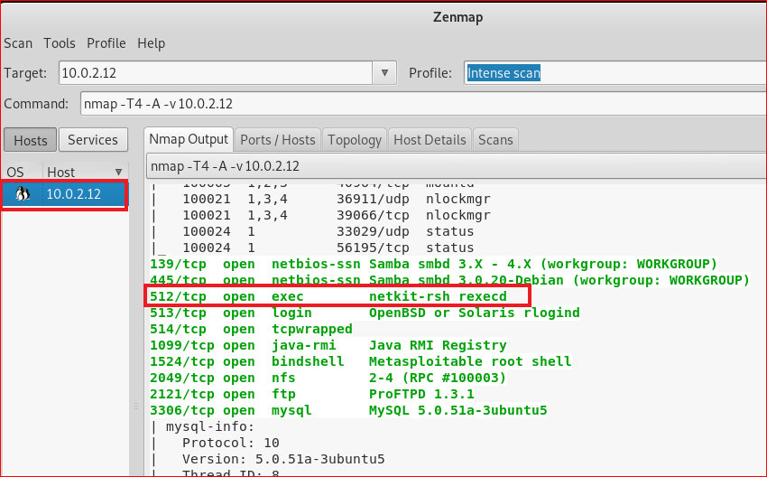

Slide 5
search possible vulnerabilities

Slide 6
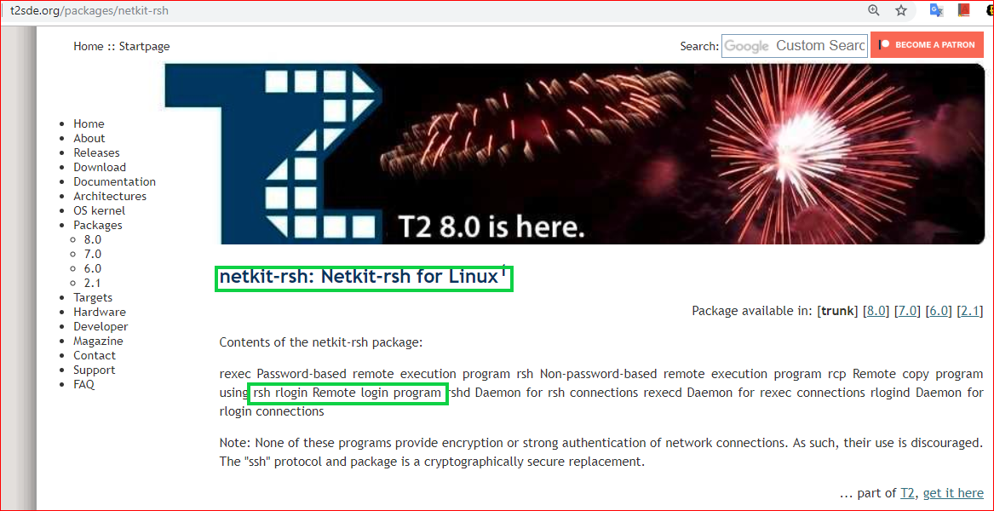

Slide 7
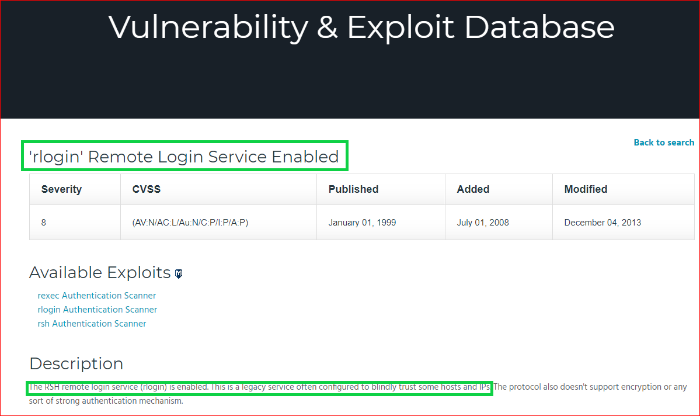

Slide 8
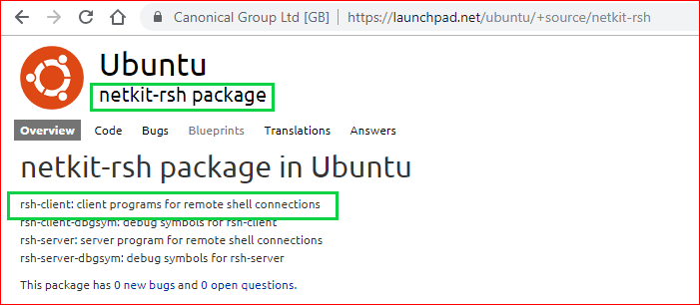

Slide 9
Remote Login

Slide 10
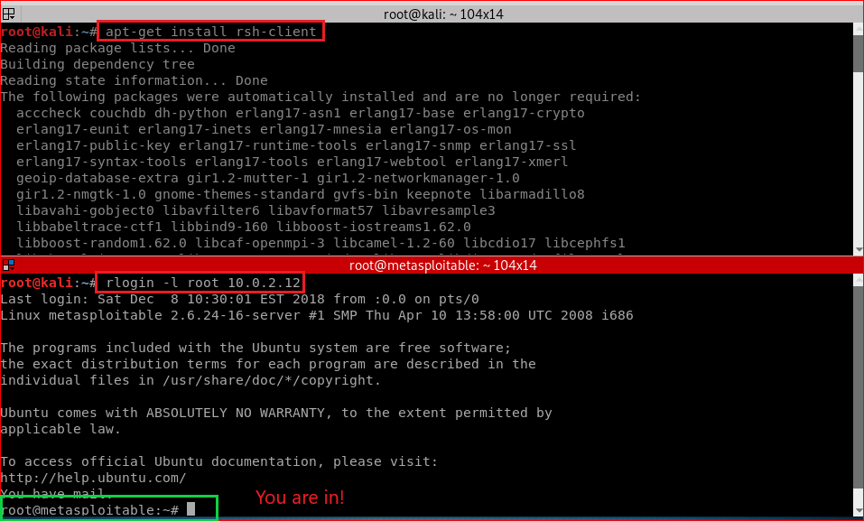

Slide 11
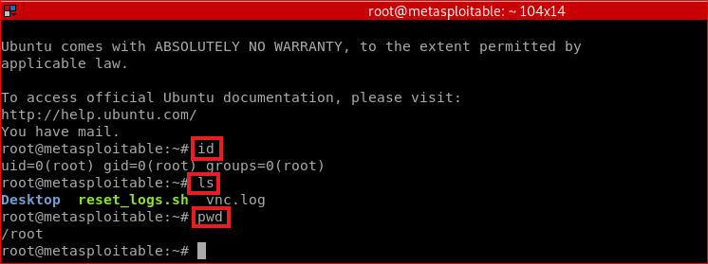

Slide 12
Forensic Investigation

Slide 13

