Slide 1
Inject Commands to Servers

Slide 2
target information gathering

Slide 3
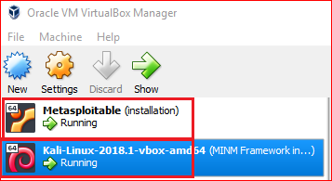

Slide 4
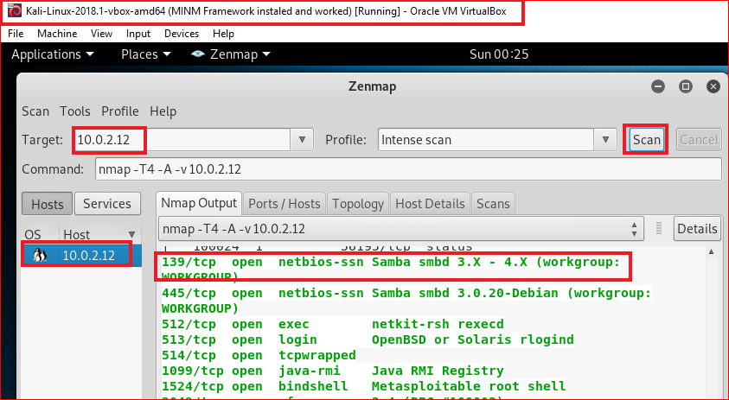

Slide 5
Search potential vulnerabilities

Slide 6
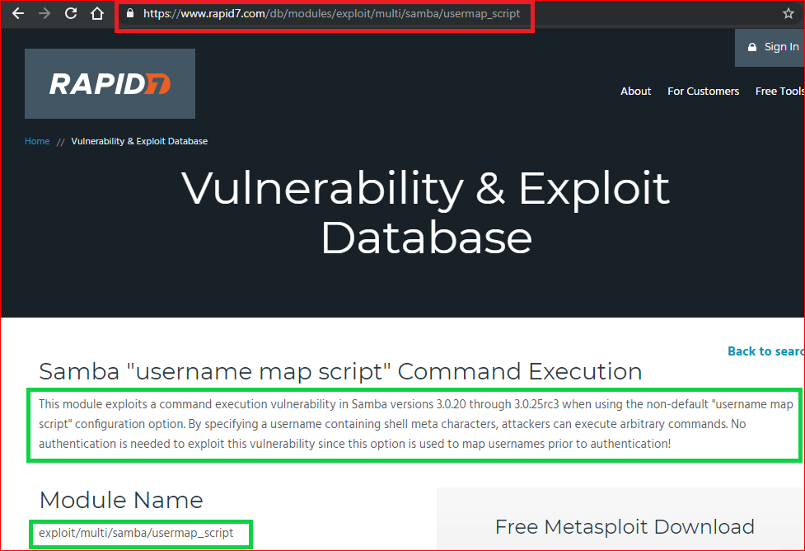

Slide 7
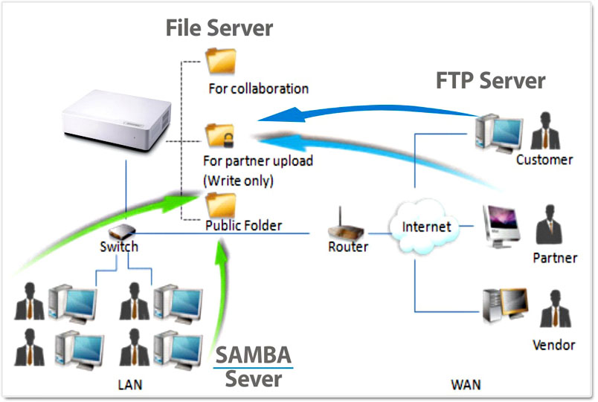
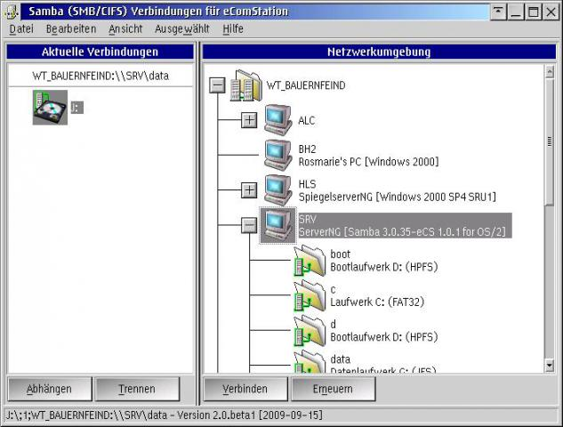
What is Samba?
A software, Samba, provides file and print services for various Microsoft Windows & Linux clients

Slide 8
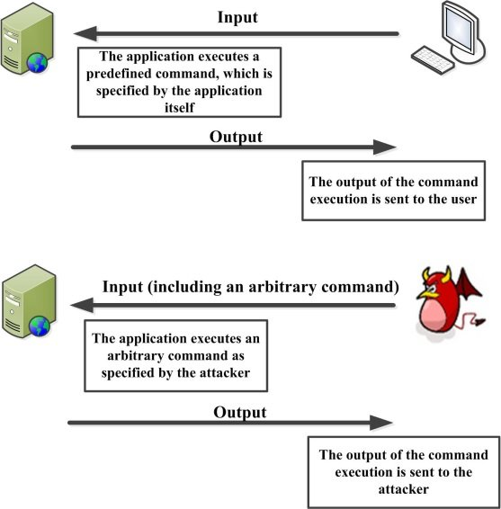
Command injection
An attack in which the goal is execution of arbitrary commands on the host operating system via a vulnerable application.
When an application passes unsafe user supplied data (forms, cookies, HTTP headers etc.) to a system shell.
https://www.researchgate.net/figure/Command-injection-attacks_fig1_322875799

Slide 9
Inject commands to Samba

Slide 10
Injection details
Samba is running on servers
We inject arbitrary commands to Samba
Commands allow malicious users (e.g., Kali) to gain controls to the servers

Slide 11
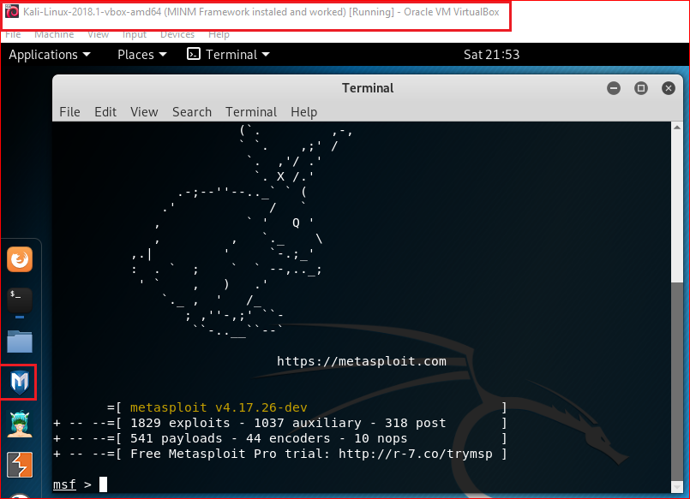
msfconsole
Notes:
Msf
consle

Slide 12
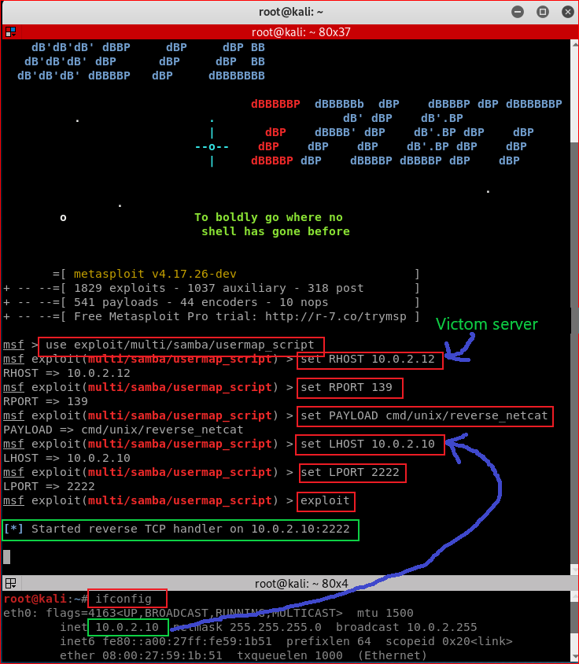

Slide 13
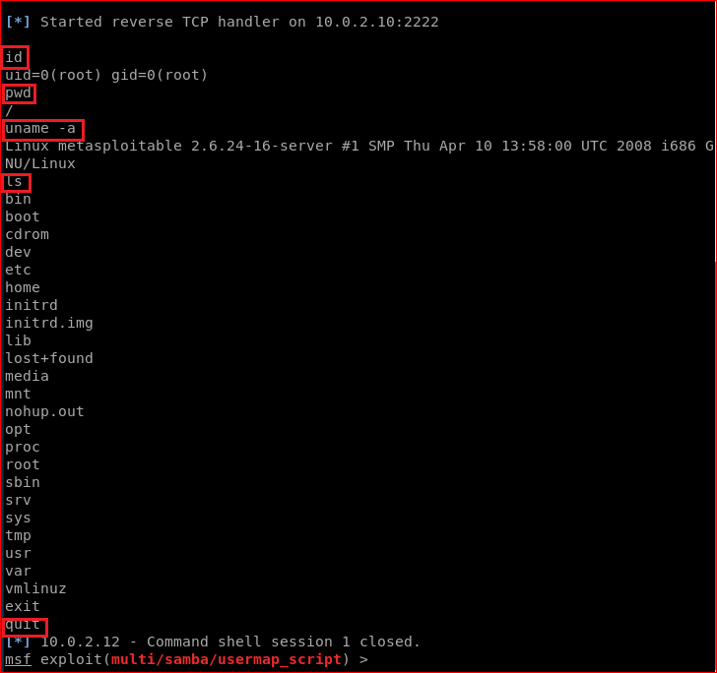

Slide 14

server side forensics using firewall

Slide 15
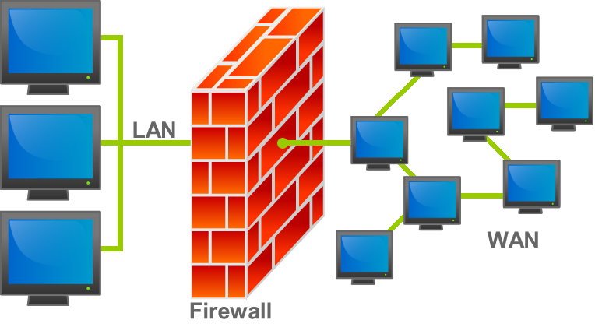
What is a firewall
https://en.wikipedia.org/wiki/File:Firewall.png

Slide 16
Create a rule for monitoring traffics
Your job is to find forensic evidence.
The evidence will tell us when intruder’s IP.

Slide 17
Reference
http://xahlee.info/linux/linux_iptables_basics.html
http://vault.centos.org/3.6/docs/html/rhel-rg-en-3/s1-iptables-options.html

