Slide 1
Cloning Websites

Slide 2
Credential Harvester

Slide 3
Overview
Utilize web cloning of a web- site that has a username and password field
Harvest all the information posted to the website

Slide 4
Cloning and listening

Slide 5

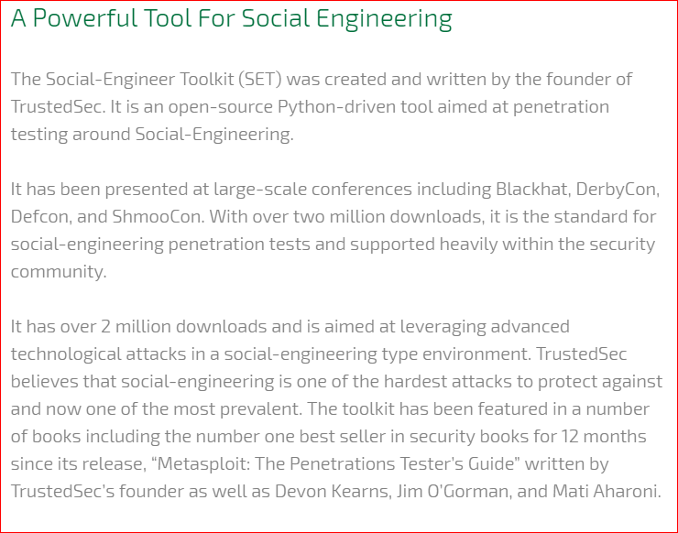

Slide 6

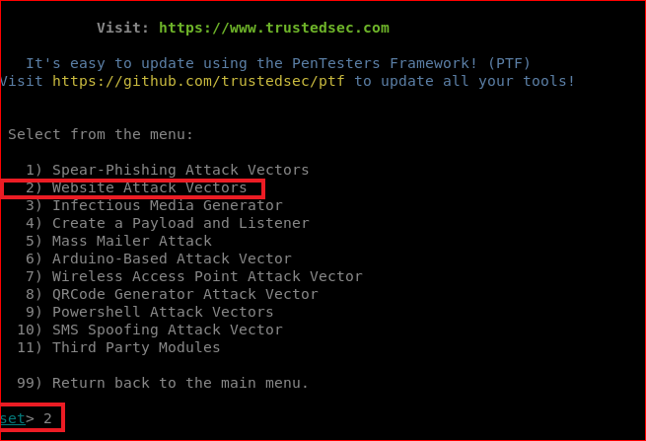

Slide 7
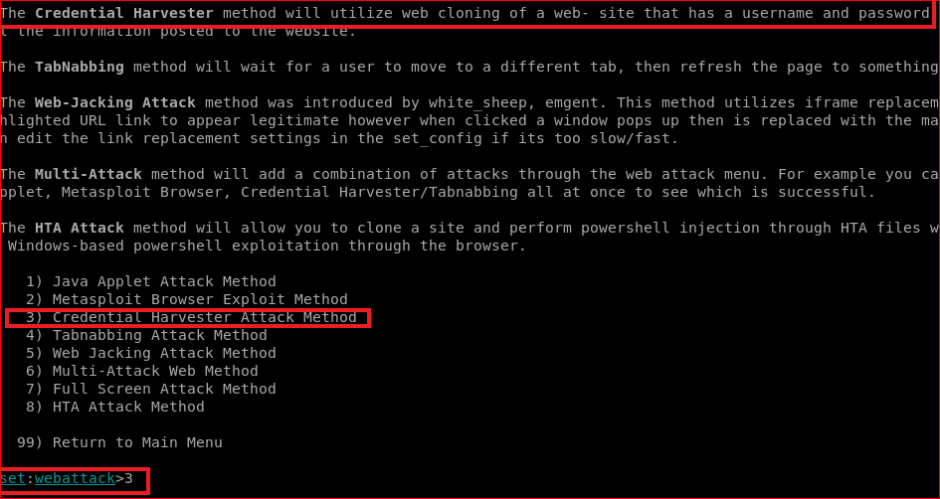

Slide 8
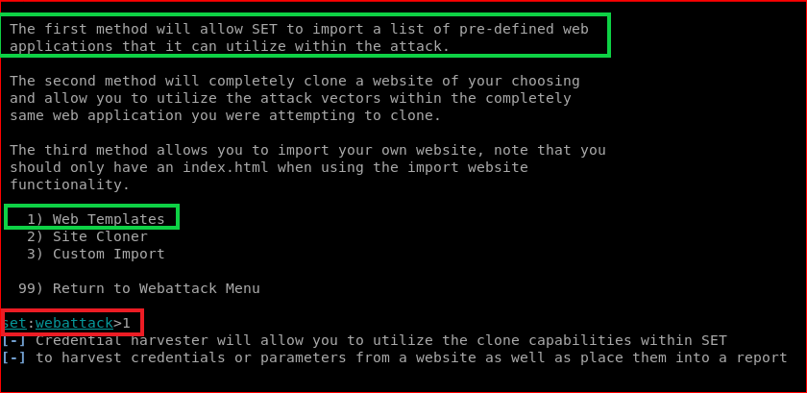

Slide 9
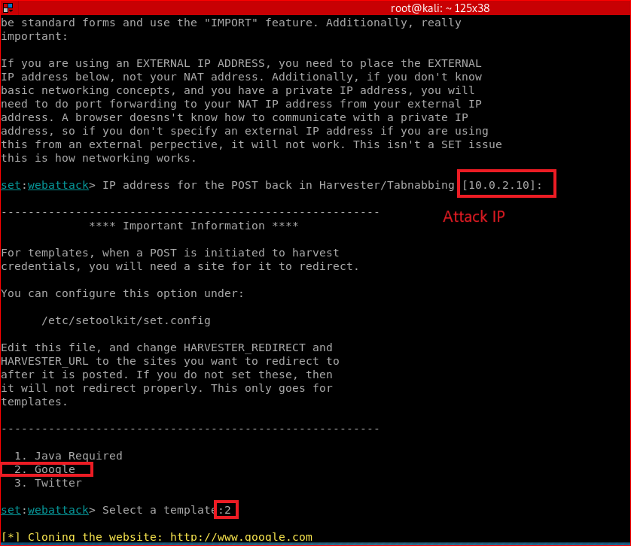

Slide 10
Victims use fake websites

Slide 11
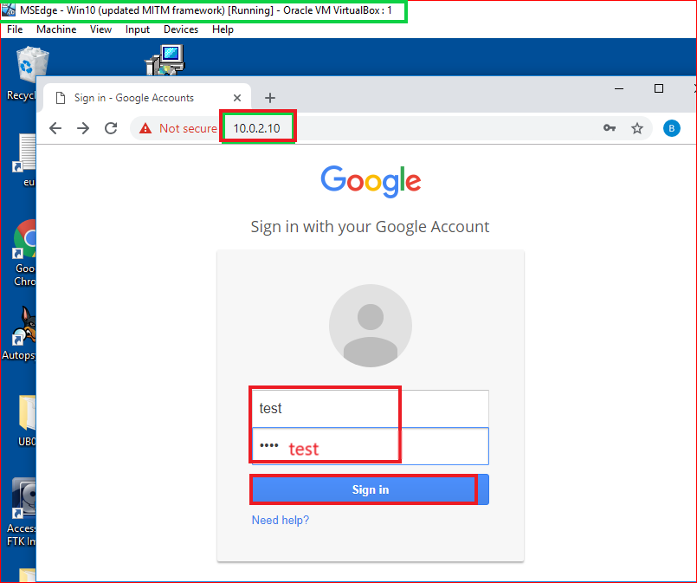

Slide 12
Attackers obtain passwords

Slide 13
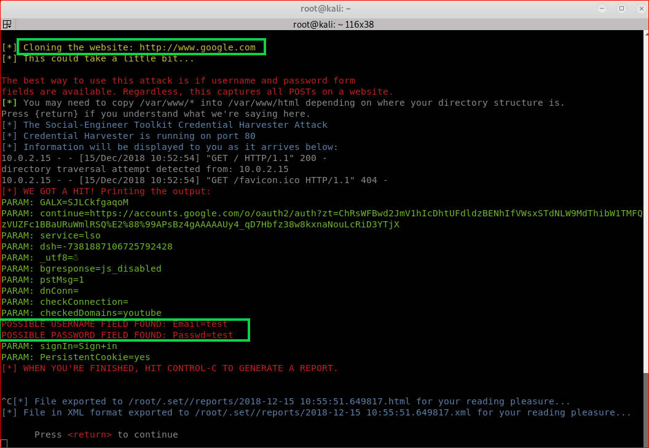

Slide 14
Forensic evidence to detect the attack

Slide 15
Reference
https://github.com/trustedsec/social-engineer-toolkit

