Slide 1
Using Empire to Create a Backdoor

Slide 2

Introduction
Empire
a post-exploitation framework
offers cryptologically-secure communications and a flexible architecture
Empire stage process
a key-exchange protocol used by Empire is called Encrypted Key Exchange (EKE).
to bypass common anti-virus solutions.
Example: WindowsPowershell Empire
Reverse http
victim acts as client. Not the attack.
Backdoor connect to me (attacker) to void anti-virus detection.

Slide 3
Backdoor Installation

Slide 4
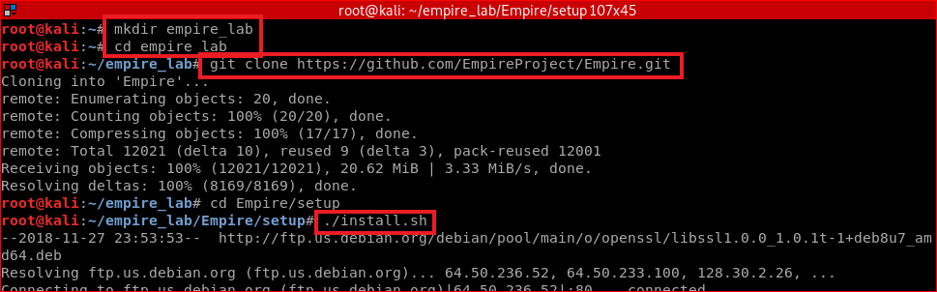
Download Empire

Slide 5
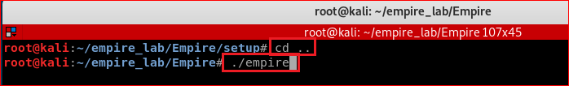
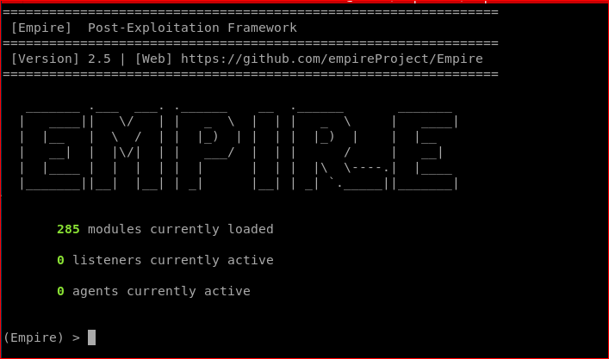
Run Empire

Slide 6
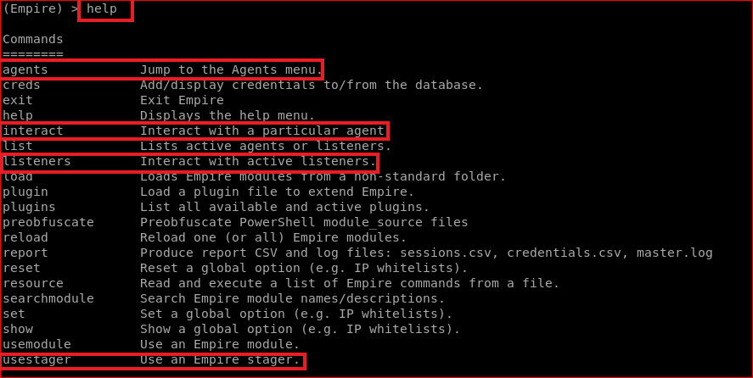
Top level commands

Slide 7
Create a Listener

Slide 8
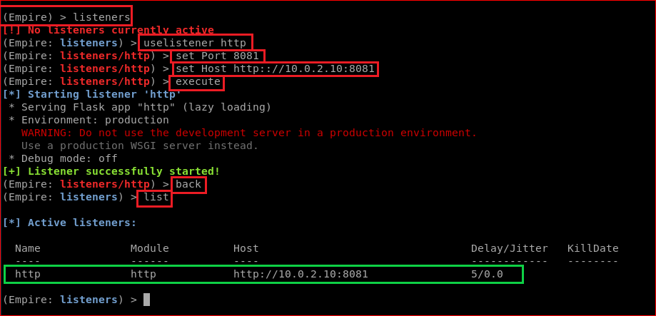

Slide 9
create a backdoor for Windows 10

Slide 10
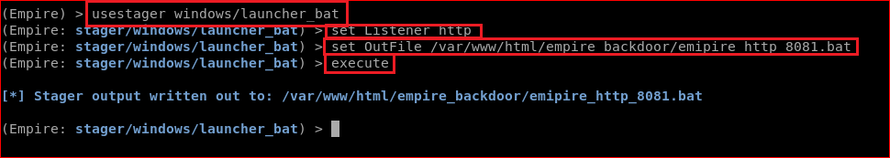

Slide 11
Victim download the backdoor

Slide 12

Kali host a fake website

Slide 13
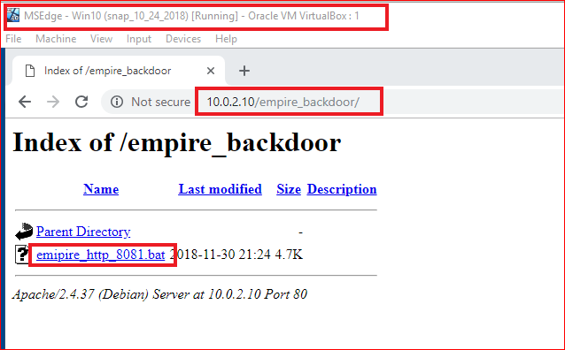
Victim run the backdoor

Slide 14
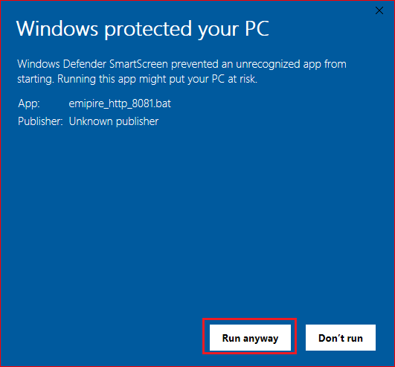

Slide 15
Access to victim's computer

Slide 16
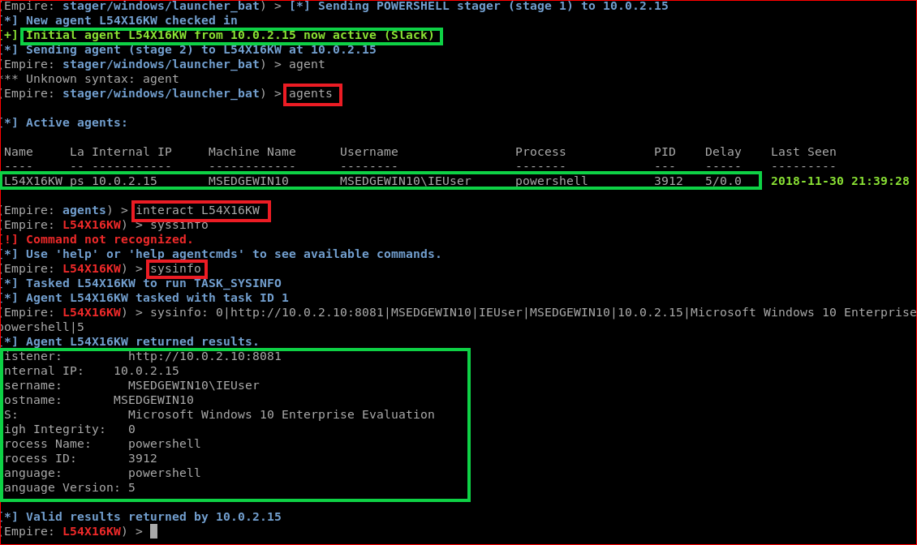

Slide 17
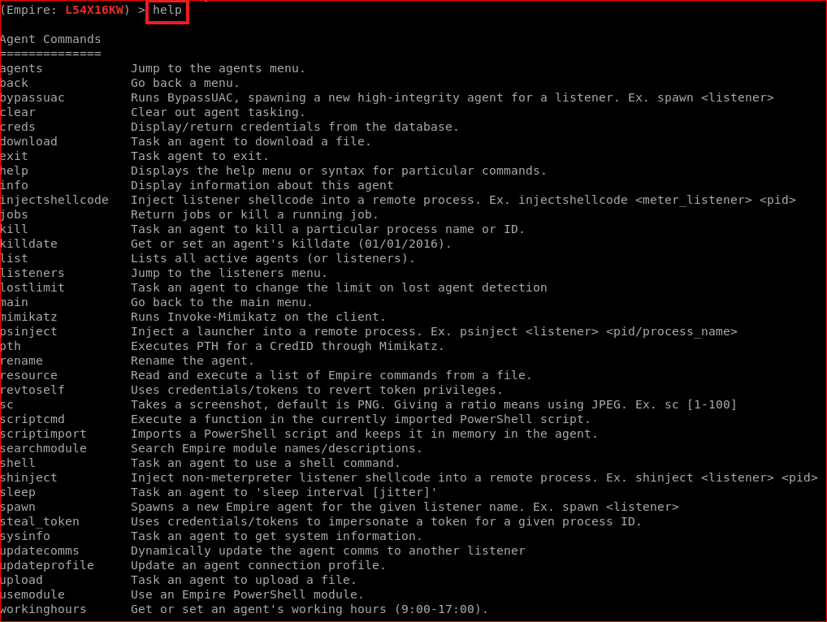

Slide 18
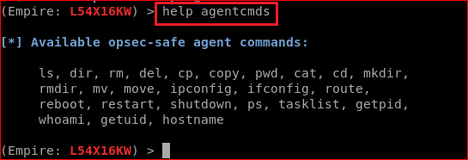
Commands for finding evidence

