Slide 1
File System Implementation
Yejin Choi (ychoi@cs.cornell.edu)

Slide 2
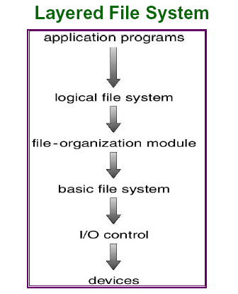
Layered File System
Logical File System
  Maintains file structure via FCB (file control block)
File organization module
  Translates logical block to physical block
Basic File system
  Converts physical block to disk parameters (drive 1, cylinder 73, track 2, sector 10 etc)
I/O Control
  Transfers data between memory and disk

Slide 3
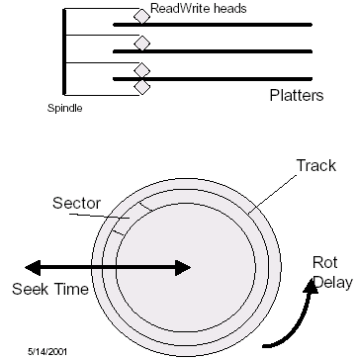
Physical Disk Structure
Parameters to read from disk:
  cylinder(=track) #
  platter(=surface) #
  sector #
  transfer size

Slide 4
File system Units
Sector – the smallest unit that can be accessed on a disk (typically 512 bytes)
Block(or Cluster) – the smallest unit that can be allocated to construct a file
What’s the actual size of 1 byte file on disk?
  takes at least one cluster,
  which may consist of 1~8 sectors,
  thus 1byte file may require ~4KB disk space.

Slide 5
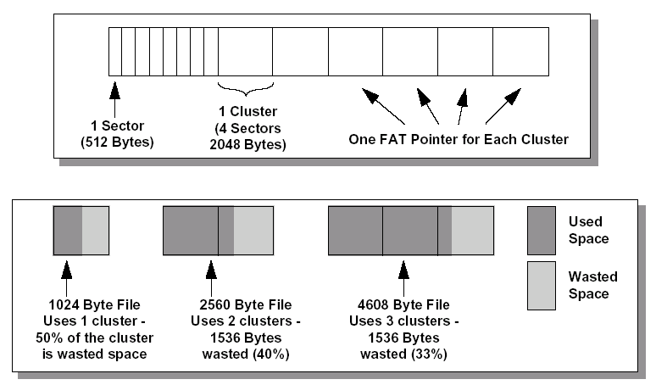
Sector~Cluster~File layout

Slide 6
FCB – File Control Block
Contains file attributes + block locations
  Permissions
  Dates (create, access, write)
  Owner, group, ACL (Access Control List)
  File size
  Location of file contents
UNIX File System ➔ I-node
FAT/FAT32 ➔ part of FAT (File Alloc. Table)
NTFS ➔ part of MFT (Master File Table)

Slide 7
Partitions
Disks are broken into one or more partitions.
Each partition can have its own file system method (UFS, FAT, NTFS, …).

Slide 8
A Disk Layout for A File System
Boot
block
Super
block
File descriptors
(FCBs)
File data blocks
Super block defines a file system
  size of the file system
  size of the file descriptor area
  start of the list of free blocks
  location of the FCB of the root directory
  other meta-data such as permission and times
Where should we put the boot image?

Slide 9
Boot block
Dual Boot
  Multiple OS can be installed in one machine.
  How system knows what/how to boot?
Boot Loader
  Understands different OS and file systems.
  Reside in a particular location in disk.
  Read Boot Block to find boot image.

Slide 10
Block Allocation
Contiguous allocation
Linked allocation
Indexed allocation

Slide 11
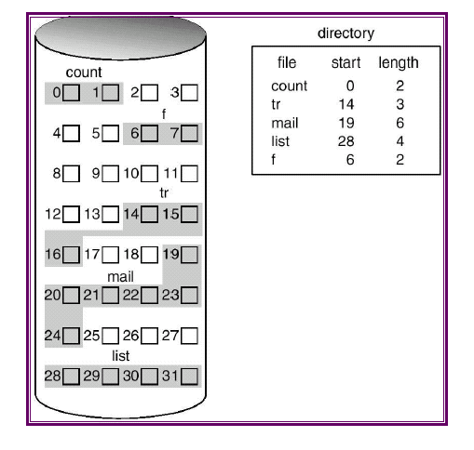
Contiguous Block Allocation

Slide 12
Contiguous Block Allocation
Pros:
  Efficient read/seek. Why?
  ➔ disk location for both sequential & random access can be obtained instantly.
  ➔ Spatial locality in disk

Slide 13
Contiguous Block Allocation
Pros:
  Efficient read/seek. Why?
  ➔ disk location for both sequential & random access can be obtained instantly.
  ➔ Spatial locality in disk
Cons:
  When creating a file, we don’t know how many blocks may be required…
  ➔ what happens if we run out of contiguous blocks?
  Disk fragmentation!

Slide 14
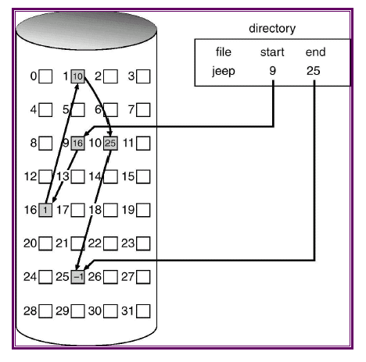
Linked Block Allocation

Slide 15
Linked Block Allocation
Pros:
  Less fragmentation
  Flexible file allocation

Slide 16
Linked Block Allocation
Pros:
  Less fragmentation
  Flexible file allocation
Cons:
  Sequential read requires disk seek to jump to the next block. (Still not too bad…)
  Random read will be very inefficient!!
  O(n) time seek operation
  (n = # of blocks in the file)

Slide 17
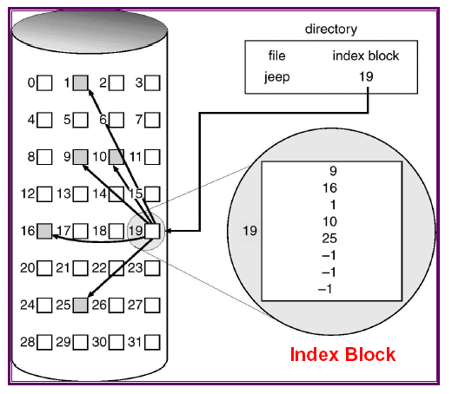
Indexed Block Allocation
Maintain an array of pointers to blocks.
Random access becomes as easy as sequential access!
UNIX File System

Slide 18
Free Space Management
What happens when a file is deleted?
➔ We need to keep track of free blocks…
Bit Vector (or BitMap)
Linked List

Slide 19
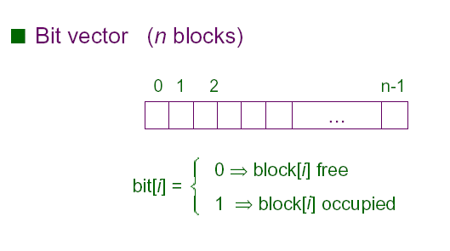
Bit Vector (= Bit Map)

Slide 20
Bit Vector (= Bit Map)
Pros
  Could be very efficient with hardware support
  We can find n number of free blocks at once.
Cons
  Bitmap size grows as disk size grows. Inefficient if entire bitmap can’t be loaded into memory.

Slide 21
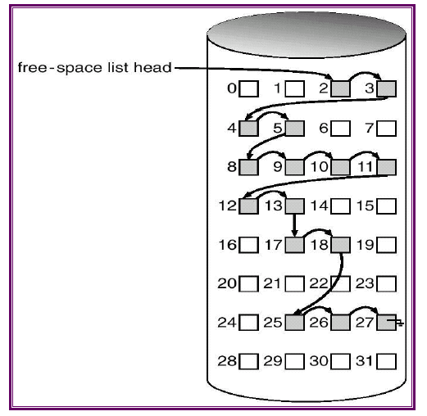
Linked List

Slide 22
Linked List
Pros
  No need to keep global table.
Cons
  We have to access each block in the disk one by one to find more than one free block.
  Traversing the free list may require substantial I/O

Slide 23
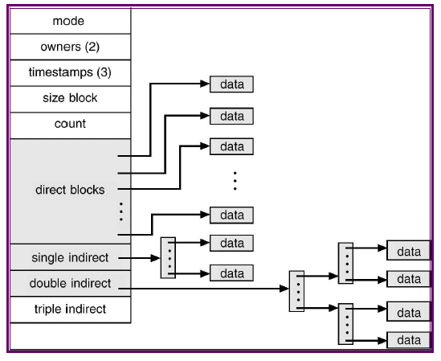
UNIX file layout overview

Slide 24
I-node
FCB(file control block) of UNIX
Each i-node contains 15 block pointers
  12 direct block pointers and 3 indirect (single,double,triple) pointers.
Block size is 4K
  ➔ Thus, with 12 direct pointers, first 48K are directly reachable from the i-node.

Slide 25
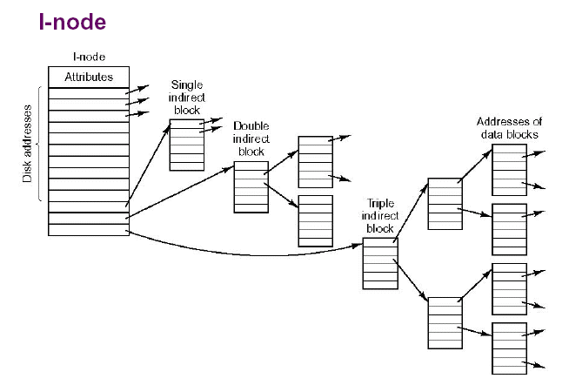
I-node block indexing

Slide 26
I-node addressing space
Recall block size is 4K, then
Indirect block contains 1024(=4KB/4bytes)entries
A single-indirect block can address
1024 * 4K = 4M data
A double-indirect block can address
  1024 * 1024 * 4K = 4G data
A triple-indirect block can address
  1024 * 1024 * 1024 * 4K = 4T data
Any Block can be found with at most 3 indirections.

Slide 27
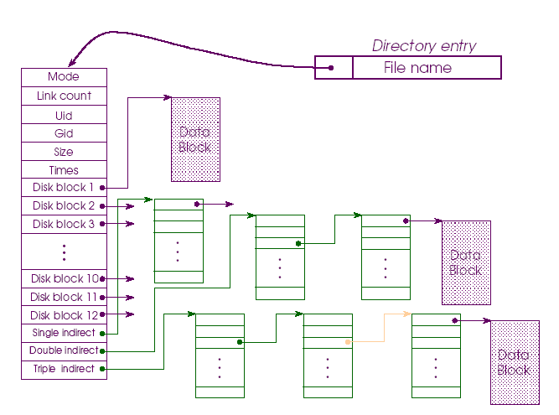
File Layout in UNIX

Slide 28
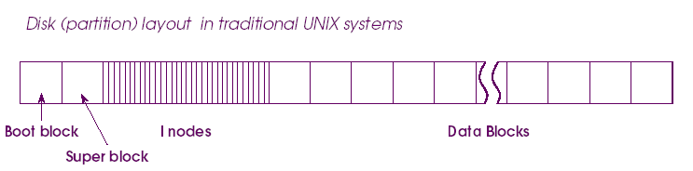
Partition layout in UNIX
Boot block
Super block
FCBs
  (I-nodes in Unix, FAT or MST in Windows)
Data blocks

Slide 29
Unix Directory
Internally, same as a file.
A file with a type field as a directory.
  so that only system has certain access permissions.
<File name, i-node number> tuples.

Slide 30
Unix Directory Example
- how to look up /usr/bob/mbox ?
Root Directory
Block 132
Block 406
1
.
I-node 6
6
.
I-node 26
26
.
1
..
1
..
6
..
4
bin
26
bob
12
grants
7
dev
17
jeff
81
books
14
lib
132
14
sue
406
60
mbox
9
etc
51
sam
17
Linux
6
usr
29
mark
8
tmp
Aha!
I-node 60
has contents
of mbox
Looking up
bob gives
I-node 26
Looking up
usr gives
I-node 6
Relevant
data (bob)
is in
block 132
Data for
/usr/bob is
in block 406

Slide 31
File System Maintenance
Format
  Create file system layout: super block, I-nodes…
Bad blocks
  Most disks have some, increase over age
  Keep them in bad-block list
  “scandisk”
De-fragmentation
  Re-arrange blocks rather contiguously
Scanning
  After system crashes
  Correct inconsistent file descriptors

Slide 32
Windows File System
FAT
FAT32
NTFS

Slide 33
FAT
FAT == File Allocation Table
FAT is located at the top of the volume.
  two copies kept in case one becomes damaged.
Cluster size is determined by the size of the volume.
  Why?

Slide 34
Volume size V.S. Cluster size
Drive Size Cluster Size Number of Sectors
--------------------------------------- -------------------- ---------------------------
512MB or less 512 bytes 1
513MB to 1024MB(1GB) 1024 bytes (1KB) 2
1025MB to 2048MB(2GB) 2048 bytes (2KB) 4
2049MB and larger 4096 bytes (4KB) 8

Slide 35
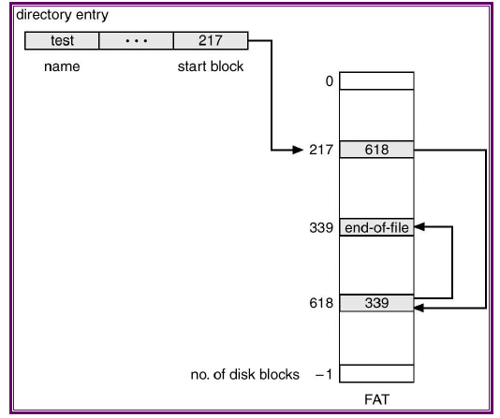
FAT block indexing

Slide 36
FAT Limitations
Entry to reference a cluster is 16 bit
  Thus at most 2^16=65,536 clusters accessible.
  Partitions are limited in size to 2~4 GB.
  Too small for today’s hard disk capacity!
For partition over 200 MB, performance degrades rapidly.
  Wasted space in each cluster increases.
Two copies of FAT…
  ➔ still susceptible to a single point of failure!

Slide 37
FAT32
Enhancements over FAT
More efficient space usage
  By smaller clusters.
  Why is this possible? 32 bit entry…
More robust and flexible
  root folder became an ordinary cluster chain, thus it can be located anywhere on the drive.
  back up copy of the file allocation table.
  less susceptible to a single point of failure.

Slide 38
NTFS
MFT == Master File Table
  Analogous to the FAT
Design Objectives
  Fault-tolerance
    ➔ Built-in transaction logging feature.
  Security
    ➔ Granular (per file/directory) security support.
  Scalability
    ➔ Handling huge disks efficiently.

Slide 39
Bonus Materials
More details of NTFS
OS-wide overview of file system

Slide 40
NTFS
Scalability
  NTFS references clusters with 64-bit addresses.
  Thus, even with small sized clusters, NTFS can map disks up to sizes that we won't likely see even in the next few decades.
Reliability
  Under NTFS, a log of transactions is maintained so that CHKDSK can roll back transactions to the last commit point in order to recover consistency within the file system.
  Under FAT, CHKDSK checks the consistency of pointers within the directory, allocation, and file tables.

Slide 41
NTFS Metadata Files
NameMFT Description
$MFT Master File Table
$MFTMIRR Copy of the first 16 records of the MFT
$LOGFILE Transactional logging file
$VOLUME Volume serial number, creation time, and dirty flag
$ATTRDEF Attribute definitions
. Root directory of the disk
$BITMAP Cluster map (in-use vs. free)
$BOOT Boot record of the drive
$BADCLUS Lists bad clusters on the drive
$QUOTA User quota
$UPCASE Maps lowercase characters to their uppercase version

Slide 42

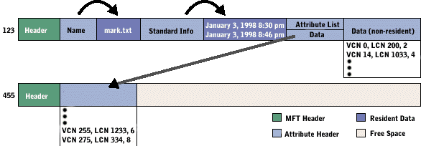
NTFS : MFT record

Slide 43
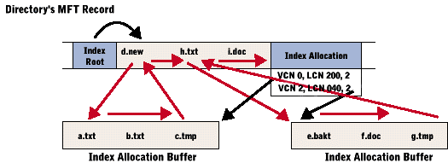
MFT record for directory

Slide 44
Application~ File System Interaction
Process
control
block
Open file
table
(system-wide)
File descriptors
(Metadata)
File system
info
File
descriptors
Directories
Open
file
pointer
array
.
.
.
File data

Slide 45
open(file…) under the hood
Search directory structure for the given file path
Copy file descriptors into in-memory data structure
Create an entry in system-wide open-file-table
Create an entry in PCB
Return the file pointer to user
fd = open( FileName, access)
PCB
Allocate & link up
data structures
Open
file
table
Directory look up
by file path
Metadata
File system on disk

Slide 46
read(file…) under the hood
read( fd, userBuf, size )
PCB
Find open file
descriptor
Open
file
table
read( fileDesc, userBuf, size )
Logical → phyiscal
Metadata
read( device, phyBlock, size )
Get physical block to sysBuf
copy to userBuf
Buffer
cache
Disk device driver

