Slide 1
Pixel 3 GMS App Investigations
Part 1: GMS Messaging
Notes:
https://digitalcorpora.s3.amazonaws.com/corpora/mobile/android_10/Non-Cellebrite%20Extraction/Pixel%203.zip

Slide 2
Google Mobile Services

Slide 3
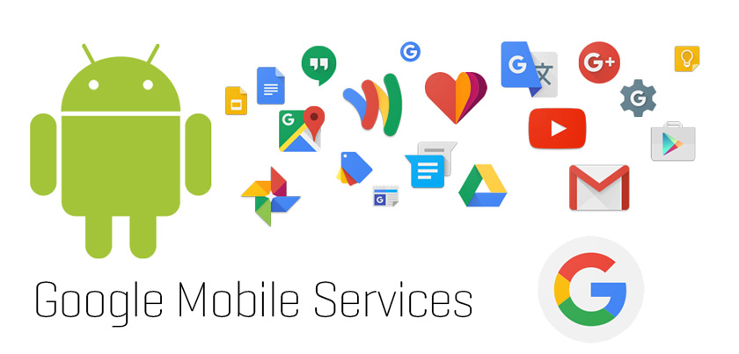
Google Mobile Services (GMS)
GMS is Google’s proprietary app and API layer on many Android devices.
It includes Google apps and services such as Messages, Maps, Photos, Play services, and Carrier/IMS services.
Forensics must distinguish AOSP/system providers from Google app data.
Package pattern often begins with com.google.*, but each app still needs directory and database validation.
Notes:
https://www.android.com/gms/

Slide 4
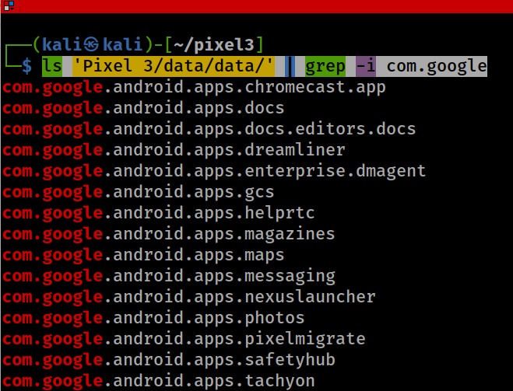

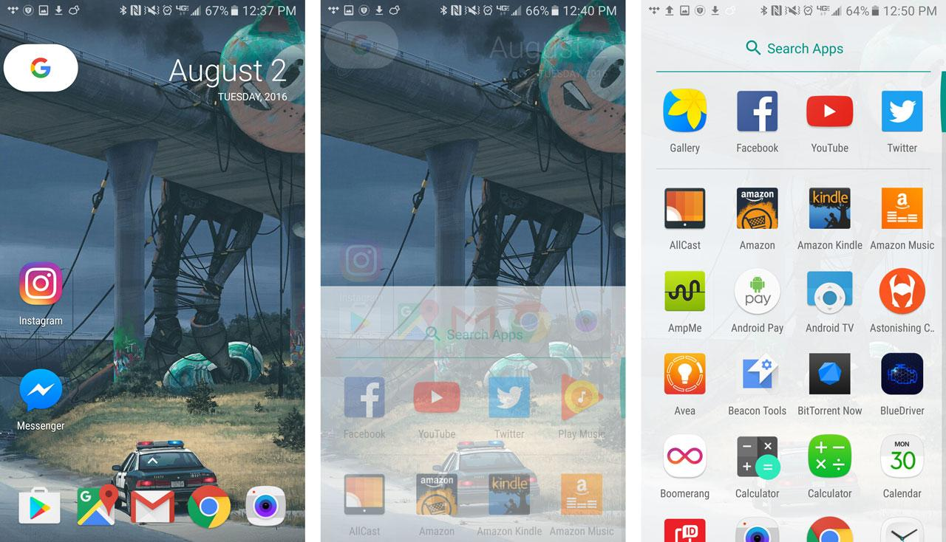
Identify Google / GMS App Packages
(com.google.*)
Example: dreamliner = Pixel wireless charging support
Notes:
ls 'Pixel 3/data/data/' | grep -i com.google

Slide 5


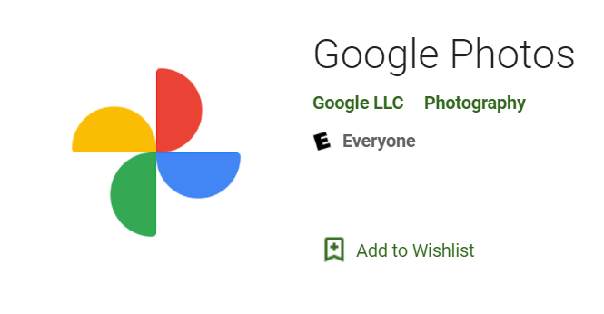
GMS App Investigation Targets
Google Messages
  com.google.android.apps.messaging
Google Maps
  com.google.android.apps.maps
Google Photos
  com.google.android.apps.photos

Slide 6
Investigating Google Messages

Slide 7
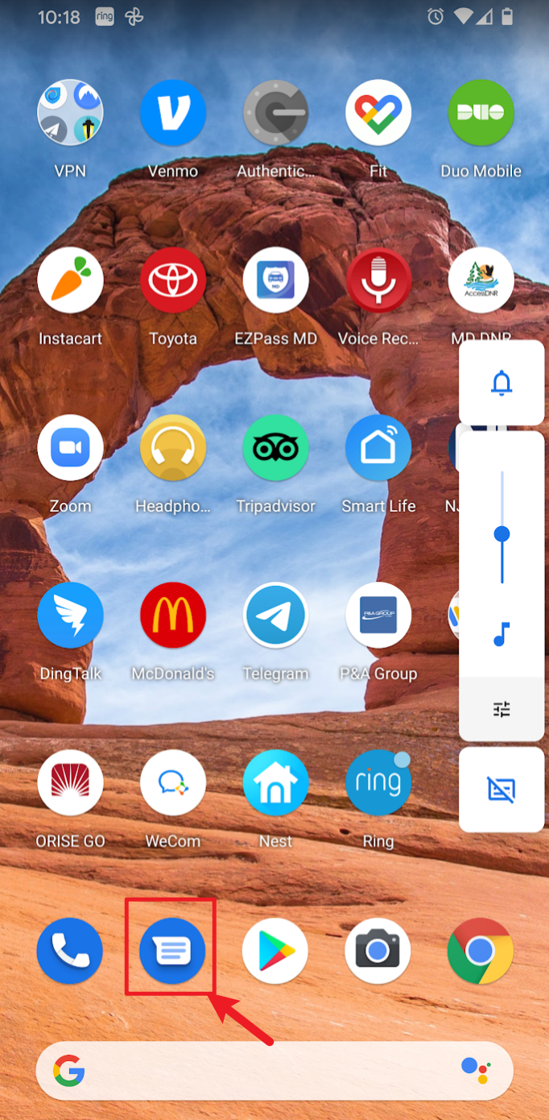
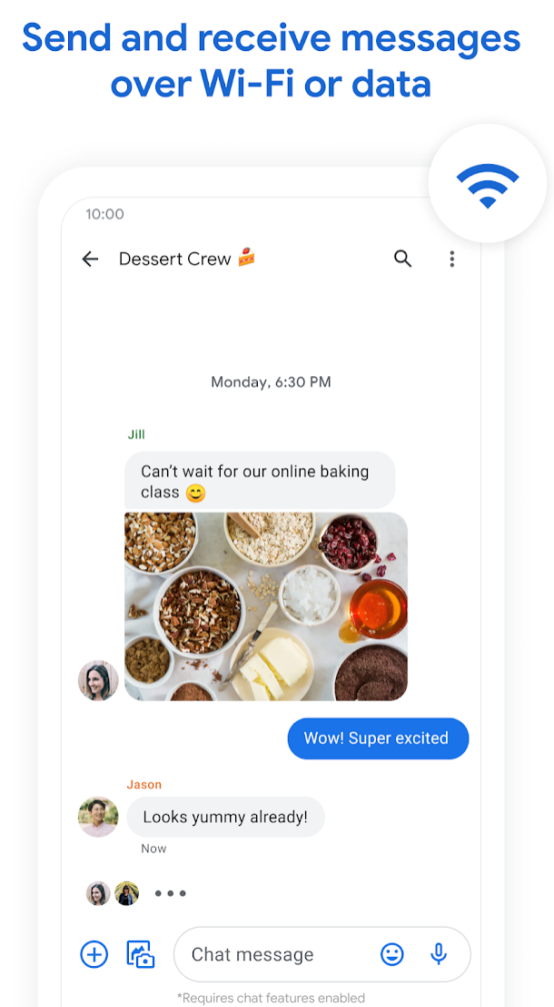
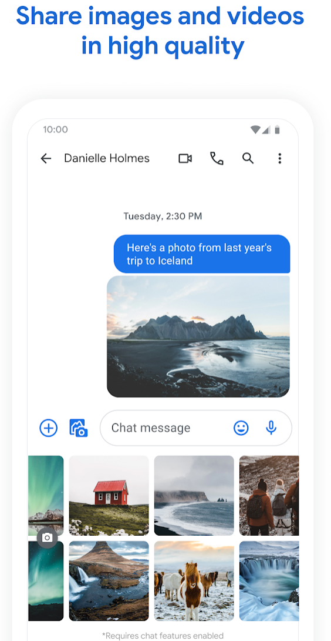
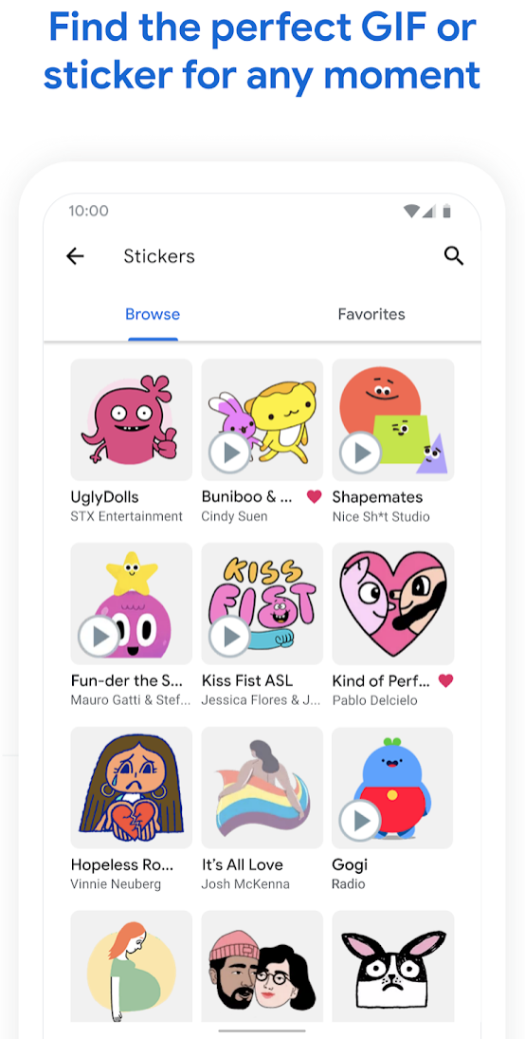
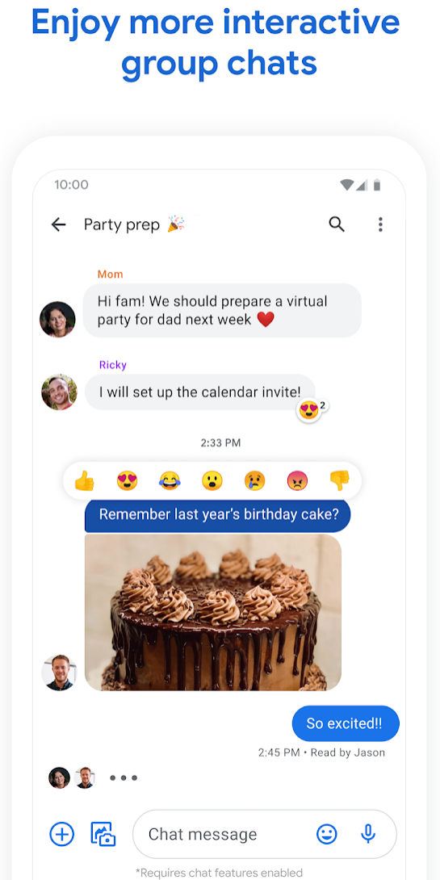
Google Messages: User-Visible Messaging App
Teaching point: Google Messages is the user-facing app. Forensics must connect the visible conversation to the underlying database rows and source artifacts.

Slide 8
Google Messages vs. AOSP Telephony Provider
Feature | Google Messages (GMS app) | AOSP Telephony Provider
Role | User-facing messaging app; may be default SMS app | System provider for SMS/MMS storage and access
SMS/MMS | Displays and sends when configured as SMS app | Stores SMS/MMS in mmssms.db
RCS | Supported through Google/Carrier RCS services | Not an SMS/MMS provider feature
Encryption | Supported RCS chats may be E2EE; SMS/MMS are not E2EE | No message E2EE at provider level
Forensic view | Inspect bugle_db and app files; pivot to provider URIs | Inspect mmssms.db: sms, pdu, part, addr, threads
Key distinction: Google Messages is an app-level interface/cache; Telephony Provider is the system SMS/MMS evidence source.

Slide 9
SMS, MMS, and RCS: evidence implications
RCS (Rich Communication Services): it’s a next-generation messaging protocol designed to replace traditional SMS and MMS on mobile phones.
Aspect | SMS | MMS | RCS
Transport | Carrier SMS channel | Carrier MMS/WAP + mobile data | IP data via carrier/Jibe RCS services
Content | Text | Text + media attachments | Text, media, reactions, receipts, typing indicators
Storage focus | mmssms.db / sms | mmssms.db / pdu, part, addr | Google Messages bugle_db; RCS/IMS data may also appear in rcs.db
Encryption | No message E2EE | No message E2EE | E2EE only for supported RCS chats; version/service dependent
Forensic caution | Default SMS app can write to provider | Attachments may live outside database | Verify schema on the actual image; Google schemas are app-version dependent
Report the observed database fields first; avoid assuming one database contains every layer of the message stack.

Slide 10
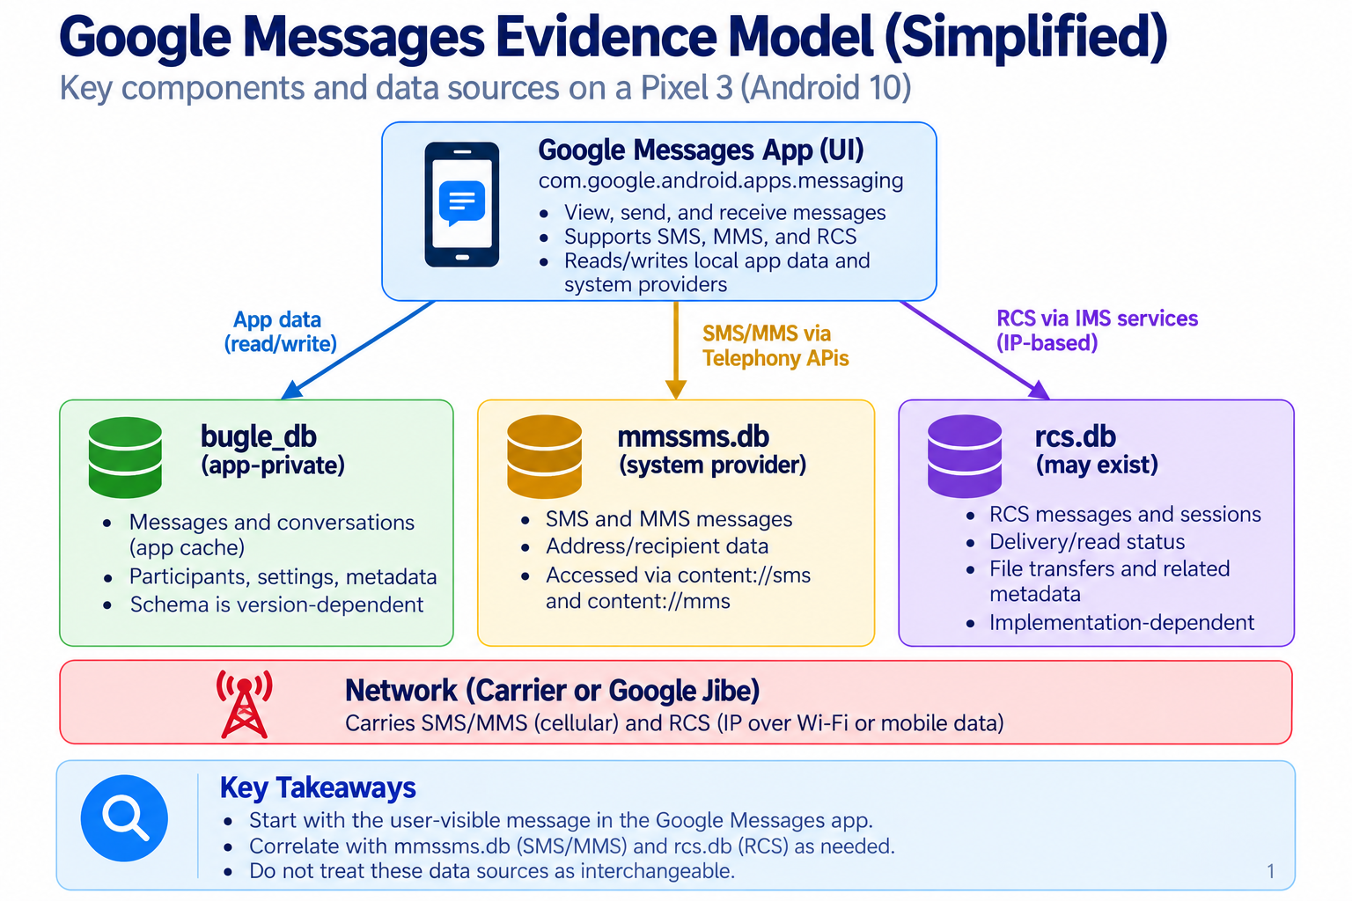

Slide 11
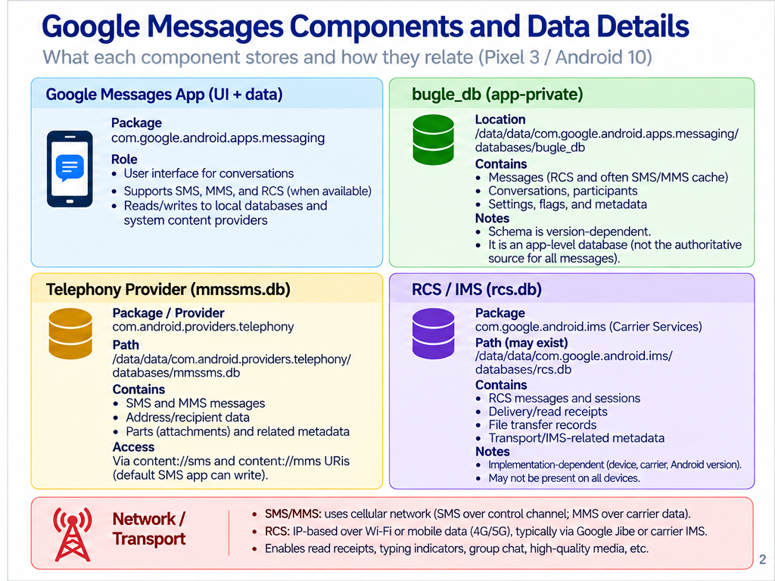

Slide 12
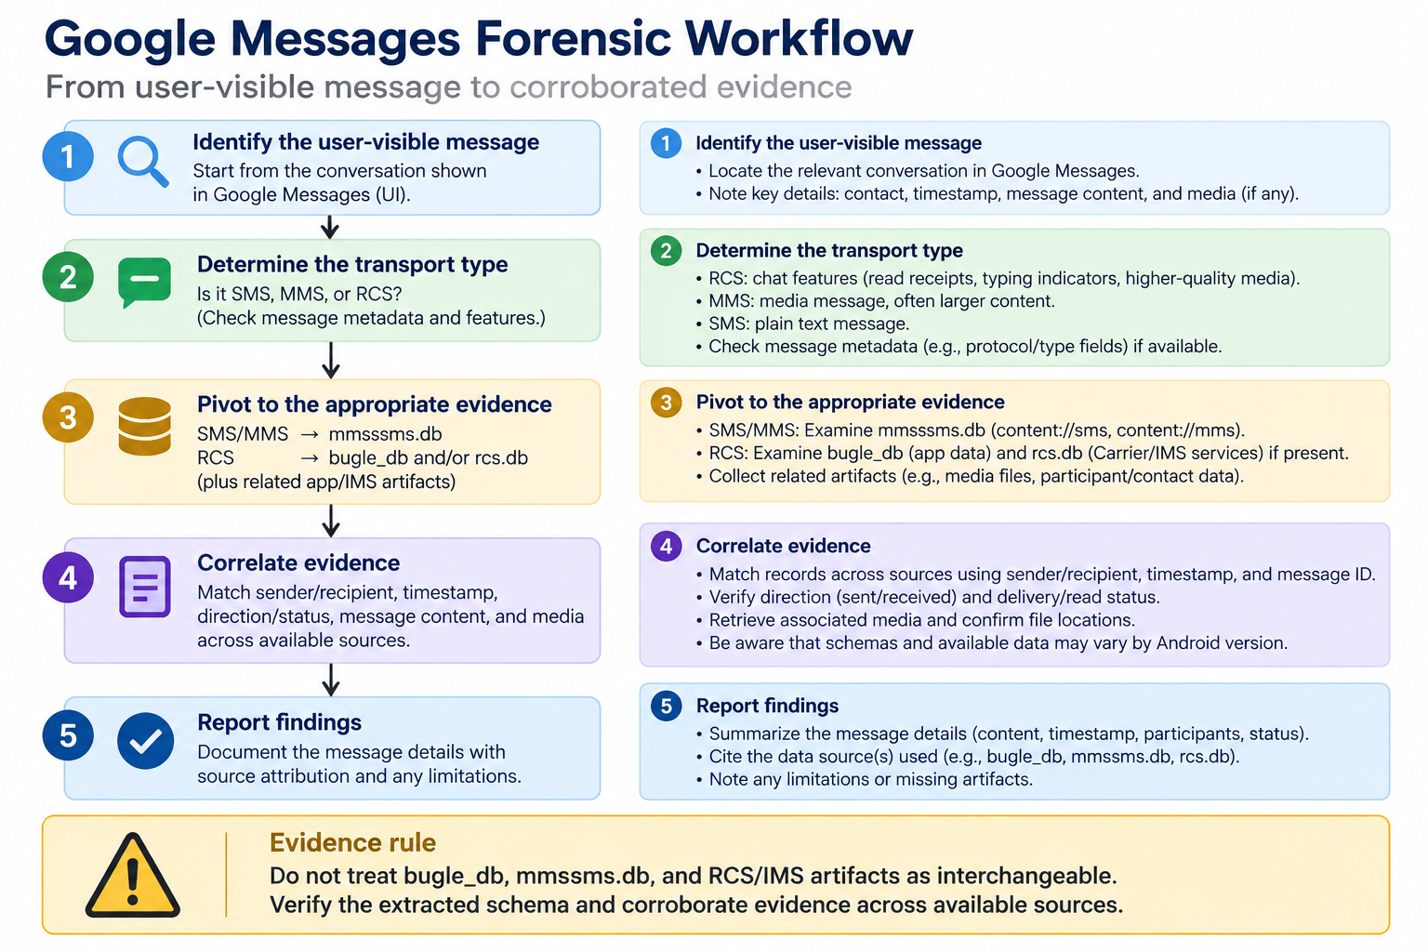

Slide 13
Investigation Questions
What message content was received around Jan. 29, 2020 at 6:20:45 PM?
Which conversation/thread does that message belong to?
Which participant/sender record is associated with it?
What do the raw read/seen/status fields indicate?

Slide 14
Google Messages: Directory Structure

Slide 15
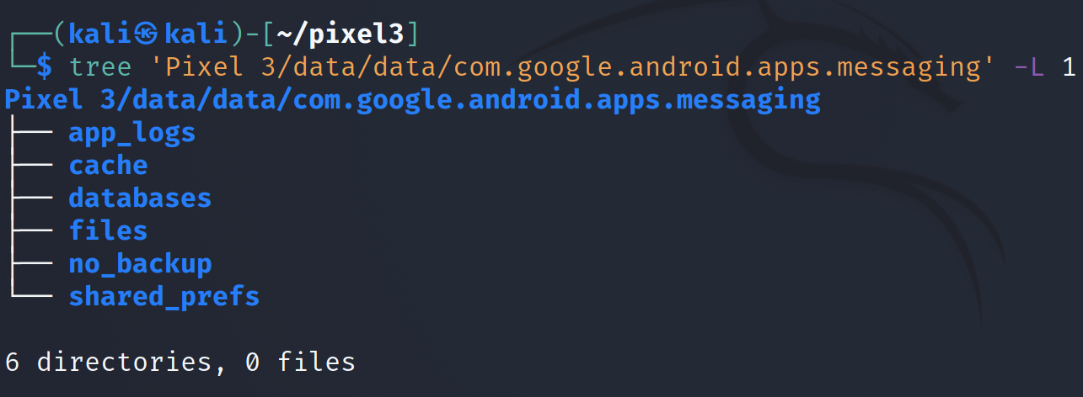
Inspect the Google Messages app directory
-L controls tree depth
subdirectories may include databases, files, cache, and attachments
Non-database artifacts can still matter: attachments, cached media, preferences, config files, and temporary files.
Forensic habit: document the path first; later conclusions should identify the exact file and table/row used.
Notes:
Cmd: tree 'Pixel 3/data/data/com.google.android.apps.messaging' -L 1

Slide 16
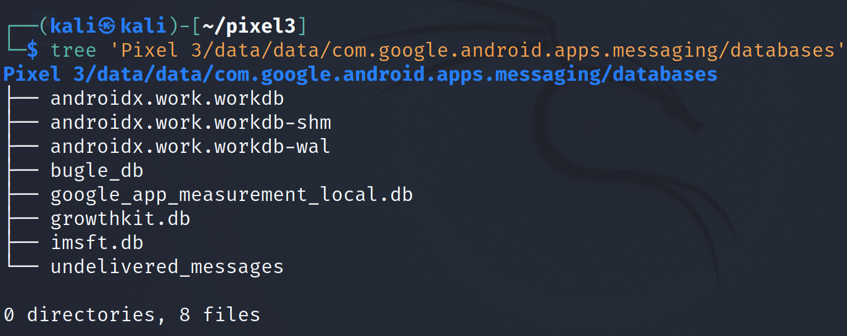
Locate the Google Messages databases directory
The presence and names of databases can vary by app version; verify the extracted image rather than assuming a fixed schema.
Notes:
Cmd: tree 'Pixel 3/data/data/com.google.android.apps.messaging/databases'

Slide 17
bugle_db

Slide 18
Purpose of bugle_db
bugle_db is the Google Messages app-level database/cache. It helps the app present SMS, MMS, and RCS conversations in one interface.
  aggregates and mirrors messages from these multiple sources
Forensic caution: its schema is internal and app-version dependent. Validate table names and columns on the extracted image before making conclusions.
Source | Protocol | Primary evidence source | How Google Messages uses it
SMS | Carrier SMS | mmssms.db / sms | May mirror/reference in bugle_db
MMS | Carrier MMS | mmssms.db / pdu/part/addr | May mirror metadata and attachments
RCS | IP-based RCS | bugle_db + Carrier/IMS data such as rcs.db | Displayed in Google Messages conversation view
App metadata | — | bugle_db | Conversation state, drafts, participants, UI/cache metadata

Slide 19
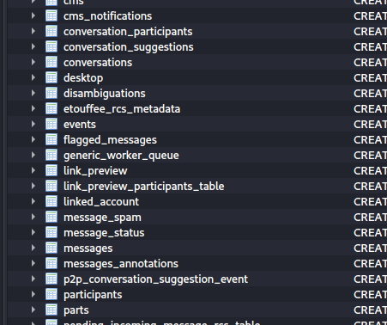
Inspecting Tables in bugle_db
conversations: thread-level grouping for messages
messages: message-level rows and metadata
(e.g., timestamps, protocol/status fields)
Use sqlite_master and PRAGMA table_info(...) to confirm the exact schema before interpreting column values.
Notes:
Cmd: sqlitebrowser 'Pixel 3/data/data/com.google.android.apps.messaging/databases/bugle_db'

Slide 20
Key bugle_db tables to inspect
Exact names and columns are Google Messages version-dependent. Use the screenshot and SQLite schema from the extracted image.
Table / group | Evidence focus | How to use it
messages | Message body, timestamp fields, sender_id, conversation_id, protocol/status fields | Starting point for user-visible message records.
conversations | Thread/chat metadata, title/name, latest message, archived/pinned/muted flags | Use conversation_id to reconstruct the conversation context.
participants | Phone numbers, names, contact-match values, RCS capability or account metadata | Use sender_id/participant links to identify senders and recipients.
attachments / parts | Media references, MIME types, thumbnails, file paths | Recover or explain photos, videos, audio, and other MMS/RCS media.
RCS-related tables | Receipts, sessions, file-transfer state, encryption/status fields | Version-dependent; corroborate with Carrier/IMS service data when present.
draft/composition | Unsent text or composition state | May show intent, partial messages, or unsent content.
Forensic rule: preserve raw values first; only then translate status, read/seen, protocol, and contact-match fields.

Slide 21
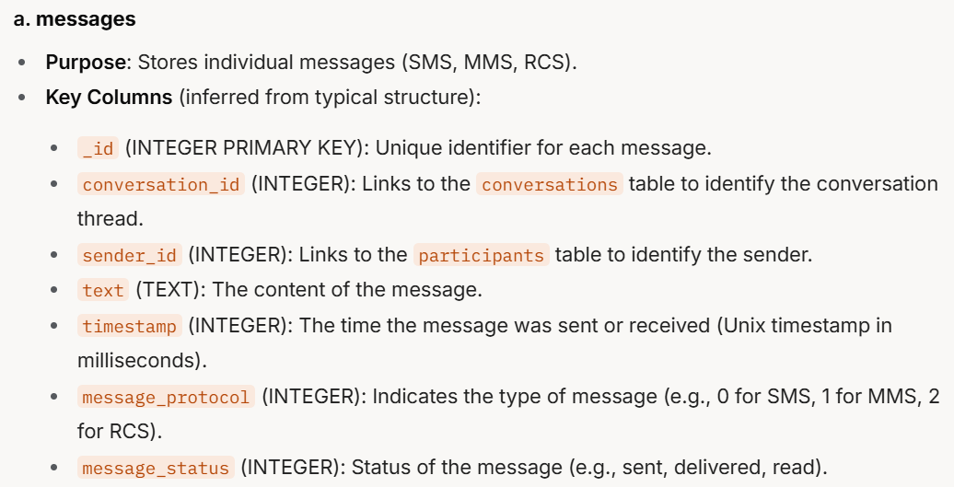
sms_message_uri can point back to the source SMS row in the Android Telephony Provider (e.g., mmssms.db / content://sms/...).
Do not stop at the app cache. If a URI or source identifier exists, pivot back to the provider database and compare raw timestamps/status fields.
Notes:
a. messages
Purpose: Stores individual messages (SMS, MMS, RCS).
Key Columns (inferred from typical structure):
_id (INTEGER PRIMARY KEY): Unique identifier for each message.
conversation_id (INTEGER): Links to the conversations table to identify the conversation thread.
sender_id (INTEGER): Links to the participants table to identify the sender.
text (TEXT): The content of the message.
timestamp (INTEGER): The time the message was sent or received (Unix timestamp in milliseconds).
message_protocol (INTEGER): Indicates the type of message (e.g., 0 for SMS, 1 for MMS, 2 for RCS).
message_status (INTEGER): Status of the message (e.g., sent, delivered, read).

Slide 22
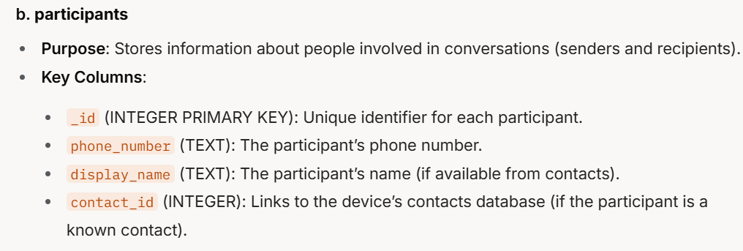
participants table: people and contact-match metadata
Use participant IDs to resolve sender/recipient context. Contact match fields may be missing, stale, or app-generated; preserve raw values.
Notes:
b. participants
Purpose: Stores information about people involved in conversations (senders and recipients).
Key Columns:
_id (INTEGER PRIMARY KEY): Unique identifier for each participant.
phone_number (TEXT): The participant’s phone number.
display_name (TEXT): The participant’s name (if available from contacts).
contact_id (INTEGER): Links to the device’s contacts database (if the participant is a known contact).

Slide 23
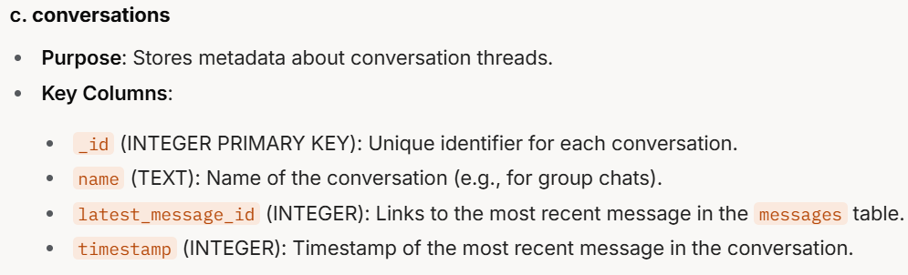
conversations table: thread-level context
Use conversation_id to group message rows into the displayed thread. Then inspect the latest-message and state fields cautiously.
Notes:
c. conversations
Purpose: Stores metadata about conversation threads.
Key Columns:
_id (INTEGER PRIMARY KEY): Unique identifier for each conversation.
name (TEXT): Name of the conversation (e.g., for group chats).
latest_message_id (INTEGER): Links to the most recent message in the messages table.
timestamp (INTEGER): Timestamp of the most recent message in the conversation.

Slide 24
messages Table

Slide 25
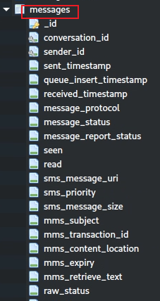
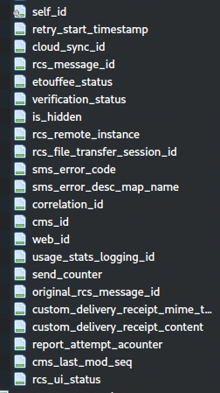
messages table: high-value fields (1)
conversation_id: groups the row into a conversation/thread.
sender_id: points to the participant/sender record.
timestamp fields: preserve raw values and convert carefully with timezone context.
protocol/source fields: help distinguish SMS, MMS, and RCS-related records.
status/read/seen fields: interpret using the extracted schema, not assumptions from the UI.

Slide 26
messages table: high-value fields (2)
sms_message_uri: may point back to a Telephony Provider SMS row, such as content://sms/123.
MMS metadata: subject/content-location/media fields may require attachment or part-table review.
RCS identifiers/status fields: app-version specific; verify the schema and corroborate with available service artifacts.
Raw status values: preserve before translating into sent/delivered/read/failed categories.
App cache warning: bugle_db reflects the Google Messages view; it should be corroborated with source artifacts when possible.

Slide 27
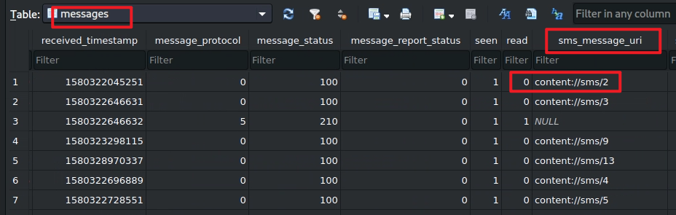
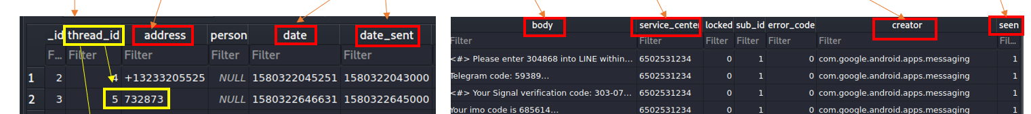

messages Table Content: Source Pointer
The highlighted value points to a source SMS row in the Android Telephony Provider
(com.android.providers.telephony / mmssms.db).
Forensic action: use the URI/source pointer to compare the Google Messages cache with the underlying SMS/MMS record.

Slide 28
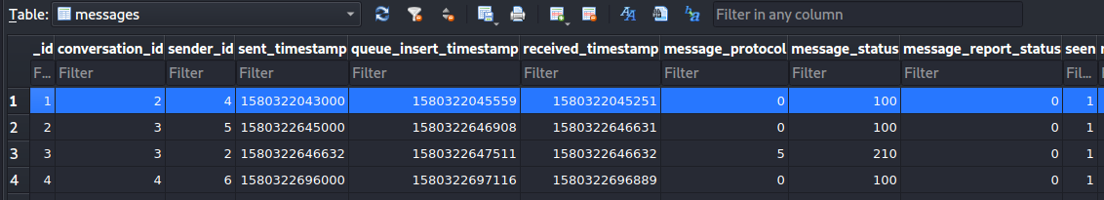
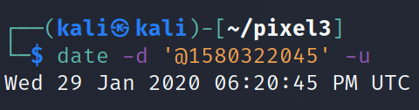
Received timestamp: preserve the raw value, then convert to local time and UTC as needed.
Answer the question with both the raw timestamp field and the converted time; note timezone assumptions explicitly.

Slide 29
Find the conversation_id
conversation_id = 2
Pivot: message row → conversation_id → conversations table. This connects one message to the displayed thread.

Slide 30
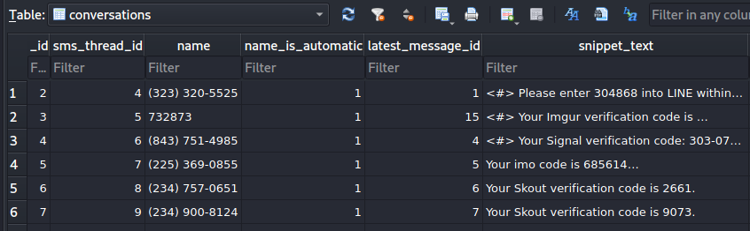
conversation name/title
Conversation context for the message received around Jan. 29, 2020 at 6:20 PM
Look up conversation _id = 2
Do not confuse the message timestamp with the conversation timestamp; verify which column is being displayed.

Slide 31
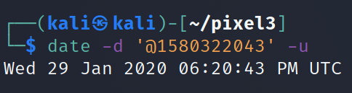
When was the message sent by the other party?
Sender/remote timestamp field
Compare receive time and send time when both exist. A delay can be meaningful, but it must be supported by the raw fields.

Slide 32
Join to participant table
Who sent the message?
Pivot: messages.sender_id → participants._id. Use participant fields to identify the sender/phone/address shown by the app.

Slide 33
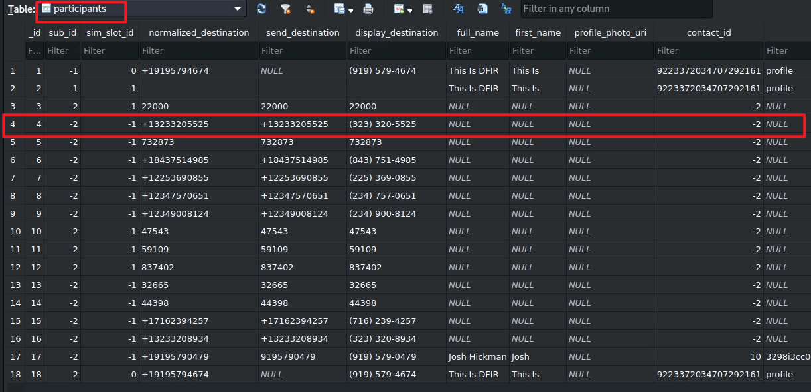
normalized / international format
display-friendly format
-2 : no local contact match
Interpret contact-match fields carefully. A missing contact match does not mean the number is unknown; it means the app did not link it to a local contact record.

Slide 34
Seen flag in this table:
0 = not seen by the user interface
1 = shown/seen in the user interface
Read receipts may require separate RCS/status fields.
Has the message been seen or read?
Do not overstate “seen” as proof of human reading. Report the flag and explain what the app/database field supports.

Slide 35
Summary: GMS Messaging Investigation
Understand the application role: Google Messages is the UI/cache, not the only evidence source.
Locate app data: com.google.android.apps.messaging.
Open bugle_db and verify the schema on the extracted image.
Explore messages, conversations, participants, attachments, and protocol/status fields.
Use source pointers such as sms_message_uri to pivot back to system SMS/MMS artifacts.
Corroborate timestamps, sender identity, status/read flags, and media with source databases/files.
State conclusions as database-supported interpretations, not assumptions about user intent.

Slide 36
